Slide 1

Dual Credit
2016-17
New Mexico Public Education Department

Slide 2
Dual Credit (DC)
Fastest-growing choice (AP, honors, DC, or online)
2012 to 2015 unique students increased 22%
2014-15 17,331 courses

Slide 3
Today’s presentation
Application Process
How awards are determined
Spending the funds
Q&A

Slide 4

Dual Credit
Request For Information (RFI)
Rfi required for funding

Slide 5

Timeline
  RFI Due by 5:00 PM
May 16, 2016

Slide 6

Eligibility
Funding is available for
all eligible LEAs who submit a
RFI by May 16, 2016.
Eligible LEAs
  Districts (includes District Charter Schools)
  State Chartered Schools
  State-Supported Institutions
  BIE-Funded High Schools

Slide 7

  Completed RFI Includes
Master Agreement
Signed Assurances
Questionnaire
Cover Page

Slide 8
How Awards are Determined

Slide 9
Dual Credit Funding
Funding comes in two allocations
Allocation I is 85%
Allocation II is 15%
Additional funds may available – distributed with Allocation II

Slide 10
Allocation I
  Awarded based on enrollment (30%) and dual credit counts (70%)
  Award I will be 85% of the computed allocation
  Award letters are issued in September

Slide 11

Timelines-I
Allocation I
  Initial BAR must be
  submitted by
  November 15, 2016
  Claim against BAR by
  March 10, 2017

Slide 12

Allocation II
To qualify for Allocation II funding LEA must do the following:
  Expend and claim all of the the awarded Allocation I funds March 10, 2017
  STARS data submitted
      Enrollment
      Dual credit

Slide 13
Rescinding Allocation
  No BAR by November 15, 2016
  No claims against BAR by March 10, 2017
  Incomplete or non-submission of STARS dual credit or enrollment data (40th and 80th day)

Slide 14
Timelines- II
Allocation II – After March 10, 2017
  Voluntarily rescind unneeded funds
  Request participation in additional distribution
  Full liquidation by June 30, 2017

Slide 15

Additional Funds
Expend and claim all Allocation I funds
A request in writing for additional funds (due March 10, 2017)

Slide 16
Spending the funds

Slide 17
What is reimbursable
Summer – can be claimed – two cases
  1.Class begins and ends by 6/30 – invoice and pay by 6/30
  2.Class ends after 6/30 – invoice and pay after 6/30 (next fiscal year)
Rental Textbooks – yes, and online editions are also acceptable
“Weird” courses – tighten up your master agreement
Notes:
These can be on different slides

Slide 18

Submitting the RfR
Use RfR form on PED website
http://www.ped.state.nm.us/ped/CCR_programs_dualcredit.html
New form –not required but includes all the elements we need for approving your claim
Suggestion – partner with your postsecondary to get invoices ASAP – put timelines in a MOU

Slide 19

Enrolling students
Use enrollment form on PED website
http://www.ped.state.nm.us/ped/CCR_programs_dualcredit.html
New form
stars ID
stars course code
NSP

Slide 20
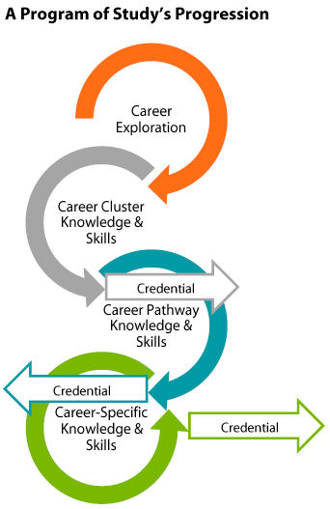
Making it matter
Courses need to align to Next Step Plan
College Success – only when appropriate for the student’s plan!
Consider other classes – especially last course toward a program of study

Slide 21
Programs of Study
A comprehensive approach for delivering academic and CTE to prepare students for postsecondary education and career success. Students earn industry credentials and/or college credit during high school.
CORE
+
CTE
+
DE
POS
CAREER AND
TECHNICAL
EDUCATION
DUAL
ENROLLMENT
PROGRAMS
OF
STUDY

Slide 22
Quality & Rigor
RfI has survey about teacher qualifications
Higher Learning Commission accreditation guidelines require increased standards for DC instructors

Slide 23

Bad idea?
Elective or core? – For core credit, must align to common core or other standards for the class it is replacing
Wait for student to complete before reimbursing – no! this is an access issue
Charging student for
general fees – no! postsec is
obligated to waive general
fees for DC classes

Slide 24
Questions?
Elaine Perea
505-827-6715
elaine.perea@state.nm.us
Marc Duske
505-827-6712
Marc.duske@state.nm.us

