Slide 1

Seamless Summer Option
Provides free, nutritious meals to New Mexico’s Children when school is out

Slide 2
What is the Seamless Summer Option?
Allows SFA participating in the National School Lunch Program (NSLP) to provide free summer meals in low income areas during the traditional summer vacation periods.
Designed to encourage SFAs to provide meals during the summer and other vacation periods.
This Option combines features of the National School Lunch Program (NSLP), School Breakfast Program(SBP) and Summer Food Service Program (SFSP).

Slide 3

How Does it Work?
National School Lunch Program (NSLP)
Seamless transition to serve summer meals
Seamless Summer Option (SSO)
Notes:
Once summer school session ends, SFAs may continue to serve meals through the end of summer!
Kids still need good food, even when school is out. Now it’s easy to accommodate them!
You can apply to operate the Seamless Summer Option through the National School Lunch (NSLP). Continue the same meal service rules and claiming procedures used during the regular school year. The SSO permits SFAs participating the NSLP and/or SBP to serve meals during summer.
The SFA’s will need to apply to participate in SSO, once approved they can serve meals to children for free!

Slide 4
Types of Sites
Open
Restricted Open
Closed Enrolled
Camps
Migrant
USDA recommends to operate as Open Sites
Notes:
USDA recommends to operate as an Open sites
Open Sites - A school or non-school site within the geographical boundaries of a school. Meals available to all children residing in the area where 50% of the children are certified eligible for free and reduced meals based on school or census data.
Restricted Open –Meets Open Site criteria, but is restricted for security, safety or control
Closed Enrolled- Specific group of children, participating in a program or activity. At least 50% of children enrolled at the site are approved for free & reduced or location is within geographical area where 50% of children are F&R
Camps-May be residential or non-residential (day camp). For enrolled children eligibility must be established. May claim up to three meals (supper follows lunch reimbursement and meal pattern).
Migrant-Primarily serving children of migrant families through age 18, as certified by a migrant coordinator.

Slide 5
Eligibility
SFA must provide documentation to support site eligibility
  Site is located within the geographical boundaries of the attendance area of a school where ≥ 50% of the children are certified for free or reduced priced meals
SFA’s may use census data to establish eligibility
Certified for 5 years!
Notes:
Site eligibility requirements are the same as for Summer Food Service Program. The following types of sites may participate and may be located in schools or at non-school facilities: buildings, parks or other outdoor locations, and mobile feeding sites.
Census data – 50 % or more of children on a census block group must be eligible for free or reduced pricing. Also the Area eligibility mapper is a tool that will help state agencies and sponsors determine area eligibility using census data.
Eligibility certification is good for 5 years. Do not need to re-determine every year.

Slide 6
Area Eligibility Mapper
Tool to determine area eligibility using census data
  http://www.fns.usda.gov/areaeligibility
  Instructions for determining area eligibility
  http://www.fns.usda.gov/sites/default/files/Census%20Instructions%202014_0.pdf
Notes:
Use these tool to determine area eligibility when SFA data isn’t 50% or more of F & R.

Slide 7

CEP or Provision 2 Schools
Not automatically considered area eligible
  Use census data, CEP percentage, or base year data
  Work with the CSHWB for eligibility questions
Notes:
There are eligibility flexibilities, so contact us with any questions!
Data from the school’s base year should be used to establish that at least 50% of the children are certified eligible for free or reduced price school meals to determine area eligibility.
If CEP, schools should use their individual school CEP percentage to qualify.

Slide 8

Compliance with SSO
Performance Standard 1
  Accurate Meal Counting/Claiming
Performance Standard 2
  Meal Pattern and Nutritional Quality
General Area’s
  Civil Rights
  Food Safety
  Potable Water
  On-site monitoring
Notes:
Compliance is similar to NSLP. Edit checks are not required for SSO.

Slide 9
Performance Standard 1
Meal Counting
Children Only
End of the Point of Service
Claims
Submit Monthly Claim
By the 10th of the month
Recordkeeping
Keep all SSO materials, 3 years
Daily, Weekly, Monthly records
Notes:
Count the number of reimbursable meals served at end of POS; Meal counts must represent only complete meals served to children
Edit checks are not required for SSO
Can combine May with June claim, and July with August BUT must keep counts separate by month

Slide 10
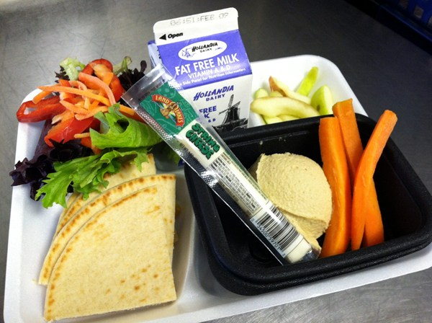
Reimbursement
  Reimbursements for all persons 18 years or younger including student SSO workers at the free rate.
  Meals served at camps are reimbursed at free rate only to eligible F&R children
Individuals over 18 with a state-defined mental or physical disability.
Adult meals may not be claimed towards reimbursement.
Notes:
Track adult meals for appropriate resource management.

Slide 11

Second Meals
  SSO sites must plan and prepare one meal per child
  SFA may serve complete second breakfasts to students and the breakfasts may be counted towards claim for reimbursement*
SFA may serve second lunches or snacks to students, but these meals cannot be claimed for reimbursement
*State Agency will not reimburse for poor planning, or purposeful second meals claiming – determined during agency review
Notes:
*SA will not reimburse for poor planning, or purposeful second meals claiming – determined during agency review

Slide 12
2017 SSO Reimbursement Rates
Meal | Regular Rate + 6 cents | Severe Need
Breakfast | $1.71 | $2.04
Lunch | $3.24 | N/A
Snack | $0.86 | N/A
*Rates are for all states except for Alaska and Hawaii
Notes:
Reimbursement rates are based off of SY 16-17 and are in effect until the end of June 30, 2017.
Qualifying schools will continue to receive the severe need breakfast rate under SSO and the $0.02 differential for lunch (and supper)
Still receive the PBR (Performance Base reimbursement) $0.06 additional reimbursement for lunch (and supper)

Slide 13
Meal Time Periods and
Meal Combinations
BRK
Lunch
Snack
During morning hours
Between 10:00 am- 2:00 pm
Spaced between meals
Allowable combinations per site
Maximum 2 per site -unless operating as a camp site
BRK
Lunch
Lunch
Snack
BRK
Snack
Notes:
Restriction on the number and type of meals that may be served each day are:
SFAs offering the SSO must follow the meal NSLP and SBP meal pattern requirements in effect the SY prior to the beginning of service of SSO.
Designated times for meals must follow the SBP and NSLP regulations.
Camps max 3 meals.

Slide 14

Performance Standard 2
SFA’s must follow NSLP and SBP meals pattern requirements -7 CFR 210.10 and 7 CFR 220.8
Make every effort to follow age/group and ensure minimum meal patterns are met.
Production Records are records for meals that are produced and must be kept
Meals must be eaten on-site
Notes:
SFAs should make every effort to follow the age/grade group requirements. If SFA is having difficulty, work with state agency.
Production records are needed in order to show SA compliancy with the meals. Records for food purchases are necessary to document such as receipts and invoices.

Slide 15
Performance Standard 2
Offer vs Serve- optional
  Allows students to decline components
  Does not mean multiple choices within components
  Breakfast – Student must take 3 items and at least ½ C of Fruit
  Lunch – Student must take 3 components including ½ C of fruit or vegetable
Notes:
Offer vs. Serve is allowed at sites but is not required at SSO sites.
As in NSLP, staff must be trained on OVS and understand the requirements to ensure meals are reimbursable.

Slide 16


Public Notification
Press release to the local media
Backpack flyers
Door hangers
Computerized calls
Email
Please keep outreach materials on file
http://www.fns.usda.gov/sfsp/raise-awareness
Notes:
Promoting the program is a requirement
Ensure that the nondiscrimination statement is on all SSO material.
More than 49 million Americans live in households that don’t have enough food to feed their families every day, yet our country produces enough food to feed everyone so let’s raise awareness in our communities.

Slide 17

On-Site Monitoring
On-site monitoring form
Each site must be monitored at least once
Must be completed within first 2 weeks of operating SSO (Please send to NMPED-CSHWB)
Checks for Compliance:
  Meal Counting
  Claiming
  Menu Planning
  Food Safety
Notes:
NMPED-CSHWB has a monitoring form that is required for SSO to fill out and submit within 2 weeks of SSO operation.
As in NSLP, meal counting, claiming, menu planning and food safety are all requirements for compliance in the SSO.

Slide 18
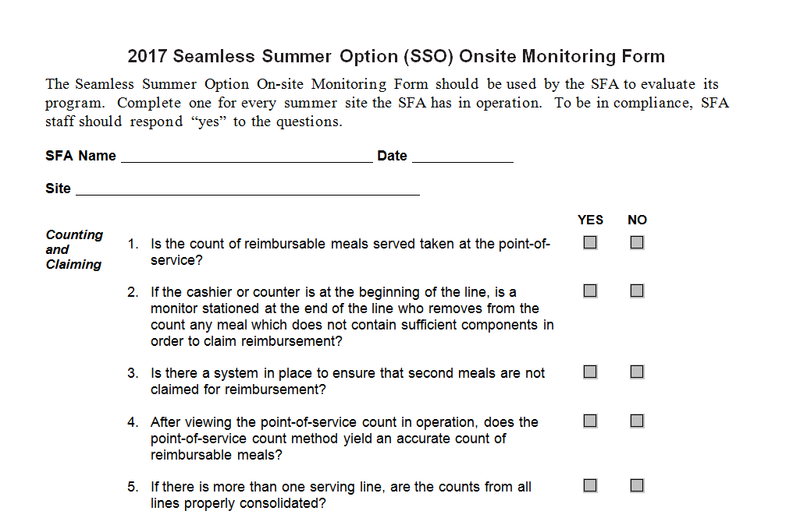
Notes:
Sample of SSO On-Site Monitoring. This is a 2 page document and must have certifying signature.

Slide 19

Farm to Summer
Serving locally sourced foods
Organizing gardening activities
  (working with garden-based organizations in your area)
Hosting cooking demonstrations with local foods
Field trips to farmers markets or farms
http://www.fns.usda.gov/farmtoschool/farm-summer
https://www.fns.usda.gov/sites/default/files/f2s/FactSheet_Farm_to_Summer.pdf
Notes:
The term “farm to school” encompasses efforts that bring locally or produced foods into summer meal sites along with hands-on activates and food-related education into the classroom curriculum. Farm to summers is the integration of these activities in SSO. It’s an extension of the fam to school model.
-Serving local foods can add variety and appeal to meals, while also providing a range of complementary activities that keep kids interested and engaged in summer programming.

Slide 20


2016 Statistics
Over a million meals served in SSO!
Last year 39 school districts participated in SSO
There were 212 sites for last summer
Estimated daily meals state wide
    Breakfast: 334,194
    Lunch: 684,064
    Snacks - 1,378
    Total meals - 1,018,258
Notes:
Last year’s participating School Districts decreased, however the meals increased.

Slide 21
USDA Memo SP 09-2017: 2017 Edition of Q & A for the NSLP’s SSO
USDA Memo SP 07-2016: Local Foods and Related Activities in Summer Meal Programs, with Questions and Answers
USDA Memo SP 06-2016: Promoting Nutrition in Summer Meal Programs, with Best Practices
USDA Memo SP 05-2016: Meal Service Requirements in the Summer Meal Programs, with Questions and Answers
Additional Resources

Slide 22

Any questions?
Please contact us!
Health Educator and SSO Program Lead
(505) 827-3574
terence.mirabal@state.nm.us

