Slide 1

District Test Coordinator Training
PED Assessment Bureau
September 2019
**Note to all DTCs: Please be advised that additional in person and virtual regional trainings will take place starting this fall to inform LEAs of technology and/or testing requirements for math and language arts testing related to the current procumbent. Trainings will be announced once more details are known.

Slide 2
Outcomes for Participants
Understand changes for 2019-20
  Statewide assessment system
  Graduation requirements
Understand state policies and requirements
  Test administration
  Test security
  Testing irregularities
Be prepared for fall testing
Notes:
Changes to assessment system first – stakeholder engagement, task force
Changes to graduation last so elementary DTCs can leave

Slide 3
NMPED Vision & Values
Vision: all students in New Mexico are engaged in a culturally and linguistically responsive education system that socially, emotionally, and academically prepares each student for success in college, career, and life.
Values
  Student-centered
  Responsive
  Collaborative
  Reflective
Notes:
Vision: State proficiency assessments, when correctly administered, measure objectively what academic content students know and what skills they possess, thus providing an accurate metric of student preparation for college, career, and life.

Slide 4
Start of the Year Assessment Communications
2019-20 SY
Lynn Vásquez
Director
Assessment of Student Learning

Slide 5
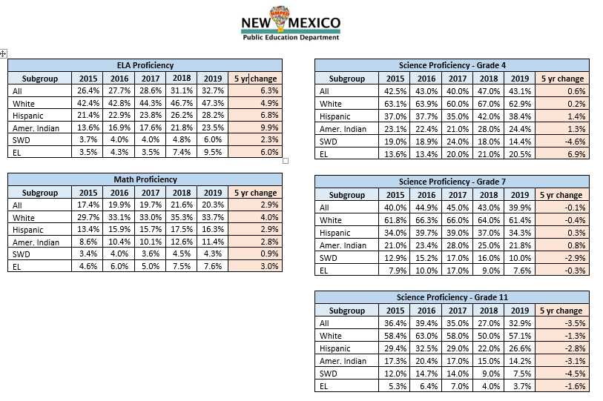

Slide 6

Minimum Federal Testing Requirements:
Under the Every Student Succeeds Act (ESSA) Title I, states must administer an annual tests in:
reading and/or language arts to all students in grades 3-8 and once in high school.
mathematics to all students in grades 3-8 and once in high school.
science at least once to students in each of grades 3-5, 6-9, and 10-12.
English language proficiency assessment for English Learners (ELPA).

Slide 7
Glance of Events
Timeline | Assessment Events
January 2019 | Governor’s Executive Order to Transition from PARCC
March 2019 | Stakeholder engagement meetings
April – May 2019 | Transition (TAMELA) assessment administered
April – June 2019 | Student Success Task Force convened
July-September | Procurement for new assessment components; informed by community engagement feedback, Task Force and identifying other assessment needs
Fall 2019 | Full Student Success Task Force Report

Slide 8
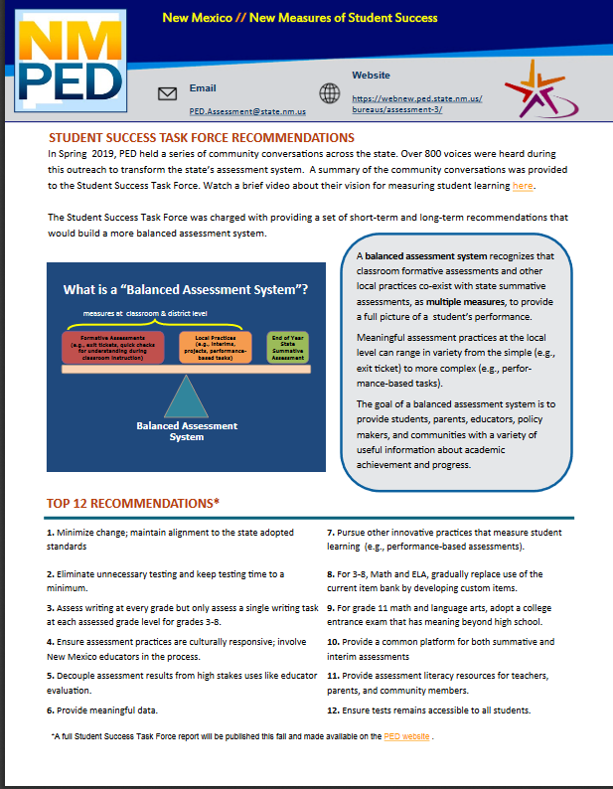
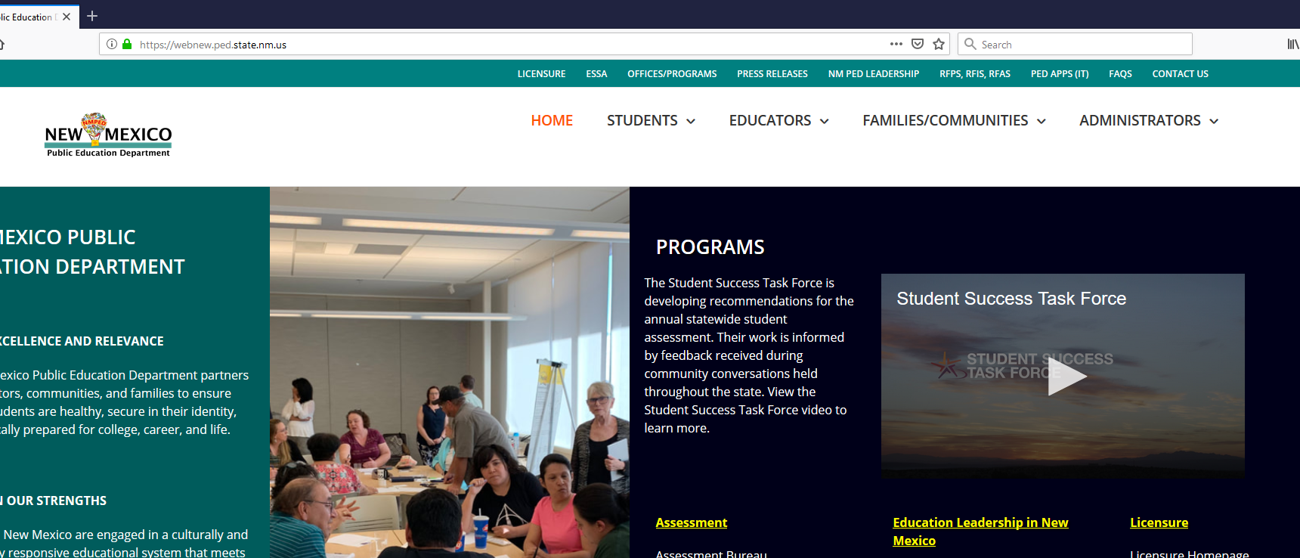
Student Success Task Force

Slide 9
Some Task Force Recommendations
Minimize change
Minimize testing time
Cultural responsiveness
Decouple performance
Balanced assessment system
Assessment literacy

Slide 10
What is a “balanced assessment system?”
End of Year State Summative Assessment

Slide 11
What is a “balanced assessment system?”
Local Practices (e.g., interims, projects, performance-based tasks)
End of Year State Summative Assessment

Slide 12
The Balanced Assessment System
measures at classroom & local district level
Formative Assessments
(e.g., exit tickets, quick checks for understanding during classroom instruction)
Local Practices (e.g., interims, projects, performance-based tasks)
End of Year State Summative Assessment

Slide 13
Required Tested Content | Grades | 2018-19 | 2019-20
Math & Language Arts | 3-8 | Transition Assessment (TAMELA) | NM-MSSA, replaces TAMELA 3-8
 | 9-10 |  | Grade 9 & Grade 10 (TBD)
 | 11 |  | College Entrance Exam (TBD)
SBA Spanish Reading | 3-11 | 3-11 | 3-11; alignment to CCSS en español
Science | 4, 7, 11 | SBA Science | End of SBA
 | 5, 8, 11 |  | NM-ASR
Alternate Math/ELA/Science/Social Studies (Significant cognitive disability) | 3-8, 10-11 | NMAPA | End of NMAPA after Fall 2019
 | 3-8, 9 & 10 (TBD) & 11 |  | DLM, End of social studies
English Language Proficiency | K-12 | ACCESS for ELLs | ACCESS for ELLs
English Language Proficiency (Alternate) | 1-12 | ALT-ACCESS | ALT-ACCESS
End of Course (E0C) Content | 4-12 | EoCs Required | No Required EOCs in grades 4-8 Optional High School core subject area EoCs for graduation
Early Literacy | K-2* | Istation | Istation
Early Childhood Observation Tool | Pre-K, K | ECOT | ECOT

Slide 14
Current Procurement
Required RFP Components “Must Haves” | Optional RFP Components “Nice to Haves”
Grades 3-8 Math/ELA transitioned by 2023 or sooner | Grades 9 and 10 (e.g., PSAT, ACT Aspire)
Grade 11 High School College Ready (e.g., SAT/ACT) | K-2 interim assessment system (math & ELA) 3-12 Interim; modular unit assessments focusing on lowest performance areas; optional LEA use.
 | Grades 3-8 Spanish Language Arts; aligned to CCSS en español; progressively developed
 | K-12 Support for local summative and interim assessment operations
 | Assessment & Data Literacy Tools and Resources

Slide 15
Assessment Costs
Assessment | Cost per Student Form*
 | LEA | State | Total
ACCESS | $17.00 | $10.75 | $27.75
Alt ACCESS | $47.00 | $30.00 | $77.00
NMAPA | $75.00 | $652.29 | $727.29
DLM** | 0 | $294.93 | $294.93
NM-ASR CBT | $7.64 | $34.81 | $42.45
NM-ASR PBT | $12.86 | $34.81 | $47.67
SBA CBT | $11.21 | $31.24 | $42.45
SBA PBT | $16.93 | $31.24 | $48.17
Math/ELA | TBD | TBD | TBD
EoCs** | 0 | $3.00 | $3.00
Istation | 0 | $9.41 | $9.41
*PED covers additional program management, development, and delivery cost beyond what is shown
**LEA costs for paper-based EoCs are for local printing.

Slide 16
Assessment Bureau Norms
Bureau memorandums are typically sent to Superintendents, Charter Directors, and District Test Coordinators
During the school year, a weekly Assessment Bureau Newsletter is distributed to your DTC
Our primary communication is with your DTC; the DTC is the liaison between the Assessment Bureau and your district.
Calls from parents, teachers, and STCs will typically be routed back to the DTC.
  Exception: concern that warrants investigation

Slide 17
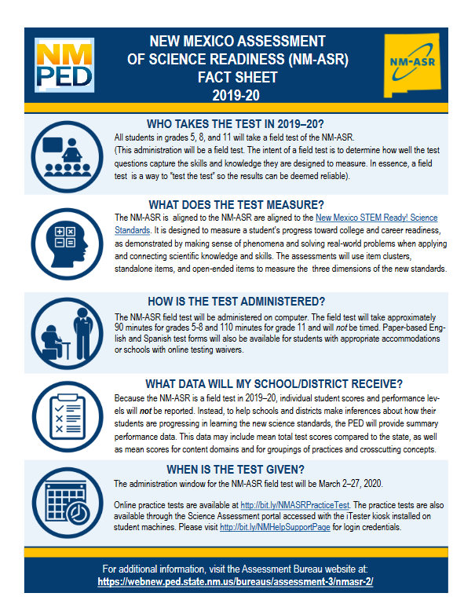
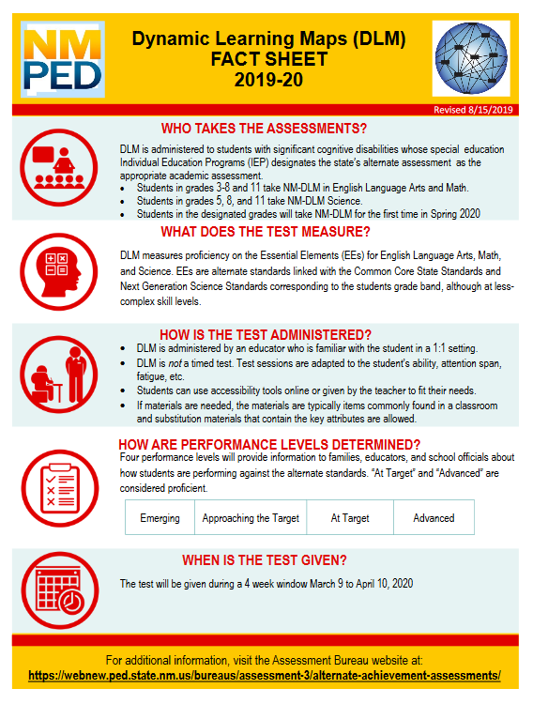
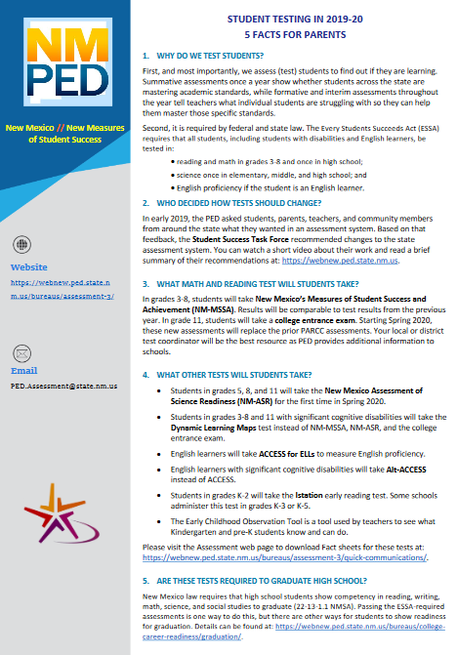
Facts Sheets & FAQs
Facts Sheets may be revised after math/Ela procurement concludes

Slide 18

Graduation Requirements
Coursework (not changing) and competency requirements
No primary and alternate demonstration of competency (ADC)
No ADC waivers
Menu of options
No fall re-tests of Transition or SBA
No minimum attempts on Transition or SBA before moving to EoCs
Extra attempt on EoC permitted:
  3 for standard pathway
  4 for modified pathway

Slide 19
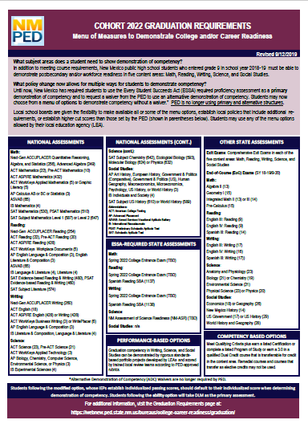
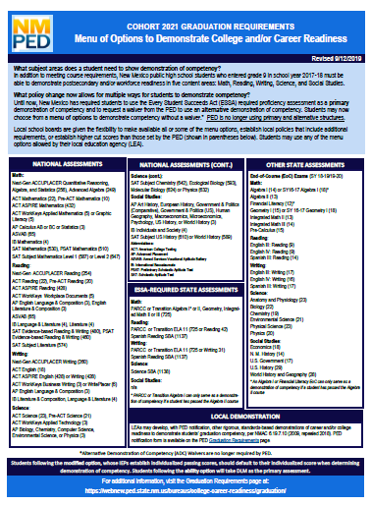
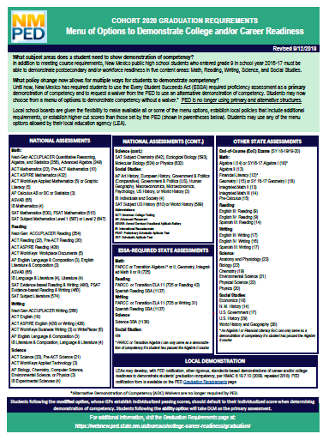
Menu of Options
by Cohort

Slide 20
Cohort 2020
Entered grade 9 in 2016-17 school year
6.19.7 NMAC 2009 applies
Cohort 2021
Entered grade 9 in 2017-18 school year
6.19.7 NMAC 2009 applies
Cohort 2022
Entered grade 9 in 2018-19 school year
6.19.7 NMAC 2018 applies
Cohort 2023
Entered grade 9 in 2019-20 school year
6.19.7 NMAC 2018 applies

Slide 21
Menu of Options
ESSA-required assessments
  Transition Assessment, PARCC, SBA
  College entrance exam (Cohort 2021 and beyond)
  NM-ASR (Cohort 2022 and beyond)
Other state assessments
  EoCs (Cohorts 2020, 2021, 2022)
  Exit Exams (Cohort 2023 and beyond
Nationally recognized exams such as SAT, ACT, ACCUPLACER, ASVAB, AP, IP
Local Demonstration (Cohorts 2020 and 2021)
Competency-based options (Cohorts 2022 and beyond)
Performance-based options (Cohorts 2022 and beyond)

Slide 22
Graduation Information
Graduation requirements web page:
https://webnew.ped.state.nm.us/bureaus/college-career-readiness/graduation/
Coursework requirements contact:
JoAnn Beuerle, College and Career Readiness Bureau
JoAnn.Beuerle@state.nm.us or (505) 827-6717
Assessment requirements contact:
Brigette Russell, PhD, Assessment Bureau
Brigette.Russell2@state.nm.us or (505) 827-6528

Slide 23

New Mexico Assessment of Science Readiness (NM-ASR)
Spring 2020 Census Field Test

Slide 24
NMASR Census Field Test Overview
Testing Window: March 2, 2020 -March 27, 2020
Grades 5, 8, and 11
Computer and Paper (English or Spanish)
Braille and Large Print
Year-Round Practice Tests Online
https://newmexico.onlinehelp.cognia.org/
Notes:
Manuals are available on this website.

Slide 25
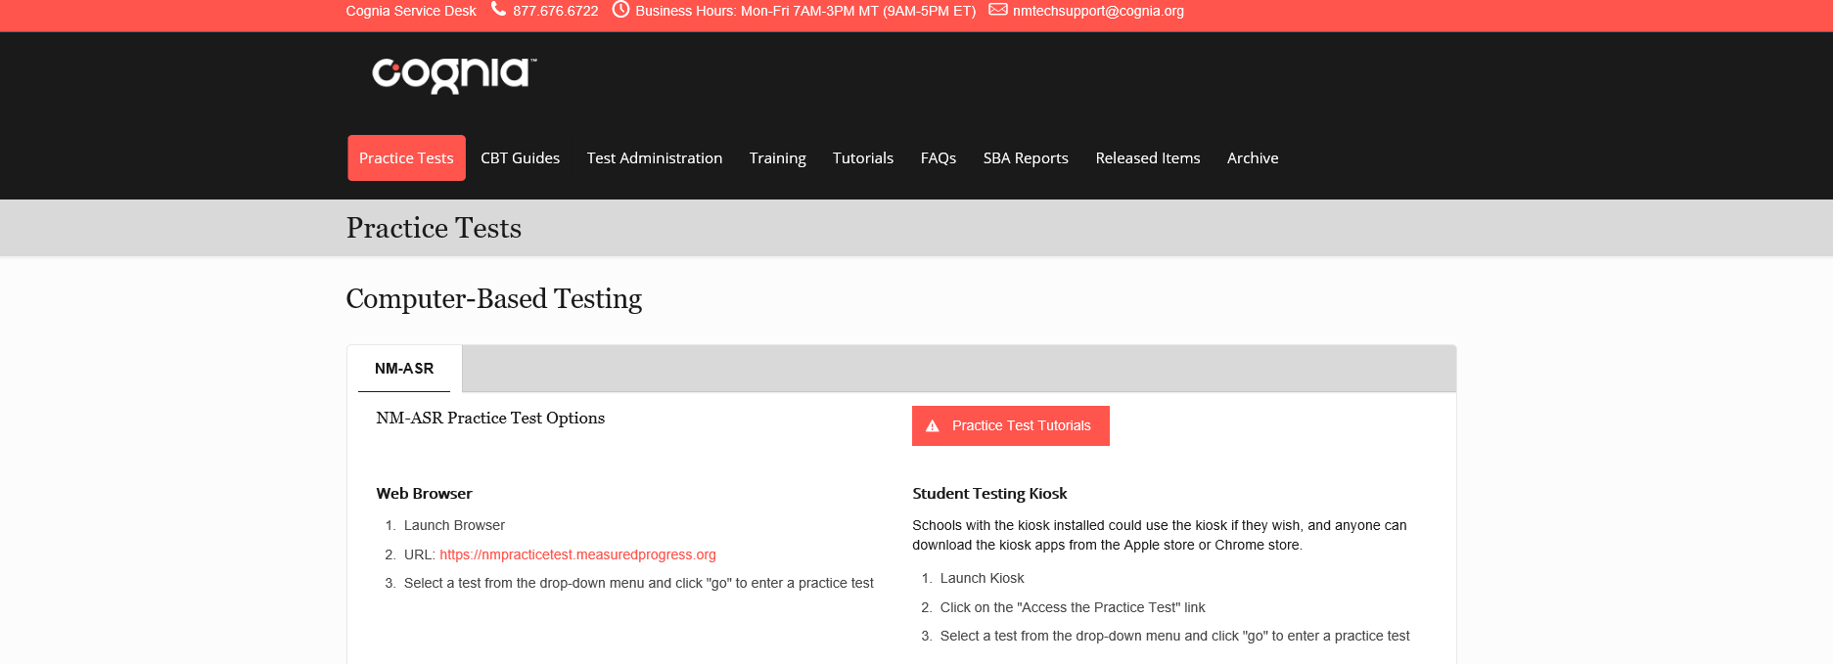

Slide 26
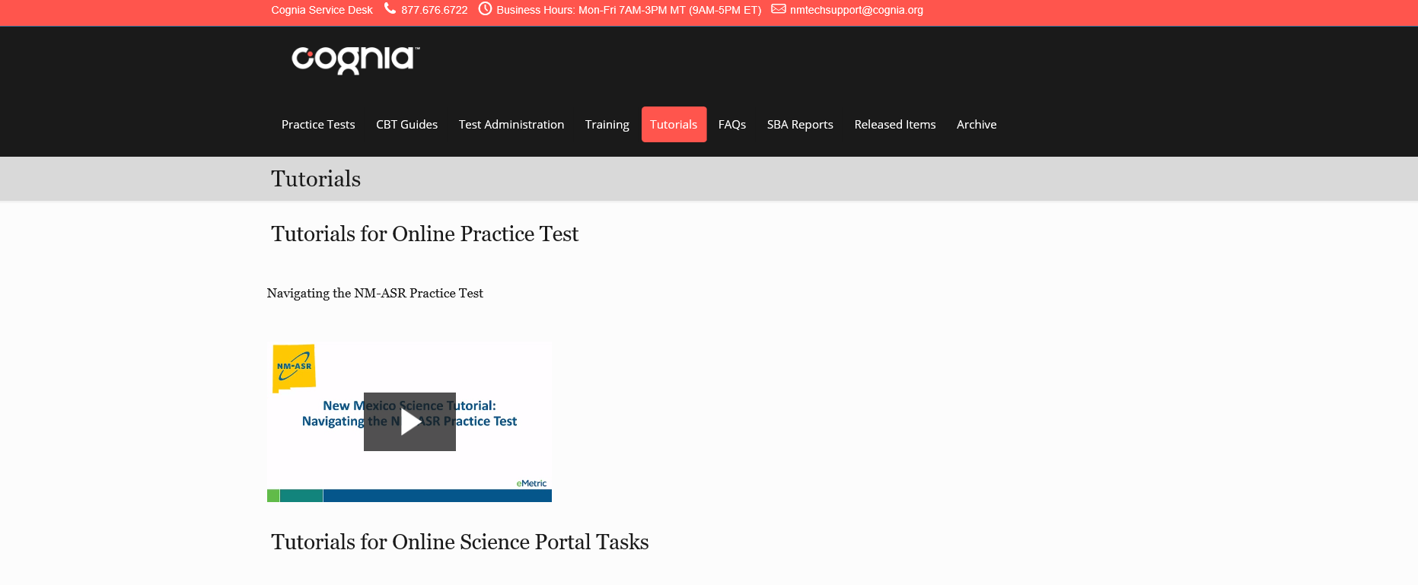

Slide 27


LEA Pre-ID Uploads
NM-ASR and SBA Spanish Reading
PED uploads pre-ID file
LEA uploads file to overwrite
Cognia and Emetric will provide information and training

Slide 28
STEM Ready! Science Resources
STEM Gauge link: https://go.cognia.org/instructional-support-materials-for-new-mexico-science-educators
Additional instructional materials can be found on PED Instructional Materials webpage: https://webnew.ped.state.nm.us/bureaus/instructional-materials/
Course maps and science resources can be found on PED Math & Science Bureau webpage: https://webnew.ped.state.nm.us/bureaus/math-science/

Slide 29
Census Field Test Price Reduction
Because the NM-ASR reporting will not include individual student reporting, the price LEAs pay per student has been reduced. Prices, including shipping and handling of all test materials, are as follows:

Slide 30
NM-ASR and SBA Help & Support
Website: https://newmexico.onlinehelp.cognia.org/
Customer support: nmhelp@cognia.org or 1-877-6766722
Tech support: nmtechsupport@cognia.org
PED Contact: Xavier DeLeon
Xavier.DeLeon@state.nm.us or (505) 827-6747

Slide 31

Dynamic Learning Maps

Slide 32
How is DLM Like NMAPA?
Alternate academic assessment for students with significant cognitive disabilities
Alternate academic standards linked to Common Core
TA qualifications: licensure and TA certification
1:1 administration
Year end administration
Test results included in accountability calculations

Slide 33
How is DLM Different from NMAPA?
 | DLM | NMAPA
Standards | Essential Elements (EEs) | EGBEs
Cognitive Structure | Learning maps | Learning progressions
Focus | Instruction + Assessment | Assessment only
Balance | Instructionally embedded assessment option | Summative year end only
Delivery | Computer based, paper option | Paper based
Administration | Computer adaptive, short testlets | Test items sequential in
Interrater Reliability | DLM establishes | Second raters required
Graduation | Not an Alternate Demonstration of Competency, no fall testing | Alternate Demonstration of Competency, fall testing for Seniors

Slide 34
Timeline | Dynamic Learning Maps (DLM) Roll-out
Sept. 2019 | Getting to Know DLM webinars; recorded Fall trainings for DTCs and Tech Coordinators available through DLM website
Oct. 2, 2019 1:00-1:30MST | DLM Q&A chat session in support of Fall DTC training
Nov. – Dec. 2019 | Online teacher training on Essential Elements (DLM standards)
Nov. 2019 (TBD) | In-person DTC training by DLM in Albuquerque
Jan. – Feb. 2020 | Online Test Administrator Training
Jan. 11, 2020 | TAs complete First Contact survey and Personal Needs and Preferences Profile
Jan. 20, 2020 | DTC Spring Training recording available through DLM website
Jan. 29-30, 2020 | DLM Q&A sessions in support of Spring DTC training
Feb. 3-12, 2020 | Data verification and student rostering
Mar. 9 – Apr. 10, 2020 | Testing Window for grades 3-8 and 10-11 math & ELA; 5, 8 and 11 science
Insert corrected DLM Roll out slide here
Text
Text
Text

Slide 35
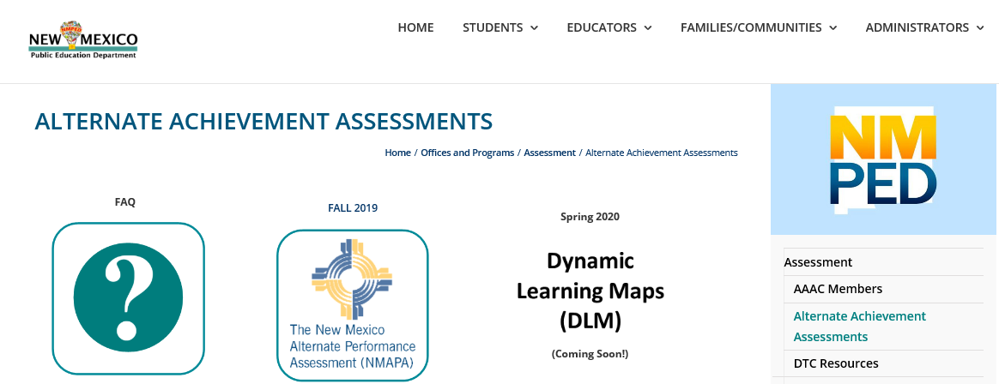
“Getting to Know DLM” Webinar Recording and Slide Pack are Posted Here

Slide 36
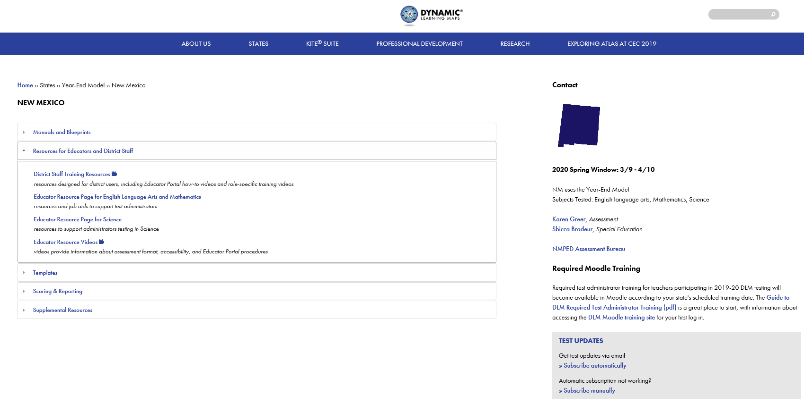

Slide 37
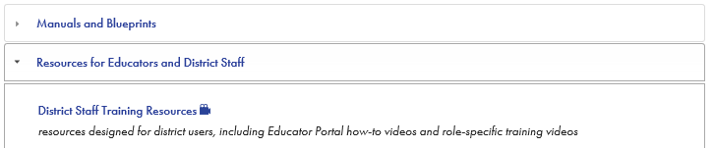
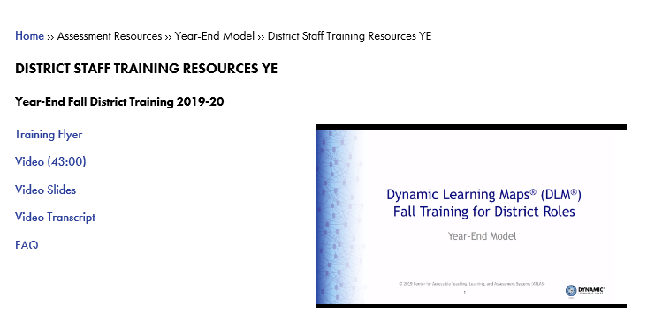

Slide 38

DLM Fall Training for District Roles
Recorded video available from DLM Topics covered:
the basics of the DLM alternate assessment design and its terminology
roles and responsibilities of assessment coordinators, data managers, and technology personnel
the types of extracts and reports available to help monitor and manage the assessment
Enroll in an optional online Q & A chat session by watching the video and completing the registration form. Wednesday, October 2, 2019 at 1:00 - 1:30 PM

Slide 39
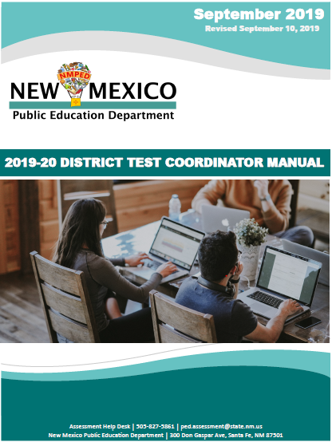
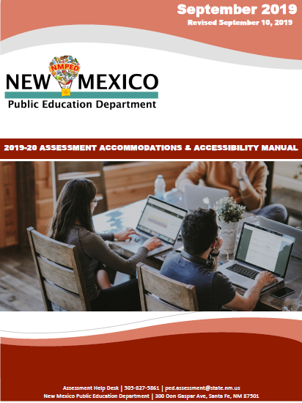
Policies & Procedures

Slide 40
Federal Statute
Every Student Succeeds Act (ESSA): Assessment Requirements
  Grades 3-8 math and language arts
  Elementary, middle, and high school science
  Participation of all students: SWD, ELs
  Students with disabilities
  English learners (Els)
  95% reporting
  1% cap on alternate assessment
  DTC Manual pp. 3-4
Notes:
Refer them to manual pages; explain which assessments are required, the 95% participation and reporting requirement, define SWD and Els, accommodations, alternate assessment briefly as these are in later sections

Slide 41
Federal Statute
Individuals with Disabilities in Education Act (IDEA)
Rehabilitation Act (Section 504)
Equal Educational Opportunities Act
Civil Rights Act
Family Educational Rights and Privacy Act (FERPA)
Health Insurance Portability and Accountability Act (HIPAA)
  DTC Manual p. 4

Slide 42
New Mexico Statute
NMSA 22-2C Assessment & Accountability Act
  Assessment system
  Accountability and reporting
  Adoption of content and performance standards
NMSA 22-13-1.1 Graduation Requirements
  Coursework and competency requirements
  Competency: math, reading, writing, science, social studies
  DTC Manual pp. 4-5

Slide 43
New Mexico Administrative Code (NMAC)
6.10.7 NMAC Standardized Testing Procedures and Requirements
  Roles & responsibilities, licensing
  Test administration & security
6.19.7 NMAC Demonstration of Competency for Graduation
6.29.1 NMAC Standards for Excellence
  Section K, graduation requirements
  DTC Manual pp. 5-6

Slide 44
Statute, code, and procedures in place
Educators know statute, code, and procedures
Test administration and security procedures followed
Students demonstrate what they know and what they can do
Valid test results

Slide 45
Roles & Responsibilities
PED Assessment Bureau
School District
Superintendent
DTC
State Charter or BIE School
Administrator
Test Coordinator
School A
Principal
STC
School B
Principal
STC
TAs
Proctors
School C
Principal
STC
TAs
Proctors
TAs
TAs
Proctors
Proctors
  DTC Manual pp. 7-12

Slide 46
 | PED License | Responsibilities
DTC District Test Coordinator | Teacher Administrator Counselor Student success advisor | Liaison with PED, vendors, STCs Know 6.10.7 NMAC, manuals, PED trainings, technology specifications, accommodations District test security policy, train STCs, TAs Reports irregularities to PED
STC School Test Coordinator | DTC licenses or Instructional support provider | Know 6.10.7 NMAC, manuals, district policy Train TAs, proctors Secure test materials, testing environment Assigns Accommodations and accessibility features
TA Test Administrator | Same as STC | Administers tests, following security policy Ensures Accommodations and accessibility features are enabled
Proctor | Can be EA | Assist TA monitoring students
  DTC Manual pp. 8-11; 6.10.7.7 NMAC
Notes:
Go through the specific requirements of each role in manual, including administrators

Slide 47
Superintendent
Appoints DTC and Technology Coordinator
  Forms in DTC Manual, Appendix F
  Every year and when changes
Verification
  Test security
  Staff training
  Accommodations
  10 days after testing
  DTC Manual, p. 7

Slide 48
DTC
Liaison with PED and vendors
Submits all forms (DTC Manual, Appendix F)
Source of assessment information for district and school staff, parents, community
Attend all mandatory PED trainings
Develop district test security policy
Trains STCs and all personnel involved in testing
  DTC Manual, pp. 8-9

Slide 49
DTC, cont.
Technical requirements
Pre-ID data data
Accommodations
Licensed staff
Secure materials
  Systems for tracking, storage, destruction, return
Irregularities
Exemptions, waivers
Document retention (5 years)
  DTC Manual, pp. 8-9

Slide 50
Principal
Attend all trainings held by DTC or STC
Verification
  Test security
  Staff training
  Accommodations
  10 days after testing
  Form sent to DTC not PED
  District retains 5 years

Slide 51
STC
Attend trainings DTC deems mandatory
Ensure district policy followed at all times
Ensure TAs and proctors
  Licensed, trained, certified (specific assessments)
  Have TAMs at least a week before
  Sign confidentiality agreement
  DTC Manual, pp. 9-10

Slide 52
STC, cont.
Testing locations
  25:1 ratio (see pp. 9-10)
  Materials removed (see p. 16)
Secure materials
Accommodations
Technical requirements
Students use correct tickets or labels
Report irregularities to principal and DTC
  DTC Manual, pp. 9-10

Slide 53

District Policy
At least as rigorous as state
Secure materials
Scheduling
  Allow enough time with breaks
  PBT: all schools in district follow same schedule to extent possible; follow order in booklets
  CBT: schedule same content/grade as close together as resources permit

Slide 54
Testing Irregularities: Is every incident an irregularity?
Testing Irregularity
DTC notifies PED within 3 days, conducts investigation
Incident DTC thinks may constitute an irregularity
DTC contacts PED program manager for the assessment
DTC submits irregularity report or documents file, as directed
PED determines whether test result is valid or invalid
Incident that does not constitute an irregularity
DTC documents incident but does not submit to PED
Documentation retained for 5 years
PED program manager decides whether incident should be reported
DTC submits irregularity report w/recommendation within 10 days
  DTC Manual, pp. 17-20

Slide 55
Avoiding Irregularities Before They Happen
Scheduling
  Sufficient time to complete before lunch or end of day
  Breaks
Before testing
  students correctly matched to the SSID on the label or ticket
  accommodations and accessibility features assigned
  technology and materials ready and working properly
  students do not have unauthorized electronic devices
Monitor actively during and after test sessions
  DTC Manual, p. 17

Slide 56
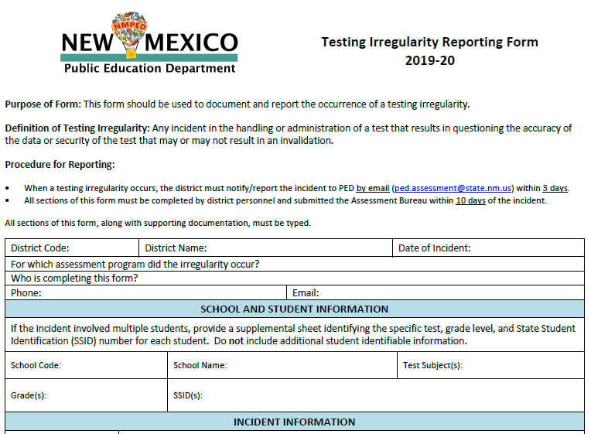
Reporting Irregularities
Phone or email program manager within 3 days
Submit form within 10 days
Form in DTC Manual, p. 49

Slide 57
Void vs Invalidate
Void
  Wrong test started
  Voided
  Correct test assigned and completed
  Score valid
Invalidate
  Test completed
  Score not valid because
    Cheating
    Accommodations incorrectly assigned
    etc.
  DTC Manual, pp. 9-10

Slide 58

It’s time to play,
Test Security Treasure Hunt!!

Slide 59

How to Play
Work with your table mates to find answers to questions about test security
Object of the game: Be the first table to find the correct answer. You must cite your answer to win the point.
Materials: NMAC 6.10.7 in your DTC Manual

Slide 60
Accessibility Supports
Universal Tools
(all students)
Accessibility Features
(designated students)
Accommodations
(students with IEP,
504, or EL Plan)
  DTC Manual, pp. 21-23
  Accommodations Manual, all

Slide 61
Universal Tools
Available to All Students
CBT (built in) or PBT
Examples:
  blank paper
  answer eliminator
  highlighter
  calculator (on test sections that allow)
  zoom or magnifier
  Accommodations Manual, pp. 6-7

Slide 62
Accessibility Features
Available to Designated Students
Designated by team such as SAT or by agreement among teacher, student, and parent
Only assign if used in classroom instruction
On CBT, must be enabled in platform
Examples:
  color contrast
  directions read aloud, clarified, or repeated
  headphones as noise buffer
  human reader or text-to-speech on a math or science (accommodation on ELA)
  Accommodations Manual, p. 7

Slide 63

Accommodations
Available Only to Students with EIP or 504 Plan, or ELs
Changes in procedures or materials that ensure equitable access
Only assign if used in classroom instruction
Examples:
  Human reader or text-to-speech on ELA assessment
  Calculator on non-calculator section
  Extended time (on timed test)
  Braille
  Accommodations Manual, pp. 7-8

Slide 64
Accommodations vs Modifications
Modifications: Changes in student response or test administration that change the construct of the test
  Change what the test is intended to measure
  Give students an unfair advantage
  Lead to invalid test result
Examples:
  Allowing use of a dictionary
  Paraphrasing a test question for a student
  Accommodations Manual, p. 8

Slide 65
Non-standard & Emergency Accommodations
Non-standard accommodations
  E.g., Cell phone for blood glucose monitoring, homebound student test at home
  Submit form (DTC Manual, p. 48) at least 2 weeks before test
Emergency accommodations
  E.g., student breaks arm and can’t write or use a mouse
  504 Plan if time
  Non-standard accommodation form if not
  Accommodations Manual, p. 13

Slide 66
Accommodations and Irregularities
Administering an assessment with an accommodation that is not in a student’s legal plan is an irregularity.
Administering an assessment without an accommodation that is in a student’s plan is an irregularity.
Avoid irregularities by checking and double checking which accommodations are assigned to students
  Accommodations Manual, p. 8

Slide 67
Making Decisions about Accommodations
Step 1: Expect Students to Achieve Grade-level Standards
Step 2: Learn About Accessibility Supports for Instruction and Assessment
Step 3: Identify Accessibility Supports for Instruction and Assessment
Step 4: Administer Accessibility Supports During Instruction and Assessment
Step 5: Evaluate Use of Accessibility Supports in Instruction and Assessment
Five-step Decision-making Process
  Council of Chief State School Officers (CCSSO) Accessibility Manual, PED Accommodations Manual, pp. 9-12

Slide 68
Participation, Exemptions, Alternate Assessments
All students (95%)
Medical exemptions
Accommodations for students with disabilities
Alternate assessment for students with severe cognitive disabilities (1%)
English learners
  Accommodations (except on English proficiency assessment)
  ELA exemption first year in US schools
  Testing in home language of Spanish
Notes:
See next slides for detail on each

Slide 69
English Learners
<1 year
ELA test may be waived and ELP results substituted
No waiver required: do not submit
3-5 years
May test in English with or without accommodations or in the home language of Spanish with PED approval
Submit waiver to test in Spanish
5+ years
Must test in English
No waivers granted: do not submit
1-3 years
May test in English with or without accommodations or in the home language of Spanish
No waiver required: do not submit
May test in English with or without accommodations or in the home language of Spanish
  DTC Manual, pp. 15-16

Slide 70
Alternate Assessment
IEP team determines whether student takes
  General assessment
  General assessment with accommodations
  Alternate assessment (1%)
Alternate assessment
  Measures alternate content standards
  Fall 2019: NMAPA (seniors for graduation only)
  Spring 2020: DLM
  DTC Manual, p. 25; Accommodations Manual, pp. 13-14
Notes:
Federal law caps at 1% and PED must monitor if LEAs exceed, but PED cannot tell LEA that a student can’t take the alternate assessment; IEP team must decide

Slide 71
Medical Exemption
Serious illness, injury, or medical emergency
Verified in writing by licensed medical provider
  Do not submit to PED
  Keep on file 5 years
Document in IEP or 504 Plan if student has one
Submit through Test Coordinator Portal
  DTC Manual, pp. 23-24, 45-47

Slide 72
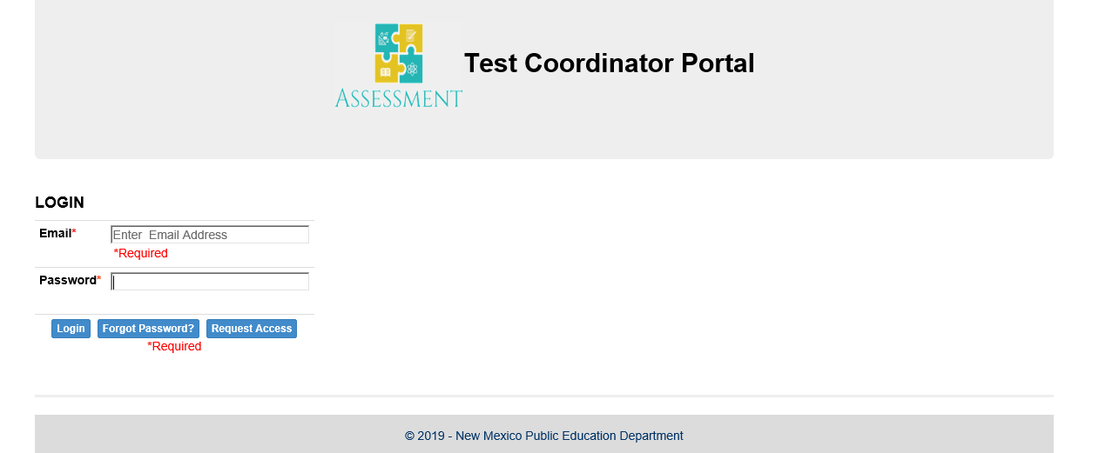
  PED creates DTC accounts; DTCs create STC accounts
  Forms created by STCs must be approved by DTCs
  Only DTCs submit to PED.
  DTC Manual, p. 41

Slide 73
PED Assessment Forms
Before Testing
Superintendent Designation
Staff and Student Confidentiality Agreements
Request for Medical Exemption (submit in portal)
Request for Non-standard Assessment Accommodation
During Testing
Testing Irregularity Reporting Form
After Testing
Superintendent’s and Principal’s Verification
Missing Test Materials Reporting Form
Local Demonstration of Graduation Competency
  DTC Manual Appendix F, pp. 41-54

Slide 74
New Mexico’s Statewide Assessment Model
Aligns to state adopted academic standards
Produces results used to inform college and career readiness
Undergirds the belief that all students can learn and achieve at high levels
Holds schools and the PED accountable to create equity and opportunities for students
Required State Assessments
NM-MSSA
WIDA ACCESS
Istation
NMAPA DLM
NM-ASR
NAEP
ECOT
College Entrance

Slide 75
Fall 2019
Istation
Aug. – Sept.
NMAPA (seniors only)
Oct. 14 – Nov. 1
NAEP
Oct. 14 – Dec. 20
Selected schools
13-year-olds
EoCs
LEA schedule
Optional
As needed for graduation
Fall 2019 Tests
EoCs (optional)
WIDA & W-APT
Istation
NMAPA
NAEP
ECOT
Precision Exams (optional)

Slide 76

Istation’s Indicators of Progress (ISIP)
Early literacy assessment in English or Spanish
Monthly progress monitoring to improve instruction
Students required to take ISIP in benchmark months:
K-2 in all schools statewide
K-3 in RAMS schools
K-5 in K-5 Plus schools
Beginning of Year (BOY) | Middle of Year (MOY) | End of Year (EOY)
August – September | January 1 – 31 | May 1 – 31

Slide 77
On Demand Assessment
To administer more than once in a month
Benchmark months use first administration
To use an On Demand for the benchmark, submit an irregularity
Report irregularities only in benchmark months

Slide 78
Entering Student Data
Include for all students:
State ID (STARS)
Date of birth

Slide 79
ISIP Reports Available Immediately
Level 5:
Above 80th
Level 4: 61-80th
Level 3: 41-60th
Level 1: 0-20th
Level 2: 21-40th
Administer assessments and view reports at https://secure.istation.com

Slide 80
Computer Adaptive Testing (CAT) and Kindergarten Scores
Kindergarten Tests | More Advanced Tests
Listening Comprehension (LC) Vocabulary (VOC) Letter Knowledge (LK) Phonological/Phonemic Awareness (PA) | Alphabetic Decoding (AD) Reading Comprehension (CMP) Spelling (SPL) Text Fluency (TF)
New subtests introduced more slowly
Subtests that show the strengths will remain available longer

Slide 81
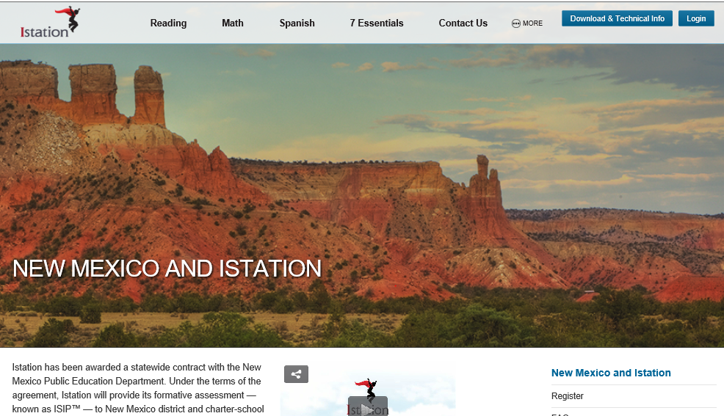
Technical specifications, Getting Started Guide, FAQs, manuals, videos, PD registration at https://www.istation.com/NewMexico.

Slide 82
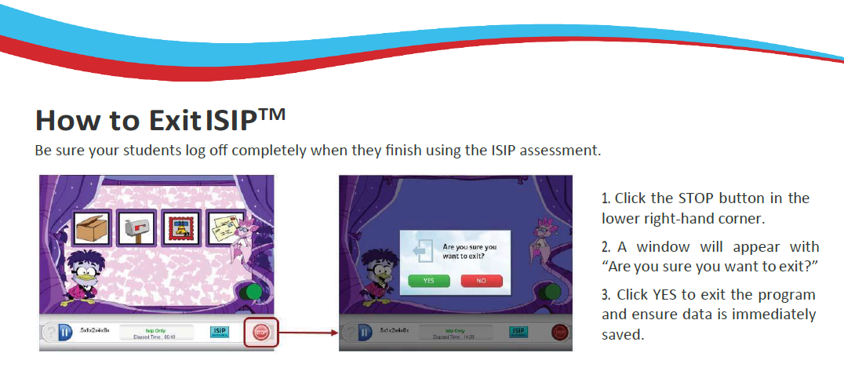
Not logging off causes tests not to be recorded
Most irregularities on Chromebooks and iPads

Slide 83
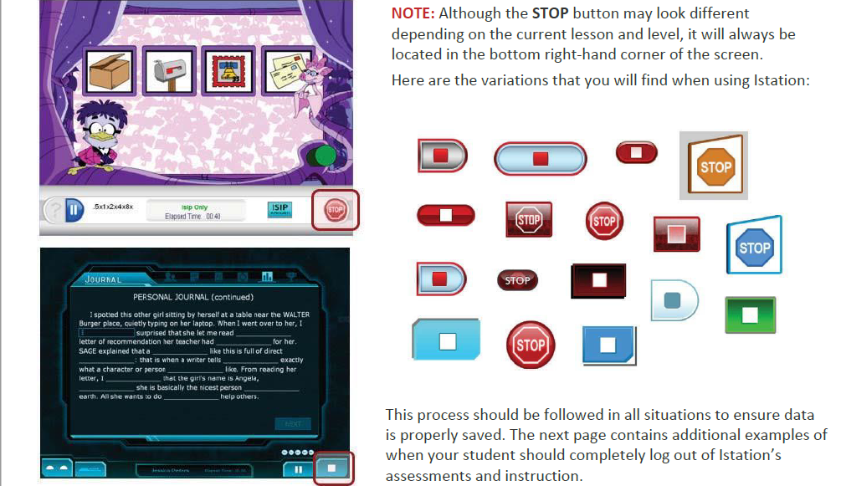

Slide 84
Istation Help & Support
Website with FAQs, technical specifications, videos, webinar links, teacher resources: www.istation.com/newmexico
Secure site to administer tests and view reports: https://secure.istation.com
Support: support@istation.com or (866) 883-7323 (press 2)
PED Contact: Brigette Russell, PhD
Brigette.Russell2@state.nm.us or (505) 827-6528

Slide 85
National Assessment of Educational Progress (NAEP)
NAEP Long-Term Trend (LTT)
  Trends back to 1971 for reading and 1973 for math
  Typically every 4 years, but not since 2011-2012
Paper-based
Math and reading
Schools already notified
Nationally representative age-based sample
  Age 13: October 14 – December 20, 2019
  Age 9: January 6 – March 13, 2020
  Age 17: March 16 – May 22, 2020

Slide 86
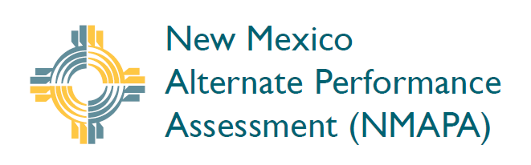


New Mexico Alternate Performance Assessment
(NMAPA)
Notes:
Note: I rearranged slides, be flexible.

Slide 87

What’s New for NMAPA Fall Administration?
All users will need to create a new password.
No students will require a second rater.
Orders will be shipped to districts but packaged by school
DTCs can place orders for only TA Kits and Student Score Forms in TIDE.
DTCs set the deadline for return of Materials
Used SSFs and optional student scoring worksheets should be returned using the return shipping envelope for express delivery.
Blank SSFs should be returned in the original shipping with all other materials
Students must be added into TIDE no later than November 14, 2019.
Notes:
AIR suggests Nov. 8
See DTC Manual for more information

Slide 88
DTCs are responsible for the accuracy of student data
Before testing:
Verify preID data in TIDE for completeness and accuracy
Check preID labels, destroy preID labels with inaccurate information
After testing:
A preID label is affixed to the correct SSF
If no preID label, verify student information on SSF cover
Ensure used SSFs are packaged separately from all other materials
Resolve data discrepancies by the deadline

Slide 89
NMAPA Fall Retest
Dates to Calendar
Initial order window | August 19–September 16
DTC receives NMAPA materials | September 30
TIDE additional order window | October 14–28
Test administration window | October 14–November 1
DTC deadline to schedule mandatory UPS pickup | November 8
STC/TA deadline to return NMAPA materials to DTC | Set by DTC
UPS pickup deadline for DTC to return materials to AIR | November 14
Districts receive student score reports | By January 29

Slide 90
Into, Through, and Beyond NMAPA
Who takes NMAPA?
Who gives NMAPA?
Entering and correcting student pre-ID data and ordering test materials
Correcting data discrepancies
Test reports

Slide 91
Who takes NMAPA: Guiding Questions for IEP Teams
Does the student’s past and present performance in multiple settings (home, school, community) indicate that a significant cognitive disability is present?
Does the student need intensive, pervasive, or extensive levels of support in school, home, and community settings?
Do the student’s current cognitive and adaptive skills and performance levels require direct instruction to accomplish the acquisition, maintenance, and generalization of skills in multiple settings (home, school, and community)?
Notes:
Not just an academic disability, adaptive skills such as feeding, dressing, getting around
1:1, repeated instruction
Multiple settings e.g., learning to button a shirt at school may not generalize to home

Slide 92
Information from questions 1-3 drives placement decisions:
Instruction
Assessment
Instruction in the general education academic standards is not appropriate, even with intensive accommodations and supports
Instruction in alternate academic standards is appropriate
Participation in the general assessment is not appropriate, even with intensive accommodations and supports
The alternate assessment is appropriate for the child
Notes:
Veteran DTCs: What challenges do you face working with IEP team decisions impacting alternate assessment administration? Data? Access to IEP placement decisions? Test orders?
A: Elbow partner: What part can a DTC play in working with IEP teams to avoid these issues? in decision making about assessment?
Accessibility features, accommodations, access to IEP placement decisions, ordering windows

Slide 93
Which Seniors Take the Retest?
Students in grade 12 or higher with significant cognitive disabilities i.e., cohort 2020 or earlier, entered 9th grade in SY 16-17 or earlier
Seniors who need to demonstrate graduation competency only
Graduation Ability option passing scores:
Note: IEP teams may assign different passing scores
 | English Language Arts | Mathematics | Science | Social Studies
Grades 12, 12+ | 479 | 506 | 501 | 500

Slide 94
Who gives NMAPA?
NMAPA TAs must:
be certified or licensed employee of the district;
be familiar with student and vice versa
be familiar with the current Test Administrator Manual;
be trained in and knowledgeable about proper test administration and security;
complete and sign an NMPED Staff Confidentiality Agreement; and
have completed the online NMAPA training within the past two years.
NO second raters needed!!

Slide 95
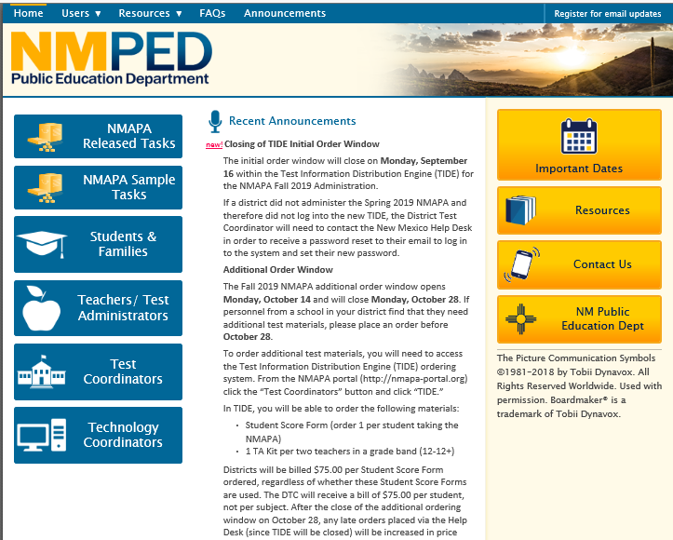
NMAPA Portal http://nmapa-portal.org/

Slide 96
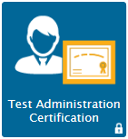

NMAPA Online Training
Test Administrator online training is at
Click on Teacher/TA tab,
then click

Slide 97
NMAPA Online TA Training
  The five training modules can be completed in multiple sessions.
  Can be taken on individually or as part of a group training
    Manipulatives will be available to print out prior to watching the modules for you to use during training.
    A certificate can be printed at the end of training, and TAs must be re-certified every two years.

Slide 98
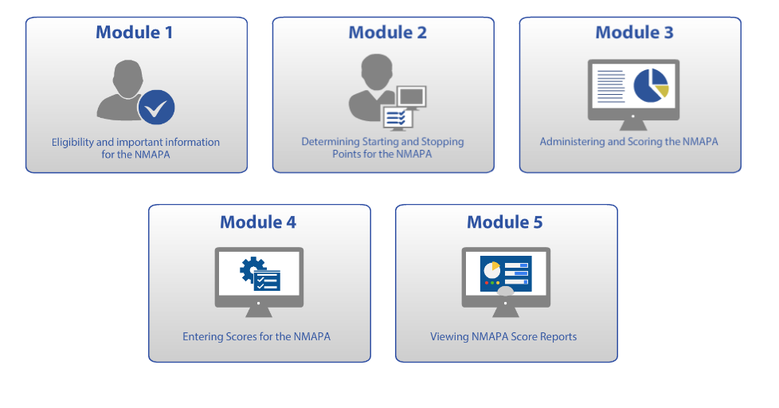
Online Training Modules

Slide 99


Pre-ID Data Entry/Correction and Online ordering
IMPORTANT! Correct student data and enter missing students. Check roster.
Order materials:
  Student Score Forms (SSF) @ $75.00
  TA Kits for all tested grades. For each school: 1 per 2 TAs per grade band
  Additional order window:
  Monday, October 14 to Monday, October 28. On Oct. 29 late orders are $150 per SSF
Notes:
Initial order window closed 9/16.
$75 used or unused

Slide 100
TIDE Platform
Test preparation, administration, post-administration
Manage user and student information and rosters
Order testing materials and track orders.
List of enrolled students
  uploaded from external systems
  features for adding students manually

Slide 101

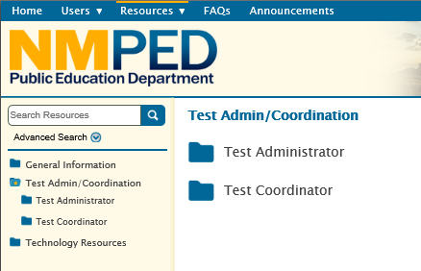
Through NMAPA: Manuals, User Guides, etc.
District Test Coordinator Manual
Test Administrator Manual
TIDE User Guide
ORS User Guide

Slide 102
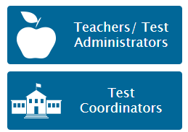
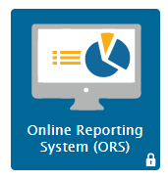
Beyond NMAPA: Online Reporting System (ORS)
Click on either tab
Goes to:
Discrepancy Resolution System
Reports and data files
Notes:
Online access to score reports and score data
Users access the ORS through TIDE
DTCs or STCs must add Test Administrators
as users in TIDE

Slide 103
Online Reporting System (ORS)
Web-based
Provides score reports for each student who takes NMAPA
Levels of reports available
  LEA
  School
  Teacher
  Roster
  Student

Slide 104
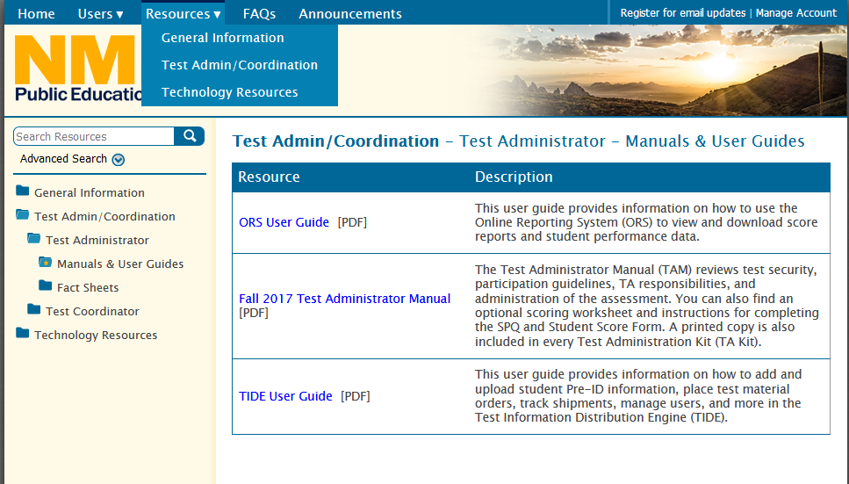
Resources

Slide 105
NMAPA Quick Links
Sample Test Items | http://nmapa-portal.org/sample-tasks.stml
Test Coordinator Manuals | https://nmapa-portal.org/resources/manuals-and-user-guides2/
Teacher Resources | https://webnew.ped.state.nm.us/bureaus/assessment/new-mexico-alternative-performance-assessment/teacher-resources/
Parent Resources | https://nmapa-portal.org/resources/general-information/
Ordering Test Information Distribution Engine (TIDE) | www.nmapa-portal.org
NMAPA Help Desk | 1-800-254-6130 NMHelpDesk@air.org

Slide 106
NMAPA Help & Support
Website: www.AIR.org
TIDE (NMAPA Portal): www.nmapa-portal.org
Support: NMHelpDesk@air.org or (800) 254-6130
PED Contact: Karen Greer
Karen.Greer@state.nm.us or (505) 827-6509
h

Slide 107

Say good-bye to NMAPA

Slide 108
WIDA Screener and W-APT
Training provided earlier this year by Language & Culture Division
Website and secure portal: https://wida.wisc.edu
WIDA HelpDesk: help@wida.us or (866)-276-7735
  Test preparation, user guides, certification, training, manuals, accommodations
WIDA Assessment Management System (AMS): http://widaams.us/
WIDA-AMS HelpDesk: WIDA@DataRecognitionCorp.com or (855)-787-9615
  Login issues, ordering materials, adding students and test sessions, printing test tickets, technology issues, unlocking and invalidating tests
PED Contact:
  Kirsi Laine, Deputy Director of Language and Culture Division
  Kirsi.Laine@state.nm.us or (505) 827-6505

Slide 109

Technology Change for
WIDA Screener and ACCESS for ELLs
Transition to Central Office Service (COS)
Delete Testing Site Manager (TSM) configurations prior to testing
Archived webinars on the transition: https://portal.wida.us/client/DownloadLibrary.aspx
For assistance, contact Data Recognition Corporation (DRC) Customer Service at 855-787-9615 or WIDA@datarecognitioncorp.com

Slide 110

End of Course (EoC) Exams
No longer required by PED
LEAs use for local purposes and on local schedule
Use to demonstrate gradation competency
  No fall re-tests of Transition or SBA
  No minimum attempts on Transition or SBA
  Extra attempt permitted:
    3 for standard pathway
    4 for modified pathway

Slide 111
End of Course (EoC) Exams
Only EoCs used to demonstrate graduation competency on www.nmepic.com platform
Other EoCs available to LEAs by email request from PED.Assessment@state.nm.us
Seniors can use to demonstrate gradation competency
  No fall re-tests of Transition or SBA
  No minimum attempts on Transition or SBA before moving to EoCs
  Extra attempt permitted:
    3 for standard pathway
    4 for modified pathway

Slide 112
EoC Help & Support
Platform: www.nmepic.com
PED Contact: Adam Rios
Adam.Rios@state.nm.us or (505) 827-5861
h

Slide 113

Precision Career Technical Education (CTE) Exams
Industry recognized certifications
32 adopted Precision Exam titles available at no cost to LEAs
Discounted pricing for site licenses with access to 150+ exams
Optional
Website: www.PrecisionExams.com
Contact: Adam Rios, Adam.Rios@state.nm.us or (505) 827-5861

Slide 114
Questions about assessments?
Contact the PED Program Manager
Test | Program Manager
NM-MSSA, College Entrance Exam | Lynn Vasquez; Lynn.Vasquez@state.nm.us; 505-827-3888
NM-ASR, SBA Spanish Reading | Xavier DeLeon; Xavier.DeLeon@state.nm.us; 505-8276747
Istation | Brigette Russell, PhD; Brigette.Russell2@state.nm.us; 505-827-6528
WIDA Screener, W-APT | Kirsi Laine; Kirsi.Laine@state.nm.us; 505-827-6505
NMAPA | Karen Greer; Karen.Greer@state.nm.us; 505-827-6509
EOCs, Precision Exams | Adam Rios; Adam.Rios@state.nm.us; 505-827-5861
ECOT | Brenda Kofahl, Brenda.Kofahl@state.nm.us; 505-827-6627
ACCESS, Alt-ACCESS | Karen Greer; Karen.Greer@state.nm.us; 505-827-6509
DLM | Karen Greer; Karen.Greer@state.nm.us; 505-827-6509
NAEP | Marie Julienne, PhD; Marie.Julienne@state.nm.us; 505-827-3982

Slide 115
Thank you!
Questions?

