Slide 1
NATIONAL SCHOOL LUNCH (NSLP) AFTERSCHOOL SNACK PROGRAM (ASSP)
Feeding a child at school is such a simple thing – but it works miracles.
By: Jerome Armijo, Health Educator

Slide 2
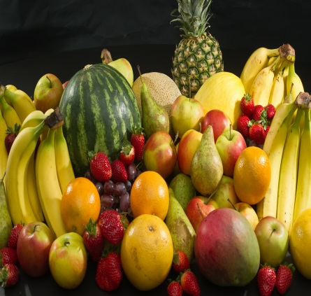
TEST YOUR KNOWLEDGE
Notes:
WE HAVE FOUR DIFFERENT SNACK GROUPS . WHICH SNACKS WOULD BE IN COMPLIANCE PER USDA MEAL PATTERN REQUIREMENTS? AND WHAT IS THE REQUIRED SERVING AMOUNT FOR EACH OF THE CREDIBLE FOOD COMPONENTS? WE WILL REVIEW THE REQUIRED AMOUNTS AS WE GO ON. REMEMBER TWO LIQUIDS SHOULD NEVER BE SERVED FOR SNACK.

Slide 3
OBJECTIVES
By the end of this presentation each participant will be able to:
Identify qualifying criteria for the Afterschool Snack Program (ASSP)
Understand the application and claiming process.
Implement the ASSP Meal Pattern Requirements.
Train sites to be in compliance with all program regulations.

Slide 4
DEFINITION
As defined in federal regulation 7 CFR, Part 210, an “Afterschool Snack Program means a program providing organized child care services to enrolled school-aged children after school hours for the purpose of care and supervision of children. Those programs shall be distinct from any extracurricular programs organized primarily for scholastic, cultural, or athletic purposes.”

Slide 5
PURPOSE
The intent of the Afterschool Snack Program (ASSP) is to assist schools that operate organized supervised programs which include; educational and enrichment activities. Eligible programs serving snacks to children that meet USDA requirements may be claimed for reimbursement.

Slide 6
QUALIFYING CRITERIA
The SFA must:
Participate in the National School Lunch Program
The Afterschool Snack Program must:
Provide regularly scheduled educational/enrichment activities and be available to all children
Include children only through the age of 18 years
ASSP snacks are served only after the end of the school day. Schools are not eligible for reimbursement for snacks served before or during the school day, unless the school operates an Expanded Learning Time Program. Refer to FNS Memorandum SP 04-2011.
Notes:
Examples of eligible education or enrichment activities include: homework assistance, tutoring, supervised “drop-in” athletic programs, extended day programs, drama activities, and arts and crafts programs. Organized interscholastic programs or community-level competitive sports are not eligible to participate. State agencies can provide further information regarding afterschool care program eligibility.

Slide 7
PROGRAM REQUIREMENTS AT THE SFA LEVEL
Complete Application
Create Menu
Conduct Training with Staff
Monitor Sites
Submit Monthly Claims
Submit Quarterly Reports

Slide 8
APPLICATION PROCESS AND APPLICATION INFORMATION
SFA Level complete the application on the 2018-19 NSLP Application OR Student Nutrition Website
Information needed to complete application:
Dates of Operation
Time snack program starts and ends
Days of the week program operates
Approximate number of Student participants
Educational/Enrichment Activities being offered
Menu

Slide 9
ELIGIBILITY
Area-Eligible
The schools or a school in a qualifying area that has at least 50% or more enrolled students approved for free or reduced meals. All Snacks are served at no charge to all participating children and reimbursed at the free rate.
Non Area-Eligible
A school that has less than 50% of the enrolled student approved for free or reduced price meals. Snacks must be counted and claimed based upon the child’s approved eligibility (free, reduced, or paid). Snacks are reimbursed at the free, reduced, and paid snack rate.
Notes:
An afterschool care program site is area eligible if it is located at a school or in the attendance area of a school where at least 50 percent of the enrolled children are eligible for free or reduced price meals. For example, if a high school with less than 50 percent free or reduced price school enrollment is located in the attendance area of a middle school with 50 percent or more of the enrolled children eligible for free or reduced price meals, then the afterschool care program located in the high school would be area eligible. For more information, see: SP 08-2017, CACFP 04-2017, SFSP 03-2017: Area Eligibility in the Child Nutrition Programs, December 1, 2016. Sites that are not area eligible must document participating children’s individual eligibility status. In most cases, children participating in the NSLP Afterschool Snack Service will have an eligibility determination for the NSLP. The SFA sponsoring the afterschool care program could use participating children’s eligibility status for the NSLP to document individual eligibility for the snack service. If an approved free or reduced price application or direct certification match is not on file for a child, the SFA will earn the paid rate of reimbursement for snacks served to that child unless the child’s household applies and is approved for free or reduced price benefits.

Slide 10
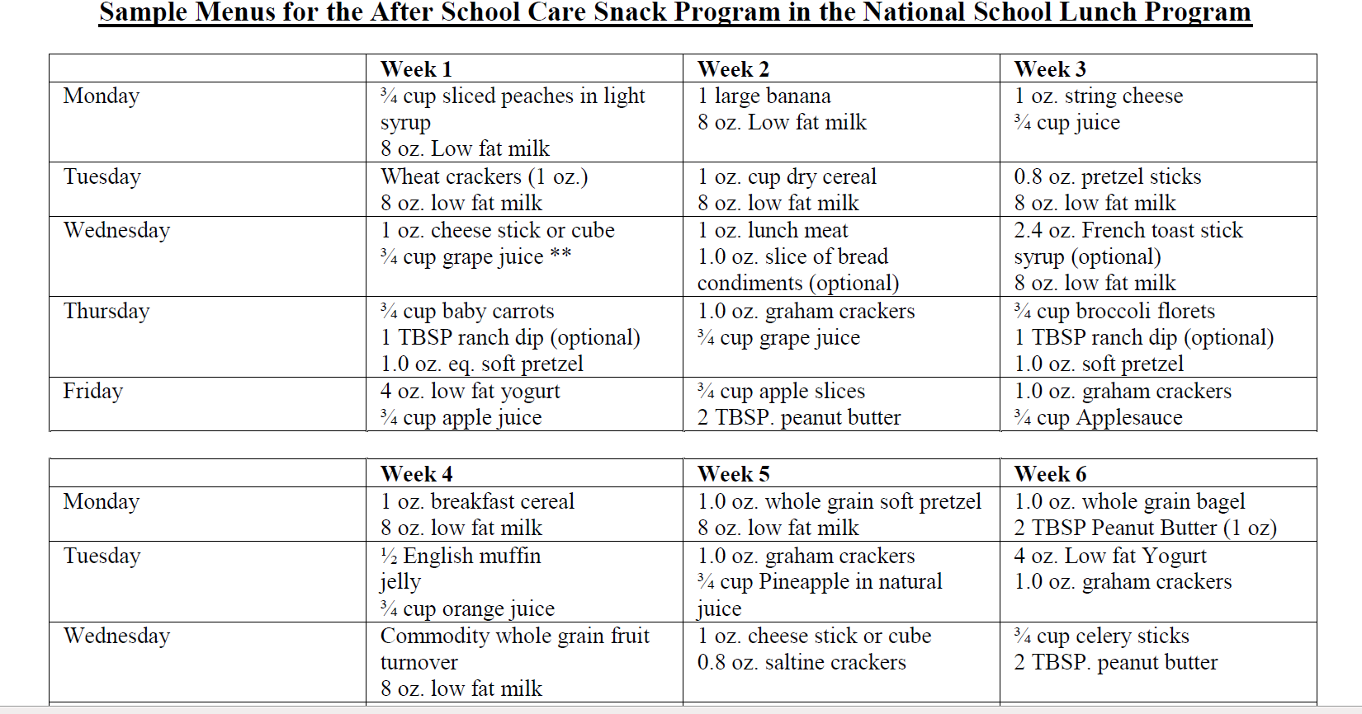
MENUS
A Sample Menu must be uploaded with Application
Each menu must contain at least two credible components per day

Slide 11
Select 2 of the 4 Components

Slide 12
Milk
Serving Size: 1 CUP
Fat Free Flavored or 1% Milk Unflavored
Milk cannot be served when the only other component is juice
Same rules as above for lactose free & lactose reduced milk
*Whole, 2% and low fat flavored milks not allowed

Slide 13
Fruit and Vegetables
SERVING SIZE: ¾ CUP
If serving a juice instead of fresh fruit, it must be 100% juice
Two liquid components such as juice and milk cannot be served for snack. It can only be One liquid component.
Special Guidance:
No more than half of the weekly fruit offering may be 100% juice.
Dried fruit counts as double: 3/8 cup raisins = 3 /4 cup fruit.
Frozen with or without added sugar.
Canned in light syrup, fruit juice or water.

Slide 14
Whole Grains
SERVING SIZE: 1 SERVING
Ingredients must include:
Enriched flour or whole grains or a combination of both
Cereals must be whole grain, enriched or fortified
Special Guidance:
All grains must be “whole-grain rich”
Half of all grains for the week must be “whole-grain rich”
“Whole-grain rich”= At least 50% whole grains and the rest of the product/blend must be enriched flour.
A serving is a “1 oz equivalent” based on 16 grams of grain per serving
Cereals must be whole grain rich and fortified
Notes:
Just called “grains” now. Lunch: K-8 requires a 1 oz equivalent per day. 9-12 is a 2 oz eq. per day.
Examples: whole grain breads, tortillas and cereals. Companies are on board with these changes!

Slide 15
Meat/ Meat Alternate
SERVING SIZE: 1 OZ
Meat examples:
Lean Meats
Meat Alternates examples:
Eggs, cheese, tofu, yogurt, beans, nut butters, nuts and seeds.
Notes:
9-12 is 2 oz serving size

Slide 16
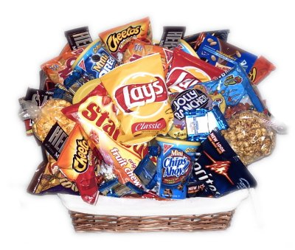
NON CREDITABLE ITEMS
Ice cream
Kool-Aid
Cokes
Lemonade
Pudding
Fruit Snacks
Jell-O
Candy, Chocolate bars, etc.
Potato chips
Donuts
Cupcakes
Sports Drinks

Slide 17
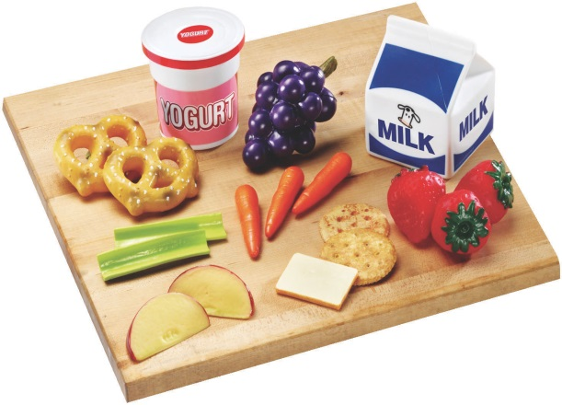
Healthy Snacks
Baby carrots (other veggies) with low fat ranch dressing
Grilled cheese sandwich on Whole Grain (WG) bread (low fat cheese)
Apples or bananas with peanut butter
Turkey and cheese on WG bread with tomato and lettuce
Fresh fruit with light mozzarella string cheese sticks
Yogurt with nuts and raisins
Low fat tortilla chips with salsa and shredded cheese
Hard boiled egg with a piece of fresh fruit
Beans, low fat cheese and salsa
Veggies with hummus
Notes:
½ cup carrots has almost 200% of Daily allowance of Vit A.

Slide 18
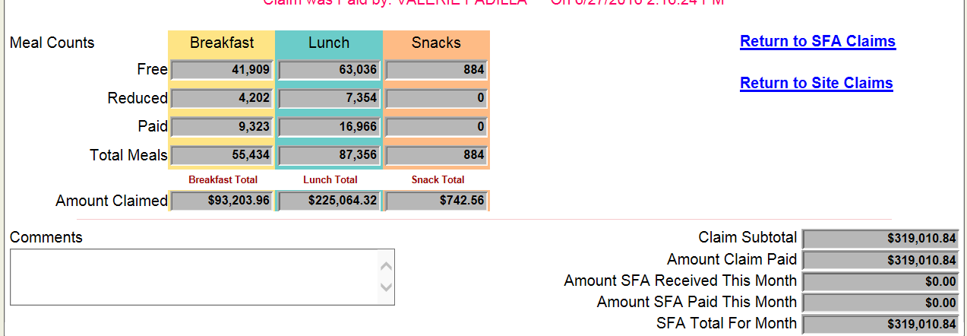
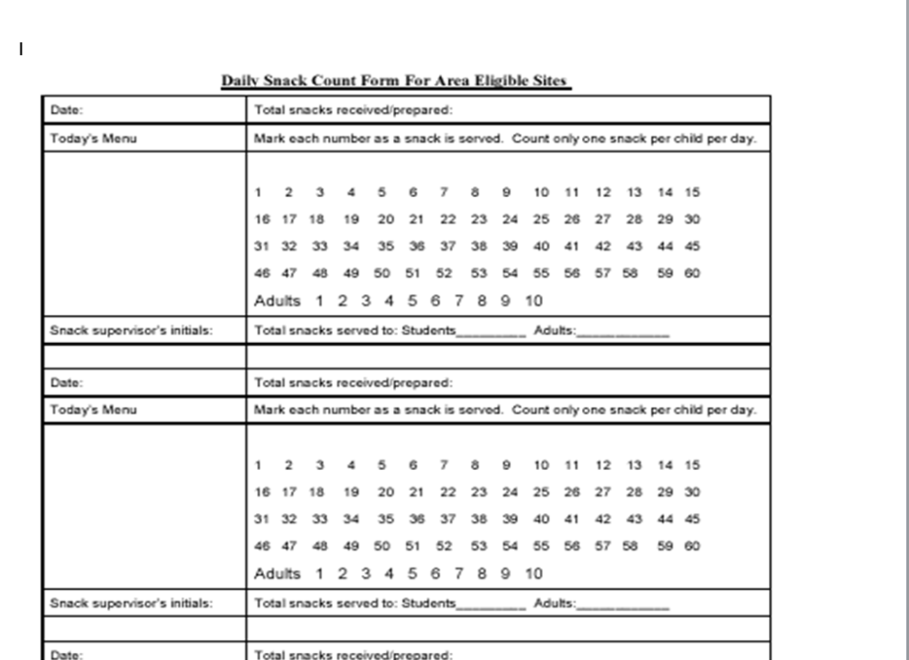
CLAIMS
Completed online in the claim system under the SFA District/School site
Receive reimbursement with Student Breakfast Program and National School Lunch Program claims (if applicable)
Notes:
Area eligible sites must record and report the total number of snacks served each day. Non-area eligible sites must record and report the number of snacks served each day by category of reimbursement (i.e., free, reduced price, or paid). Area eligible sites must maintain documentation to demonstrate area eligibility. All sites must maintain documentation of compliance with the meal pattern.

Slide 19
2018/19 ASSP REIMBURSEMENT RATES

Slide 20
FOOD SAFETY
Should have Food Safety/Hazard Analysis Critical Control Point (HACCP) at each site to also include Standard Operating Procedures (SOP) for Snack Service
SOP should include regulatory procedures for:
Proper food preparation
Time and Temp Control
Proper Serving Techniques
Proper Storage/holding equipment/facilities

Slide 21
MONITORING
The SFA must review each site two times during the school operating year
First review must take place within the first 4 weeks of beginning the program.
SFA conducts the self-review prior to the end of each school year.
(attached example of Monitoring Form)

Slide 22
AFTERSCHOOL SNACK (ASSP) MONITORING FORM

Slide 23
RECORDKEEPING
Provide accurate and daily Production Records
(attached example of ASSP Production Record)
Provide accurate Daily Meal Counts and
Attendance Records
Meal Counts must be taken at Point of Service
(attached example of Daily Meal Count and
Attendance Sheet)
Claim no more than one snack per child per day

Slide 24
AFTERSCHOOL SNACK PROGRAM (ASSP) PRODUCTION RECORD

Slide 25
AFTERSCHOOL SNACK PROGRAM (ASSP) DAILY ATTENDANCE AND MEAL COUNT FORM

Slide 26
AFTERSCHOOL SNACK PROGRAM RESOURCES
http://www.fns.usda.gov/school-meals/afterschool-snacks
https://webnew.ped.state.nm.us/bureaus/student-success-wellness/

Slide 27
Questions?

Slide 28
THANK YOU
Jerome Armijo Health Educator
(505)827-1465
Jerome.Armijo@state.nm.us

