Slide 1
FRESH FRUIT AND VEGETABLE (FFVP)
FRESHLY PRESENTED BY
Felix Griego
KRISTINA FERNANDEZ CLAIMS

Slide 2
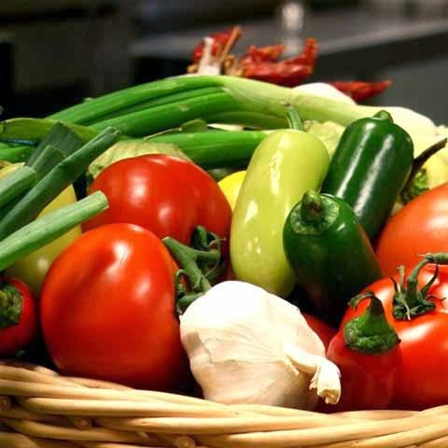
Overview
WHAT IS THE FRESH FRUIT AND VEGETABLE PROGRAM (FFVP) GOALS
SCHOOL SELECTION CRITERIA FROM THE USDA
TWO TYPES OF COSTS
DAILY OPERATION OF FFVP
NEW PROCEDURE FOR ENTERING YOUR CLAIMS FOR FFVP
HELPFUL HINTS

Slide 3
USDA GUIDELINES FOR FFVP
PROVIDE A VARIETY OF FREE. FRESH FRUITS AND VEGETABLES
INTRODUCING SCHOOL CHILDREN TO A VARIETY OF PRODUCE THAT THEY OTHERWISE MIGHT NOT HAVE THE OPPORTUNITY TO SAMPLE
MAKE A DIFFERENCE IN CHILDREN’S DIETS TO IMPACT THEIR PRESENT AND FUTURE

Slide 4
NUTRITION EDUCATION
INTERGRATE PROGRAM ACTIVITIES WITH OTHER SCHOOL EFFORTS TO PROMOTE HEALTH NUTRITION, HEALTHY WEIGHT AND PHYSICAL ACTIVITY
PUBLICIZE THE AVAILABILITY OF FFVP FOR CHILDREN WIDELY WITHIN THE SCHOOL THROUGH USE OF THE PUBLIC ADDRESS SYSTEM, FLYERS MONTHLY SCHOOL MENUS AND OTHER USUAL MEANS OF COMMUNICIATION.
USE THE FREE EDUCATIONAL MATERIALS FROM USDA TOOL KIT https://www.fns.usda.gov/ffvp/fresh-fruit-and-vegetable-program

Slide 5
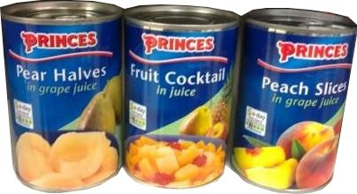
UNALLOWABLE COSTS
IF DIP FOR VEGETABLES IS PROVIDED, IT MUST BE FAT-FREE OR LOW-FAT AND MUST BE LIMITED TO A 2 OUNCE SERVING SIZE.
DIP FOR FRUITS IS NOT ALLOWED
PEANUT BUTTER
CREAM CHEESE
FROZEN, CANNED, DRIED AND OTHER TYPES OF PROCESSED FRUITS AND VEGETABLES ARE NOT ALLOWED.

Slide 6
REMEMBER
WHEN PURCHASING FOR THE PROGRAM THE GOAL IS TO SERVE FRESH FRUITS AND VEGETABLES IN THEIR NATURAL STATE AND WITHOUT ADDITIVES (FFVP SIZES SHOULD REFLECT THE AGES AND PREFERENCES OF STUDENTS) (EXAMPLE YELLOW KIWI)
LIMIT THE SERVICE OF COOKED FRESH VEGETABLES TO NO MORE THAN ONCE EACH WEEK AND ONLY WHEN INCLUDED AS PART OF A NUTRITION EDUCATION LESSON
SERVE THE STUDENTS DURING THE SCHOOL DAY AND AT LEAST TWICE A WEEK AND SEPARATELY FROM THE NSLP AND SCHOOL BREAKFAST PROGRAM SERVICE TIMES.

Slide 7
SCHOOL SELECTION CRITERIA
ELEMENTARY SCHOOL STUDENTS
MUST OPERATE THE NATIONAL SCHOOL LUNCH PROGRAM (NSLP)
BASED ON THE % OF FREE AND REDUCED PRICE MEALS WITH THE HIGHEST PRIORITY GIVEN TO SCHOOLS WITH HIGHEST % OF LOW INCOME STUDENTS

Slide 8
TWO TYPES OF COSTS
OPERATING COSTS
MINIMUM OF 85% AND A MAXIMUM OF 100% OF THE GRANT AWARD CAN BE EXPENDED ON OPERATING COSTS
ADMINISTRATIVE COSTS
LIMITED TO 15% (§211.6) OF YOUR SCHOOLS’S TOTAL FFVP GRANT
EXAMPLE YOUR TOTAL ALLOCATION FOR FFVP
$30,000 YOU COULD SPEND $4,500 FOR ADMIN. COSTS

Slide 9
OPERATING COST
Include FRESH fruit and vegetable cost, freight and taxes
LABOR COSTS
Washing and chopping produce
Preparing Trays
Delivery of Fresh Fruit and Vegetables
Small Supplies/Other
Napkins, Paper Plates, Utensils, Bowls, Trays, Baskets, Trash Bags and Cleaning Supplies to name a few

Slide 10
ADMINISTRATIVE COSTS
A maximum of 15% of the funds may be used for non-operating costs or administrative costs based on the total grant awarded.
Documented expenses for planning the program, managing the paperwork, and all other aspects of the FFVP not related to preparation and serving of FFVP.

Slide 11
PRODUCTION RECORDS
FFVP PRODUCTION RECORDS
MAINTAIN ON A DAILY BASIS
RECORD FRUITS AND VEGETABLES SERVED
RECORD LEFTOVERS

Slide 12
PLAN TO SPEND YOUR TOTAL ALLOCATION
FIGURE THE AMOUNT TO BE SPENT EACH MONTH AND SPEND IT
FFVP PRESENTED EVERY MONTH THROUGHOUT THE SCHOOL YEAR
DO NOT SPEND ALL YOUR FUNDS THE FIRST COUPLE OF MONTHS AND END THE PROGRAM

Slide 13
REIMBURSEMENT CLAIM
FUNDS DISBURSED BASED ON CLAIMS SUBMITTED
SUBMIT MONTHLY CLAIMS SHOWING MONTHLY EXPENDITURES
DO NOT SUBMIT MORE THAN ONE MONTHLY CLAIM AT A TIME THIS IS UNALLOWABLE PER THE USDA §211.9(4)(C)
SUBMIT YOUR REIMBURSEMENT MONTHLY BY THE 10th OF EVERY MONTH
READABLE VENDOR INVOICES, FINANCIAL PAGE

Slide 14
LATE SUBMISSION
MONTHLY CLAIMS FOR REIMBURSEMENT SHALL BE SUBMITTED BY THE SFAS TO THE STATE AGENCY NOT LATER THAN 60 DAYS FOLLOWING THE LAST DAY OF THE FULL MONTH COVERED BY THE CLAIM IN ACCORDANCE WITH §211.9 OF THE PROPSED RULE.
CLAIMS NOT POSTMARKED AND SUBMITTED WITHIN 60 DAYS SHALL NOT BE PAID WITH PROGRAM FUNDS UNLESS FNS DETERMINES THAT AN EXCEPTION SHOULD BE GRANTED

Slide 15
FFVP WILL NO LONGER BE SUBMITTED THROUGH OBMS
Starting October 1, 2019 FFVP will be entered in:
Student Nutrition Portal
https://sns.ped.state.nm.us/PORTAL/start.aspx
Kristina will have more on this process

Slide 16
QUESTIONS ABOUT THE FFVP PROGRAM ?

