Slide 1
BACK TO SCHOOL CONFERENCE
DANA MALONE – State Coordinator for Education of Homeless Children and Youth
LAURA HENRY - State Coordinator for Migrant Education & Foster Care Point of Contact

Slide 2
Identifying and Supporting Our Highly Mobile Students

Slide 3
OBJECTIVES
Understand the impact of educational disruption on highly mobile students, including children and youth who are experiencing homelessness, who are in the foster care system and who are migratory.
Become familiar with Federal and New Mexico laws that ensure equitable access to education and supports educational stability.
Identify resources for administrators and teachers to support highly mobile students and their families.

Slide 4
ECHY, FOSTER and MIGRANT
Main themes:
Identification
School stability
School enrollment
Support for academic success
Child-centered, best interest decision making

Slide 5
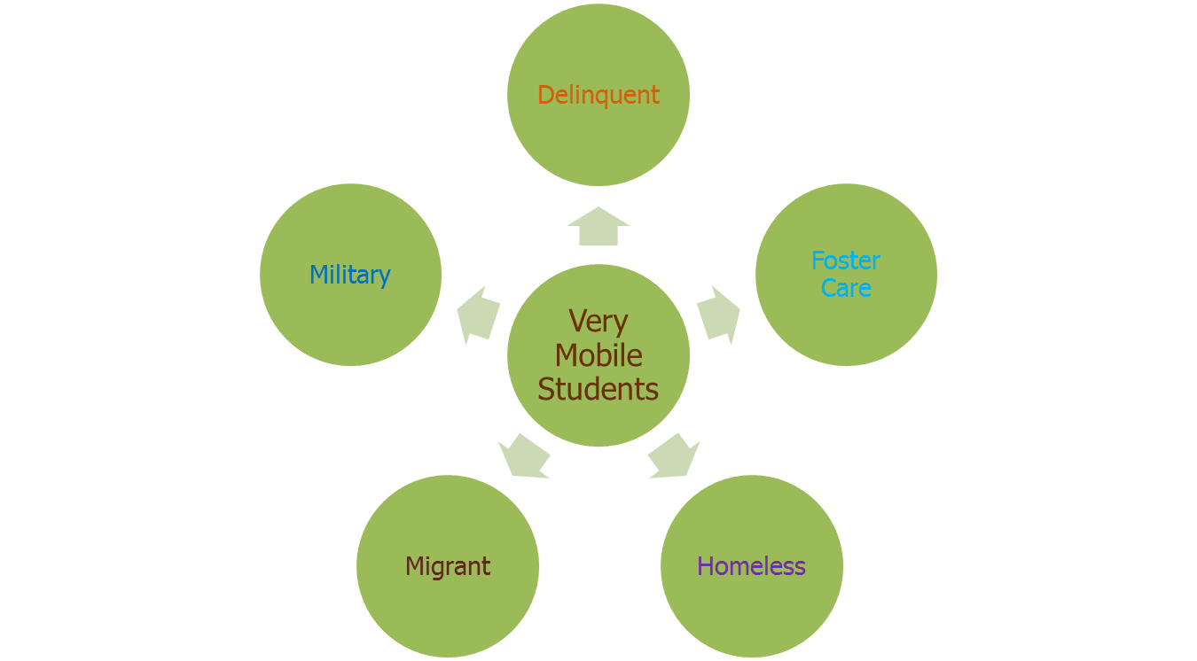
WHO ARE OUR HIGHLY MOBILE STUDENTS
Notes:
What other groups of children and youth could be added to this graph?

Slide 6
WHAT CAUSES HIGH MOBILITY?
Becoming homeless
Migratory parents’ seasonal agricultural job ended and the family must to move to find more work.
Children are removed from the home and placed in foster care. Foster home placements change.
Youth are placed in a juvenile detention center or behavioral health treatment facility far from their family and school.
Behavioral issues may create frequent school changes.

Slide 7
IMPACTS OF HIGH MOBILITY ON CHILDREN AND YOUTH
Higher incidences of:
Acute and chronic illnesses
Fatigue and hunger
Emotional trauma, depression, anxiety
Stereotypes and lack of awareness
Lack of adequate, timely health care
Lack of clothing appropriate to season, geography
Exposure to toxins—Environmental and Substance Abuse
Lack of transportation
Lack of school supplies
School enrollment requirements (school records, health records, proof of residency, guardianship)
Notes:
What have you observed?

Slide 8
IMPACTS OF HIGH MOBILITY ON CHILDREN AND YOUTH
Higher rates of depression and anxiety
Uncertainty re: living/family situation
Social isolation
Separation from family
Emotional trauma
Lack of services
Transportation
Health Care
Behavioral Health Care
Societal Stigma
Stereotyping
Lack of awareness, understanding

Slide 9
HIGH MOBILITY AND EDUCATIONAL DISRUPTION
Frequent school changes
Loss of 4-6 months academic progress per school change
Disruption of educational and personal routines
Creates stress in and out of school
Transition to different culture and/or country
Language and social challenges

Slide 10
HIGH MOBILITY AND EDUCATIONAL DISRUPTION
Disruption of relationships with peers and teachers
Difficulty trusting and establishing new relationships
Under-identification of student needs
Language, culture

Slide 11
HIGH MOBILITY AND EDUCATIONAL DISRUPTION
Curriculum changes leading to achievement gaps and academic difficulty
Same grade, different texts or subjects
Credits not transferring among schools/districts
No system for earning partial credits
Chronic Absences
Related to working with migrant parents, not being enrolled in timely manner, court appearances, etc.
Notes:
Christina example of achievement gap due to curriculum change

Slide 12
HIGH MOBILITY AND EDUCATIONAL DISRUPTION
Falling behind in academics
Students may be older than peers in class
Changes to extracurricular activities
New school does not offer same activities, sports, clubs
Lower graduation rates
Affects all groups of highly

Slide 13
IDENTIFYING CHILDRED AND YOUTH
Coordination with community agencies and entities
Public health clinics
Food kitchens
Homeless and domestic violence shelters
Faith communities
Housing and public assistance agencies
Law enforcement
Behavioral health, recovery resources

Slide 14
IDENTIFYING CHILDREN AND YOUTH
Become familiar with youth-serving agencies and places that youth frequent
Drop in centers
Teen parent programs
Street outreach programs
Health centers that teens use
LGBTQ youth organizations
Parks, restaurants, etc. where youth hang out
Notes:
Where else in your community do kids tend to gather?

Slide 15
IDENTIFYING HIGHLY MOBILE STUDENTS
School resources for identification:
Enrollment and withdrawal forms
Family needs assessments
Occupational surveys
School counselors, social workers
School nurses
Athletic coaches
Food service staff
Librarians

Slide 16
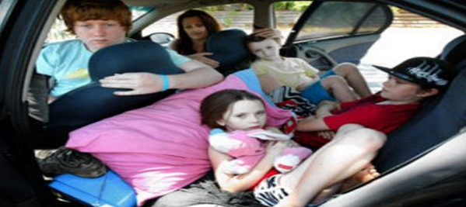
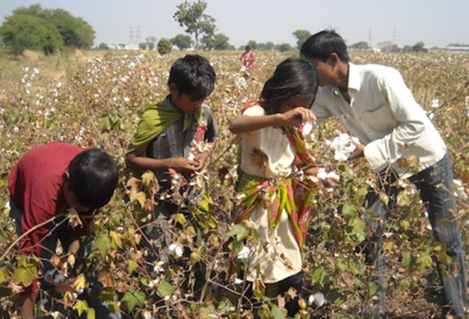
FOCUS ON 3 SUBGROUPS

Slide 17
WHAT SERVICES ARE THESE STUDENTS ELIGIBLE FOR?
Free school lunches and other school meals
School enrollment assistance
Tutoring and homework help
Preschool programs
Afterschool programs (extended learning)
Summer school programs
Referrals to High School Diploma or GED programs
Credit accrual and credit recovery
Health screenings and referrals
Supplies necessary to participate in school
Referrals to community and school resources
Resources for English Language acquisition
Mentoring Services
Transportation
Housing

Slide 18
SCHOOL STABILITY AND PLACEMENT
* LEAs must determine the school that is in the best interest of the child or youth to attend.
*LEAS must presume that staying in the school of origin is in the student's best interest, and
*The definition of "school of origin" also includes preschools.

Slide 19
STUDENTS IN FOSTER CARE
24 hour substitute care away from parents/guardians
In custody and care of state and tribal child welfare agencies
Includes foster family homes, foster homes of relatives, group homes, emergency shelters, residential facilities, child care institutions and pre-adoptive homes.

Slide 20
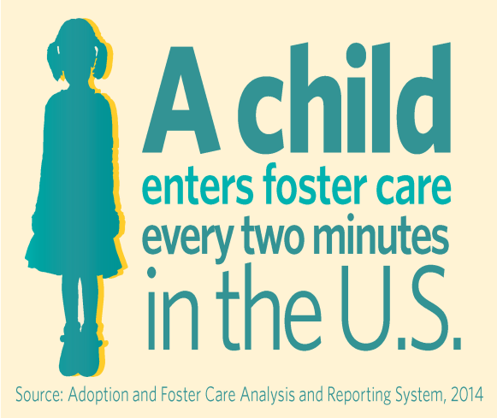
STUDENTS IN FOSTER CARE – NATIONAL TRENDS
All ages:
2x more likely of being absent from school
56%--75% change schools when first going into foster care
17-18 year olds:
2x more likely of having out of school suspension
3x more likely of being expelled
Average reading level is 7th grade
50% complete college by age 18
20% attend college
(Foster Care & Education.org)
https://datacenter.kidscount.org/data/bar/6244-children-in-foster-care-by-age-group?loc=33&loct=2#2/33/false/573/1889,2616,2617,2618,2619,122/12989

Slide 21
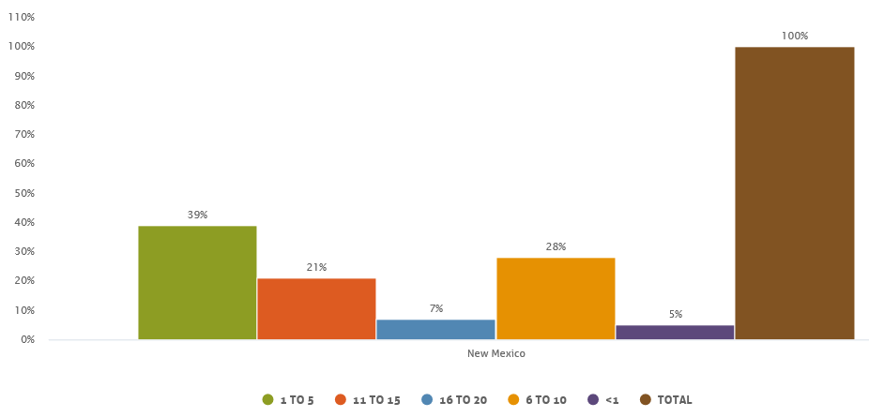
STUDENTS IN FOSTER CARE – NEW MEXICO
In New Mexico in 2016, 56% of children in foster care were between the ages of 6-20 years of age.
https://datacenter.kidscount.org/data/bar/6244-children-in-foster-care-by-age-group?loc=33&loct=2#2/33/false/573/1889,2616,2617,2618,2619,122/12989

Slide 22
STUDENTS IN FOSTER CARE – NEW MEXICO
In 2016, of the 1263 children and youth waiting for adoption:
8% waited less than 12 months
35% waited 12-23 months
32% waited 24-35 months
18% waited 3-4 years
7% waited more than 5 years
The longer a child is in foster care, the more likely they are to move from placement to placement.
https://datacenter.kidscount.org/data/bar/6244-children-in-foster-care-by-age-group?loc=33&loct=2#2/33/false/573/1889,2616,2617,2618,2619,122/12989
Notes:
https://datacenter.kidscount.org/data/tables/6679-children-in-foster-care-waiting-for-adoption-by-amount-of-time-waiting?loc=1&loct=2#detailed/2/33/false/870/2980,2983,2982,2984,2981,2986/13735,13734

Slide 23
STUDENTS IN FOSTER CARE – NEW MEXICO
In 2016, 49% of children in foster care in New Mexico had more than two placements.
https://datacenter.kidscount.org/data/tables/8822-children-in-foster-care-with-more-than-two-placements?loc=1&loct=2#ranking/2/any/true/870/any/17681

Slide 24
ESSA AND EDUCATIONAL STABILITY STUDENTS IN FOSTER CARE: TITLE I PROVISIONS
Emphasis on remaining in school of origin (SOO)
Foster home changes often cross school attendance areas or are in a different school district.
Staying in the school of origin when a student is moved to a different foster care home reduces educational and social disruption.

Slide 25
ESSA AND EDUCATIONAL STABILITY STUDENTS IN FOSTER CARE: TITLE I PROVISIONS
Best Interest Determination Meeting (BID)
If a move to a foster home that is located in a different school or district is possible or is happening, staff of the district/state charter who know the student well and CYFD hold a Best Interest Determination Meeting—preferably with the student.

Slide 26
ESSA AND EDUCATIONAL STABILITY STUDENTS IN FOSTER CARE: TITLE I PROVISIONS
Best Interest Determination Meeting (BID) (cont.)
Student centered
Considers a variety of factors to determine if remaining in the school of origin is best for the student
Transportation
If the BID determines the student should stay in the school of origin, CYFD and the district/state charter collaborate to ensure transportation for the student

Slide 27
MIGRANT EDUCATION PROGRAM – ELIGIBILITY CRITERIA
Must have a Certificate of Eligibility (COE) completed by a recruiter and validated by PED MEP staff
Meets ALL eligibility criteria (below)
Age: Between the ages of 3 and 21 years old
No high school diploma or GED obtained
Moved across school district lines within the past 36 months due to economic necessity (school interruption)
Is a resident in the State of NM for at least one day during the program year
Program year: September 1 – August 31
Youth who are migratory workers themselves or a spouse of a migratory worker.
“Migrant” does NOT mean the same as an “immigrant.”
An immigrant MAY be migrant ONLY if s/he meets the eligibility requirements.

Slide 28
ELIGIBILITY REQUIREMENTS FOR PARTICIPATION
A child is considered “migratory” if the parent or guardian is a migratory worker in the agricultural, dairy, lumber, or fishing industries and whose family has moved during the past three years.
A "qualifying" move can range from moving from one residence to another or across school district boundaries due to economic necessity. A young adult may also qualify if he or she has moved on his own within the past three years to engage in qualifying work or sought to obtain qualifying work.
The eligibility period is three years from the date of the last move. Eligibility is established through an interview conducted by a Migrant Education recruiter who visits both home and employment locations where migrant workers are employed.

Slide 29
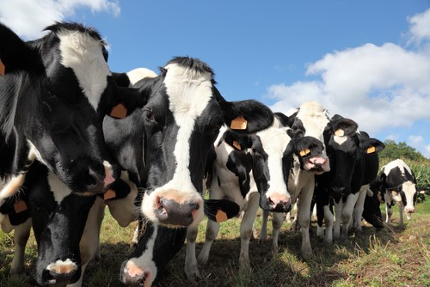
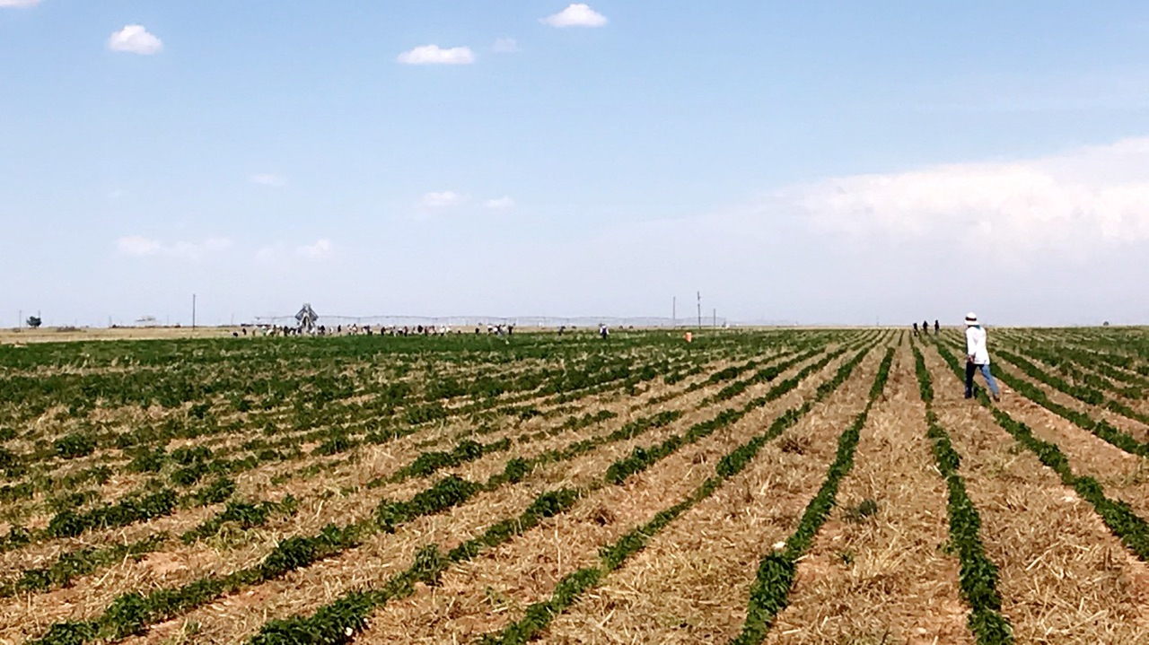
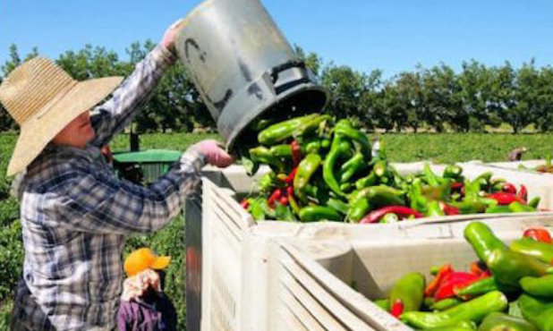
NEW MEXICO’S QUALIFYING WORK
OTHER QUALIFYING WORK INCLUDES: FISHING INDUSTRIES AND LUMBER

Slide 30
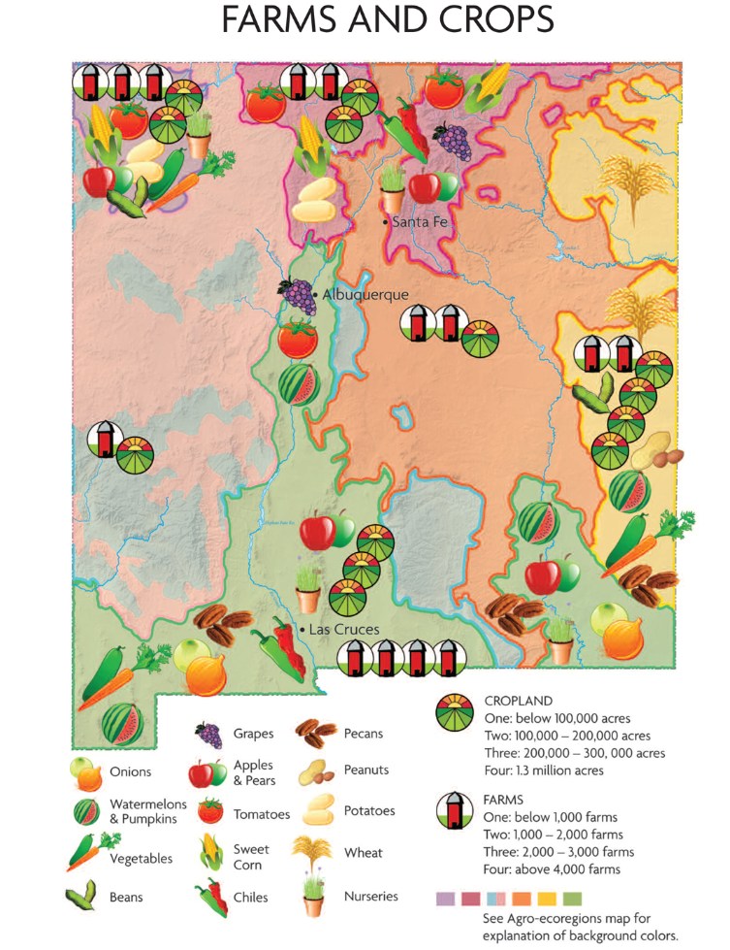
QUALIFYING WORK
Top commercial crops for the mass market in NM are: pecans, onions, greenhouse nursery crops, and chile. Peanuts (about 10,000 acres), potatoes (about 5,500 acres), sweet corn and dry beans (about 7.500 acres) are important in specific agro-ecoregions. There are many farms growing apples (over 900 totaling over 2,000 acres), and over 1,000 acres each of grapes, pistachios, pumpkins, and watermelons.
Hemp is a new crop that falls under the qualifying work for the MEP.

Slide 31
MIGRANT EDUCATION PROGRAMS – SUPPLEMENTAL GRANT (Title I – C)
Clovis Municipal Schools
Deming Public Schools
Dexter Consolidated Schools
Gadsden Independent Schools
Hagerman Municipal Schools
Hatch Valley Public Schools
Las Cruces Public Schools
Portales Municipal Schools
Roswell Independent Schools
Truth or Consequences Municipal Schools

Slide 32
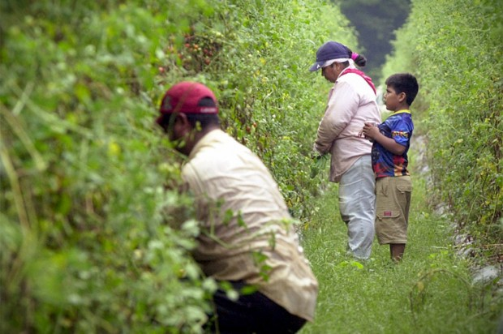
MIGRATORY CHILDREN HIGH MOBILITY & EDUCATIONAL CHALLENGES
Due to educational disruption and language barriers, migratory students are often academically behind their peers; may be older than peers in their grade
Lower graduation rates
Older, migratory children sometimes work with their parents and family members during the day and miss out on in-school and out-of-school activities

Slide 33
MIGRATORY CHILDREN HIGH MOBILITY & EDUCATIONAL CHALLENGES
Frequent moves among schools, school districts and states
Learning how to navigate in a new school in the middle of the school year
Social isolation—difficult to maintain relationships with peers and adults in school due to moves

Slide 34
ESSA AND EDUCATIONAL STABILITY MIGRATORY STUDENTS: TITLE I, PART C – EDUCATION OF MIGRATORY STUDENTS
Purpose:
Ensure that migratory children receive full and appropriate opportunities to meet the same challenging State academic content and student academic achievement standards that all children are expected to meet;
Design programs to help migratory children overcome educational disruption, cultural and language barriers, social isolation, various health-related problems, and other factors that inhibit the ability of such children to do well in school, and to prepare such children to make a successful transition to postsecondary education or employment; and
Ensure that migratory children benefit from State and local systemic reforms.

Slide 35
ESSA AND EDUCATIONAL STABILITY MIGRATORY STUDENTS: TITLE I, PART C – EDUCATION OF MIGRATORY STUDENTS
Purpose:
Support high-quality and comprehensive educational programs for migratory children to help reduce the educational disruptions and other problems that result from repeated moves;
Ensure that migratory children who move among the States are not penalized in any manner by disparities among the States in curriculum, graduation requirements, and State academic content and student academic achievement standards;
Ensure that migratory children are provided with appropriate educational services (including supportive services) that address their special needs in a coordinated and efficient manner.

Slide 36
EDUCATIONAL RESOURCES FOR MIGRATORY STUDENTS
Title I, Part A (Improving the Academic Achievement of the Disadvantaged)
Title I, Part C (Migrant Education Programs)
IDEA (Individuals with Disabilities Education Act)
English Language Acquisition Programs (under Title III)
National Clearinghouse for English Language Acquisition https://ncela.ed.gov/

Slide 37
EDUCATIONAL RESOURCES FOR MIGRATORY STUDENTS
Title I, Part C
Migrant Education Programs (MEP): provides educational and supportive services to children who are migratory agricultural workers or fishers or who move with a parent or guardian who is a migratory agricultural worker or fisher. Newly arrived immigrant children may qualify as eligible migratory children on a case-by-case basis— provided they meet the program requirements and fit the program-specific definition of migratory child.

Slide 38
EDUCATION FOR HOMELESS
CHILDREN AND YOUTH
They are HIDDEN IN PLAIN SIGHT……
In our communities and in our schools

Slide 39
WHICH STUDENT IS HOMELESS?

Slide 40
WHERE WOULD YOU GO IF YOU LOST YOUR HOUSING TODAY?

Slide 41
STUDENTS EXPERIENCING HOMELESSNESS ELIGIBILITY FOR HOMELESSNESS: CONTEXT FOR DEFINITION
Shelters do not exist in many suburban and rural areas, and often are full where they do exist.
Eligibility conditions of shelters sometimes exclude families with boys over the age of 12, or unaccompanied minors.
Youth on their own fear adult shelters and have no safe living options in many communities.
Shelters often have 30, 60, or 90 day time limits.
Motels may not be available, or may be too expensive or unsafe.
Families/youth may be unaware of alternatives, fleeing in crisis.

Slide 42
Educational Definition of Homelessness: “lacking a fixed, regular, and adequate nighttime residence”
“Doubled-Up”
Sharing housing:
*Loss of housing
*Economic hardship
* Similar reason
Shelters/Transitional Housing
Living in cars, parks, public spaces, in abandoned building and substandard housing
Living in motels, hotels due to the lack of alternative adequate accommodations
Living in trailer parks/campgrounds
due to the lack of alternative adequate accommodations
Living in abandoned building and substandard housing. bus or train stations, or similar settings

Slide 43
STUDENTS EXPERIENCING HOMELESSNESS WHO IS CONSIDERED “HOMELESS”?
Migratory children living in homeless circumstances
Unaccompanied youth living in homeless circumstances
If you think you know a student who might be homeless:
Get as much information as possible
Refer them to your LEA’s Homeless Liaison
You can find contact information for your Homeless Liaison here:
https://webnew.ped.state.nm.us/bureaus/student-success-wellness/mckinney-vento/

Slide 44
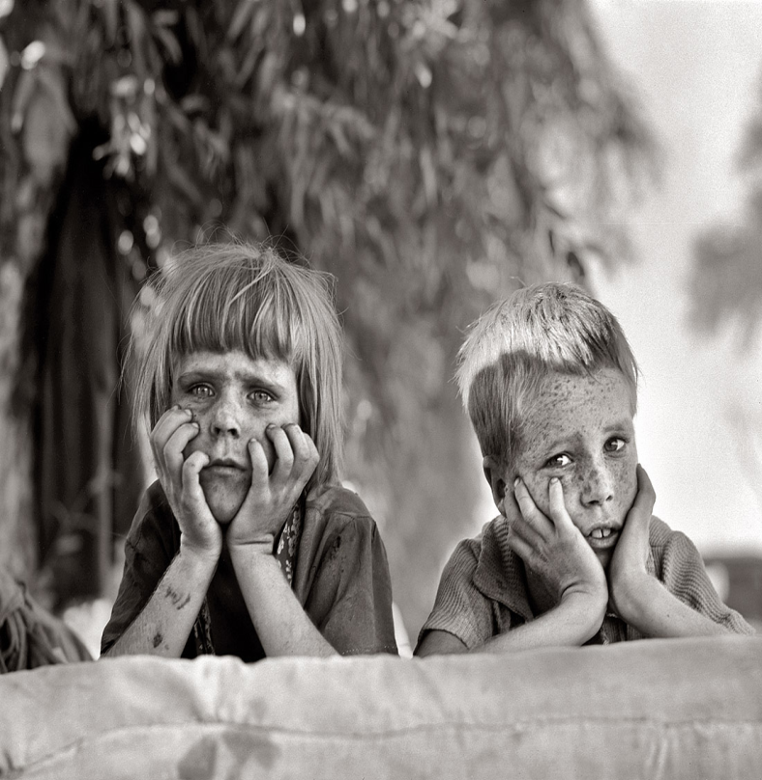
How many students experience homelessness in New Mexico Schools?

Slide 45
STUDENTS EXPERIENCING HOMELESSNESS SY 2016-2017
Primary Nighttime Residence
Shelters/TH – 11%
Doubled-up – 75%
Unsheltered – 9%
Hotels/Motels – 5%

Slide 46
STUDENTS EXPERIENCING HOMELESSNESS SUBGROUPS
Special Population | # of Students Experiencing Homelessness | % of total
Unaccompanied Homeless Youth (54% increase from SY 15-16) | 1,543 | 13%
Migratory Children/Youth | 32 | 1%
Children with Disabilities | 2,465 | 21%
Limited Eng. Proficient (LEP) students | 2,558 | 22%

Slide 47
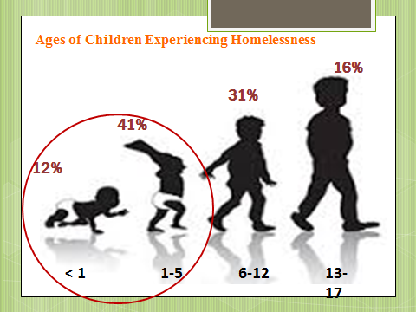
STUDENTS EXPERIENCING HOMELESSNESS YOUNG CHILDREN AND HOMELESSNESS
51% of all children in HUD homeless shelters are under the age of 6.
The age at which a person is most likely to stay in a homeless shelter in the United States is infancy (under age 1).

Slide 48
ONE THING TO REMEMBER
If identified as “homeless” at any point in the year:
Continue to receive free meals until the end of the academic year in which the student becomes permanently housed;
Includes preschool.

Slide 49
WHAT YOU NEED TO KNOW:
Homeless, Foster and Migrant students are categorially eligible for free meals
Once a child is certified as eligible to receive free school meals, eligibility remains in effect for the duration of the current school year and for up to 30 days after the first operating day of the subsequent school year or until a new eligibility determination is made in the new school year, whichever comes first.

Slide 50
FOOD SERVICE STAFF AS PARTNERS
Have regular contact with your LEA Homeless Liaison, Foster Care Liaison, and Migrant Program Staff
Cafeteria managers often help identify these students, contacting the appropriate program specialist (liaison) when they notice students who:
repeatedly are unable to pay for lunch;
are hoarding food;
eat frequently from other students’ trays, or
need assistance with a lunch application.

Slide 51
FREQUENTLY ASKED QUESTIONS –RELATED TO SCHOOL MEALS
Q. What should we do if there are delays in processing the free school meal paperwork for a student experiencing homelessness?
A: Due to the streamlined procedures for homeless students outlined by USDA statutes and policy, generally there should be no delay in determining their eligibility.
Q. If a homeless child changes schools, does the child continue to receive free school meals in the new school?
A: Once a child is certified as eligible to receive free school meals, eligibility remains effective for the remainder of the school year and continues for a maximum of 30 days after the first operating day in the subsequent school year, or when a new eligibility determination is made in the new school year, whichever comes first. If a student changes schools within the same LEA, the free meal certification must continue. If a student moves to a new LEA, the new district may rely on the eligibility determination of the prior district without incurring liability for any error.

Slide 52
FAQ CONTINUED…
Q: One of our students just lost housing. We identified him as homeless and enrolled him for free school meals immediately; but he has unpaid meal fees from a period of time prior to his homelessness. How should we handle those unpaid fees?
A: Regardless of past fees, every student identified as homeless is categorically eligible for free meals from the date on which the local liaison or shelter director documents the student’s homelessness. There can be no delay in providing free meals to students who meet the relevant eligibility criteria due to unpaid fees.
Q: How can an unaccompanied homeless youth be enrolled for free school meals?
A: Like other homeless students, unaccompanied homeless youth are categorically eligible for free school meals.
A shelter staff or Homeless Liaison can document the student’s eligibility;
Direct certification is the quickest and easiest way to provide youth with meals immediately.
If not directly certified, youth who are 18 years of age or older and youth who are legally emancipated under state law may complete their own meal applications.

Slide 53
FAQ CONTINUED…
Q: If a homeless child changes schools, does the child continue to receive free school meals in the new school?
A: Once a child is certified as eligible to receive free school meals, eligibility remains effective for the remainder of the school year and continues for a maximum of 30 days after the first operating day in the subsequent school year, or when a new eligibility determination is made in the new school year, whichever comes first. If a student changes schools within the same LEA, the free meal certification must continue. If a student moves to a new LEA, the new district may rely on the eligibility determination of the prior district without incurring liability for any error.

Slide 54
FOR QUESTIONS: PLEASE CONTACT US
Dana Malone
(505) 827-1810
dana.malone@state.nm.us
Laura Henry
(505) 827-1829
Laura.Henry@state.nm.us

