Slide 1
Safe Schools, Safe Cafeterias Melanie Granito, Safe Schools Coordinator Jimmie Thompson, Health Education Coordinator
Notes:
Introductions.

Slide 2
SSP History
Since 2008
Required as part of School Wellness
Policy, NMAC 6.12.6
NM SSP Guidance Document
Required from every school
Approx. 50 elements + Assurances
Triennial PED review & approval
Notes:
How many of you are aware of what is in your school’s safety plan?
I’m going to start with a quick history of Safe Schools Planning in NM.
Since 2008, NM has had a requirement for SSPs, as part of our School Wellness Policy.
Every public and state charter school is required to have an SSP and submit it to the PED every three years. The SSP is a living document is meant to be reviewed and updated at least once a year, or more often if circumstances (physical setting, staff turnover, recent emergency events) dictate. Part of Melanie’s job is to review each school’s SSP on a tri-annual basis. School level, not district level, although some SSPs are district SSPs.
Every year about 300 plans are up for approval by the PED.
Safe Schools Planning encompass a lot of important elements. A couple of key things to know is that SSPs:
are living documents,
they need to be customized for each individual school because each school has a unique set of circumstances and needs
that the best SSP is not worth the paper it’s printed on unless it is properly exercised—everyone in your school needs to know how to use it

Slide 3
The goals for safe schools in New Mexico
Students, school staff, parents and communities will understand that safe schools are everyone’s responsibility and, in the long run, benefit the whole community.
All school personnel will be able to carry out their duties in a safe, secure, healthful, caring and respectful work environment.
All students will have access to public educational services in a safe, secure, healthful, caring and respectful learning environment

Slide 4
Where does the cafeteria staff fit in to school safety?
Notes:
That is why we are here. According to the survey sent out by the nutrition bureau, school safety is a concern of food service staff.
Thank you for bringing this to our attention. As you saw, one of the goals of the plan is that all personnel be able to carry out their duties in a safe and secure environment. You will not feel safe at work if you are not aware of what is in your school’s plan.

Slide 5
Safe Schools Planning Team
Notes:
The cafeteria staff, whether you are district staff or contract staff, are integral to all areas of school safety. Most cafeterias are in operation for at least 4 hours of the school day. Chances are high that if and when an emergency occurs, some of the staff and students will be in the cafeteria.
Not only should cafeteria staff be made aware of the what is in their school’s safety plan, there should be representation on the school safety planning team. The expertise of a member of the staff that is aware of all of the aspects of cafeteria operation and procedures can give valuable insight in to planning for all the stages of the preparedness cycle.

Slide 6
The Preparedness Cycle
Prevention
Mitigation
Protection
Response
Recovery
Notes:
This is the preparedness cycle used by all entities that deal with emergency management.
Your schools plan includes all of these and a little more. The plan includes maps and floor plans including water, gas and electrical system shut-offs. This would be specifically important in the cafeteria kitchen. It also includes assurances for food safety inspections, communicable disease management, pest management and ID badging to name a few.
Are you required to wear an ID badge at work?

Slide 7
Prevention and Protection
The plan addresses:
Health services inclusive of all students, staff and community
Infectious and communicable disease control and response
Behavioral and mental health supports inclusive of counseling and conflict resolution
Bullying prevention
Suicide awareness and prevention
Best Practices:
Situational awareness
Wearing badges and approaching those who do not have them
Keeping exterior doors and perimeter fencing closed and locked at all times
Ideas?
Notes:
Prevention is exactly what it says. The plan is required to address those items on the left in detail. Those items on the right are common sense strategies towards prevention. Be aware of what is going on around you. We become blind to little things when we go through our daily routines. Practice being more aware of things outside the norm from the time you get out of your car until the end of the day. Are there broken lights in the parking area or on the exterior of the building? Report these to facilities. Someone could be planning to come back after dark and perpetrate a crime. Is there an unattended backpack under some bushes? What might that indicate? Did you just see a student prop open an exterior door right before a passing period?
Everyone who is supposed to be in the building should be wearing some kind or identification, from staff to volunteers including maintenance and custodial and kitchen. All staff should approach anyone in the building who is not wearing proper ID and escort them to the office for ID. This can be done politely with the explanation that this system is in place to keep our kids safe.
If you are receiving an order, man the open door so that you know who is coming in. If it is not the delivery person, close the locked door.

Slide 8
Protection
Practice
Time is taken to directly teach the staff and students the rules
Rules are re-taught often
Rules and procedures are communicated to staff, students and parents often in different ways
Access Control
Traffic safety
Facility safety
Playground safety
Bicycle safety
Internet safety

Slide 9
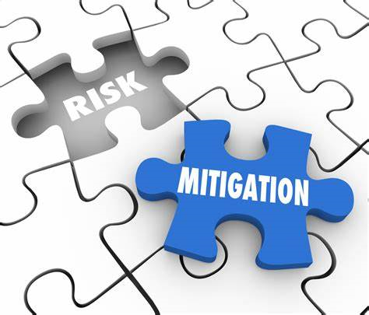
Mitigation
Understanding
Assessment
Drill and Exercise
Review, Revise and Share
ID and prioritize risks, threats and hazards
Assess capacity and culture, ID a Behavioral Threat Assessment Team
Considerations for special populations
Practice all forms of drills
Make changes when there are facility and staff changes
Share with local responders and community
Notes:
No matter how thorough the planning, it is not possible to avoid all emergencies. Knowing that emergencies will occur and taking steps to lessen the severity of the consequences is imperative to emergency planning.
Understanding: Each site needs to understand the threats and hazards that are unique to them. In Deming it might be planning for blowing dirt closing roads and having to keep students at school past dismissal. In Ruidoso it might be going into a shelter in place situation if there is a bear sighted nearby. Your school may be located near a rail line and you might have to plan for toxic spill threats. Domestic violence spillover is a threat that needs to be addressed by all schools.
Assessment: Capacity is knowing if you have people with special skills in your building: those that are CPR certified, volunteer firefighters and so forth. Create a behavioral threat assessment team-get to know the kids and report when you notice that they are not acting like themselves. Maybe they are suddenly missing a lot of school or their eating habits have changed. Let someone know
Drill: Think about the kids who are on medication to manage diseases like asthma or who have mobility issues. What are you going to do if you are in lockdown for hours and a child starts having an asthma attack or needs to have blood sugar regulated. Plan for kids with mobility issues in an off site evacuation.
Revise your plans if there are changes to the buildings or changes to staff that have important roles in your emergency operations team. Have backups in case someone is absent in an emergency.
The entire plan should be shared with local emergency responders and managers. The plan is secure otherwise and not subject to open records laws. Tell parents about having the plan and the parts that they need to know in an emergency like off site reunification sites.

Slide 10
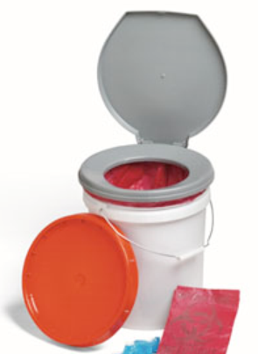
Section V: RESPONSE
Incident Command Team
Protective Actions
Lockdown
Shelter-in-Place
Evacuation
Active Shooter Protocol
Notification/Messaging
Media Relations Plan
Notes:
Response: The capabilities necessary to stabilize an emergency once it has already happened or is certain to happen in an unpreventable way. Appropriate response means to establish a safe and secure environment, save lives and property, and facilitate the transition to recovery.
While some see Response as the chief mission area for which they must plan and prepare (perhaps because it is what happens during an incident), an effective SSP cannot overlook all of the mission areas—Prevention, Protection, Mitigation, Response and Recovery. Schools must have SSPs that address the totality of these areas, all of which are equally important and rely upon each other’s success for effective execution. Remember that preparedness is cyclical in nature,
IC Team—Assign roles and know who has what responsibility when an emergency occurs and practice your roles. During a crisis, you’re not going to be efficient in your assigned roles if you’ve never exercised what is expected of you. Also know that once first responders arrive, they’re in charge of the incident and you’re in charge of school-related issues. These might be: helping FR’s with floor plans and the layout of the school (your facilities manager may be asked to accompany law enforcement as they clear a school after a crisis event), accounting for students and staff who have evacuated, managing your family reunification site, dealing with media, notifying parents.
Make sure you have plans for evacuation, shelter-in-place, lockdown, and active shooter. These are PED requirements.
Lockdown: Keeping the bad guy out. Used to protect building occupants from potential dangers in the building or external threats that may enter the building. This normally calls for lights out, silencing cells phones, moving against a wall out of sight from the door.
Shelter-in-Place: Keeping the bad stuff out. Shelter where you are and isolate the inside environment from the outside environment. The normal learning environment continues during a shelter-in-place, but no outside access to the school is permitted.
Evacuation: Moving building occupants from the buildings to a pre-determined safe area.
There are variations on LD and SIP (“Lockout” is one) and some schools have levels of LD (1,2,3) but whatever your school uses make sure its consistent and everyone understands what the procedures are.
Active Shooter: coming in 2 slides
Notification and messaging: It is certain that during a school emergency, parents/guardians will begin arriving at the school—even if you advise them not to. It is important to notify parents/guardians in advance of possible campus emergency response actions that will be used if an emergency happens during school hours. While it is not necessary to detail every step for them, it is important for parents/guardians to be aware of the protective actions the school may take, such as: lockdown, shelter-in-place and evacuation and what those mean. This will not eliminate the possibility of parents/guardians arriving at the school during an emergency, but it should help to reduce the number of parents/guardians who do, as well as reduce their anxiety about the situation. Schools may use the Sample Parent/Guardian Letter found in Appendix B in the PED Guide as a template to advise parents on emergency procedures.
In addition to advance notification of how these protective actions will proceed in your school should they be necessary, it is also important to notify parents/guardians as soon as possible when an emergency occurs at a school. Providing parents/guardians with accurate information on the response actions occurring at the school, as well as with clear instructions on their expected actions, is essential. Instructions can reiterate the relevant sections of the pre-event letter referenced above and may also include where and when to pick-up students if an early release or off-site relocation occurs. For both accuracy and liability purposes, it is better to message something to the effect of “We are in the process of establishing the safety status of all students and staff” rather than “Everyone is safe” if the crisis is not over and everyone’s safety has not been confirmed.
Most schools or districts have a mass notification system to bulk call, text and/or e-mail information to parents/guardians. For these systems to be effective, schools must maintain a database of current parent/guardian phone numbers and/or e-mail addresses. Posting updates on the school or district website is also common practice, although schools must keep in mind that the websites are public and some information should not be available to the general public, such as the relocation or reunification site, which should only be sent to parents/guardians.
It is imperative that accurate, factual information be delivered, starting with the first outgoing message. In addition, because so many students—at an ever younger age—have cell phones, it is likely that parents/guardians will receive texts or e-mails from their child sooner than they do from the school. An effective way to minimize inaccurate information being transmitted from student to their parent/guardian, is to have pre-scripted messages prepared that students may send their parents/guardians. While a pre-scripted message may not fit all potential circumstances, it will provide schools an advantage during the initial stage of a crisis. This will not entirely eliminate continued student-parent/guardian communication, but it can help to minimize inaccurate information being transmitted.

Slide 11
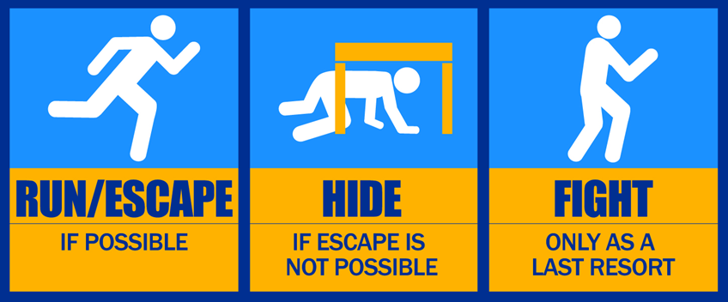
Incident Command
Written protocol for evacuation, shelter in place and lockdown
Early dismissal
All acts of violence including active shooter, bomb threat, animal on campus, fire, loss of water or power
Suicide
Transportation Emergencies
Media
Response

Slide 12
Section VI: RECOVERY
Relocation
Staff Trained, Primary & Secondary Sites Identified
Notification
Reunification
Accountability & Custody
COOP
Psychological/Emotional Recovery
Notes:
Response: The capabilities necessary to stabilize an emergency once it has already happened or is certain to happen in an unpreventable way. Appropriate response means to establish a safe and secure environment, save lives and property, and facilitate the transition to recovery.
While some see Response as the chief mission area for which they must plan and prepare (perhaps because it is what happens during an incident), an effective SSP cannot overlook all of the mission areas—Prevention, Protection, Mitigation, Response and Recovery. Schools must have SSPs that address the totality of these areas, all of which are equally important and rely upon each other’s success for effective execution. Remember that preparedness is cyclical in nature,
IC Team—Assign roles and know who has what responsibility when an emergency occurs and practice your roles. During a crisis, you’re not going to be efficient in your assigned roles if you’ve never exercised what is expected of you. Also know that once first responders arrive, they’re in charge of the incident and you’re in charge of school-related issues. These might be: helping FR’s with floor plans and the layout of the school (your facilities manager may be asked to accompany law enforcement as they clear a school after a crisis event), accounting for students and staff who have evacuated, managing your family reunification site, dealing with media, notifying parents.
Make sure you have plans for evacuation, shelter-in-place, lockdown, and active shooter. These are PED requirements.
Lockdown: Keeping the bad guy out. Used to protect building occupants from potential dangers in the building or external threats that may enter the building. This normally calls for lights out, silencing cells phones, moving against a wall out of sight from the door.
Shelter-in-Place: Keeping the bad stuff out. Shelter where you are and isolate the inside environment from the outside environment. The normal learning environment continues during a shelter-in-place, but no outside access to the school is permitted.
Evacuation: Moving building occupants from the buildings to a pre-determined safe area.
There are variations on LD and SIP (“Lockout” is one) and some schools have levels of LD (1,2,3) but whatever your school uses make sure its consistent and everyone understands what the procedures are.
Most frequently under-addressed are in this Recovery part of the plan. This is the really advanced planning part of the “If…then” scenarios. Reunification, Relocation and Continuity Of Operations Plans are difficult.
Reunification: This may not be so difficult if all of the students and staff have relocated to the same place. Making sure the proper adults are the ones who are picking up the kids may be manageable. Every teacher has a “GO BAG” with copies of registration cards. You may have preplanned to have grade levels gathered in one area or a couple of people in charge of signing kids out. How do you keep your high school kids from getting in their own cars and driving off or leaving with friends? What if your students and staff had to scatter to avoid danger? Do you have a plan to communicate with everyone? At your reunification site, are prepared to deal with press? Or with a parent who does not yet know that their child is injured or deceased? How do you communicate to parents where your reunification site is? And to stay away from school if there is an emergency occurring there.
Relocation: This goes beyond a temporary site to have students and staff reunify with family. This is the “What if..then” scenario that has your current operational site
Notification and messaging: It is certain that during a school emergency, parents/guardians will begin arriving at the school—even if you advise them not to. It is important to notify parents/guardians in advance of possible campus emergency response actions that will be used if an emergency happens during school hours. While it is not necessary to detail every step for them, it is important for parents/guardians to be aware of the protective actions the school may take, such as: lockdown, shelter-in-place and evacuation and what those mean. This will not eliminate the possibility of parents/guardians arriving at the school during an emergency, but it should help to reduce the number of parents/guardians who do, as well as reduce their anxiety about the situation. Schools may use the Sample Parent/Guardian Letter found in Appendix B in the PED Guide as a template to advise parents on emergency procedures.
In addition to advance notification of how these protective actions will proceed in your school should they be necessary, it is also important to notify parents/guardians as soon as possible when an emergency occurs at a school. Providing parents/guardians with accurate information on the response actions occurring at the school, as well as with clear instructions on their expected actions, is essential. Instructions can reiterate the relevant sections of the pre-event letter referenced above and may also include where and when to pick-up students if an early release or off-site relocation occurs. For both accuracy and liability purposes, it is better to message something to the effect of “We are in the process of establishing the safety status of all students and staff” rather than “Everyone is safe” if the crisis is not over and everyone’s safety has not been confirmed.
Most schools or districts have a mass notification system to bulk call, text and/or e-mail information to parents/guardians. For these systems to be effective, schools must maintain a database of current parent/guardian phone numbers and/or e-mail addresses. Posting updates on the school or district website is also common practice, although schools must keep in mind that the websites are public and some information should not be available to the general public, such as the relocation or reunification site, which should only be sent to parents/guardians.
It is imperative that accurate, factual information be delivered, starting with the first outgoing message. In addition, because so many students—at an ever younger age—have cell phones, it is likely that parents/guardians will receive texts or e-mails from their child sooner than they do from the school. An effective way to minimize inaccurate information being transmitted from student to their parent/guardian, is to have pre-scripted messages prepared that students may send their parents/guardians. While a pre-scripted message may not fit all potential circumstances, it will provide schools an advantage during the initial stage of a crisis. This will not entirely eliminate continued student-parent/guardian communication, but it can help to minimize inaccurate information being transmitted.

Slide 13
Reunification, Relocation and Continuity of Operations
What if…?
Staff scattered in an evacuation
You could not continue meal service at your current location
Your site had to relocate to another
building

Slide 15
Melanie Granito, Safe Schools Coordinator
505-827-1589
Melanie.Granito2@state.nm.us
Jimmie Thompson, Health Education Coordinator
505-827-1804
jimmie.thompson@state.nm.us

