Slide 1
Seamless Summer Option
Providing free, Nutritious meals to the kids of new Mexico
Back to School Conference
Terence Mirabal
9/18/2019

Slide 2
What is Seamless Summer Option?
National Food Lunch Program (NSLP) to provide a FREE summer meal.
Encourage for SFAs to provide meals during the summer and school breaks.
Feature is a combination of the NSLP, School Breakfast (SBP) and Summer Food.

Slide 3
Site Eligibility Options
1. Verify site are in an area where 50% of the children are eligible for free/reduced price
2. Area eligibility of site, use NoKidHungry.org
3. Census Block Group (CBG), use NoKidHungry.org

Slide 4
Area Eligibility Mapper
Tool to determine area eligibility using census data:
http://www.fns.usda.gov/areaeligibility
Instructions for determining area eligibility:
http://www.fns.usda.gov/sites/default/files/Census%20Instructions%202014 0.pdf
**CEP or Provision 2 Schools are not automatically considered area eligible**

Slide 5
Types of Sites
Open
Restricted Open
Closed Enrolled
Camps
Migrant
USDA recommends to operate as Open Site

Slide 6
Open Site
At least 50% of the children eligible for free or reduced price school meals under the NSLP or SBP. A description of the source of eligibility information if such information is used to identify individually eligible students.
NOTE: SSO sites that choose to establish eligibility using census data are required to use the most recent data available. The new American Community Survey (ACS) makes updated information available annually.

Slide 7
Restricted Open
At least 50% of the children eligible for free or reduced school meals under NSLP or SBP.
Restricted open must include information as to why the site is restricted on basis of security, safety or control.

Slide 8
Compliance with SSO
Meal Counting/Claiming
Meal Pattern & Nutritional Quality
Civils Rights, Food Safety, Portable Water, & On-Site Monitoring
**Compliance is similar to NSLP guidelines. Edit Checks are not required for SSO**

Slide 9
Meal Counting/Claiming
Children Only for all persons 18 years or younger.
(individuals over 18 with a state defined mental or physical disability)
End of the Point Service
Submit Monthly Claim by the 10th of the month (Similar to NSLP)
Adults can buy meal but may not be claimed towards claiming.
**Adult meal price is commodity + food to make sure adult meal are covering the expense**

Slide 10
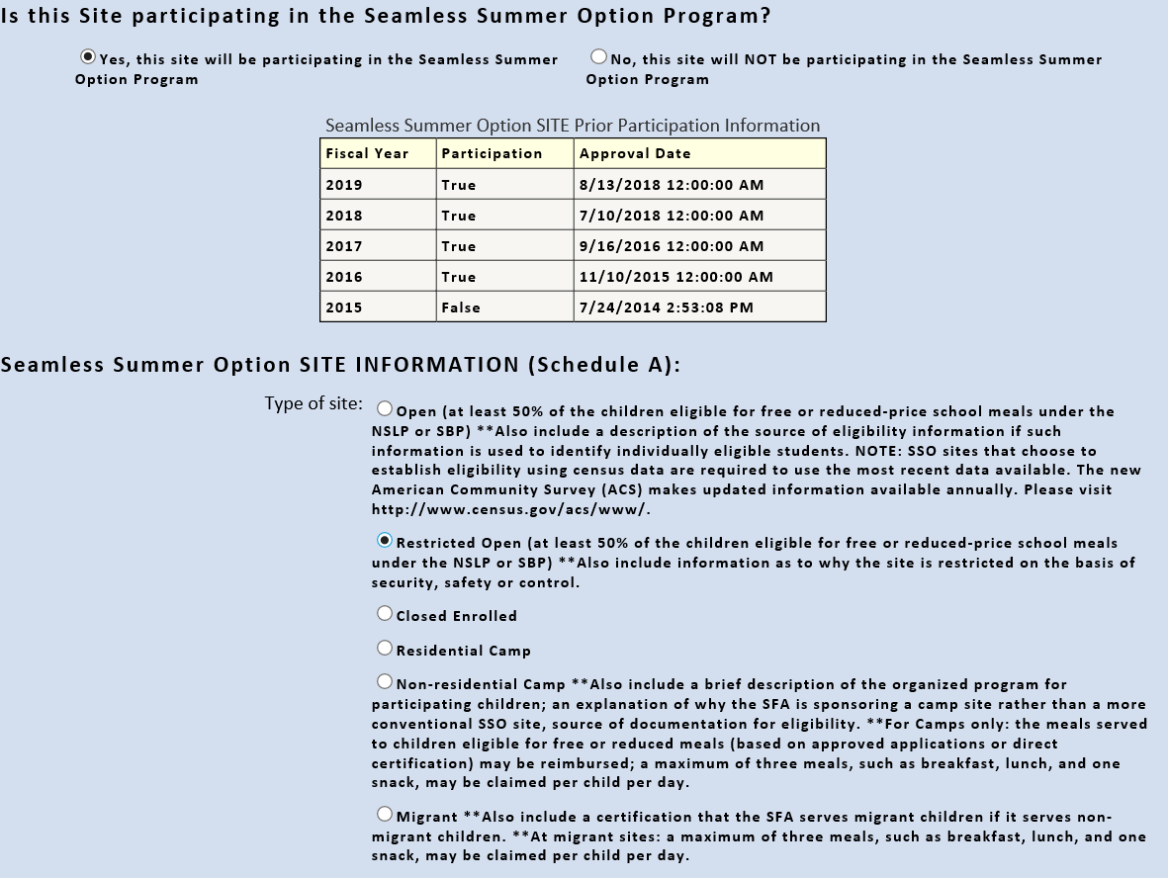
Site Participation for SSO
At each site within your SFAs district make sure to clarify if the site will participate with a YES or NO.
If YES need to put site information for which type of site

Slide 11
Site Participation for SSO
Site Information input should have:
Start/End of SSO operation
What days of the week will the site operate
Indicate the number of days of operation in each month that SFAs will participate in SSO

Slide 12
Meal Time Periods / Meal Combinations
Breakfast
Morning hours
7:00-10:00am
Breakfast---Lunch
Lunch
Between 10:00-2:00pm
Lunch---Snack
Snack
Combination of morning / after lunch hours
Breakfast---Snack
Maximum 2 per site- Unless operating as a camp site

Slide 13
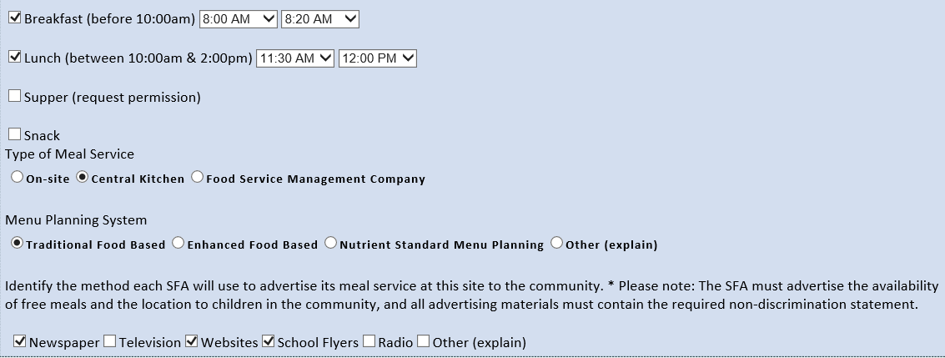
Site Participation for SSO
Indicate which meal(s) that will be served and time
Indicate type of meal service and which menu planning system that will be implemented
Identify the method each SFA will use for advertisement of SSO

Slide 14
Site Information for SSO
Template will be provided before SSO will begin.
Information for all SSO Sites for SFA’s

Slide 15
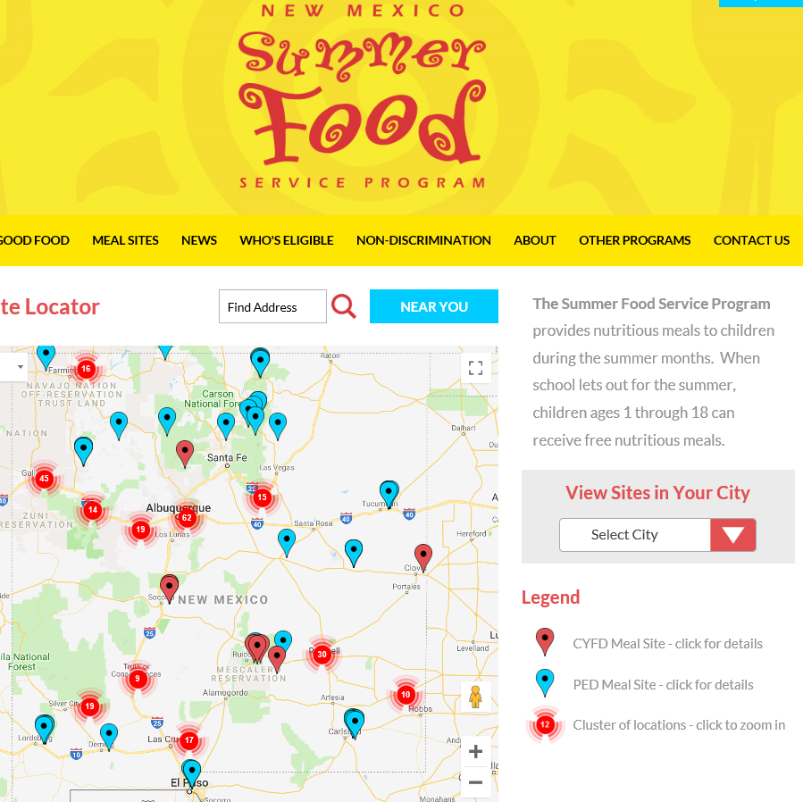
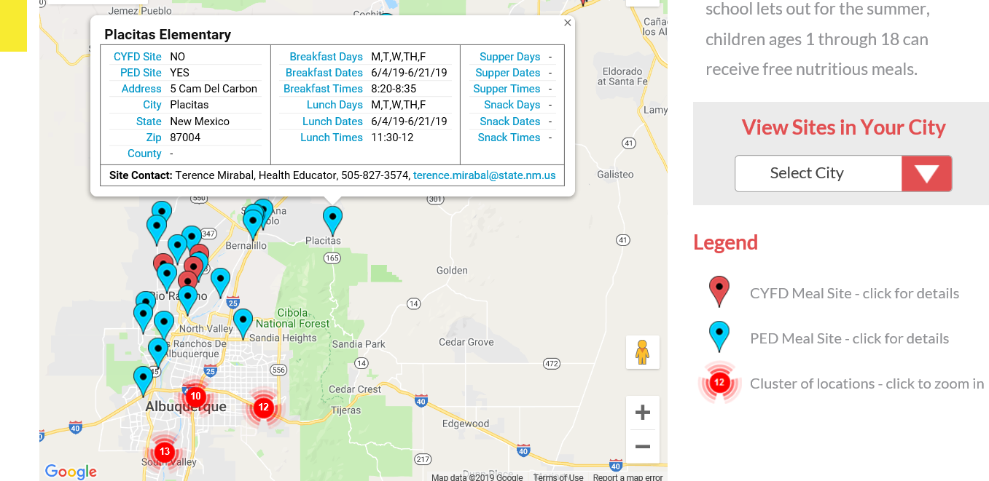
Site Information for SSO
Template provided will help guide communities for
in depth information for SFA’s.

Slide 16
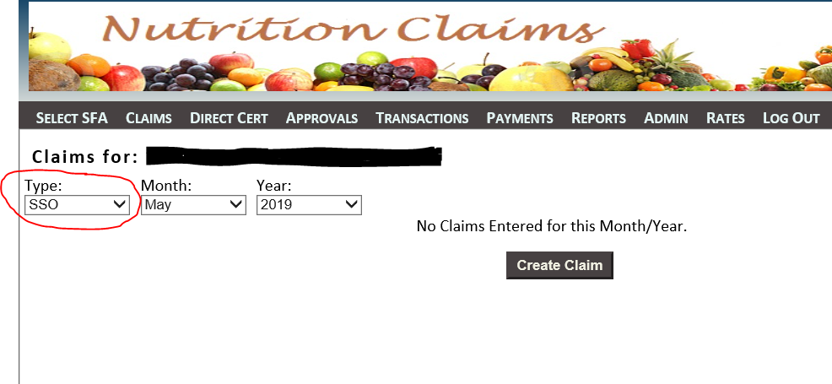
Claiming Procedure in Student Nutrition Portal
In Student Nutrition Portal for monthly claim SFAs have to change “Type” from NSLP to SSO and “Create Claim” for the month of claim.
SFAs must also upload verification of numbers.
Claim will not submit until complete
June- SSO months to claim:
SSO Months: May- June- July- August

Slide 17
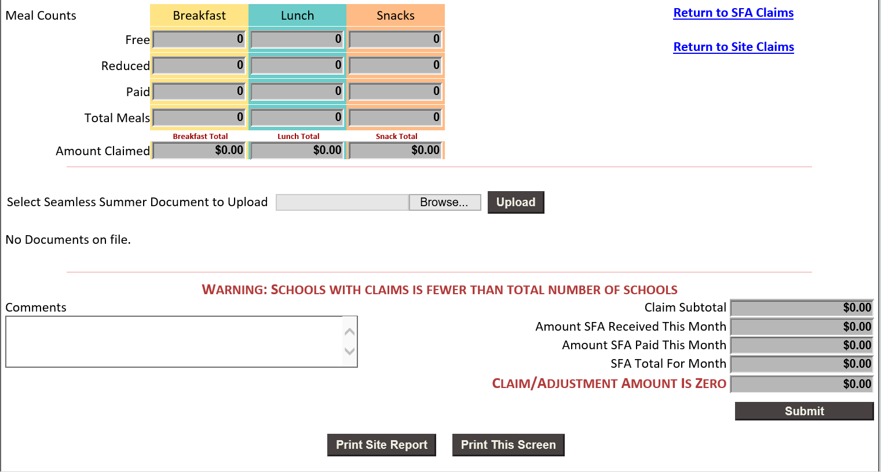
Claiming Procedure in Student Nutrition Portal
Must download your monthly claim that reflects reimbursement numbers
(claim summary)

Slide 18
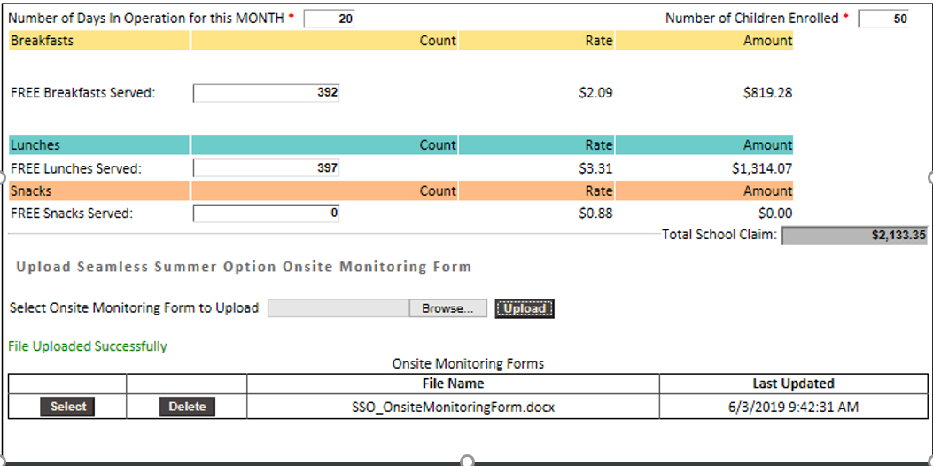
Claiming Procedure in Student Nutrition Portal
On-Site Monitoring Form will need to be uploaded with first months claim (July) for each site.
(site claim)

Slide 19
SSO Reimbursement Rates
**Rates are for all states except for Alaska and Hawaii
Meal | Regular Rate + 6 cents | Severe Need
Breakfast | $1.81 | $2.14
Lunch | $3.39 | N/A
Snack | $0.91 | N/A

Slide 20
Meal Pattern/Nutritional Quality
Breakfast
Lunch
Snack (2 out of 4)
1oz Grain
1cup Fruit/Vegetable
1 cup Milk
2oz M/MA
2oz Grain
1 cup Fruit
1 cup Milk
1oz M/MA
2oz Grain
½ cup Fruit/Vegetable
1 cup Milk
(Grades 9-12 meal pattern shown)

Slide 21
Meal Pattern
Make every effort to follow age/group and ensure minimum meal patterns are met
SFAs are feeding wide variety of kids use grade 9-12 meal patterns
Production Records are records for meals that are produced and must be kept
NSLP and SBP meal patterns can be found:
7 CFR210.10 & 7 CFR 220.8

Slide 22
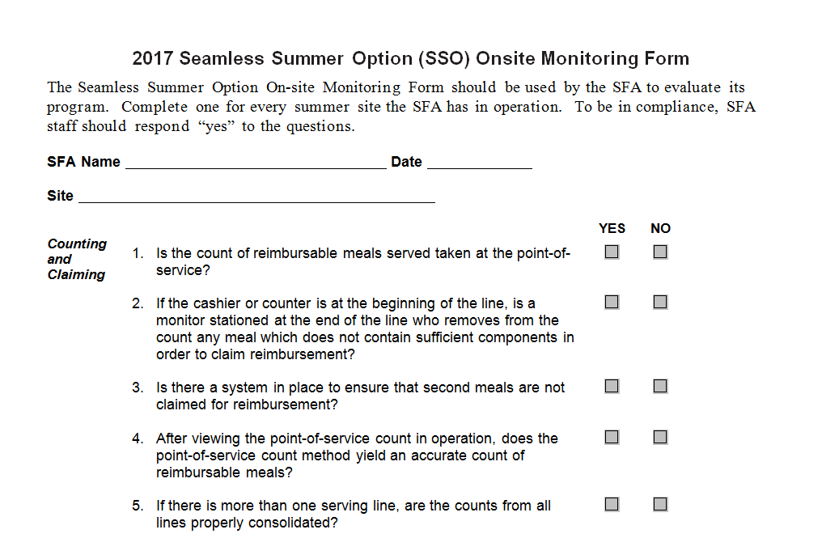
On-Site Monitoring Form
Each site must be monitored at least
once
On-Site form must be completed
within first 2 weeks of operating SSO
(Attach with monthly claim)
On-Site Monitoring Form will check
for Compliance:
Meal Counting
Claiming
Menu Planning
Food Safety

Slide 23
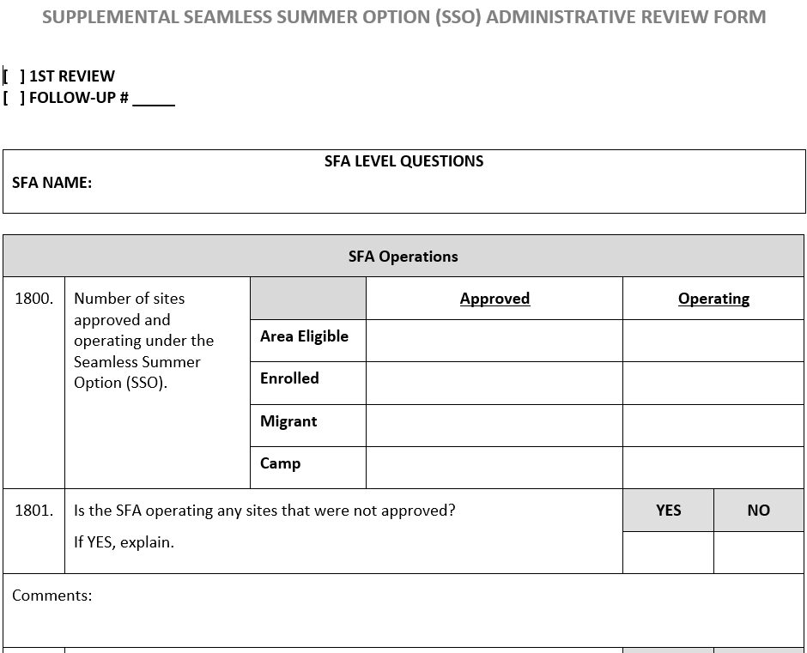
Administrative Review
If your SFA received a Administrative Review during the SY, then you will also have a SSO Review.

Slide 24
Common Mistakes for SSO
Meals have to be eaten on site
Plan summer school meal times accordantly
No grab an go
Civil Rights poster and nondiscrimination statement, meal of day must be visible for public at each meal site

Slide 25
Public Notification
Press release to local Media
Examples: Newspaper, Radio, Social Media, Letter to households
School/Backpack Flyers
Door Hangers
Computerized Calls
Emails
Please keep outreach materials on file
USDA Raise Awareness: http://www.fns.usda.gov/sfsp/raise-awareness

Slide 26
2019 Summer Statistics
Last Year 50 School Districts Participated
Plus 5 Districts from 2018
Last Year 307 Sites Participated
Plus 85 Sites from 2018

Slide 27
USDA Memo SP 09-2017: 2017 Edition of Q & A for the NSLP’s SSO
USDA Memo SP 07-2016: Local Foods and Related
Activities in Summer Meal Programs,
with Questions and Answers
USDA Memo SP 06-2016: Promoting Nutrition in
Summer Meal Programs, with Best Practices
USDA Memo SP 05-2016: Meal Service Requirements
in the Summer Meal Programs, with Questions and Answers
Additional Resources

Slide 28
Any Questions? Please Contact me!
Terence Mirabal
505-827-3574
terence.mirabal@state.nm.us

Slide 29
Governors Initiative
United front with all agencies:
Children, Youth & Families Department
Child and Adult Care Food Program
Human Services Department
Income Support Division
Public Education Department

Slide 30
Governors Initiative
CYFD-Increase number of food sites for breaks:
Thanksgiving, Fall, and Spring Break
PED-Increase number of food sites for winter
(USDA Regulations, PED can provide meals only if >10 days)

Slide 31
Increase After School Snack, SSO, BAB and CACFP Programs in SY 19-20
Our bureau, Student Success and Wellness will push SFA’s for more sites to offer After School Snack, SSO, and BAB Programs in SY 19-20 thus increasing the amount of meals and snacks offered to children.
Work with all SFA’s to provide as many extension of SSO in as many sites as possible over the winter break in SY 19-20.
We will work with CYFD and push more of our SFA’s to offer the CACFP at Risk Supper program.

