Slide 1
Cooking with the Seasons Kendal Chavez – Farm to School Specialist September 19, 2019

Slide 2
Working with Local Growers

Slide 3
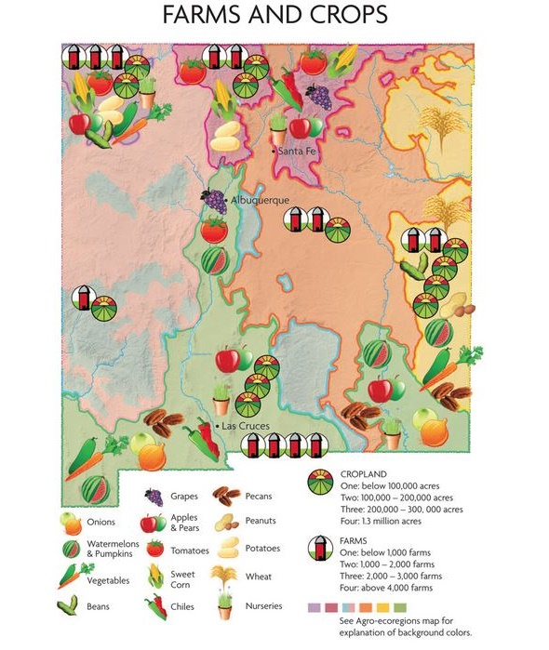
Top Agricultural Commodities in New Mexico
Dairy products - $1.3B
Cattle & Calves - $823.8M
Pecans - $220.8M
Hay - $109M
Onions - $106.6M
Chile - $44.6M
Cotton - $31.9M
Field Corn - $22.4M
Wheat - $15.7M
Sorghum - $7.65M

Slide 4
Myth-busting
USDA requires all food served in school cafeterias to be “certified” or from an established vendor from an “approved vendor” list

Slide 5
“Approved Vendors”
The selection and management of vendors is up to the SFA, not the PED!

Slide 6
Myth-busting
“Local” is defined by the USDA as “within 300 miles from the district’s administrative office”

Slide 7
“Local” is defined as the State of New Mexico

Slide 8
Myth-busting
Districts must buy the same food for all schools in their program / farmers must provide enough product for all students in the district

Slide 9
Work with your local growers first, then backfill with prime produce vendors and broadline distributors

Slide 10
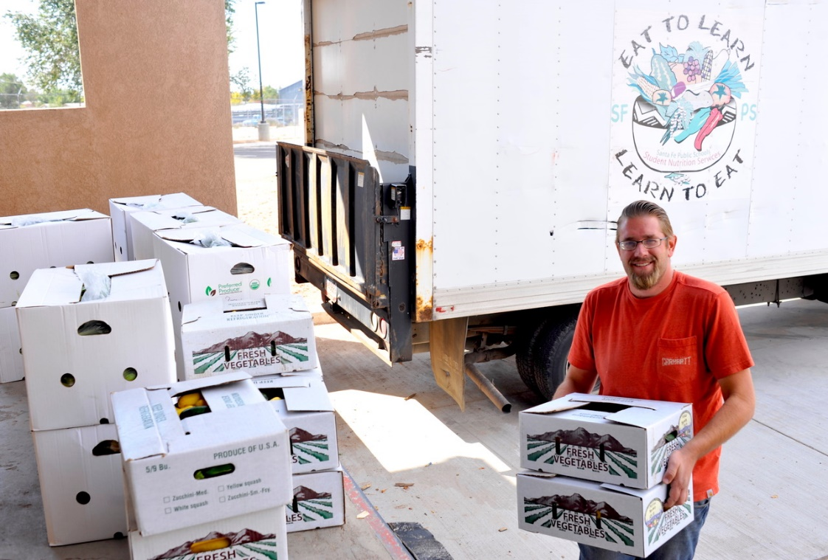
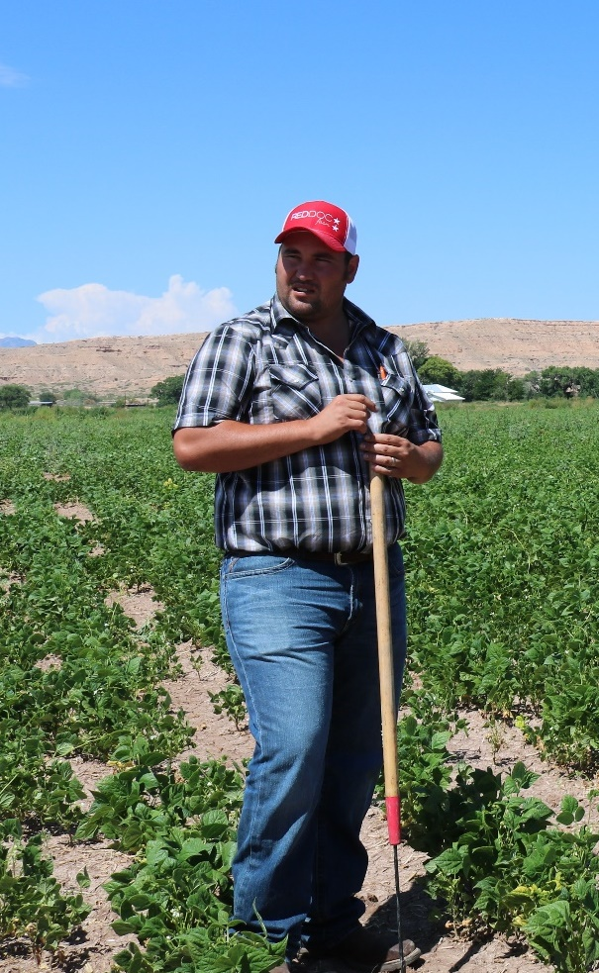
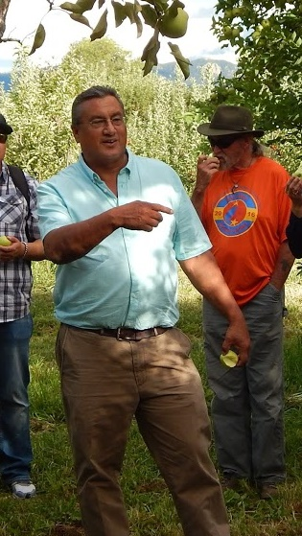
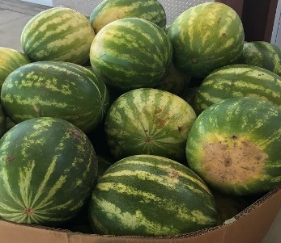
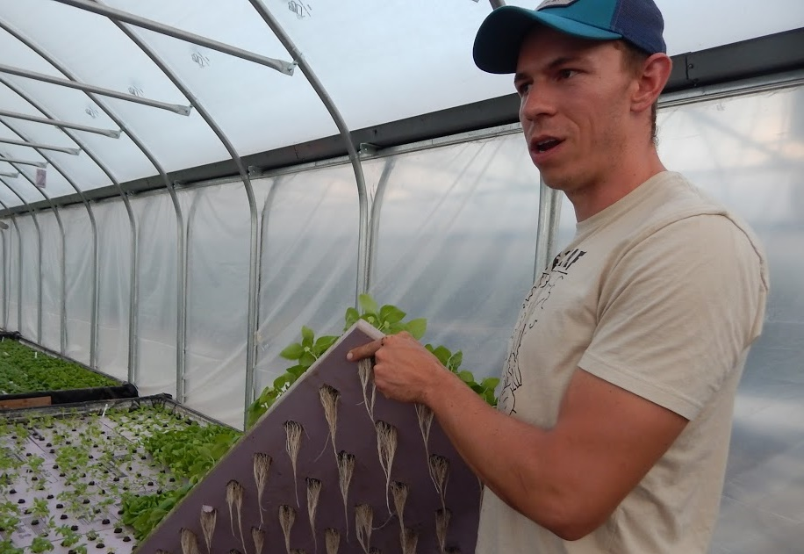
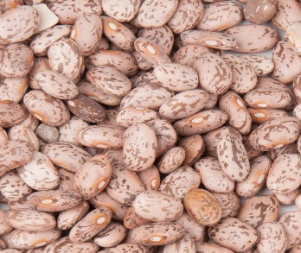
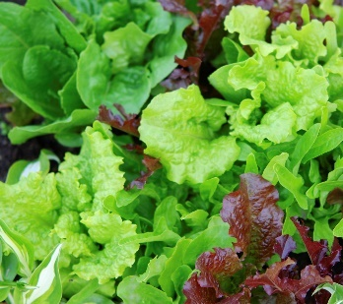
Discussion: Tips and Tricks

Slide 11
Planning for Local

Slide 12
How are you menu-ing local items??

Slide 13
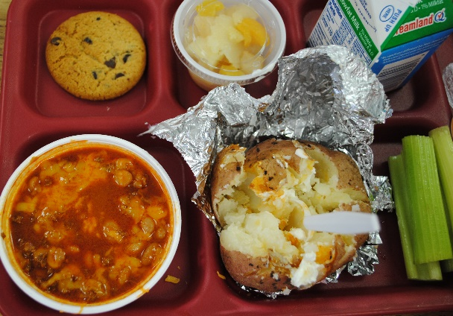
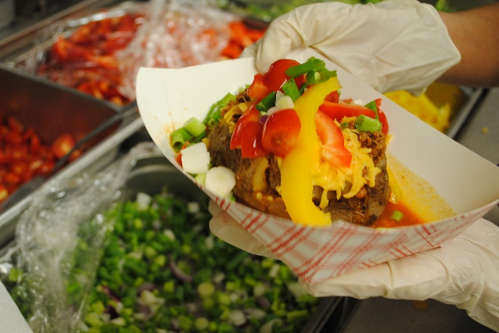
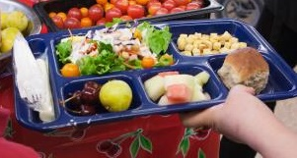
Menu Local
Swap out one menu item for a product grown in New Mexico!

Slide 14
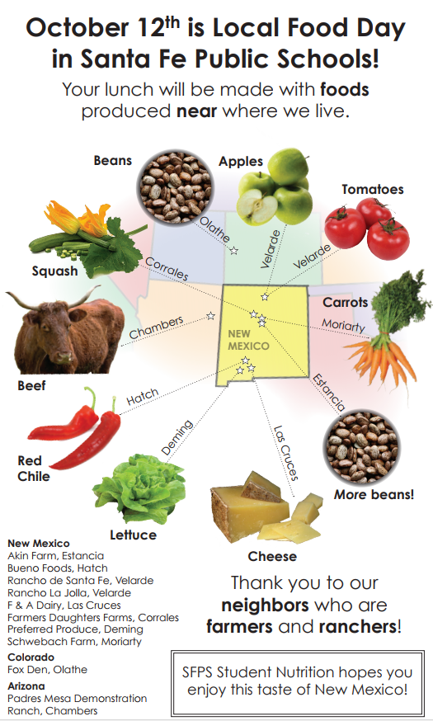
Organize a Local Food Day

Slide 15
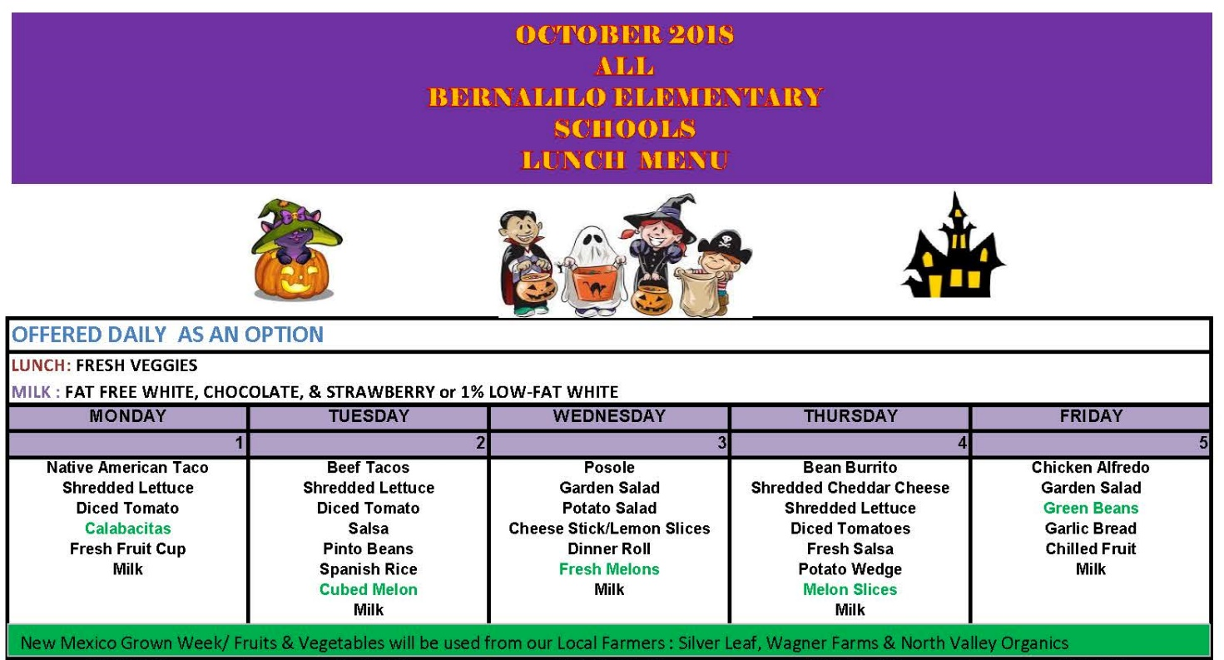
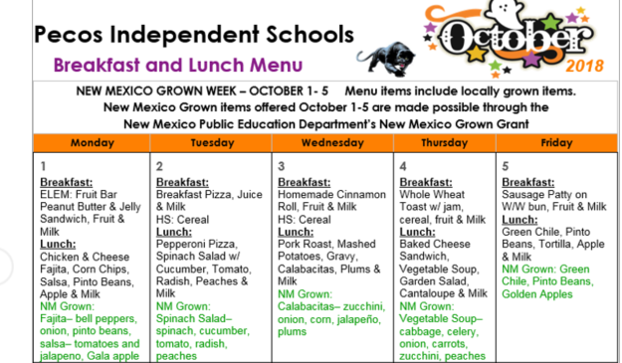
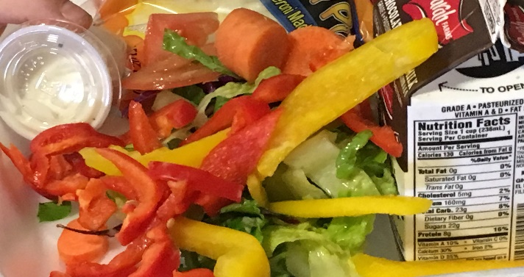
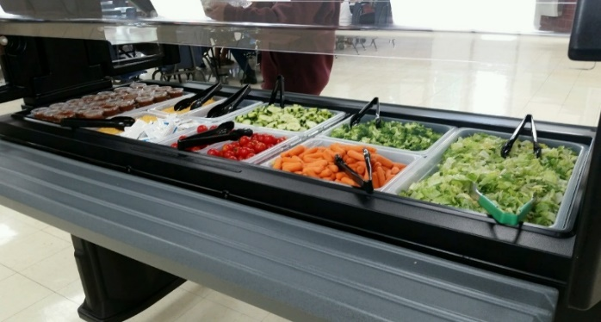
Local Week
Localize it: use local in your salad bar, hot vegetable side, entrée, or fresh fruit offerings!

Slide 16
Seasonality Guide for New Mexico Schools

Slide 17
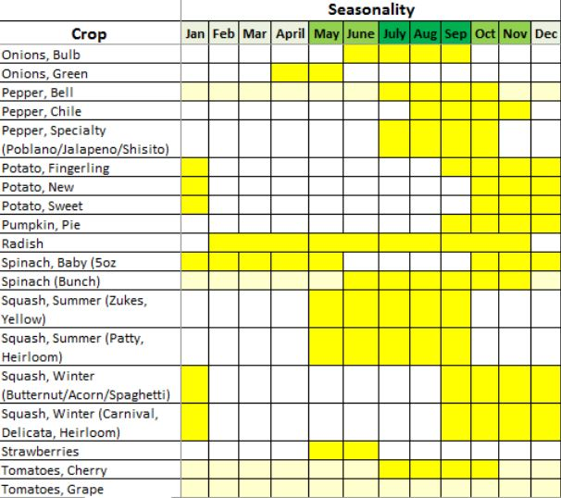
Product Availability

Slide 18
September - November
Days get shorter, temperatures drop, and the abundance of summer winds down…
What’s available to purchase?

Slide 19
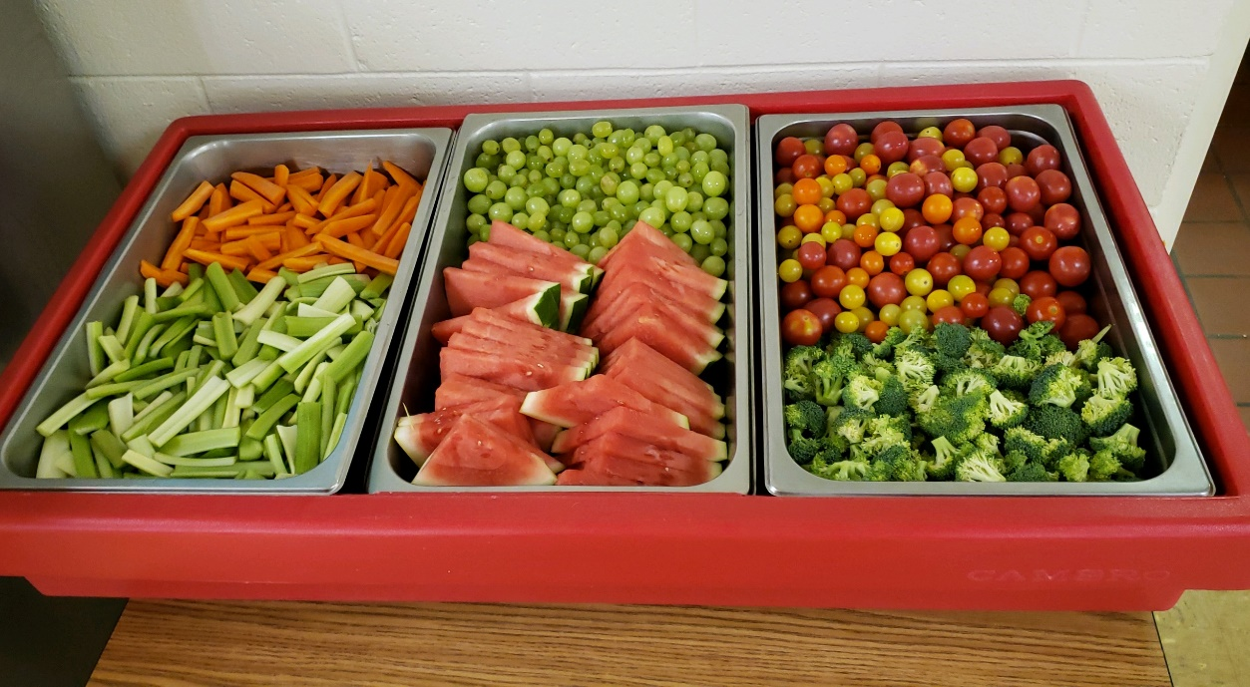
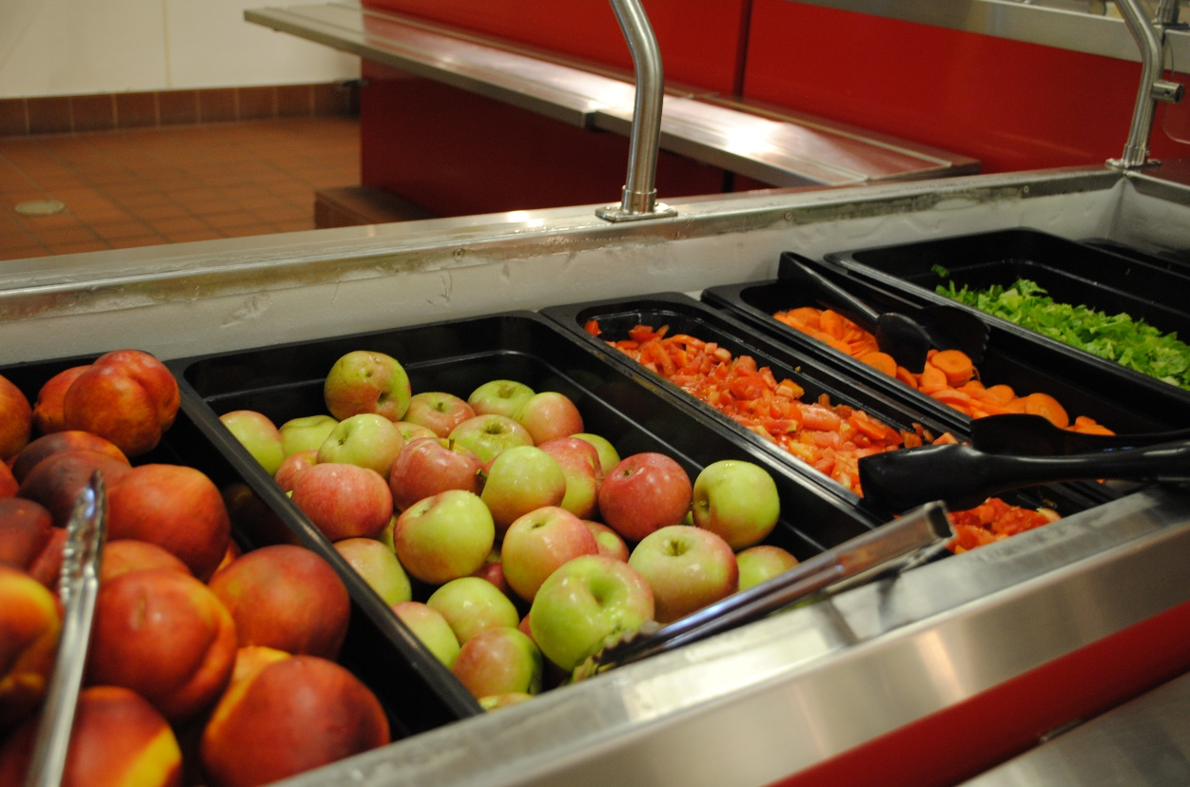
Produce Available
Apples, pears, peaches, plums
Melons
Tomatoes
Summer squash
Head lettuce
Salad greens
Cucumbers
Peppers
Onions
Posole
More info at: http://farmersmarketsnm.org/resources/shopper-resources/whats-in-season/northern-nm/

Slide 21
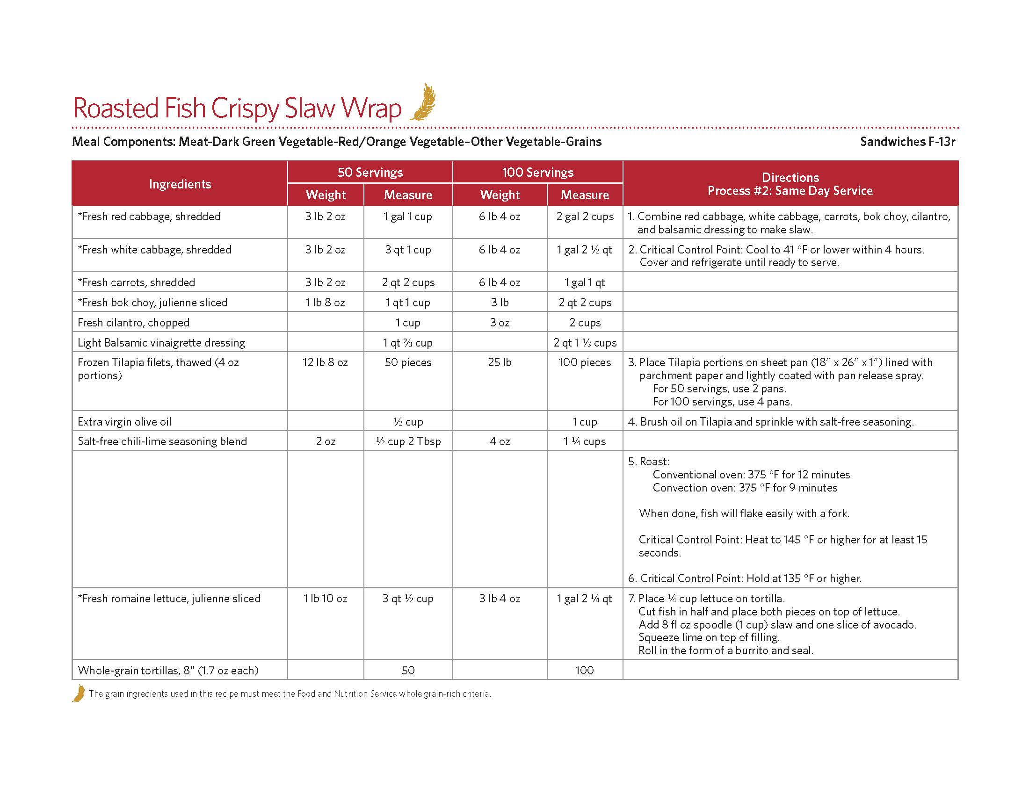

Slide 22
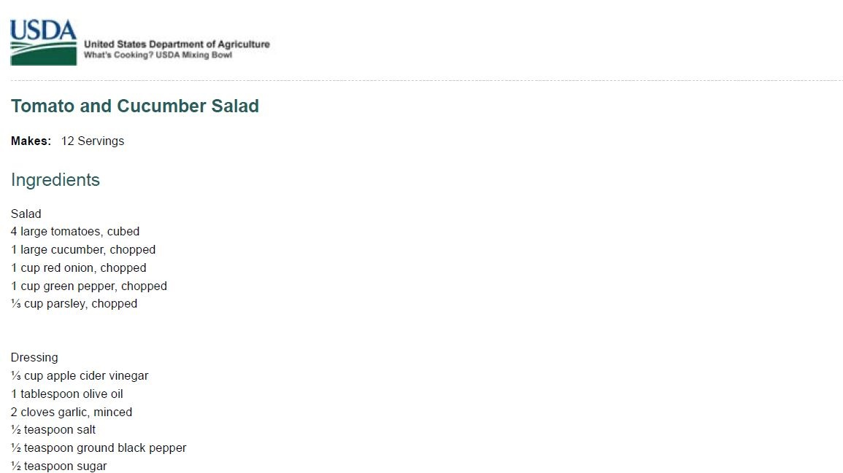
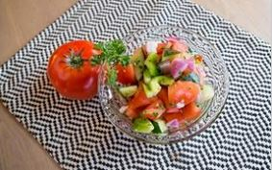

Slide 23
December - February
It’s snowy, frigid and dry…
What’s available to purchase?

Slide 24
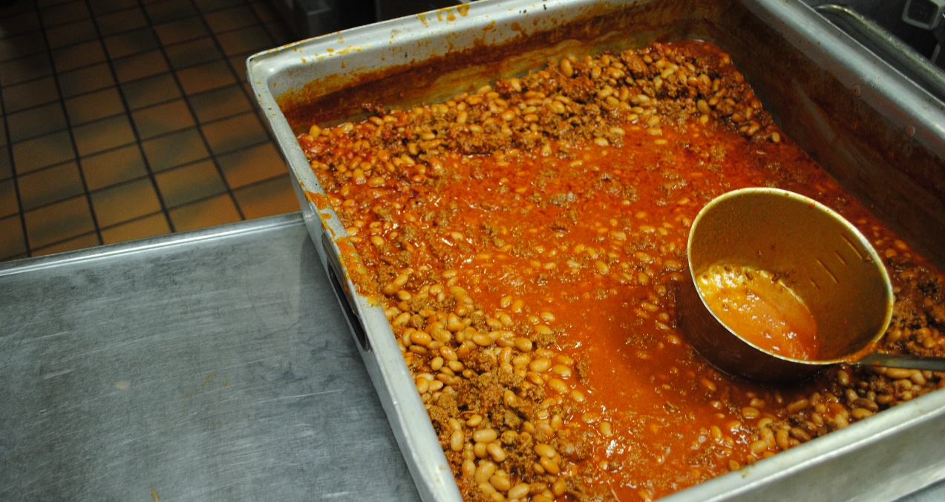
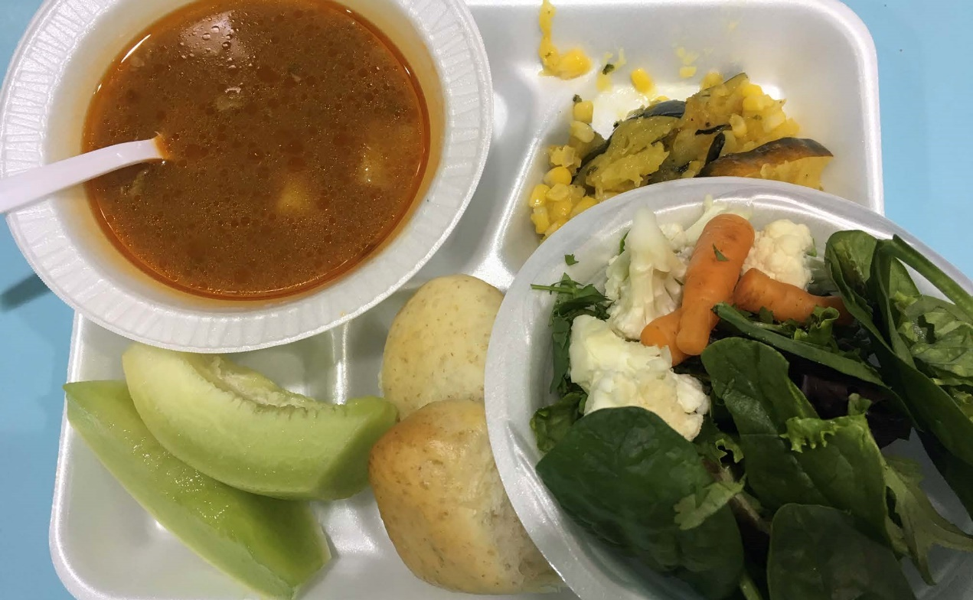
Produce Available
Beets
Carrots
Potatoes
Sweet potatoes
Lettuce – salad mix
Spinach
Winter squash
Source: http://farmersmarketsnm.org/resources/shopper-resources/whats-in-season/northern-nm/

Slide 25
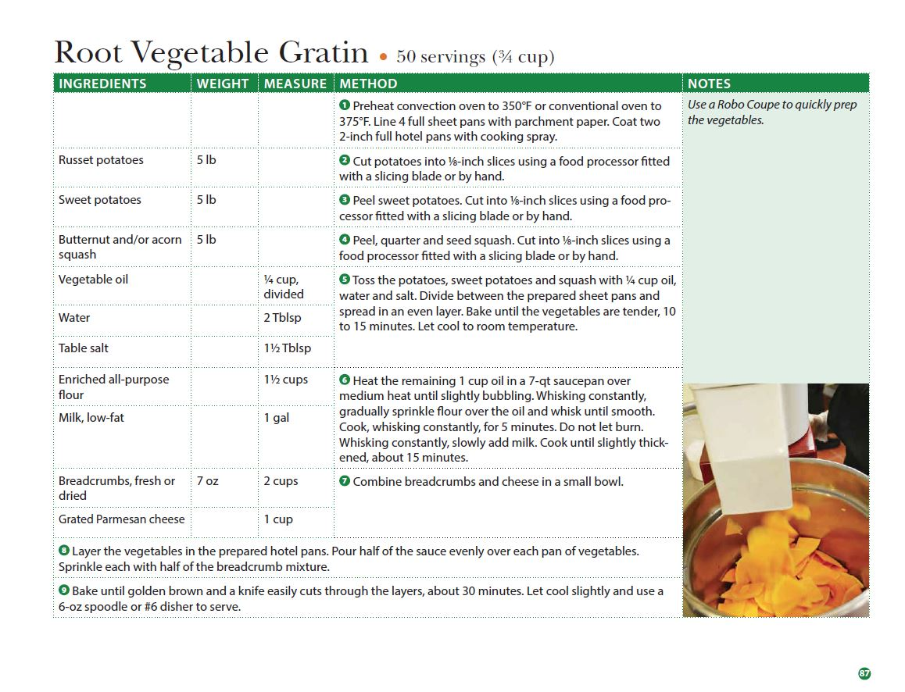

Slide 27
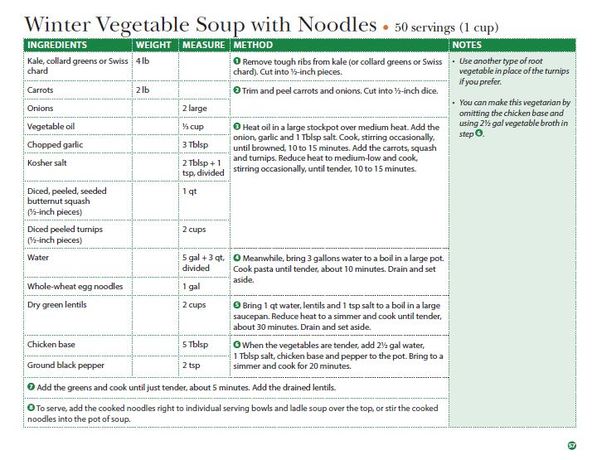

Slide 28
March - May
Here come the winds and intense temperature fluctuation…
What’s available to purchase?

Slide 29
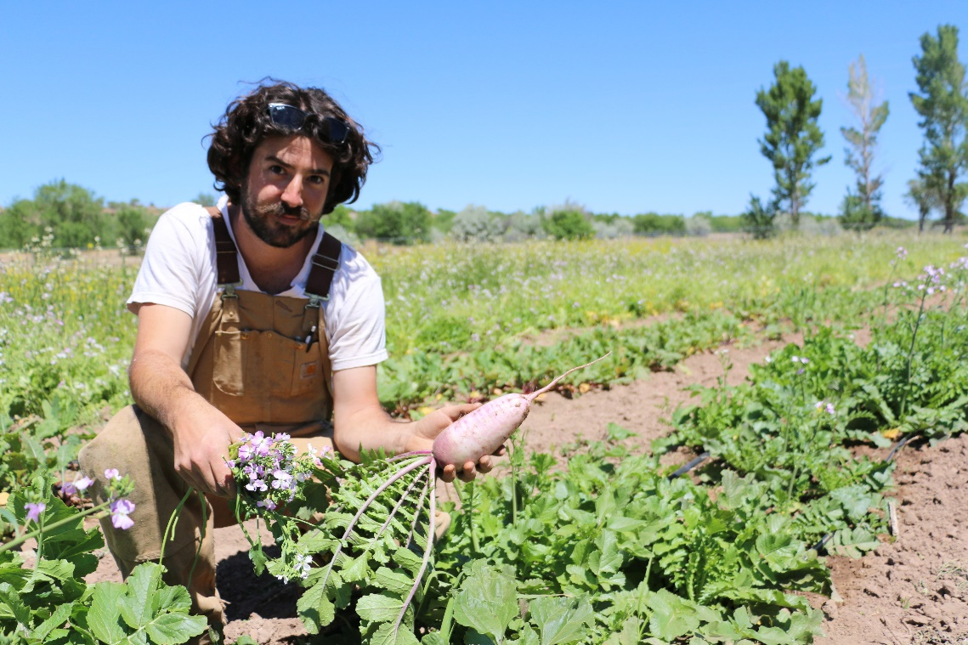
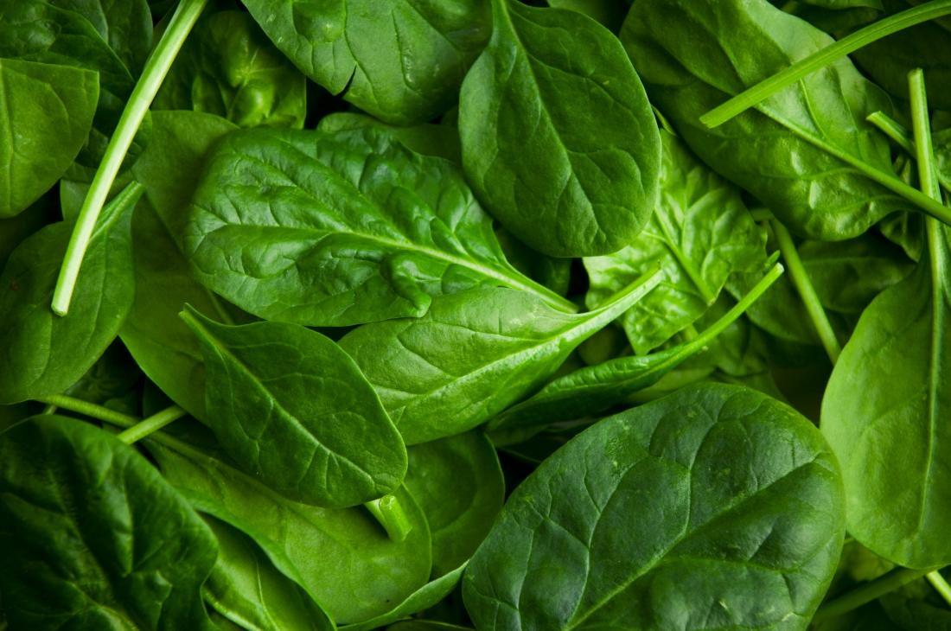
Produce Available
Asparagus
Arugula
Carrots
Lettuce – salad mix
Radish
Spinach
Turnips
Rutabaga
Parsnip
Source: http://farmersmarketsnm.org/resources/shopper-resources/whats-in-season/northern-nm/

Slide 30
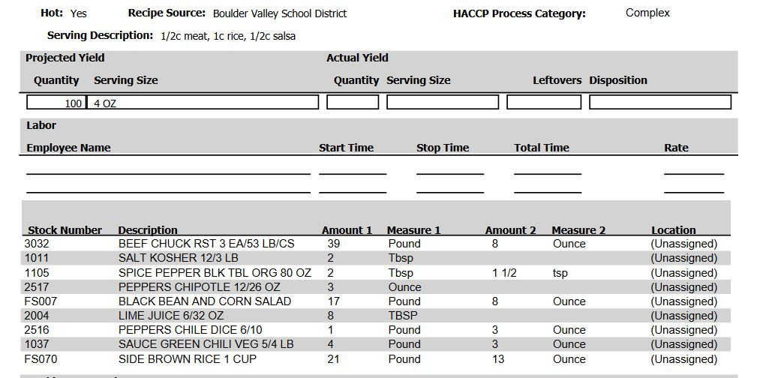

Slide 31
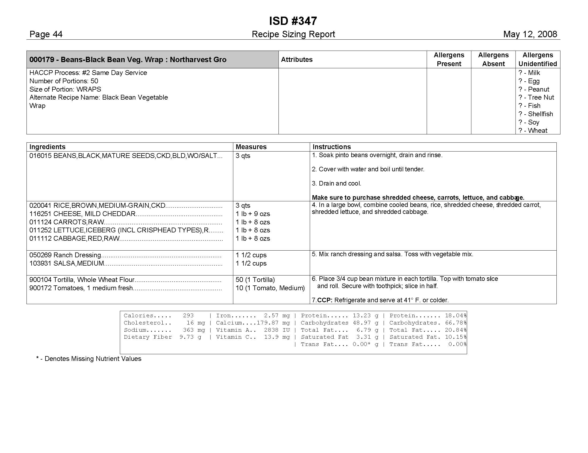

Slide 32
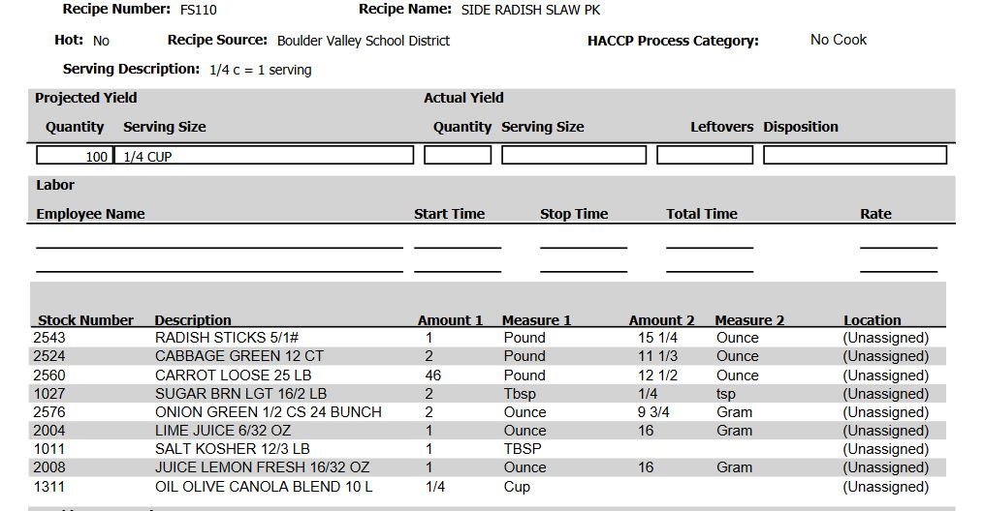

Slide 33
June - August
Warm-season abundance is finally here…
What’s available to purchase?

Slide 34
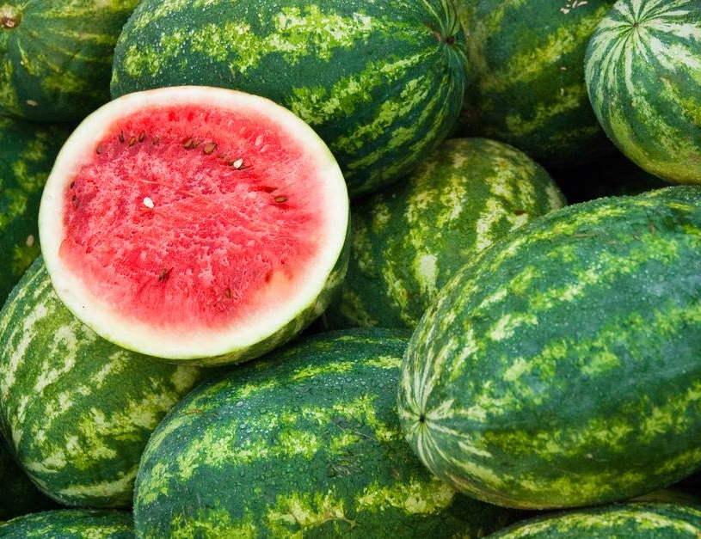
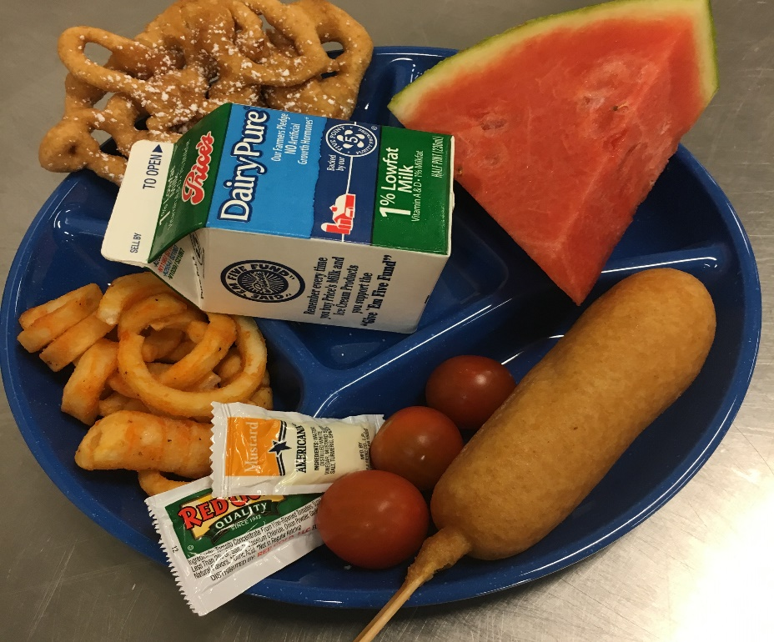
Produce Available
Beets
Broccoli
Cucumber
Eggplant
Salad greens/head lettuce
Melons
Onions
Tree fruit
Peppers
Summer squash
Tomatoes
Source: http://farmersmarketsnm.org/resources/shopper-resources/whats-in-season/northern-nm/

Slide 35
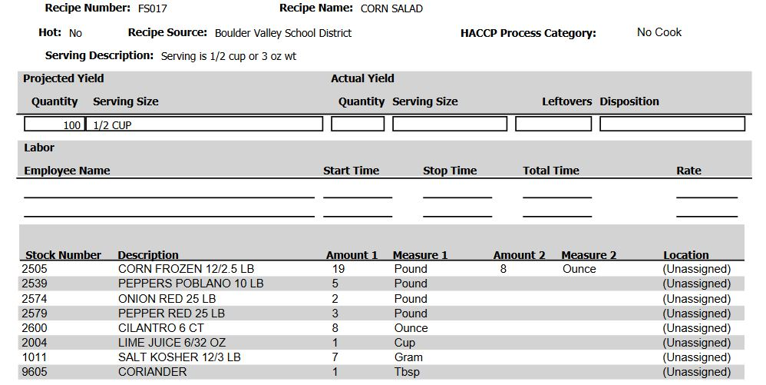

Slide 37
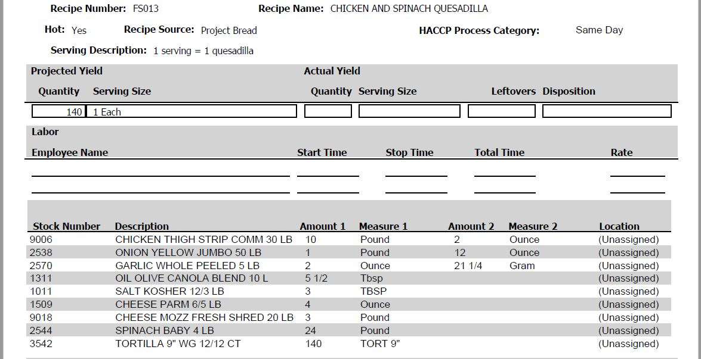

Slide 38
New Mexico Grown Week 2019

Slide 39
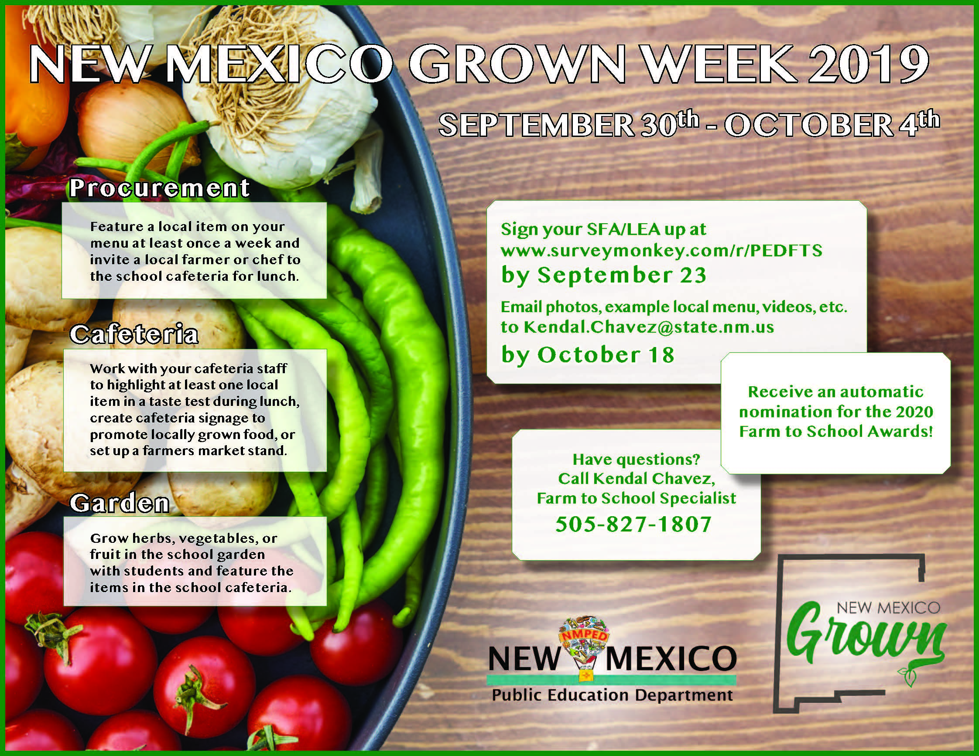
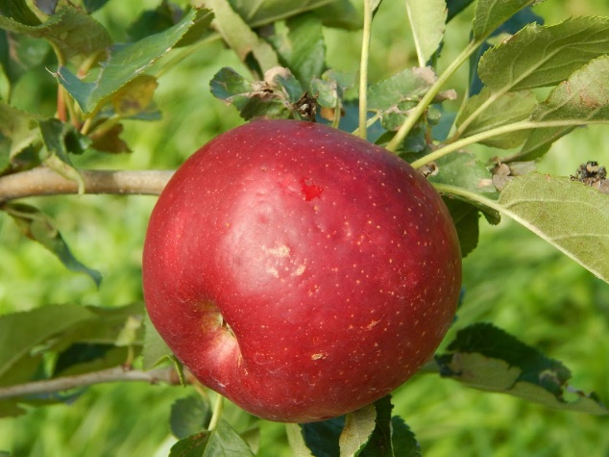
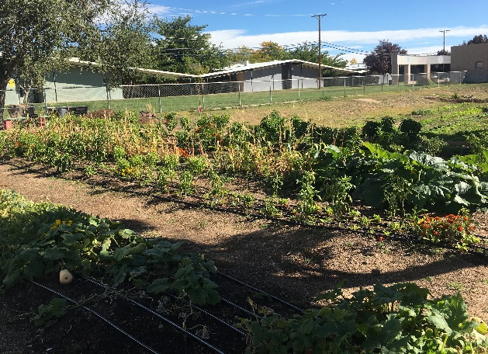

Slide 40
Celebrate with Us!
Sign your SFA/LEA up at https://www.surveymonkey.com/r/PEDFTS by September 23, 2019
Email a picture, example local menu, videos, etc. to Kendal.Chavez@state.nm.us by October 18, 2019
Receive an automatic nomination for the 2020 Farm to School Awards!

Slide 41
Discussion: What will you focus on this year to improve your farm to school program?

