Slide 1
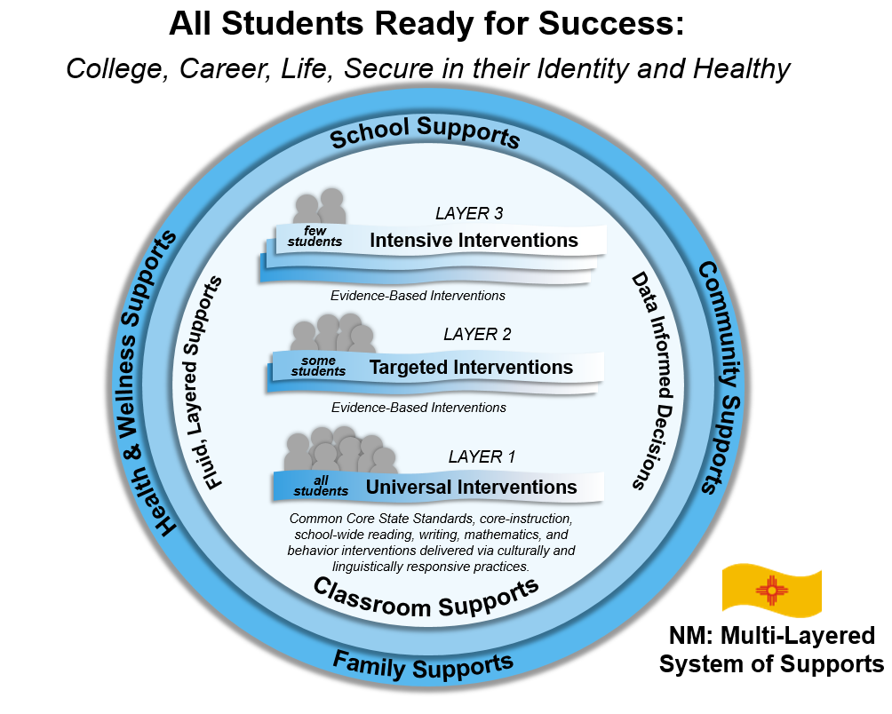
MLSS – Implementation Driver Meeting #1 October 2, 2019

Slide 2
Introductions
Kenneth Stowe
MLSS State Coordinator
Director: Title I, Part D
David Forbush, Ph.D.
Center for Technical Assistance for Excellence in Special Education (TAESE)
Tyler Monson
TAESE - Tech Support

Slide 3
Utah Interpreter
Training Program
Major Centers and Projects
Dispute Resolution in Special Education (12 States)
Center on Low Incidence Disabilities
AEM - Prime TAESE - Partner
WestEd - Prime
TAESE - Partner
NASDSE / TAESE
Orientation and Training for New State Special Education Directors
SEA Jobs Alike
Capacity Building
Workgroups
Kansas Technical Assistance System Network
Montana Comprehensive System of Personnel Development (CSPD) and Higher Education Consortium
New Mexico Intensive Technical Assistance
South Dakota Specialized Technical Assistance
Arizona Center for Professions in Education (ACPE)

Slide 4
Meeting Purposes...The Big Picture!
Build a community of practice around MLSS
Convey pertinent information about the MLSS framework
Create an environment of feedback and technical assistance

Slide 5
Agenda
9:00-9:05 Welcome and Introductions
9:05-9:20 Implementation Driver Overview
9:20-9:40 MLSS Manual Overview
9:40-9:45 SAT Manual and Documentation
9:55-10:00 Wrap-Up and Session Survey

Slide 6
By end of session I will:
Understand the basics of implementation stages.
Understand key elements and supports for Layer 1.
Understand key elements of the SAT process and how MLSS works to support the team.
Know how to contact the PED for technical assistance.

Slide 7
Successes and Challenges
What successes are you having in your MLSS implementation?
What challenges?
What are you doing to navigate through or around your challenges?

Slide 8
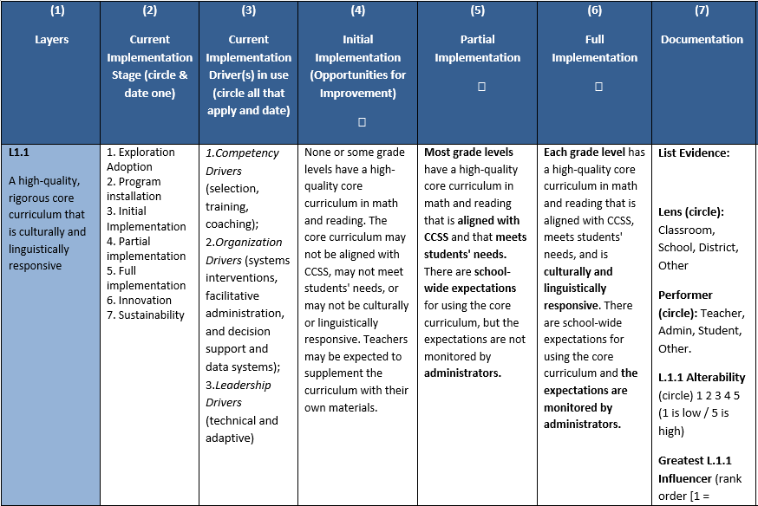
Today
Next
Session
Implementation Rubric
Stages & Drivers

Slide 9
Implementation Stages Stage 1 - Exploration & Adoption
Activities:
Shared communication about strengths and needs.
Review and identify programs, practices and interventions that match target areas.
Develop methods to promote “buy-in” for teachers, administration, and other stakeholders.
Identification of effective innovations that may fill gaps in current approaches.
Assessment of existing implementation drivers needed to support practitioners and others, identification of needed resources and their sources.

Slide 10
Implementation Stages Stage 1 - Exploration & Adoption
Activities & Results:
The result of “exploration & adoption” is a common understanding and acceptance of the EBP and the required implementation supports. Also, a collective decision to proceed (i.e. mutually informed agreement).

Slide 11
Implementation Stages Stage 2 - Program Installation
Activities & Results:
Develop interview methods and prepare interviewers to select practitioners and staff to do the new work.
Develop data collection sources and protocols.
Develop timely training, preparing a coaching service delivery plan...

Slide 12
Implementation Stages Stage 3 - Initial Implementation
Activities & Results:
Use newly learned skills (EBP) and adjust to accommodate and support the EBP.
Develop staff competencies required to implement the EBP.
Develop coaching and support plans for implementing educators.
Help administrators adjust organization roles and activities to align with the program.
Help leaders support the processes of using the EBP and to incorporate the necessary implementation supports.

Slide 13
Implementation Stages Stage - 4 - Partial Implementation
Activities & Results:
Fidelity measures and reporting processes are being identified.
PD on the EBP and associated “in-context” coaching is offered to bring about high-fidelity implementation.
Outcome data measures and reporting processes are being identified.
Building and/or district administrative policies and practices are reviewed to determine if they will negatively compete with, or block EBP implementation.

Slide 14
Implementation Stages Stage – 5 - Full Implementation
Activities & Results:
Fidelity measures and reporting processes in place.
Outcome data measures and reporting processes in place.
Building and/or district administrative policies and practices are amended to support continued implementation and are adapted based on feedback loops.

Slide 15
Implementation Stages Stage - 6 - Innovation
Activities & Results:
EBPs and evidence-based practices, after being implemented with fidelity for sufficient time often require alterations, or innovations to fit a school’s unique context.
Trim the EBP, retaining critical features.
Watch the data to ensure innovations are enhancing student learning.

Slide 16
Implementation Stages Stage - 7 - Sustainability
Activities & Results:
After the EBP is fully implemented, and innovated to enhance student learning, then the challenge is to sustain the practice while bringing in other initiatives.
Ensure the EBP is institutionalized and is sustained with less effort and with automaticity.
Watch implementation data and outcome data…watch for “implementation drift.”

Slide 17
What Stage is Your School in?
1. Exploration & Adoption
2. Program Installation
3. Initial Implementation
4. Partial Implementation
5. Full Implementation
6. Innovation
7. Sustainability

Slide 18
Q-1 - In what ways have you and your staff used your MLSS Implementation Manuals so far? Q-2 - What successes and challenges arose in your use?

Slide 19
MLSS Manual Overview

Slide 20
MLSS Manual Overview Layer 1
The MOST IMPORTANT LAYER!
All students receive Layer 1 - universal interventions which include high-quality differentiated core instruction aligned to the Common Core State Standards (CCSS), that is delivered via Culturally and Linguistically Responsive Instruction to meet the needs of most students.
Layer 1 also includes a system of Positive Behavioral Interventions and Supports (PBIS) for all students, and universal screening (assessments) to identify students whose needs are not satisfactorily met by Layer 1 interventions alone.

Slide 21
MLSS Manual Overview Layer 2
The focus of Layer 2 interventions is individualized and targeted interventions to support student’s acquisition of the knowledge and skills identified in the CCSS and to support student success with Layer 1 high-quality differentiated instruction.
Notes:
Frequent communication with parent(s) or guardian(s) regarding assessed student progress is vital during Layer 2 targeted interventions. If a student receiving Layer 2 targeted interventions is not making expected progress, the student may need even more intensive intervention (i.e., Layer 3 intensive interventions).

Slide 22
MLSS Manual Overview Layer 2 – Continued
Students receiving Layer 2 targeted interventions receive core curriculum and instruction plus targeted evidenced-based interventions: (not an exhaustive list)
Applying evidenced-based interventions and data-driven instruction in small group learning settings;
Instruction with reading or math coaches; and
Health and wellness interventions may include social or behavioral contracts or guided small group social work interventions.
A key aspect of Layer 2 targeted interventions is progress monitoring to assess students’ responses to targeted interventions.
Notes:
Frequent communication with parent(s) or guardian(s) regarding assessed student progress is vital during Layer 2 targeted interventions. If a student receiving Layer 2 targeted interventions is not making expected progress, the student may need even more intensive intervention (i.e., Layer 3 intensive interventions).

Slide 23
MLSS Manual Overview Layer 3
Layer 3 intensive interventions include core curriculum and instruction, and intensive and individualized evidenced-based interventions.
Layer 3 evidenced-based interventions may be provided for a longer duration than Layer 2 interventions, may be provided more frequently, be provided in smaller groups, or otherwise be more intensive.
Students receiving Layer 3 interventions receive all Layer 1 and 2 interventions needed for the student to achieve a desired pattern of learning.

Slide 24
Layer 1: Observational Tools
The purpose of the observation tools is to identify the knowledge and skills students have at the time of program entry.
The information collected through authentic observations provides information about a student’s existing skills and thereby directs instruction to the unique needs of children in birth to kindergarten programs.

Slide 25
Layer 1: Screening/ Benchmark Assessments
The purpose of a screening assessment in reading is to identify students at risk for negative reading outcomes and students on-track to successful reading outcomes.
Screening data are used to make decisions about the level of instructional support students need to achieve favorable learning outcomes.
Grades K-8: It is recommended that a screening be administered to all students at least three times per year (beginning, middle, and end of the school year).
Grades K-3: Screening should focus on the early foundational literacy skills.
Grades 4-8: Screening should focus on reading fluency or prosody, and reading vocabulary and comprehension.

Slide 26
Layer 1: Screening/ Benchmark Assessments
The purpose of a screening assessment in reading is to identify students at risk for negative reading outcomes and students on-track to successful reading outcomes.
Screening data are used to make decisions about the level of instructional support students need to achieve favorable learning outcomes.
Grades 9-12: Screening assessments should be administered at the beginning of the year in grade 9. For students who are not yet reading at grade-level, it is recommended that schools administer an assessment to identify their specific reading instruction needs.
Grades 9-12: Screening should focus on reading fluency or prosody, reading vocabulary and comprehension.

Slide 27
Layer 1: Progress Monitoring
Layer 1/Tier 1 (Benchmark): Assessments only need to be conducted three times a year.
Layer 2/Tier 2 (Moderate Risk): Assessments need to be conducted at least one time per month, and two times per month is recommended.
Layer 3/Tier 3: Assessments need to be conducted once a week twice a month at a minimum). Tier is used here and below because this table is from the published NM Literacy Framework.
Progress monitoring is essential.
Frequent progress monitoring is necessary for students who are below grade-level expectations.
In order to reach this goal, schools need frequent, timely, and actionable information on whether students are making enough progress to reach the outcomes in the timeframe for which outcome goals are set.

Slide 28
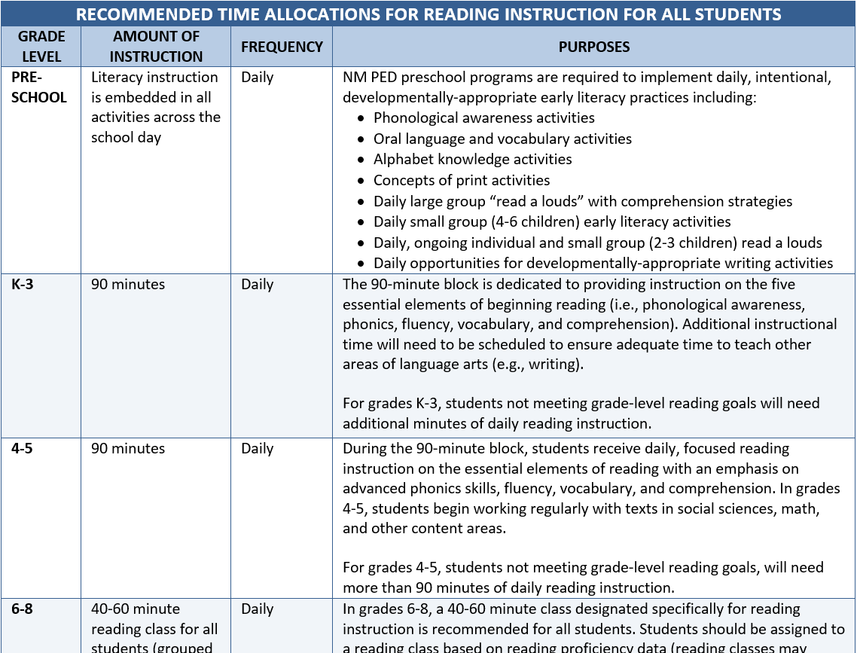
Layer 1: Time Allocations – Page 15

Slide 29
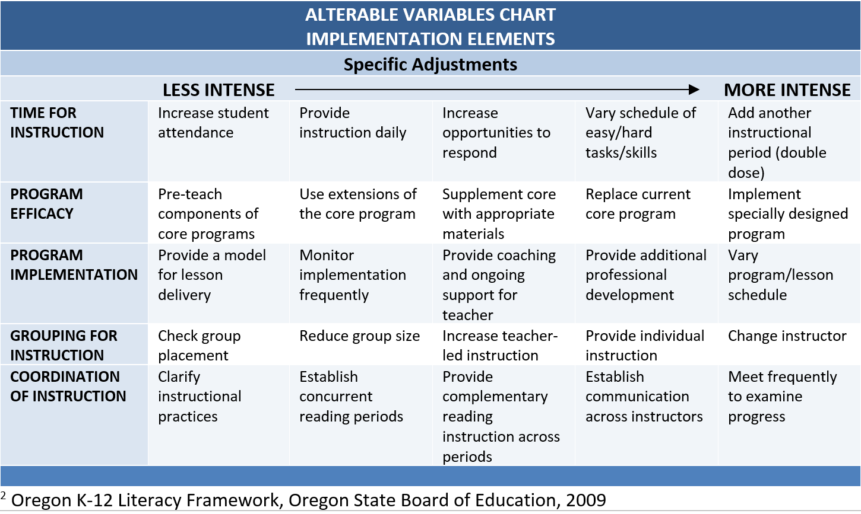
Layer 1: Lesson Implementation
Layer 1: Alterable Variables – Page 17

Slide 30
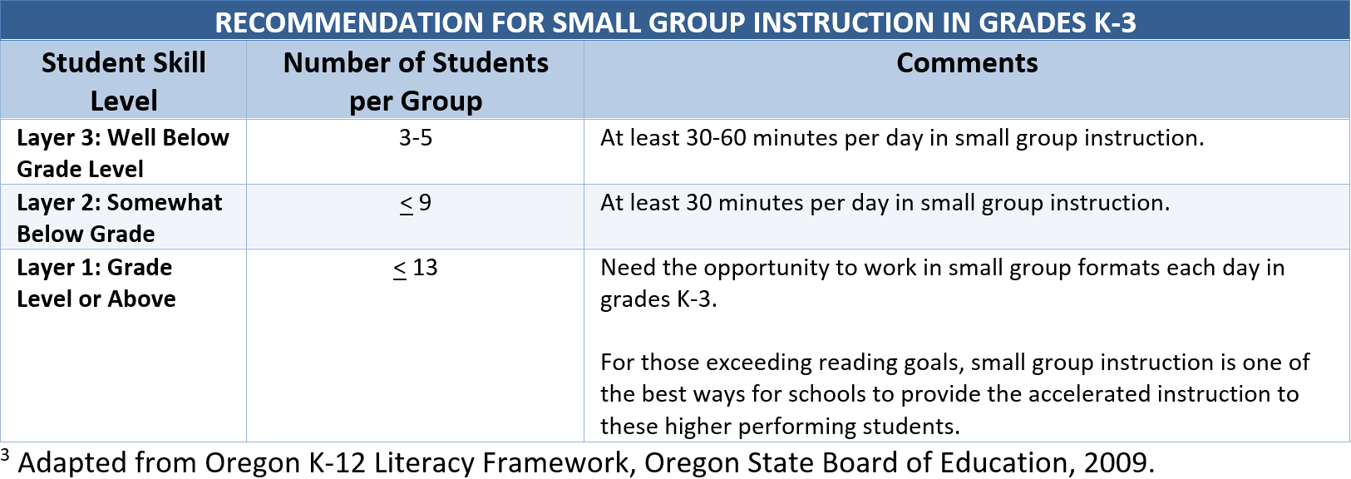
Layer 1: Small Group Instruction
Layer 1: Small Group Instruction
Page 18

Slide 31
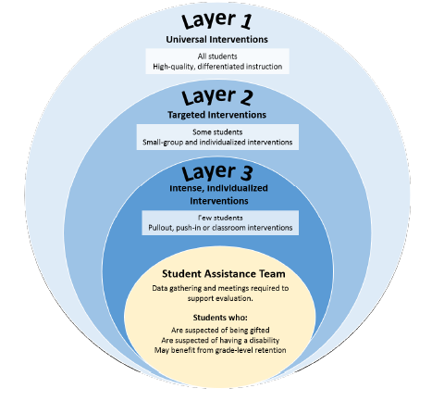
Student Assistance Teams Supplemental Guide
The SAT process and the provision of high-quality instruction and interventions can help teachers meet the needs of students.

Slide 32
Student Assistance Teams Supplemental Guide
The approach to interventions and the movement between universal, targeted and intensive interventions, as detailed in the MLSS, provides for a greater impact on student achievement and well-being.

Slide 33
Student Assistance Teams Supplemental Guide
MLSS will strengthen New Mexico’s supports for all students including those experiencing academic or behavioral needs. MLSS also employs student wellness to improve outcomes in student achievement.

Slide 34
Student Assistance Teams: Using MLSS as an Intervention
Decisions regarding layered interventions are made by the classroom teachers and support personnel closest to the students. A SAT Meeting is not required to increase or reduce layered supports within a layer, or move back and forth across layers in the MLSS process.
Schools provide support to families through this process, so parents and families understand the needs for the process and for moving up and down increasingly intensive layered interventions and can support the interventions, changes of interventions, and intervention adjustments.
Interventions through MLSS provide the opportunity for initial interventions.
A student’s response to those interventions may indicate the SAT process is necessary, particularly if the instructional staff may want to retain the student, or suspect the student is gifted or has a disability.

Slide 35
Student Assistance Teams: Using MLSS as an Intervention support
While the MLSS provides immediate, data-informed supports for students struggling academically and behaviorally, it does not preclude the initiation of the SAT process for students who may benefit from the creation of an Academic Improvement Plan (AIP) or a Behavior Intervention Plan (BIP).
Under NM state statute, the AIP is a written plan required for students in grades K–8 who have been retained and those who have been promoted despite a retention recommendation. The AIP is developed by the SAT.
A BIP is often preceded by a Functional Behavioral Assessment (FBA). An FBA may occur in layer 2 or 3 of the MLSS process.
A student receiving Special Education services is eligible to receive all appropriate supports through MLSS.

Slide 36
Student Assistance Teams: Documentation
Though districts and charter schools may use or develop whichever forms that meet their particular needs, the SAT referral packet should include the following information:
Academic and or behavioral concerns (Sample forms include - Teacher Form, Teacher Input for Addressing Behavior Form, Intervention for Behavior Form, Student Profile);
Documentation of outcomes of attempted intervention progress monitoring (sample forms for progress monitoring include - SAT Action/Intervention Plan);
Parent/guardian communications (included in the Teacher Form);
Results of universal screening (sample Vision Screening Form and Hearing Screening Form);
Observations of the student (sample Student Observation Form);
Implementation data regarding the use of rigorous, high-quality curriculum and methodologies (sample Fidelity Assurance Form).
MLSS Individual Student Intervention Sheet

Slide 37
Thank You
Please send all technical assistance requests to the following email address:
Multi.LayeredSS@state.nm.us

