Slide 1
MLSS Implementation Driver Meeting #2
11-14-2019

Slide 2
Agenda
9:00-9:10 Introductions
9:10-9:25 Implementation Driver Overview
9:25-9:45 Completing the Implementation Rubric
9:45-10:00 Requesting Technical Assistance
10:00-10:30 Q & A

Slide 3
SURVEY
Please record your district, school, and title

Slide 4
MLSS – Teacher Ambassador Work Group
Presentation by Alan Griffin:
Purpose of the Teacher Ambassador Program
Purpose of the Working Group
Description of the first project

Slide 5
SURVEY
The Teacher Ambassador Work Group will be tasked with several projects. Please type your ideas for resources that may develop or organize to help support your staff with MLSS implementation.

Slide 6
Implementation Driver Overview: Competency Drivers
Deep implementation of evidence‐based practices (EBPs) starts with:
Competency drivers: getting the right people on the team, and then actively working to develop, improve, and sustain team members with skills training and coaching.

Slide 7
Implementation Driver Overview: Competency Drivers
Deep implementation of evidence‐based practices (EBPs) starts with:
Selection: Effective staffing requires identifying the skills necessary for the work ahead. These skills are the criteria for selecting staff; they also direct training and coaching for new and existing staff.
Training: Teachers, leaders, and staff need training on the theory, values, and actions of a practice or innovation, and should be provided with time to practice needed skills.
Coaching: Skills can be introduced in training, but they must be practiced and mastered, with high levels of accuracy and fluency in the classroom and school. Coaching is key to supporting the transfer of skills from training to school and classroom settings.

Slide 8
SURVEY
Which competency driver do you feel is the most difficult to understand?

Slide 9
Implementation Driver Overview: Organization Drivers
Organization drivers are the systemic components that are essential in creating an educational environment ready for, and supportive of, change. Key organization components that drive successful and deep implementation include:
Systems Interventions, which reduce or eliminate institutional barriers while enhancing elements in a system that support and sustain change.
Facilitative Administration creates and maintains a hospitable environment, supporting intentional change and new ways to work.
Decision Supporting Data Systems gather performance data and analyze processes and outcomes.

Slide 10
SURVEY
Which organization driver do you feel to be the most difficult to understand?

Slide 11
Implementation Driver Overview: Leadership Drivers
Leadership drivers are the leadership approaches that transform systems and create change. Different challenges with implementing evidence‐based practices call for different leadership approaches.
Adaptive Leadership skills are needed to clarify the institutional vision, bring people together, and champion change.
Technical Leadership skills are needed to manage continuing implementation supports. These skills represent the managerial side of leadership.
Sometimes, adaptive and technical skills are embodied in the same leader. In other cases, leadership responsibilities must be spread more widely to achieve the skills that drive implementation.

Slide 12
SURVEY
Which leadership driver do you feel to be the most difficult to understand?

Slide 13
Completing the Implementation Rubric: What is it?
The MLSS Implementation Rubric:
Describes implementation of the MLSS.
Provides monitoring measures of MLSS components.
Evidence to support full implementation can be found in the documentation column of the tool.
Pages 53-68
Keep in Mind: Full Layer implementation is the desired rating, but implementation takes time.

Slide 14
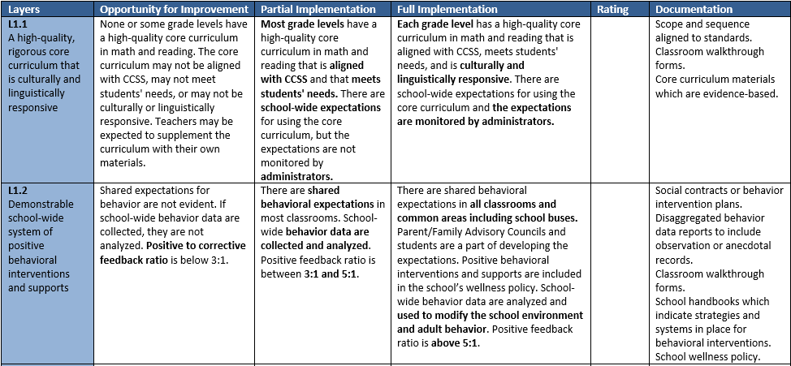
Completing the Implementation Rubric: How do I use it?
1
2
4
3
Directions:
Take note of the layer/program element. If the description is new to you, read the section of the manual that is associated with it.
Determine if you meet the rubric description for Opportunity for Improvement, Partial Implementation, or Full Implementation.
As you work to evaluate each layer/program element, make sure you are being mindful of the evidence/documentation you have to support your rating.
Rate your stage of implementation.

Slide 15
SURVEY
Rate your understanding of the process to complete the Implementation Rubric.

Slide 16
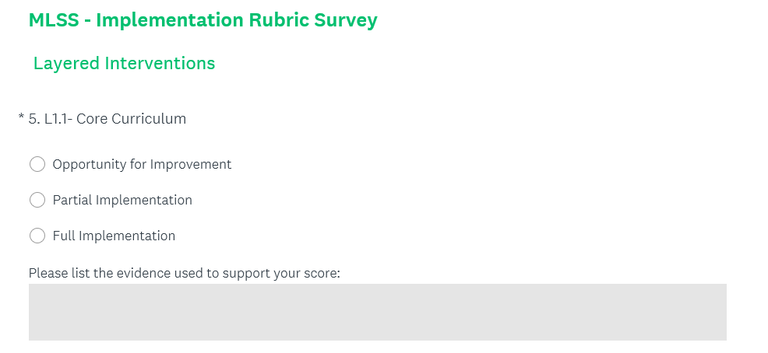
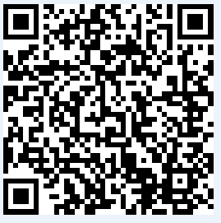
Completing the Implementation Rubric: How do I communicate back to the PED?
After completing the implementation rubric, you will need to submit your findings to the PED no later than December 13th @ 5pm via SurveyMonkey.
https://www.surveymonkey.com/r/YV7S62C

Slide 17
Completing the Implementation Rubric: What do I do with the data?
Communicate findings back to your campus leadership team.
Determine which elements require the greatest attention.
Work with the team to develop a vision for what Full Implementation would look like with a specific focus on the policies and documentation needed to ensure success.

Slide 18
Requesting Technical Assistance: How can the PED help me?
The PED can help with your implementation of MLSS by:
Being a thought partner as you work to understand the MLSS framework and identifying areas of need
Identifying relevant resources
Working with REC to identify people and programs that align with your needs

Slide 19
SURVEY
Rate your understanding of how to request assistance from the PED for MLSS support.

Slide 20
Implementation Spotlight Interview
We are looking to feature a school that to spotlight one of the key elements of MLSS implementation in a NEW MLSS quarterly newsletter!
The key elements are:
Classroom Supports - Data-Driven Instruction and Data-Informed Decision Making
Classroom Supports - High-Quality Core Instruction and Interventions
School Supports - Informed and Effective School Leadership and Systems
School Supports - Collaboration and Processes for Providing a Layered Continuum of Supports
School Supports - Positive School Culture and Climate
Health and Wellness Supports - Student Wellness
Family and Community Supports - Family Engagement
Please type your district/school name and the key elements you would like to spotlight for our first MLSS Newsletter.

Slide 21
What are my responsibilities for documentation during the MLSS pilot?
The documentation process and forms used to monitor progress and refer students to SAT or special education testing will remain local decisions to be made by each LEA.

Slide 22
Q & A

Slide 23
Thank You!
Please send all information and support requests to:
Multi.LayeredSS@state.nm.us

