Slide 1
2020 Instructional Material Review Grades 9-12 ELA, SLA, WL, ELD
FORM F ALIGNMENT AND SCORING RUBRIC
INFORMATION WORKSHOP FOR PROVIDERS/PUBLISHERS
JANUARY 7, 8, & 9, 2020

Slide 2
Instructional Material
Bureau Staff
Anthony Burns
Bureau Chief
Charlotte McLeod
Education Administrator
Deb Marquez
Education Administrator

Slide 3
Agenda
• Instructional Material Review/Definitions
• Form D: Research-based Effectiveness
• Form Submission Deadlines
• Overview of Review Process
• Form F: Citation Alignment and Scoring Rubric - Overview
• Form F—Fill in the Blanks
• Material and Form F Citation Video

Slide 4
INSTRUCTIONAL MATERIAL DEFINITION
Instructional Material—school textbooks and other educational media that are used as the basis for instruction, including combinations of textbooks, learning kits, supplementary material and electronic media (not to include computers, laptops, handheld computers, or other devices).

Slide 5
INSTRUCTIONAL MATERIAL DEFINITION
Core Instructional Material—the comprehensive print or digital educational material, including basal material, which constitutes the necessary instructional components of a full academic course of study in those subjects for which the department has adopted content standards and benchmarks.
Supplementary Materials—supporting instructional material used to reinforce, enrich, or enhance instruction driven by core instructional material. Pursuant to Section 22-15-8 NMSA 1978, the department may choose not to review supplementary materials.

Slide 6
RESEARCH-BASED EFFECTIVENESS (DEFINITION)
Research-based effectiveness is the demonstrated effectiveness of instructional material in supporting students to meet or exceed grade-level goals according to New Mexico content standards, and as demonstrated by the best available evidence for curricula in the relevant grade and subject. For core instructional material, evidence shall include an independently conducted experimental or quasi-experimental research study or review by nationally-recognized, independent experts in curricula review. LEA-created core instructional materials may also demonstrate effectiveness using correlational evidence that students using the core instructional material meet or exceed grade-level proficiency as measured by the state assessment.

Slide 7
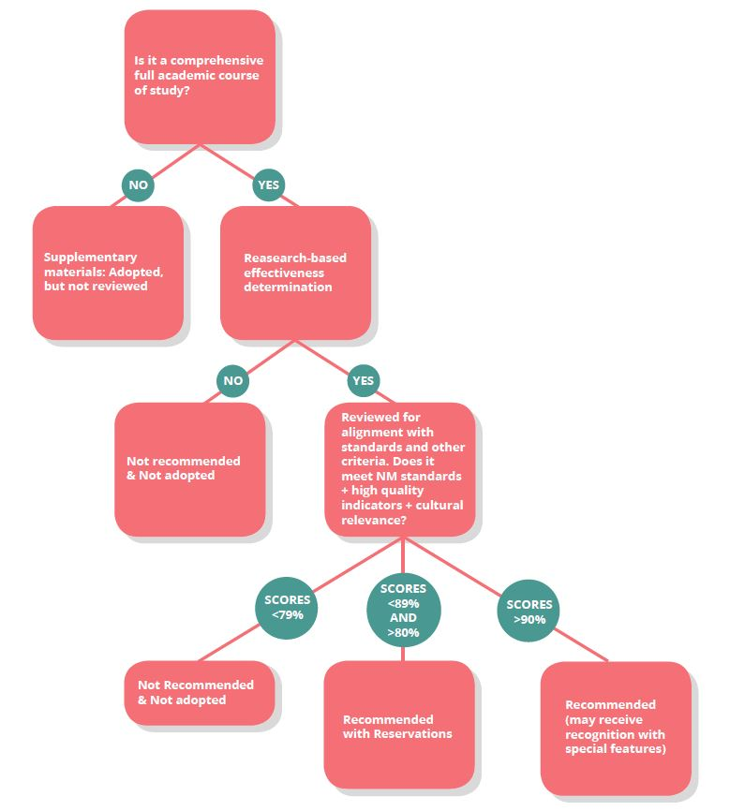
Adoption Process
and Designation

Slide 8
RESEARCH-BASED EFFECTIVENESS DETERMINATION FOR CORE
Instructional materials that have been submitted on Form E: List of Instructional Materials, certified on Form B: Certification of Instructional Materials, and verified by the department to be Core, will be evaluated based upon the criteria established for Form D: Research-Based Effectiveness Determination.
Core instructional materials that do not meet the research-based effectiveness criteria within Form D: Research Based Effectiveness Determination will not be reviewed and will not be adopted.
Providers/Publishers will be informed by January 27, 2020, of their status concerning research-based effectiveness determination.
If you are submitting material for core consideration, please begin the process of filling out the appropriate Form F: Alignment and Scoring Rubrics.

Slide 9
SUBMISSIONS
Grades 9-12 ELA, SLA, WL, ELD
Titles submitted for consideration for adoption as core and that have been determined to be research-based are reviewed at the Review Institute in June.
Materials submitted to the Review Institute must be in review sets. Each review set should be bound together as a package and should contain ONLY the following:
1 teacher edition
1 student edition
1 student workbook, if applicable
1 Form C Official Sample Label, attached to the backside of the package and covering any ISBN printed on the book/material.
There should be a total of (6) separate review set packages for each title submitted for the Review Institute.
Titles submitted as supplementary will not be reviewed and will not be accepted at the Review Institute.

Slide 10
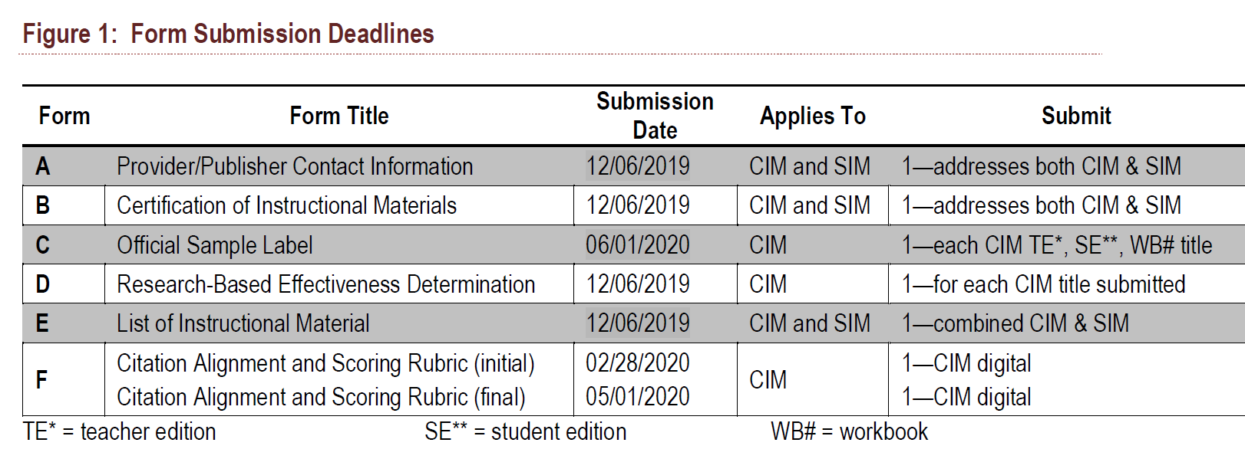
FORM SUBMISSION DEADLINES

Slide 11
ADDITION AND WITHDRAWAL DEADLINES

Slide 12
OVERVIEW OF REVIEW PROCESS
Materials are reviewed by 3 Reviewers: one content leader and two teachers (all licensed Level II and Level III teachers).
Provider/Publisher submissions are scored against rubrics for alignment with the following:
adopted New Mexico State Standards for each content area under review;
content specific high-quality indicators;
and general high-quality indicators (see page 20 of the RfA for standards).
Adoption determination:
90 percent or higher = adopted as Recommended
80 – 89 percent = adopted as Recommended with Reservations
79 percent or less = not adopted, not on multiple list

Slide 13
FORM F: CITATION ALIGNMENT AND SCORING RUBRICS--INITIAL
General RfA Information (RfA p.56-57)
Forms F will be placed in publisher’s Google drive after the Form F webinars are completed.
Each Form F must remain in your assigned Google drive throughout the process; do not download it or transfer it to another format and then transfer it back.
Initial Form Fs must be completed in the publisher drive by 2/28/20.
You may not use a citation more than once across all sections of the rubric.
IMB will review initial Form F citations for possible issues. IMB will address any issues using the comment function in the Form Fs. Comments will appear on the rubric on or before 3/27/20 as to any changes or modifications that need to be made in the citations before submitting final Form Fs.

Slide 14
FORM F: CITATION ALIGNMENT AND SCORING RUBRICS--FINAL
Final Form Fs must be finished by 5/1/2020. We will remove them from your Google drive for use during the Summer Review Institute on 5/2/20.
All work on the Form F MUST be completed within the Google drive.
The Form F will be the rubric used to review your submitted material at the Summer Review Institute.
Citations must be included for each standard and criterion.
Do not enter N/A or not applicable as a response.
You may not use a citation more than once across all sections of the rubric.

Slide 15
FORM F: COVER PAGE
Insert material information in the empty cells for the provider/publisher section.

Slide 16
PROVIDER/PUBLISHER INSTRUCTIONS
Each rubric section includes instructions for the Providers/Publishers.

Slide 17
FORM F: STANDARDS REVIEW
The Standards Review section includes the following:
ELA:
Common Core State Standards for ELA
New Mexico Content Standards for ELA
SLA:
Common Core State Standards for SLA
New Mexico Content Standards for SLA
World Languages:
World Readiness Goal Areas and Accompanying Standards
ELD:
English Language Development Standards (WIDA)
ELA/ELD:
Common Core State Standards for ELA
New Mexico Content Standards for ELA
English Language Development Standards (WIDA)

Slide 18
FORM F: STANDARDS REVIEW INSTRUCTIONS
Insert two citations for each standard using only the Teacher Edition of the review set.
Reviewers will score the materials based on the citation as:
Meets the standard
Partially meets the standard
Does not meet the standard
Reviewers then provide evidence from the materials that supports their score.
NOTE: Reviewers will be using the student materials to cite the standard, score it, and provide evidence on the standards section of rubric.
Remember: You may not use a citation more than once across all sections of the rubric.

Slide 19
FORM F: STANDARDS REVIEW INSTRUCTIONS

Slide 20
FORM F: CONTENT SPECIFIC REVIEW INSTRUCTIONS
Insert one citation for each criterion using the Student Edition, Teacher Edition, or Student Workbook, unless noted specifically within the criterion.
Reviewers will score the materials based on the citation as:
Meets expectations of the criterion
Partially meets expectations of the criterion
Does not meet expectations of the criterion
Reviewers then provide evidence from the materials that supports their score.
Remember: You may not use a citation more than once across all sections of the rubric.

Slide 21
FORM F: CONTENT SPECIFIC REVIEW INSTRUCTIONS

Slide 22
FORM F: ALL CONTENT REVIEW
The All Content Review section includes high quality indicators such as:
Progression in the standards
Coherence at grade level and across grade levels
Lesson structure and pacing
Teacher planning/student learning
Assessment
Technology
Cultural relevance and responsiveness

Slide 23
FORM F: ALL CONTENT REVIEW INSTRUCTIONS
Insert one citation for each criterion using the Student Edition, Student Workbook, or Teacher Edition.
Reviewers will score the materials based on the citation as:
Meets expectations of the criterion
Partially meets expectations of the criterion
Does not meet expectations of the criterion
Reviewers then provide evidence from the materials that supports their score.
Remember: You may not use a citation more than once across all sections of the rubric.

Slide 24
FORM F: ALL CONTENT REVIEW INSTRUCTIONS

Slide 25
Sample Publisher Rubric
The sample rubric with guidance comments has been placed in the Forms F folder of your publisher Google drive.

Slide 26
FORM F: DOs AND DON’Ts
Remember: You may not use a citation more than once across all sections of the rubric.
Do: Build your Forms F within your publisher Google drive.
Do: Provide citations that are targeted.
Do: Enter short, concise citations.
Do: Provide citations that give broad exposure to the text/material.
Do: Enter the best citation that addresses each standard or criterion.
Do not: Remove Forms F from your publisher drive.
Do not: Convert Forms F from Google Sheets to Excel or any other format.
Do not: Cite an entire chapter or multiple pages.
Do not: Attempt to unlock cells.
Do not: Change the Form F formatting in any way.

Slide 27
Form F Publisher/IMB Conferences
Please begin citations for each tab on the Form Fs you will be submitting.
Take note of questions you have about the rubric or how your materials are cited.
Email Deb Marquez at debra.marquez@state.nm.us when you are ready to set up a video conference.
Deb will send a calendar invite to the contact person and they will forward it to all necessary participants.
All video conferences will be held in Google Meet.

Slide 28
MATERIAL AND FORM F
CITATION VIDEO
Provider/Publishers submitting Core material are required to create a short video presentation (no more than 20 minutes) for each Core review set submitted. The video must include:
an explanation of the structure of the material;
detailed explanation of the citation strategies used in completing the Form F Citation Alignment and Scoring Rubric (Provider/Publisher’s notations, acronyms, abbreviations, headings, and features);
and instructions on how to access online or digital material necessary for the review.
The video may not include any sales or contact information.
A link to each video will be due by February 28, 2020, to imb.contact@state.nm.us along with any access information needed to review the video.
See page 23 of the RfA for complete instructions and guidelines.

Slide 29
AFTER THE SUMMER REVIEW INSTITUTE
Subsequent to the review, results will be presented to Secretary of Education:
core materials that are designated as recommended;
core materials recommended with reservations; and
supplementary materials.
Once items are adopted on the multiple list, agreements will be sent to Providers/Publishers for signatures.

Slide 30
Thank you
Thank you for attending today’s webinar.
Please submit in writing any further questions you have to: imb.contact@state.nm.us.

