Slide 1
MLSS Implementation Driver Meeting #5
2-26-2020

Slide 2
Agenda
9:00-9:05 Welcome
9:05-9:15 Teacher Ambassador Check-in
9:15-9:20 Implementation Survey Reminder
9:20-9:35 Feedback Survey Discussion
9:35-10:00 MLSS and Behavior Supports
10:00-10:20 Behavior Discussion
10:20-10:30 Feedback Survey

Slide 3
MLSS – Teacher Ambassador Work Group
Presentation by Karen Komar:
28th year of teaching - Taught at the elementary, middle & high school level
Currently teach business & computer software at Jal High School in Jal
NHS advisor & senior advisor
Former volleyball & basketball coach
Served on numerous committees, SAT team, principal committee & superintendent committee and currently serve on the administrative cadre
Serve for the Jal Youth Advisory Board, and serve on the town census committee
I am a NMTLN Liaison as well as State Ambassador

Slide 4
Implementation Rubric Survey
What is it?
Self-assessment of each pilot campus’ baseline implementation of the MLSS framework
What will the PED use this data for?
The PED will use this data to guide break-out session ideas for upcoming trainings?
Why should I spend the time to do this?
Transparent measure on a vast array of programs, policies, and initiatives
Starting point to begin collaboration with other districts and schools
What can I use this data for?
Professional development opportunities
Systems and policies
Teacher supports
Family and community supports
Will this data be used as an accountability measure?
This data will only be used to guide supports at the State, LEA, and campus level

Slide 5
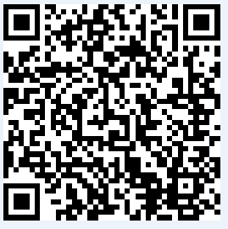
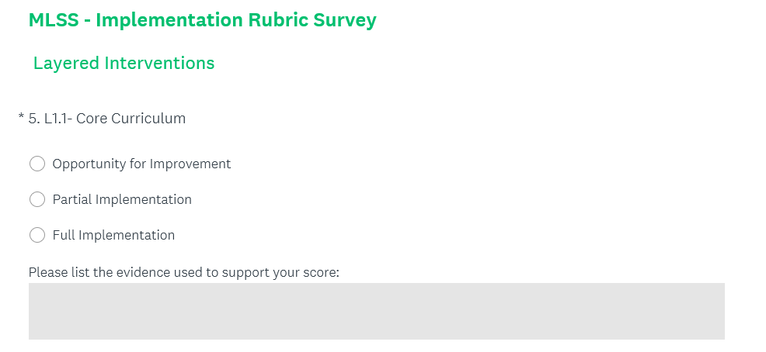
Completing the Implementation Rubric
https://www.surveymonkey.com/r/YV7S62C

Slide 6
Universal Behavioral Supports
A demonstrable school-wide system of positive behavioral interventions and supports (PBIS)
School-wide
Responsive to language and culture
Data collection
Non-punitive
Consistent
Note: No matter what system of PBIS is used, all schools are required to have an anti-bullying policy in accordance with New Mexico Administrative Code (NMAC) 6.12.7
https://webnew.ped.state.nm.us/bureaus/safe-healthy-schools/bullying-prevention/
Notes:
The bridging component focuses on creating opportunities to practice situational appropriateness or utilizing appropriate cultural and linguistic behaviors.

Slide 7
Layer 1 – Behavioral Support Examples
5:1 positive reinforcement to corrective feedback
Effective anti-bullying policies and messaging
Positive social interaction with each student each day
Processes and procedures for common classroom functions
Social contracts
Character development curriculum
Explicit behavior expectations for common areas

Slide 8
Social Emotional Learning (SEL)
Cognitive, affective, and behavioral competencies necessary for a young person to be successful in school, work, and life.
Self-awareness: the ability to understand one’s emotions and how they influence behavior
Self-management: the ability to calm down when upset, to set goals and work toward them, and to manage and control emotions
Social awareness: the ability to recognize what is appropriate in certain settings and empathize with others
Responsible decision making: the ability to make decisions that take into account social standards, consequences, and context
Relationship skills: the ability to communicate well, to listen and respond appropriately, and to negotiate conflict
Collaborative for Academic, Social, and Emotional Learning (CASEL): https://casel.org/

Slide 9
Layer 2 Behavioral Supports
When a student struggles with the school-wide behavioral expectations or needs further emotional health support
The teacher and school health and wellness team should gather and analyze data in order to identify possible interventions
Develop a menu of evidenced-based behavior interventions
Parental/guardian notice and consent are highly recommended but not required for Layer 2 interventions or monitoring.
May be short-term, intermediate, or long-term.
Available to ALL struggling learners

Slide 10
Layer 2 – Behavioral Support Examples
Self-monitoring
Token economies
Counseling
Small groups focused on social issues that may precipitate changes in behavior (e.g. divorce, grief, body image issues, anger management, etc…)
Daily behavior logs
Behavior contracts
Sensory tools
Organizational tools

Slide 11
Layer 3 Behavioral Supports
Students identified as experiencing behavioral crisis or those not making expected progress with Layer 2 interventions will have access to Layer 3 interventions:
Utilize non-punitive methods for teaching appropriate behaviors to replace behaviors impairing learning, social interaction, and school climate
Students receiving Layer 3 interventions are not suspended, in- or out-of-school at a greater frequency or for more time than other students receiving layer 1 or 2 interventions
Behavior plans should include data collection and analysis systems to determine their effectiveness in supporting student behavior.
Consistently monitor student progress and related data and adjust until supportive behaviors are attained.
Communication with the student and family is key to success.

Slide 12
Layer 3 – Behavioral Support Examples
Continuous adult supervision
Social stories
Individual schedule
Structured breaks
Communication log with family
Proximity control

Slide 13
Discussion – Issues with Implementing Behavioral Supports

Slide 14
Discussion – MLSS and Systems Alignment
Teacher buy-in
Layer 3 supports and the general education environment
Universal dyslexia screener
Process and forms for referring a student to SAT or special education

Slide 15
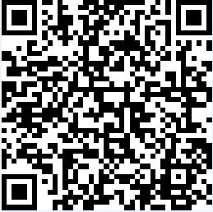
Feedback Survey
Please take 2-3 minutes to complete this brief feedback survey. This will be how your attendance is recorded.
https://www.surveymonkey.com/r/5PTPKPH

Slide 16
Thank You!
Please send all information and support requests to:
Multi.LayeredSS@state.nm.us

