Slide 1
District Test Coordinator 101: DTC RESOURCES October 2, 2020
Xavier DeLeon
Assessment Coordinator
Assessment Bureau
Investing for tomorrow, delivering today.
Notes:
To change the image on this slide, select the picture and delete it. Then click the Pictures icon in the placeholder to insert your own image.

Slide 2
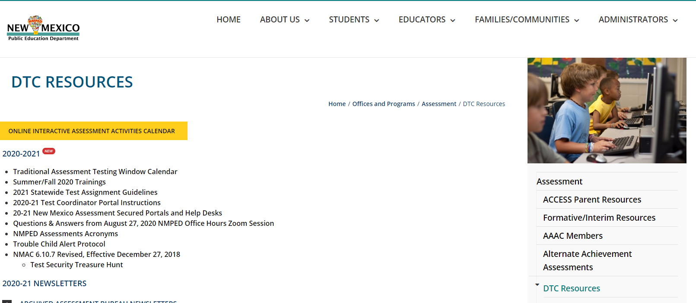
DTC Resources Department Page
Online Interactive Assessment Activities Calendar
2020-21 Newsletters
Test Coordinator Portal
Test Coordinator Forms
Cohort Resources
Lists of AAAC & TAC Members

Slide 3
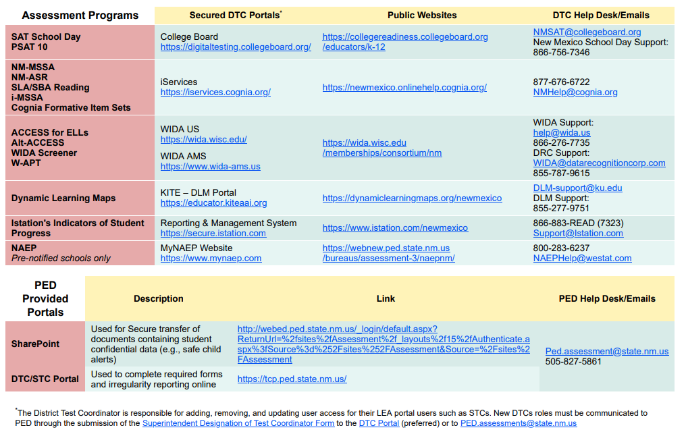
Secured Portals & Help Desks

Slide 4
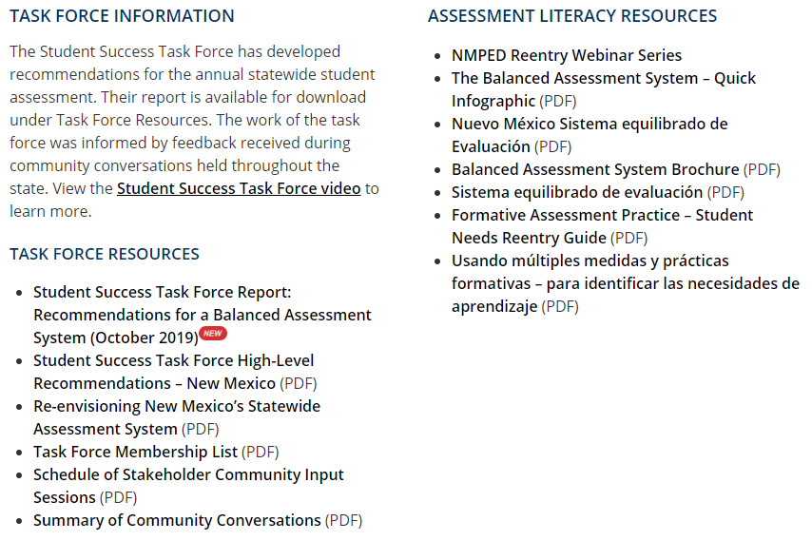
Assessment Literacy & Task Force
Balanced Assessment System (i.e. video, infographic, etc.)
NMPED Reentry Webinar Series
Assessment Literacy Resources

Slide 5
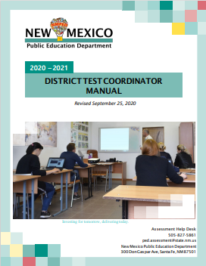
Manuals
DTCs are required to review all manuals before administering an assessment.
District Test Coordinator Manual
Accommodations and Accessibility Manual

Slide 6
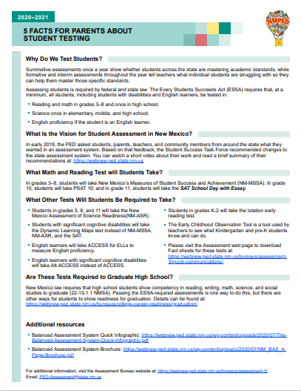
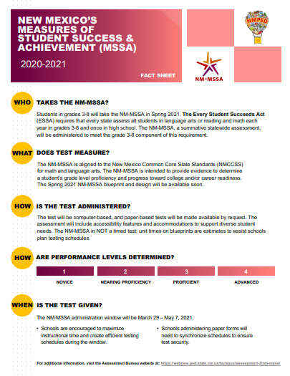
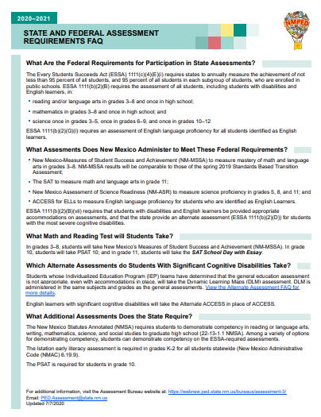
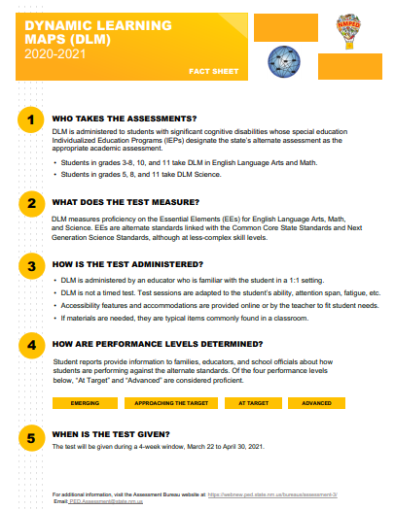
FAQs & Factsheets
FAQs
Factsheets

Slide 7
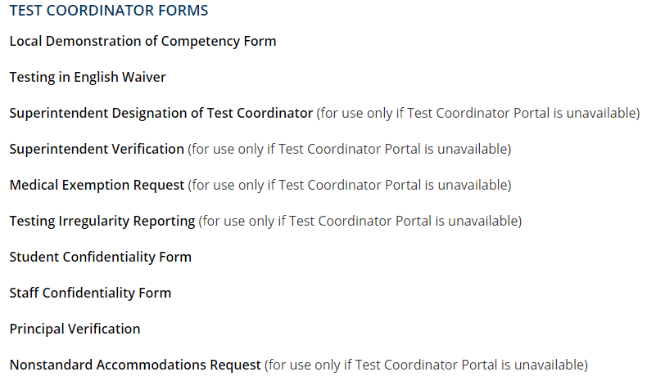
DTC Forms
Retain locally; need not submit to PED
Notes:
At this time we are not requiring LEAs to submit local demonstrations of competencies. All forms are available in paper, but we highly recommend you submit all forms available in the TCP in the TCP.

Slide 8
Flowchart: Irregularity Submission to Investigation
Step 2
The PED Investigations Bureau and the Administrative Prosecutors will initiate procedures to evaluate the Complaint for investigation and potential administrative prosecution.
DTC submits irregularity to PED Assessment Bureau
Assessment Bureau reviews and determines potential foul play may have occured involving a licensed educator
Ideally, LEA staff member, or Assessment Staff in some cases, completed the Licensure Complaint Form.
Form is submitted to Camille Malloy in Investigations Office (Camille.Maloy@state.nm.us)
Step 1
Step 3
Licensure Complaint form: https://webnew.ped.state.nm.us/bureaus/general-counsel/general-counsel-documents-and-forms/

Slide 9
Safe/Troubled Child Alert Protocol
Vendors contact PED Assessment Coordinator (PED AC)
PED AC downloads the trouble child alerts from vendor secured portal and places it in the districts SharePoint folder.
PED AC calls the District Test Coordinator (DTC) and sends an email with the SharePoint URL.
DTC notifies principal, counselor, or other personnel at the school to do a wellness check.
The PED AC will contact CYFD at 1-855-333-SAFE [7233] or #SAFE
DTC will report to PED AC about the status of wellness check without needing to provide additional information.
Notes:
During testing, the DTC may be notified by the PED of a safe child alert. This occurs when a child chooses to express any issues at home, in school, and life that are causing distress during the assessment.
“School officials have an official responsibility to report cases where child abuse or neglect is suspected, or if the child is at risk of any type of harm”
In the event that child abuse or neglect is suspected, NMSA 1978 32A-4-3 requires that the Children, Youth, and Family Department (CYFD), or in the case of a tribal school, the tribal authorities, be notified

