Slide 1
AFTERSCHOOL SNACK PROGRAM (ASSP)

Slide 2
Presenters
Angelica Ruelas, CDM
Health Educator
Sharona L. Secatero, MPA
Staff Manager

Slide 3
Purpose of ASSP
The Afterschool Snack Program (ASSP) is a component of the National School Lunch Program (NSLP) and is a federally assisted snack service that fills the afternoon hunger gap for school children. During COVID – 19, SFA’s can provide a daily snack to children along with weekends and during holidays. Eligible SFA’s serving snacks to children that meet USDA requirements may be claimed for reimbursement.

Slide 4
Overview of ASSP
The NSLP Afterschool Snack Service offers cash reimbursement to help SFAs provide a nutritional boost to children enrolled in afterschool activities.
Participating SFAs receive cash subsidies from the USDA for each reimbursable snack they serve (up to one reimbursement per participant per day).
In return, SFA’s must serve snacks that meet Federal requirements.

Slide 5
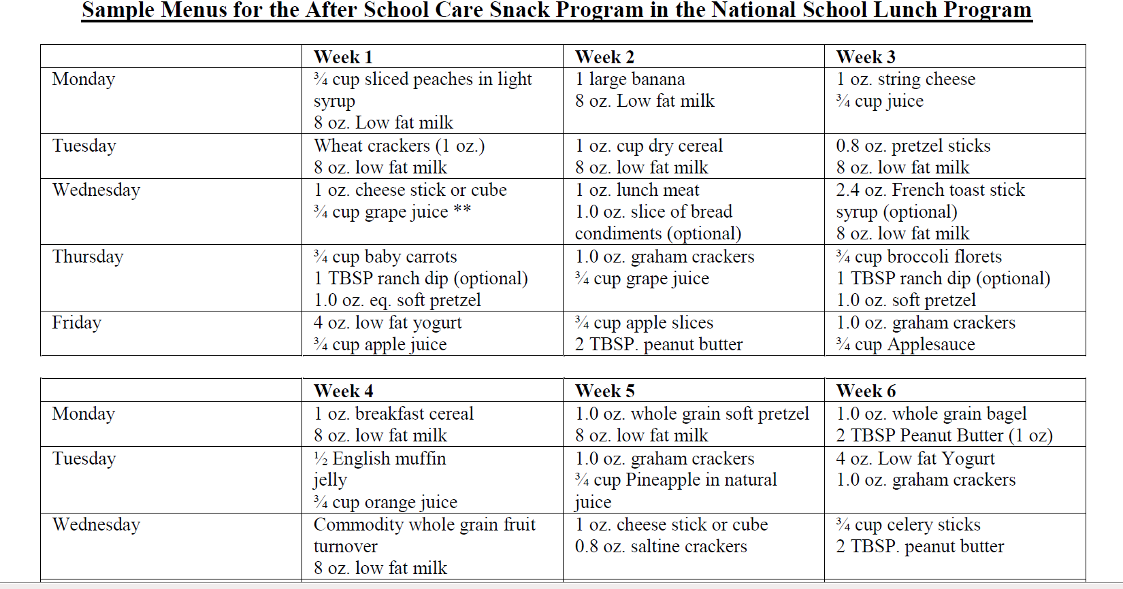
MENUS
Each menu must contain at least two credible components per day. To qualify for reimbursement, ASSP snacks must meet federal requirements. Afterschool snacks must include at least two servings of different foods from these four components: Fluid milk, meat/meat alternate, vegetable/fruit, and whole or enriched grain.

Slide 6
Select 2 of the 4 Food components from below

Slide 7
Example Food Items/Components
One item but contains two components
This item contains both a
grain and a meat alternate.

Slide 8
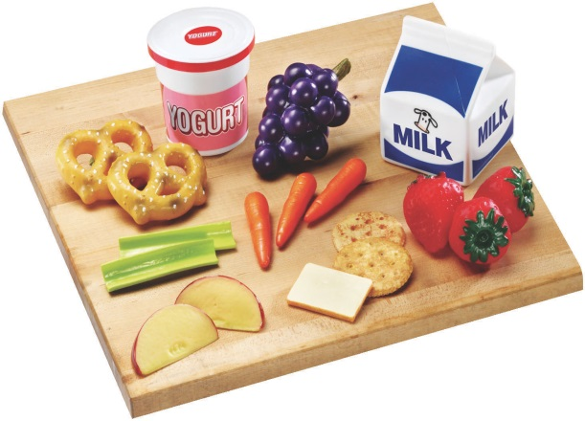
Healthy Snack Ideas
Baby carrots or other veggies with low fat ranch dressing
Grilled low-fat cheese sandwich on Whole Grain (WG) bread
Apples or bananas with peanut butter
Turkey and cheese on WG bread with tomato and lettuce
Fresh fruit with light mozzarella string cheese sticks
Yogurt with nuts and raisins
Low fat tortilla chips with salsa and shredded cheese
Hard boiled egg with a piece of fresh fruit
Beans, low fat cheese and salsa
Veggies with hummus
Notes:
½ cup carrots has almost 200% of Daily allowance of Vit A.

Slide 9
Detailed Claim Resources
NMPED Claims Tutorial for NSLP and SSO
https://sns.ped.state.nm.us/SNP/PDF/General%20Forms/NSLPClaimsTutorial.pdf
Claim for Reimbursement Submission & Deadlines
https://sns.ped.state.nm.us/SNP/PDF/General%20Forms/NewClaimsOverview4.pdf
To open links: right click and select open hyperlink to view on website.

Slide 10
COVID – 19 Afterschool Activity Waiver Opt in required
In an effort to minimize the potential exposure of the novel coronavirus (COVID-19), USDA has granted a nationwide waiver that grants states the flexibility to serve afterschool snacks and meals outside of a structured environment and without an educational or enrichment purpose. This waiver allows for the following child nutrition programs: National School Lunch Program, School Breakfast Program, Child and Adult Care Food Program, and Summer Food Service Program, to serve snacks and meals outside of the standard afterschool setting. These waivers are effective immediately, and remains in effect through June 30, 2020, or until expiration of the federally declared public health emergency, whichever is earlier.
https://www.fns.usda.gov/cn/covid-19-afterschool-activity-waiver

Slide 11
FOOD SAFETY
Should have Food Safety/Hazard Analysis Critical Control Point (HACCP) at each site to also include Standard Operating Procedures (SOP) for Snack Service
SOP should include regulatory procedures for:
Proper food preparation
Time and Temp Control
Proper Serving Techniques
Proper Storage/holding equipment/facilities

Slide 12
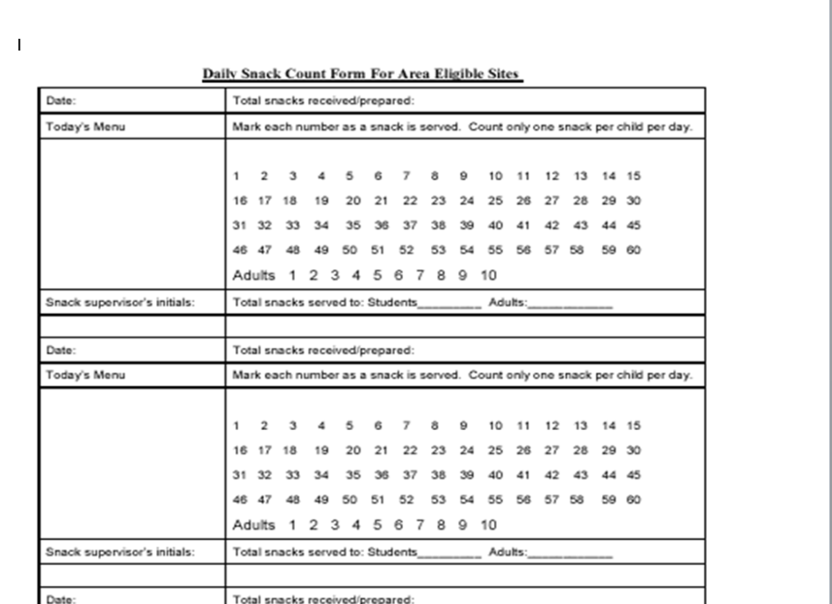
RECORDKEEPING
Provide accurate and daily Production Records
Provide accurate Daily Meal Counts (Claim no more than one snack per child per day)

Slide 13
AFTERSCHOOL SNACK PROGRAM (ASSP) PRODUCTION RECORD

Slide 14
Questions and Answers ?

Slide 15
THANK YOU
Angelica Ruelas Health Educator/
After School Snack Program Coordinator
(505)490-0494
Angelica Ruelas@state.nm.us

