Slide 1
Charter Schools Program (CSP) Distance Learning Grant
Subgrantee Monitoring February 2021
Investing for tomorrow, delivering today.
Notes:
To change the image on this slide, select the picture and delete it. Then click the Pictures icon in the placeholder to insert your own image.

Slide 2
CSP DISTANCE LEARNING GRANT
Elementary and Secondary Education Act (ESEA) § 4403
Federal waiver October 2020
Code of Federal Regulations: 2 CFR § 200.331(a)
OBMS fund code: 24146
Program period: 90-day pre-award period (90 days prior to date of notification) to end of FY21
Not entire FY as most federal grants
Limited by uniform guidance and terms of federal waiver

Slide 3
PROGRAM PERIOD
90 days prior to date of notification to end of FY21
Round 1 Subawards
Notified 12/16/20
Program period: 9/17/20—6/30/21
Round 2 Subawards
Notified 1/13/21
Program period: 10/15/20—6/30/21

Slide 4
BUDGET ADJUSTMENTS
Adjustments between budget line items will be approved provided proposed expenditures are allowable
To request a budget adjustment, make changes on the budget tab of the program application and email it to the program manager. If the changes are approved, submit a BAR in OBMS.

Slide 5
ALLOWABLE EXPENDITURES
Hardware
Software and licenses through the 2020-21 school year
Professional development associated with providing instruction by distance learning
Social work, educational counseling, and family engagement
Costs associated with returning to in-person or hybrid instruction after distance learning

Slide 6
QUARTERLY REPORTING
US Department of Education requires quarterly reporting on PED website to include:
Funds expended
Services provided
Students served
Remote instructional time
Student participation in remote classes
Student outcomes (when available)
Demonstration of progress in overcoming challenges in providing distance learning

Slide 7
QUARTERLY REPORTING
PED CSP staff will compile report based on RfRs submitted in OBMS and school reports submitted in Google Forms
School reports due:
Q3 1/1-3/31/21: due April 30, 2021
Q4 4/1-6/30/21: due July 31, 2021

Slide 8
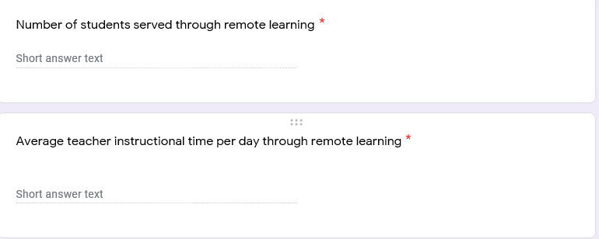
QUARTERLY REPORT GOOGLE FORM

Slide 9
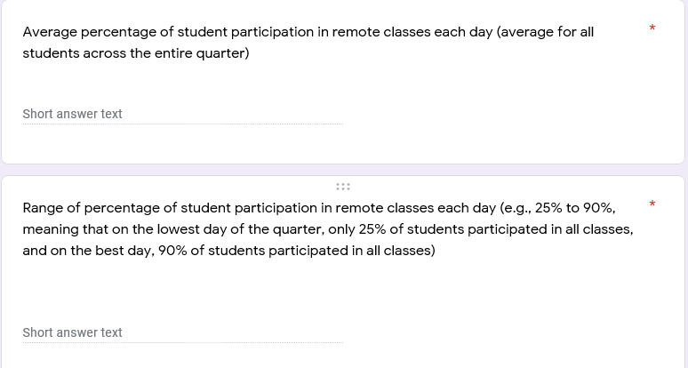
QUARTERLY REPORT GOOGLE FORM

Slide 10
QUARTERLY REPORT GOOGLE FORM

Slide 11
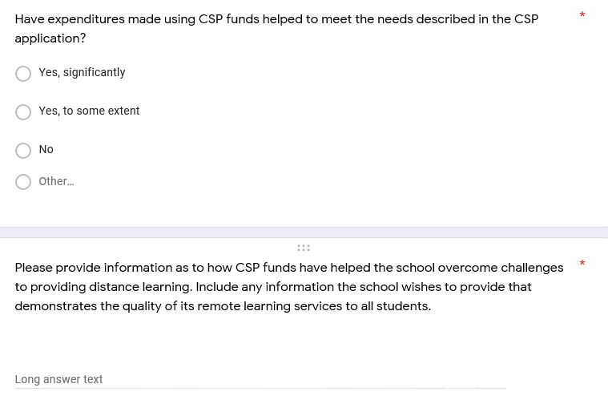
QUARTERLY REPORT GOOGLE FORM

Slide 12
QUARTERLY REPORT GOOGLE FORM

Slide 13
MONITORING
Desktop monitoring
Expenditures in OBMS
Quarterly submission through Google Form
Process for tracking grant-funded equipment
CSD annual site visit
No separate in CSP visit
Zoom follow-up if needed

Slide 14
GRANT-FUNDED EQUIPMENT
Hardware and equipment purchased with CSP funds must be logged and tracked.
Grant-funded equipment to be disposed of by way of sale, transfer, or scrapping requires prior approval in writing from the program manager.

Slide 15
TRACKING GRANT-FUNDED EQUIPMENT
Sample tracking spreadsheet
Schools may use tracking system of their choice

Slide 16
TECHNICAL ASSISTANCE
The CSP team is 100% grant-funded. Helping our subgrantees serve students is our job, and we are always happy to hear from you and to answer questions.
Program Manager:
Brigette Russell, Ph.D.
Brigette.Russell2@state.nm.us
Program Coordinator (Fiscal & Budget):
Valerie Cordova
Valerie.Cordova2@state.nm.us

Slide 17
Questions

