Slide 1
SPRING TRAINING 2021
COVID 19 MEAL SERVICE
WAIVERS UPDATE
Presented by: Dawn Garcia

Slide 2

WHAT IS A WAIVER?
Pursuant to section 2202(a) of the Families First Coronavirus Response Act (FFCRA, PL 116-127)
and in light of the exceptional circumstances of the novel coronavirus (COVID-19) public health
emergency, FNS is establishing a nationwide opt-in waiver to minimize the impact of school year
(SY) 2019-2020 COVID-19 related school closures on State Distributing Agencies’ SY 2020-2021
USDA Foods entitlement.
A waiver is an act of temporarily opting out of regular rules and regulations through a written statement.
To opt into waivers issued, SFA’s must have a current NMPED opt in form on file for SY20-21.
USDA has issued several waivers to exempt SFA’s from certain rules and regulations to operate meal
service in a safe manner during COVID-19.

Slide 3
MEAL SERVICE WAIVERS
There are 8 Meal Service Waivers
Area Eligibility
Meal Time Flexibility
Non-Congregate Feeding
Parent Pick up
Offer Versus Serve Flexibility
Meal Pattern Flexibility
Afterschool Snack Educational Activity
Fresh Fruit and Vegetable Program Parent Pick Up
For more information on NMPED waivers visit: https://www.fns.usda.gov/disaster/pandemic/covid-19/new-mexico
Notes:
This waiver for ASSP: grants states the flexibility to serve afterschool snacks and meals outside of a structured environment and without an educational or enrichment purpose.

Slide 4
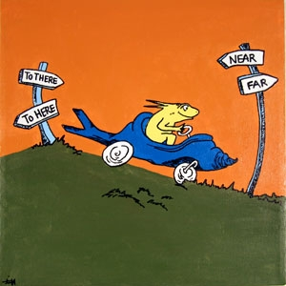
Area Eligibility
Facilitates the supplying of meals to all children in need.
This waiver does not need to be opted into.
All participating schools are automatically approved through NMPED during the COVID-19 health emergency.

Slide 5

Meal Time Flexibility
A school with an approved waiver for meal service times may establish times that support streamlined access to nutritious meals.
The waiver provides flexibility for both NSLP, SSO, and Afterschool Snack. Breakfast does not need to be served at or near the beginning of the school day. Flexibly is given to SFA’s to serve both breakfast and lunch at the same time and does not need to be served between the standard times of 10am and 2pm.
NMPED recommends multiple serving times to increase social distancing of students and minimizing spread of COVID-19 for those remote and hybrid students.
This waiver extends the Nationwide of meal service time restriction in the National School Lunch Program Seamless Summer Option – EXTENSION – granted on August 31, 2020 that expires on December 31, 2020 – through June 30, 2021. This extension does apply to the National School Lunch Program (NSLP), Seamless Summer Option (SSO) and the Afterschool Snack Program (ASSP).

Slide 6

Non-Congregate Feeding
Schools may provide non-congregate meals during COVID-19 related operations throughout the school year 2020-21.
This waiver is an extension of the Nationwide Waiver to Allow Non-congregate Feeding in Child Nutrition Programs and is effective July 1, 2020 through June 30, 2021. This extension does apply to the National School Lunch Program (NSLP), Seamless Summer Option (SSO), and Afterschool Snack Program (ASSP).
Children do not need to be served or consume the meal on the school campus.
Schools that have student’s attending via hybrid are strongly encouraged to have students eat all meals in the classroom.
All meals must be claimed under SSO, except for RCCI’s and those who
already received an exemption from NMPED Nutrition Director. RCCI’s will
continue to operate and claim as NSLP.

Slide 7
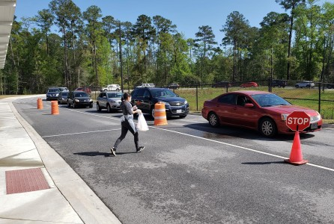
Parent Pick Up
Schools can allow non-congregate meal distribution during COVID-19.
Meals may be distributed to a parent or guardian to take home to their children.
Parents can pick up meals at a school site or at a bus stop.
Schools must have a plan to maintain accountability and program integrity.
Meals may be distributed to all children ages 1-18 including those children who DO NOT attend the school. Community children can get a meal from the nearest SFA.

Slide 8
Offer Versus Serve Flexibility
This waiver, waives the requirement for senior high schools (as defined by the State educational agency) to participate in Offer Versus Serve during school year 2020-2021.
"The Centers for Disease Control and Prevention has recommended that schools serve individually plated meals in classrooms instead of in a communal cafeteria. Schools attempting to adhere to this guidance may be unable to also effectively adhere to offer versus serve requirements."
OVS required in High Schools, but is now waived to reduce the spread of COVID-19.
This allows schools to provide food in a fast, and safe manner for students.
Allows schools to provide meals via grab n’ go, in the classroom or transferred and delivered on busses.

Slide 9

Meal Pattern Flexibility
Waives the requirements to serve meals that meet the meal pattern requirements during school year 2020-2021.
This waiver extends the Nationwide Waiver to Allow Meal Pattern Flexibility and support access to nutritious meals in the Child Nutrition Programs - Extension #8 that was granted on October 9, 2020 and remains in effect until June 30, 2021.
This waiver applies to the:
National School Lunch program (NSLP)
National School Lunch Program Seamless Summer Option (SSO)
Schools should do their best to follow the USDA meal pattern requirements unless it is not feasible. (Ex: certain meal components not available or substitutions made to meal patterns.)
You can claim breakfast or lunch meals for reimbursement that do not meet the meal pattern, as long as a waiver is submitted for each instance.

Slide 10
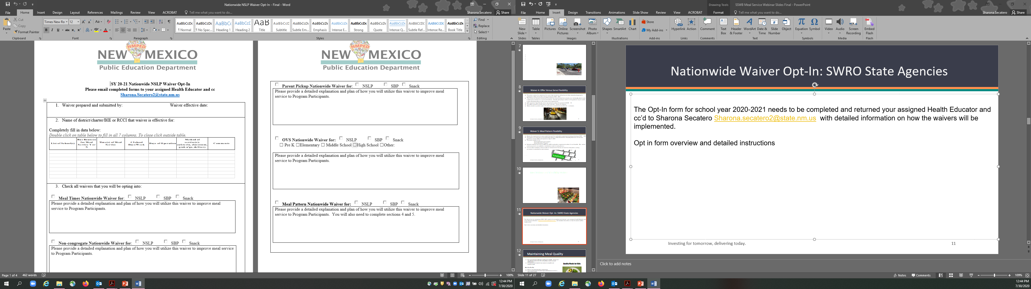
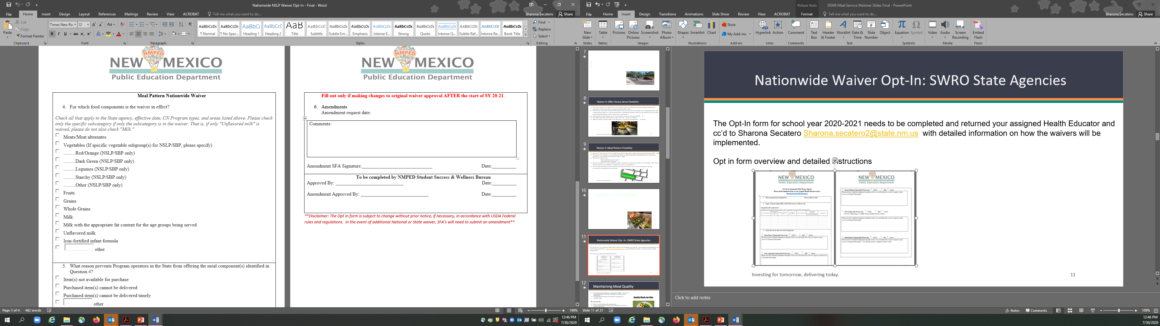
Nationwide Waiver Opt-In: SWRO State Agencies
The Opt-In form for school year 2020-2021 should already have been completed and returned your assigned Health Educator and cc’d to Sharona Secatero.
Health Educators will be reviewing Opt-In forms during Spring 2021 SSO Spot Checks to ensure all operating programs are accounted for.
Nationwide Waiver Opt-In: SWRO State Agencies

Slide 11


ADDITIONAL WAIVERS
After School Snack Program Waiver
Waives enrichment activity
Allows for Parent Pick Up or delivery
Fresh Fruit and Vegetable Parent Pick Up
Allows for Parent Pick Up or delivery

Slide 12

CONTACT INFORMATION
Dawn Garcia, BA
Health Educator
505.819.1876
dawn.garcia2@state.nm.us

