Slide 1
Preparing for your SSO Monitoring and Technical Assistance
Presenter: Sharona Secatero, MPA
staff manager
Student Success & Wellness Bureau(SSWB)
Spring 2021 Training

Slide 2
Administrative Reviews
Due to COVID-19, USDA has granted NMPED to Hold off on Administrative reviews for the 2020-2021 school Year.
**Only RCCI’s that are due will be scheduled to have a virtual review for Spring 2021.
NMPED proposed an alternative oversight plan that includes a 2 -year extension to their 3-year School Meals Administrative Review Cycle. This new 5-year cycle will provide the state additional time to conduct reviews.
Notes:
Currently, we have just started a new 3-yr cycle starting 2019-2021.

Slide 3
Alternative Plan For Spring 2021
In light of this Health Emergency, Food Nutrition Services (FNS) will waive program monitoring requirements for administrative reviews except for the RCCI’s that are due.
An alternative plan was approved by USDA which requires that NMPED offers SSO technical assistance to those SFA’s that are operating the Seamless Summer Option (SSO) by using the FNS SSO Administrative Review Forms. This oversight measure will help ensure program integrity of SFAs that are operating SSO this year.
NMPED will ensure SSO program oversight through technical assistance that is provided to SFAs, which will assist with operational challenges and ensure program compliance.

Slide 4
SSO Spring Monitoring and Technical Assistance
Your assigned Health Educator will begin scheduling your SSO Monitoring and Technical Assistance this month February 2021.
A monthly phone call or email will be completed every month beginning February 2021.
This will ensure that current email addresses are updated and communication is open between SSWB and SFA’s.
If you need any assistance, our staff will be able to assist you and provide any additional support and technical assistance while operating as SSO.

Slide 5
Monitoring of SSO
For Spring 2021, you will need to send your Health Educator the following for ensure program integrity and compliance for SSO.
Picture of current Civil Rights poster
Completed SFA SSO Monitoring Form
Professional Standards tracker for staff
Temperature logs
Current food safety health inspection report
Video or pictures of meal service
Meal counting and claiming documentation
Edit checks and production records
Update and review of NMPED Waiver Opt in form.
Review of meal service dates/times for the NM.GOV meal website https://www.newmexico.gov/education/meal-sites-for-children/
Notes:
The goal of food safety is to lessen the chance of someone getting sick from eating contaminated food.
A HACCP food safety plan is a written guide outlining what you do to lessen the chance of food contamination and illness.
Maintaining Logs for:
Refrigerator & Freezer Temperature
Cooking and Reheat Temps
Cooling Temps
Thermometer Calibration Log
Food safety checklist
Maintaining storage – dates on dry goods

Slide 6
Production Records
Federal Regulation (7 CFR Section 10.10(a)(3)) stipulates that “Schools must keep production and menu records for the meals they produce. These records must show how the meals contribute to the required food components, food items or menu items every day.”
It must be completed daily and show food planned, food prepared, and food served.
It supports your claim for reimbursement and helps you forecast for future planned meals and can be used to order food and control food waste.
Must be kept for 3 years.
Production records are required for NSLP, SBP, ASSP, FFVP.

Slide 7
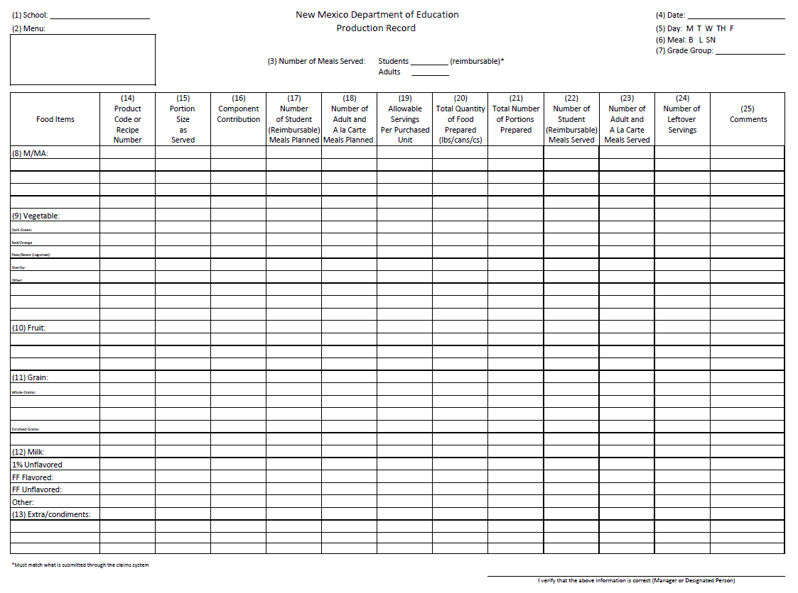

Slide 8
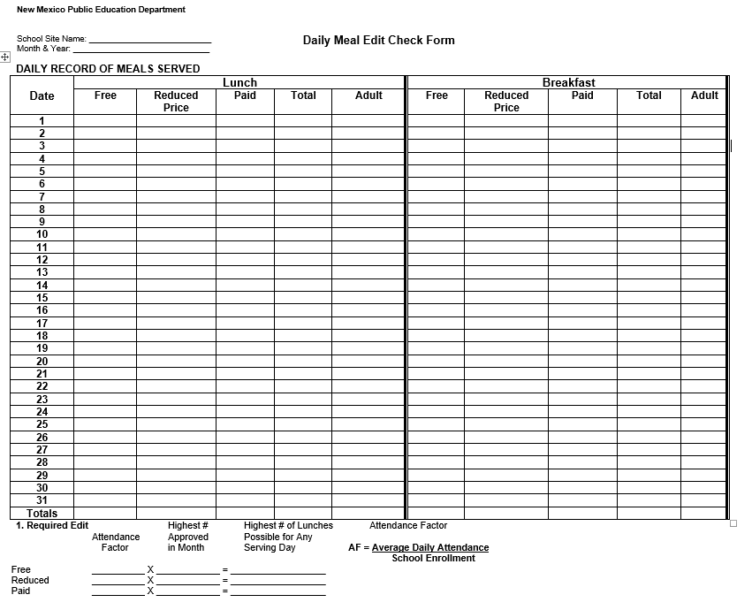
Edit Checks
Regulations require schools to complete a daily edit check for each of its schools prior to consolidation of the daily lunch counts for the monthly claim. The purpose of the edit check is to identify errors in the schools’ lunch counts and/or problems with the meal counting and claiming procedures so that necessary corrections are made.
To obtain your Attendance Factor (AF):
AF = Average Daily Attendance
School Enrollment

Slide 9
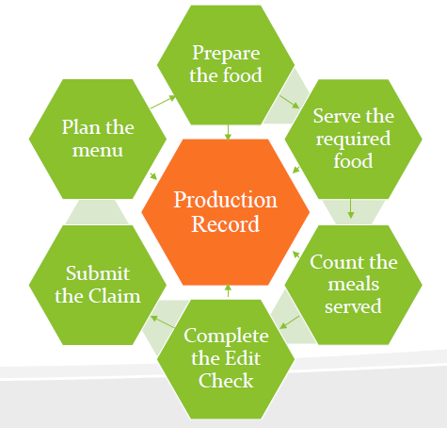
Production Records – at the core of a successful Child Nutrition Program!
Notes:
Going back it starts with the menu planning, ensuring meal pattern requirements are met. Entering your planned menu in your production record, preparing the food, recording it, serving it, recording that and counting the meals served and entering the meals in the edit check form before submitting your SFAs claim.

Slide 10
General Areas – Civil Rights
Green “And Justice for All” poster 11x17
Non-Discrimination Statement (long & short)
Public Release
Menus (short statement)
Civil Rights Training Yearly
Civil Rights Policy & Compliant Procedures

Slide 11
Professional Standards: Tracking Training Hours
All Directors – Each year: at least 12 hours of annual continuing education/training in addition to the food safety training required in the first year of employment.
All Managers - Each year: at least 10 hours of annual continuing education/training.
All Other Staff - Each year: at least 6 hours of annual continuing education/training.
Part-Time Staff - Each year: at least 4 hours of annual continuing education/training, regardless of the number of part-time hours worked.

Slide 12
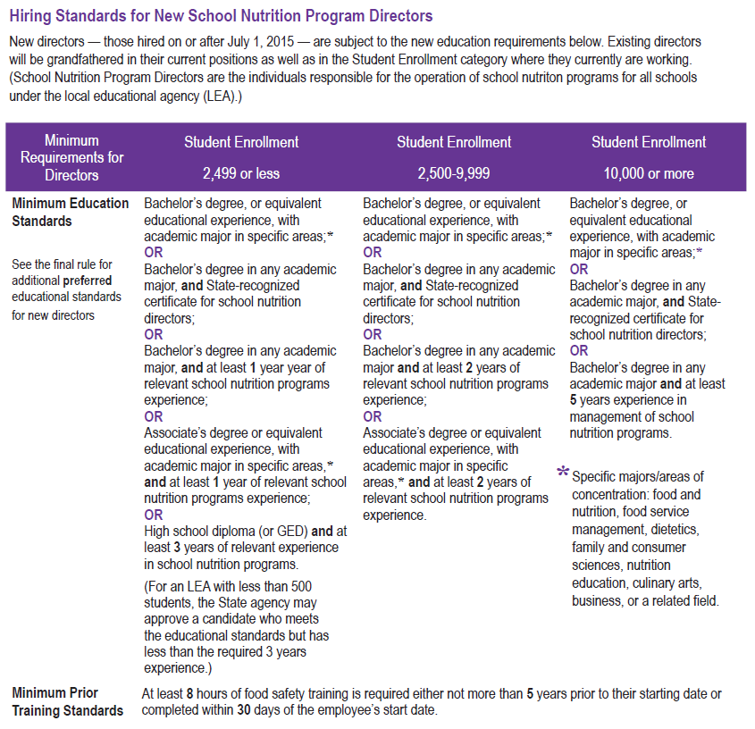
UPDATE!
2,499 OR LESS
Old - School Nutrition Required
Any relevant food service experience
New – State Agency has the discretion to approve the hiring of an applicant with volunteer or unpaid relevant food service experience on an individual basis.
FEWER THAN 500 STUDENTS
Providing SA with the discretion to approve the hiring of a school food service experience, provided that the applicant has the minimum education to satisfy the hiring standards for LEAs with 2,499 students or fewer.

Slide 13
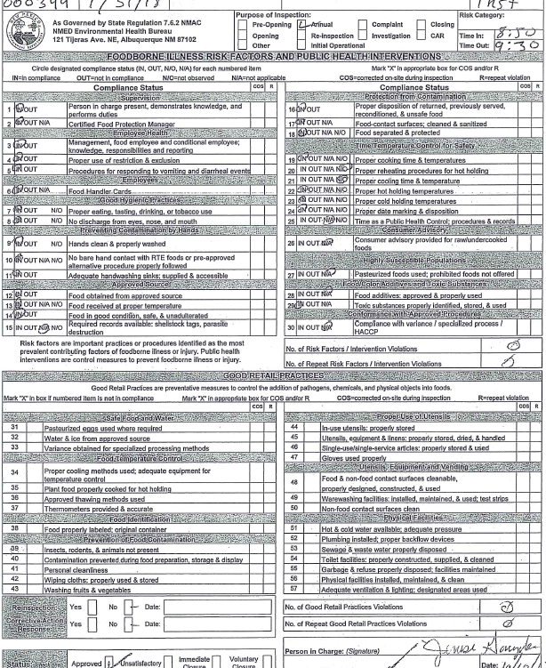
Food Safety Inspection Report
Have 2 Food Safety Inspection Reports
Documentations for request of 2nd Food Safety Inspection

Slide 14
Recordkeeping
SFAs must maintain all program records for a period of three (3) years after submission of the final claim for reimbursement for the fiscal year.
Documents to be kept on file but not limited to (agreements and free and reduced-price policy statements; approved and denied free and reduced-price meal applications; procedures and documentation for direct certification for free meals, if applicable; procedures for alternate point of service, meal counts, if applicable; verification records; Claims, menu and food production records, local wellness policy, temperature logs, civil rights compliance, SBP/Summer Food outreach)

Slide 15
Thank you!
Thank you for feeding the children of New Mexico!

