Slide 1
Student Success and Wellness Bureau
By:
Felix Griego, Deputy Director, MBA

Slide 2
Overview
Verification
742 Verification Report Data Elements
742 Submission Demonstration
P-EBT
Updates

Slide 3
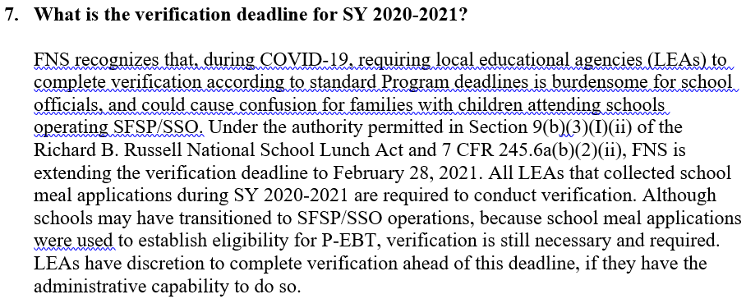
USDA FNS New Guidance
SP 04-2021, CACFP 03-2021, SFSP 03-2021:
Questions and Answers Relating to the Nationwide Waiver to Allow Summer Food Service Program and Seamless Summer Option Operations during School Year 2020-2021 – Q&As

Slide 4
FNS 742 Verification Report What is the FNS 742 Report?
Annual Verification Report that is required by USDA to be filled out by all School Food Authorities operating under the NSLP
Provides results of the verification process within a Districts Certification and Application for free/reduced price meal benefits in the National School Lunch Program for their students
July 1-October 1 Snapshot data of current school year.
Verification of applications needs to be done by February 28, 2021 of applications collected from July 1-October 1, 2017.
Submitted by PED SSWB to USDA on March 15 of that current school year. We are waiting for the final day due to extensions given

Slide 5
742 Verification Process
Important Things to Know:
All SFA’s have to fill out the FNS 742 Verification Report
CEP, Provision 2 Non-base year, RCCI’s fill out SFA’s information along with Section 1 & 2 only, they are Not Required to complete any thing else other then check Box (3-1) and Box (5-1).
Standard and Provision 2 Base Year SFA’s are REQUIRED to fill out all sections 1-5.
Verification Process should be done by ALL SFA’s by February 28, 2021 (NEW).

Slide 6
Important Things to Know Continued:
Section 5 is where you report the actual verification findings of applications from July 1-October 1.
You must ONLY select “Standard” sample size verification process (Section 5-3.1) unless,
Qualifies and is considering one of the “Alternate” sample size methods one or two, you must meet the qualification and REQUIRES a formal request and state approval.
SFA’s must utilize and submit the NEW FNS 742 Template provided to Vincent Baca at Vincent.Baca@state.nm.us
Note: SFA’s are required to submit by email the completed Excel Spreadsheet (No other format is accepted) of the NM PED FNS 742 Reporting Template to Student Success and Wellness Bureau (SSWB) with no errors.

Slide 7
Filling out the Verification Report Section 1:
Section 1 is related to all general SFA information like total school sites and total enrollment.
A- Refers to total number of schools/sites
B- Refers to total number of students
Note: Depending on entered data some areas will auto fill

Slide 8
Section 2:
This section is for SFA’s operating alternate provisions (Provision 2 and CEP).
2-2aB, 2-2bB –Multiply the most recent base year free and reduced percentage times current enrollment.
(Average of schools free %) X (total students at sites) = Number of Students
2-4 and 2-5 are not applicable for most SFA’s in NM.
NOTE: NO SFA’s can establish P2 base years this year.

Slide 9
Section 3:
3-2B: Standard and Provision 2 base year school sites only report students in this section.
Report SNAP students as of the last operating day in October 2021 along with any extended eligibility SNAP students

Slide 10
Section 4
ONLY SFA’s that are collecting applications from students (Provision 2 base year and Standard Schools) report in this field.
All CEP and Provision 2 Non-Base Year do NOT report in this field but would rather enter zero’s for section 4.
For T-1 and T-2 will auto fill depending on your free and reduced data that is entered.

Slide 11
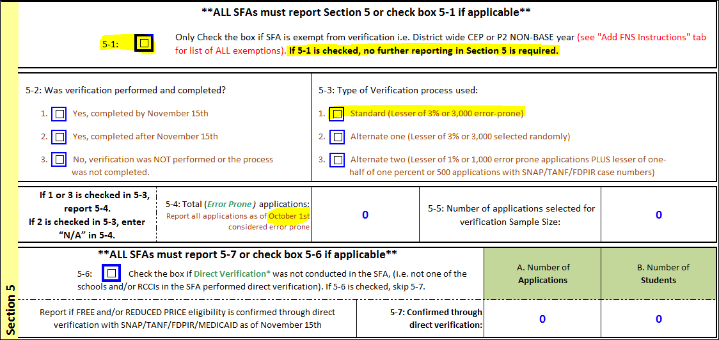
Section 5 ( Conduct Verification Process)
All CEP and Provision 2 non-base year SFA’s are exempt from section 5 and should check 5-1.
All SFA’s should select option 5-3.1 standard verification method which you will verify 3% of free and reduced applications only collected July 1-October 1 .
If you wish to select other methods of verification State approval is needed.
Verification is using records (Letter Method) from a public agencies to verify income and/or program participation [Not Direct Certification]

Slide 12
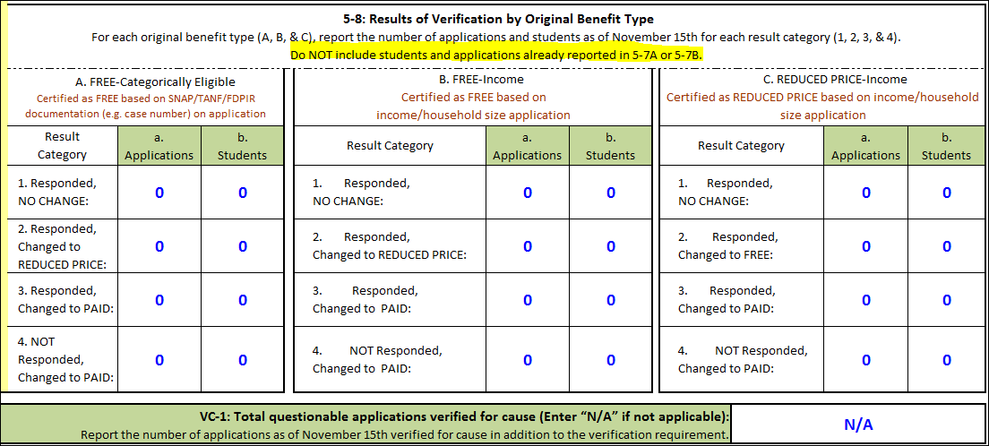
Section 5 Continued…….
The SFA will report its verification finding in section 5-8.
VC-1: Applications that were verified for “cause” in addition to the selected applications (most SFA’s will enter N/A)

Slide 13
Submitting the NEW 742 Template
You will need to submit the completed FNS 742 template Vincent Baca of the SSWB no later than February 28, 2021.
Without errors flagged

Slide 14
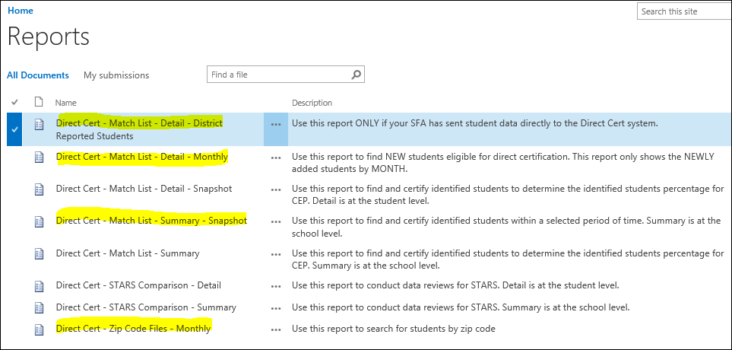
Direct Certification System and Reports Available
URL: https://eui.ped.state.nm.us/sites/DirectCert/default.aspx

Slide 15
P-EBT: Who, What, Why, Where, When
Who?
Partnership of USDA, PED, and Human Service Department to Issue the Pandemic Electronic Benefits(PEBT) to Students and Families.
Qualified Free and Reduced Students that participate in the NSLP for SY 20-21 for remote/virtual school days only.
What?
Issue P-EBT Similar to Debit Card to purchase food at P-EBT SNAP participating Stores.
Issue $6.82(NEW) per qualified remote/virtual day
Why?
Federal funded program under USDA FNS to supplement the breakfast, lunch, snack(NEW) meals that students would normally get in school.

Slide 16
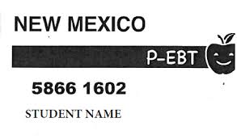
P-EBT: Who, What, Why, Where, When Continued…..
Where?
PEBT cards are mailed to the address provided to the PED in the name of the oldest qualified student in the household.
Students and families can purchase food at any participating SNAP stores.
When?
Began when Covid-19 school closures begun
PEBT Issuances began in May and will continue until June 30, 2021.
Will occur every 2 months
Next benefits will be staggered

Slide 17
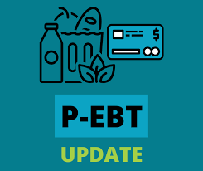
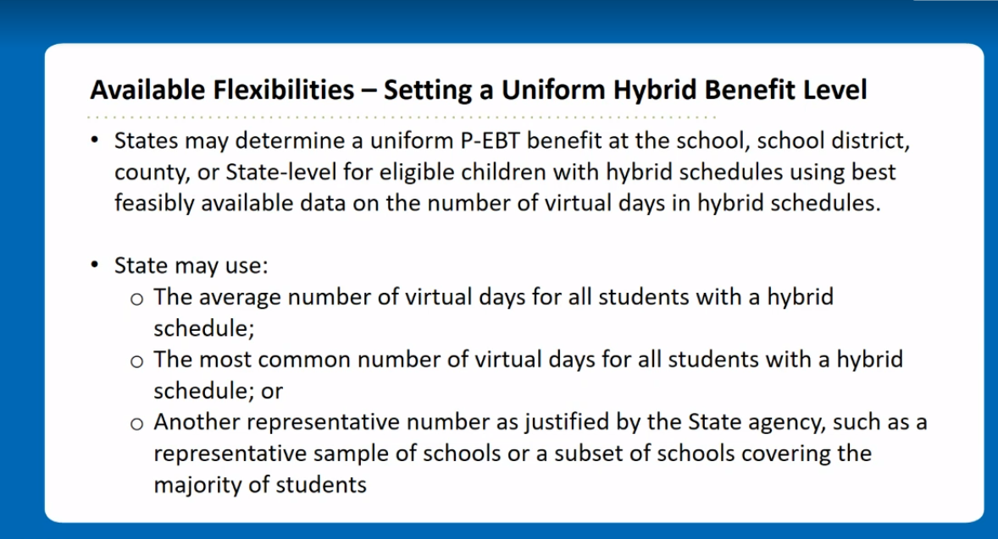
New Guidance P-EBT
Increase Funding
Increase daily amount $5.86-$6.82
Increase Flexibilities
Newest SP Memo SP05_CACFP04_SFSP04s Q and A #4 for Nationwide waiver to allow SSO SFSP through SY 2020-21 (002)

Slide 18
Process of Issuing PEBT
Federal Government Issues Funds
The PED Gets Approved Plan by USDA FNS
SFA’s Submit data to PED
PED sends data to HSD
HSD/Contractors Issue the P-EBT to the Students

Slide 19
Importance of Student Data
Validating and Verifying Data per USDA regulations and guidance
Collaborate with Staff submitting data to the PED
Collection of Applications for Families
Current, Vetted and Correct data
Student Address (Address Changes Yes NM)
Correct Parent Guardian Data
Collection of learning Models from Admin. Staff

Slide 20
Latest Update and Issuance
October and November Issuances will be sent on February 27, 2021
New Mexico Plan Approved through June 30, 2020.
Only issue P-EBT for students on remote days\
Superintendents notify PED Deputy Secretary’s on qualified remote days.
Next Phases of P-EBT issuance (utilize STARS reporting periods)
Send Benefits 2 month timeframe
Patience with Please

Slide 21
Resources
HSD P-EBT Website: https://www.hsd.state.nm.us/LookingForAssistance/p-ebt.aspx
PED Website: http://webnew.ped.state.nm.us/bureaus/student-success-wellness/
Yes NM Website(Check benefit or change address): https://www.yes.state.nm.us/yesnm/pandemic/pebt?execution=e1s1
USDA Website: https://www.fns.usda.gov/snap/state-guidance-coronavirus-pandemic-ebt-pebt
PED/HSD Hotline Number- 1-833-415-0569
Request a new Card: 1-800-843-8303

Slide 22
Questions
Felix Griego, Deputy Director, MBA
Email: felix.griego@state.nm.us

