Slide 1
SY 21-22 Kick off with SSO Webinar
COVID 19 MEAL SERVICE
WAIVERS UPDATE
Presented by: Dawn Garcia, Health Educator

Slide 2

WHAT IS A WAIVER?
A waiver is an act of temporarily opting out of regular rules and regulations through a written statement.
Pursuant to section 2202(a) of the Families First Coronavirus Response Act (FFCRA, PL 116-127)
and in light of the exceptional circumstances of the novel coronavirus (COVID-19) public health
emergency, FNS has re-established many of the nationwide waivers for (SY) 2021-2022 due to COVID-19.
To opt into waivers issued, SFA’s must have a current NMPED opt in form on file for SY 2021-2022.
USDA has issued several waivers to exempt SFA’s from certain rules and regulations to operate meal
service in a safe manner during COVID-19.
**Please keep in mind that if you are planning on doing traditional meal service,
and plan not to utilize any waivers, you may opt-out of the flexibilities.

Slide 3
MEAL SERVICE WAIVERS
There are 8 Meal Service Waivers:
Area Eligibility
Meal Time Flexibility
Non-Congregate Feeding
Parent Pick up
Offer Versus Serve Flexibility
Meal Pattern Flexibility
Afterschool Snack Educational Activity
Fresh Fruit and Vegetable Program Parent Pick Up
For more information on NMPED waivers visit: https://www.fns.usda.gov/disaster/pandemic/covid-19/new-mexico
Notes:
This waiver for ASSP: grants states the flexibility to serve afterschool snacks and meals outside of a structured environment and without an educational or enrichment purpose.

Slide 4
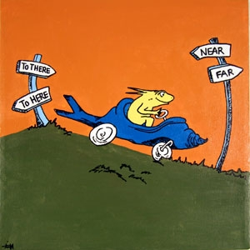
Area Eligibility
Facilitates the supplying of meals to all children in need.
This waiver does not need to be opted into.
All participating schools are automatically approved through NMPED during the COVID-19 health emergency.

Slide 5

Meal Time Flexibility
A school with an approved waiver for meal service times may establish times that support streamlined access to nutritious meals.
The waiver provides flexibility for both NSLP, SSO, and Afterschool Snack. Breakfast does not need to be served at or near the beginning of the school day. Flexibility is given to SFA’s to serve both breakfast and lunch at the same time and does not need to be served between the standard times of 10am and 2pm.
NMPED recommends multiple serving times to increase social distancing of students and minimizing spread of COVID-19 for those remote, online and hybrid students.
This Nationwide meal service time restriction in the National School Lunch Program Seamless Summer Option effective July 1, 2021 – through June 30, 2022. This does apply to the National School Lunch Program (NSLP), Seamless Summer Option (SSO) and the Afterschool Snack Program (ASSP).

Slide 6

Non-Congregate Feeding
Schools may provide non-congregate meals during COVID-19 related operations throughout the school year 2021-22.
The Nationwide Waiver allows non-congregate feeding in Child Nutrition Programs and is effective July 1, 2021 through June 30, 2022. This applies to the National School Lunch Program (NSLP), Seamless Summer Option (SSO), and Afterschool Snack Program (ASSP).
Children do not need to be served or consume the meal on the school campus if you are doing Grab n’ go meals.
Schools that have student’s attending via hybrid are strongly encouraged to have students eat all meals in the classroom.
Breakfast and Lunch must be claimed under SSO. If you are doing snack, this must be claimed as NSLP. In this case of doing all 3 meals, you will have 2 separate monthly claims to submit.

Slide 7
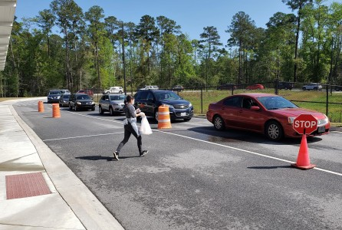
Parent Pick Up
Schools can allow non-congregate meal distribution during COVID-19.
Meals may be distributed to a parent or guardian to take home to their children if they are remote, online or hybrid students. If the SFA is an open SSO site and offering meals to the community for children ages 1-18 years of age, they can provide Grab n Go sites.
Parents can pick up meals at a school site or at a bus stop.
Schools must have a plan to maintain accountability and program integrity.
Under SSO, meals may be distributed to all children
ages 1-18 including those children who DO NOT attend
the school. Community children can get a meal from the
nearest SFA SSO open site.

Slide 8
Offer Versus Serve Flexibility
This waiver, waives the requirement for senior high schools (as defined by the State educational agency) to participate in Offer Versus Serve during school year 2021-2022.
OVS is required in High Schools, but is now waived to reduce the spread of COVID-19.
This allows schools to provide food in a fast, and safe manner for students.
Allows schools to provide meals via grab n’ go, in the classroom or transferred and delivered on busses.

Slide 9

Meal Pattern Flexibility
Waives the requirements to serve meals that meet the meal pattern requirements during school year 2021-2022.
This waiver extends the Nationwide Waiver to Allow Meal Pattern Flexibility and support access to nutritious meals in the Child Nutrition Programs - July 1, 2021 through June 30, 2022
This waiver applies to the:
National School Lunch program (NSLP)
National School Lunch Program Seamless Summer Option (SSO)
Schools should do their best to follow the USDA meal pattern requirements unless it is not feasible. (Ex: certain meal components not available or substitutions made to meal patterns.)
You can claim breakfast or lunch meals for reimbursement that do
not meet the meal pattern, as long as a waiver is submitted for
each instance and is on file with NMPED SSWB.

Slide 10
Nationwide Waiver Opt-In: SWRO State Agencies
The Opt-In form for school year 2021-2022 needs to be completed and returned to your assigned Health Educator by August 21, 2021.
If an SFA will be utilizing the traditional cafeteria service, a completed opt in form is not needed, but the opt out box must be selected.
Any SFA without the required opt in forms on file will have their claims put on hold until received.

Slide 11
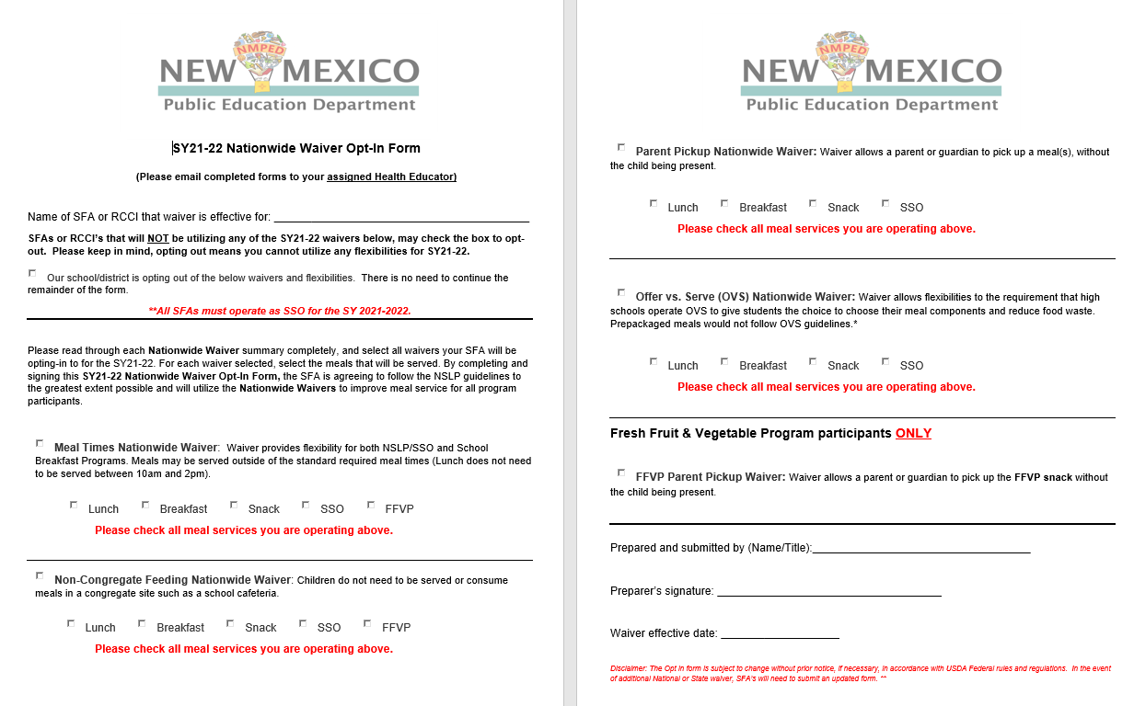
Nationwide Waiver Opt-In: SWRO State Agencies

Slide 12
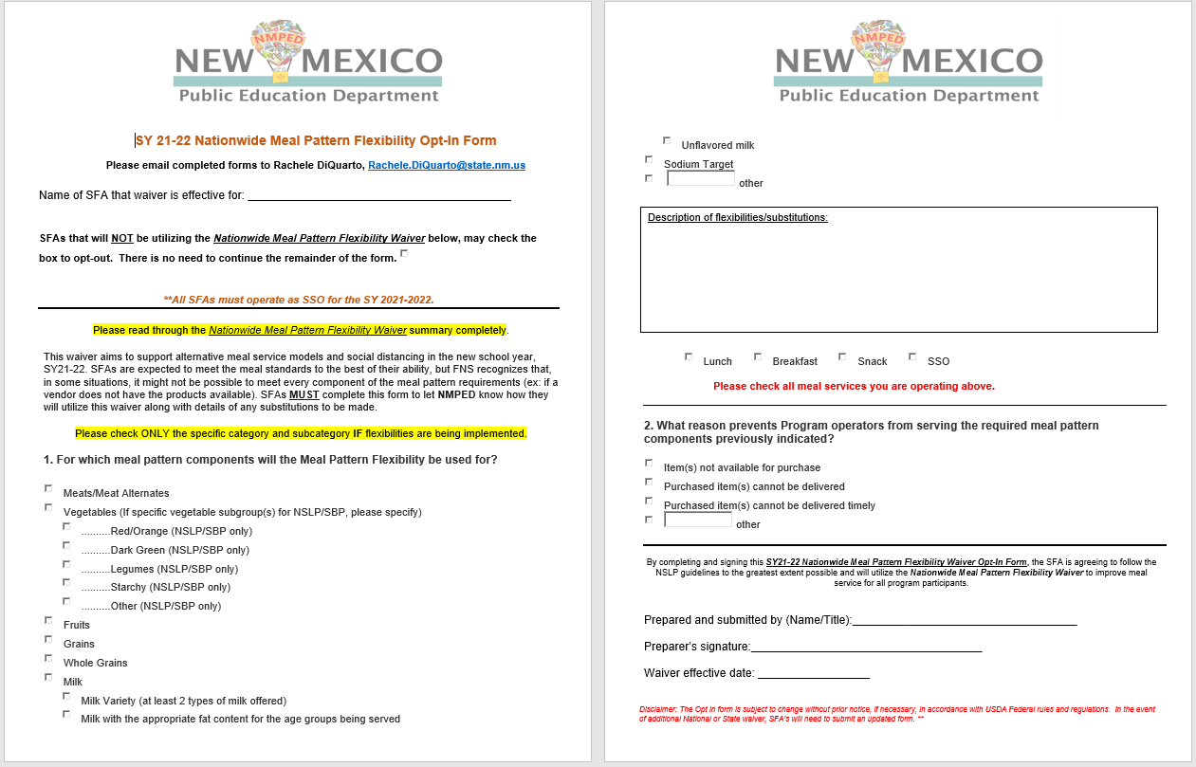
Nationwide Meal Pattern Flexibility Waiver Opt-In

Slide 13


ADDITIONAL WAIVERS
After School Snack Program Waiver
Waives enrichment activity
Allows for Parent Pick Up or delivery
Fresh Fruit and Vegetable Parent Pick Up
Allows for Parent Pick Up or delivery

Slide 14

CONTACT INFORMATION
Dawn Garcia, BA
Health Educator
505.819.1876
dawn.garcia2@state.nm.us

