Slide 1
Stakeholder Engagement – Students with Disabilities under IDEA B
Parent Input Meetings
April 15, 2021
10:00 a.m. and 6:00 p.m.
Investing for tomorrow, delivering today.
Notes:
To change the image on this slide, select the picture and delete it. Then click the Pictures icon in the placeholder to insert your own image.

Slide 2
Today’s Meeting Objectives
Overview of the State Performance Plan (SPP)/Annual Performance (APR) required by the Individuals with Disabilities Education Act (IDEA)-Part B
Review data available for Indicators 1 to 16
Parent input on each Indicator including:
Data Analysis
Target Setting
Evaluating Progress
Improvement Strategies

Slide 3
Stakeholder Engagement
Focused Stakeholder Groups
6 Groups reviewed 11 different target indicators
Required Stakeholders
Parents
PED Acceptance of Baselines and Targets
All information gathered at Focused and Required Stakeholder Meetings will be shared
Provided recommendations for baselines and targets for 11 indicators
Tribes
All information gathered at Focused Stakeholder Meetings will be shared
Will provide recommendations on all targets
Will accept, ratify and establish baselines and targets for each indicator
IDEA Panel

Slide 4
Housekeeping
Meeting Norms
Everyone has valuable information to provide
Raise your hand via Zoom
Leah Johnson will acknowledge those with raised hands
Lower hand

Slide 5
Housekeeping
Meeting Norms
Sign in and Input
See chat box for link https://forms.gle/48r8aV3TgwHePvZ3A
Chat box available for questions
Moderated by Leah Johnson
Jamboard available for feedback
Moderated by Matthew Kump
Notes taken by Crystal Vigil

Slide 6
Jamboard
Matthew Kump

Slide 7
Introduction to the State Performance Plan (SPP)/Annual Performance Report (APR)

Slide 8
Individuals with Disabilities Education Act – Part B
A student that 1.Has a disability and 2.The need for specialized instruction
Disability Categories:
Gifted Services are a New Mexico rule and gifted students are not counted in any of the data reported to the Office of Special Education Programs (OSEP)
- Intellectual Disability
- Hearing Impairment
- Speech or Language Impairment
- Visual Impairment
- Emotional Disturbance
- Orthopedic Impairment
- Development Delayed (To age 8)
- Autism
- Traumatic Brain Injury
- Other Heath Impairment
- Specific Learning Disability
- Deaf-Blindness
- Multiple Disabilities

Slide 9
Overview of the State Performance Plan (SPP)/ Annual Performance Report (APR)
States receiving funds from the U.S. Department of Education, to implement the Individuals with Disabilities Education Act (IDEA) must develop a State Performance Plan (SPP)
The SPP describes State efforts to meet the requirements and purposes of IDEA, Part B
States must report on the performance of the SPP through the Annual Performance Report (APR)
Completing the SPP and APR relies on the collection and use of a variety of data

Slide 10
IDEA B Indicators Reporting in the SPP/APR
2 Types of Indicators – Compliance and Target Indicators
Indicators up to FFY2019:
Compliance Indicators |  | Target Indicators
Indicator 4B | Suspension/Expulsion | Indicator 1 | Graduation | Indicator 8 | Parent Involvement
Indicator 9 | Disproportionate Representation | Indicator 2 | Drop out | Indicator 14 | Post-School Outcomes
Indicator 10 | Disproportionate Representation | Indicator 3B & 3C | Assessment Participation & Outcomes | Indicator 15 | Resolution Sessions
Indicator 11 | Child Find/60 Day Timeline | Indicator 4A | Suspension/Expulsion | Indicator 16 | Mediation
Indicator 12 | Part C to B Transition | Indicator 5 | Education Environments
Indicator 13 | Secondary Transition | Indicator 6 | Preschool Education Environments
 |  | Indicator 7 | Preschool Outcomes

Slide 11
Key Terminology
Baseline: The number that is the starting point, the minimum rate.
Target: The rate the State must meet.
State Rate/State Data: All data from all school districts combined to make the State Rate/State Data.
Measurement: The measurement method that the OSEP has identified.

Slide 12
Target Indicators

Slide 13
Graduation Rates (Indicator 1)
Youth with IEPs (ages 14-21) that graduated with a regular high school diploma

Slide 14
Graduation Parent Input
Analyzing Data
Target Setting
Evaluating Progress
Improvement Strategies
Decisions to be made:
What should the baseline be?
What should the targets be?
Should the targets increase each year?
If Yes, by how much?
How will changing the measurement (no 4 year adjusted cohort rates) impact the rates?
Will the COVID-19 pandemic impact graduation rates?

Slide 15
Drop out Rates (Indicator 2)
Number of youth with IEPs (ages 14-21) who exited special education due to dropping out

Slide 16
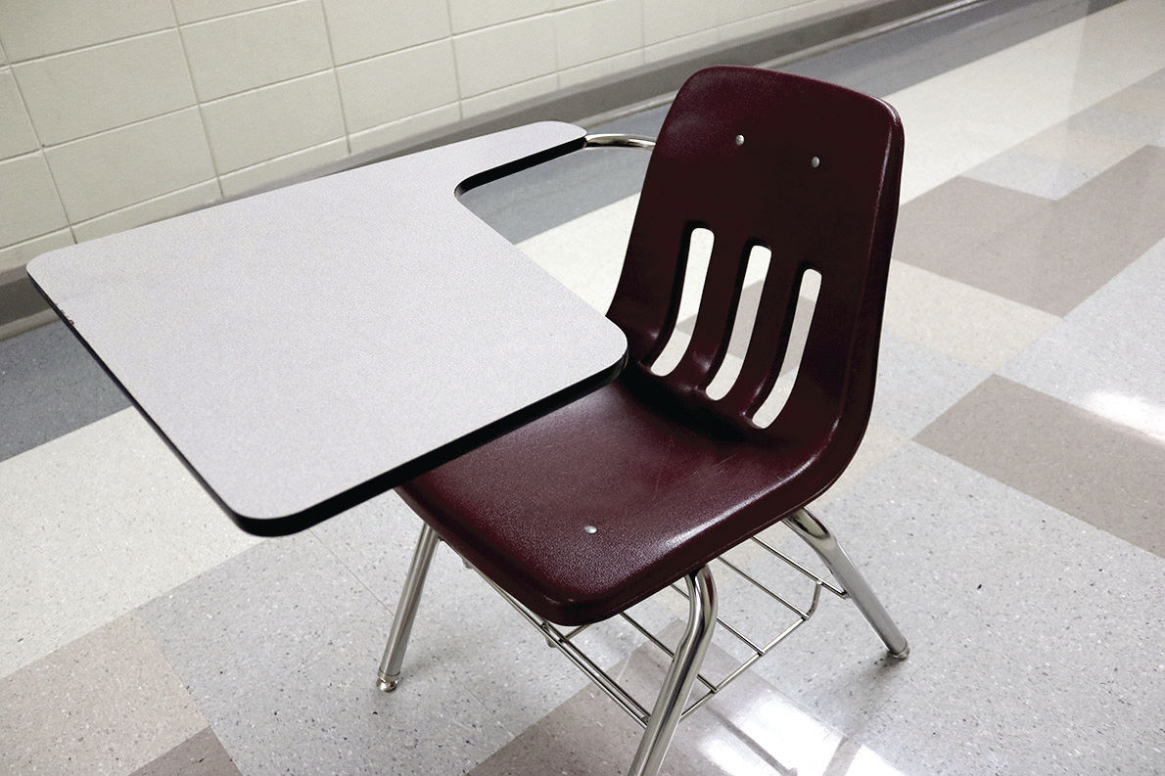
Drop out Parent Input
Analyzing Data
Target Setting
Evaluating Progress
Improvement Strategies
Decisions to be made:
What should the baseline be?
What should the targets be?
Should the targets increase each year?
If Yes, by how much?
Will the COVID-19 pandemic impact drop out rates?

Slide 17
Statewide Assessment (Indicator 3)
Participation and performance of children with IEPs on statewide assessments:
Participation rate for children with IEPs.
Proficiency rate for children with IEPs against grade level academic achievement standards.
Proficiency rate for children with IEPs against alternate academic achievement standards.
Gap in proficiency rates for children with IEPs and all students against grade level academic achievement standards.

Slide 18
State Assessment Participation Rate (Indicator 3A)

Slide 19
State Assessment Reading Proficiency Rate (Indicator 3B)

Slide 20
Assessment Parent Input
Analyzing Data
Target Setting
Evaluating Progress
Improvement Strategies
Decisions to be made:
What should the baseline be for A, B , C and D?
By grade 4, 8 and High School
What should the targets be for A, B , C and D?
By grade 4, 8 and High School
Should the targets increase each year?
If Yes, by how much?
Will the COVID-19 pandemic impact assessment rates?

Slide 21
Suspension/Expulsion Rates (Indicator 4A)
Percent of districts that have a significant discrepancy in the rate of suspensions and expulsions of greater than 10 days in a school year for children with IEPs.

Slide 22
Suspension/Expulsion Parent Input
Analyzing Data
Target Setting
Evaluating Progress
Improvement Strategies
Decisions to be made:
What should the baseline be?
What should the targets be?
Should the targets increase each year?
If Yes, by how much?
Will the COVID-19 pandemic impact suspension/expulsion rates?

Slide 23
Learning Environments –Ages 5 to 21 (Indicator 5)
5. Percent of children with IEPs aged 5 (and in Kindergarten) through 21 served:
A. Inside the regular class 80% or more of the day;
B. Inside the regular class less than 40% of the day; and
C. In separate schools, residential facilities, or homebound/hospital placements.

Slide 24
Indicator 5A

Slide 25
Indicator 5B

Slide 26
Indicator 5C

Slide 27
Learning Environments Ages 5 to 21 Parent Input
Analyzing Data
Target Setting
Evaluating Progress
Improvement Strategies
Decisions to be made:
What should the baseline be for A, B and C?
What should the targets be for A, B and C?
Should the targets increase each year?
If Yes, by how much?
How will including 5 year old students in kindergarten impact each category?
Will the COVID-19 pandemic impact learning environment rates?

Slide 28
10 Minute Break
Please fill out the Sign In/Feedback Sheet

Slide 29
Learning Environments – Ages 3 to 5 (Indicator 6)
6. Percent of children with IEPs aged 3, 4, and aged 5 who are enrolled in a preschool program attending a:
Regular early childhood program and receiving the majority of special education and related services in the regular early childhood program; and
Separate special education class, separate school or residential facility.
Receiving special education and related services in the home.

Slide 30
Indicator 6A

Slide 31
Indicator 6B

Slide 32
Learning Environments Ages 3 to 5 Parent Input
Analyzing Data
Target Setting
Evaluating Progress
Improvement Strategies
Decisions to be made:
What should the baseline be for A and B?
No data available for C, what should that baseline be?
What should the targets be for A and B?
No data available for C, what should that target be?
Should the targets increase each year?
If Yes, by how much?
How will excluding 5 year old students in kindergarten impact each category?
Will the COVID-19 pandemic impact learning environment rates?

Slide 33
Preschool Outcomes (Indicator 7)
7. Percent of preschool children aged 3 through 5 with IEPs who demonstrate improved:
Positive social-emotional skills (including social relationships);
Acquisition and use of knowledge and skills (including early language/ communication and early literacy); and
Use of appropriate behaviors to meet their needs.

Slide 34
Indicator 7 - A1, B1, C1

Slide 35
Indicator 7 – A2, B2, C2

Slide 36
Preschool Outcomes Parent Input
Analyzing Data
Target Setting
Evaluating Progress
Improvement Strategies
Decisions to be made:
What should the baseline be for A, B and C?
What should the targets be for A, B and C?
Should the targets increase each year?
If Yes, by how much?
Will the COVID-19 pandemic impact preschool outcomes?

Slide 37
Parent Involvement (Indicator 8)
8. Percent of parents with a child receiving special education services who report that schools facilitated parent involvement as a means of improving services and results for children with disabilities.

Slide 38
Parent Involvement Parent Input
Analyzing Data
Target Setting
Evaluating Progress
Improvement Strategies
Decisions to be made:
What should the baseline be?
What should the target be?
Should the targets increase each year?
If Yes, by how much?
What demographic data point should the State select?
Will the COVID-19 pandemic impact parent involvement rates?

Slide 39
Post School Outcomes (Indicator 14)
14. Percent of youth who are no longer in secondary school, had IEPs in effect at the time they left school, and were:
Enrolled in higher education within one year of leaving high school.
Enrolled in higher education or competitively employed within one year of leaving high school.
Enrolled in higher education or in some other postsecondary education or training program; or competitively employed or in some other employment within one year of leaving high school.

Slide 40
Post School Outcomes (Indicator 14A)

Slide 41
Post School Outcomes (Indicator 14B)

Slide 42
Post School Outcomes (Indicator 14C)

Slide 43
Post School Outcomes Parent Input
Analyzing Data
Target Setting
Evaluating Progress
Improvement Strategies
Decisions to be made:
What should the baselines be for A, B and C?
What should the targets be A, B and C?
Should the targets increase each year?
If Yes, by how much?
What demographic data point should the State select?
Will the COVID-19 pandemic impact post school outcome rates?

Slide 44
Dispute Resolution and Alternative Dispute Resolution Options
Third Party Intervention/Pre-complaint Mediation
State Level Complaint
PED Investigation into alleged violations of IDEA and State rules
Student centered violations, systemic violations, sometimes both
Due Process Hearing Request
Adversarial hearing (Court like proceeding)
Student centered
Resolution Session
Mediation (Post-complaint)
Can be requested in order to resolve some or all issues related to the above complaints
Facilitated IEP (Currently only Post-Complaint)
Can be requested in order to resolve some or all issues related to the above complaints
https://webnew.ped.state.nm.us/bureaus/special-education/dispute-resolution/

Slide 45
Resolution Sessions (Indicator 15)
15. Percent of hearing requests that went to resolution sessions that were resolved through resolution session settlement agreements

Slide 46
Resolution Sessions Parent Input
Analyzing Data
Target Setting
Evaluating Progress
Improvement Strategies
Decisions to be made:
What should the baseline be?
What should the target be?
Should the target increase each year?
If Yes, by how much?
Will the COVID-19 pandemic impact resolution session rates?

Slide 47
Mediations (Indicator 16)
16. Percent of mediations held that resulted in mediation agreements.

Slide 48
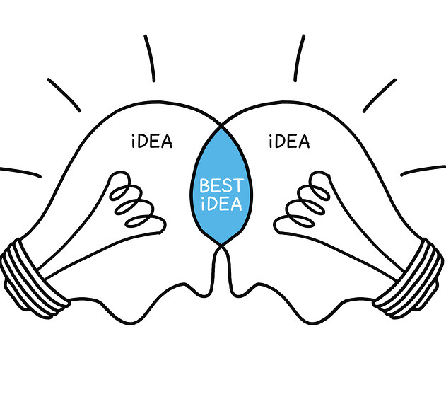
Mediations Parent Input
Analyzing Data
Target Setting
Evaluating Progress
Improvement Strategies
Decisions to be made:
What should the baseline be?
What should the target be?
Should the target increase each year?
If Yes, by how much?
Will the COVID-19 pandemic impact mediation rates?

Slide 49
Parent Liaison
Answer questions
Explain alternative dispute resolution options
Parent rights
IEP process and parent’s role
Provide resources
Link to available community services
Sbicca Brodeur
Sbicca.brodeur2@state.nm.us
505-490-2490

Slide 50
Thank you for participating!
Contact Information
Charlene Marcotte, Data Supervisor
Charlene.Marcotte@state.nm.us
(505) 309-1688
☺ Stay Safe! Stay Healthy! ☺

