Slide 1
Student Success and Wellness Bureau (Nutrition)
Direct Certification/STARS/Verification Spring SY 21-22
By:
Felix Griego, Deputy Director, MBA
Investing for tomorrow, delivering today.
Notes:
To change the image on this slide, select the picture and delete it. Then click the Pictures icon in the placeholder to insert your own image.

Slide 2
Overview
Direct Certification Match System
STARS Nutrition Data Elements
742 Verification Report Data Elements
SSWB FRL Verification Process
P-EBT and Importance of Reported Updated Data

Slide 3
Direct Certification (DC) Match System
SharePoint System established for Nutrition to find students that participate in the National School Lunch Program as “Identified Students” which are certified by the School/District for free lunch and breakfasts.
Human Services Department Data Reports Submitted Monthly to PED with List of Students receiving SNAP/TANIF benefits
Matched Reports Generated by Algorithm of student and Schools level data.
STARS Student Enrollment Data 40day, 80day, 120Day, End of Year Data.

Slide 4
Data Elements the DC System Provides
HSD Data (Monthly)
SNAP /TANIF
Foster (CYFD)
STARS Data (40day, 80day, 120day, EOY)
Homeless
Migrant
Headstart
Free and Reduced

Slide 5
Reports Generated by DC System
NSLP program - district, school and student reports used to certify students for free meals.
STARS Coordinators - District, School and Student level reports used to enter data for free and reduced students and Economically Disadvantage Student data.
Title 1 - Summary reports with school level reports that can be used to Rank Schools.
K-5 Plus - Reports used to identify eligible schools for Program.
E-Rate Funding
All reports are found in specific designated areas Identified by specific Program in STARS.

Slide 6
Impact of DC Match System Data
STARS Data Reported by Districts
Effective National School Lunch Program Provisions
National School Lunch Program qualifies students for free Lunch based on “Identified Student” Data
Provide District Socio-Economic Poverty Data

Slide 7
Entities Impacted by DC Matched System
Public Education Department
Student Success & Wellness Bureau
Title 1
K-5 Plus Program
STARS Reporting
District/Schools
Food Service Directors
Title 1 Directors
STARS Coordinators
Administrators
Househould Pandemic Support
Students/ Funding/ Important Reports

Slide 8
Outcomes of DC Matched System
Pros
Provide accurate student data for PED and School/Districts (98.6% accuracy)
New optional student data request in student template (alternate id, family identifier, and a second guardian name) will help increase DC Matched system percentage.
Certify more students for free meals without the application process.
Provide Baseline Poverty Data
Generate Valuable Reports for PED and Districts.
Minimize Administrative Burdens and Costs
Cons
Training

Slide 9
Stars Coordinators Reporting Elements for NSLP
Free and Reduced Category:
STARS Coordinators are required to flag all students that participate in the NSLP of their free, reduced or paid status.
Data input location- Field 33 in the student template.
Provision 2 and Community Eligibility Schools - all students participate 100% free. Therefore you report all students free for that school.
Standard Schools - Report students free, reduced and paid based on income eligibility on the application or direct certification.
Used in the issue of the Pandemic EBT for students that were certified by Food Services free and reduced. The data needs to be consistent to the LEA SIS and Food Service Software.

Slide 10
Add a Slide Title - 4
STARS Coordinators Reporting Elements for NSLP Continued…
Economically Disadvantage Field 88:
STARS Coordinator are required to flag students based on their “Identified student Category” from the DC System in the student template field 88. Nutrition does not validate this data set
Flag students with (1, 2, 3 or null value)
1 = Students on DC list that show “Y” Yes for SNAP/TANIF
2 = Students on DC list showing “Y” Yes for all other categories (Homeless, Migrant, Headstart, Foster, FDPIR)
3 = Extended Eligibility
Blank (null) = Students that are not “identified Categories”

Slide 11
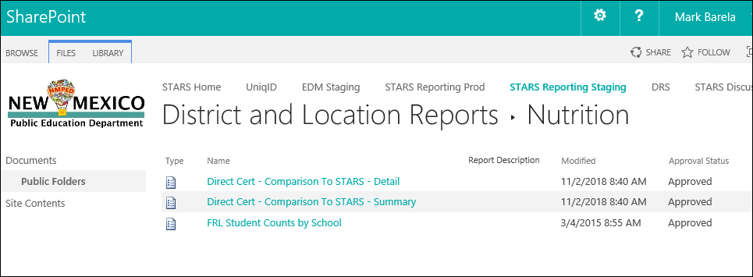
DC Report Established For STARS Coordinators to input the data required by NSLP.
Can be found in STARS under the “Nutrition tab”
Screenshot below shows the location and name of the reports established for your use.

Slide 12
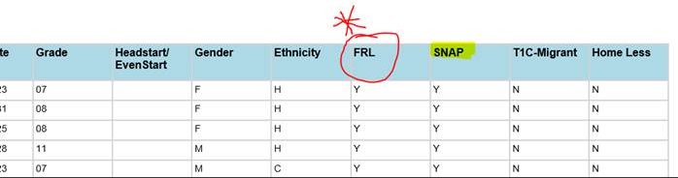
“FRL” column is a snapshot of what was reported into S.T.A.R.S for the Food Program Participation for the most recent reporting date (40D, 80D, 120D or EOY), being that they were reported by the District as participating for Free or reduced according to NSLP income applications, Economic Status or included are those directly certified from the Direct Cert Report. This column does not directly certify them categorically for free meals, it is a reference on what they were approved for on the last S.T.A.R.S reporting period.
“SNAP” column displays students matched with HSD data, with a code of “Y” and are categorically eligible for free meals without completing an application. Keeping a copy of the report on file for audit propose is your documentation for directly certified students as receiving free meals.

Slide 13
FNS 742 Verification Report
What is the FNS 742 Report?
Annual Verification Report that is required by USDA to be filled-out by all School Food Authorities with important NSLP data elements
Shows how districts are operating NSLP within its district and verifying their applications for their students
July-October Snapshot of current school year
Submitted by PED SSWB to USDA on March 15 of that current school year.

Slide 14
Correlation of STARS Data to the FNS 742 and other Purposes (P-EBT)
Free and Reduced Field
Economically Disadvantage Field
Data reported in this field should be very similar to what district Reports out in section 3 in the FNS 742 Verification Report.
District is the entity that certifies students as the 1,2,3, or Null value for both reporting elements.
DC Matched reports are made for STARS Coordinators entry.
This data can be utilized by NSLP Food Service Directors or Pandemic Services such as P-EBT
Can be a good edit check to fill out Sections 4 and 5 of the FNS 742 Verification Report for Standard and Provision 2 Base year Schools.
Most of the time this data is entered in by Food Service Directors or Staff in the districts student information system based off the applications received that school year. Need to be cautious with Human error entry.

Slide 15
Importance of Correct Student Data Reporting
Most current addresses
Addresses Update Routinely (reporting time to PED)
Consistency in Data Entry of Addresses (Physical and Mailing)
Avoid Human Error-Training or guidance
Use of Electronic system
Implement process and procedures
Ensure Parent Guardian Information Valid
Student ID number accuracy
Correct DOB
Student Free and reduced data is correct
This data is used by many entities for very important reasons and the data needs to be scrubbed down and validated on the LEA side. Failure to do so, may cause many internal and external issues when the data needs to be utilized for important reasons (Example is Pandemic EBT).
There may be a P-EBT issue for August and September and my need new Pre-K, Kindergarten, and New students data in the near future.

Slide 16
Importance of Data Reporting
It is important that the data is reported accurately in STARS because it does effect PED DC Matched accuracy percentage (98.6%) reported to USDA
Used for various other very important reasons such as P-EBT, Title 1 Ranking, and other federal allocations and or state appropriations (K-5 plus and BAB).
Data should be updated a every reporting period, when changes occur, or if new student data is available.
USDA NSLP Regulations Benchmarks:
The State performance benchmarks for directly certifying for free school meals those children who are members of households receiving benefits under SNAP are 95% for SY 2013–2014 and for each school year thereafter.
CIPs required. A State agency that fails to meet the benchmark must develop and submit a CIP to FNS for approval.

Slide 17
Contact Information
Felix Griego, Deputy Director, MBA
Work (505) 660-6203
Email: felix.griego@state.nm.us
OR
Marvin Trujillo, Data Coordinator
Work (505) 396-1080
Email: marvinn.trujillo@state.nm.us
Investing for tomorrow, delivering today.

