Slide 1
Procurement/Food Service Management Contract Training
By:
Vincent Baca, Shannon Effle

Slide 2
FOOD SERVICE MANAGEMENT COMPANIES
An FSMC is any organization, commercial, for-profit, or nonprofit, that contracts with an SFA “to manage” any aspect of the meal service
Food Service Management Company” or “FSMC” and “management company” are synonyms used throughout this training

Slide 3
REASONS SFAs MAY CONTRACT W/ FSMC
FSMCs convince board members the meal service program can be operated cheaper, easier, and more efficient with a FSMC
The board determines the district lacks the expertise /resources to operate the program
The operation is not financially sound, the general fund subsidizes the operation.

Slide 4
SFA RETAIN RESPONSIBILITIES
Program accountability
Retaining control of the:
Quality of the food service or services provided
Prices charged to children/ or prices charged to the SFA
Monitoring the:
Food service operations or general services being provided
Meal counting and claiming system
Reviewing the meal count data for each school under its jurisdiction before signing monthly claims for reimbursement or review general invoices to ensure charging to the SFA is what was stated in the contract
Retaining signature authority on the:
State Agency/SFA agreement
Free and reduced-price policy statements, and
Claims for reimbursement
Establishing an advisory board to assist in meal planning
Obtaining/maintaining all applicable health certifications
MUST monitor FSMC Crediting/Rebates/Discounts In Particular for Commodities
FSMC must give SFA Detailed Invoices to ensure Allowable costing and Commodity Crediting if applicable
NOTE: SFA should audit past invoices to ensure discounts, rebates and credits are given. If they are not, the SFA will work with the PED to ensure they get funds back in their Food Service account.

Slide 5
FSMC Procedure
Procedure/Action Item | Timeframe
Notification of SFA for RFP and Provide TA | November
State Agency RFP approval | December-January
RFP Release/Solicitation | January
Proposal Meeting and Site Visit Tour (optional for SFA) | Beginning of February
Proposals Due | End of February
Proposals Scored | Beginning of March
SFA submit solicitation score sheet, list of proposers, and final contract to state agency for approval | March
Notification of Apparent Successful Proposer | End of March
SFA and FSMC complete contract | April
Board Approval of Selected Proposer: | April-May
State Agency Approval | May-June
Contract Signed and Executed by SFA and FSMC | June
Submit signed contract to the PED | End Of June

Slide 6
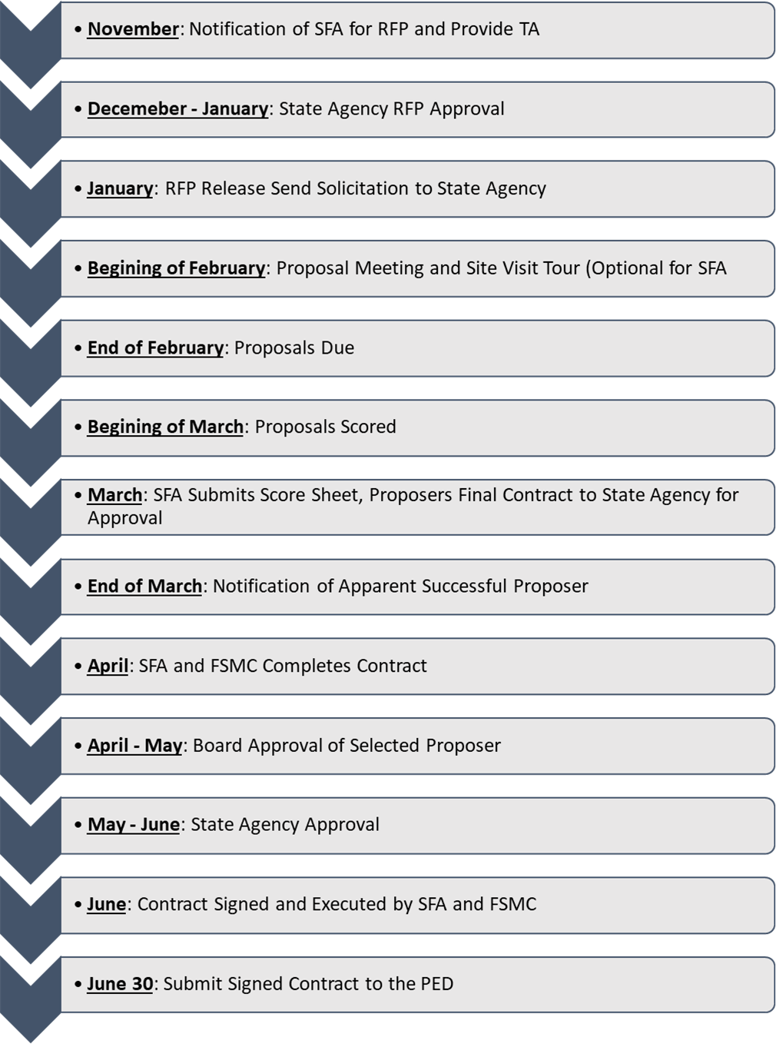
FSMC Timeline

Slide 7
FSMC CONTRACT OVERSIGHT
Solicitation
Contract
Renewal

Slide 8
SOLICITATION
Prior to writing a FSMC solicitation (RFP)
Reach for State Agency assistance if needed
Implement required Federal, State, and Local provisions within the RFP.
State Fixed and Cost Reimbursable Contracts are templates required to be used by all SFA’s.
State agency approval is required prior to contracting with a FSMC as well as with contract renewals and amendments
Reach out to all FSMC’s on state approved vendor list to achieve competition.
Release the RFP to as many vendors that can provide services to ensure a competitive process.
RFP, Solicitation, List of Bidders, scoring sheet and Contract needed prior to state agency approval and executing the contract.

Slide 9
SOLICITATION (Scope of Work)
Will the FSMC provide procurement agent services?
Solicitation must specify this service and specify what this includes
When the FSMC provides these services, the FSMC must comply with all Federal procurement requirements
What will be the FSMC’s role in:
Free and reduced price applications, verification, counting, claiming, etc.
What’s the FSMCs role regarding USDA Foods?
Solicitation must specify how USDA Foods will be:
Ordered, SFA or FSMC, within SFAs entitlement/allocation
Credited for value pass through method for the value of USDA Foods to the NPFSA
Identified on bills presented for payment
**Important to include all wants SFA wants and needs of the contract**

Slide 10
SOLICITATION
Cost Methodology
RFP Components: Fees
A la carte (Fixed Price Contracts) Meal Equivalency Factor
Catering/Non- Program Foods
Price Adjustments in Renewals Consumer Price Index(CPI)
Evaluation Criteria Score Card / Score Card
RFP needs to contain evaluation criteria
Critical for evaluation criteria to be clearly stated in the Solicitation
Price MUST be the primary scoring factor in all contracts that are going to be using Federal funds to pay for the services

Slide 11
CONTRACT AWARD
The SFA must be responsive and responsible during RFP process.
All responses received and provide answers from the SFA and RFP shall all be scored
SFA board approves
SA reviewed and approved
SA approval must be in writing prior to executing the contract

Slide 12
CONTRACT MONITORING
Monitoring include:
Food quality, safety, and inventories are maintained
All contract provisions including compliance with the:
Menu
Health inspections
Buy American
The contract terms were adhered to
All program requirements were met
Only allowable costs were paid from the NP food service account
“The contractor must separately identify for each cost submitted for payment to the school food authority the amount of that cost that is allowable (can be paid from the nonprofit school food service account) and the amount that is unallowable (cannot be paid from the nonprofit school food service account).”
State Agency Monitoring during AR and during the 3 year cycle procurement review
Contract Provisions from 2 CFR 200 Appendix II

Slide 13
Types of Contracts and Monitoring
Fixed Price Contracts
USDA Foods
Based on value of USDA Foods received
SFA monitors State agency report of allocations available
SFA ensures processed products are ordered and received to prevent processor inventory build-up and to ensure the product is received and value credited to the SFA
Purchased Foods – NONE
Discounts, Rebates and Credits are built into the fixed price established during solicitation phase

Slide 14
Monitoring FSMC Invoice
All SFA’s with a FSMC must monitor their invoices to ensure all cost are allowable or unallowable to their NSLP.
SFA shall ensure that the invoice is itemized and broken down by cost.
No Miscellaneous fees shall be charged if this is done the SFA must ask the FSMC what they are for.
The SFA shall have the FSMC invoice itemize the Management fee or give a breakdown of what the management fee covers such as FTE’s, salaries, benefits, food cost and any other management fee assigned to this fee billed to the SFA.
The SA will ask the SFA for sample invoices and all invoices must be itemized and display how credits, rebates, and discounts are applied.

Slide 15
Types of Contracts and Monitoring
Cost Reimbursable Contracts
USDA Foods
Same as Fixed Price Contract
Purchased Foods
If FSMC purchases, based on:
Eligible products [obtain list from FSMC]
Volume purchases [obtain invoices to determine: price charged, credits received]
Calculate the value of credits and proportion of credits to purchases to reconciliation value
Reconcile value with amount credited by the FSMC
**Assure that discounts, rebates and credits are identified and returned to SFAs in invoices**

Slide 16
Credits, Rebates and Discounts
The SFA and State Agency are responsible for the following
The SFA shall do monitor this process when billed by the FSMC
Review Document: How to Get FSMCs to Disclose Rebates Discounts and Credits
The SA will require the SFA to show documentation that this is being done during the PR
Review Document: How to Get FSMCs to disclose Rebates, Discounts and Credits
7 CFR 250.51(a) states, “In both fixed-price and cost- reimbursable contracts, the FSMC must credit the recipient agency for the value of all donated foods received for use in the recipient agency's meal service in a school year or fiscal year (including both entitlement and bonus foods).” Further 7 CFR 250.51(b) provides the following; “The recipient agency may permit crediting for the value of donated foods through invoice reductions, refunds, discounts, or other means. However, all forms of crediting must provide clear documentation of the value received from the donated foods—e.g., by separate line item entries on invoices.”

Slide 17
CONTRACT RENEWAL
Contract renewal is permitted, not required or automatic
Renewal options are one year at a time with a maximum of 4 renewals (per federal procurement 5 year contract duration).
Note: NMSA 13-1-30B When a procurement involves the expenditure of federal funds, the procurement shall be conducted in accordance with mandatory applicable federal law and regulations.
Subject to the same terms and conditions as established in the original solicitation and contract
Amendments, if requested, must be considered to determine if they materially change a contract
Require SFA documentation if a change is material
Change exceeds the value of the small purchase threshold (2 CFR Part 200.324(b)(5)/7 CFR Part 3016.36(g)(2)(v))
If a material change exists, a new solicitation must be published
All renewals must be state approved

Slide 18
CONTRACT RENEWAL
Some Considerations Include:
Quality of meal served by the FSMC and services provided to the SFA
FSMC’s or vendors effect on SFA finances
FSMC’s or vendors overall responsiveness and conformance to the contract’s requirements as determined by:
Contract performance management/administration documentation
Participation trends
Overall Services provided met the SFA wants and needs
Return of discounts, rebates, and credits to the nonprofit food service account
USDA Foods (fixed price and cost reimbursable contracts)
Commercially Purchased Foods (cost reimbursable contracts)

Slide 19
Resources
Electronic Code of Federal Regulations: http://www.ecfr.gov/cgi-bin/ECFR?page=browse
Office of Management and Budget: https://www.whitehouse.gov/omb/circulars_index-ffm
USDA Food Nutrition Services School Meal Regulations: http://www.fns.usda.gov/school-meals/regulations
Code of Federal Regulations 7 CFR 210.21: https://www.gpo.gov/fdsys/pkg/CFR-2013-title7-vol4/xml/CFR-2013-title7-vol4-sec210-21.xml

Slide 20
Contact Information
Vince Baca
Management Analyst
Vincent.Baca@state.nm.us
(505)819-1976
Shannon Effle
Business Operations Specialist – A
Shannon.Effle@state.nm.us
(505)490-7307

