Slide 1
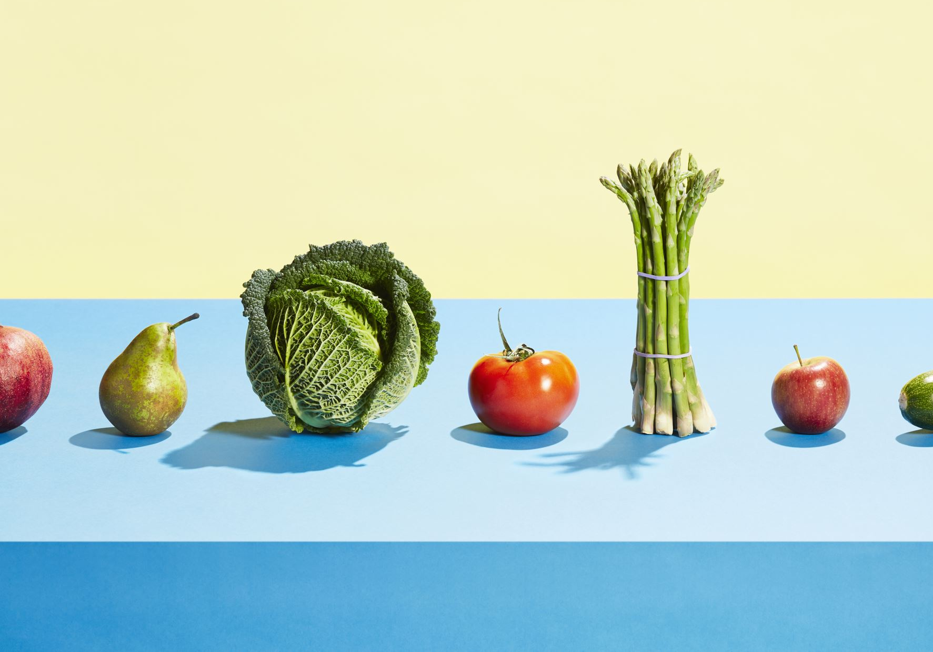
School Nutrition
Understanding nutrition and School meal pattern requirements
PRESENTED BY:
Rachele DiQuarto, Dietician-Nutritionist and Fresh Fruit & Vegetable Coordinator

Slide 2
What is Nutrition?

Slide 3
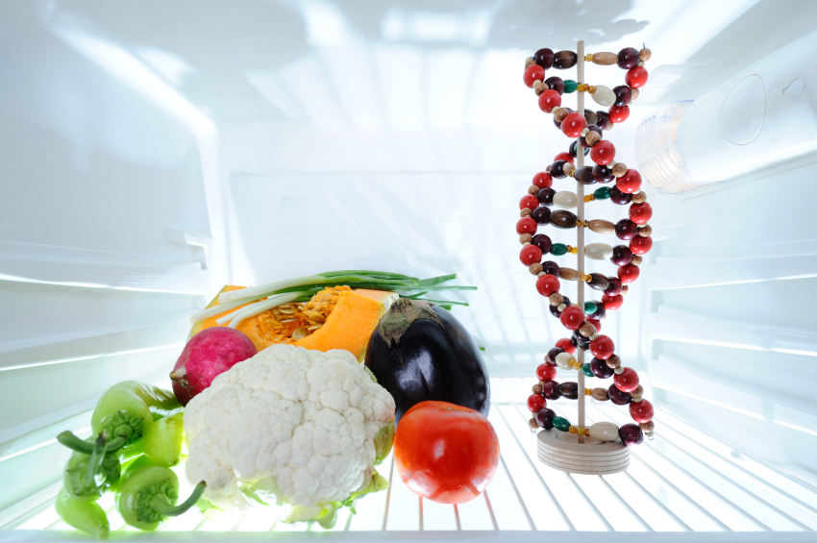
Nutrition is…
the taking in of food and other nourishing substances into the body, that influence tissue repair, growth, metabolism and overall health.
Most nutrients come from the food we eat.

Slide 4
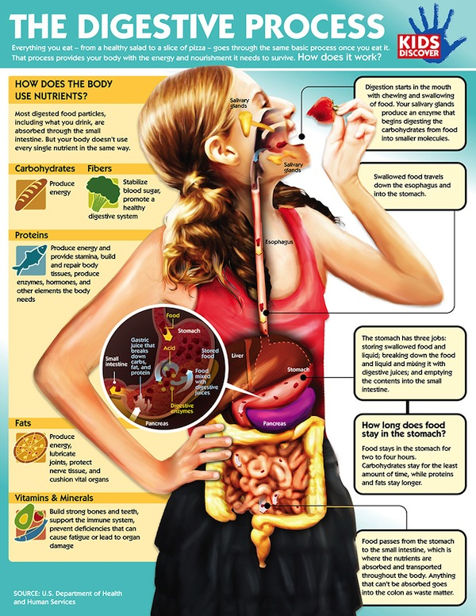
Nutrition is…
A 3-Part Process
Consumption
Digestion
Utilization of nutrients

Slide 5
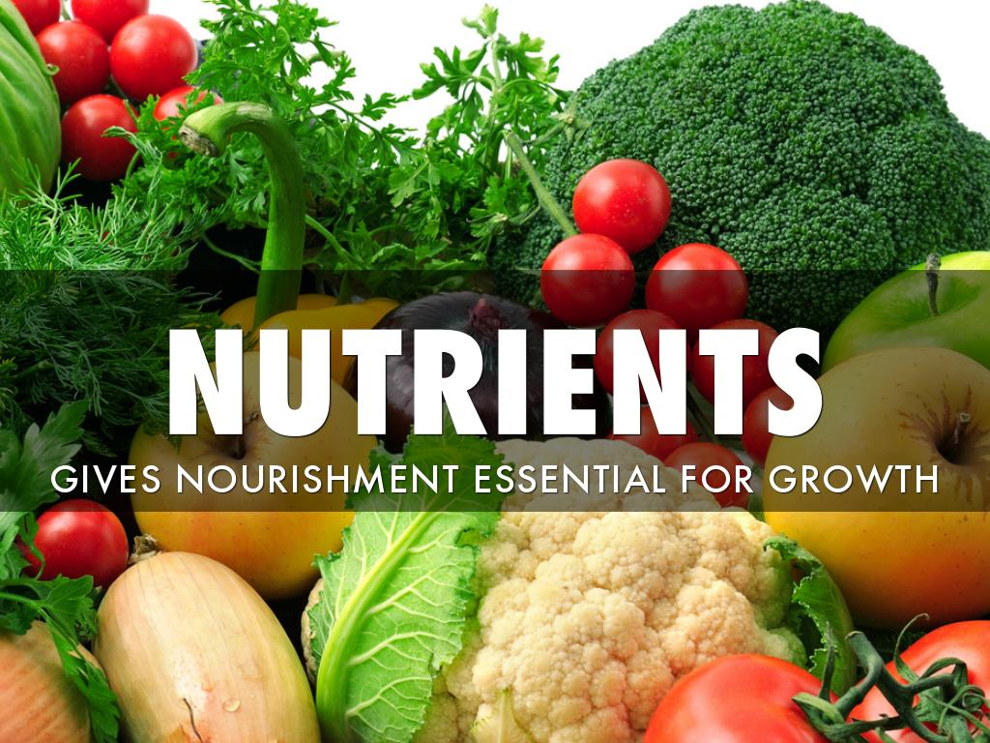
What Are Nutrients?
Substances the body needs to
regulate body functions
build/repair cells and body tissues
promote growth
obtain energy
There are 6 Essential Nutrients

Slide 6
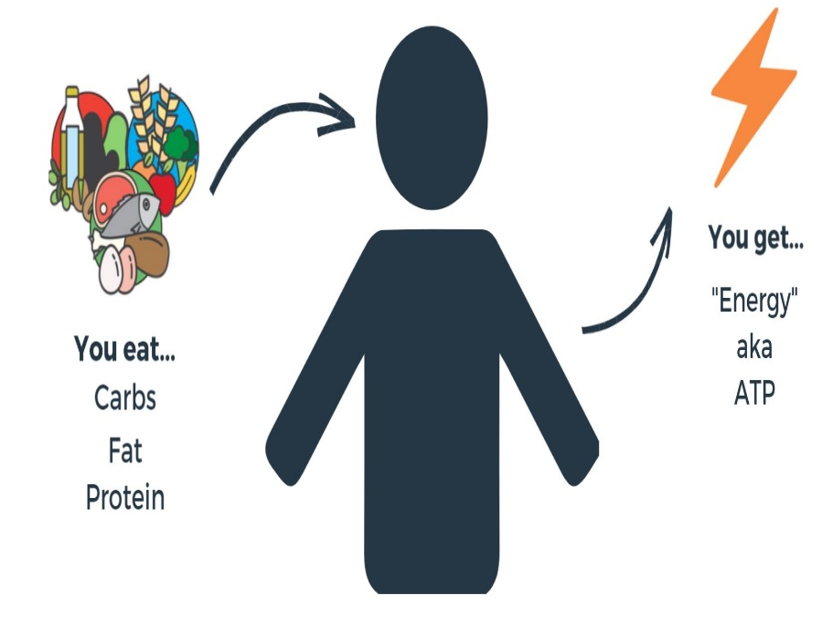
Classes of Nutrients
Carbohydrates
Proteins
Fats
Water
Vitamins
Minerals
MACRONUTRIENTS Needed in larger amounts and provide energy (calories)
MICRONUTRIENTS Needed in smaller amounts and do NOT provide energy (calories)

Slide 7
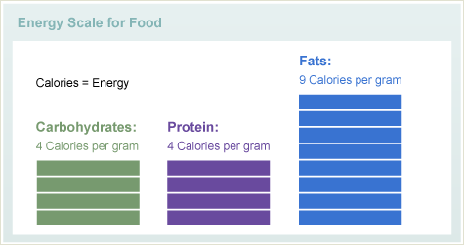
Energy Content
Trick Question: How many calories per gram are there in water, vitamins, and minerals?

Slide 8
WATER
Does NOT provide energy
Essential for all life processes
Water is the primary component of blood and tissue
It carries waste products out of the body and helps digest food.
65% of the body is water!
Most people do not drink enough.
Question: Can we offer water instead of milk for a reimbursable meal?

Slide 9
In Summary… good, balanced nutrition is critical for growth, development and overall good health. For many NM children, more than half of their daily nutrient intake comes from school meals.

Slide 10
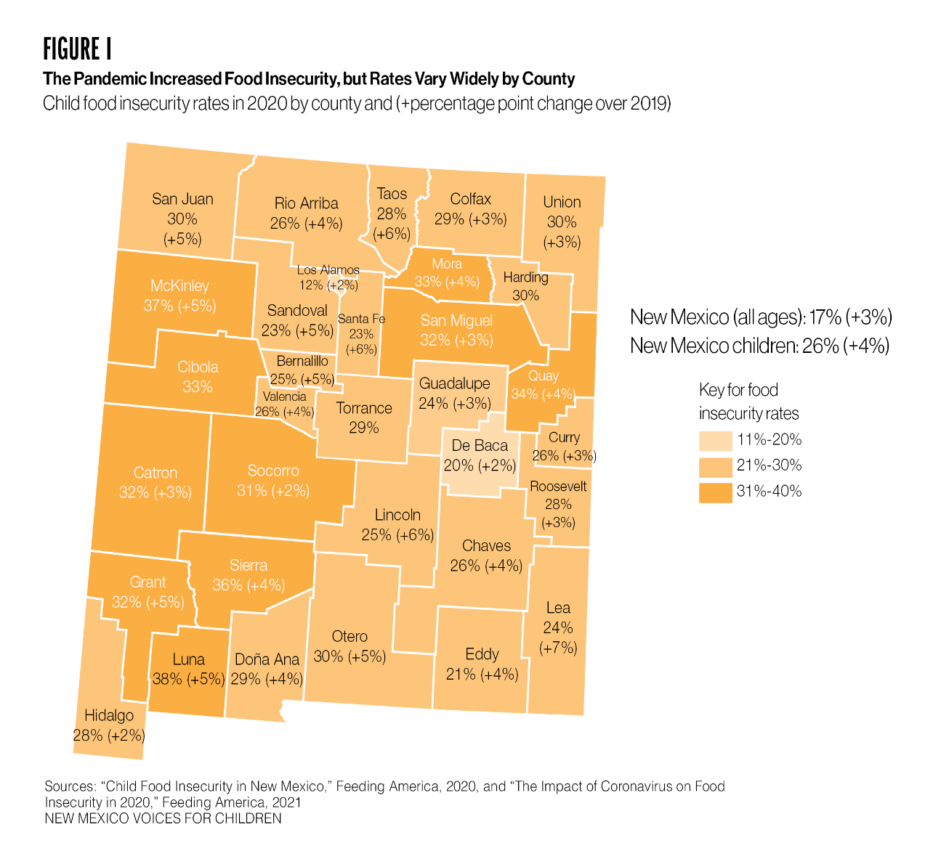
The problem is… “New Mexico has long had one of the worst rates of child food insecurity in the country. In 2020, 26% of New Mexico children experienced food insecurity,^{[4]} which is up from pre-COVID-19 levels of 22%. Due to COVID-19, food insecurity in one county was as high as 38% in 2020”

Slide 11
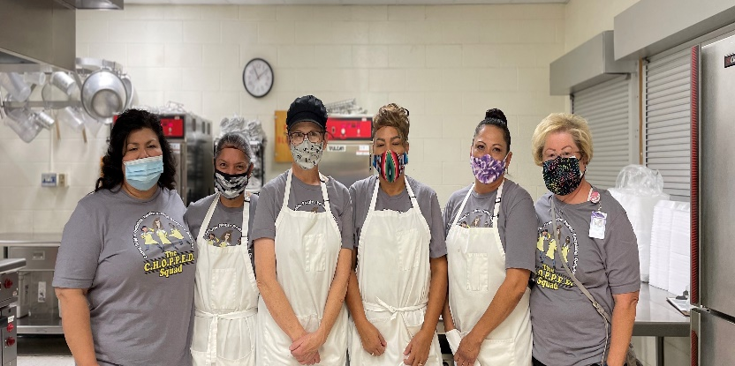
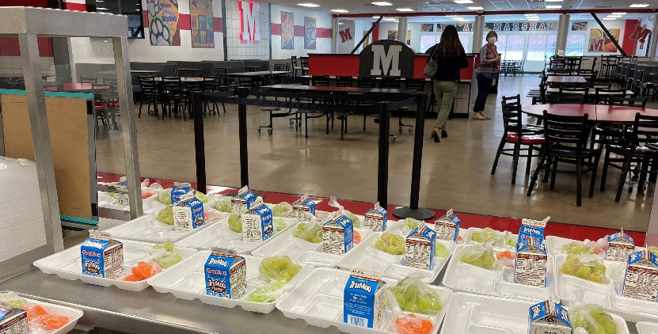
School Meals to the Rescue! “In New Mexico, approximately 75% of students participate in the free and reduced-price school lunch program. For many living in severely food insecure households school meals, may be the only regular meals they receive. “

Slide 12
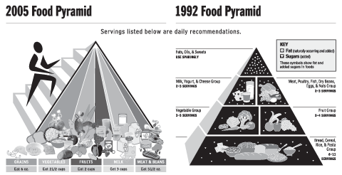
Old Dietary Guidelines

Slide 14
NSLP Meal Pattern Requirements

Slide 15
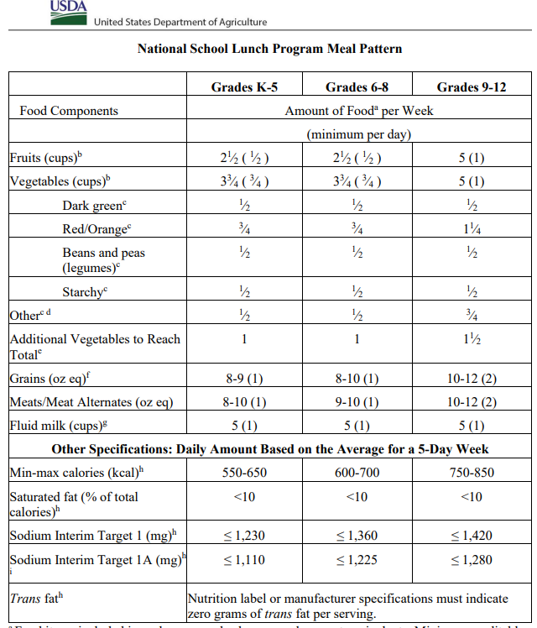

Slide 16
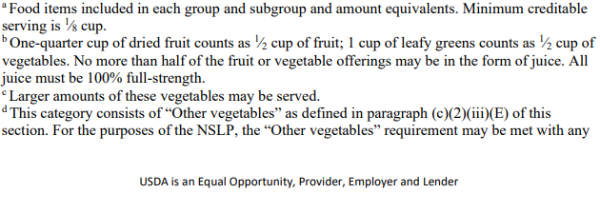

Slide 17
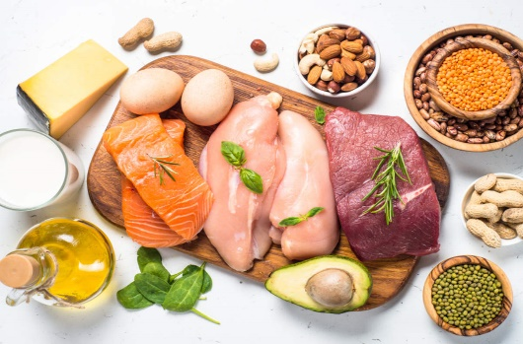
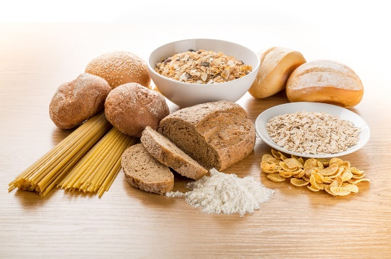
Know Your Components
5 Meal Components
M/MA – meats, eggs, cheese….
Grains – bread, rice, pasta…
Milk – fat free or low-fat 1%
Fruits – so many options!!
Vegetables (5 subgroups)

Slide 18
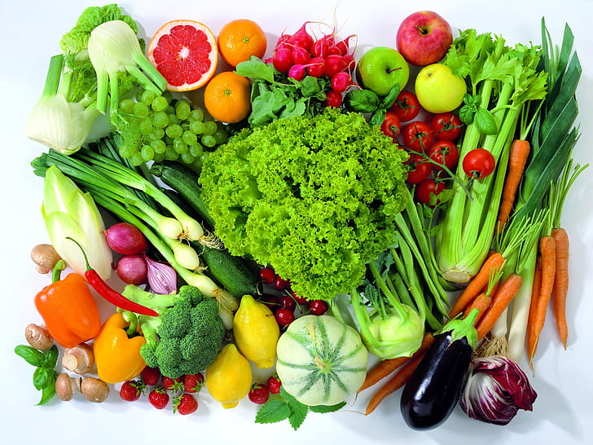
Know Your Components…
Vegetable Subgroups
Dark green – spinach, broccoli, kale…
Red/orange – carrots, tomatoes, bell peppers
Beans/peas (legumes) – pinto beans, kidney beans, peas, lentils…
Starchy – potatoes, corn, green peas…
Other – cucumbers, asparagus, green beans, cauliflower…

Slide 19
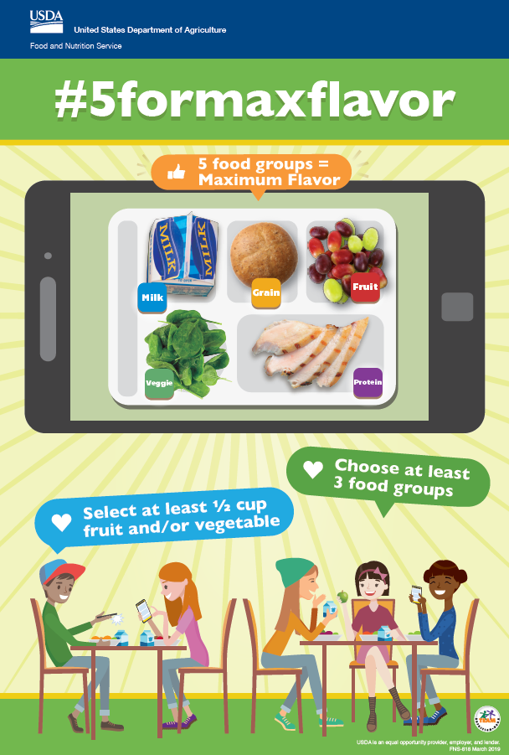
Offer vs Serve
Gives students options to select the items they WANT to eat
Reduces waste
Required for high schools

Slide 20
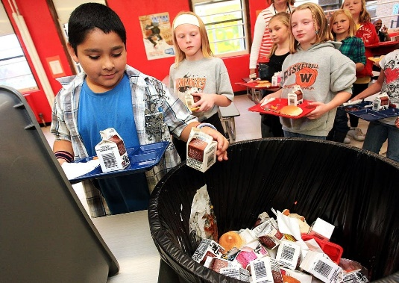
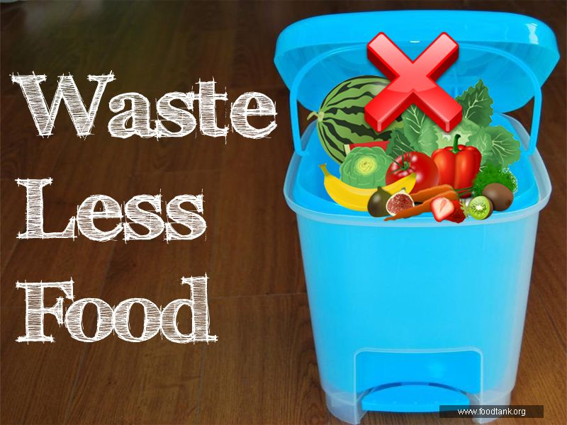
What’s the Difference?
Breakfast
Offer vs Serve
ALL 3 meal components (4 items) MUST be prepared AND offered in the required amounts
Students may take at least 3 items, one of which MUST be fruit or vegetable
The minimum serving of fruit for OVS is ½ cup BUT the student may take the full cup
Helps to reduce waste
Serve Only
ALL 3 meal components MUST be prepared AND served in the required amounts
Students must take the whole serving
May result in more waste

Slide 21
What’s the Difference?
Lunch
Offer vs Serve
ALL 5 meal components MUST be prepared AND offered in the required amounts
Students may take at least 3 components, one of which MUST be fruit or vegetable
The minimum serving of fruit or vegetable for OVS is ½ cup BUT the student may take a combo or the full cup
Helps to reduce waste
Serve Only
ALL 5 meal components MUST be prepared AND served in the required amounts
Students must take the whole serving
May result in more waste

Slide 22
Combination Foods
Some main dishes contain more than one food item or component. Don’t be fooled, make sure you count each food item.
Example 1: a burrito might contribute 2 servings of grain and 2 oz meat/ meat alternate. So, it would count as two food items at the point of sale under OVS.
Example 2: pasta with meat sauce may contribute 2 oz/servings grain, 1/2 cup vegetable and 2 oz meat alternate. The cashier could count the main dish as contributing 3 food items. This entrée alone would qualify as a reimbursable meal under OVS.
Macaroni and Cheese: Grain/Bread & Meat Alternate
Beef Taco:
Grain/Bread, Vegetables, Meat/Meat Alternate
Pepperoni Pizza: Grain/Bread & Meat/Meat Alternate

Slide 23
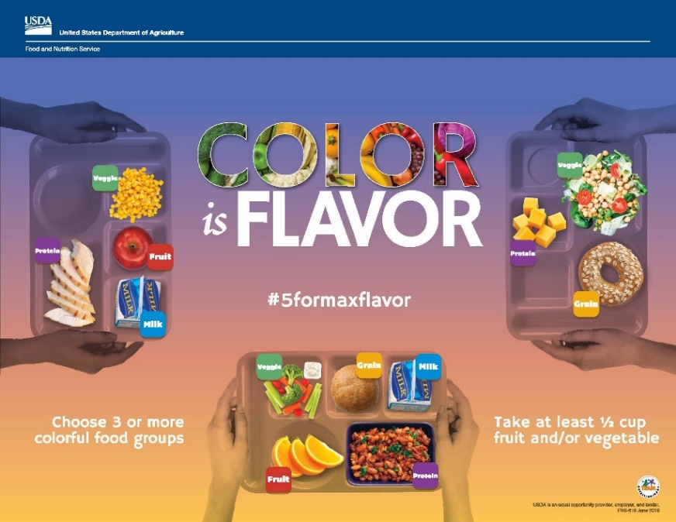
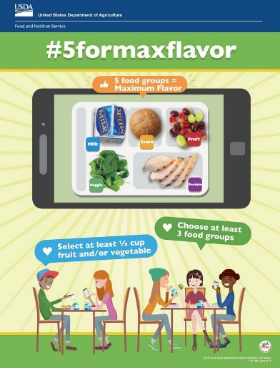
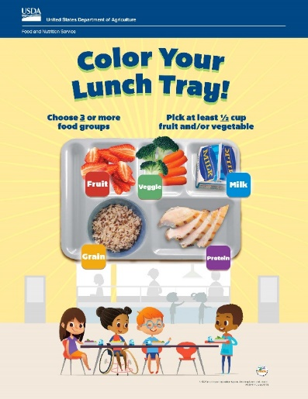
Things to Remember
Pre-plating is NOT OVS, the student must have the opportunity to select or deny components
Salad Bar after POS is NOT OVS. Unmonitored salad bars are extra and cannot contribute to a reimbursable meal
Have signage appropriate for the age groups

Slide 24
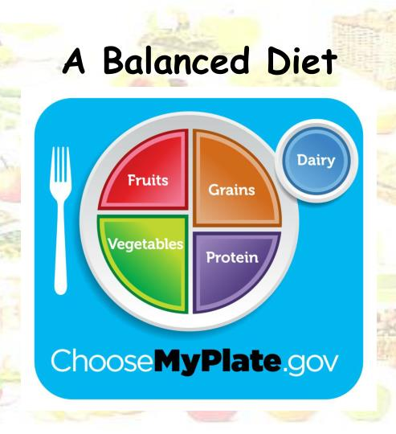
Keep It Balanced
Saturated fats, and sugars cannot be completely avoided, but they should be limited
Excess calories, not utilized by the body are stored as fat
Leads to weight gain
Teach students what healthy options and what healthy portions looks like
Healthy and balanced doesn’t have to be boring
Try new recipes and ask for feedback

Slide 25
QUESTIONS??

Slide 26
Thank YOU!

Slide 27
Resources
Home | Dietary Guidelines for Americans
https://www.fns.usda.gov/nslp
Ending Childhood Food Insecurity in New Mexico – New Mexico Voices for Children (nmvoices.org)

