Slide 1
Student Success and Wellness Bureau (Nutrition)
Standard Eligibility
By:
Kate Ullrich
Investing for tomorrow, delivering today.
Notes:
To change the image on this slide, select the picture and delete it. Then click the Pictures icon in the placeholder to insert your own image.

Slide 2
Overview
Distributing Applications & Household Outreach
Processing Applications
Determining Eligibility
Notifications to Families of the Eligibility Determinations Outcomes
Conducting Verifications

Slide 3
Distributing Applications & Household Outreach
Prototypes Google Drive: https://drive.google.com/drive/folders/1wt0lypJTh2Uo5F36azdUoMyBw6n2SEoM?usp=sharing
Prototype: USDA Application for Free and Reduced Meals updated with USDA Income Guidelines
Prototype: Instructions for Households Free & Reduced Meals
Prototype: Household Notice for Free and Reduced Meals
Prototype: FAQ’s for Households Free and Reduced Meals
USDA Income Guidelines
SFA’s can pre-populate data (other than income data) from the prior school year or from STARS.

Slide 4
Distributing Applications & Household Outreach
SFAs must ensure all households receive an application for free and reduced price meal benefits.
Applications may be distributed by the postal service, e-mailed to the parent or guardian, or included in information packets provided to students.
Due Date: Beginning of School Year

Slide 5
Processing Applications
Notes:
To change the image on this slide, select the picture and delete it. Then click the Pictures icon in the placeholder to insert your own image.

Slide 6
Processing Applications
Applications must be reviewed in a timely manner. Whenever possible, applications should be processed immediately, and must be processed within 10 operating days. This is particularly important for children who are not eligible to receive carryover benefits because they were not certified as eligible for free or reduced price meals during the previous school year.
The SFA must not delay determinations if the household fails to provide any non-essential information.
See “Procedures for SFAs - USDA Eligibility Manual for School Meals - Determining and Verifying Eligibility” page 60

Slide 7
Processing Applications
Two Routes for Applications
Applications for students based on INCOME
Eligibility Determination
Applications for students from Direct Certification (Categorically Eligible)

Slide 8
Determining Eligibility
Notes:
To change the image on this slide, select the picture and delete it. Then click the Pictures icon in the placeholder to insert your own image.

Slide 9
Determining Eligibility Based on DC
We will not go into depth into the Direct Certification method, as this topic is covered extensively by Deputy Direction Felix Greigo’s “DC STARS Verification” training
Please refer to step by step instructions: “Eligibility Determinations- Performing Eligibility Determinations using Direct Cert System”

Slide 10
Determining Eligibility Based on INCOME
According to 7 CFR 245.2 a complete income-based application must provide:
Names of all household members;
Amount, source, and frequency of current income for each household member;
Signature of an adult household member (an electronic signature is acceptable for web-based applications); and
Last four digits of the Social Security Number of the household’s primary wage earner or another adult household member, or an indication that no adult household member has a Social Security Number.
Income field blank?
Any income field left blank is a positive indication of no income.
Applications with blank income fields are to be processed as complete.
The adult household member’s signature (or electronic signature) certifies that there is no income to report.

Slide 11
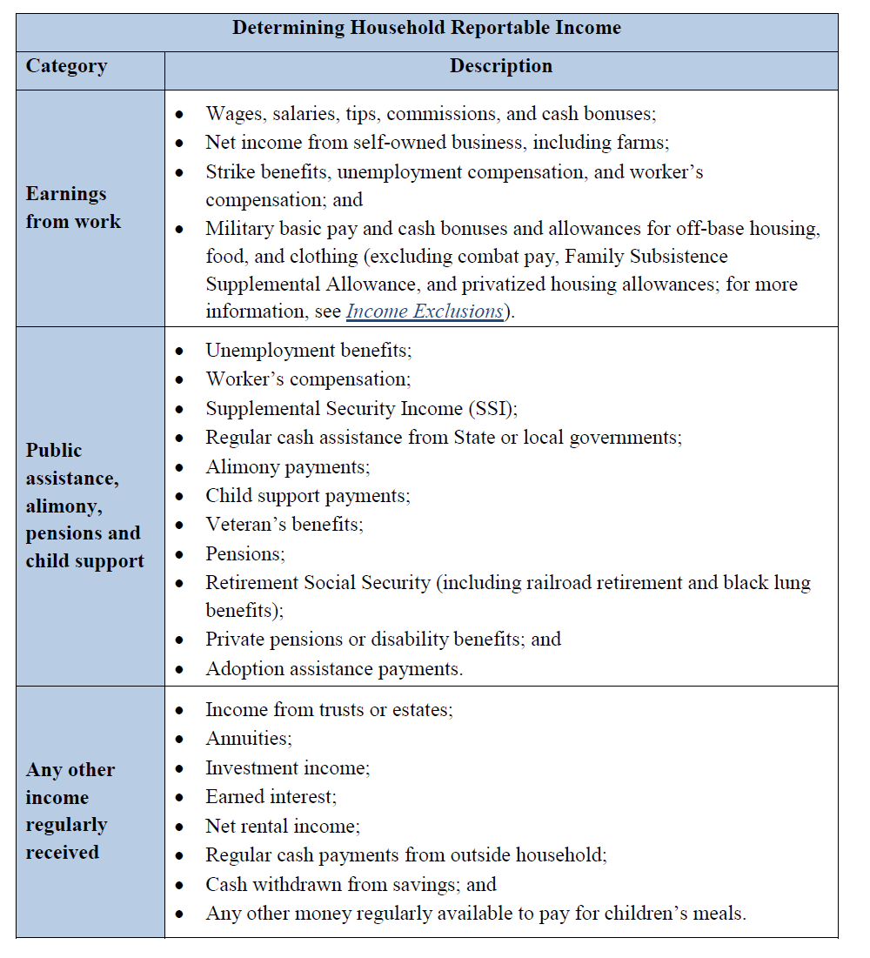
Determining Eligibility Based on INCOME
What is considered “Income” under the NSLP program?
Salary
Pensions
Child Support
Spousal Support
Special Circumstances?
Seasonal Workers
Income for Self-Employed
Rental Properties
Foster Children
Child’s Income
See “Procedures for SFAs - USDA Eligibility Manual for School Meals - Determining and Verifying Eligibility” page 27

Slide 12
Determining Eligibility Based on INCOME
What is NOT considered “Income” under the NSLP program?
SNAP benefits
FDPIR benefits
FDPIR benefits
Payments for Foster children
Student Financial Assistance
Payday loans or other bank loans
Infrequent earnings received on a irregular basis (baby-sitting, dog watching, mowing lawns).
This list is not exhaustive. For the complete list please visit both sites:
https://www.ssa.gov/OP_Home/ssact/title16b/1612.htm#ACT-B1612-B
http://www.socialsecurity.gov/OP_Home/cfr20/416/416-app-k.htm

Slide 13
Determining Eligibility Based on INCOME
Identify Error-Prone Applications
Keep Error-Prone Applications together or easily pulled, for the Verification process later.

Slide 14
Determining Eligibility Based on INCOME
RCCI Resident Applications:
Each child is considered a household of ONE (unless the child is a “Day Student”)
An application must be completed for each child unless the RCCI falls under a categorically eligible program like CYFD, or Juvenile Justice programs.
Documentation must be signed by RCCI’s Eligibility Official.
RCCI Resident Applications may use the USDA Prototype, or the facility’s documentation, so long as the documentation includes:
Child’s Name
Any income received by the child
Child’s Date of Birth
Date of Admission
Date of Release
Official’s Title and Contact Information.

Slide 15
Notifications to Families of the Eligibility Determinations Outcomes
Notes:
To change the image on this slide, select the picture and delete it. Then click the Pictures icon in the placeholder to insert your own image.

Slide 16
Notifications to Families of the Eligibility Determinations
Per 7 CFR 245.6(c)(6) Households must be notified the eligibility determination within 10 operating days of receipt of the application and status must be implemented.
SFA’s must document the notification to the households as follows:
Indicate the approval date.
Indicate the level (Free, Reduced or Paid) for each child
Sign or initial and date the FRL Application (or electronically approve/acknowledge).
You can record this information on the FRL Application or you can use a separate document (such as an email).
An application must be completed for each child unless the RCCI falls under a categorically eligible program like CYFD, or Juvenile Justice programs.
Documentation must be signed by RCCI’s Eligibility Official.

Slide 17
Notifications to Families of the Eligibility Determinations
Per 7 CFR 245.6(c)(6) Households must be notified the eligibility determination within 10 operating days of receipt of the application and status must be implemented.
SFA’s must document the notification to the households as follows:
Indicate the approval date.
Indicate the level (Free, Reduced or Paid) for each child
Sign or initial and date the FRL Application (or electronically approve/acknowledge).
You can record this information on the FRL Application or you can use a separate document (such as an email).
An application must be completed for each child unless the RCCI falls under a categorically eligible program like CYFD, or Juvenile Justice programs.
Documentation must be signed by RCCI’s Eligibility Official.

Slide 18
Notifications to Families of the Eligibility Determinations
Per 7 CFR 245.6(c)(6) Households must be notified the eligibility determination within 10 operating days of receipt of the application and status must be implemented.
SFA’s must document the notification to the households as follows:
Indicate the approval date.
Indicate the level (Free, Reduced or Paid) for each child
Sign or initial and date the FRL Application (or electronically approve/acknowledge).
You can record this information on the FRL Application or you can use a separate document (such as an email).
An application must be completed for each child unless the RCCI falls under a categorically eligible program like CYFD, or Juvenile Justice programs.
Documentation must be signed by RCCI’s Eligibility Official.

Slide 19
Conducting Verifications
Notes:
To change the image on this slide, select the picture and delete it. Then click the Pictures icon in the placeholder to insert your own image.

Slide 20
Conducting Verifications
Ideally verification process begins September 1 but MUST begin no later than Oct 1.
Per the USDA, verification must be based on a school’s application pool as of October 1 each school year.
However, FNS regulations at 7 CFR 245.6a(c)(3) allow SFAs to begin verification once they begin the application approval process for the current school year and have approved applications on file.
This means SFAs are not required to wait until October 1 to initiate the verification process, and may instead choose to begin conducting verification once they have approved applications.
Why start early?
Eases administrative burden by distributing the tasks and responsibilities over a longer period of time.
Mitigates rush of document processing, and urgent follow up communications.

Slide 21
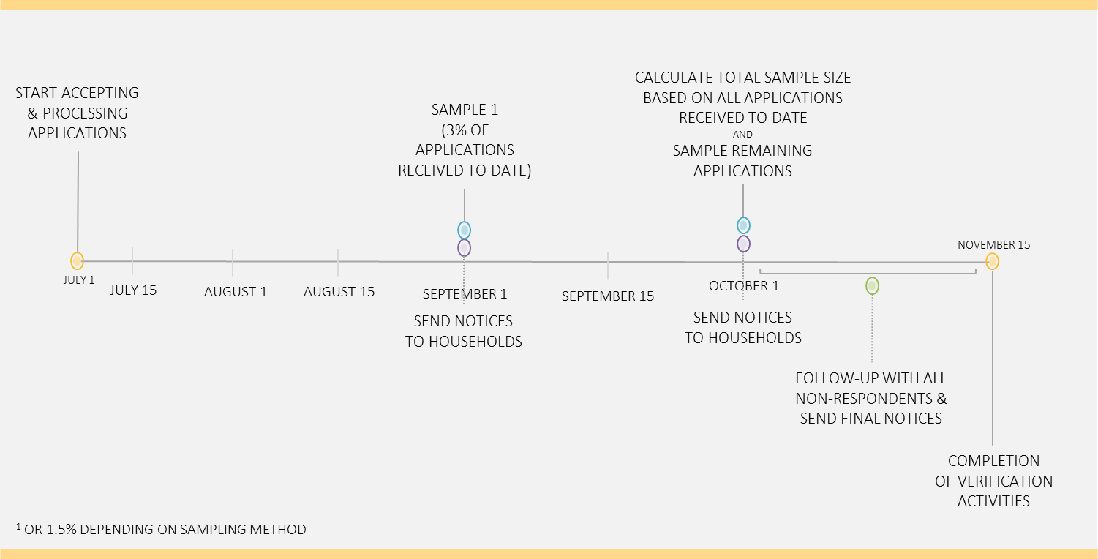
Conducting Verifications
Use Enrollment Data to calculate 3% Sample Pool. Will ensure second round is not necessary.
Example of SFA’s Timeline starting prior to Oct 1:

Slide 22
Conducting Verifications – Sample Pool
Starting no later than October 1:
Establish Sample Pool Size
Calculate necessary sample pool size. (By using 3% of enrollment will ensure you meet the minimum requirements).
Use the 742 calculator to determine sample pool size.

Slide 23
Conducting Verifications – Sample Pool
Establish Composition of Sample Pool: As noted earlier, as applications are processed, identify any Error Prone applications for verifications.
SFA must complete the Sample Pool Size with applications using this priority:
Error-Prone Income Applications
Applications stating SNAP participants (use Direct Certification system to verify).
Randomly selected from remaining pool.
Once minimum Sample Size Pool is met, no need to complete with remaining categories.

Slide 24
Conducting Verifications – Sample Pool
Establish Composition of Sample Pool: Further explanation:
The SFA may not have enough applications that meet the criterion for sample sizes based on Error-Prone Applications. When this happens, the SFA moves to the second category, Applications with SNAP information. If the criterion for sample size is still not met, the SFA must select, using random sampling, additional approved income applications to complete the required sample size [7 CFR 245.6a(c)(5)].
In other situations, the number of Error Prone Applications may exceed the required sample size. When this happens, the SFA must randomly select, using random sampling, the required number of applications from all Error-Prone applications.

Slide 25
Conducting Verifications – Reviewing Sample Pool
Once the sample pool has been selected, but BEFORE outreach to homes, the SFA’s determining official must review each approved application selected for verification to ensure the initial determination was accurate.
Note: SFAs who conduct a confirmation review of all applications at the time of determinations is not required to conduct confirmation reviews prior to verification.
The confirmation review must be done by an individual other than the individual who made the initial eligibility determination [7 CFR 245.6a(e)(1)].
This requirement is waived if the SFA uses a technology-based system with a high level of accuracy in processing an initial eligibility determination.

Slide 26
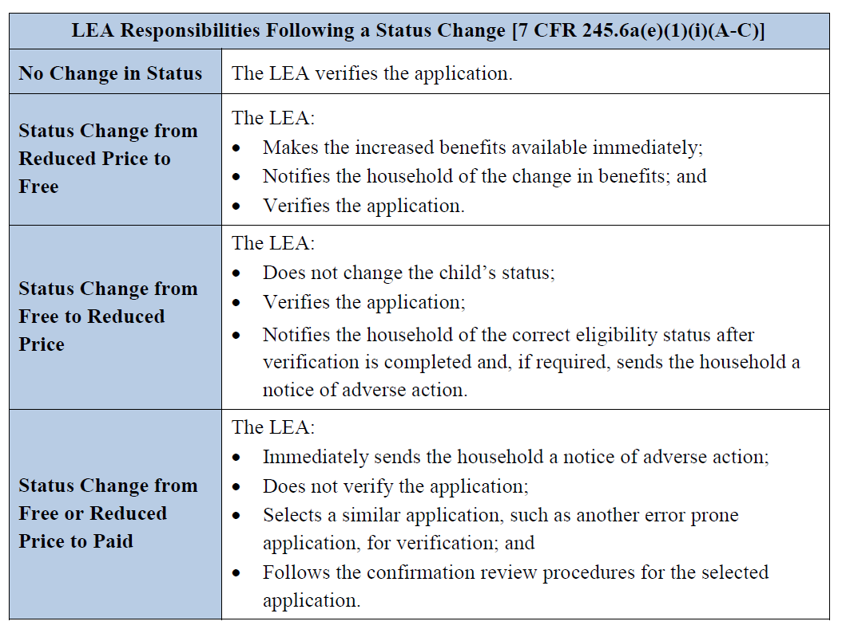
Conducting Verifications – Next Steps
Once any required confirmation sample pool reviews are completed, next steps as follows:

Slide 27
Conducting Verifications – Household Notice of Selection
Once sample pool reviews are complete, the SFA proceeds with household notification.
When a household is selected for verification, the SFA must inform the household, in writing, of its selection and must provide a list of the documents or other forms of evidence the household must submit to the SFA.
Any communications with households concerning verification must be in an understandable and uniform format and, to the maximum extent practicable, in a language that parents and guardians can understand [7 CFR 245.6a(f)].
Protype letters are available in the Google Drive.

Slide 28
Conducting Verifications - Household Notice of Selection
Minimum requirements per 7 CFR 245.6a(f)(6), (f)(7), and (j) for Household Outreach for the 3% Sample Pool for Income Applications:
Verification Request to Household
One follow-up attempt to contact non-responding households
10-day advance notification of a reduction or termination of benefits.

Slide 29
Conducting Verifications – Supporting Documentation for the Income Verification
When a household is selected for verification, it must provide “sources of information” (supporting documentation), to the SFA to confirm current income.
According to 7 CFR 245.6a(a)(7), supporting documentation (“sources of information), may include:
Written evidence
Collateral contacts
Systems of records.
Households which dispute the validity of information acquired through collateral contacts or a system of records must be given the opportunity to provide other documentation [7 CFR 245.6a(a)(7)(iv)].

Slide 30
Conducting Verifications – Supporting Documentation for the Income Verification
Written Documentation for Income
The name of the household member
The amount of income received;
The frequency received;
The date the income was received.
A pay stub with no dates would be insufficient written evidence for an income eligible application.

Slide 31
Conducting Verifications – Supporting Documentation for the Income Verification
The verifying official should examine the documentation provided to ensure the child for whom the application was made is part of a household currently participating in an eligible program or is a foster child.
If written evidence is insufficient to confirm the income information on the application, the SFA may require use of collateral contacts.

Slide 32
Conducting Verifications – Follow Up with Households
The SFA must make at least one attempt to contact the household when the household does not adequately respond to the request for verification [7 CFR 245.6a(f)(6)].
“Non-response” includes no response and incomplete or ambiguous responses that do not permit the SFA to resolve children’s eligibility for free and reduced price meals.
The required follow-up attempt may be in writing (mail or e-mail) or by telephone or text message.
The SFA must document contact was attempted.
Additionally, the SFA must ensure LEP households are provided adequate language assistance and understand the need to respond to the verification request, as outlined in Section 9(b)(8) of the NSLA and USDA LEP guidance.

Slide 33
Conducting Verifications – Follow Up with Households
The SFA must make a follow-up attempt when:
The household does not respond to the initial request for verification;
The household submits insufficient or obsolete written evidence;
The household does not designate collateral contacts; or
The collateral contacts are unable or unwilling to provide the requested evidence.
When following up with households, the SFA:
Must inform the household that failure to provide adequate written evidence or failure to designate an adequate collateral contact will result in termination of benefits;
Must attempt to obtain the missing written evidence or collateral contact information; and
Must contact the household to complete the verification process, if the collateral contact is unwilling or unable to provide the requested information.

Slide 34
Conducting Verifications – Follow Up with Households
If, after at least one follow-up attempt, the household responds and provides all needed evidence, verification is considered complete for the household.
A household’s refusal to cooperate with efforts to verify will result in moving the household to Paid status.
Households refusing to complete the verification process are counted toward meeting the SFA’s required sample of verified applications [7 CFR 245.6a(f)4)]
As appropriate, the SFA would complete verification by:
Informing the household there is no change in benefits;
Notifying the household its benefits will be increased; or
Sending notice of adverse action.

Slide 35
Conducting Verifications – Household Responses
Household Responses (Household Actions): The household submits either adequate written evidence or collateral contact corroboration of income or categorical eligibility.
Verification Status and Action: Verification is considered complete for this household.
No Changes to Status

Slide 36
Conducting Verifications – Household Responses
Household Responses (Household Actions): The household submits either adequate written evidence or collateral contact corroboration of income indicating that the children should receive either a greater or lesser level of benefits.
Verification Status and Action: Verification is considered complete for this household when the household is notified that its benefits will be increased or decreased. If benefits are decreased, a notice of adverse action must be sent before verification is considered complete.

Slide 37
Conducting Verifications – Household Responses
Household Responses (Household Actions): The application provided case numbers. It is determined that no household member is receiving benefits from an Assistance Program.
Verification Status and Action: Verification is considered complete when the notice of adverse action is sent.

Slide 38
Conducting Verifications – Household Responses
Household Responses (Household Actions): The household indicates, verbally or in writing, that it no longer wishes to receive free or reduced price benefits.
Verification Status and Action: Verification is considered complete when the notice of adverse action is sent.

Slide 39
Conducting Verifications – FNS742 & Record Retention
All verified applications must be readily retrievable on an individual school basis.
All documents submitted by the household for the purpose of
Confirming eligibility;
reproductions of those documents;
Or annotations made by the determining official indicating which documents were submitted by the household;
The date of submission also must be retained;
Along with all relevant correspondence between the households selected for verification and the school or LEA [7 CFR 245.6a(h)].
This documentation, including documentation concerning any appeals, must be kept by the SFA to demonstrate compliance with the verification requirements when SFAs are reviewed by State or Federal officials.
The documentation must be kept for a minimum of three years, after the date of the fiscal year to which they pertain.

Slide 40
Conducting Verifications – 742 & Record Retention
SFAs must also maintain a description of their verification efforts, this information can be documented using the FNS742 excel file:
A summary of the verification efforts including the selection process (FNS742);
The total number of applications on file on October 1 (FNS742); and
The percentage or number of applications that are/will be verified by November 15 (FNS742)
The SFA must also be able to demonstrate compliance with the confirmation review requirement and provision of a no-cost telephone number for assistance in the verification process.

Slide 41
Conducting Verifications – FNS742 & Record Retention
Individual Applications
For each application verified, the SFA must keep records of the source of information used to verify the application, such as wage stubs or names and titles of collateral contacts. When verification information is needed for Administrative Review purposes, the LEA must be able to provide the following information for each school selected for review:
Copies of all relevant correspondence between the households selected for verification and the SFA, including notices of adverse action and records of follow-up attempts, information obtained from collateral contacts, etc.
One of the following for all documentation used to verify eligibility:
All documents submitted by the household or reproductions of those documents;
Direct verification results; or
Documentation from Assistance Program or Other Categorically Eligible Program officials, with dates of receipt of benefits and date of the information provided.

Slide 42
Conducting Verifications – FNS742 & Record Retention
Individual Applications
Documentation for any change in eligibility as a result of verification, including:
The reason for the change
The date the household was notified;
The date it became effective, if necessary; and
If applicable, records of follow-up attempts and results for termination for non-response.
The title and signature of the verifying official.
Criteria for replacing applications for verification.
In cases where the actual documents or photocopies submitted by the household cannot be kept, the verifying official must make a written record of the documents submitted by the household including the type of document (e.g., wage stubs or a letter from an employer, income shown on the document, time period of the income, and the date of the document).

