Slide 1
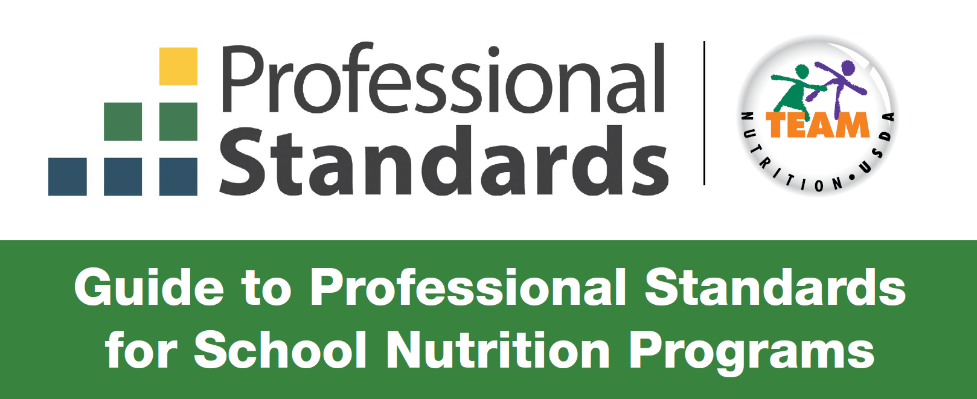
Presented by:
Nicole Martinez – SSWB Health Educator and Sharona Secatero – SSWB Staff Manager

Slide 2
Objectives
Understand what professional standards in the NSLP are and why they are important
Discuss the resources available for meeting the requirements of professional standards
Examine roles and ensure all staff members meet their professional standards requirements
Notes:
Professional Standards for school nutrition professionals is a key provision of the Healthy, Hunger-Free Kids Act of 2010 (HHFKA). The final rule, published March 2, 2015, requires a minimum amount of annual training hours for all state directors of school nutrition programs, state director of distributing agencies, school nutrition program directors, managers, and staff. Required training topic areas will vary according to position and job requirements. There are also minimum hiring standards for new state directors of school nutrition programs, state directors of distributing agencies that oversee USDA Foods, and school nutrition program directors.
In developing the final professional standards, USDA considered input from a variety of sources, including representatives from state agencies, school districts, and school nutrition professional associations. FNS carefully reviewed all public comments and listened to the concerns of stakeholders

Slide 3
Welcome to Professional Standards 101
The United States Department of Agriculture (USDA) has created professional standards for State and local school nutrition program personnel.
The required professional standards consist of:
Hiring Standards
Annual Training
For school nutrition program directors of school food authorities (SFAs), State directors of school nutrition programs, and other staff.

Slide 4
The annual training has a simple GOAL!
They help assure the success of the National School Lunch Program (NSLP) and School Breakfast Program (SBP)
Enhance the image of the school nutrition professionals and their influence in the community.
Build job skills and empower the staff to lead and efficiently operate school nutrition programs

Slide 5
Who needs to track Professional Standards?
School Nutrition directors not only have their own annual training requirements, but also oversee annual training requirements for managers and staff.
Required professional standards vary by three job categories: directors, managers and staff.
At the local level, there are many different job titles of individuals who perform similar duties
Director’s
Manager’s
Staff
For example: In situations where the school manager also performs the duties of a director, the manager must meet the required professional standards as a director.

Slide 6
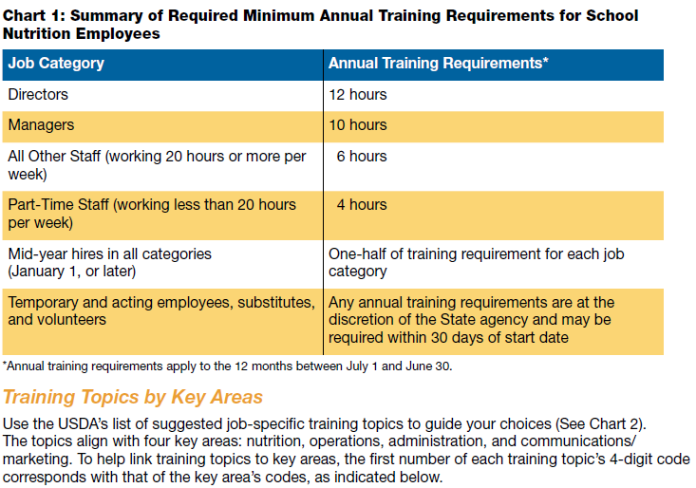
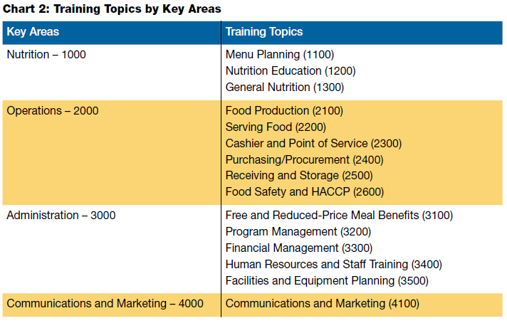
Annual Training Requirements

Slide 7
Where can I find training?
USDA Professional Standards Training Database
Professional Standards Training Tracker Tool | Food and Nutrition Service (usda.gov)
USDA FNS Office of Food Safety
https://www.fns.usda.gov/ofs/food-safety
USDA FNS Team Nutrition
https://TeamNutrition.usda.gov
Institute of Child Nutrition (ICN)
https://theicn.org
State Agencies
Exhibits at Conferences
Professional Organizations:
Local In-Service Training
Food Service Suppliers
Ex: Manufacturers, distributors and brokers
New Mexico Eat & Learn
www.nmeatandlearn.com
Registration code: NM2021
Other Resources: Universities and community colleges

Slide 8
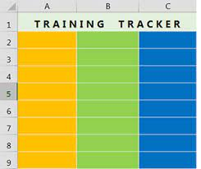
Do I need to keep track? YES!
The regulation does not specify the kind of records that must be kept.
Records that list employee name, employer/school, training title, topics/objectives, training source, dates and total training hours would be appropriate to demonstrate compliance with annual training requirements.
Records must be maintained and made available to the State agency upon request.
Some training hours must be completed each year.
For example: Civil Rights
Documentation of annual training requirements is part of the Administrative Review.

Slide 9
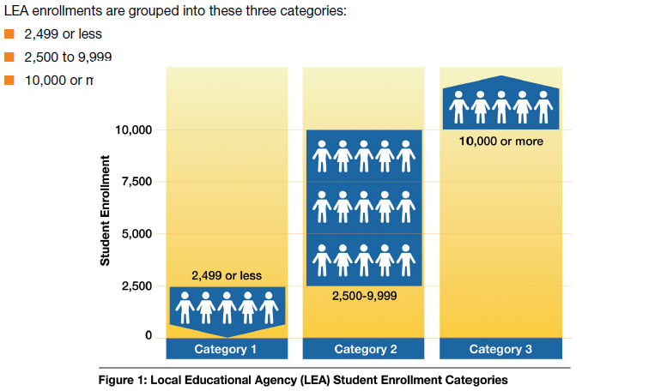
What are the Hiring Standards for New School Nutrition Program Directors?
Hiring Standards depend on LEA enrollment size.

Slide 10
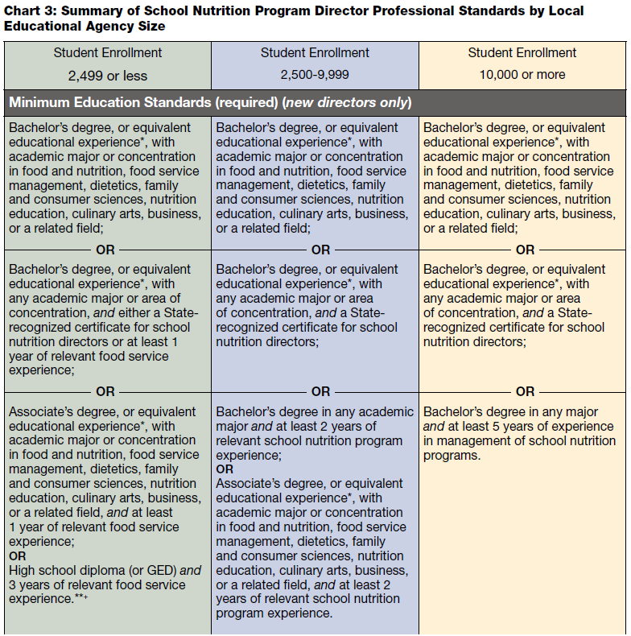
Minimum Education Standards

Slide 11
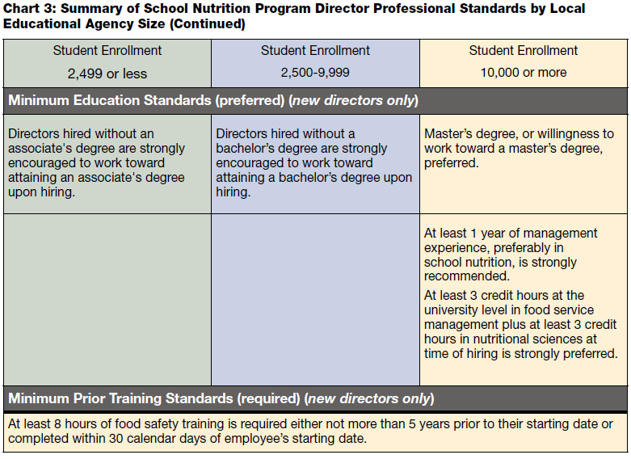
For LEAs with 2,499 students or fewer, a State agency can approve an SFA to use the nonprofit school food service account to pay the salary of a school nutrition program director who does not meet the hiring standards so long as the SFA is complying with a State agency-approved plan to ensure the director will meet the required professionals standards.

Slide 12
SSWB Training & Guidance for SFA’s
Based on past Administrative Reviews, or survey taken by your State agency, you may be aware of the most important trainings needed.
Performance Standard 1: Meal Eligibility, Counting & Claiming
Performance Standard 2: Meal Quality, Meal Components, Serving Sizes and national quality
General Areas: Food Safety, Civil Rights, Wellness Policy, Professional Standards, etc.

Slide 13
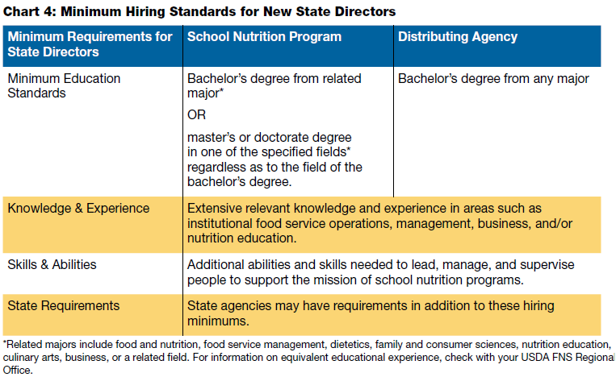
What are the minimum Hiring Standards?
In addition to annual training requirements, the standards also establish minimum hiring standards for State directors hired on or after July 1, 2015

Slide 14
Conclusion
In the end, the professional standards for all local and State school nutrition professionals help ensure a capable workforce.
State Agencies and USDA provide support and resources to the SFA’s to meet annual training requirements and hiring standards.
Most importantly, the required professional standards help all schools to provide safe, nourishing meals that model and foster wise food choices in children today for a healthier tomorrow.
THANK YOU!!
If you have any questions, please contact your Health Educator.

