Slide 1
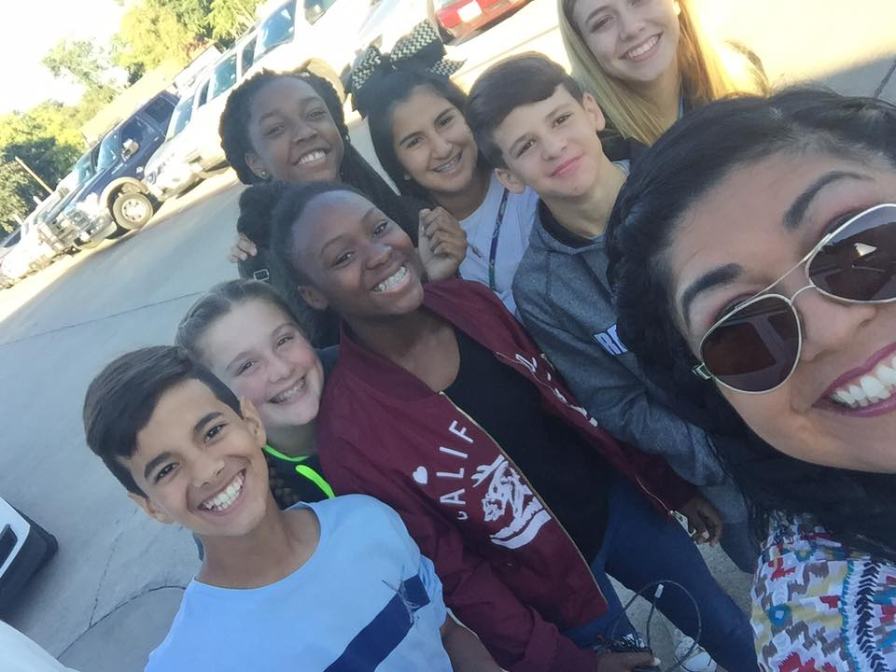
Let’s get smart about Smart Snacks in Schools
Presented by: Tanya Matson-SSWB
Afterschool Snack Coordinator/HE

Slide 2
You understand and acknowledge that:
The training you are about to take does not cover the entire scope of the program; and you are responsible for knowing and understanding all handbooks, updates, notices, and guidance, as well as any other form of communication that provide further guidance, clarification or instruction on operating a Student Nutrition Program.

Slide 3
Welcome to an interactive training
If you would like to participate in the interactive questions.
You will need to have a cell phone to participate in the interactive training portion. You can take a picture of the QR code or type in classpoint.app in your phone's browser. I will give you a few minutes to get logged on.
Let’s get smart about smart snacks!

Slide 4
New Mexico schools continue to thrive. Students around the state are provided with healthy school meals, including fruits, vegetables, and whole grains, through the National School Lunch Program and the School Breakfast Program.
The USDA- has published Smart Snacks in Schools standards that will build on these healthy advancements by ensuring that all snacks and other beverages offered for sale to students at the school are delicious and nutritious.

Slide 5
Introduction:
The Healthy, Hunger-Free Kids Act (2010) provided the U. S. Department of Agriculture (USDA) the authority to establish minimum nutrition standards for all foods and beverages sold outside of the federal child nutrition programs in schools. The standards are practical and science-based. They are intended to provide healthy school nutrition environments. In this section, I will describe the standards for foods and beverages, I will discuss their applicability, explain how fundraisers are to be handled, describe recordkeeping requirements, address frequently asked questions, and provides links to valuable resources.

Slide 6
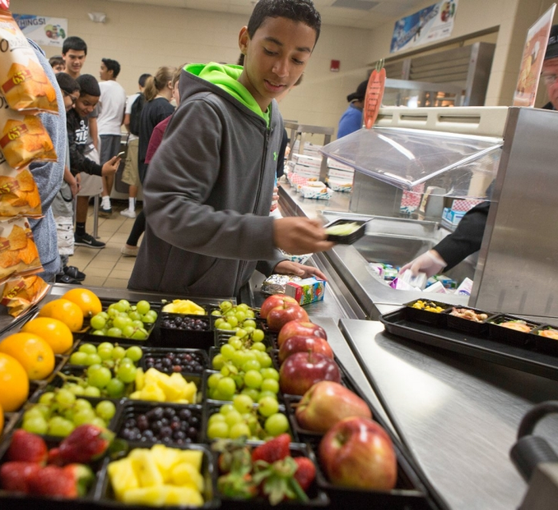
Nutrition Standards for Foods
Any food sold in schools must:
Be a “whole grain-rich” grain product; or have as the first ingredient a fruit, a vegetable, a dairy product, or a protein food; or be a combination food that contains at least ¼ cup of fruit and/or vegetable; or contain 10% of the Daily Value (DV) of one of the nutrients of public health concern in the 2010 Dietary Guidelines for Americans (calcium, potassium, vitamin D, or dietary fiber).

Slide 7
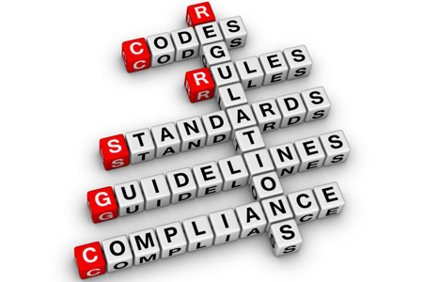
Foods must also meet several nutrient requirements:
Calorie limits
Snack items: ≤ 200 calories
Entrée items: ≤ 350 calories
Sodium limits
Snack items: ≤ 230 mg**
Entrée items: ≤ 480 mg
Fat limits
Total fat: ≤35% of calories
Saturated fat: < 10% of calories
Trans fat: zero grams
Sugar limit
≤ 35% of weight from total sugars in foods

Slide 8
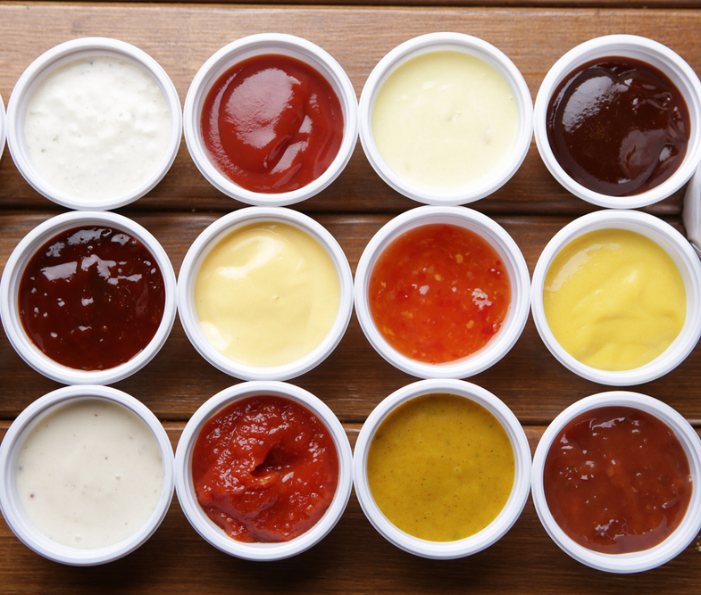
Extras
Extras such as cream cheese, salad dressing, and butter must be included in the nutrient profile as part of the food item sold.
This helps control the amount of calories, fat, sugar, and sodium added to foods.

Slide 9
Nutrition Standards for Beverages
All schools may sell:
Plain water (with or without carbonation)
Unflavored low-fat milk
Unflavored or flavored fat-free milk and milk alternatives permitted by NSLP/SBP
100% fruit or vegetable juice and
100% fruit or vegetable juice diluted with water (with or without carbonation), and no added sweeteners.

Slide 10
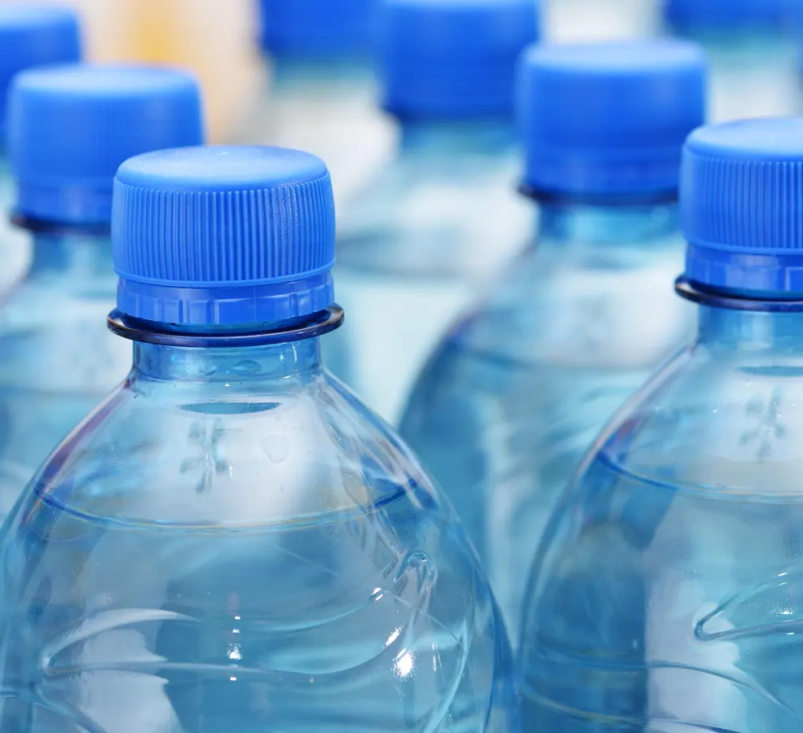
Elementary schools may sell up to 8-ounce portions, while middle schools and high schools may sell up to 12-ounce portions of milk and juice.
There is no portion size limit for plain water.

Slide 11
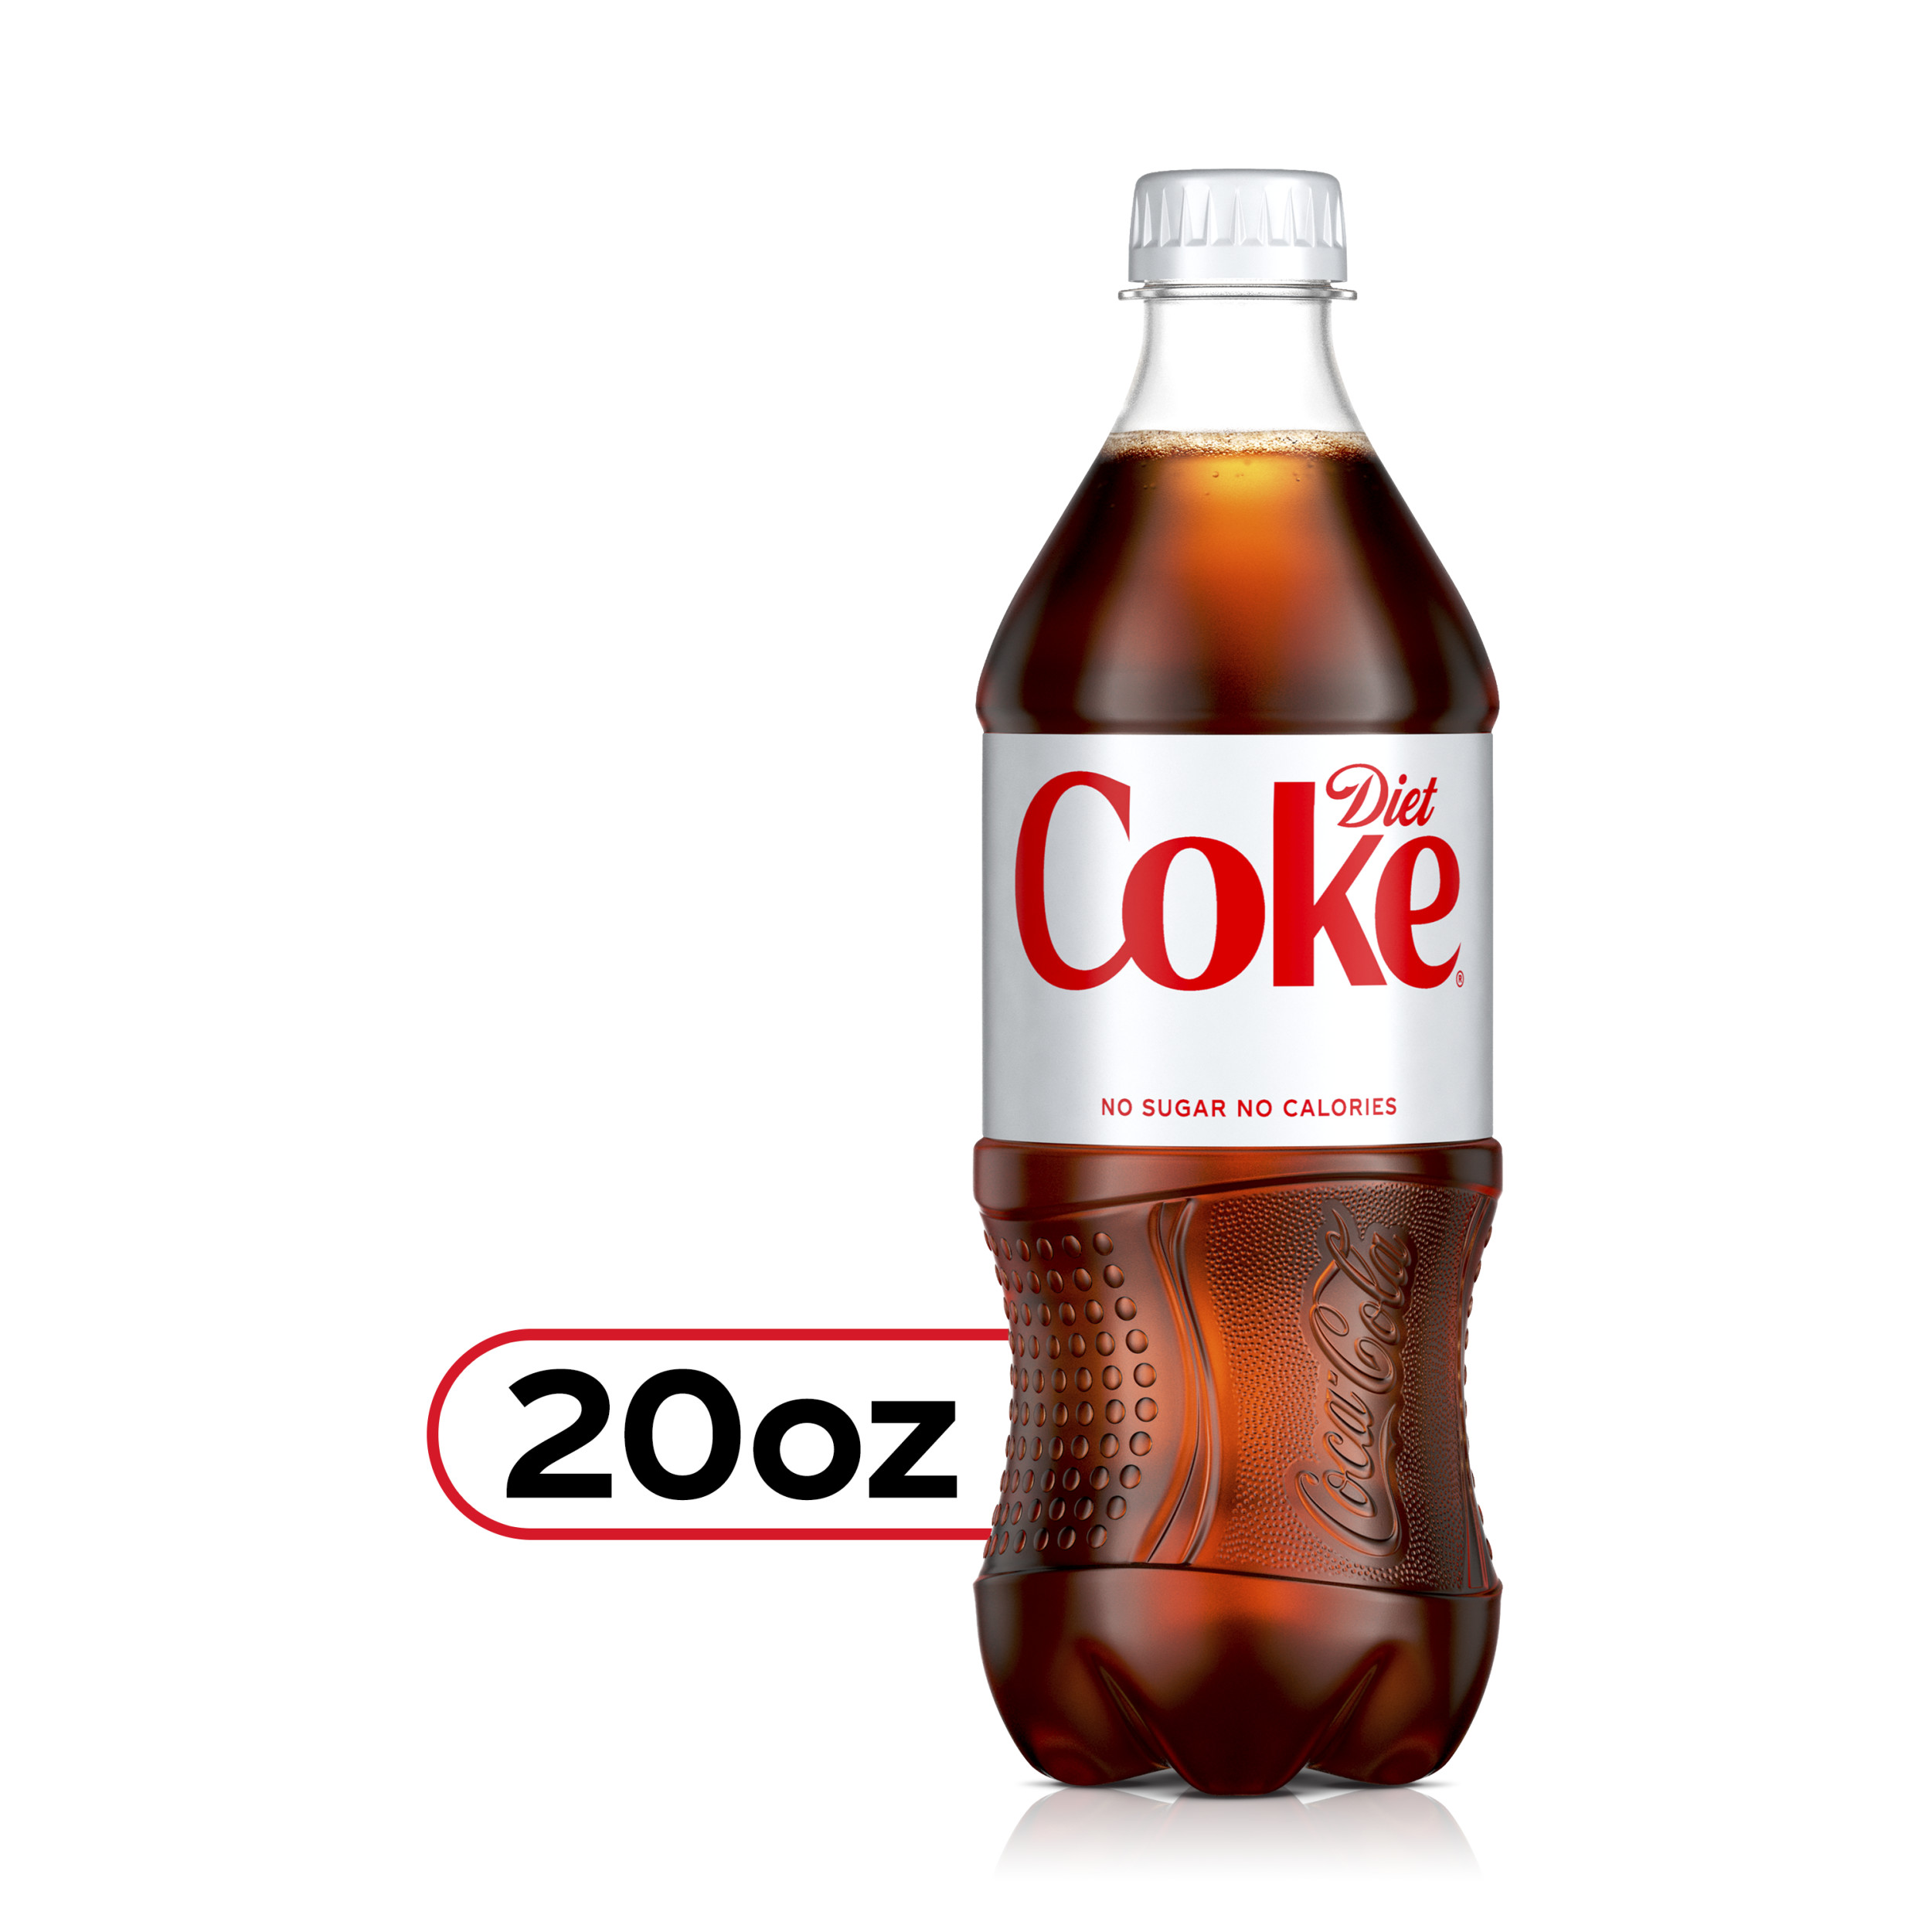
The Smart snack standards allow additional for high school:
“no calorie” and “lower calorie” beverage options
for high school students.
No more than 20-ounce portions of calorie-free, flavored water (with or without carbonation); and other flavored and/or carbonated beverages that are labeled to contain < 5 calories per 8 fluid ounces or ≤ 10 calories per 20 fluid ounces.
No more than 12-ounce portions of beverages with ≤ 40 calories per 8 fluid ounces, or ≤ 60 calories per 12 fluid ounces

Slide 12
Other Requirements: Fundraisers
A fundraiser is an event that includes an activity in which currency/tokens/tickets, etc., are exchanged for the sale/purchase of a product in support of the school or school-related activities. Examples include bake sales, candy bar sales, and vending machines where profits are used to support a school-sponsored club or activity, such as the school band or sports team.

Slide 13
The smart snack standards do not apply during non-school hours, on weekends, and off-campus fundraising events.
6.12.5.8 NMAC – A fundraiser may be conducted only up to one school day on two occasions per semester or trimester term in a school that participates in United States Department of Agriculture school meals programs.

Slide 14
Smart Snacks Scenarios You will be presented with three (3) scenarios.
Select whether Smart Snacks Standards Apply or Do Not Apply
A vending machine located outside of the lunchroom that is turned on after the last lunch period until 3:30 PM, which is the end of the normal school day.
A. Smart Snacks Standards - APPLY
B. Smart Snacks Standards – DO NOT APPLY

Slide 15
Scenario #1
Smart Snacks standards apply because food and/or beverages are being sold to students outside of the school meal programs on the school campus during the school day.

Slide 16
A concession stand is open in the lobby outside of the school gym during an evening basketball game, which starts two hours after the end of the normal school day.
Smart Snack Standards – APPLY
Smart Snack Standards – DO NOT APPLY

Slide 17
Scenario #2
Smart Snacks standards do not apply. Food and/or beverages are being sold outside of the school meal programs on the school campus, but not during the school day.

Slide 18
As part of a classroom lesson about a foreign country, a teacher brings in and offers to students' samples of food items that are commonly consumed in the country being studied.
A. Smart Snacks Standards – APPLY
B. Smart Snacks Standards – DO NOT APPLY

Slide 19
Scenario #3
Smart Snacks standards do not apply. Food and/or beverages are being offered to students outside of the school meal program on the school campus during the school day. However, the food/beverages are not being sold to students. (Note: The teacher would need to follow the school’s nutrition standards for non-sold, offered foods listed in the local school wellness policy.

Slide 20
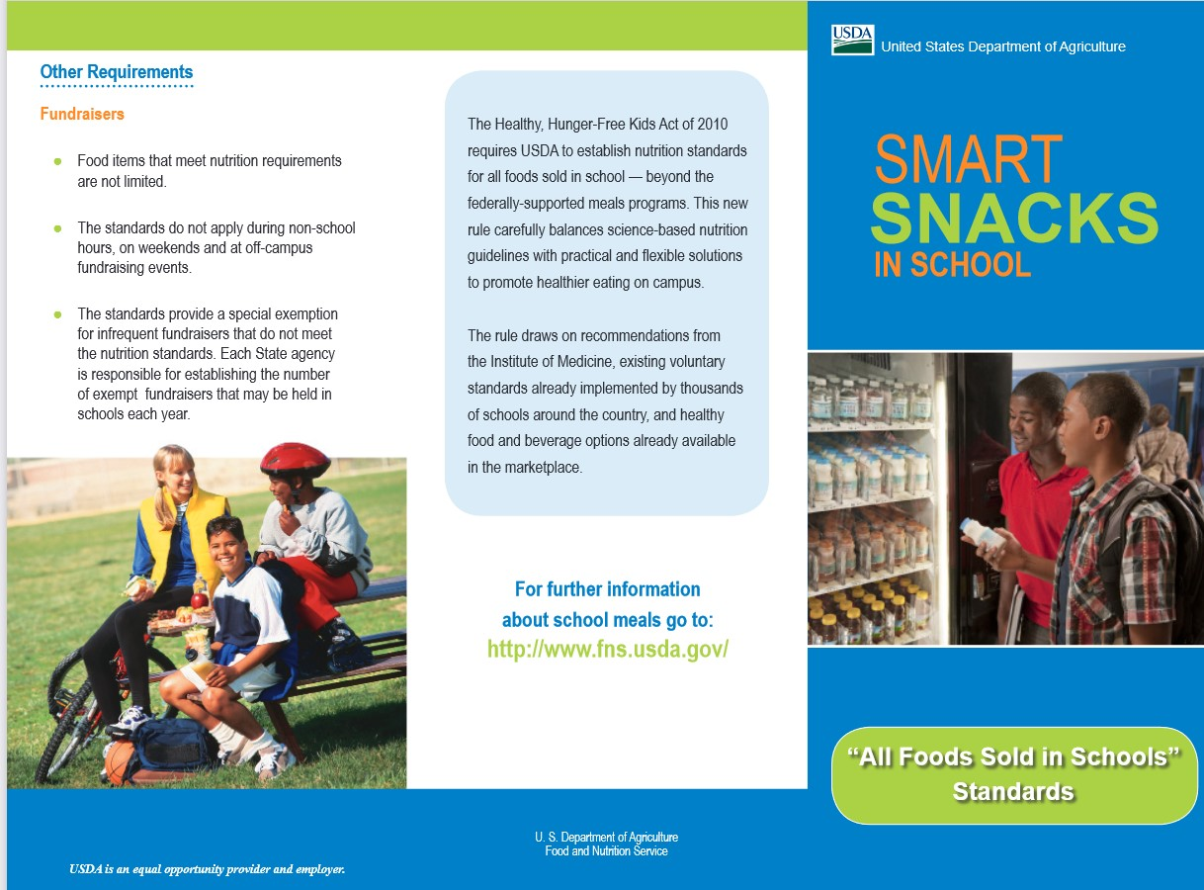
Let’s test our knowledge
You can refer to your handouts to answer.

Slide 21
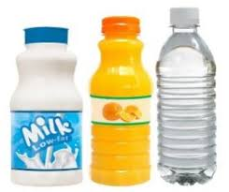
Other than plain water, the size limit for beverages in elementary schools is _____ ?
Select one:
A. 8 fl. oz.
B. 12 fl. oz.
C. 16 fl. oz.
D. 20 fl. oz.

Slide 22
The maximum serving size for a calorie-free beverage in high schools is _____ ?
Select one:
A. 12 fl. oz.
B. 16 fl. oz.
C. 20 fl. oz.
D. 24 fl. oz.

Slide 23
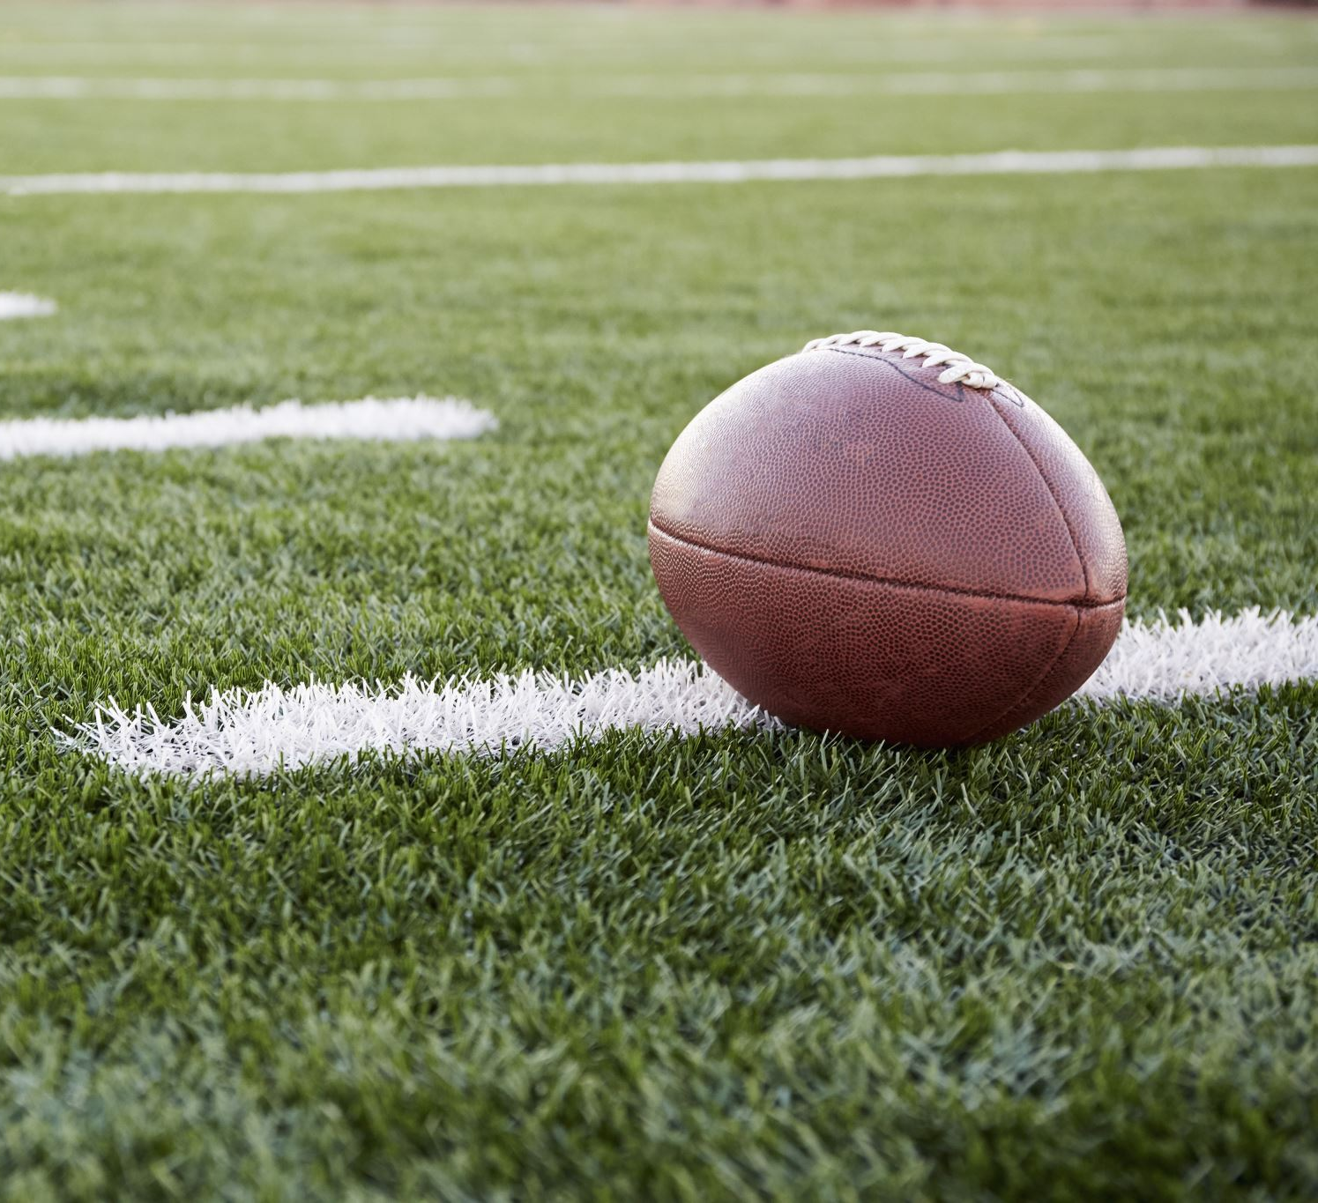
A concession stand is open during a Friday night high school football game. Do Smart Snacks standards apply to the snacks sold at the concession stand?
Select one:
a. Yes
b. No

Slide 24
Snacks that parents send to school for birthday celebrations must meet Smart Snacks standards.
Select one:
A. True
B. False

Slide 25
Plain water, low fat milk, non-fat milk, and 100% fruit/vegetable juice are allowable for sale at all grade levels.
Select one:
A. True
B. False

Slide 26
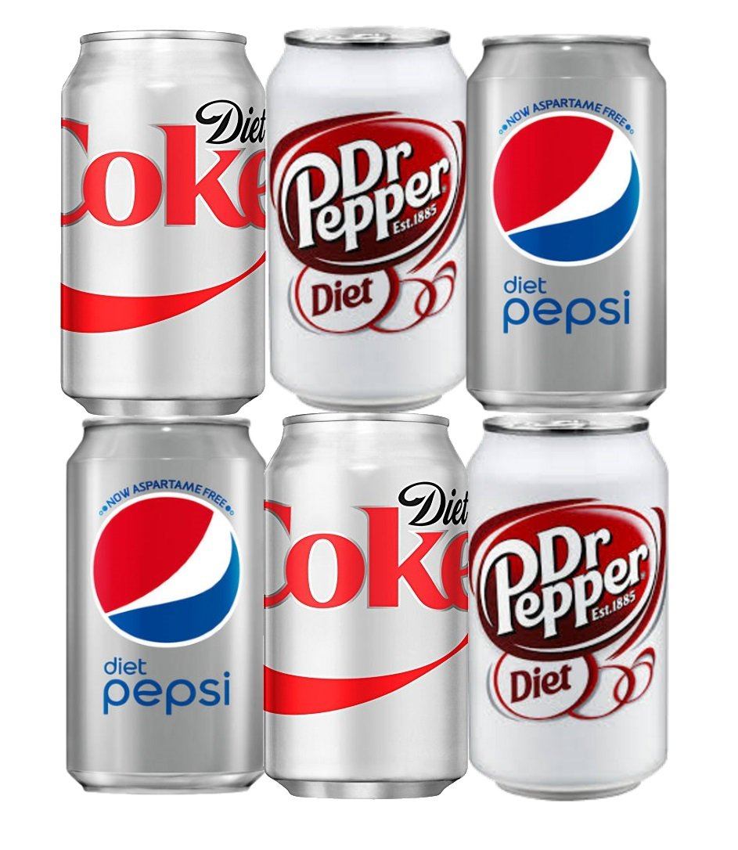
Diet soda may be sold in high schools.
Select one:
A. True
B. False

Slide 27
Smart Snacks Product Calculator
The Alliance for a Healthier Generation has developed an online calculator that can be used to determine if products meet the USDA Smart Snacks in School nutrition standards. USDA has determined that the results from the calculator are accurate in assessing product compliance.
The Smart Snacks Product Calculator can be accessed at:
https://foodplanner.healthiergeneration.org/calculator/

Slide 28
Administrative Responsibilities
Recordkeeping
Local Education Agencies (LEAs) and School Food Authorities (SFAs) are required to maintain records such as receipts, nutrition labels, and nutrient calculations or printouts from the Alliance for a Healthier Generation’s online Smart Snacks calculator.
SFAs maintain records for competitive foods sold under the nonprofit school food service account.
LEAs maintain records for all other competitive food sales, including for exempt fundraisers in each building.

Slide 29
Monitoring and Compliance
State agencies will monitor compliance with the standards through a review of LEA records as part of the state agency administrative review.
At this time, if violations have occurred, technical assistance and corrective action plans will be required.

Slide 30
If you have any questions, feel free to contact your assigned Health Educator.
In accordance with Federal Civil Rights law and U.S. Department of Agriculture (USDA) Civil Rights regulations and policies, the USDA, its agencies, offices, and employees, and institutions participating in or administering USDA programs are prohibited from discriminating based on race, color, national origin, religion, sex, gender identity (including gender expression), sexual orientation, disability, age, marital status, family/parental status, income derived from a public assistance program, political beliefs, or reprisal or retaliation for prior credible activity, in any program or activity conducted or funded by USDA (not all bases apply to all programs). Remedies and complaint filing deadlines vary by program or incident.
Persons with disabilities who require alternative means of communication for program information (e.g., Braille, large print, audiotape, American Sign Language, etc.) should contact the responsible Agency or USDA's TARGET Center at (202) 720-2600 (voice and TTY) or contact USDA through the Federal Relay Service at (800) 877-8339. Additionally, program information may be made available in languages other than English.
To file a program discrimination complaint, complete the USDA Program Discrimination Complaint Form, AD-3027, found online at How to File a Program Discrimination Complaint and at any USDA office or write a letter addressed to USDA and provide in the letter all of the information requested in the form. To request a copy of the complaint form, call (866) 632-9992. Submit your completed form or letter to USDA by: (1) mail: U.S. Department of Agriculture, Office of the Assistant Secretary for Civil Rights, 1400 Independence Avenue, SW, Washington, D.C. 20250-9410; (2) fax: (202) 690-7442; or (3) email: program.intake@usda.gov.
USDA is an equal opportunity provider, employer, and lender.

Slide 31
Thank you for your time and thank you for feeding the students of NM.
Tanya Matson
Tanya.berry1@state.nm.us
505-396-0032

Slide 32
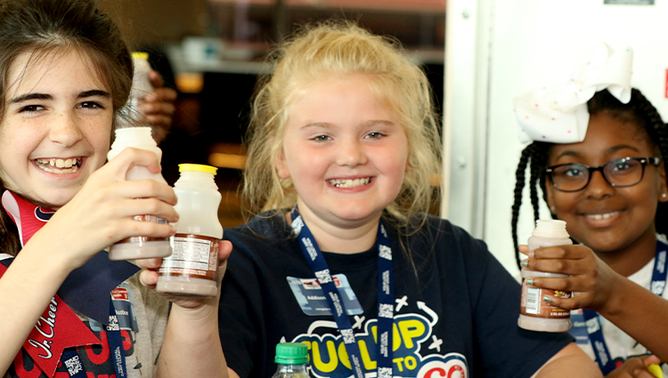
The information presented was relevant to my job.
Agree
Neutral
Disagree

Slide 33
Attending the session increased my job knowledge and will be
useful in operating a successful school nutrition program.
Agree
Neutral
Disagree

Slide 34
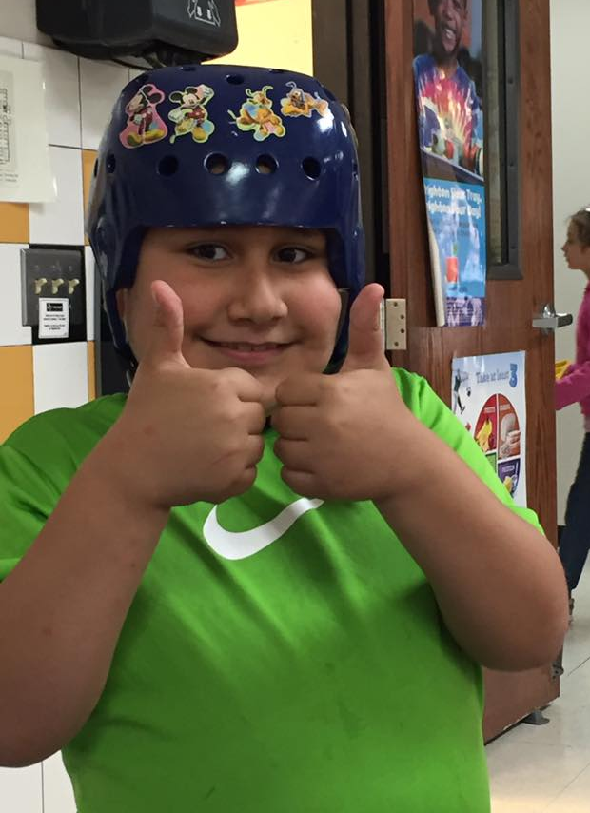
Participating in today's session was worth my time.
Yes
No

Slide 35
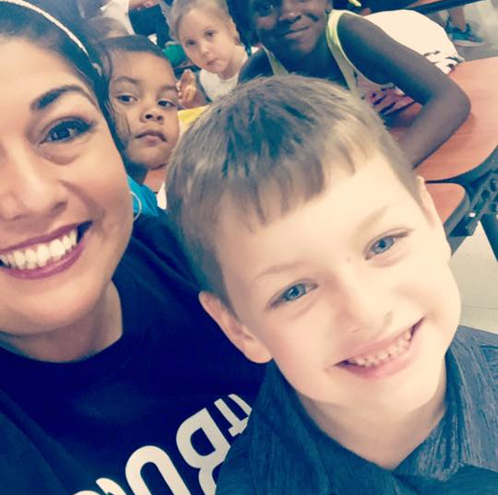
The information I found most useful was:

