Slide 1
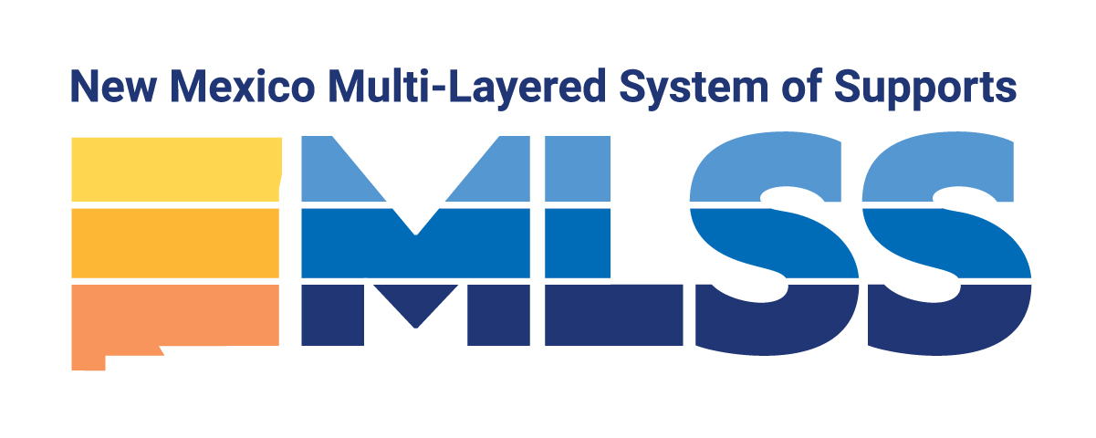
New Mexico's Multi-Layered System of Supports
An Overview for Building Successful Schools
Presenter:
Christopher Vian MLSS and Gifted Specialist
Division of Curriculum and Instruction
Investing for tomorrow, delivering today.
Notes:
To change the image on this slide, select the picture and delete it. Then click the Pictures icon in the placeholder to insert your own image.

Slide 2
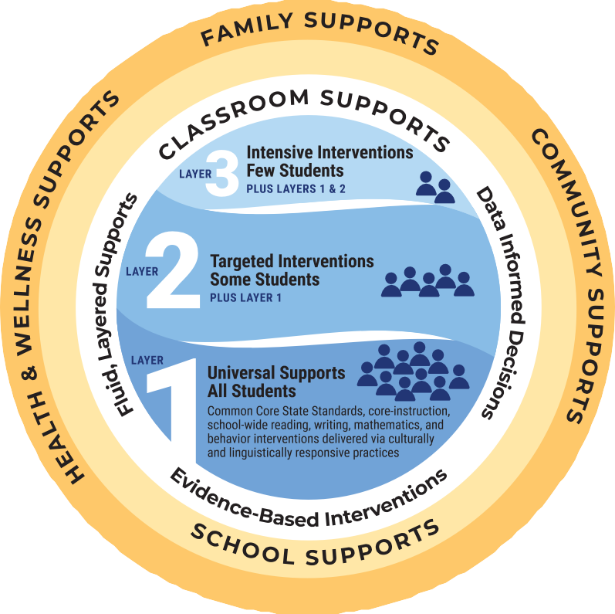
Session Objectives
By the end of this session you will be able to:
recognize the seven core elements of MLSS and be able to explain them to another educator;
understand and be able to describe the MLSS graphic components and how each component is coordinated to aid all students in being ready for college, career, life, secure in their identity and healthy;
identify student health and wellness supports and how they contribute to holistic student success; and
make connections to the positive work of New Mexico educators.
Notes:
Gwen

Slide 3
Where were you? Equity and Education
Think about the first time you realized not all students receive an equitable education.
Year
Place
Your role
Brief context: 2-3 sentences
You can apply it to your own experience, education or discuss a specific instance
Author: Sharroky Hollie
Culturally and Linguistically Responsive Teaching and Learning (2nd Edition)(2017)

Slide 4
What is the MLSS?
New Mexico’s adaptation of the Response to Intervention (RtI) framework.
This support is accomplished by identifying and supporting students’ learning and behavioral needs, and by recognizing and providing the resources teachers, health and wellness personnel and school administrators require for full implementation and long-term sustainability of MLSS.
Notes:
Gwen

Slide 5
What is in NMAC?
Updates the instructional framework and guidance on the response to intervention (6.29.1.9 NMAC) process in New Mexico to be less burdensome, more comprehensive, and to include resources available at each layer of support.
All students shall have access to layer 1, 2, and 3 interventions without a need to convene a SAT team or a referral to special education or related services.
At any layer, a parent may request initial evaluation to determine whether a student is a child with a disability requiring special education and related service.
There are no additional documentation requirements under the MLSS outside of what is already required for education professionals.
Notes:
Gwen

Slide 6
Seven Core Components of MLSS DASH Aligned
Classroom Supports
Data-driven Instruction and Data-informed Decision Making
High-Quality Core Instruction and Intervention
School Supports
Informed and Effective School Leadership and Systems
Collaboration and Processes for Providing Layered Supports
Positive School Culture and Climate
Health and Wellness Supports
Student Wellness
Family and Community Supports
Family and Community Engagement
Notes:
Gwen

Slide 7
Why MLSS?
The MLSS model will provide support to ALL students including students who are migrant, in foster care, experiencing homelessness, and students with disabilities. MLSS will allow teachers and health and wellness staff to intervene quickly when students are struggling academically or behaviorally by providing immediate support to those students in an educational crisis.
Dufour discusses the need to get away from the “if” that determines success
If you have: a good home, an IEP, good behavior, etc.
MLSS empowers teachers to use their professional judgement and make data-informed decisions regarding the students in their classrooms.
Decisions regarding layered interventions are made by the classroom teachers and support personnel closest to the students.
MLSS reinforces the fact that ALL students are general education students first.
Notes:
Gwen

Slide 8
How is MLSS different from RtI?
Some of the differences between MLSS and the former Response to Intervention (RtI) model:
Layer 3 is not Special Education. Layer 3 intensive supports are for ANY student who needs them.
There is no specified minimum amount of time for a student receiving a layer of supports to wait before determining the effectiveness, or lack thereof, of the interventions.
Students may move up and down the layers of supports as data indicate.
Notes:
Gwen

Slide 9
The Efficacy of RtI
Notes:
Gwen

Slide 10
ALL MEANS ALL
Under the previous RtI model:
students with disabilities could not get services until they reached Tier 3;
once a student was moved to Tier 3, a student would no longer receive Tier 1 & 2 interventions;
Students with disabilities who were also identified as English Learners (EL) would no longer receive Tier 1 & 2 interventions.
MLSS directly confronts structures that stifle equity and limit opportunities for ALL subgroup populations identified in ESSA by making intensive intervention systems available to ALL struggling learners and reducing the number of harmful pull out situations.
Notes:
Gwen

Slide 11
Core Component Activity (10min)
Read the Core Components descriptions for each listed below on pages 5-7.
As a group, come to a consensus on which of the Core Components you believe your schools are doing well. In the first space provided, discuss what (programs, policies, procedures) your schools are doing to meet the guidance provided in that section.
As a group, come to a consensus on which of the Core Components you believe your schools could improve upon. In the second space provided, discuss what (programs, policies, procedures) your schools could implement to ensure alignment with the guidance provided.
If you have any remaining questions, please record them in the last space provided.

Slide 12
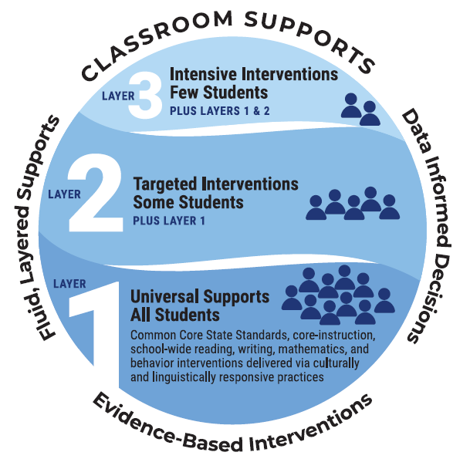
Classroom Supports
Classroom supports are provided by the instructor in a responsive, data-driven, and efficient manner. Each of the three-layers of the MLSS takes part in the classroom.
High-quality core instruction and interventions
Data-driven instruction and data-informed decision making
Note: All supports and interventions that live inside the classroom are supplemented by the school, health & wellness, community, and family supports in a fluid and consistent manner.
Notes:
Gwen

Slide 13
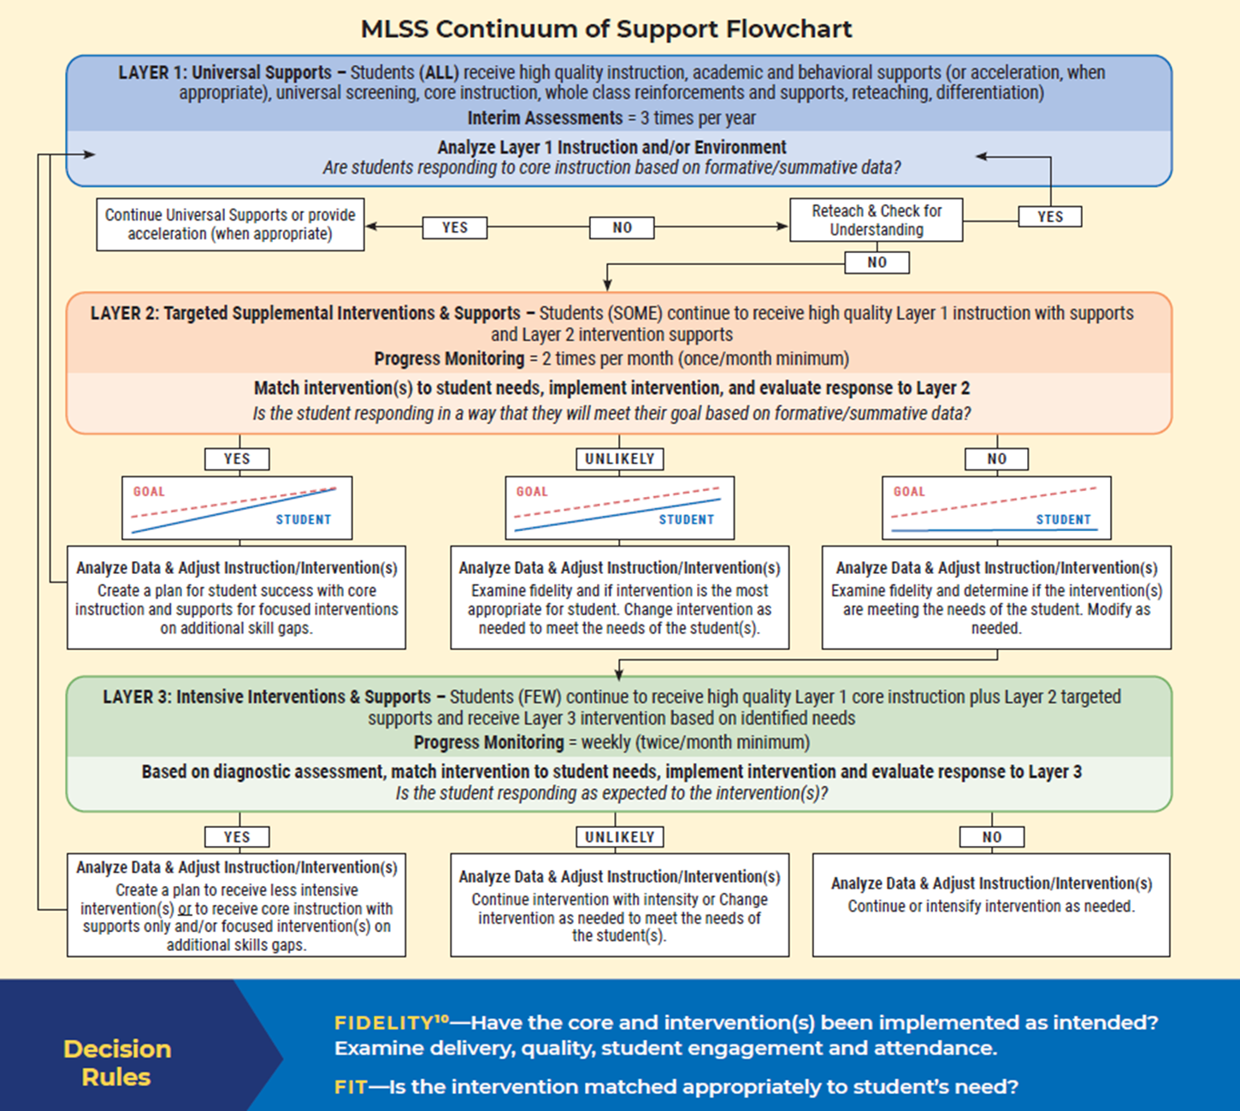
Moving Through the Layers
As educators see a need for more intensive academic and behavioral supports it is essential to remember that:
students may now move up and down through the layers without having to “live” in one area;
though our students are diverse and have a variety of strengths and needs, they all have a right to access universal, Layer 1, interventions;
at each layer, interventions must have evidence to support their effectiveness.
Notes:
Gwen

Slide 14
Moving Through the Layers
As educators see a need for more intensive academic and behavioral supports it is essential to remember that:
students may now move up and down through the layers without having to “live” in one area;
though our students are diverse and have a variety of strengths and needs, they all have a right to access universal, Layer 1, interventions;
at each layer, interventions must have evidence to support their effectiveness.
Notes:
Gwen

Slide 15
Layer 1: Supports for ALL students
6.21.1.9 (E) (1): In layer 1, the school and school district shall ensure that adequate universal screening in the areas of general health and well-being, language proficiency status, and academic levels of proficiency has been completed for each student enrolled. If data from universal screening and progress monitoring suggests that a particular student is in need of additional behavioral and academic supports, then teacher teams shall make a determination on whether or not the student would benefit from layer 2 interventions. Teacher teams, when making a determination for moving a student up or down a layer may consult with non-teacher staff such as counselors, paraprofessionals, administrators, and ancillary personnel to inform the teacher team on how to plan and implement relevant learner interventions in the general education environment.
Notes:
Gwen

Slide 16
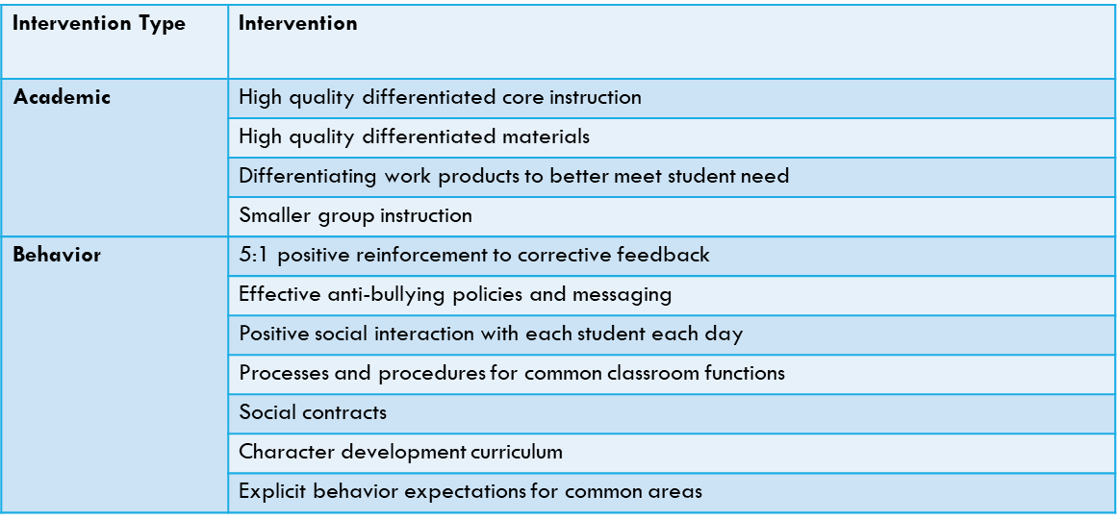
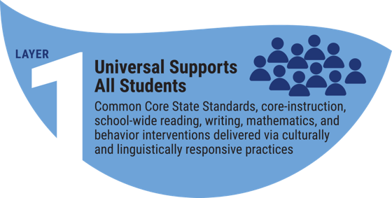
Layer 1: Supports for ALL students
Notes:
Gwen

Slide 17
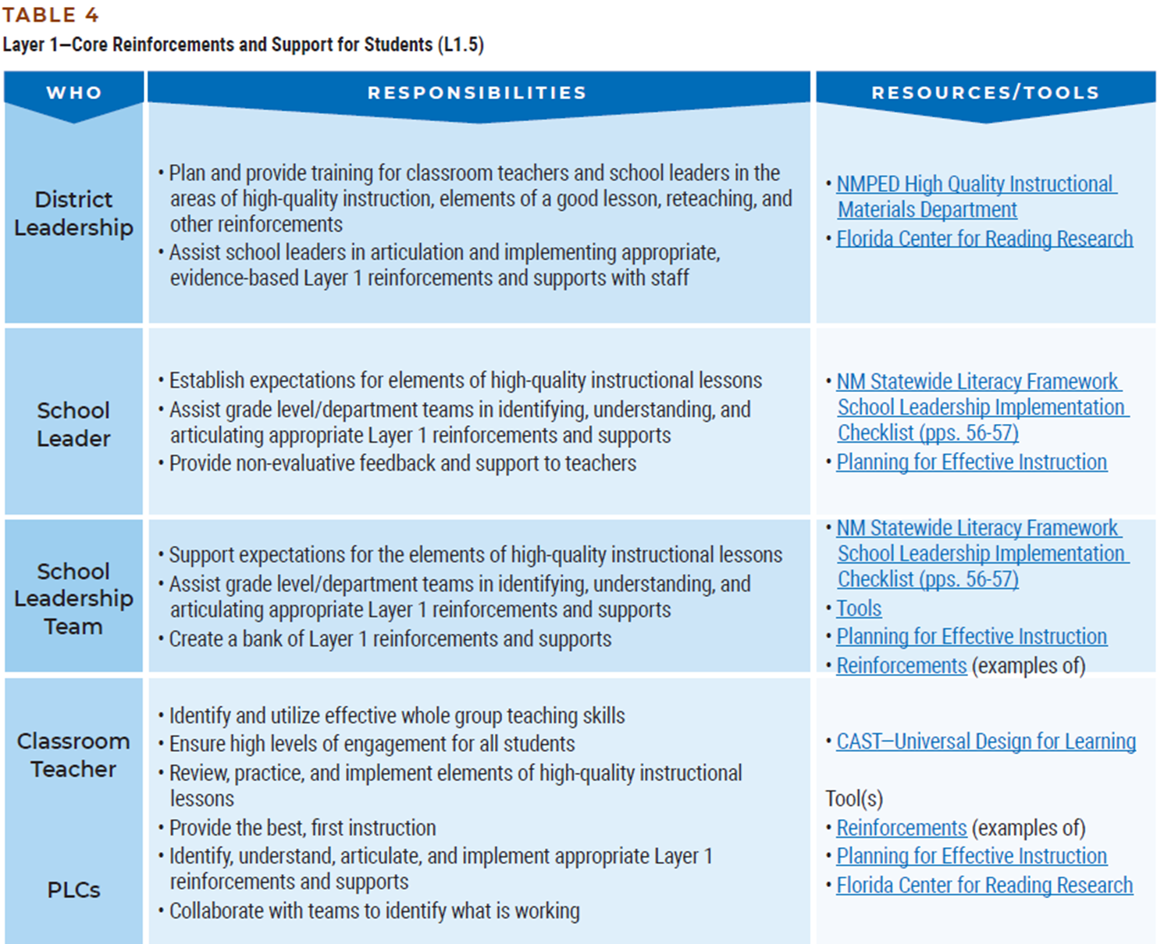
Layer 1: Supports for ALL students
All levels of educator leadership have a direct part in ensuring that Layer 1 (Universal) supports are provided to ALL students, especially students with IEPs, BIPs and AIPs
Notes:
Gwen

Slide 18
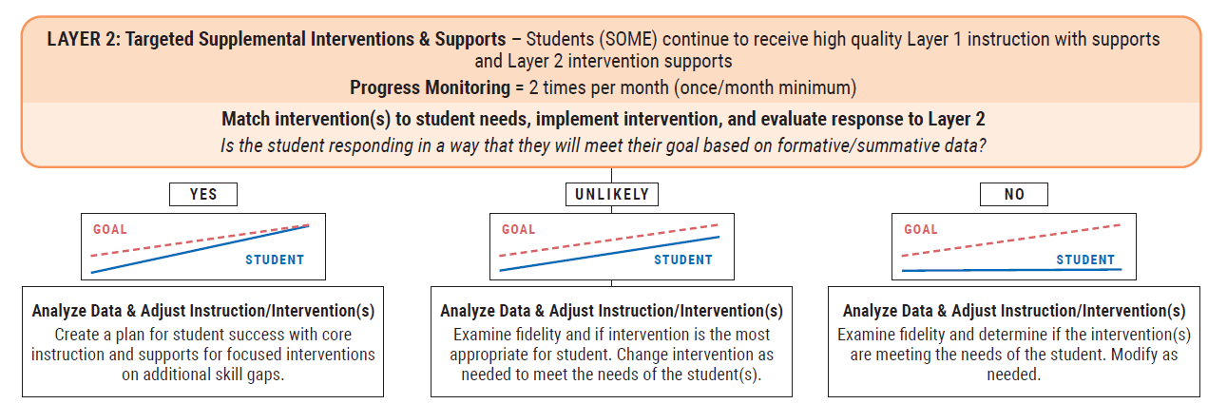
Layer 2: Targeted Interventions for SOME students
6.21.1.9 (E) (2): In layer 2, a properly-constituted teacher team shall conduct the student study process and consider, implement, and document the effectiveness of appropriate evidence-based interventions utilizing curriculum-based measures. As part of this process, the teacher team shall address culture and acculturation, socioeconomic status, possible lack of appropriate instruction in reading or math, teaching and learning styles and instructional delivery mechanisms in order to rule out other possible causes of the student's educational difficulties.
Notes:
Gwen

Slide 19
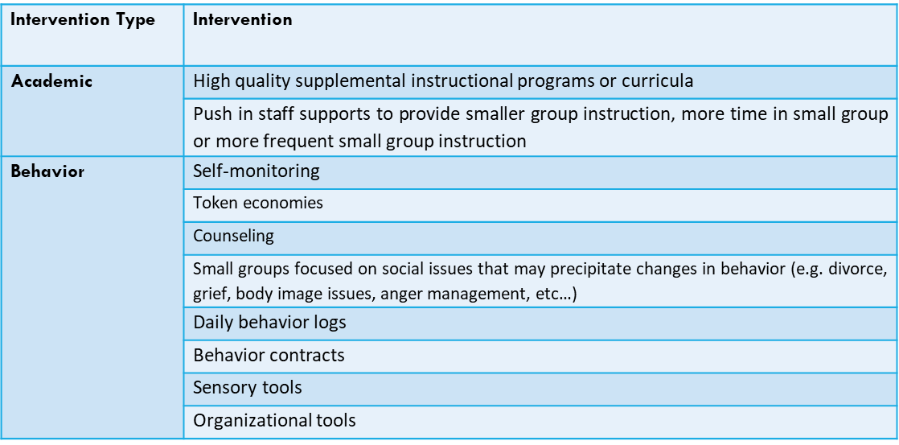
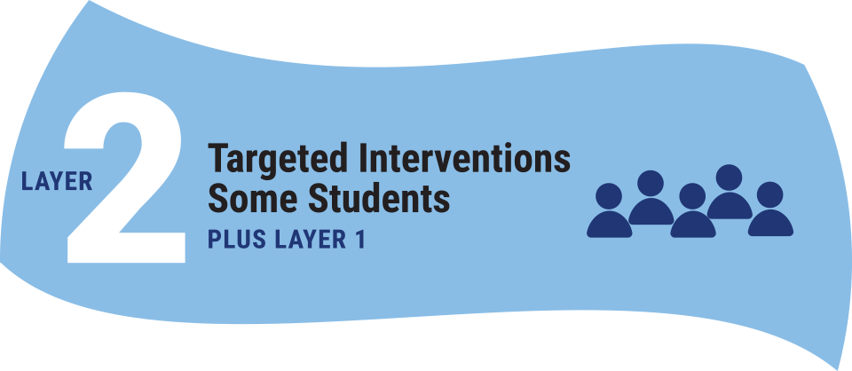
Layer 2: Targeted Interventions for SOME students
Notes:
Gwen

Slide 20
Layer 3: Interventions for FEW students
6.21.1.9 (E) (3): In layer 3, students are provided with intensive academic and behavioral supports that are progress monitored on a bi-weekly basis. At the end of each progress monitoring cycle, the teacher team shall evaluate the efficacy of the supports provided using all available data. At that time, the teacher team may decide whether to continue with the current support, change the intensity, or nature of support. If progress monitoring data suggests that the learner has benefited from provided layer 3 supports and does not show concern for recidivism, than the teacher team may decide to move the student out of receiving layer 3 supports.
Notes:
Gwen

Slide 21
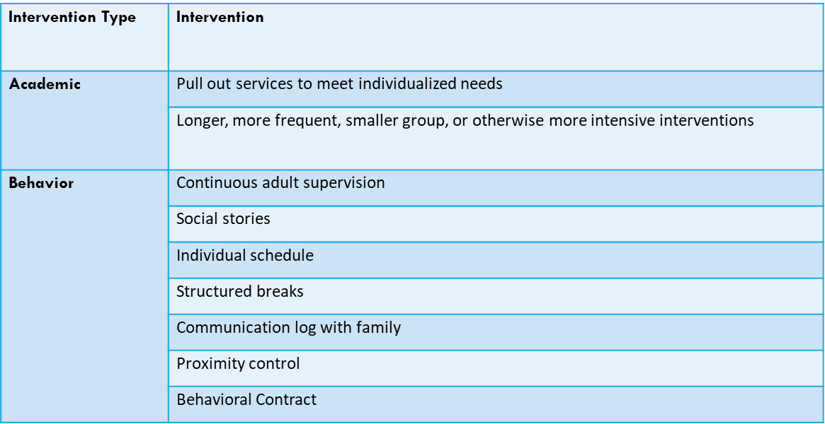
Layer 3: Intensive Interventions for FEW students
Notes:
Gwen

Slide 22
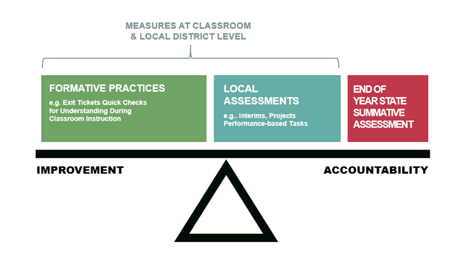
Balanced Assessment System
Gauge current status of student achievement status by using multiple measures / sources of evidence
Assessments should not be used to withhold grade-level content.
Notes:
Lynn

Slide 23
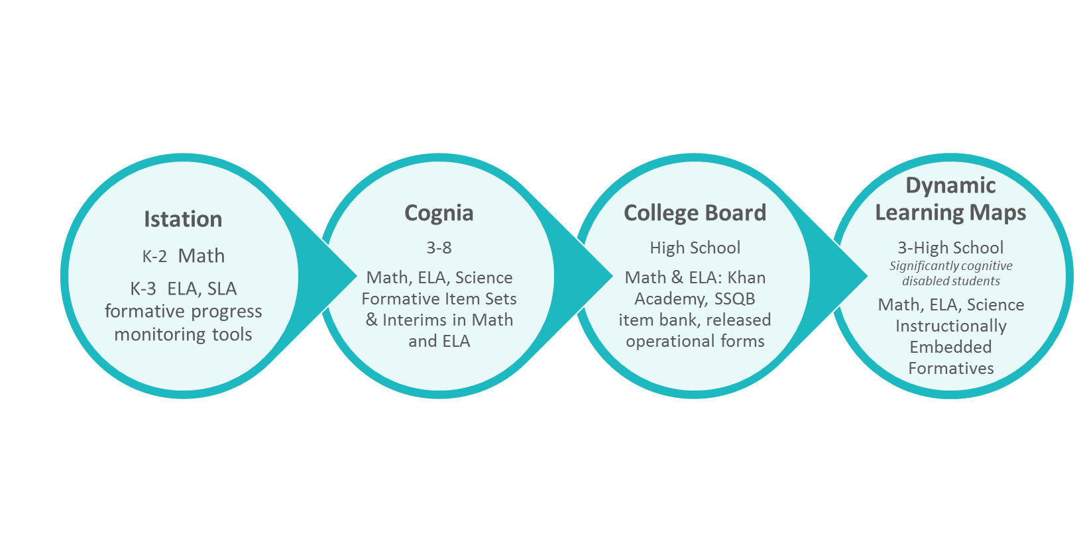
Assessment Resources

Slide 24
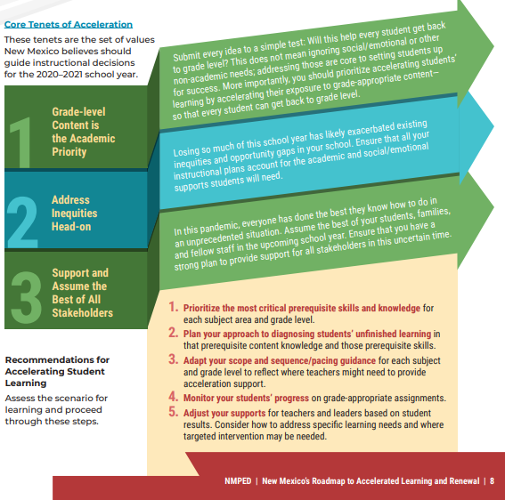
NM Instructional Acceleration
Guidance:
https://webnew.ped.state.nm.us/wp-content/uploads/2020/07/NMPED_SupportDoc_InstructionalAcceleration-1.pdf
Notes:
Jacque

Slide 25
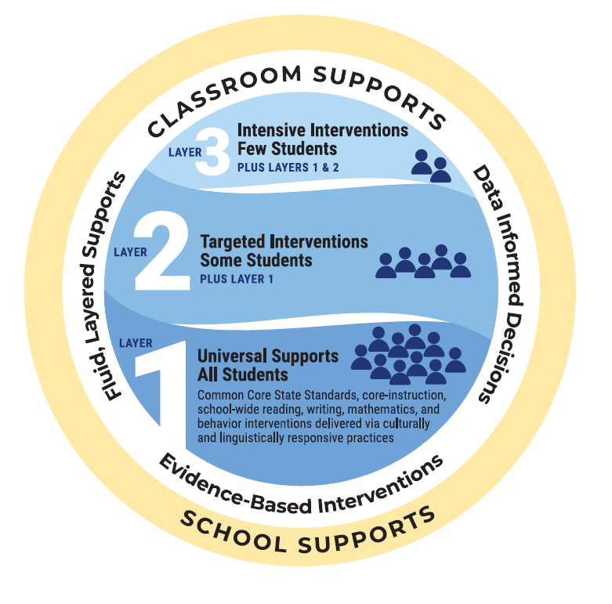
School Supports
School supports provide educational professionals with the climate and systems necessary to address student needs within the classroom:
Informed and effective school leadership and systems
Collaboration and processes for providing a layered continuum of supports
Positive school culture and climate
Notes:
Gwen

Slide 26
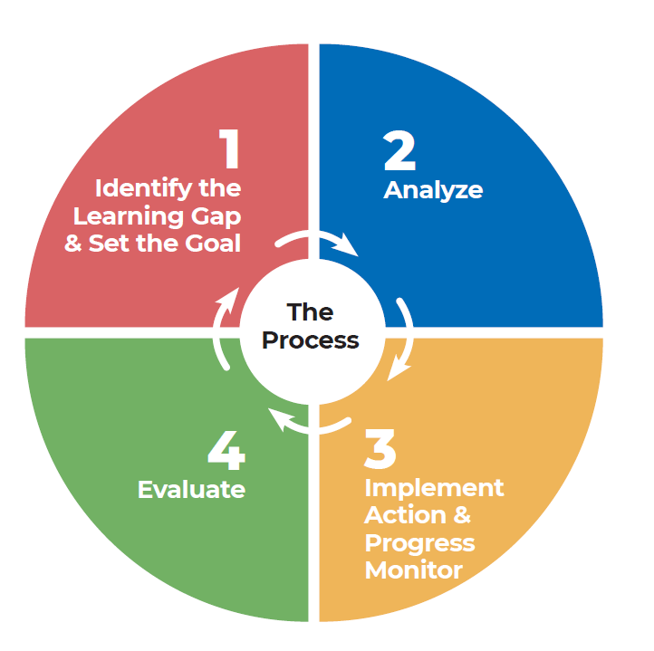
School Supports – PLCs
Teachers and other team members, such as a school counselor and specialists in different areas, meet to identify students in need of interventions and determine what interventions should be used.
This helps make support for individual students part of every classroom, rather than instructional interventions taking place only in isolated environments.
As teachers systematically apply supports, collect data, and monitor results, a team meets regularly to discuss student progress.
Dufour: The school should be a PLC, not just have PLCs
Notes:
Gwen

Slide 27
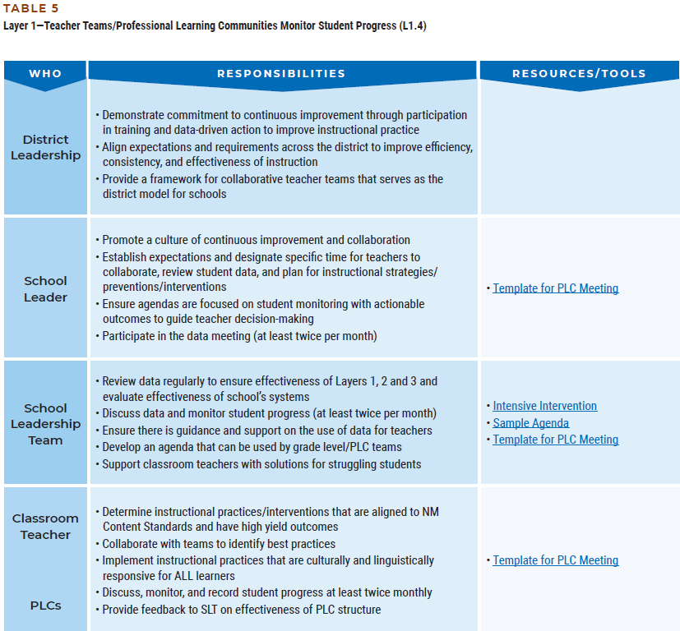
School Supports – PLCs
Collaborative teacher meetings are purposeful, data-driven, and supported by district and school administrators.
PLCs are inclusive of support staff and meet to identify students in need of interventions and determine what interventions should be used.
As teachers systematically apply supports, collect data, and monitor results, a team meets regularly to discuss student progress.
Notes:
Gwen

Slide 28
Wrap Around Supports
Students often require supports that exist outside of the school walls. Therefore, when addressing the academic and behavior needs of students, it is imperative that we consider the following:
Health and Wellness Supports
Family Supports
Community Supports
Note: It is important to remember that these are SUPPORTS to the interventions that we provide in the classroom. The responsibility to address a student’s needs lives within the walls of the school.
Notes:
Gwen

Slide 29
Health and Wellness Supports
Coordinated school health programs provide a collaborative framework for linking health and education:
Partnerships with community-based organizations to enhance learning
Health education and life skills
Healthy and safe environment
Social and emotional wellbeing
Staff wellness
Family, school, and community partnerships
Health services
Physical education and activity
School-based and school-linked health care services
Notes:
Gwen

Slide 30
Family Supports
Family support and engagement supports student success by providing parents with strategies and skills to support their children in meeting learning targets:
Quiet time at home
Volunteering at school
Reading to students
Communicating with teachers
Parent teacher conferences
Family stability
Case management
Notes:
Gwen

Slide 31
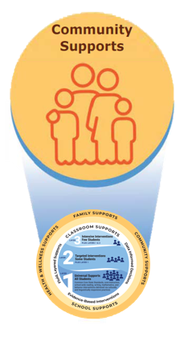
Community Supports
Community schools address the holistic needs of the student and the community at large:
Integrated student supports
Expanded and enriched learning time and opportunities
Active family and community engagement
Collaborative leadership and practice
Notes:
Gwen

Slide 32
SAT Overview
What is staying the same?
All of the requirements for SAT in NMSA & NMAC
What has changed?
What has changed is the method to which students get to SAT:
PLC Referrals: PLCs are the first line of defense against of the over-referral of students to SAT and Special Education
Are NMPED approved forms required for SAT?
No. LEAs (districts & state-authorized charters) may use whichever forms they have developed that best meet the needs of their students and teachers.
Sample forms are provided in the Supplemental SAT Guide (MLSS Webpage)
Notes:
Gwen

Slide 33
Highlights from 2021-2022
809 schools worked to submit the MLSS Self-Assessment
287 LEA coaching reports generated
2,738 LEA coaching hours provided
NEW SAT Forms & Process released
Notes:
Gwen

Slide 34
Looking Forward to 2022-2023 Principles of Practice
Building teacher collaborative teams (PLC) to act as the first line of defense against the over-referral of students to SAT and Special Education
Focus on accelerated learning practices to ensure equitable access to grade-level instruction and resources
“Grade-level standards are the floor, not the ceiling”
Implementation of high-dosage tutoring to support Layer 2 & Layer 3 interventions
Use of the New Mexico Instructional Scope (NMIS) to ensure that instructional planning utilizes the principles of the Universal Design for Learning (UDL)
Notes:
Gwen

Slide 35
Updated Resources
Resources available on our updated webpage:
Manuals and Guidance:
NEW MLSS Manual
NEW MLSS Implementation Guide
SAT Forms & Process
Trainings, Resources and Tools:
Four MLSS Canvas Courses
Designed for all stakeholders and educators
Updated MLSS Self-Assessment
MLSS Continuum of Support Flowchart
Updated MLSS Implementation Rubric
Notes:
Gwen

Slide 36
Requirements for Districts/Charters:
Each LEA (district/state-authorized charter) is required to:
Assign a team member to act as the MLSS POC
POC attends monthly statewide webinars
POC ensures that all schools have submitted the MLSS Self-Assessment
Notes:
Gwen

Slide 37
Services Available to ALL
Coaching hours (3hr/month)
Clarifying guidance
Assisting schools with submitting the MLSS Self-Assessment
Developing PLC’s across districts/charters
Attending leadership meetings
Analyzing data and creating implementation plans
Call your coach and ask!
Notes:
Gwen

Slide 38
Resources for POCs and Principals
Culturally and Linguistically Responsive Teaching and Learning (2nd Edition)(2017)
Leaders of Learning: How District , School, and Classroom Leaders Improve Student Achievement (2011)
Revisiting Professional Learning Communities at Work: Proven Insights for Sustained, Substantive School Improvement (2nd Edition)(2021)
Notes:
Gwen

Slide 39
Thank you!
Resources:
Please access the MLSS Webpage (link below) for the most up-to-date guidance on MLSS and related programs:
https://webnew.ped.state.nm.us/bureaus/multi-layered-system-of-supports-mlss/
Contact:
Christopher Vian
505-412-9979
christopher.vian@ped.nm.gov

Slide 40
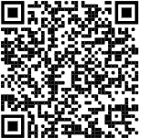
Participation Survey
Notes:
Gwen

