Slide 1
New Mexico Public Education Department (PED)
Youth Engagement Program

Slide 2
A Shared Philosophical Understanding
Meaningful youth engagement is an inclusive, intentional, mutually respectful partnership between youth and adults whereby, respective contributions are valued, and young people's ideas, priorities, needs, perspectives, skills, and strengths are integrated into the design and delivery of meaningful programs, strategies, policies, and funding mechanisms that directly impact them and their communities. With impetus from (www.youthpower.org)

Slide 3
Mission
The youth engagement program seeks to empower young people, create meaningful partnerships, and encourage their unique perspectives to be heard as they become valued change agents in the education, legislation, initiatives, systems, and programs that impact their lives and their communities.

Slide 4
Youth Engagement Program Goals
To empower young people across the state of New Mexico to help facilitate the relevant changes that need to be made in our educational system to better address the needs of its communities
To generate important dialogue by young people and is then shared with the power brokers around the state
To create a meaningful partnership between state agencies and the communities they serve
To move to the forefront the real challenges/issues that the state’s young people encounter daily
To give voice to those who are often marginalized within the state’s educational and legislative systems
To contribute to the understanding of the real legislation, initiatives and programs that would benefit New Mexican communities

Slide 5
What are the benefits of the Youth Engagement Program?
Young people benefit by gaining skills, knowledge, self-esteem, and connectedness.
Adults benefit by enhancing their own competencies, learning to better understand and value youth, and increasing their commitment and energy to their organizations.
Organizations benefit by improving their programs, gaining community recognition, and attracting funders.
Communities benefit by improving quality of life, coordinating youth services, and authentically embracing diversity by representing young people. https://actforyouth.net/youth_development/engagement/
State Agencies benefit by understanding and moving forward relevant and appropriate legislation that directly addresses the needs of its young people and its communities

Slide 6
Mark Kolokoff
PED Youth and Community Liaison
Mark is a Chicago native and has been teaching for over three decades. He holds a BA in Theatre, a dance minor, and an MA in Theatre Education from the University of Northern Colorado (UNC).
Mark has directed over 75 theatre production ranging from straight plays to musicals and loves the creative process!
He was Colorado’s High School Theatre Teacher of the Year in 2009, given the Educator’s Award by UNC’s Graduate Program in 2012 and inducted into the Colorado State Thespian Hall of Fame in 2013.
As the new Youth and Community Liaison, Mark is very excited to continue his work with the young people of New Mexico and help facilitate having their voices impact their education and access to opportunities.
Mark has been married to Jeannette for 39 years and has two children, Briana, and Weston. He also enjoys playing Pickle Ball, cultivating roses, working with dogs (especially his poodle, Roxie) and of course, theatre.

Slide 7
Youth and Community Liaison Job Responsibilities
The Youth and Community Liaison will:
Manage:
the Secretary’s Student Advisory Council
legislative engagement opportunities
student networking
creation of resources, toolkits, and communication artifacts
local and statewide events

Slide 8
Facilitate:
the SAC monthly and quarterly meetings
youth engagement events and youth summit
schools in developing positive home-school relationships with families
communications with stakeholders
the creation of youth engagement programs
the building of statewide coalitions on key issues, supporting civic and legislative engagement serving and including youth engagement stakeholders-
parents and families
community-based organizations
state-wide partnerships
schools and educators
legislative leaders
State-wide New Mexico communities
divisions within the agency
other youth groups

Slide 9
Engage:
in meaningful communication and feedback regarding key initiatives
in collaboration with youth and community organizations and divisions
in the promotion of engagement opportunities to target audiences
in consultation and advisement to the executive leadership team regarding youth issues and priorities
in support for the agency’s strategic outcome efforts/plans

Slide 10
Youth Engagement Program Structure

Slide 11
PED Youth Engagement Structure
Youth Issues (partial list)
Depression/Mental Health Violence in Schools
Stress Education Inequality/Equity
Academic Pressures Bullying
Sexual Activity Academic Problems/Success
Peer Pressure Social Media
Identity Racism
The New Normal Growing Up Too Fast
Drug/Alcohol Abuse Indigenous people’s Issues
Poverty Time Management
Vision and Framework E=engagement/G=goal)
Participate in the dialogue (E) Establishing a shared language (E)
Alignment to strategic priorities (G) Welcoming all families (G)
Communicating effectively (E) Supporting student success (G)
Speaking up for every child (G) Sharing leadership (E)
Collaborating with communities (E
Families
Business
Community
Responsive
Transformative
Leadership/
Voice
Training
Student Centered
PED
Communities/
Adults
Student
Advisory Council
PED
Youth and Community
New Mexico’s Youth
PED
Vision and Framework
Core Values
Innovative
YOUTH
VOICE
YOUTH
VOICE
Liaison
Collaborative
Reflective
Advocacy
Change
Agent
YOUTH VOICE
Civic
Organizations
Laws
Practices
NM Youth
Organizations
State
Agencies/
Legislation
Policies &
Initiatives
Programs

Slide 12
Communication
Process
Share/Listen
Youth
Organizations
Schools
PED
Civic Leaders
Adults/
Families
Reflect
Validate
Youth
Voice
S.A.C.
Act
Reflect

Slide 13
Student Advisory Committee member’s duties
Attend all monthly and quarterly virtual meetings with PED liaison
Compile and prioritize youth issues
Act as liaison for one of the five regions (this will be done in teams of 2or 3)
Attend virtual regional meetings to discuss relevant issues (Fall/Winter, 2021-22)
Take part in Inspire 2022 student panel
Plan for break-out session during Secretary’s Community Advisory Conference
Or
Attend Youth Summit 2022, if offered
Or
Plan on implementing pilot School-Based Peer2Peer Support Program

Slide 14
Alignment with PED’s Strategic Plan
Youth Support,
Possible Actions/Programs

Slide 15
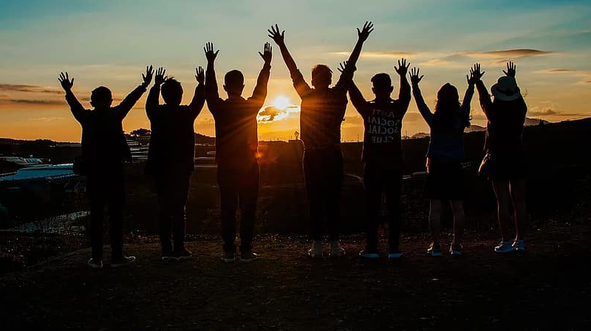
School-Based Peer2Peer Support Groups

Slide 16
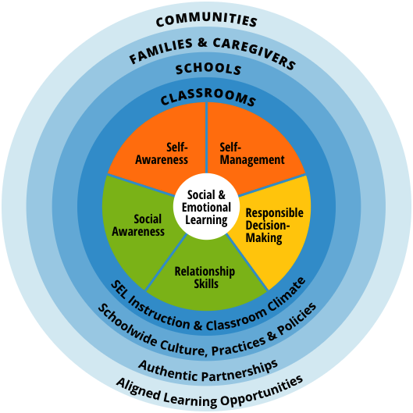

Slide 17
New Mexico’s Public Education Department’s Strategic Plan includes the following language related to social-emotional learning (SEL)
“Ensure that every school provides consistent opportunities for students to cultivate, practice, and reflect social and emotional competencies (self- awareness, self-management, social awareness, relationship skills, and responsible decision-making)“
“A whole child and culturally responsive education includes the development and integration of social and emotional learning (SEL) into academic learning. Social-emotional skills (e.g., self-regulation, collaboration, problem-solving, conflict resolution, perseverance, resilience) are also essential in 21st century”
“Culturally responsive SEL also provides a means for building skills for critical examination of existing biases and inequities and promotes more equitable outcomes”
“A growing body of research in the learning sciences demonstrates that all children learn when they feel safe and supported. Each child, regardless of background, needs both supportive environments and well-developed abilities to manage stress and conflict”
“Another review of 327 school climate studies found that support for student psychological needs and academic accomplishment is reflected in higher grades, higher test scores, and increased motivation to learn and is associated with strong interpersonal relationships, communication, cohesiveness, and belongingness between students and teachers”
“Effective practices implemented as a result of the social and emotional learning framework indicates that students gain increased social and emotional learning competencies, including self-awareness, self- management, social-awareness, relationship skills, and responsible decision-making”

Slide 18
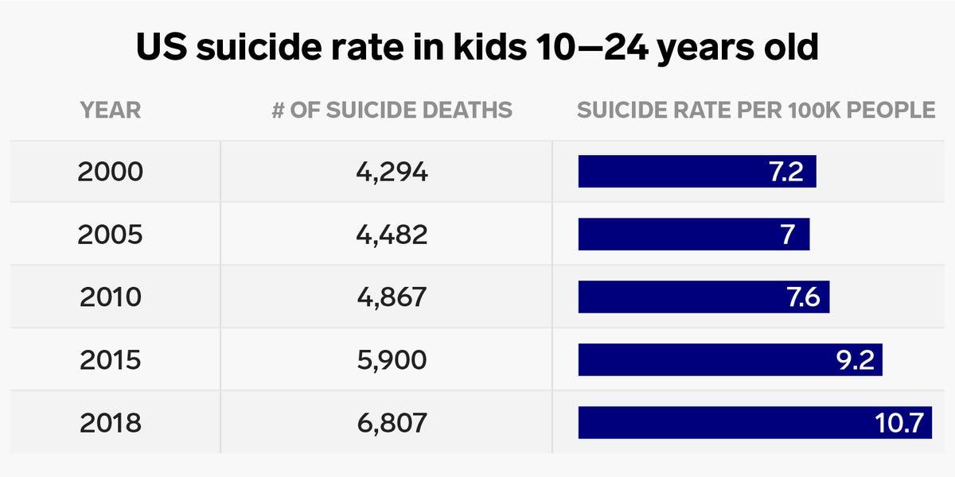
Suicide is the second-leading cause of death among people aged 15 to 24 in the U.S. Nearly 20% of high school students report serious thoughts of suicide and 9% have made an attempt to take their lives, according to the National Alliance on Mental Illness.
In February, a Pew survey found that 70 percent of teens say anxiety and depression is a "major problem" among their peers

Slide 19
According to statistics from the New Mexico Department of Health website, New Mexico has the second-highest rate of suicide in the nation, with a rate that is consistently 50% higher than the national average. Suicide is the eighth leading cause of death in our state for all ages but is the leading cause of death in 15- to 17-year-olds (this rate also includes unintentional injuries). It is the second-highest cause of death in age ranges from 5 to 14 and 18 to 35.

Slide 20
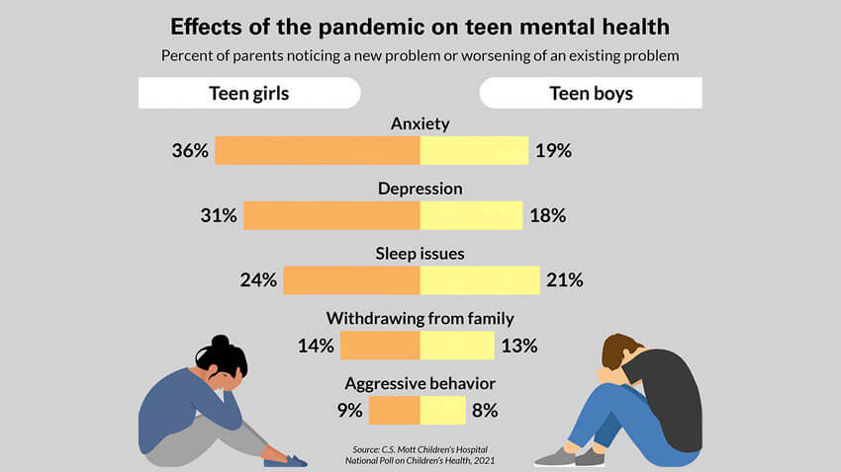

Slide 21
The following notes reflect the discussion that took place on May 1, 2022, between NMPED’s Student Advisory Council and Mark Kolokoff, NMPED’s Youth and Community Liaison, regarding the mental health issues that are dramatically impacting students in New Mexico and the nation. This topic was generated by the students.
Please activate the link below to access the narrative of this discussion.
Student Advisory Council Discussion notes-Mental Health

Slide 22
WHAT ARE School-Based PEER2Peer SUPPORT GROUPS?
School-Based Peer2Peer Support groups - - are groups of Students who gather to share common concerns or personal issues and experiences associated with a particular problem, condition, illness, or personal circumstance. In a support group, students can talk with other students who are like themselves – young people who can truly identify with what others are going through and can share the type of practical insights that can only come from firsthand experience.
Some of the common characteristics of support groups include:
Students who are all directly affected by a particular issue, illness, or circumstance and need help
A licensed professional in attendance for every meeting
Small sizes, to better allow all students to be heard and share
A commitment to attend the meeting on a regular basis
Peer leaders that are trained to facilitate and lead the group discussions
Meetings that take place at a prescribed time, weekly, during the school day
Resources for services that students may seek for further help

Slide 23
The Rationale
Peer2Peer support programs can be defined as peer-to-peer interaction in which individuals who are of approximately the same age take on a helping role, assisting students who may share related values, experiences and lifestyles.
Peer2Peer support programs can enhance the effectiveness of school counseling programs by increasing outreach and raising student awareness of services. Through proper selection, training and supervision, peer support can be a positive influence within the school and community. Research indicates peer support programs are helpful when focused on assisting students with social/emotional or academic problems, who are often marginalized and those with disabilities. Peer support programs can also help create a positive school culture and connectedness to the school community for all involved

Slide 24
The issues may be discussed in the School-Based Peer2Peer Support Groups include, but are not limited to:
Depression/Mental Health Violence in Schools Stress
Education Inequality Academic Pressure Bullying
Sexual Activity Academic Equality Peer Pressure
Social Media Identity Issues Racism
The New Normal Growing Up Too Fast Poverty
People of Color Issues Drug/Alcohol Abuse Advocacy
Suicide Social/Emotional Learning

Slide 25
Core Values
Acceptance
Respect
Equity
Dignity
Engagement
Relevance

