Slide 1
The Power of Question Formulation for Lifelong Learning
A Community of Practice (CoP) for social studies educators
Investing for tomorrow, delivering today.

Slide 2
Virtual Norms - Please change your name on Zoom to add your school district or charter school name and your role (ex., Luna Lovegood– Hogwarts, student) - To change your name, click on the three dots on the right side of your picture, and select change your name - If your Wi-Fi allows, please leave your camera on - Your microphone was muted upon entry, please leave it muted - Please use the chat box to ask questions, we will answer questions as we go
Investing for tomorrow, delivering today.

Slide 3
Disclaimer
This presentation contains examples and resource materials that are provided for the user’s convenience. The inclusion of any material is not intended to reflect its importance, nor is it intended to endorse any views expressed, or products or services. These materials may contain the views and recommendations of the presenter as well as hypertext links, contact addresses and websites to information created and maintained by other public and private organizations. The opinions expressed in any of these materials do not necessarily reflect the positions or policies of the New Mexico Public Education Department (NMPED). The NMPED does not control or guarantee the accuracy, relevance, timeliness, or completeness of any outside information included in these materials. Mentions of specific programs or products in these examples are designed to provide clearer understanding and are not meant as endorsements.¹
¹Language adopted from the U.S. Department of Education ​

Slide 4
Norms
Respectfully contribute your ideas
Focus on what matters
Ask thoughtful and clarifying questions
Listen to understand
Link and connect ideas
Invite all perspectives
Recognize and suspend assumptions
Participate fully and be present

Slide 5
The Power of Question Formulation for Lifelong Learning
Sarah Westbrook
Director of Professional Learning
The Right Question Institute
Sarah.westbrook@rightquestion.org, @Sarah RQI

Slide 6
Who is in the room?
Please share:
Your name
Grade/subject

Slide 7
To Access Today’s Materials:
https://bit.ly/RQINM
Notes:
This leads to an event page on rightquestion.org

Slide 8
Access RQI’s Free QFT Resources
https://rightquestion.org/education/resources
Classroom Examples
Instructional Videos
Planning Tools & Templates

Slide 9
Use and Share These Resources
The Right Question Institute offers materials through a Creative Commons License. You are welcome to use, adapt, and share our materials for noncommercial use, as long as you include the following reference:
“Source: The Right Question Institute (RQI). The Question Formulation Technique (QFT) was created by RQI. Visit rightquestion.org for more information and free resources.”
Access the full library of resources: http://rightquestion.org/education/resources

Slide 10
Today’s Agenda
Welcome
Why Spend Time on Teaching the Skill of Question Formulation?
Collaborative Learning with the Question Formulation Technique (QFT)
Explore Real Classroom Examples & Applications
Why is Question Formulation Important Now?
Q&A

Slide 11
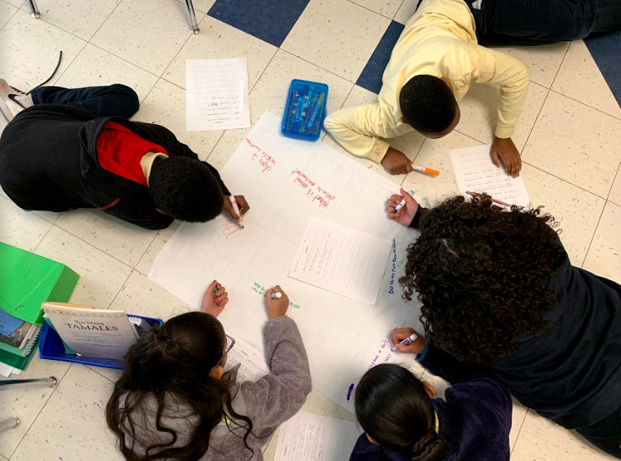
Why spend time teaching the skill of question formulation?

Slide 12
Origin of the Right Question Institute: Parents in Lawrence, Massachusetts, 1990
“We don’t go to the school because we don’t even know what to ask.”

Slide 13
"There is no learning without having to pose a question."
- Richard Feynman
Nobel Laureate, Physics, 1965

Slide 14
“We must teach students how to think in questions, how to manage ignorance.”
– Stuart Firestein
Former chair, Department of Biology,
Columbia University

Slide 15
College Presidents on What College Students Should Learn
“The primary skills should be analytical skills of interpretation and inquiry. In other words, know how to frame a question.”
- Leon Botstein, President of Bard College
“…the best we can do for students is have them ask the right questions.”
- Nancy Cantor, Former Chancellor of University of Illinois
The New York Times, August 4, 2002

Slide 16
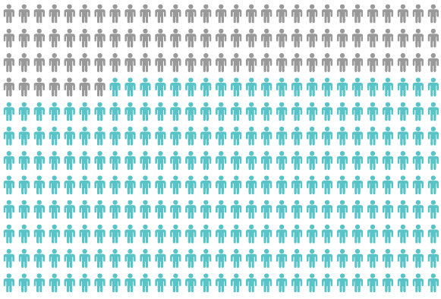
Yet, Only 27% of Graduates Believe College Taught Them How to Ask Their Own Questions
Alison Head, Project Information Literacy at University of Washington, 2016

Slide 17
But, the problem begins long before college…

Slide 18
Question Asking Declines with Age
Tizard, B., Hughes, M., Carmichael, H., & Pinkerton, G. (1983).
Pearson, J.C. & West, R. (2009)
Notes:
Tizard, B., Hughes, M., Carmichael, H., & Pinkerton, G. (1983). Children’s questions and adults’ answers. Journal of Child Psychology and Psychiatry, 24, 269-281.
Girls (mean age 3 years 11 months) from working class and middle class families asked 24 and 29 questions per hour at home, respectively. At school, these same girls asked on average 1.4 and 3.7 questions per hour (working and middle class, respectively)

Slide 19
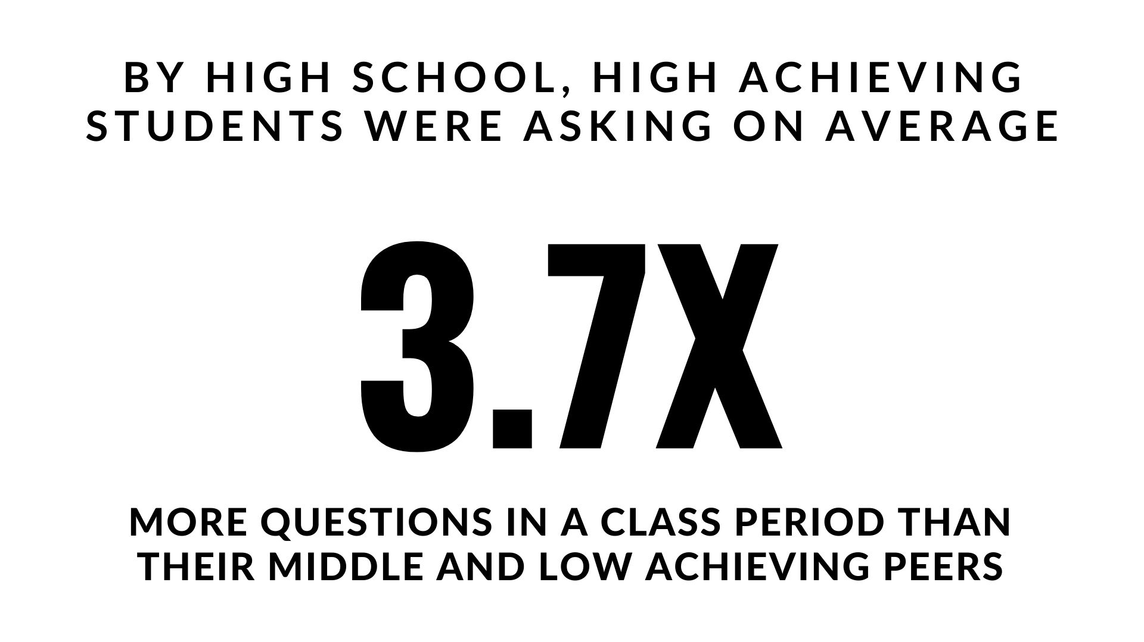
Which students ask questions?
Tizard, B., Hughes, M., Carmichael, H., & Pinkerton, G. (1983)
Carter, A., Croft, A., Lukas, D., Sandstrom, G. (2017).
Notes:
First: Tizard, B., Hughes, M., Carmichael, H., & Pinkerton, G. (1983). Children’s questions and adults’ answers. Journal of Child Psychology and Psychiatry, 24, 269-281.
Girls (mean age 3 years 11 months) from working class and middle class families asked 24 and 29 questions per hour at home, respectively. At school, these same girls asked on average 1.4 and 3.7 questions per hour (working and middle class, respectively)
Second:
Good, T. L., Slavings, R. L., Harel, K., Emerson, H. (1987). Student Passivity: A Study of Question Asking in K-12 Classrooms. Sociology of Education, 60, 187 & 189.
Classroom observations made across 22 k-12 classrooms which tracked students’ question asking behavior showed that in upper grades, low-achieving students ask fewer questions in a 50 minute class period than other students. : On average, high achieving students asked 3.7X the number of questions middle and low achieving students asked in the high school grades.
Quote from study: The data in Table 2 indicate that low achievers in upper grades ask fewer questions than younger low achievers. Tables 2 and 3 also show that low-achieving students continue to be active participants through the third grade; however, by the sixth grade, they have become relatively passive. The data thus support the view that low-achieving elementary students learn to avoid asking questions in the classroom. In higher grades, it is clear that low-achieving students ask fewer questions in class than other students.

Slide 20
We can work together on creating more opportunities for all students to ask their own questions

Slide 21
We Are Not Alone
More than 1 million classrooms worldwide

Slide 22
What happens when students do learn to ask their own questions?

Slide 23
Research Confirms the Importance of Questioning
Self-questioning (metacognitive strategy):
Student formulation of their own questions is one of the most effective metacognitive strategies
Engaging in pre-lesson self-questioning improved students rate of learning by nearly 50% (Hattie, p.193)
John Hattie
Visible Learning: A Synthesis of Over 800
meta-Analyses Relating to Achievement, 2008
Notes:
UC Davis Research Linking Curiosity to Memory (UC Davis) 2014
The Fullerton Longitudinal Study (FLS), a 30-plus year study of the development of giftedness across various points in time conducted by Adele and Allen Gottfried of California State University ”This finding has strong implications for the development of STEM considering that curiosity is a fundamental predictor of the aspiration to become a scientist.”
S. von Stumm, B. Hell, T. Chamorro-Premuzic. The Hungry Mind: Intellectual Curiosity Is the Third Pillar of Academic Performance. Perspectives on Psychological Science, 2011 meta-analysis shows They found that curiosity did, indeed, influence academic performance. In fact, it had quite a large effect, about the same as conscientiousness. When put together, conscientiousness and curiosity had as big an effect on performance as intelligence.

Slide 24
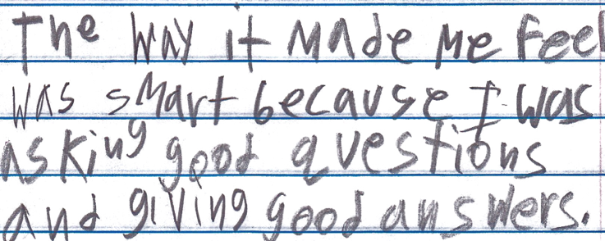
Student Reflection
“The way it made me feel was smart because I was asking good questions and giving good answers.”
-Boston 9th grade summer school student

Slide 25
Today’s Agenda
Welcome & Community Building
Why Spend Time on Teaching the Skill of Question Formulation?
Collaborative Learning with the Question Formulation Technique (QFT)
Explore Real Classroom Examples & Applications
Why is Question Formulation Important Now?
Q&A

Slide 26
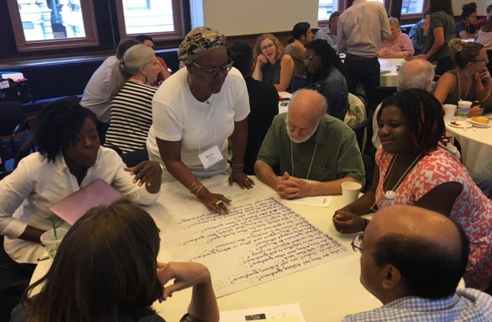
Collaborative Learning with the Question Formulation Technique (QFT)

Slide 27
There are 2 icons you will see:
Please think or work on the task assigned
Use the chat box to share some of your work

Slide 28
The Question Formulation Technique (QFT)
Individuals learn to:
Produce their own questions
Improve their questions
Strategize on how to use their questions
Reflect on what they have learned and how they learned it

Slide 29
Rules for Producing Questions
1. Ask as many questions as you can
2. Do not stop to answer, judge, or discuss
3. Write down every question exactly as stated
4. Change any statements into questions
Notes:
If you are working alone, rule #3 becomes: “write down every question as it first comes to mind.” Don’t judge yourself!

Slide 30
Produce Questions
Ask Questions
Follow the Rules
Ask as many questions as you can.
Do not stop to answer, judge, or discuss.
Write down every question exactly as it was stated.
Change any statements into questions.
Number the Questions

Slide 31
Question Focus
Some students are not asking questions.
🡪Now, ask questions. Number the questions. Follow the rules:
Ask as many questions as you can.
Don’t stop to answer, judge, or discuss.
Record each question exactly as it was stated (or first came to mind).
Change any statements into questions.

Slide 32
Categorize Questions: Closed/Open
Definitions:
Closed-ended questions can be answered with a “yes” or “no” or with a one-word answer.
Open-ended questions require
more explanation.
Directions: Identify your questions as closed-ended or open-ended by marking them with a “C” or an “O.”

Slide 33
Discuss
Closed-ended Questions
Advantages
Disadvantages

Slide 34
Discuss
Open-ended Questions
Advantages
Disadvantages
Notes:
The point here is that the closed-ended questions are equally useful as open-ended!

Slide 35
Improve Questions
Take one closed-ended question and change it into an open-ended question.
Take one open-ended question and change it into a closed-ended question.
Add these as new questions to your list
Closed
Open
Open
Closed

Slide 36
Prioritize Questions
Review your list of questions
Choose three questions that you feel are most important.
While prioritizing, think about your Question Focus, Some students are not asking questions.
Then, think about why you chose those questions.
After prioritizing, use the chat box to share ONE of your priority questions.

Slide 37
Action Plan
In order to answer your priority questions:
What do you need to know? Information
What do you need to do? Tasks
Write down a couple ideas you have.
After prioritizing, use the chat box to share ONE possible action step.

Slide 38
Reflect
What did you learn?
How did you learn it?
How could you use it in your work?

Slide 39
A Look Inside the Process

Slide 40
The QFT, on one slide…
Ask as many questions as you can
Do not stop to discuss, judge or answer
Record exactly as stated
Change statements into questions
Question Focus
Produce Your Questions
Follow the rules
Number your questions
Improve Your Questions
Categorize questions as Closed or Open-ended
Change questions from one type to another
Strategize
Prioritize your questions
Action plan or discuss next steps
Share
Reflect
Closed-Ended:
Answered with “yes,” “no” or one word
Open-Ended: Require longer explanation
Source: The Right Question Institute rightquestion.org
Notes:
I

Slide 41
Three thinking abilities
with one process

Slide 42
Thinking in many different directions
Divergent
Thinking

Slide 43
Narrowing Down, Focusing
Convergent
Thinking

Slide 44
Thinking about Thinking
Metacognition

Slide 45
Today’s Agenda
Welcome & Community Building
Why Spend Time on Teaching the Skill of Question Formulation?
Collaborative Learning with the Question Formulation Technique (QFT)
Explore Real Classroom Examples & Applications
Why is Question Formulation Important Now?
Q&A

Slide 46
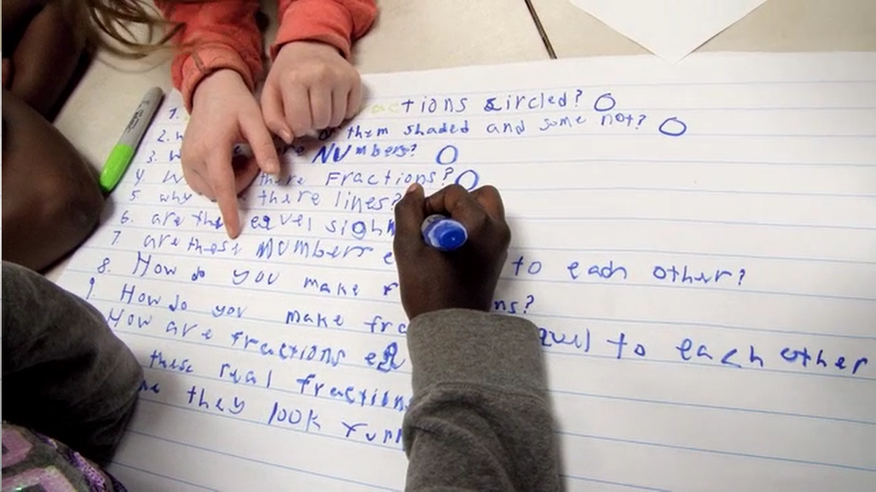
Exploring Classroom Examples

Slide 47
Classroom Example: Kindergarten
Teacher: Jennifer Shaffer, Walkersville, MD
Topic: Non-fiction literacy
Purpose: To engage students prior to reading a nonfiction text about alligators

Slide 48
Question Focus
Photograph by Nuwan Samaranayake, 2013

Slide 49
Student Questions
Is the alligator camouflaged?
Why do the babies have stripes?
Are those baby crocodiles?
Is it a mom or dad crocodile?
What is the green stuff?
Why are they in the water so low?
Where are they going?
Why are the baby alligator’s eyes white and the mom’s black?
Why are baby alligators on top of the momma alligator?
Why does momma or daddy have bumps on them?

Slide 50
Virtual Classroom Example: 7th Grade
Teacher: Melissa Lawson, Folsom, CA
Topic: Japanese American Internment during World War II
Purpose: To help students engage with primary sources to begin a research process.

Slide 51
Question Focus
Lange, Dorothea. (1942) Oakland, CA, Mar. 1942.
A large sign reading "I am an American" placed in the window of a store on December 8, the day after Pearl Harbor. The store was closed following orders to persons of Japanese descent to evacuate from certain West Coast areas.
[Photograph] Retrieved from the Library of Congress, https://www.loc.gov/pictures/resource/cph.3a24566/.

Slide 52
Selected Questions
Why is the car there?
Who was the owner of the car?
Is that a BMW or something?
Where is this?
Who took the photograph?
Why is there a sign that says, I am an American?
Who is “I”?
What does "Wanto Co.," mean?
Who wrote the "I Am an American" sign?
Was the 'I am American' because the owner was of Japanese heritage and defending him/herself from prosecution? (after Pearl Harbor)
11) When the picture was taken, was the store open or closed?
12) Why was this picture taken?
13) What year is this from?
14) Who decided to close the store?
15) What happened to the store after this?
16) What happened to the Japanese Americans?
17) Did they ever get full fledged justice?

Slide 53
Asking and Answering via Padlet

Slide 54
Student Reflections
“I learned that we cannot draw conclusions just by looking at a picture once. You can look at it and ask questions to learn more. I am wondering if we can use this technique on other things.”
“Not only did I learn about the picture we were analyzing, but I learned that asking questions makes me want to think more and it makes me curious. Once I started asking questions and reading other peoples responses, I was very interested and curious about the questions that were posted.”
“I learned that I should have been using this for my History Day paper.”

Slide 55
Make Your Own Padlet
Access the QFT Padlet Template Here:
https://padlet.com/sarahwestbrook1/QFT2
Access all of RQI’s Virtual Learning Resources:
https://rightquestion.org/remote-learning-resources/

Slide 56
Classroom Example: High School
Teacher: Daniel Fouts, Des Plaines, IL
Topic: 12th Grade Government unit on the American presidency at moments of crisis
Purpose: To engage students at the start of the unit and to help students select a topic for an independent project

Slide 57
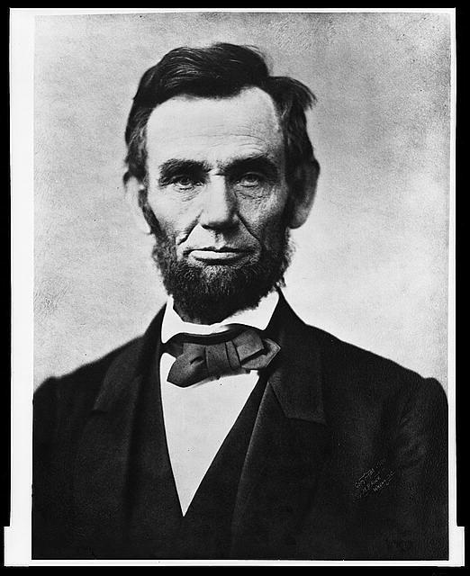
Question Focus
“Nearly all men can handle adversity; but if you really want to test a man’s character, give him power.”
https://www.loc.gov/pictures/item/96522529/

Slide 58
Student Questions
How does power challenge one’s morality?
Should everyone have some type of power?
Does power make people corrupt?
What if the person who is is qualified for power doesn’t attain it?
How is a man’s power tested?
What is considered power?
What defines good character?
How can we ensure that the good men get the power?
What kind of man can handle adversity?
What can power tell us about a man’s character?
How can power be obtained by adversity?
Why are some people affected by power differently?
If adversity supposedly makes you stronger, does that mean that power makes you weaker?

Slide 59
Next Steps
Each student selected 1 question from the class list to work on throughout the unit
Students answered their question using research and knowledge from the unit in a two-page reflection paper
Students shared their reflections in a class discussion on the final day of the unit

Slide 60
Today’s Agenda
Welcome & Community Building
Why Spend Time on Teaching the Skill of Question Formulation?
Collaborative Learning with the Question Formulation Technique (QFT)
Explore Real Classroom Examples & Applications
Why is Question Formulation Important Now?
Q&A

Slide 61
Why is the skill of question formulation so important now?

Slide 62
In the Age of Google
“How should you respond when you get powerful new tools for finding answers?
Think of harder questions.”
– Clive Thompson
Journalist and Technology Blogger

Slide 63
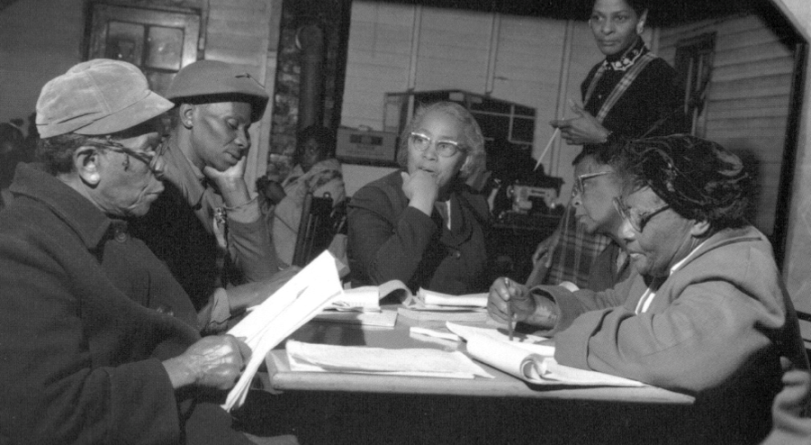
Questions and Democracy
“We need to be taught to study rather than to believe, to inquire rather than to affirm.”
– Septima Clark
Chapter 6 on Septima Clark in Freedom Road: Adult Education of African Americans (Peterson, 1996)

Slide 64
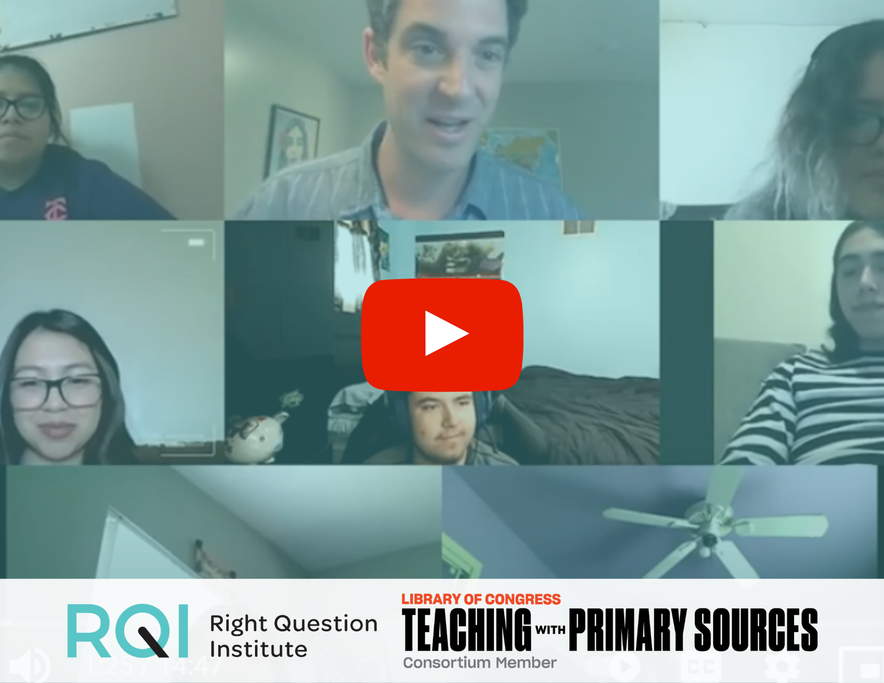
Learn more about the QFT
Watch videos to hear from teachers and students
Check out real lesson plan examples
Learn more on your own time
Explore our free Resource Hub for Using the QFT with Primary Sources at rightquestion.org/primary-sources

Slide 65
Thank you!
What are your questions?

Slide 66
Use and Share These Resources
The Right Question Institute offers materials through a Creative Commons License. You are welcome to use, adapt, and share our materials for noncommercial use, as long as you include the following reference:
“Source: The Right Question Institute (RQI). The Question Formulation Technique (QFT) was created by RQI. Visit rightquestion.org for more information and free resources.”
Access the full library of resources: http://rightquestion.org/education/resources

Slide 67
Survey
Please provide feedback for today’s CoP
See the link in the chat box
https://docs.google.com/forms/d/e/1FAIpQLSeUQFeAuLGtxgaCCSctXZn4i18ORdaKG5fz9ouwkvcyebW-9A/viewform
Notes:
https://docs.google.com/forms/d/e/1FAIpQLSeUQFeAuLGtxgaCCSctXZn4i18ORdaKG5fz9ouwkvcyebW-9A/viewform

Slide 68
Upcoming Community of Practice Meetings
Our Worlds App
Immersive Reality
Dec. 8
11:00 AM- 12:00 PM
Notes:
https://us02web.zoom.us/meeting/register/tZcpd-qurzgqG9yVQNSeEV2qpxCoR1kC_RIA

Slide 69
Closing Please complete the survey. The link is provided in the chat box. If you have any Social Studies related questions, please reach out to: Roxann Morris Native American Curriculum Specialist C: (505) 490-5918 | Help Desk: (505) 827-5800 Visit the webpage: NMPED Literacy and Humanities Thank you! We look forward to our next CoP!
Investing for tomorrow, delivering today.

