Slide 1
Instructional Material Depository – Carmenlita Lewis
Instructional Material Ordering
Listing of Instructional Material

Slide 2
ARCHWAY BOOK DEPOSITORY
One Stop Shop
Lowest Prices in the Nation for Adopted Materials
Prices are under contract for Six Years
Shipping Rates 1% Will Call or 5% Flat Fee
Customer Service Dedicated to New Mexico Schools
Ordering Platform iSTAR

Slide 3
Adopted vs. Non Adopted Pricing and Freight

Slide 6
Ordering Materials Online Entering Inventory Online
I
Instructional Material Ordering
Listing of Instructional Material

Slide 7
Welcome
www.istaronline.com

Slide 8
Capabilities:
Search – Look up Publisher titles
Budget – Add or Edit Budgets
Shop – Place new or edit existing order
Order Inquiry – Check Status, Get POD (proof of delivery)
Inventory – Update Inventory for non iSTAR purchases

Slide 9
SEARCH

Slide 10
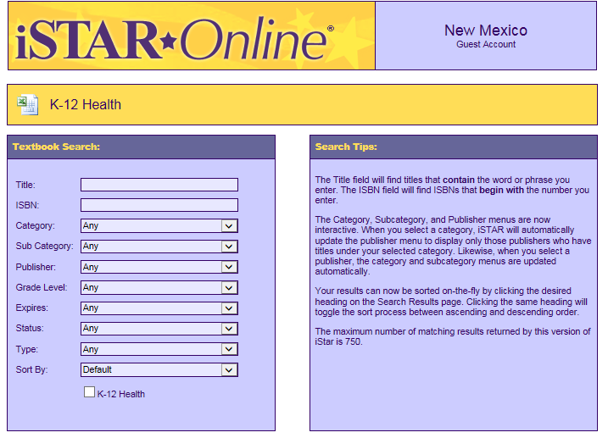
SEARCH
Download the current year adoption list
Search a title using
Publisher
Category and Subcategory
Grade level
Expiration date
Title not on iSTAR?
Call 505-317-4829 or email newmexico_depository_support@archway.com

Slide 11
GET STARTED

Slide 12
DON’T HAVE AN ACCOUNT?
Ask your district to give you your registration key (under campus access tab)
Have your district office set you up (under the Manage user accounts tab)
Leave your information with ARCHWAY
Email: newmexico_depository_support@archway.com

Slide 13
BUDGETS

Slide 14
Only authorized users or administrators can create or change the IM BUDGET.
District offices can set-up secondary IM budgets for campus locations or campuses may use the District Budget
District and campuses can also set up additional budgets for non-State allocated monies.

Slide 15
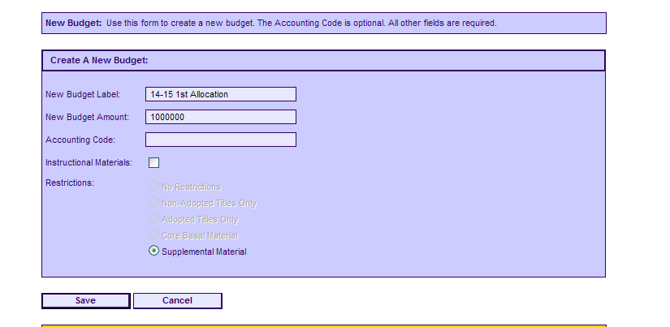
Creating a New Budget
Give your budget a unique label.
Enter the amount . Click the SAVE button.
Order adopted and non adopted on the same order

Slide 16
Adjusting a Budget
You may adjust any iSTAR budget by changing the Total Budget or the Current Charges .
EX: You receive additional money from a fundraising event, you might increase the Total Budget column.
All budget adjustments are permanently logged.

Slide 17
SHOP

Slide 18
Pick New Estimate of Needs if creating an estimate or New Regular Order if placing an actual order
Create a Unique Label
Select a Budget if keying a regular order
Select your campus if necessary

Slide 19
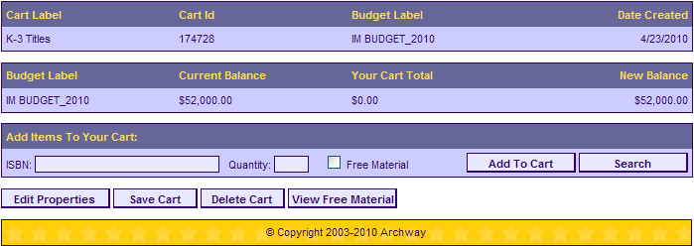
Begin entering your titles.
You can invoke the search function from your order or enter your ISBN # directly.
Make sure that if an item is free, you check the Free Material box.

Slide 20
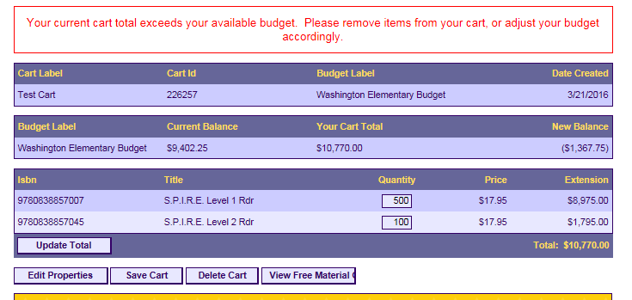
If you go over your budget you will need to remove items from your cart

Slide 21
Editing Your Carts
Choose cart to view details.

Slide 22
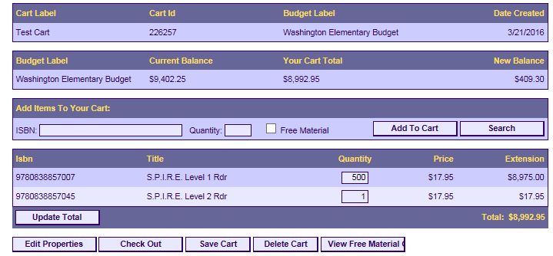

Slide 23
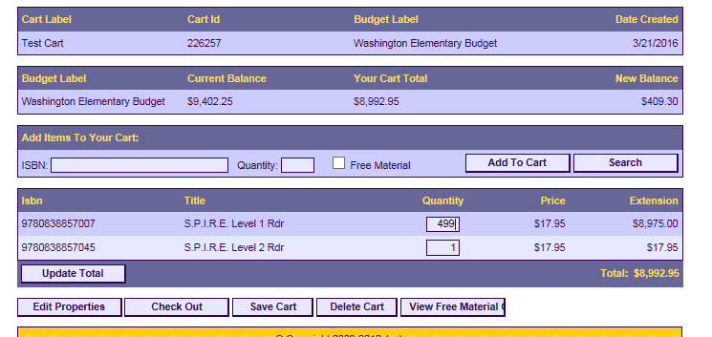
Click on the quantity you would like to change.
Enter the new quantity.

Slide 24
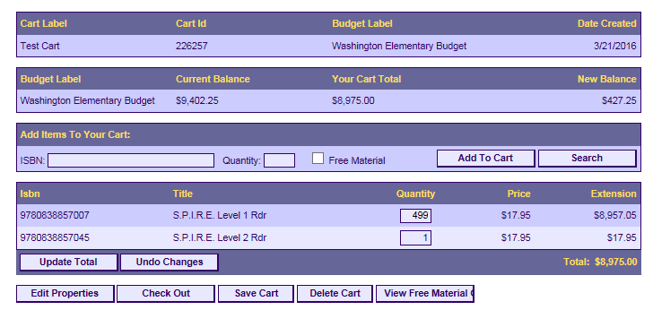
Click Update Total

Slide 25
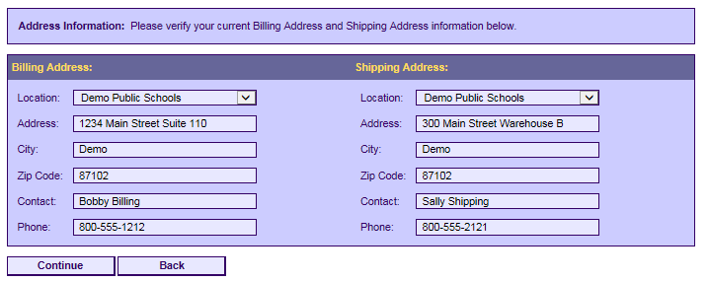
Checking out EON and Regular Order
Verify and Click Continue

Slide 26
Click on Queued tab
Pick order to be completed

Slide 27
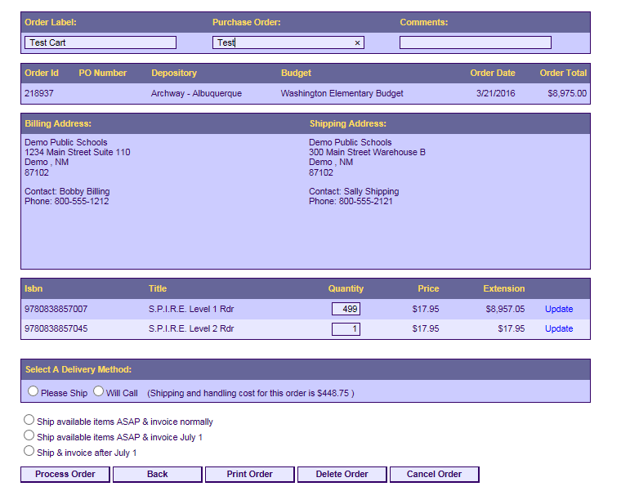
Add your PO Number. If you don’t have a PO yet, enter Pending

Slide 28
Ship or Pick up?
Here you can Print your order & choose either to have your books Shipped or Picked up.
Shipping is 5% of total order for Archway. A 1% handling fee is required for pick up orders.

Slide 29
NOTE: If you are planning to pick up your orders, our new address is:
4525 Paseo del Norte N.E.
Albuquerque, NM 87113

Slide 30
Submitting an EON (estimate of needs)
An EON is not an order. To convert the estimate

Slide 31
ORDERS

Slide 32
Once ARCHWAY has “picked up” your order, it can be viewed under the Confirmed Tab.
Once in Confirmed Tab, you can also view each order individually and see what has been shipped.
CONFIRMED ORDERS

Slide 33
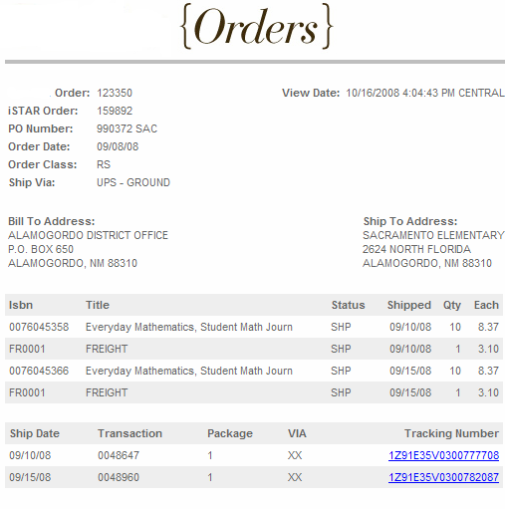
Check date of when books shipped.
Click on tracking #’s to go to tracking information to see who signed for packages and when were packages delivered.

Slide 34
INVENTORY

Slide 35
Click on the Inventory button:

Slide 36
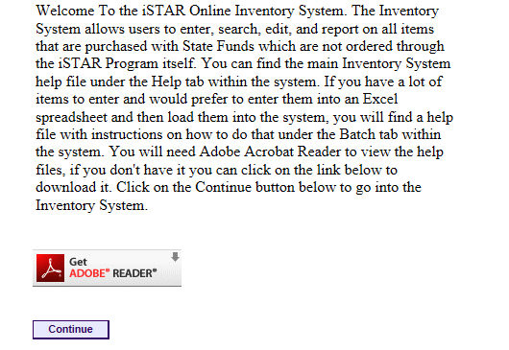

Slide 37
Click on the Reports Button:

Slide 38
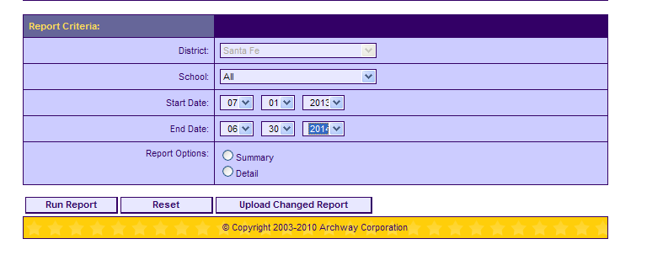
Download Inventory Report
Select run report.
Save as an Excel file to use for entering purchases into the itemized list(s) of the annual report.

Slide 39
Add any purchases not made through iSTAR to your EXCEL file.
NOTE: The file now contains a column which indicates whether the item is adopted or non- adopted

Slide 40
Any Questions?
Please contact Archway at
505 317 4829 (Carmenlita) or
505 317 4753 (Frank)
Newmexico_depository_support@archway.com
Frank_Romero@archway.com

