Slide 1



NSLP 101
An Overview of the National School Lunch Program

Slide 2
Program Overview
The National School Lunch Program (NSLP) is a Child Nutrition Program, federally funded and administered by the United States Department of Agriculture Food and Nutrition Service. NSLP operates in public and nonprofit private schools and residential childcare institutions (RCCIs). The program provides nutritionally balanced, low-cost or free lunch to school children each school day.
The program was established under the National School Lunch Act, signed by President Harry Truman in 1946. At the state level, the New Mexico Public Education Department, Student Success and Wellness Bureau is the administering agency that works with schools and other sponsoring organizations to provide nutritious meals, and snacks for children.
Reimbursement is provided in three levels (Free, Reduced-Price and Paid) to the School Food Authority (SFA) for each meal that meets the federal requirements and is served to an eligible school child.

Slide 3
School Food Authorities (SFAs) that participate in the NSLP and other school-based child nutrition programs, agree to:
Serve meals that meet federal program requirements
Operate a nonprofit food service program
Offer free, reduced-price and paid meals to eligible children based on household eligibility
Not overtly identify or discriminate against any eligible child
Offer school nutrition programs for all students without regard to race, color, national origin, sex, age, disability, religion, ancestry, and/or sexual orientation

Slide 4
Reimbursable school lunch meals must meet the following guidelines:
Offer 5 meal components (grain, meat/meat alternate, fruit, vegetable & milk).
Servings of grains must meet daily and weekly minimum serving sizes.
  80% of grains offered weekly, must be whole grain rich
Servings of fruit must meet daily and weekly minimum serving sizes.
Servings of vegetables must meet daily and weekly minimum serving sizes from each of the specified vegetable subgroups.
Servings of meat/meat alternates must meet daily and weekly minimum serving sizes.
2 types of milk must be offered.
  Milk must be fat-free (skim) or low-fat (1%) and may be flavored or unflavored.
Meals must adhere to minimum and maximum average calorie range for the week.
Calories from saturated fat cannot exceed 10% of total calories.
Meals must meet sodium limitations (Sodium Interim Target 1A)
If the school is participating in Offer versus Serve, a reimbursable meal must have at least 3 of the 5 food components; one of which must be at least a ½ cup fruit OR vegetable.

Slide 5

The School Breakfast Program (SBP) is a federally funded meal program operating in public and nonprofit private schools and residential childcare institutions. It provides nutritionally balanced, low-cost or free breakfast to school children each school day.

Slide 6
Reimbursable school breakfast meals must meet the following guidelines:
Offer four items from three required components (grain, fruit or vegetable, milk).
Servings of grains must meet daily and weekly minimum serving sizes.
  80% of grains offered weekly, must be whole grain rich
Servings of fruit must meet daily and weekly minimum serving sizes.
2 types of milk must be offered.
  Milk must be fat-free (skim) or low-fat (1%) and may be flavored or unflavored.
Meals must adhere to minimum and maximum average calorie range for the week.
Calories from saturated fat cannot exceed 10% of total calories.
Meals must meet sodium limitations (Sodium Interim Target 1A)
If the school is participating in Offer versus Serve, a student must select at least 3 items (not components); one of which must be at least a ½ cup of fruit, to make a reimbursable meal.
  OVS is optional for breakfast, for all grades.

Slide 7
The Seamless Summer Option (SSO) combines features of the NSLP, SBP, and the Summer Food Service Program. This option reduces the paperwork and administrative burden making it easier for schools to feed children from low-income areas during the traditional summer vacation periods.
The After School Snack Program (ASSP) provides reimbursement for snacks provided to school children participating in structured enrichment programs after the school day ends. Schools with 50% or greater free and reduced-price eligible students, or in the attendance area of a school with 50% or greater free and reduced-price eligible students, may provide the snacks at no charge to any participating student.
Other Programs

Slide 8

USDA Fresh Fruit & Vegetable Program (FFVP)
FFVP is a supplemental program that offers fresh fruits and vegetables at no charge to students outside of school meal serving times. FFVP is targeted to elementary schools which have the highest Free and Reduced enrollment.
Each Spring all interested schools must apply by completing an application and submitting it to the NMPED. Awarded schools receive funding at ~$50-$75 per student to implement the program the following school year.

Slide 9
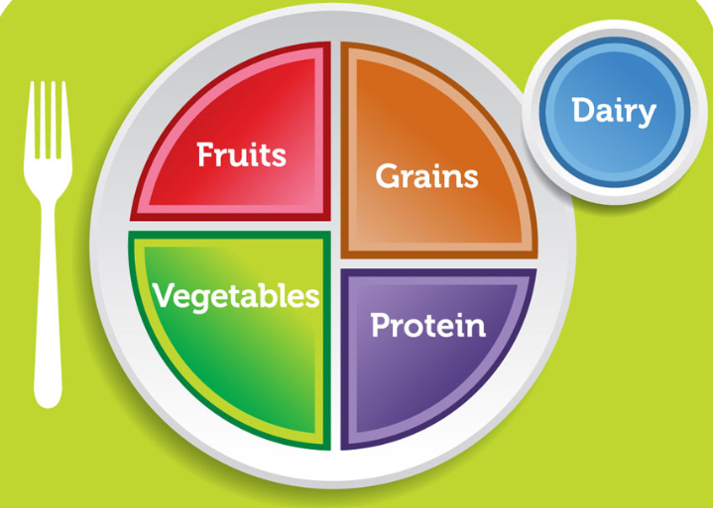
NSLP Meal Pattern Requirements
The lunch meal pattern must offer foods from all five meal components.

Slide 10
Grade Groupings
The USDA National School Lunch Program (NSLP) and School Breakfast Program (SBP) meal patterns have three grade groupings:
    K-5
    6-8
    9-12
  Each of the grade groups has specific meal pattern requirements that must be met. Requirements for the K-5 and 6-8 grade groups overlap, allowing a school that has overlapping grades in K-5 and 6-8, or a K-8 school, to plan to serve the same amount of food for the entire school.
  The 9-12 grade group does not have overlapping requirements with the two younger grade groups. This means that a school that is K-12, would need to be prepared to serve at least two grade groups, K-8 and 9-12.

Slide 11
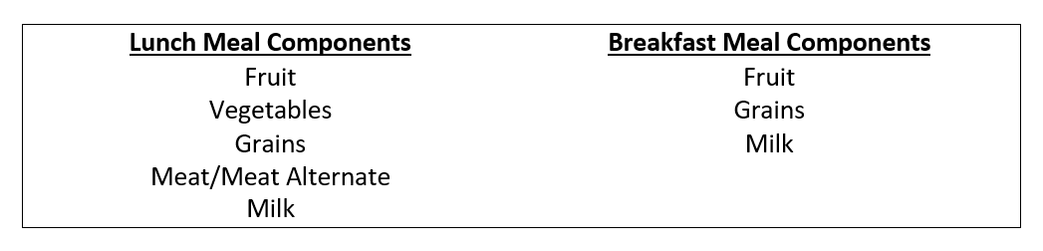
Meal Components
Meal components are food groups established by USDA to provide the basis for the meal patterns used in menu planning. Each component is based on the nutrient content of foods in each category.

Slide 12
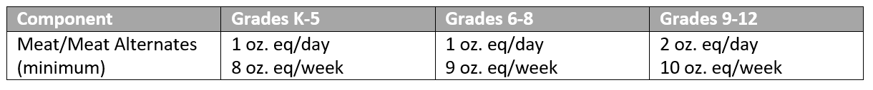
Meat/Meat Alternates
Meat and meat alternates include beef, pork, poultry, fish, eggs, cheese, nuts and seeds, nut and seed butters, beans and legumes, cottage cheese, and yogurt. In addition, tofu and soy yogurt may be credited as a meat/meat alternate provided they are commercially made and credit as follows:
  Tofu - 2.2 ounces or ¼ cup of commercially prepared tofu must contain at least 5 grams of protein and the ¼ cup portion will equal 1 oz. of meat/meat alternate.
  Soy yogurt - ½ cup of liquid volume is credited as 1 oz. of meat/meat alternate.
*When crediting beans and legumes as a M/MA component, they cannot also be credited as the vegetable subgroup in the same meal.

Slide 13

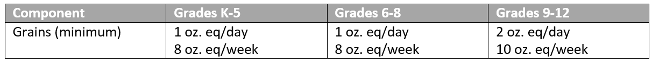



Grains
At least 80% of grains offered weekly, must be whole grain rich, the remaining 20% must be enriched.
Whole grain rich products are those that contain 100% whole grain or a 50/50 blend of whole grain and enriched grains.
This Photo by Unknown Author is licensed under CC BY-SA-NC
This Photo by Unknown Author is licensed under CC BY-SA-NC

Slide 14

Ounce Equivalencies for Grains
As stated in USDA Memo SP-2012 Grain Requirements for the National School Lunch Program and School Breakfast Program, grain products must be credited using the oz eq method. This criterion is applied to various products as follows:
Baked goods, such as breads, biscuits, bagels, etc., require 16 grams of creditable grain ingredients in order to provide 1 oz eq credit.
For cereal grains such as oatmeal, pasta, and brown rice, etc., a 1 oz equivalent is 28 grams (approximately 1 oz by weight) of dry product. Since these grains are served cooked and water is added in preparation, the cooked volume equivalent is ½ cup cooked cereal, pasta, or rice.
For ready-to-eat (RTE) breakfast cereal, 28 grams or 1 oz of product is considered an ounce equivalent. The oz equivalent volumes are 1 cup flakes or rounds, 1.25 cups puffed cereal, and ¼ cup granola.

Slide 15
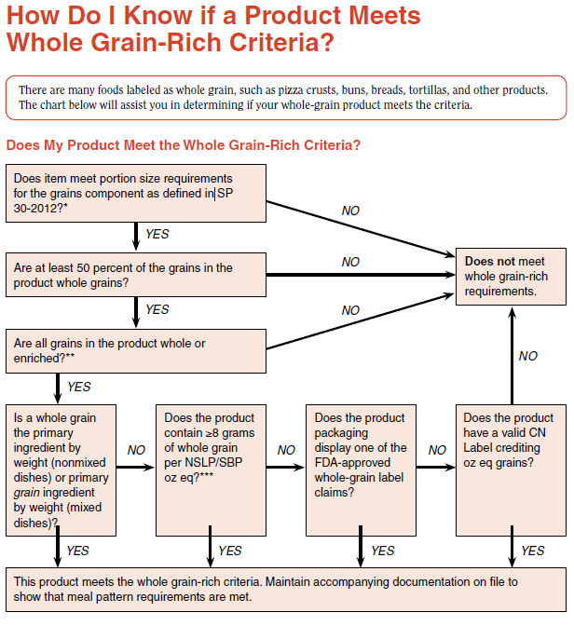

Slide 16

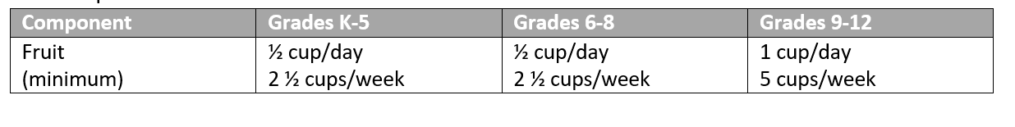
Serving a variety of fruit in different forms is strongly encouraged as offering a choice increases the likelihood that more students may select and eat one.
Fruit may be fresh, frozen, canned, or dried. While there is a daily minimum, there is no maximum limit for the amount of fruit servings offered.
Canned fruit must be in 100% juice, light syrup, or water.
When dried fruit is offered, the amount credited is twice the amount served (ex: ¼ cup raisins credits as ½ cup).
100% fruit juice may be used to meet no more than half of the weekly fruit requirement.

Slide 17

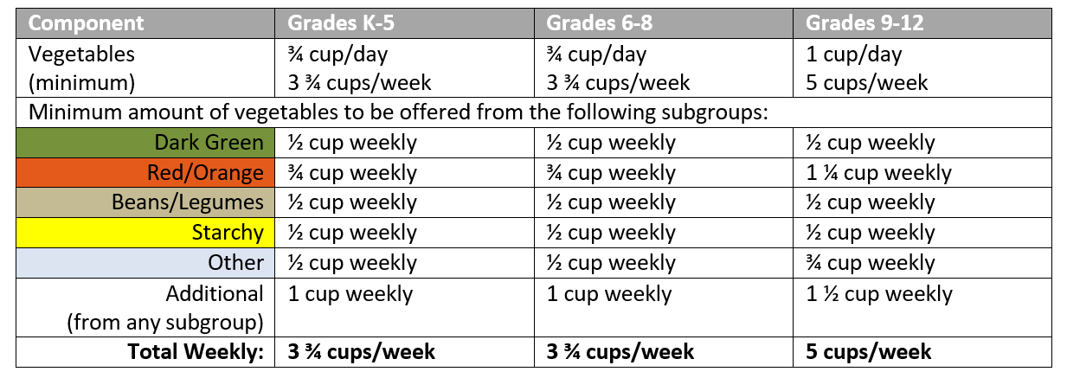

Vegetables
Choices from the following vegetable sub-groups must be served in minimum amounts over the course of the week.
*For raw leafy greens, such as lettuce, 1 cup credits as a ½ cup of the vegetable component.
*Dried beans and legumes may be used as either a vegetable or a meat/meat alternate but NOT BOTH in the same meal.

Slide 18



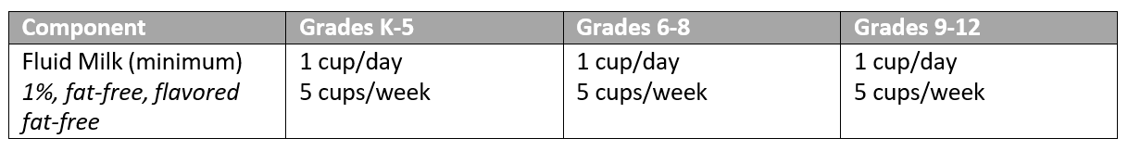
Milk
Fluid milk must be offered daily
At least two milk choices must be offered from the following options:
unflavored 1% milk
unflavored fat-free milk
or flavored fat-free milk.
**For students who are lactose intolerant, a reduced lactose or lactose free milk may be provided. This is specially treated cow’s milk so it is an acceptable substitute. For those who cannot drink cow’s milk, only approved milk substitutes can be provided.

Slide 19
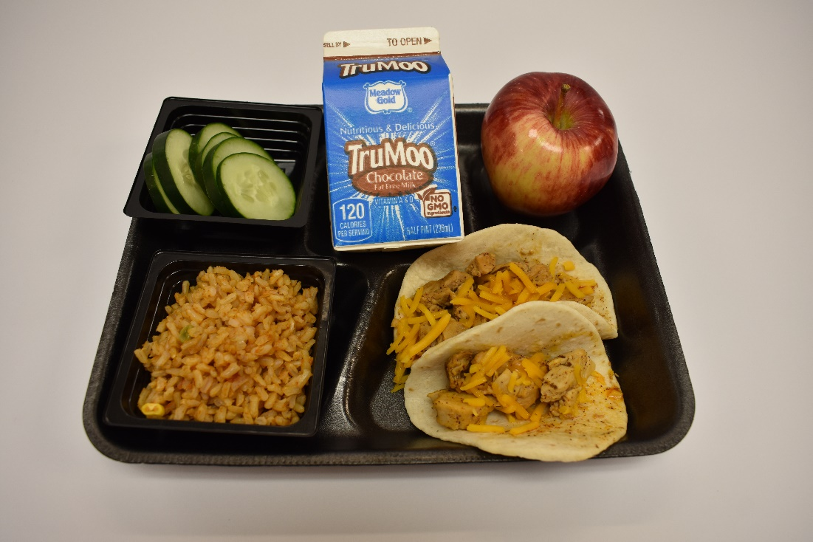
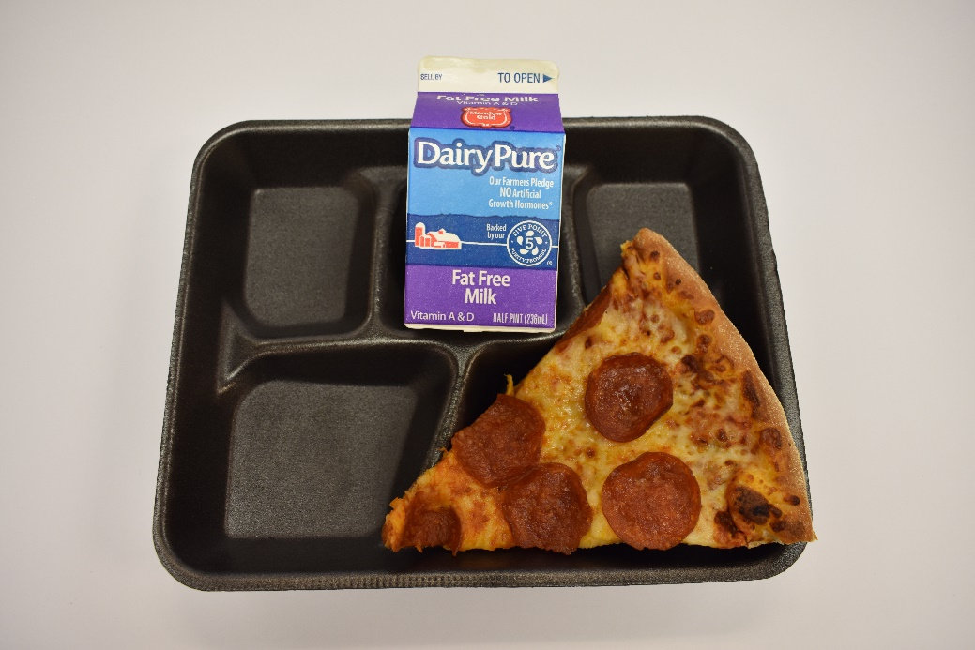
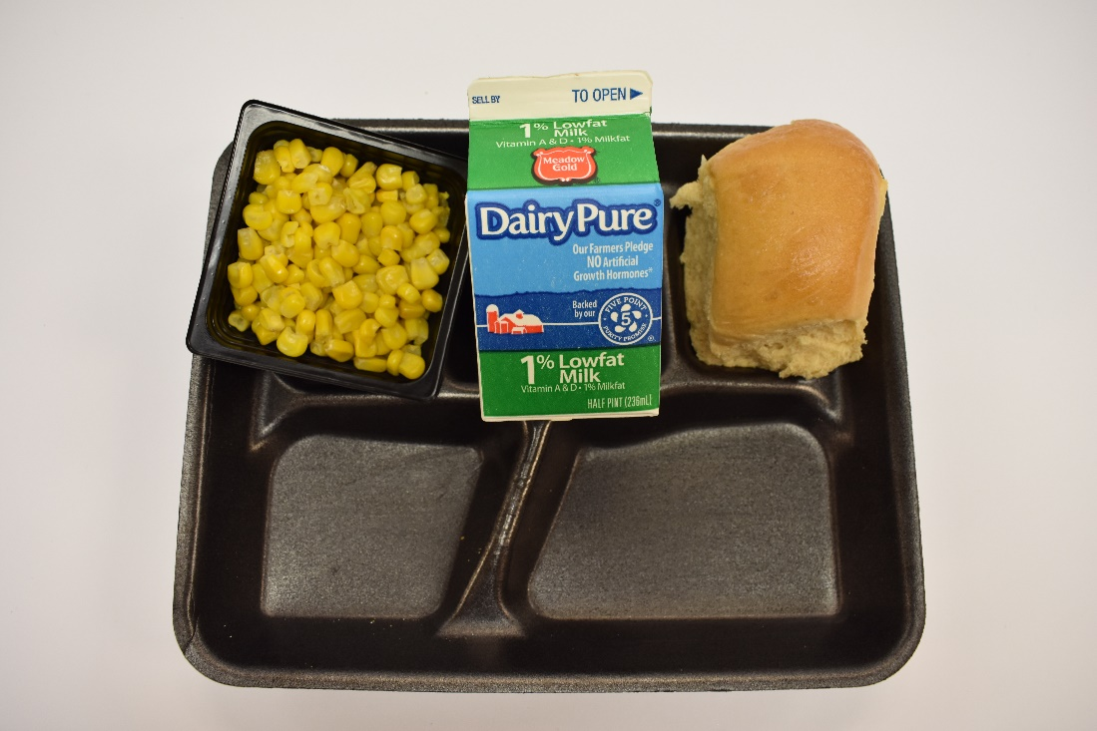
Offer versus Serve (OVS) in Lunch
OVS is a requirement of NSLP for all high schools, and is optional for lower grades.
OVS requires that all 5 food components (grains, meat/meat alternate, fruit, vegetables and milk) be offered in the required quantities and students may decline 1 or 2 of the 5 required components.
Students must select at least 3 of the required components, one of which must be at least ½ cup of fruit and/or vegetable.

Slide 20

SBP Meal Pattern Requirements
The breakfast meal pattern must include food from three meal components (grain, fruit and milk).

Slide 21
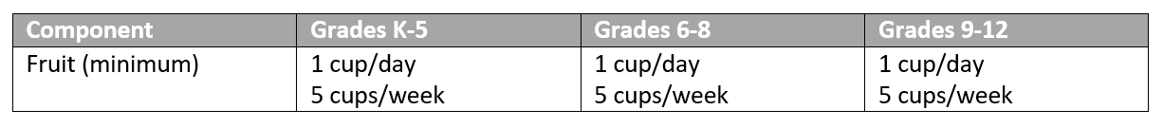
Fruit (breakfast)
One (1) cup of fruit must be offered each day and students must select a minimum of a ½ cup equivalent for the breakfast to be reimbursable.
    *Vegetables may be substituted for fruit.
    *If offering a starchy vegetable, you must offer an additional two cups of vegetables from another subgroup (dark green, red/orange, beans and peas (legumes) and other.
    *One quarter cup of dried fruit counts as ½ cup fruit and 1 cup of leafy greens counts as ½ cup of vegetables.
    *No more than half of the fruit or vegetable offerings may be in the form of juice. All juice must be 100% full strength.

Slide 22

Grains/Bread
If grain components are offered in amounts larger than the minimum serving size amount of 1 oz. eq, and equal full oz. equivalent serving amounts, such as a 2 oz. eq muffin, or a 3 oz eq. bagel, then the menu planner has the option to count it as either 1, 2 or 3 items for Offer versus Serve. Items that are larger than 1 ounce but not full ounce equivalents, like a 1.5 ounce cinnamon roll, this would count as a 1 ounce food item in Offer versus Serve (OVS).

Slide 23
Meat/Meat Alternate (optional)
It is not a requirement to offer a meat/meat alternate as part of the School Breakfast Program. Schools do have the option of offering a meat/meat alternate after the minimum 1 oz. eq daily grain requirement is offered. In this instance, a 1 oz. equivalent of a meat/meat alternate may credit as the additional 1 oz. equivalent of grain. Schools also have the option of offering a meat/meat alternate as an additional food and not credit it toward any component.
With respect to OVS, grains and meat/meat alternates must be offered and served in full ounce equivalents to count as an item.

Slide 24
Milk
Fluid milk requirements are the same for breakfast as they are for lunch.
At least two milk choices must be offered from the following options:
unflavored 1% milk
unflavored fat-free milk
or flavored fat-free milk.
**For students who are lactose intolerant, a reduced lactose or lactose free milk may be provided. This is specially treated cow’s milk so it is an acceptable substitute. For those who cannot drink cow’s milk, only approved milk substitutes can be provided.

Slide 25
Offer versus Serve (OVS) at Breakfast
OVS is optional for all grades in the School Breakfast Program. To carry out this option, schools must offer at least 4 items from the 3 required meal components (grains, fruit and milk). Students may decline 1 item but must select at least ½ cup of fruit and at least 2 other items.
When counting meals for reimbursement, it is important for the cashier or person taking the meal count be able to identify whether each student has taken the minimum amount to make a reimbursable meal.

Slide 26
Menu Planning
The menu is the core of NSLP and must list all food items offered to students as part of a reimbursable meal. When planning the menu, the menu planner must follow meal based menu planning . Planners should consider he foods currently available in inventory, USDA Foods, as well as the food service budget.

Slide 27
Menu Planning Checklist
Determine number of days to be planned.
Check your inventory. What food is currently on hand?
What USDA foods will be delivered during the month for which you are planning?
Consider meal participation for previous menus.
Consider culturally acceptable foods.
Focus on grade group(s) to be served.
Decide on the number of entrée choices to be offered.
Consider the equipment, or lack thereof, in the kitchen.
Select the entrée for each day being planned.
Select the other required meal components. Keep in mind the NSLP requirement to offer a variety of vegetable subgroups throughout the week.
Ensure at least 2 milk choices are offered.
Make sure the daily and weekly minimum serving sizes are met for each component.
Consider marketing ideas, menu themes, school events, and seasonal items.
Consider the condiments you may wish to offer with the meal.

Slide 28
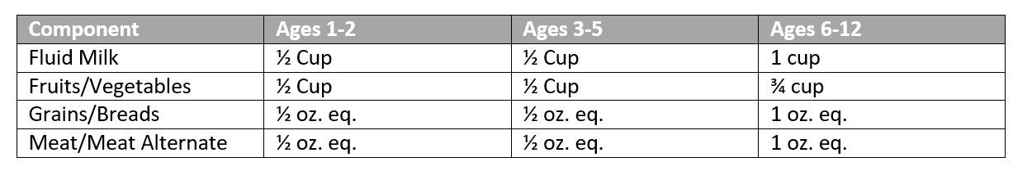
After-School Snack Program Meal Pattern
Afterschool snacks must contain at least two different components of the following four: a serving of fluid milk; a serving of meat or meat alternate; a serving of vegetables or fruits or 100 % vegetable or fruit juice; a serving of whole grain or enriched bread or cereal.
Note:
    The serving size of fruits/vegetables is ¾ cup for school-aged children (ages 6-12)
    Juice may not be served when milk is served as the only other component
    For students ages 13-18, follow the ages 6-12 guidelines you may choose to offer more

Slide 29

Requirement to Post Menus
Schools are required to post the breakfast and lunch menu near the beginning of the meal service line(s) so students know what foods can be selected as part of complete a reimbursable meal.
They also need to include the requirement to select a minimum ½ cup fruit or vegetable with a meal. Menus do not need to include foods that are only served as an a la carte option. This requirement can be satisfied in the form of a written daily or weekly menu, through use of a sample/display tray, or by a menu poster.

Slide 30
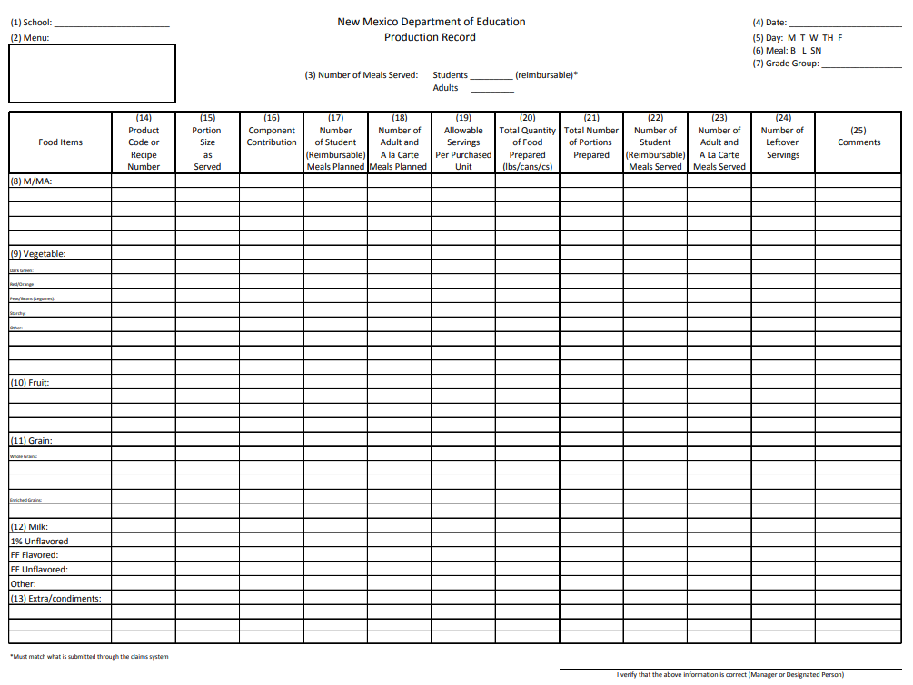
Production Records
Federal Regulation (7 CFR Section 210.10(a)(3)) stipulates that “Production and menu records shall be maintained to demonstrate that the required number of food components and food items or menu items are offered on a given day. Production records shall include sufficient information to evaluate the menu’s contribution to the requirements on nutrition standards…and the appropriate levels of nutrients and calories…whichever is applicable.”
Production records are required to be kept for the School Breakfast Program, National School Lunch Program and the After School Snack Program. They support the claiming of reimbursable meals, provide a historical record of meal service and serve as a tool to monitor food cost.

Slide 31

Production records should include the following information:
      Name of the Site
      Date
      If the site participates in Offer Versus Serve (OvS)
      Grade groups being served (K-5, 6-8, K-8, 9-12 )
      Daily Menu and food items (including condiments & leftovers from another day)
      Recipe Number or Product Brand Name
      Planned Portions sizes
      Quantities Prepared/Total projected servings
      Contribution to food components
      Actual Student Servings and Actual Other Servings (adult, a la carte)
      Amount Leftover

Slide 32
Non-creditable Foods
Often there are foods that do not contribute to meeting meal pattern requirements but are added to a meal for interest and/or flavor. Examples are salad dressings and sandwich condiments. It is commonly known that these items are non-creditable, meaning they do not contribute to meal pattern requirements. However, there are other foods that are less obvious. For example, cream cheese is sometimes thought of as a meat/meat alternate. However, it has too little protein to count as part of the meat/meat alternate group. You are allowed to serve non-credible foods, just remember that they will count toward the weekly calorie limits. Examples of non-credible foods include:
Bacon | Bacon Bits
Butter/Margarine | Cream
Cream Cheese | Condiments & dressings
Ice Cream/Frozen Yogurt | Minced fish
Popcorn | Pepperoni
Potato Chips | Popsicles
Pudding | Salami

Slide 33
Smart Snacks in Schools
All schools participating in the National School Lunch and/or School Breakfast Program are required to follow the Smart Snacks Nutrition Standards. These standards apply to all foods and beverages sold to students during the school day, outside of, or in addition to, the reimbursable
meal. These includes items sold a la carte as well is in vending machines, school stores and fundraisers. These standards apply during the school day anywhere on school campus/grounds that students have access to. A school day is defined as midnight to 30 minutes after the end of the school day.

Slide 34

Is that a “Smart Snack”?
Alliance for a Healthy Generation has developed a Smart Snacks Calculator that can be used to determine whether the snacks being sold to students meet the standards. To use the calculator, you will need the nutrition label. Once you have entered the data, the calculator does the math and tells you if your snack meets the standards. If it does not meet the standards, it tells you the unmet standard(s). The Smart Snacks Calculator can be found here:
https://schools.healthiergeneration.org/focus_areas/snacks_and_beverages/smart_snacks/

Slide 35
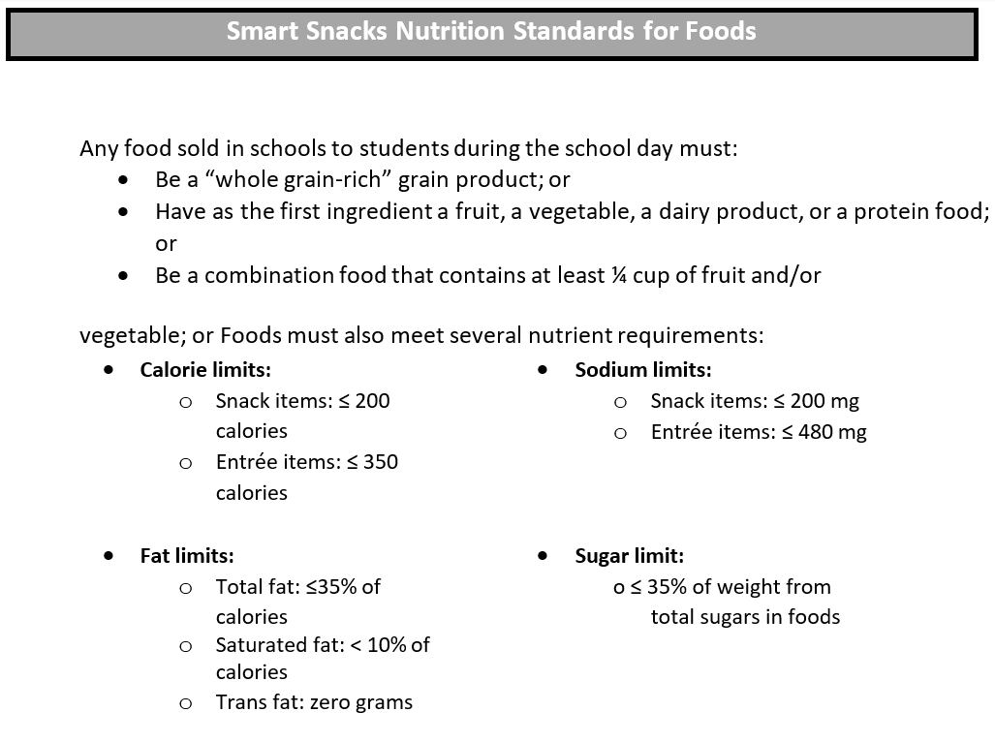

Slide 37


Slide 38
Student Eligibility (STANDARD vs CEP)

Slide 39
Standard
Must collect FRL Applications
Eligibility and benefit issuance determinations (FRL Application Income vs Direct Certification)
  Free, Reduced or Paid
Verification of applications
Required to complete and submit FNS-742
Community Eligibility Program (CEP)
Minimum threshold of 40% ISP required to participate (% based on April 1 data)
No FRL Applications required
Must re-establish every four years
Required to complete and submit FNS-742

Slide 40
Benefit Issuance and Meal Counting

Slide 41
Master List/Benefit Issuance List
Once eligibility has been determined, a list must be created and maintained to indicate which students are eligible for free and reduced meals. This is called a Master List or a Benefit Issuance List and is a roster of student names that includes information about student eligibility. This is a confidential list and should be kept in a secure location.
The list should contain:
    Student name
    Application number (recommended but not required)
    Grade
    Eligibility
    Date of eligibility determination
    Approval reason (income, DC, etc.)
    Status Change: date of change, eligibility changed to (F or R), reason for change, withdrawal date
As updates are made to the list, do not remove any names. The Master List serves as a “live” document that provides a history of eligibility information for individual students over the entire school year. For example, if a student leaves school, that student’s name should remain on the list. The date, status change, and reason will indicate a student is no longer eligible for meal benefits because he or she has withdrawn. All lists should be kept for 3 years plus the current school year.

Slide 42
Point of Service Document
The Point of Service Document is a listing of currently eligible students that is used by food service staff at the point of service. Updated information from the Master List must be provided in a timely fashion to make sure the Point of Service Document is updated and the student receives the correct benefit. This may be a roster or checklist where eligibility status, if available, is listed in a form only identifiable to the person claiming the meals for reimbursement. This document must prevent overt identification meaning the eligibility category is protected and known only by those school officials who deal directly with the counting and claiming system.
Replacement of Benefit Issuance Documentation
Depending on the benefit issuance documentation chosen, students may misplace or lose tickets, identification cards, etc. The USDA has issued specific instructions (FNS Instruction 765-7, Revision 2) regarding lost, stolen, or misused benefit issuance documentation. The purpose of this guidance is to assist sponsors in developing or revising district/school policies while ensuring compliance with federal regulations.

Slide 43
Accountability: Meal Counting and Claiming
To receive reimbursement, sites must accurately count, record, and claim the number of reimbursable meals actually served to students by category: Free, Reduced and Paid. The number of meals served Free, Reduced and Paid claimed for reimbursement must have adequate documentation on file to support the claim.
The meal counting and claiming system includes the following:
  Eligibility Documentation
  Collection Procedures
  Point of Service Counts
  Reports
  Claim for Reimbursement
  Internal Controls
Each of the above elements are important; and all work together to provide accurate and acceptable documentation for meal reimbursement.

Slide 44
1. Eligibility Documentation - The SFA must have documentation to claim free or reduced- price meals for reimbursement. Documentation includes Free and Reduced Price School Meal Applications, Direct Certification list, homeless and/or migrant liaison list, Head Start list, and lists of residential students in RCCIs.
2. Collection Procedures – Different systems may be used to collect payment for student meals. These include pre-payment, post-payment and payment at the Point of Service. Regardless of the means used to collect payment, the SFA must prevent overt identification to keep students’ eligibility for free or reduced meals confidential.
3. Point of Service Counts(for non-special provision schools) - Meals must be counted daily at the Point of Service (POS), the point in the food service line where it can be determined that a reimbursable meal, containing all required components, has been served to an eligible student. Alternative systems, including remote serving areas such as classrooms, must be pre-approved by the state agency.

Slide 45
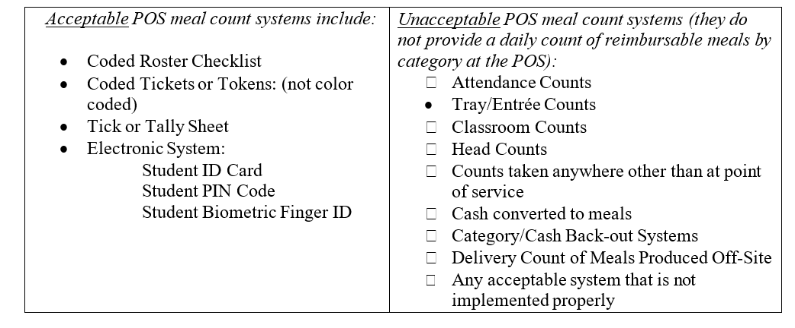

Slide 46
4. Reports – The numbers of reimbursable meals served daily, by category of eligible students are recorded and reported by personnel trained to observe and record reimbursable meals.
  Meal Count Edit Check - the SFA must evaluate the lunch meal counts for each site prior to submission of the Claim for Reimbursement. The Daily Record Form: School Lunch found on our website under ‘Forms’ > ‘Daily Operations Forms’, will assist you in performing an edit check and will help identify and prevent errors in recording and consolidating meal counts.
    The process compares the daily number of free, reduced-price and paid lunches claimed for each site to the following:
      Highest number of eligible students by category
      Attendance-adjusted eligible students for each category
    The Daily Record Form: School Lunch also compares the monthly number of free, reduced and paid lunches claimed for each site to the maximum number of meals allowable to the total number of meals claimed by category.
    It is required that the meal count edit form is completed each month for sites participating in NSLP.
    When completing the meal count edit form normal rounding rules do not apply. Do not round up; leave the decimal should one occur during calculations.

Slide 47
The SFA shall promptly follow-up through phone contact, on-site visits or other means when the internal controls used by the school(s) or SFA for the claims process indicate the likelihood of meal count problems. When problems or errors are identified, the meal counts shall be corrected prior to submission of the monthly Claim for Reimbursement. Improvements to the meal count system shall be made to ensure that the meal counting system consistently results in meal counts of the actual number of reimbursable free, reduced and paid meals served for each day of operation.
School Detail & Claim for Reimbursement – This is how SFAs report required information to receive subsidy payment for meals served. The monthly Claim for Reimbursement is submitted electronically by the SFA in the Nutrition Claims Portal New Mexico Student Nutrition Claims Welcome and Alerts (state.nm.us)
6. Internal Controls - The SFA must establish internal controls to ensure an accurate Claim for Reimbursement has been made. Here are a few examples of internal controls:
  Segregation of duties
  On-site visits – required to be completed for each site prior to February 1 of each year
  Reconciliation of production records to meals

Slide 48
Preventing Overt Identification
A system for counting and claiming meals must prevent overt identification. This means the eligibility category of any child must be protected and known only by those school officials who deal directly with the counting and claiming system.
Codes on checklists, rosters or tickets are one method of preventing overt identification. A code must be difficult to recognize, but not so confusing that the person taking the count has difficulty identifying the category. Some codes are too easily recognizable and therefore allow overt identification. These include the actual words “free,” “reduced-price” and “paid” or the use of the letters “F,” “R” or “P.” In addition, the use of different colors for different designations is also prohibited.

Slide 49


Slide 50

Federal and State Regulations

Slide 51
Record Retention
Documentation related to child nutrition programs must be maintained on file in the LEA for three (3) years plus the current school year. Documentation refers to any materials related to certification, verification, benefit issuance and claiming, including but not limited to, Free & Reduced Price Meal Applications, verification letters to families, verification documents received from families, menus, production records, and procurement. When discarding information, records containing student information must be shredded and destroyed.
Water During Meal Service
Schools participating in the National School Lunch Program and/or School Breakfast Program must make potable water available to children at no charge in the place where breakfast meals, lunch meals are served. For example, if students are permitted access to a water fountain, or a faucet is available for students to fill their own bottles or cups with drinking water. Use of water fountains are commonly used to meet this requirement. Whatever method is used, the water must be available without restriction in the location where meals are served.
While potable water is required to be made available to students, it is not considered part of the reimbursable meal and students are not required to take the water. Although, reimbursement is not available for this requirement, reasonable costs associated with the provision of potable water are an allowable expense to the non-profit food service account. Providing bottled water to students is not a reasonable and necessary cost to the program and therefore the program must charge for bottled water or be paid for by a source other than food service.

Slide 52
Local Wellness Policy
Any school that participates in a program authorized under the National School Lunch Act, must establish a Local Wellness Policy which:
  Sets goals for nutrition education, nutrition promotion, physical activity, and promoting student wellness.
  Sets nutrition guidelines for all foods available on school campus during the school day, both sold and available at no charge to students.
  Assures nutrition guidelines for school meals will not be less restrictive than federal policy.
  Establishes a plan for measuring effectiveness.
  Involves physical education teachers, school health professionals, parents, students, and representatives from the school food service department, school board, school administration, and the public in the development of the Local Wellness Policy.
  Includes the implementation of periodic review and updates.

Slide 53

Additional requirements include:
Permitting physical education teachers and school health professionals on the team of collaborators to develop and review local wellness policy.
Informing and updating the public (including parents, students, and others in the community) about the content and implementation of the local wellness policies.
LEAS are required to make available to the public a triennial assessment of the local wellness policy including:
  The extent to which schools are in compliance with the local wellness policy;
  The extent to which the LEA’s local wellness policy compares to model local school wellness policies; and
  The progress made in attaining the goals of the local wellness policy.
Acceptable methods for informing and updating the public may include dissemination of printed or electronic materials to families of school children and other members of the community at the beginning of the school year and/or posting on the district or school website. Whatever method is chosen, the information must be made available to the public by LEAs in an accessible, easily understood manner.

Slide 54

Accommodating Children with Disabilities and/or Special Dietary Needs
For a student with a documented disability which affects their diet, substitutions MUST be made to the regular meal. To accommodate special dietary needs, the following requirements must be met:
  A medical statement is completed and signed by a medical authority (MD, DO, NP, PA)
  The statement must explain how the disability restricts the child’s diet and food(s)/beverage(s) to be omitted and foods/beverages to be substituted.
  Having a complete statement on file allows the modified meal to be claimed for reimbursement even if it does not follow the meal pattern requirements.
*If the physician statement does not contain sufficient information, the school nurse or food service director should contact the physician for clarification.
For a student without a disability
Reasonable substitutions may be made to the reimbursable meal. Substitutions must still adhere to meal pattern requirements and cannot effect normal program operations.
For a student without a disability requesting fluid milk substitution
A fluid milk substitution may be made if requested by a parent or medical authority. Lactose- free cow’s milk and soy milk that meets the USDA criteria are permissible.

Slide 55
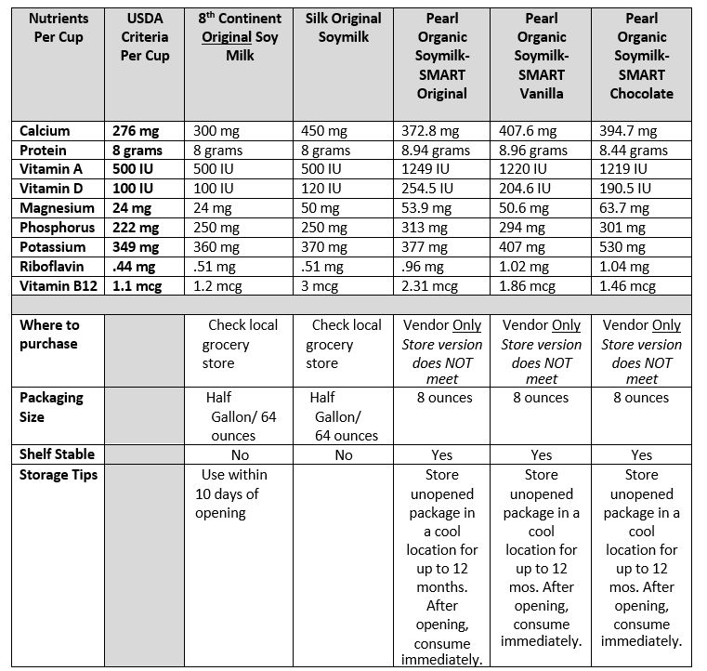
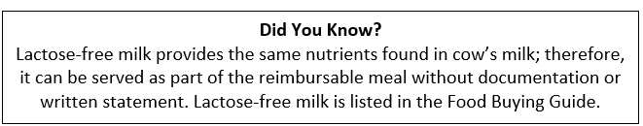
Products Which Meet USDA’s Nutrition Standards for Milk Substitutions
Not all students with a disability will require a dietary accommodation. For those students that do have a special dietary need, determining how to make reasonable accommodations takes careful planning, good communications with the family, and knowledge of food preparation techniques to prevent cross contamination.

Slide 56
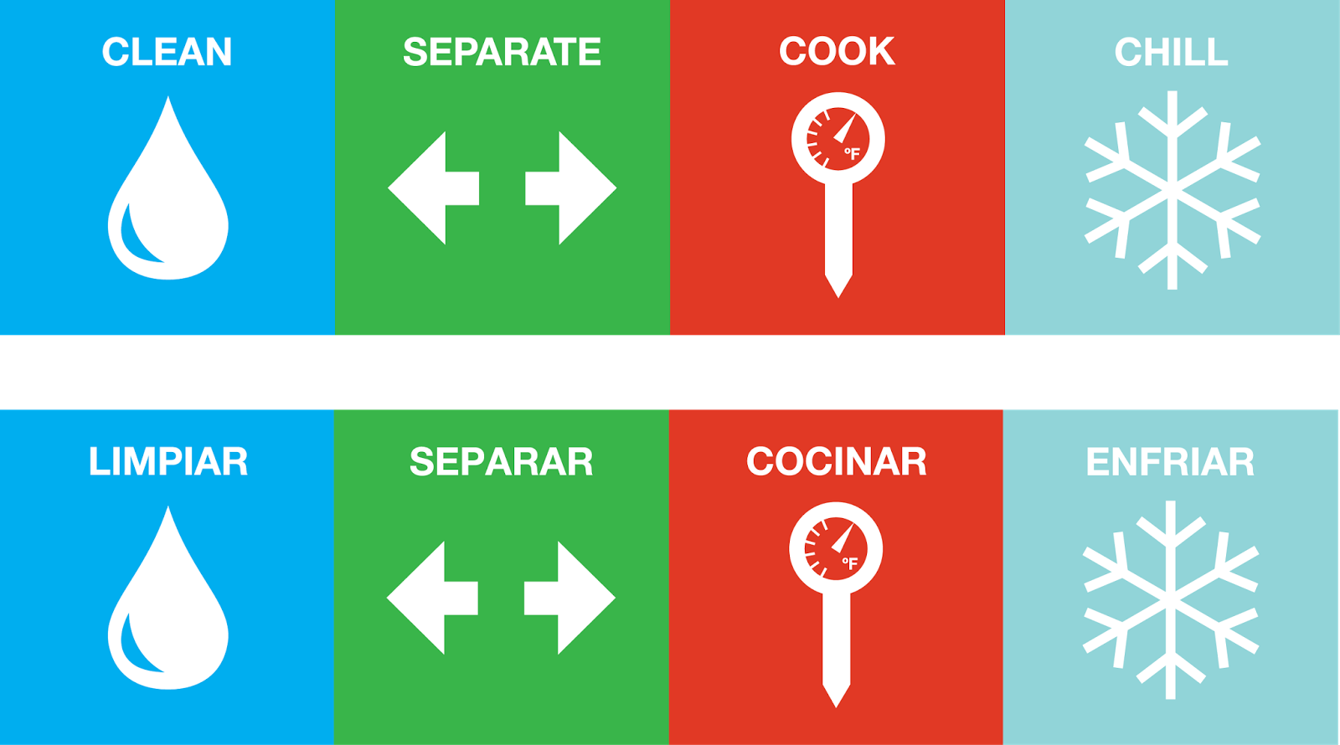
Food Safety

Slide 57
Food Safety Plan
SFAs are responsible for developing a comprehensive food safety plan for all sites that prepare and serve food. The plan must be based on the Hazard Analysis and Critical Control Point (HACCP) principles and must conform to guidance issued by the USDA. Standard operating procedures for safe food handling must include any facility or part of a facility where food is stored, prepared, or served, such as on school buses, in hallways, school courtyards, kiosks, classrooms or other locations outside the cafeteria for SBP, NSLP, SMP, FFVP, and after school snack programs.
A school food safety program must include the following elements:
  A Written Food Safety Plan – A food safety plan must be developed for each food preparation and service site. The food safety plan must include how to apply HACCP principles by doing the following:
    Documenting recipe/menu items in the appropriate HACCP process category
    Documenting Critical Control Points of food production
    Monitoring
    Establishing and documenting corrective actions
    Record keeping
    Reviewing and revising the overall food safety plan periodically
  Documented Standard Operating Procedures (SOPs) – SOPs are a very important factor in developing an effective food safety plan. An SOP serves as a specific food safety process and is designed to control hazards not outlined specifically in the general HACCP plan. For example, soiled and un-sanitized surfaces of equipment and utensils should not come into contact with raw or cooked (ready-to-eat) food. Proper procedures to prevent this should be covered by an SOP.

Slide 58

Health Inspections
Each school year SFAs must obtain two food safety inspections for each site where food is prepared or served. Copies of these inspections must be maintained at the SFA or at the site for seven years. The most recent food sanitation report must be posted in a prominent location that is viewable by the general public. Generally, this means in the cafeteria or near a serving window, not in the kitchen or office.
If a SFA has not received the food sanitation inspections by March 31, a letter must be written to the local health department requesting the required two food sanitation inspections for each site where food is prepared or served. The letter must be maintained at the SFA or at each site as documentation of your attempt to comply with two food inspections as required by USDA regulations.

Slide 59
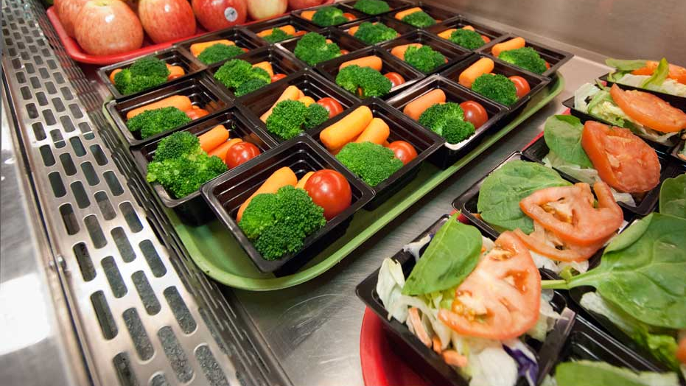
Meal Pricing

Slide 60
Setting Meal Prices
Price Equity
Section 205 of the Healthy, Hunger-Free Kids Act of 2010 requires sponsors (SFAs) participating in the National School Lunch Program to ensure sufficient funds are provided to the non-profit food service account for lunches served to students who are not eligible for free or reduced-price meals. The provision applies only to paid student lunches and does not apply to adult lunches or student breakfasts. SFAs are required to charge students for paid meals at a price that is, on average, equal to the difference between free meal reimbursement and the paid meal reimbursement.
Each school year SFAs must complete the Paid Lunch Equity (PLE) Tool. Schools that currently charge less for meal than the amount needed to create paid lunch equity are required to:
    gradually increase their prices over time until they meet the requirement or
    supplement their food service operating funds with non-federal funds to ensure equity or
    a combination of increasing their prices and supplementing with non-federal funds.

Slide 61
Pricing of Non-program Foods and Adult Meals
School food service account funds are intended to purchase food for reimbursable meals. The Healthy Hunger Free Kids Act of 2010 establishes requirements for school district revenue when foods sold outside of reimbursable meals are purchased with school food service account funds. The purpose of the Non-Program Revenue requirement is to ensure revenues from the sales of non-program foods cover food cost in the SFA food service account.
Non-program foods include, but are not limited to:
  A la carte items
  Adult meals
  Fundraisers
  Vending machines
  Seconds of entrée items (not fruits or vegetables)
*Second meals to students are not eligible for reimbursement and therefore must be priced to cover all costs associated with producing that meal.

Slide 62
Competitive Food Sales
Any food or beverage sold outside of the reimbursable meal and purchased using school food service funds is considered a competitive food. The USDA requires that each SFA limit competitive foods to encourage consumption of the reimbursable meals. Therefore, when pricing non-program items and adult meals, the SFA must set prices at a level high enough to:
  Encourage students to select the reimbursable school lunch or breakfast meal, and
  If food is purchased using school food service funds, the price must recover all the costs involved in the item including labor, overhead, paper supplies, value of USDA foods used in preparation, etc. and should reflect a profit on the item.
Adult Meals
The price set for an adult meal must cover the cost of preparing the meal including the value of USDA foods. Portion sizes for adults should be the same as served to students in grades 9 – 12. The reason adult meals are priced higher than student meals is because reimbursement is only received for student meals. The charge to adult visitors, at the discretion of school officials, may be higher than the charge paid by adult school employees.
Meals served to school nutrition program employees directly involved in the operation and administration of the breakfast and lunch programs (e.g., managers, cooks, servers, etc.) may be served at no charge and considered as a fringe benefit attributable to program costs. Therefore, the cost of such meals may be paid from program funds. Charging school food service employees for meals is left to the discretion of school officials. The reimbursement and commodities received by schools are based on the number of lunches and breakfasts served to students.
No reimbursement or commodities are provided for and meals served to adults or second meals served to students.

Slide 63
Nonprofit School Food Service Account
Revenues received by or intended for the nonprofit school food service program are to be used only for the operation or improvement of the program. These revenues shall not be used to purchase land or buildings or to construct buildings. The SFA shall limit its net cash resources to an amount that does not exceed three months average expenditures. Costs charged to the nonprofit school food service account must be both necessary and reasonable. All school foodservice revenue, and intended revenue, is considered Federal and must be reported on the monthly Claim for Reimbursement.
Indirect Costs
Indirect costs are the school nutrition program’s share of general school districts’ costs such as the costs of the Superintendent’s office, human resources, payroll, accounting, budgeting, purchasing, utilities, building maintenance, etc.

Slide 64
General Procurement Requirements
Procurement is the act of obtaining goods and services. All procurement transactions must be conducted in a manner that provides maximum open and free competition. Procurement includes, but is not limited to, food, professional services, maintenance services, utilities and supplies.
Procurement procedures must ensure they do not foster noncompetitive practices between firms, do not create organizational conflicts of interest, and do not restrict or eliminate competition.
Procurement must not place unreasonable requirements on firms, require unnecessary experience, or establish unrealistic bonding requirements. Cost plus a percentage of purchase is not an allowable system. There must be descriptions of all products purchased, and identical instructions provided to all potential vendors.
Formal standards of conduct should govern the performance of officers, employees, and agents in the award and administration of contracts. These standards should provide that officers, employees, or agents should not solicit nor accept gratuities, favors, or anything of monetary value from contractors, potential contractors, or parties of sub-agreements.
SFAs must have written selection procedures for awarding contracts. Records should be maintained to detail the significant history of procurement. These records must include, but are not necessarily limited to, the following: rationale for the method of procurement, contractor selection or rejection, basis for the cost or price, and documentation for change orders.

Slide 65

QUESTIONS?

Slide 66
Civil Rights Requirements

Slide 67
Civil Rights Requirements
All SFAs and sponsors receiving USDA funds must follow civil rights regulations and policy. Federal law prohibits discrimination on the basis of the following protected classes:
Race
Color
National Origin
Sex
Disability
Age
Protected classes under New Mexico state law include:
  Protections for persons with regard to religion, ancestry, and sexual orientation
  All Federal Child Nutrition Programs in the State of New Mexico must adopt both Federal and State protected classes

Slide 68
Public Notification
All programs must include a public notification system to inform applicants, participants, and potentially eligible persons about the program. The public notification system must include information on:
  eligibility
  benefits and services (free and reduced-price meals and snacks)
  program availability
  steps necessary for participation
  applicant rights and responsibilities
  non-discrimination policies
  procedures for filing a complaint
This information can be available on your program website and/or sent home to families at the start of each school year.

Slide 69
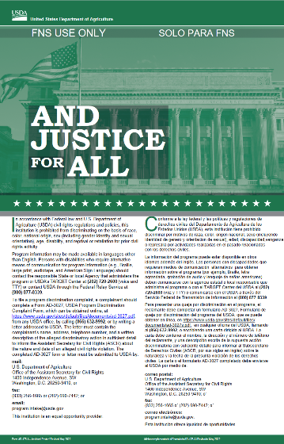
News Media Release
One of the requirements of public notification includes annually sending a public news media release that informs the general public of the availability of meals/snacks at local SFAs.
The New Mexico Department of Education sends out a media release annually that covers all SFAs.
“And Justice for All” Poster
To notify the public of program benefits & requirements, SFAs are required to post the “And Justice for All” poster in a publicly visible location at each food service site in the 11” x 17” format.
Non-discrimination Statement
  The required non-discrimination statements must be included on all program materials including eligibility notification letters, food service newsletters, and verification notification letters. A copy of the statement can be found on our website
Annual Civil Rights Training
  All staff involved with the school nutrition programs (processing of applications, meal preparation, meal service, etc.) must participate in annual civil rights training supported by adequate documentation.

Slide 70
SFA On-Site Review
NSLP regulations require each SFA, to annually conduct their own review of each site’s meal counting and claiming procedures.
SBP regulations require that the school breakfast program be reviewed annually in 50% of the sites that operate a breakfast program.
These reviews must be completed by February 1st of each school year for all sites. A sample copy of the On-Site Review Form is available on the NMPED website. A copy of the on- site review must be maintained on file at the site or SFA office for three years plus the current school year. Do not send this form to the State Agency.
If the on-site review determines a problem, the SFA must correct problems immediately and conduct a follow-up review within 45 calendar days of the initial review. A follow-up review must be conducted to determine if the corrective action resolved the problem. Written documentation is required to be maintained at the SFA or at the site.
On-site reviews are conducted to ensure at each meal service, the following internal controls are operating correctly:
  Daily meal counts by category are taken at the point of service
  All meals claimed meet meal pattern requirements
  Overt identification is prevented
  Sanitation procedures are followed

Slide 71
After-School Snack On-Site Program Review
For those participating in the After-School Snack Program through the NSLP, the SFA must review each site two times per year. The SFA must conduct the first review during the first four weeks of operation each school year. The reviews ensure reimbursable snacks are provided and served to eligible students and acceptable counting procedures have been implemented.
Documentation must be maintained on file in the LEA for five years.
A sample copy of the On- Site Review Form is available on our website.

Slide 72
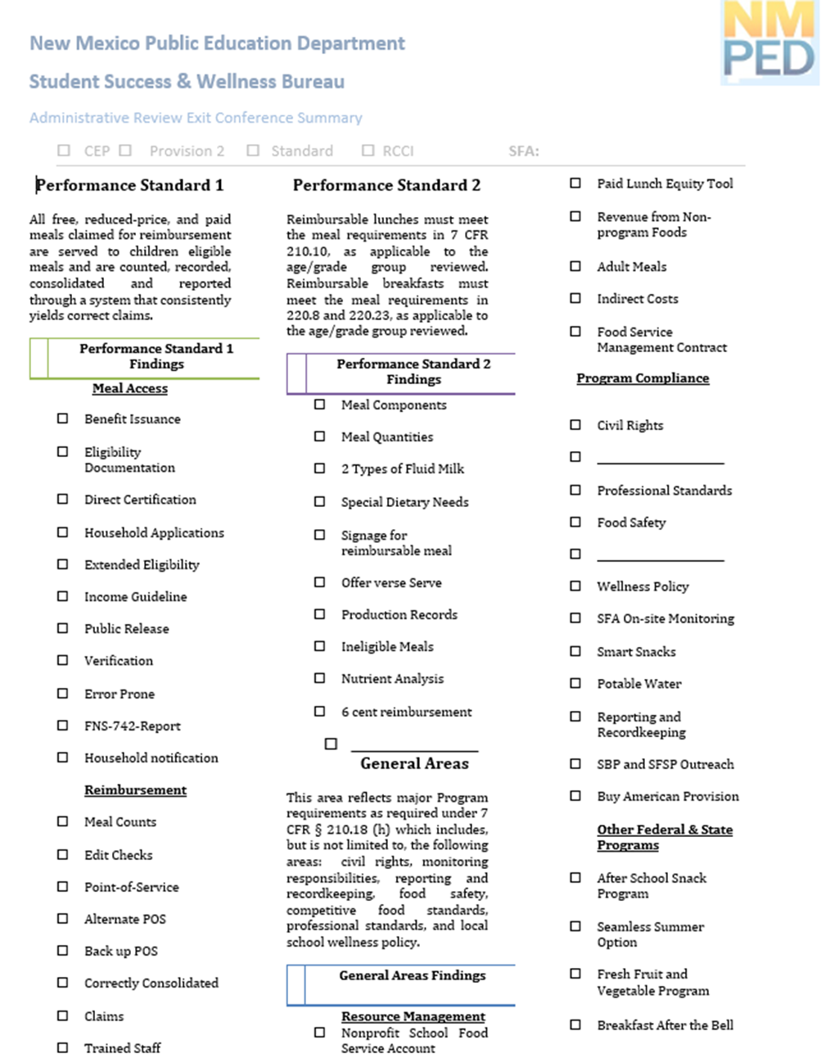
Administrative Reviews
The USDA requires the New Mexico Department of Education, to conduct administrative reviews of all SFAs participating in NSLP. Administrative reviews are comprehensive on-site evaluations conducted, at a minimum, every five years.
The review process includes an evaluation of the following critical areas and general areas
A report will be sent to the LEA detailing review findings, corrective action and any fiscal action.

Slide 73


