Slide 1
Transportation Bureau
2023 Spring Budget Workshop

Slide 2
Contact Us
Luis Fierro
Transportation Supervisor
(505) 677-6697
luis.fierro@ped.nm.gov
Daniel Bell
Transportation Specialist
(505) 470-4058
daniel.bell@ped.nm.gov
Alyssa Marquez
Financial Coordinator
(505) 629-5821
alyssa.marquez@ped.nm.gov

Slide 3
Topics
2023 Legislative Session
Bus Replacements
Budgets
6.41.4 NMAC
School Bus Inspections
CDL Clearinghouse
Training Classes
Important Dates

Slide 4
2023 Legislative Session HB-2
$126,379.5 million for transportation formula and rental fees
($2,211.5 million is included in this amount to provide an average 5% salary increase to all transportation employees)

Slide 5
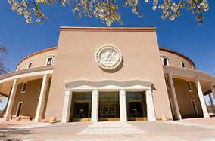
2023 Legislative Session
K-12 transportation
Transportation data will be entered on 40th day
Detailed instructions will be given at the STARS/NOVA conference

Slide 6
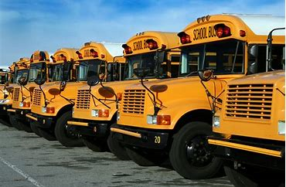
2023 Legislative Session HB-505 Capital Outlay Expenditures
School bus replacements - $16.7 million for district owned school buses to include air conditioning
School bus cameras - $315,000

Slide 7
Bus Replacements
Approval list will be sent in April and official approval letters will be sent in July
Order verification/notification that bus is no longer on route must be submitted to PED
All orders must be placed after approval letters are sent out
All buses should be delivered by
April 30th 2024 (contractor buses)

Slide 8
Bus Replacements
No waivers for contractors
District must have liens on the buses
Contractors must be approved for financing
School districts and charter schools must verify with contractors by August 1st if financing has been secured
Buyers orders must be submitted to PED to verify buses have been ordered

Slide 9
Bus Replacements (Contractor)
22-8-6 NMSA 1978 – requires the PED to calculate a value for the remaining number of years a bus can be used
Succeeding operator shall purchase
the bus(es) at the lowest appraised
value
Responsibility of the school district to
collect the overpayment

Slide 10
Bus Replacements (Contractor)
PED sends school bus replacement approval letter to the school district.
New bus must be inspected, have Zonar tags installed, make sure school district is a Lien Holder.
Contractor will purchase new school bus.
School district will submit BAR in OBMS.
Transportation Bureau approves the BAR.
Fiscal Division approves BAR and includes rental fee in subsequent months transportation distribution.
District must attach a copy of Title & Registration, Approval Letter from PED, Database Update Form and amended Appendix A&B to the BAR in OBMS.
The fund code to use for the BAR is 13000. The revenue code is 43206 and the expenditure code is 54620 .

Slide 11
Bus Replacements (District Owned)
PED sends school bus replacement approval letter to school district.
District will get a quote for a new school bus from an approved vendor. District will e-mail quote to PED for approval. PED will approve an amount and forward a grant agreement.
After the quote has been approved, district will submit a BAR in OBMS for the amount of the approved quote(s). Please attach the following with the BAR: copy of quote, signed Grant Agreement, copy of approval letter. Fund number is 27178. Revenue code is 43202 and expenditure code is 57312.
School district will order and purchase new school bus after the BAR is approved. New bus must be inspected and have ZONAR tags installed
District will submit an RFR through OBMS. The RFR must include title, registration, Database Information Update Form, Draw Request Form, invoices and cancelled checks

Slide 12
Budgets (FY24)
2022 cash balances
School districts and charter schools must send back 50% of unexpended cash balance
Must submit BAR for remaining 50%
Notes:
12
Ask the participants to reflect on these questions and then share their reflections with the group.

Slide 13
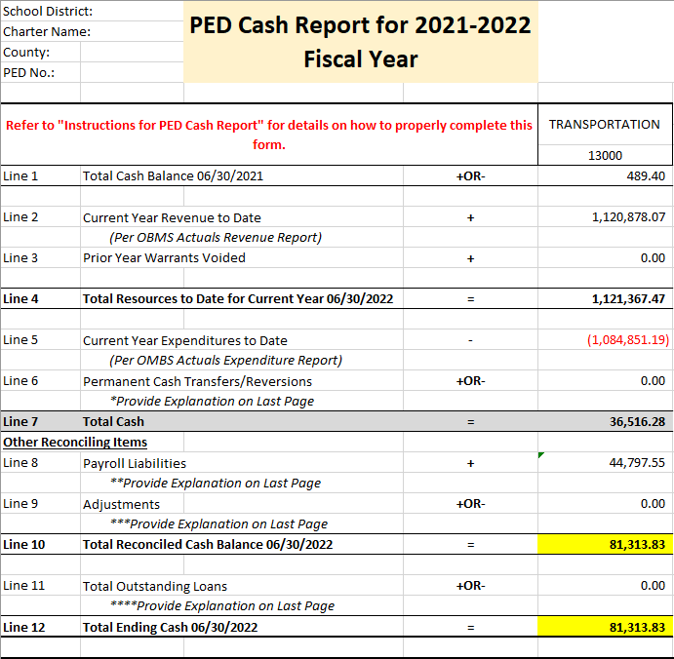
Budgets (FY24)
Notes:
13
Ask the participants to reflect on these questions and then share their reflections with the group.

Slide 14
Budgets (FY24)
Revenues equal allocation
Rental fees are included and are accurate
Total of all contracts are included
All contracts must be submitted
Appropriately budgeting FTE’s
Must include 5% salary increase
Notes:
14
Ask the participants to reflect on these questions and then share their reflections with the group.

Slide 15
Budgets (FY24)
All contracts must be submitted before budgets will be approved. Due June 15th!!
Notes:
15
Ask the participants to reflect on these questions and then share their reflections with the group.

Slide 16
Budgets (FY24)
ESTIMATED
Revenue:
11112 - Unrestricted Cash
43206 - Trans. Distribution (FY24 Final Allocation)
Expenditures:
5XXXX – TBD
54620 - Rental Equipment & Vehicles
55112 - Transportation Contractors
$XXX,XXX
$XXX,XXX
$XXX,XXX
$XXX,XXX
$XXX,XXX
$XXX,XXX

Slide 17
Budgets (FY24)
PROJECTED
Revenue:
11112 - Unrestricted Cash
43206 - Trans. Distribution (FY24 Allocation)
Expenditures: (Must include 5% salary increase)
5XXXX - TBD
54620 - Rental Equipment & Vehicles
55112 - Transportation Contractors
$0.00
$XXX,XXX
$XXX,XXX
$XXX,XXX
$XXX,XXX
$XXX,XXX
$XXX,XXX

Slide 18
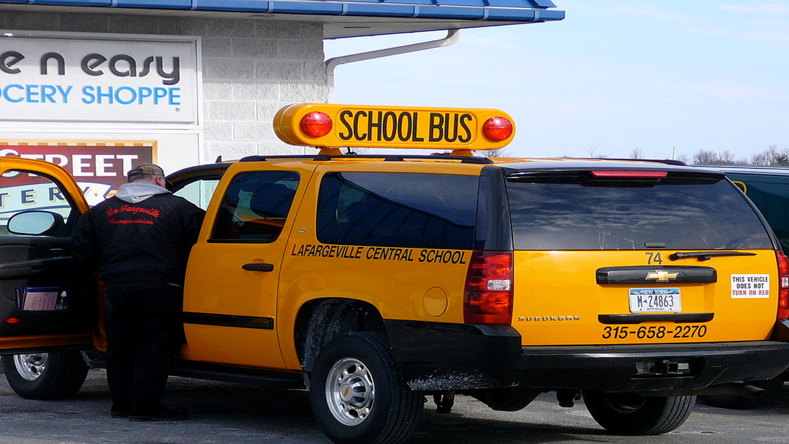
6.41.4 NMAC (To-and-from transportation in an SUV)

Slide 19
6.41.4 NMAC (To-and-from transportation in an SUV)
Request for approval must be submitted to PED prior to transporting students
Names of students to be transported
Explanation why an SUV needs to be used
A map highlighting residence of students
Copy of the driver’s pre-service training record
Photograph of the vehicle showing one side, the front and the rear clearly showing the strobe lights and lettering

Slide 20
6.41.4 NMAC (To-and-from transportation in an SUV)
In a district-owned, minimum six-passenger, full-size, extended-length, sport utility vehicle (does not include vans)
Only for 1 to 6 students
Students’ residence is 5 or more miles from the school
Driver shall be a school district employee and a certified activity driver
The vehicle and the driver shall be insured by the Public School Insurance Authority

Slide 21
6.41.4 NMAC (To-and-from transportation in an SUV)
Half the miles will be counted through the funding formula
Safety Equipment (optional)
Maximum speed limiter set at 75 mile per hour
Two way radio communication system
Operable recording video camera
Back-up camera
Painted National School Bus Yellow, but not required

Slide 22
6.41.4 NMAC (Current CPR Training)
Requires a current first aid and CPR certificate which has been obtained from a course approved by the department
No online or hybrid courses
6.41.4.13 NMAC - school bus drivers, substitute school bus drivers, school bus assistants, school owned activity drivers
6.41.4.14 NMAC - to and from drivers transporting on SUV’s

Slide 23
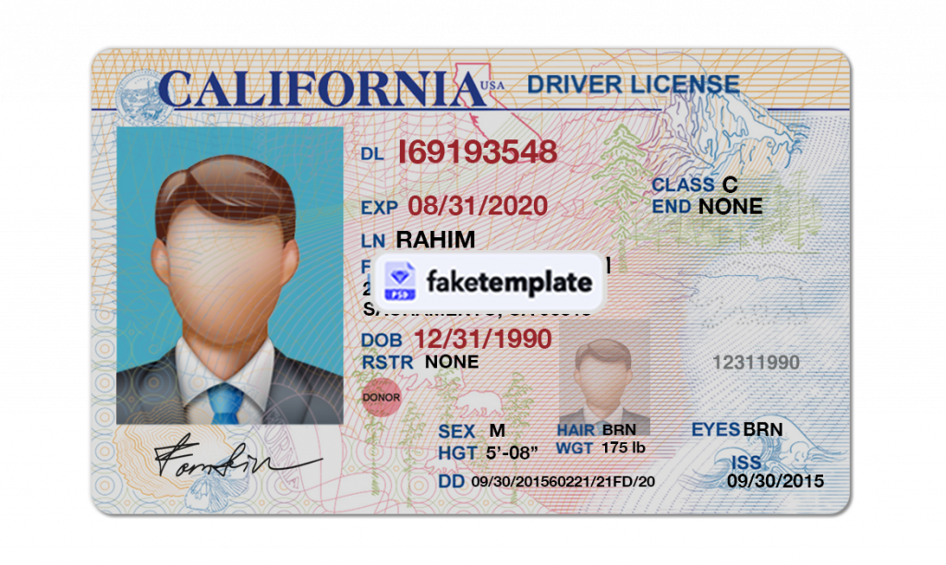
6.41.4 NMAC (Driver Files)
NMAC 6.41.4.9 S(1C) - a driving record printed annually then verified for eligibility and placed in driver’s file

Slide 24
6.41.4 NMAC (Supervisor Training)
NMAC 6.41.4.9 U.(2) - Annually a minimum of 2 hours of in-service training for supervisors is required. Content is determined by the State Transportation Director
Reviewing qualifying requirements for CDL and school owned activity vehicle drivers – 6.41.4.7 through 6.41.4.13 NMAC

Slide 25
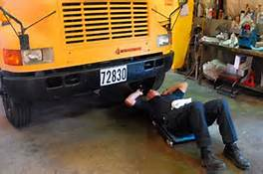
School Bus Inspections
Twice annually - district responsible for payment and signing off
Statewide memo with PED expectations
Current cycle ends May 12, 2023
Inspection notification sent to bus.inspector@ped.nm.gov

Slide 26
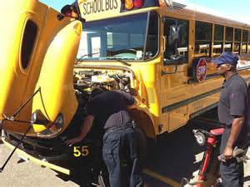
School Bus Inspections
30 minutes minimum - unless a waiver
Random Inspector Audits
Recommend that a district representative be onsite during inspections
Recommend alternating inspectors

Slide 27
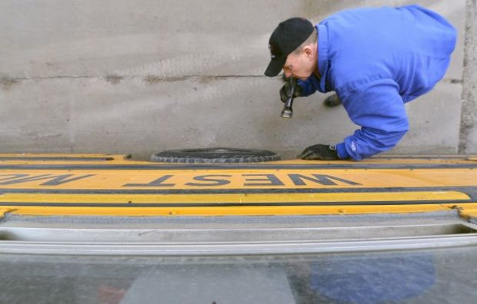
School Bus Inspections
Inspectors required to document brake measurements
Use inspections as the
time to conduct
maintenance
Failure to comply may
result in re-inspections
At the cost of the school
district and/or inspector

Slide 28
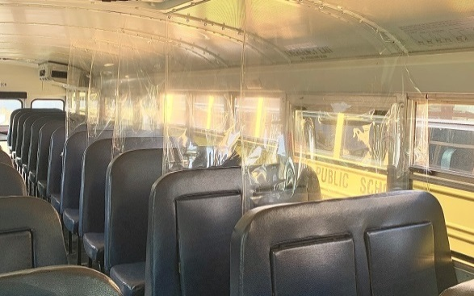
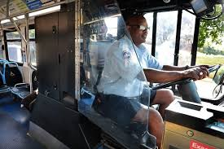
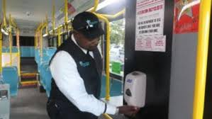
School Bus Inspections
School Bus Maintenance & Safety Audit Program manual adjusted
Aftermarket installations to enhance safety due to COVID-19 will be allowed as long as they meet all federal guidelines and regulations

Slide 29
CDL Clearinghouse (What is it?)
The U.S. Department of Transportation’s Federal Motor Carrier Safety Administration has opened registration for the CDL Clearinghouse
A database that will contain information about CDL driver’s drug and alcohol violations
Queries must be conducted annually

Slide 30
CDL Clearinghouse (Who has to register?)
Registration is congressionally mandated for the following individuals:
All drivers who hold a CDL or CLP
Employers of CDL drivers
Consortia/Third-Party Administrators
Substance Abuse Professionals
https://clearinghouse.fmcsa.dot.gov

Slide 31
CDL Clearinghouse (What is it?)
The U.S. Department of Transportation’s Federal Motor Carrier Safety Administration announced that beginning January 1, 2020 the minimum annual percentage rate for random drug testing is 50%
The minimum annual percentage rate for random alcohol testing will remain at 10%

Slide 32
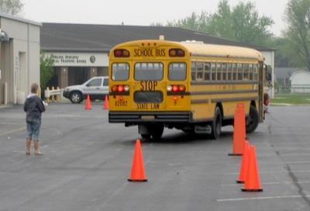
Training Classes
School Bus Driver Instructor Class
CDL Examiner Class
Activity Vehicle Instructor Class
If interested in a class email
luis.fierro@ped.nm.gov

Slide 33
Important Dates
April – FY24 Transportation Allocations (Planning Awards)
April – BAR’s for FY23 rental fees
May – Final FY23 disbursement
June 15th – School bus contracts to PED
July – School bus approvals
Notes:
33
Ask the participants to reflect on these questions and then share their reflections with the group.

Slide 34
Important Dates
July – new buses shall be ordered and goal to be delivered by December 31st
Contractors must secure financing
August – Final expenditure report and list of un-liquidated obligations
Notes:
34
Ask the participants to reflect on these questions and then share their reflections with the group.

Slide 35
Important Dates
October 11th
1st reporting date (40th day)
K-12
December 1st
2nd reporting date (80th day)
February 14th
3rd reporting date (120th day)
Notes:
35

Slide 36
Questions???

