Slide 1
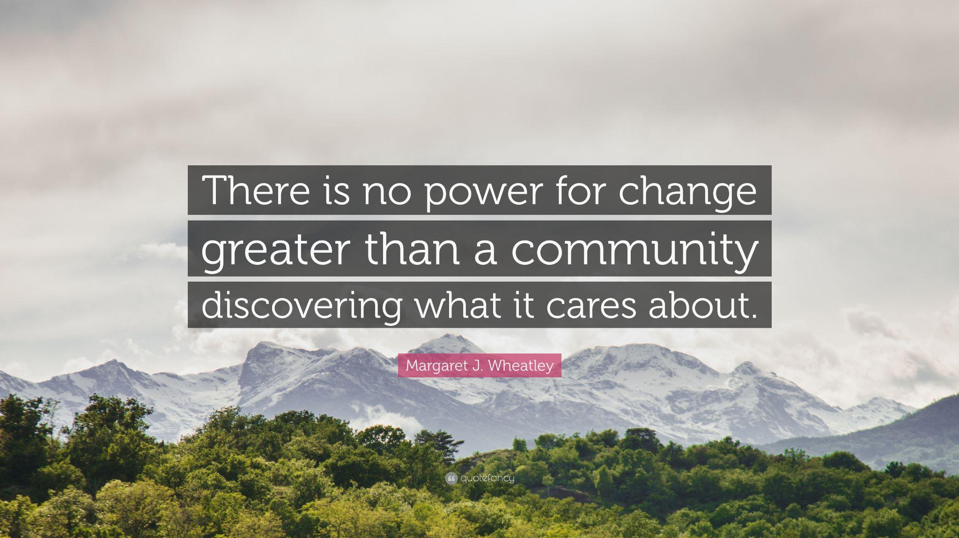

Slide 2
Community Project Based Learning
Benefits
Engaging Students
PBL Connected Learning
Careers/jobs and access to the tools used: See it to achieve it!
Social Capital: Students make connections to community people and resources
Diversity & Representation: Windows and Mirrors - students access adults from various
cultures, genders and more
Supported Process: Community Partners, resources, shopping and availability
The Community Benefits!

Slide 3
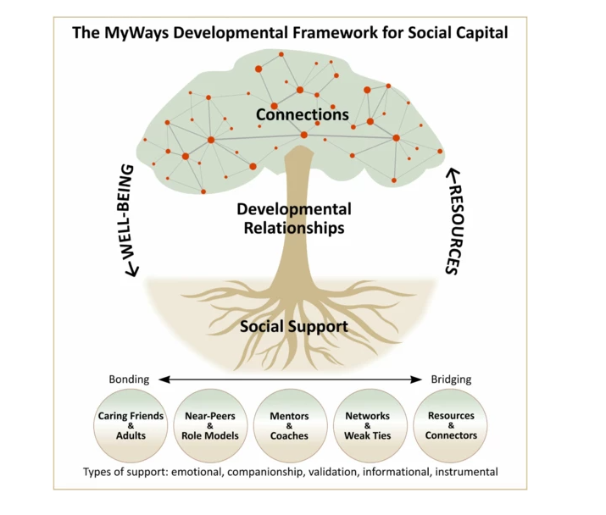
Building Social Capital: Connecting Students

Slide 4
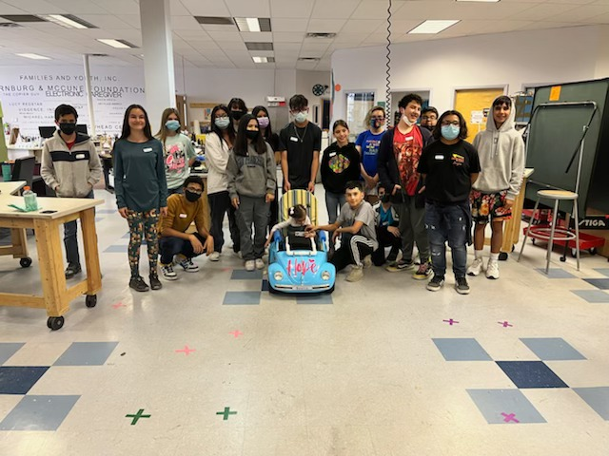
Building a Powerchair!
Mr. Marquez and Class built a Power Chair at our local makerspace for a young student.
Several Partners collaborated and worked with partners and a local funder

Slide 5
Connecting Students to Careers & College
PreK-12
Booker T Washington: 6 Preschool classrooms worked with Explora Science museum, an Engineer , and more in a year long Science Focus

Slide 6
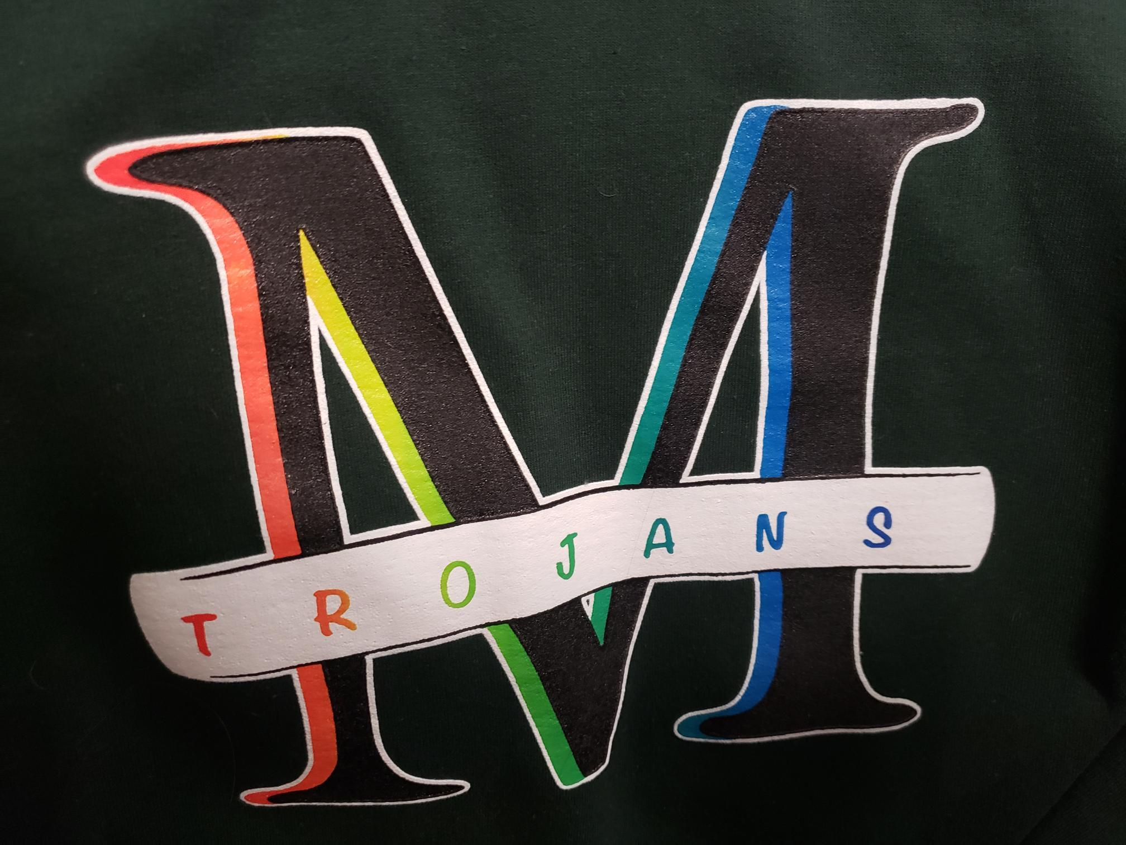
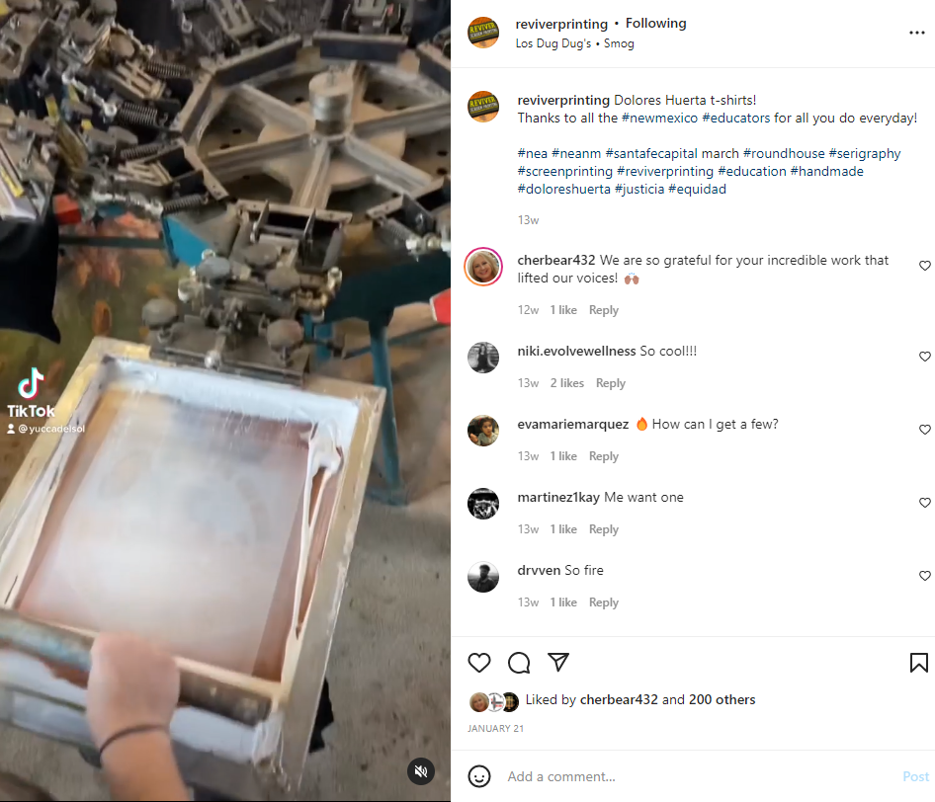
Connecting Students to Careers & College
PreK-12
Students in the Mayfield GSA Club worked with Reviver Printing through the screen printing process to create a shirt!

Slide 7
Connecting Students to Careers & College
PreK-12
Sierra Middle School AES designed a food truck, Local Entrepreneur Elizabeth Corrales brought her food truck and talked business with students. Everyone got to order!

Slide 8
Connecting Students to Careers & College
PreK-12
East Picacho invited multiple local businesses to help with Literacy Night: Camp Read A Lot was a hit!

Slide 9
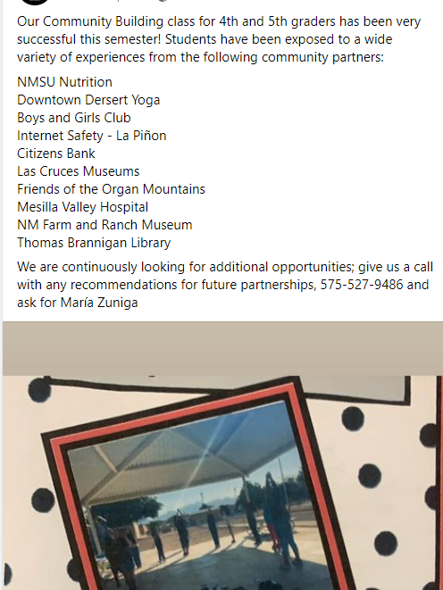
Connecting Students to Careers & College
PreK-12
Alameda brought in several Yoga and Coaches from Las Cruces for a Social Emotional school-wide project!

Slide 10
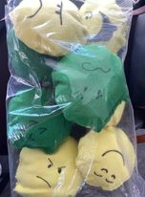
Connecting Students to Careers & College
PreK-12
Lynn Community School FACS class connected with non-profits… and students sewed blankets for local charities and emojis for Alameda Students!
Camino FACS connected too!

Slide 11
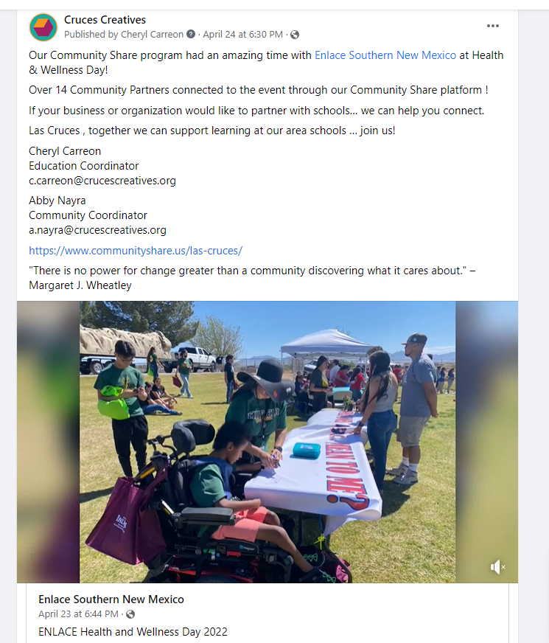
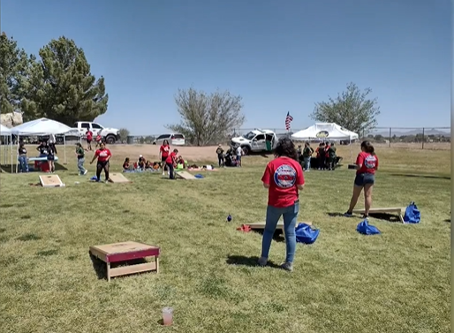
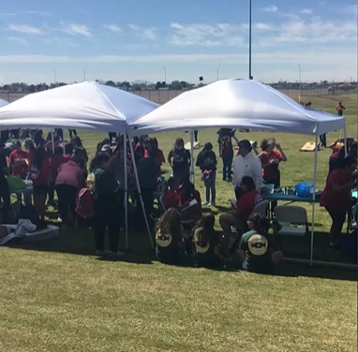
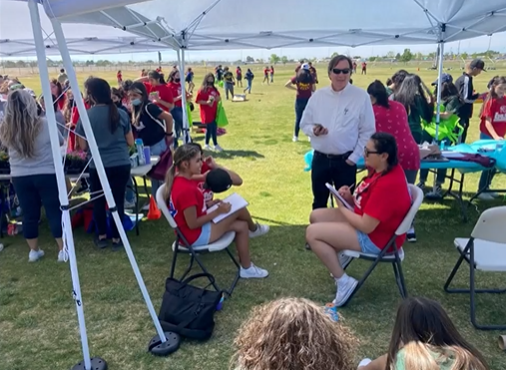
Connecting Students to Careers & College
PreK-12
Enlace transformed Track & Field into a Health & Wellness Fair inviting over 14 Community Partners

Slide 12
Contact:
Cheryl Carreon
cacarreon54321@gmail.com

