Slide 1
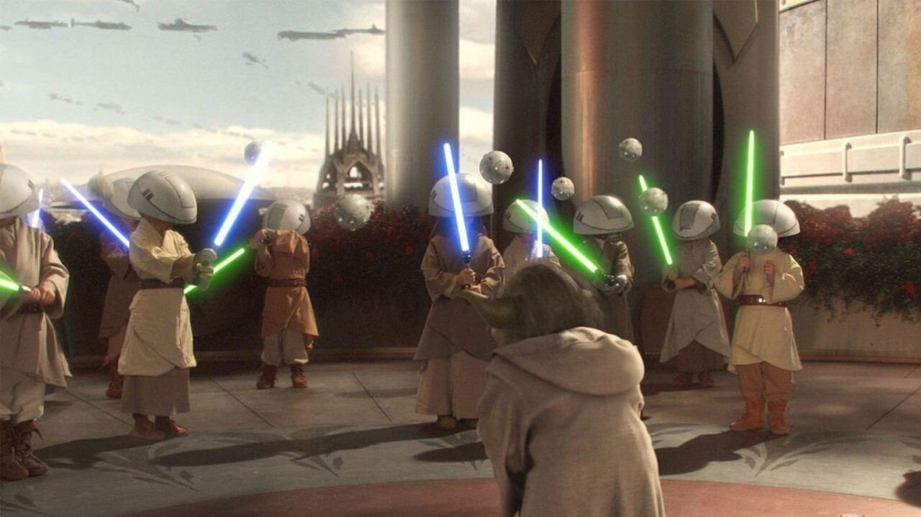
Additional Instructional Time And K12+
Nate Williams
K12+ Program Director
NMPED Community Schools Bureau

Slide 2
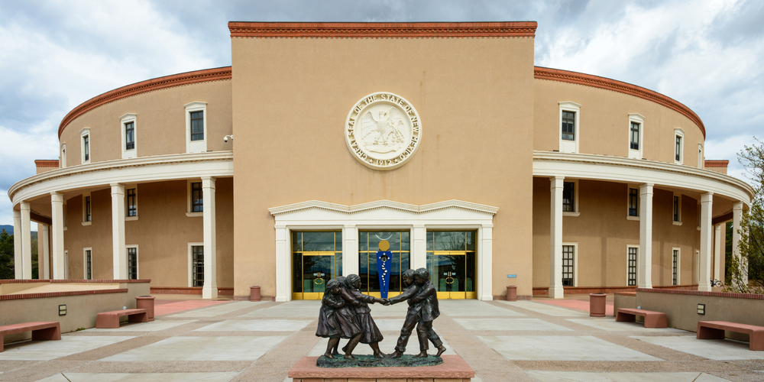
What HB 130 Does
Increases minimum instructional hour requirement to 1140 hours per year for all grades EXCEPT half-day kindergarten (550 hours)
Allows up to 60 hours of professional work time for elementary and 30 hours of professional work time for grades 7-12
Provides additional SEG (above the line) funding for extending the school year beyond 180 days (5-day week) or 155 days (4-day week), and even more for days above 190 days (5-day week) or 165 days (4-day week)

Slide 3
K12+ SEG Funding Formula
Tier 1
5-day 181-190 Days
MEM x .012 x (number of days between 181-190; 1-10 total) = Program Units
4-day 156-165 Days
MEM x .012 x (number of days between 156-165; 1-10 total) = Program Units
5-day 191-205 Days
MEM x .016 x (number of days between 191-205; 1-15 total) = Program Units
4-day 166-175 Days
MEM x .016 x (number of days between 166-175; 1-10 total) = Program Units
Tier 2

Slide 4
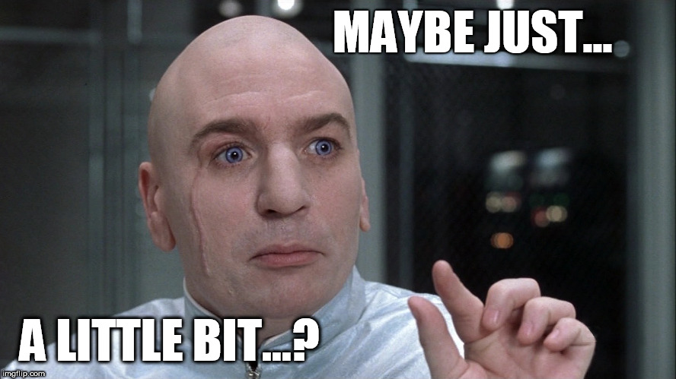
OST (*may*) count! Out-of-school time programs may count toward K12+ days IF:
The program takes place outside the
normal school day
The program is offered to all students
The program is tied to curriculum goals
Transportation to/from the program
is provided
A healthy snack is provided
The program runs for at least 2
continuous hours
The program is not funded by
another source, such as 21st CCLC
The program is free for students
to participate

Slide 5
Once those conditions are met…
Every 8 hours of K12+ OST will count as one (1) additional day for K12+ purposes, up to 6 days of K12+ days
Example: A school provides 2 hours of qualifying OST once a week for 4 weeks, that would add an additional day for K12+ funding without adding an additional instructional day.
…like Magic

Slide 6
How do schools get this funding?
There’s no application process, it’s part of SEG (above the line) funding
Will be determined through regular budget and calendar process & automatically awarded if qualified
Schools will need to demonstrate that the number of instructional hours is not less than the previous year

Slide 7
Why should we participate?
New Mexico is lagging other states in academic achievement
NM ranks below 48 other states/jurisdictions in NAEP testing
New Mexico has a larger percentage of students needing more educational attention
52% of NM students scored below NAEP basic level (National avg. 39%)
New Mexico’s students lost ground in the pandemic
NAEP score avg. dropped from 208 in 2019 to 202 in 2022
Source: 2022 Reading State Snapshot Report, National Center for Education Statistics https://nces.ed.gov/nationsreportcard/subject/publications/stt2022/pdf/2023010NM4.pdf

Slide 8
What can be done with the extra time?
What do you need?
Additional instruction in STEAM or reading
More individual tutoring
More professional collaboration
More time for SEL
More time for any needed student supports

Slide 9
In short, there’s no single answer…
HB 130 provides more learning time, it’s a local decision as to how to use that time to meet your students’ needs
What works in one school may not work in another
Communities, schools, and students are different and have different needs, use the time to better meet those needs

Slide 10
We do not expect you to implement this overnight
What follows are some practical tips on how to build consensus and make implementation successful

Slide 11
Necessary elements for successful K12+
Committed school principal and district administration
Effective buy-in from staff and students; address needs
Concrete support from community partners and families
Plenty of time to adjust to new reality
Planned, evidence & data-based, instruction by certified staff that meets student needs and interests
Sufficient incentives for staff to participate and embrace

Slide 12
How do we make K12+ implementation successful?
Staff and family buy-in
Start early and talk to them with an open mind and active listening
Acknowledge and address issues and concerns raised
Share with them the need to improve educational achievement
Truly seek input on best ways to implement – serve local needs
Incentivize participation for staff and families
Have directed open conversations with them

Slide 13
Steps to a directed conversation
Intro
Getting the issues or story
Agitation
Plan to change
Inoculation
Call the question & Assignment
Follow-up plan
Ideally done individually or in small groups

Slide 14
Directed conversation – intro & issues
1. Intro
Introduce yourself, give context to the conversation, and what you hope to find out
2. Get the issues or story
What issues are they facing with their students’ education? What concerns do they have with how things are working at school? How have these issues impacted their lives?

Slide 15
Directed conversation – agitation, plan to change & inoculation
3. Agitation
Who has the power to make change? What will happen if we do nothing?
4. Plan to change
Show that change is possible and what it will look like. Show concrete steps that are being taken.
5. Inoculation
There will be resistance, let them know what they will hear. People will not want to change calendars. The days will be too long for kids. We don’t want year-round school.

Slide 16
Directed conversation – call the question & follow-up
6. Call the question
What will it take to make change happen? What are they willing to do? How can change happen if no one takes action?
7. Follow-up
Make plans for next steps, keep progress on track. Change takes time and many steps along the way.

Slide 17
How do we convince skeptical partners?
Start with why?
“People don’t buy WHAT you do; they buy WHY you do it.” – Simon Sinek
Source: “Start With Why” by Simon Sinek

Slide 18
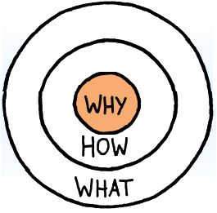
Our Golden Circle
Why?
Our students deserve every opportunity to succeed.
How?
By creating more time on task in our schools, we can meet the challenges to success our students face.
What?
Extra work on reading, math and science
Extra SEL practices
More multi-layered student supports

Slide 19
Why focus on values?
Because 98% of all thought & reasoning is unconscious
We make decisions based on our values and our gut more than facts and reason
Rational self-interest is largely a myth
A frame is a lens through which we filter information
If information does not fit within our frame, we reject it
Our values form our frame
Source: “Don’t Think of an Elephant” by George Lakoff

Slide 20
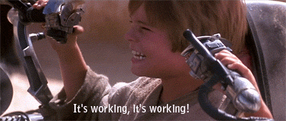
Now that we achieved buy-in and implemented K12+, how do we know it’s working?
Indicators of Success
Attendance
Academic Performance
Student/Family Engagement
Teacher & Staff Retention

Slide 21
Unmeasurable indicators of success
School climate and culture
Transform the way school is done

Slide 22
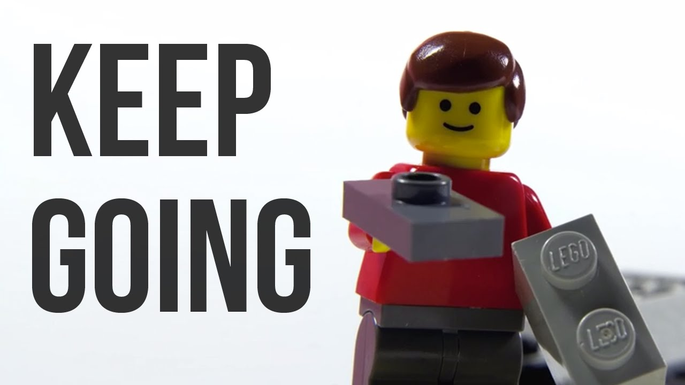
How do we ensure K12+ is sustainable?
Funding is secured in SEG (above the line) funding
Start small, don’t jump from 175 days to 205
Find stable community partners
Remember your Why
Never stop listening & adjusting `

Slide 23
K12+ Program Guidelines Manual http://bit.ly/K12PlusManual

Slide 24
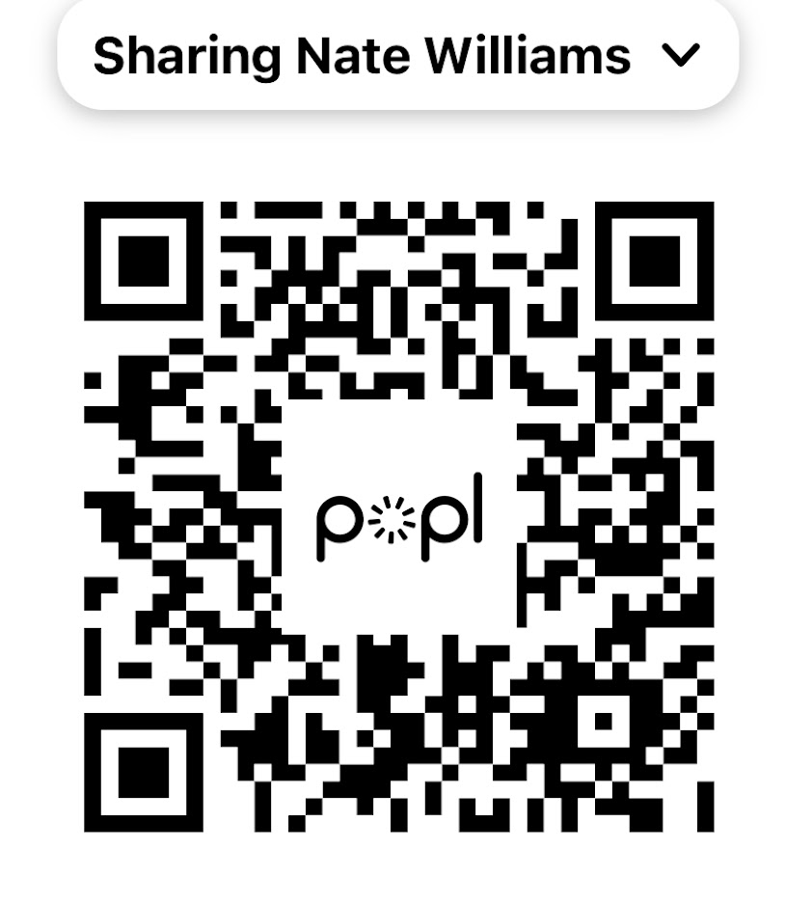
Questions? Discussion? Thank you for your time!
Nate Williams
K12+ Program Director
nathan.williams@ped.nm.gov
Cell: 505-699-9791

