Slide 1

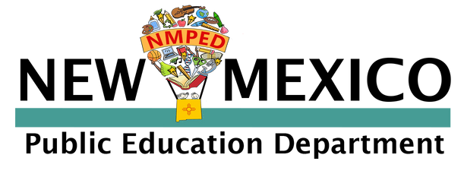







Community Schools
Community Schools
Needs Assessment
Community Level Data
Toolkit

Slide 2


About Community Level Data
A Community Schools needs assessment moves beyond the school and family needs to the local, nearby neighborhood and local scene. Community level data asks questions such as:
  What is the crime rate around my school?
  What are the demographics in the school neighborhood?
  Is there high unemployment or high rates of elderly in the neighborhood?
  Is it an industrial part of town or neighborhood?
Why Community Level Data
Creating a neighborhood level profile for your community school needs assessment is important not only to identify broader needs but also provides insight into the root causes of challenges your students face. As your school conducts this needs assessment, don't be afraid to ask hard questions or seek data that can answer those questions.

Slide 3
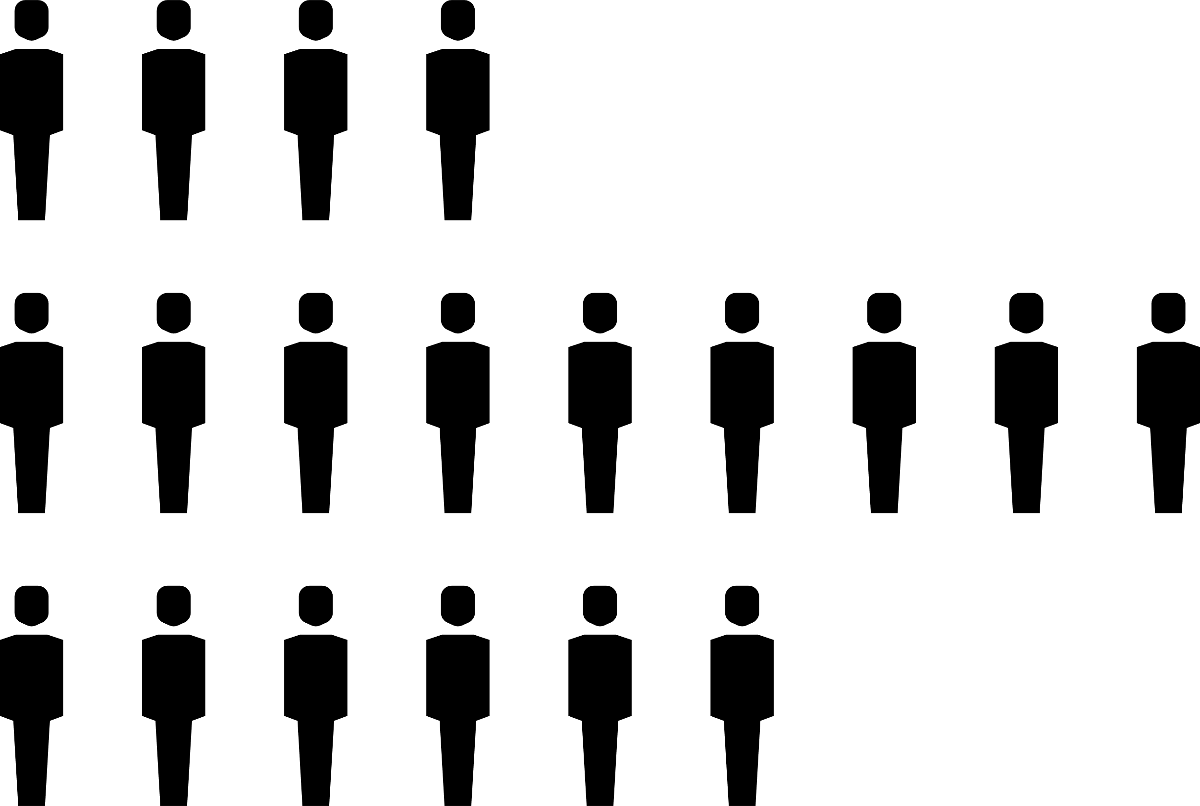





Methods of Gathering Community Level Data
Big Data
County Data
Community Level
Data
Partner and Organization Data
Neighborhood Needs Assessment

Slide 4

Big Data
What is big data and how can it support our needs assessment?
In the world of chat bots and AI, it's important to understand how to utilize big data. Big data is quantitative and is defined as extremely large data sets that may be analyzed to reveal patterns, trends, and associations, especially relating to human behavior and interactions. This can help your school understand big trends and overall systems
Some Sources of NM Big Data:
01
U.S. Census
Data
03
Data USA
02
NM Health Data
04
Rise NM

Slide 5



County Data
County Level Data
The characteristics of counties provide an overview of the demographics and situation of families generally in your county. Below are some data sources that can be searched by county.
UNM Data
by County
NM Health &
Human Services
County Economic Summaries

Slide 6

Community Level
Data
Community Level Data
The New Mexico Community Data Collaborative is a good source for community-level data in the CS needs assessment. The New Mexico Community Data Collaborative supports information about socio-demographic conditions, health and education outcomes, early childhood resources and risks, data about food access and hunger, and multiple social issues in our state. With over 1000 indicators at the neighborhood level.
New Mexico Community Data Collaborative
Explore the NM Community Data Collaborative:
County pages
Resource directory
Social initiatives

Slide 7


Partner and Organization Data
Gathering data from local partners & organizations
Is there a specific type of data you are looking for? If so, search for local organizations (non-profits, businesses, etc.) that may be experts on that topic.
Consider your current partners. Has the SBLT reached out to gather any data they might collect?
Search your local area for any non-profits, health orgs, businesses, etc. Inquire if they collect any local data.
Some good sources may include: United Way, 100% Community, Voices for Children, local government agencies, etc.

Slide 8
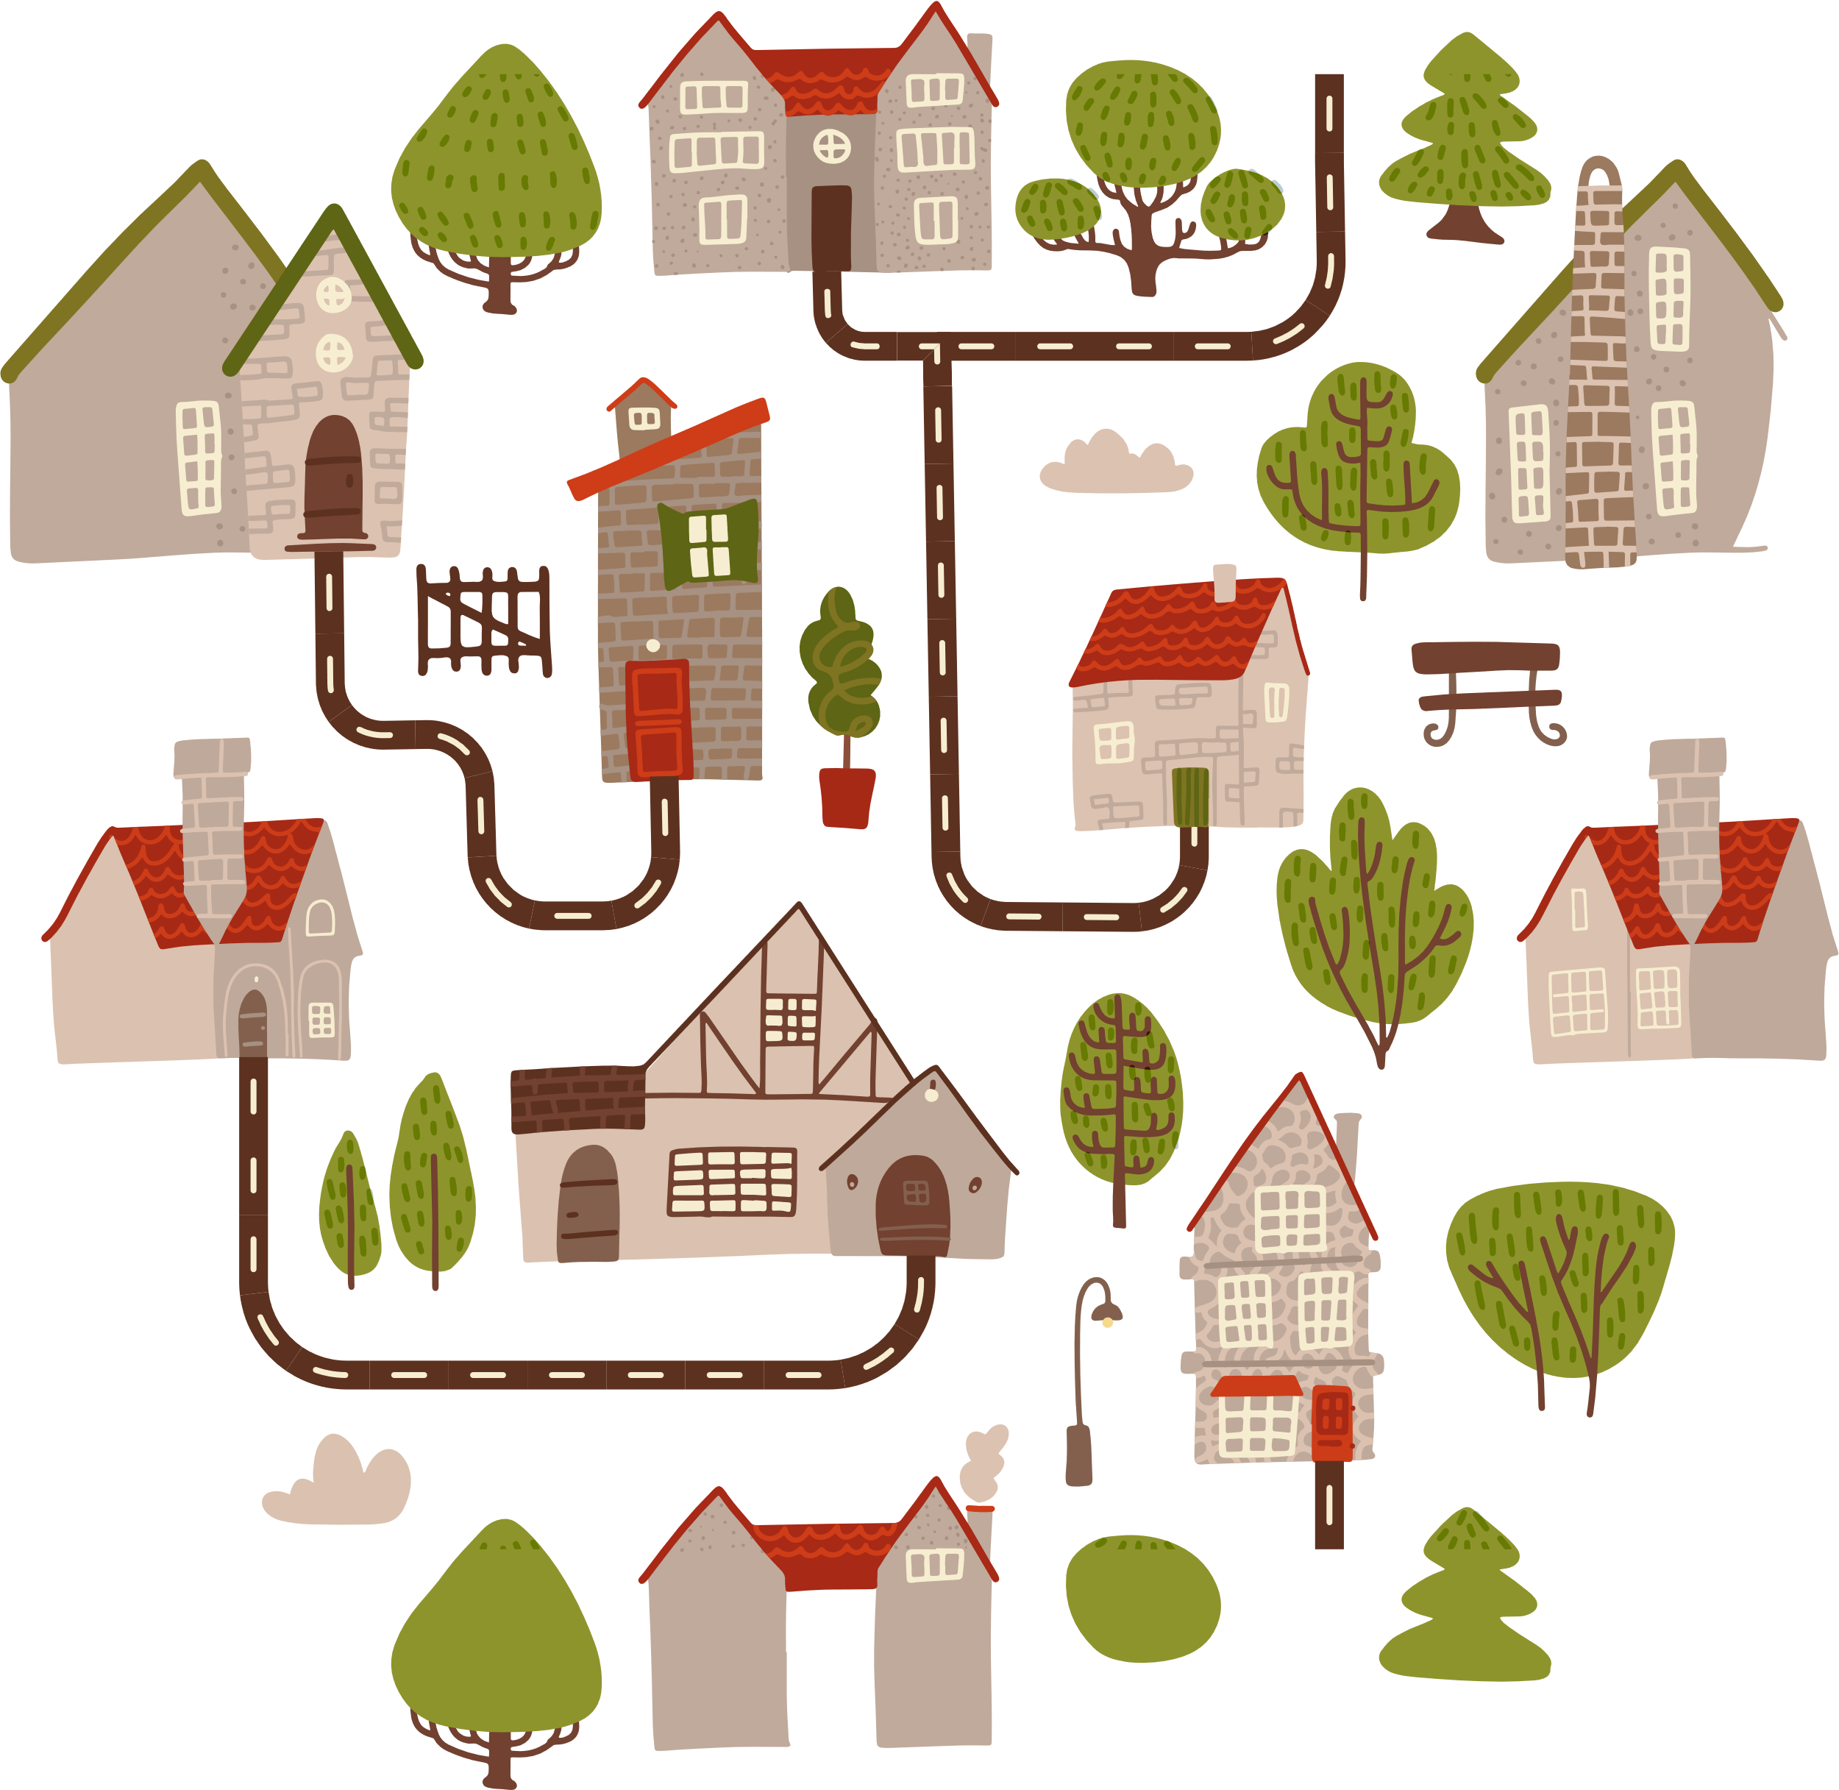
Neighborhood Needs Assessment
Conducting a Neighborhood Needs Assessment
01
Consult the SBLT if a neighborhood needs assessment is a good choice for your community school
02
Determine the "neighborhood" geographic area that surrounds the neighborhood; ensure safety measures for the asssessment
03
Determine a few key questions for those who perform this assessment for qualitative data
04
Knock on the doors of neighbors and other entities surrounding the school, asking the pre-determined questions; collect data and analyze as a SBLT

