Slide 1



Implementation Steps
Early Development Instrument (EDI)
  Lisa Stanley, Project Director
  Tyler Cole, National Implementation Manager

Slide 2
Objective
To equip District/Charter level EDI Coordinators with the nuts and bolts of EDI Implementation
  EDI basics
  Key partners
  Steps for implementation
  Timelines
  Resources and templates
  Contacts

Slide 3

The EDI
Early Development Instrument
Holistic, population measure of children’s developmental outcomes and school readiness.
Predicts ELA and Math scores 3rd -5th grade.
Reflects how well 0-5 systems are supporting children.
Allows stakeholders to:
  Look Back: To improve children’s outcomes before they arrive at kindergarten.
  Look forward: To understand incoming kindergarten cohort and support them as they progress thru school.
Developed at the Offord Center for Child Studies at McMaster University

Slide 4







Nuts and Bolts of the EDI
What is the EDI?
How is it completed?
Whole child population snapshot for NM of children’s wellbeing and school readiness in 5 key domains.
Teachers watch 30-minute video.
Then complete one EDI/student, based on recall, using on-line platform. Takes 10-15 minutes per student.
Who completes the EDI?
Completed by kindergarten teachers, on all students. This is not a test that students take.
What doesn’t it do?
Not reported at child level because not designed to screen, diagnose.
Not reported at teacher level to assure them EDI is not used to assess performance.
When is it completed?
This spring of school year 2023-2024.
Then again in spring of 2025-2026.

Slide 5
5 EDI Developmental Domains
Distribution of survey items by domain
Physical Health & Well-Being
Communication Skills
Motor skills
Physical readiness
Ability to use language
Communicate needs and understand
Social Competence
Language &
Cognitive
Getting along with peers,
Respect for others
Abilities with reading, writing, numbers, shapes
Emotional Maturity
Emotional wellbeing, feeling sad, fearful, etc.

Slide 6
16 Developmental Subdomains
Physical Health and Well-being
Physical readiness for school day
Gross and fine motor skills
Social Competence
Overall competence with peers
Respect and responsibility
Approaches to learning
Readiness to explore new things
Emotional Maturity
Prosocial and helping behavior
Anxious and fearful behavior
Aggressive behavior
Hyperactive and inattentive behavior
Language and Cognitive Development
Basic literacy skills
Interest in literacy/numeracy and memory
Advanced literacy skills
Basic numeracy skills
Physical independence

Slide 7
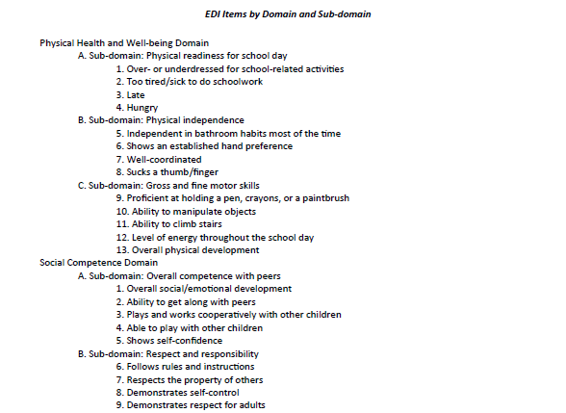
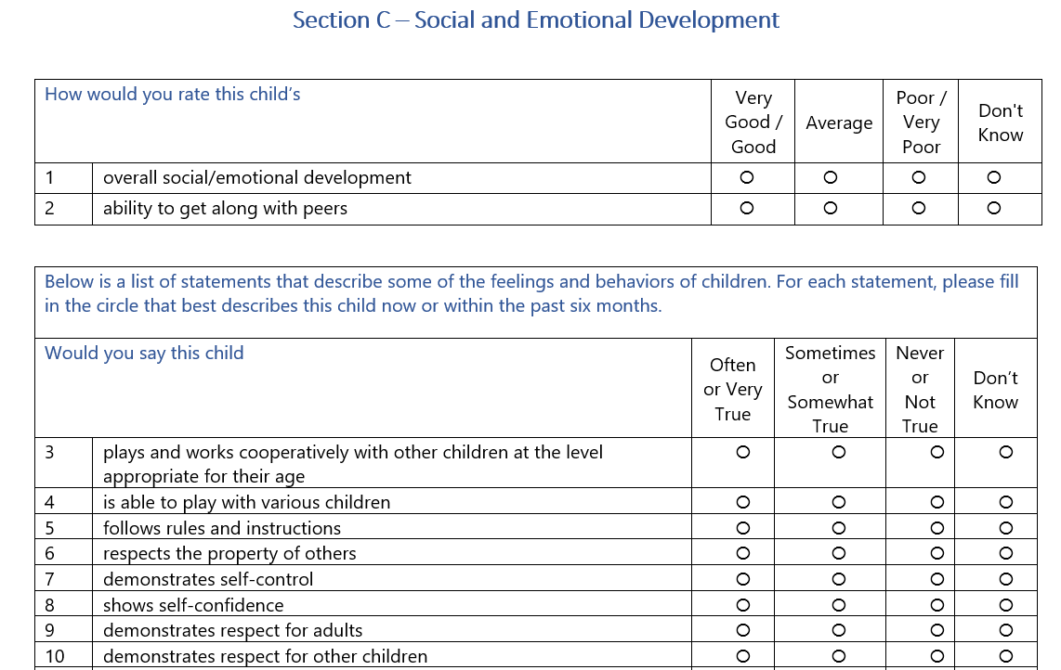
Sample of EDI Items by Domain

Slide 8
State Partners in Data Collection
UCLA: Oversee data collection, provide reports, support coaching.
PED: Coordinate with districts, provide UCLA with rosters.
ECECD: Engage partners in using EDI to improve early childhood systems.

Slide 9

Key Steps for District EDI Coordinator
EDI Data Collection Portal
Teacher Time
Communication with District staff
Parent Letter
Data Preparation
Teacher Training
Survey Administration

Slide 10

1. EDI Data Collection Portal
District EDI Coordinator
  This is the person listed on PED’s “EDI Coordinators Designation Form”
  Receives automated email from EDI Data Collection Portal which is hosted at UCLA. Asked to:
    Create a confidential password.
    Accept electronic EDI Sub-License Agreement in portal.
    Monitor teacher completion rates by school and teacher in portal.

Slide 11

2. Teacher Time
Teacher responsibilities
  Complete teacher training - asynchronous (30 minutes)
  Complete EDI for each child online (5.5 hours: 10-15 minutes per child)
  Complete one feedback form online (5 minutes)
Total estimated Time: up to 6 hours per teacher
Determine when to use teacher time
  During school time (preference)
    Sub-release day
    Professional training day
  Outside of school time
  Combination

Slide 12

3. Communication with District Staff
Each district/charter has its own norms around how and when to communicate with principals and teachers.
Some templates and suggestions
  First email
    Share purpose, responsibilities and timeline with principals and teachers.
    Ensure email contains your contact information and your district’s survey schedule/window.
  Second email
    Remind teachers of key dates.
    Provide teachers with training materials.
Notes:
.

Slide 13
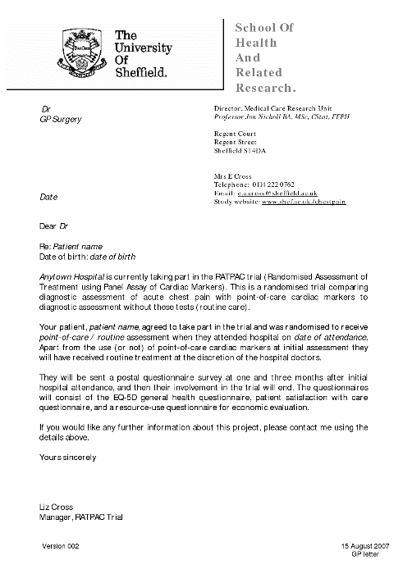
4. Parent Letter
Use the parent information letter pre-approved by UCLA.
It is an “informed consent” letter that offers an opt-out option.
No parent signature is requested.
Parent letter is available in English and Spanish.
District puts parent letter on district letterhead, adds their district contact information.
Send to parents at least a week before teachers complete EDIs.
No other changes should be made without permission from UCLA.

Slide 14
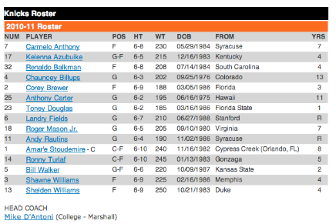
5. Data Preparation – Part 1: Student Roster
(No District Actions Needed)
What is it?
  Roster is a student-level administrative data file that PED provides to UCLA.
  UCLA uploads roster to create teacher accounts with class lists in portal.
When is the roster generated?
  PED will roster students from the Live ODS as they do with ECOT.
  Will occur by March 22nd for April 1 survey kickoff.
Will districts be able to re-roster?
  No need for districts to re-roster given PED’s Live ODS.
  District EDI Coordinators can verify schools and teachers in UCLA portal starting April 1.
    See District EDI Coordinator Portal Instruction Sheet.
    Notify UCLA of problems at DataInformedFutures@mednet.ucla.edu.
  Teachers can verify and update students in their class list in the portal.

Slide 15
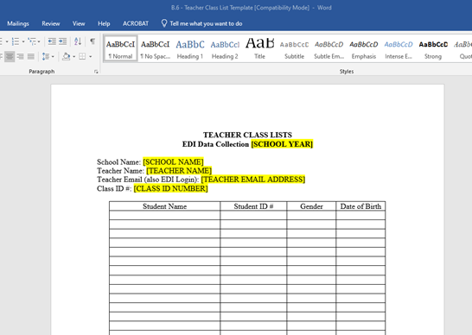
5. Data Preparation - Part 2: Hard Copy Class List
(Required for Districts)
What is it?
  District must generate the hard-copy class list and provide it to each teacher.
  Each teacher’s class list must contain the name of each student in their class AND their State Student ID (not the district ID)
  This serves as a key code for teachers because student records in the UCLA portal do not contain student names. The portal only includes State Student IDs.
When is it due:
  District provides each kindergarten teacher with their unique hard-copy class list on April 1, 2024.

Slide 16

6. Teacher Training
Kindergarten teachers required to watch the 30-minute training video before completing EDIs.
Decide how training video will be accessed
  As a group, Synchronous: https://www.youtube.com/watch?v=UOaQP9WXBCQ
  On teacher’s own time, Asynchronous (embedded in e-EDI portal once they login)
Share training materials with teachers
  Hard Copy Class List template (generated by district)
  Teacher Training video (PED website or teachers can access in portal)
  Teacher Training Guide (PED website or teachers can access in portal)
  EDI items by domain and sub-domain (PED website)
  Teacher EDI Portal Instruction Sheet (UCLA emails to Coordinators on 3/25/23.)
    It contains login URL and initial password. Do not distribute prior to April 1.

Slide 17

7. Survey Administration
Survey administration opens on April 1, 2024.
Teachers should not attempt to login prior to April 1.
Districts/charters may choose to begin after April 1 but all data collection must be completed by May 31, 2024.
On April 1, send teachers reminder of district’s administration dates and include teacher training materials.
District Coordinator monitors teacher completion rates in portal and conducts follow as needed to obtain full participation.

Slide 18
NM District EDI Coordinators: Activities, Timeline and Resources
Implementation Steps | Date | Resources https://webnew.ped.state.nm.us/bureaus/edi/
EDI Coordinator Designation Form | 3/15/24 | https://webnew.ped.state.nm.us/bureaus/edi/
Login to e-EDI Portal, accept Sub-License Agreement | 3/20/24 | District EDI Coordinator Portal Instruction Sheet
First email to principals and teachers | 3/20/24 | First email Principal/teacher letter with Logistics
Send Parent Letter home | 3/22/24 | Parent Letter EDI (English & Spanish)
Generate hard copy class lists | 3/35/24 | Hard Copy Class List template
Second email to teachers to send teacher training materials | 4/1/24 | Second email to principals and teachers
Teacher Training | 4/1/24 | Hard Copy Class List template (generated by district) Teacher Training video (PED website or teachers can access in portal) Teacher Training Guide (PED website or teachers can access in portal) EDI items by domain and sub-domain (PED website) Teacher EDI Portal Instruction Sheet (UCLA will email this sheet to District EDI Coordinators on 3/25/23)
Survey Administration | 4/1-5/31/24

Slide 19


Slide 20



PED
Jessica Montoya, jessica.montoya@ped.nm.gov
PED’s EDI Webpage: https://webnew.ped.state.nm.us/bureaus/edi/
UCLA’s Futures Team
  DataInformedFutures@mednet.ucla.edu
  Tyler Cole, Implementation Coordinator TWCole@mednet.ucla.edu
  Lisa Stanley, Project Dir. LisaStanley@mednet.ucla.edu

