Slide 1
School Transportation Bureau
Alyssa Marquez, Luis Fierro &
Cory Brook
March 20, 2024
Investing for tomorrow, delivering today.

Slide 2
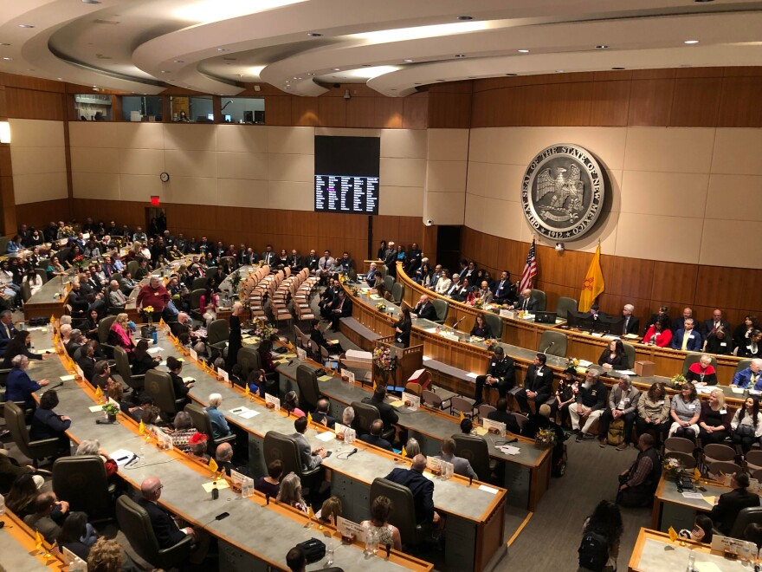
Topics
2024 Legislative Session
Bus Replacements
Budgets FY25
6.41.4 NMAC
School Bus Inspections
CDL Clearinghouse
Training Classes
Important Dates

Slide 3
2024 Legislative Session HB2
$133,793,300 for transportation allocation and contractor rental fees.
$1,488,600 is included to provide an average 3% salary increase to public school transportation personnel. Does not pertain to contractor employees.

Slide 4
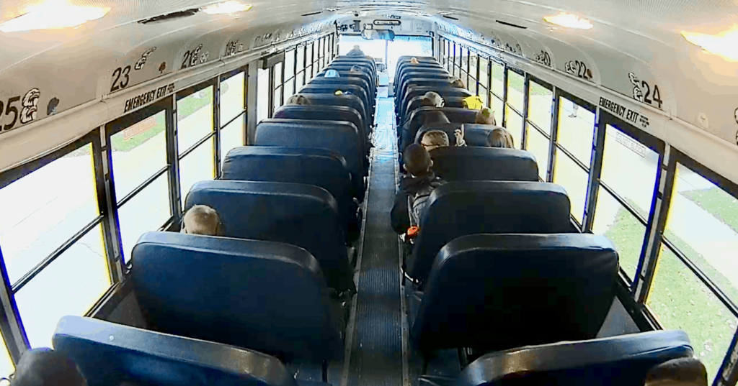
2024 Legislative Session SB275
$29,166,640 to purchase district owned to-and-from school buses to include air conditioning.
$547,500 to purchase cameras for newly purchased to-and-from school buses statewide.

Slide 5
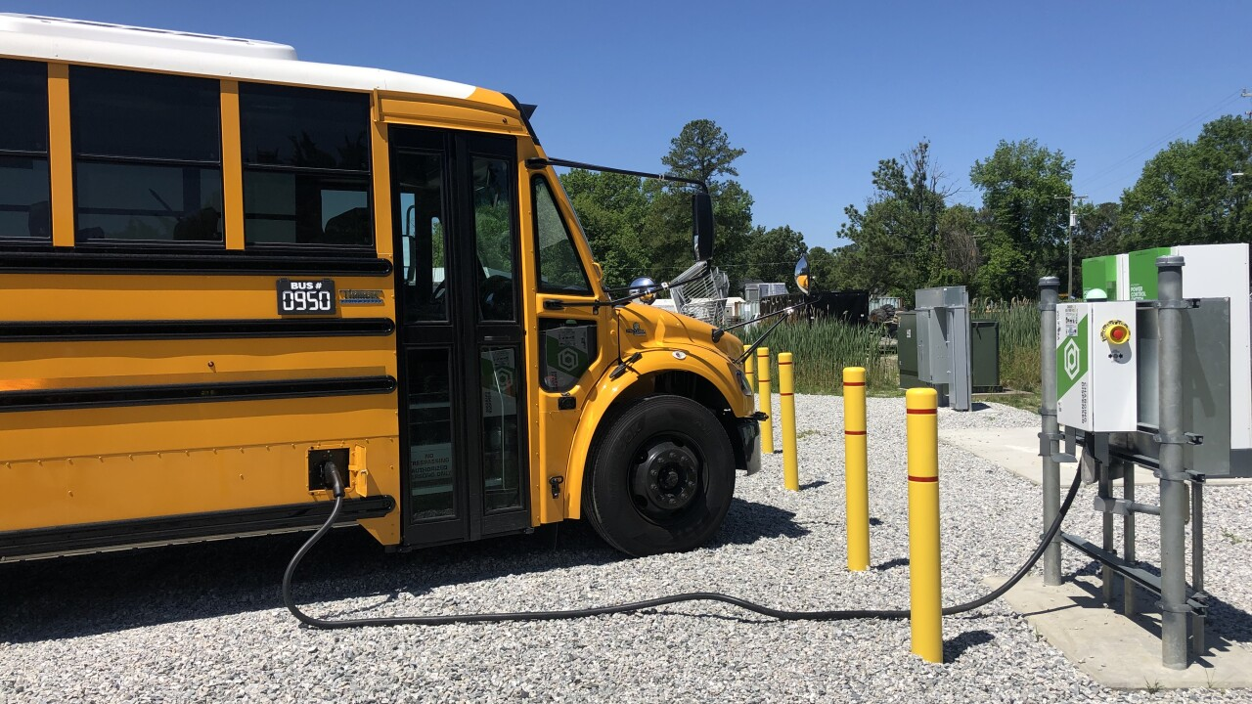
2024 Legislative Session SB275
$1,500,000 to plan, design, and construct infrastructure for fueling and charging stations for alternatively fueled buses statewide.

Slide 6
Bus Replacements District Owned
Initial replacement list will be sent in April and official approval letters will be sent in July.
Notification that a bus is no longer on route must be submitted to STB.
All orders must be placed after quotes have been submitted and grant agreements have been fully executed by all parties.
Due to supply chain issues, if a bus is expected to take longer than 1 year to build, notification must be sent to STB.

Slide 7
Bus Replacements District Owned Flowchart
STB sends bus replacement approval letter(s) to district.
District will obtain quote(s) from approved vendors; district will send selected quote to STB for approval; STB will approve quote & amount for completion of the grant agreement.
Once grant agreement is fully executed, a BAR needs to be submitted in OBMS. Fund 27178; Revenue 43202; Expenditure 57312.
District will order and purchase new bus after BAR is approved.
District will submit RfR in OBMS once the bus is received and all applicable documentation is obtained.
STB will review and approve the RfR. Fiscal Grants Management approves the RfR and processes the reimbursement for the district.

Slide 8
Bus Replacements Contractor Owned
Initial replacement list will be sent in April and official approval letters will be sent in July.
Notification a contractor will not be continuing a route or committing to the purchase of a new bus must be submitted to STB.
All orders must be placed after buyer’s orders have been submitted to STB.
Contractor buses should be delivered by April 30, 2025.
Due to supply chain issues, if a bus is expected to take longer than 1 year to build, notification must be sent to STB.
Contractors must be approved for financing.
The district/charter must be listed as a lien holder on the title of the bus.

Slide 9
Bus Replacements Contractor Owned Flowchart
STB sends bus replacement approval letter(s) to district/charter. District/charter is responsible for sharing award letter(s) with contractor.
Contractor will obtain quote(s) from approved vendor; district/charter must send buyer’s orders to STB for confirmation of order.
New bus(es) must be inspected, have zonar tags installed, GPS installed, and district/charter must be listed as a lien holder on the title.
District/charter will submit BAR in OBMS when contractor receives bus and all applicable documentation is received. Fund 13000; Revenue 43206; Expenditure 54620.
STB will review and approve BAR. Fiscal Grants Management approves the BAR and rental fee will be distributed in the transportation distribution.
Contractor receives rental fees for 5 years.

Slide 10
Bus Replacements Overpayment
22-8-27 & 22-16-3 NMSA 1978 requires PED to calculate a value for the remaining number of years a bus can be used.
Succeeding operator shall purchase the bus(es) at the lowest appraised value from preceding operator.
It is the responsibility of the district/charter to collect the overpayment. Failure to do so will result in the district/charter being held responsible for the payment.

Slide 11
Budgets FY25
2023 Cash Balance
Districts must send back 50% of unexpended cash balance.
Must submit BAR for 50% district is keeping.
BAR will be an increase, not decrease.
Charters must send back 100% of unexpended cash balance.
This is a reversion not an expenditure.

Slide 12
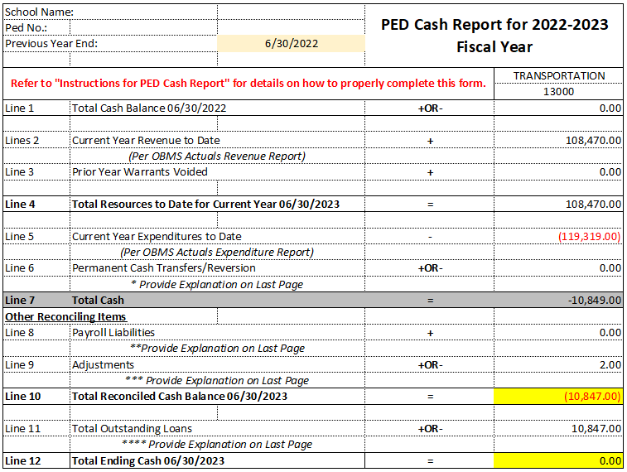
Budgets FY25

Slide 13
Budgets FY25
Revenue equals allocation amount.
Rental fees are included and are accurate.
Total of all contracts are included.
All contracts must be submitted to STB.
Appropriately budgeting full time equivalent (FTE).
Must include 3% salary increase.

Slide 14
Budgets FY25
ESTIMATED
Revenue:
11112 – Unrestricted Cash $XX,XXX
43206 – Transportation Distribution (FY25 Final Allocation) $XX,XXX
$XX,XXX
Expenditures:
5xxxx – TBD $XX,XXX
54620 – Rental Equipment & Vehicles $XX,XXX
55112 – Transportation Contractors $XX,XXX
$XX,XXX

Slide 15
Budgets FY25
PROJECTED
Revenue:
11112 – Unrestricted Cash $0.00
43206 – Transportation Distribution (FY25 Final Allocation) $XX,XXX
$XX,XXX
Expenditures:
5xxxx – TBD $XX,XXX
54620 – Rental Equipment & Vehicles $XX,XXX
55112 – Transportation Contractors $XX,XXX
$XX,XXX

Slide 16
Budgets FY25
All bus contracts must be submitted to STB before budgets will be approved.
Due by June 14, 2024!

Slide 17
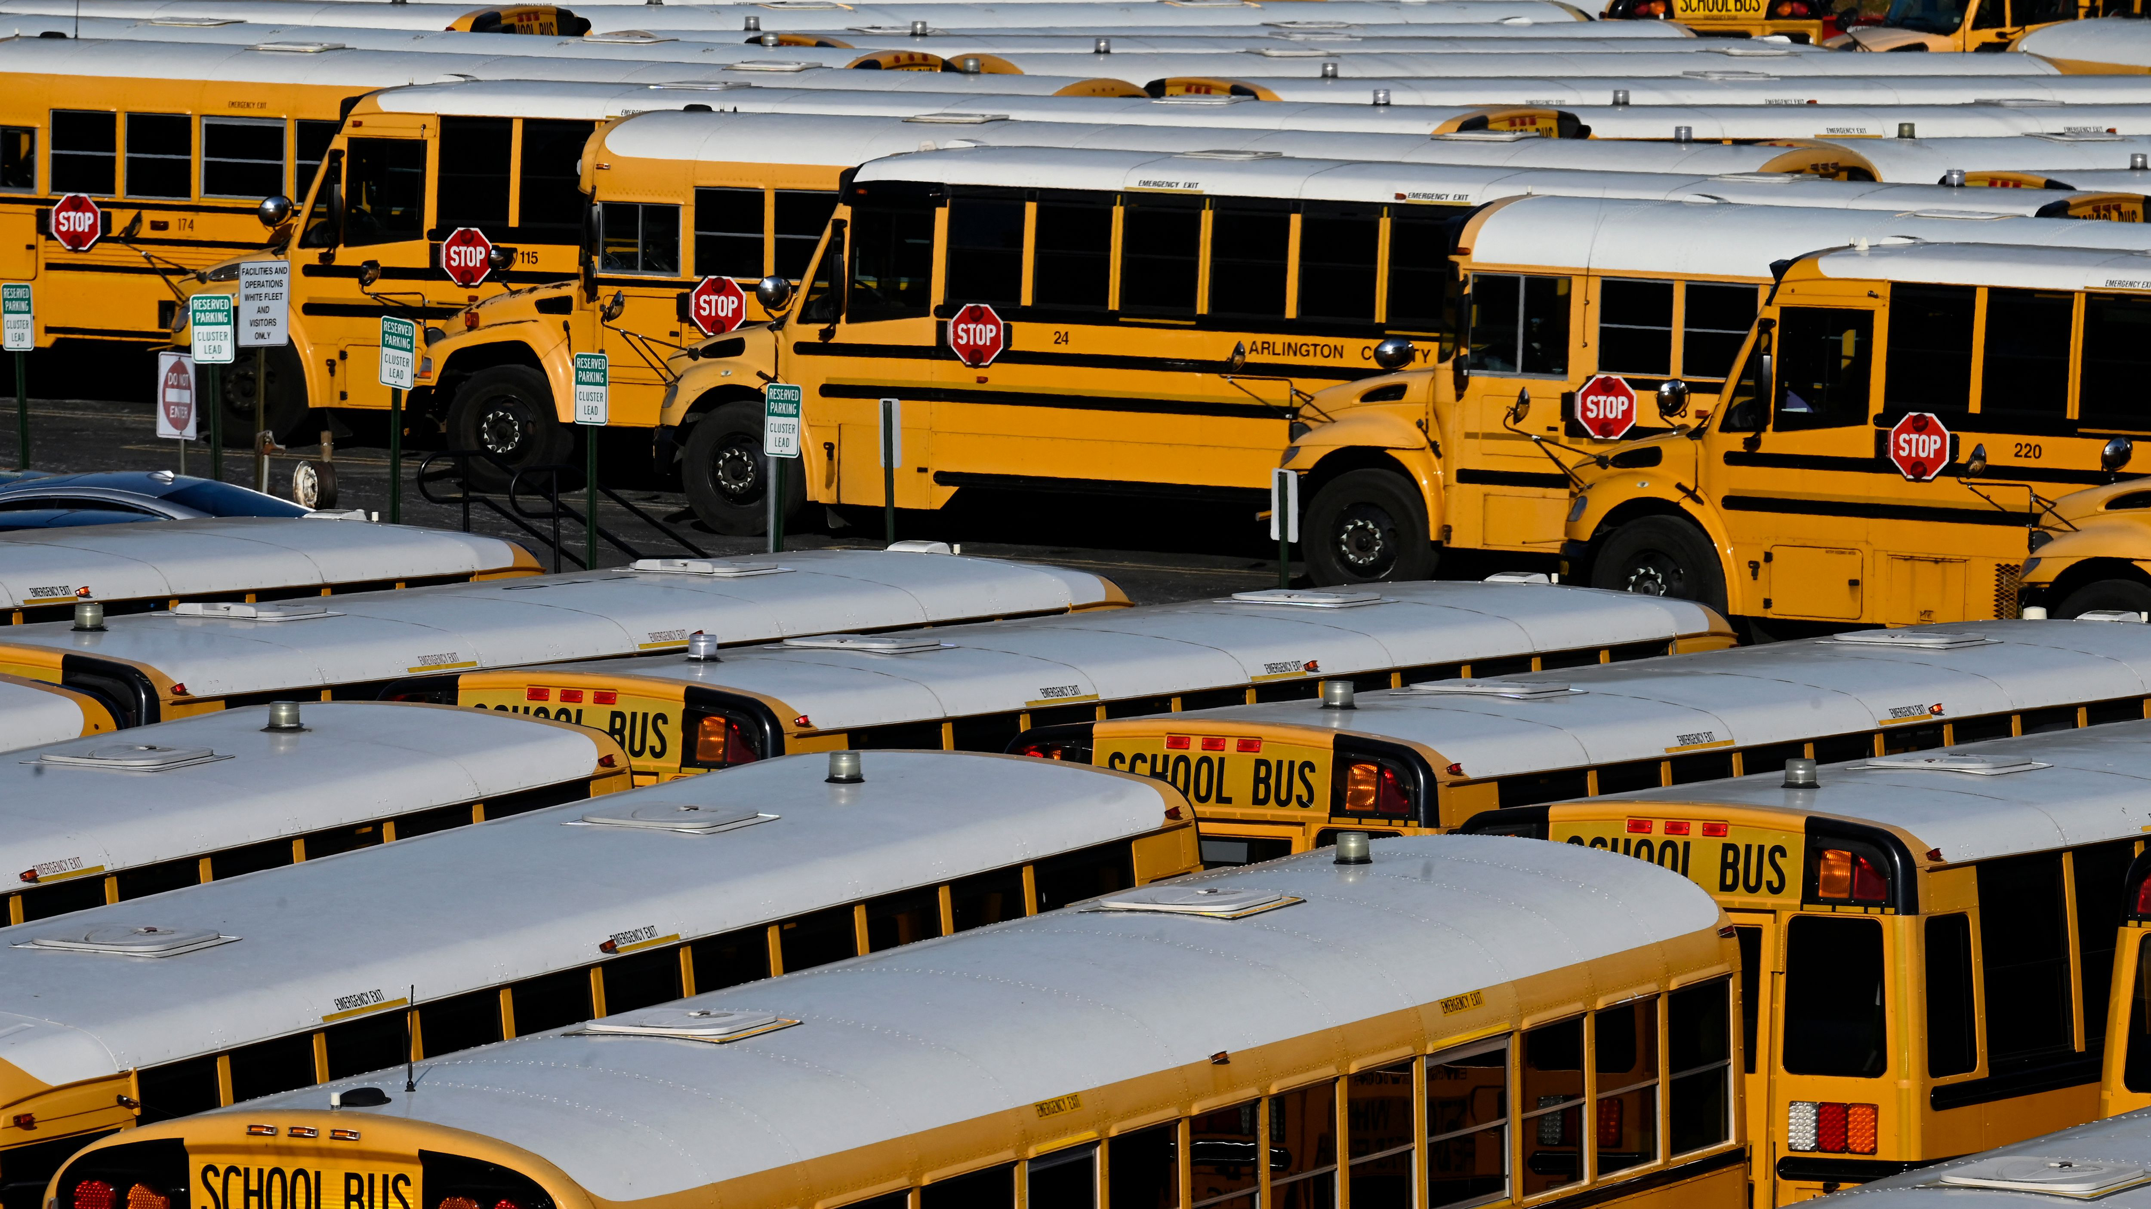
6.41.4 NMAC Standard for Providing Transportation for Eligible Students

Slide 18
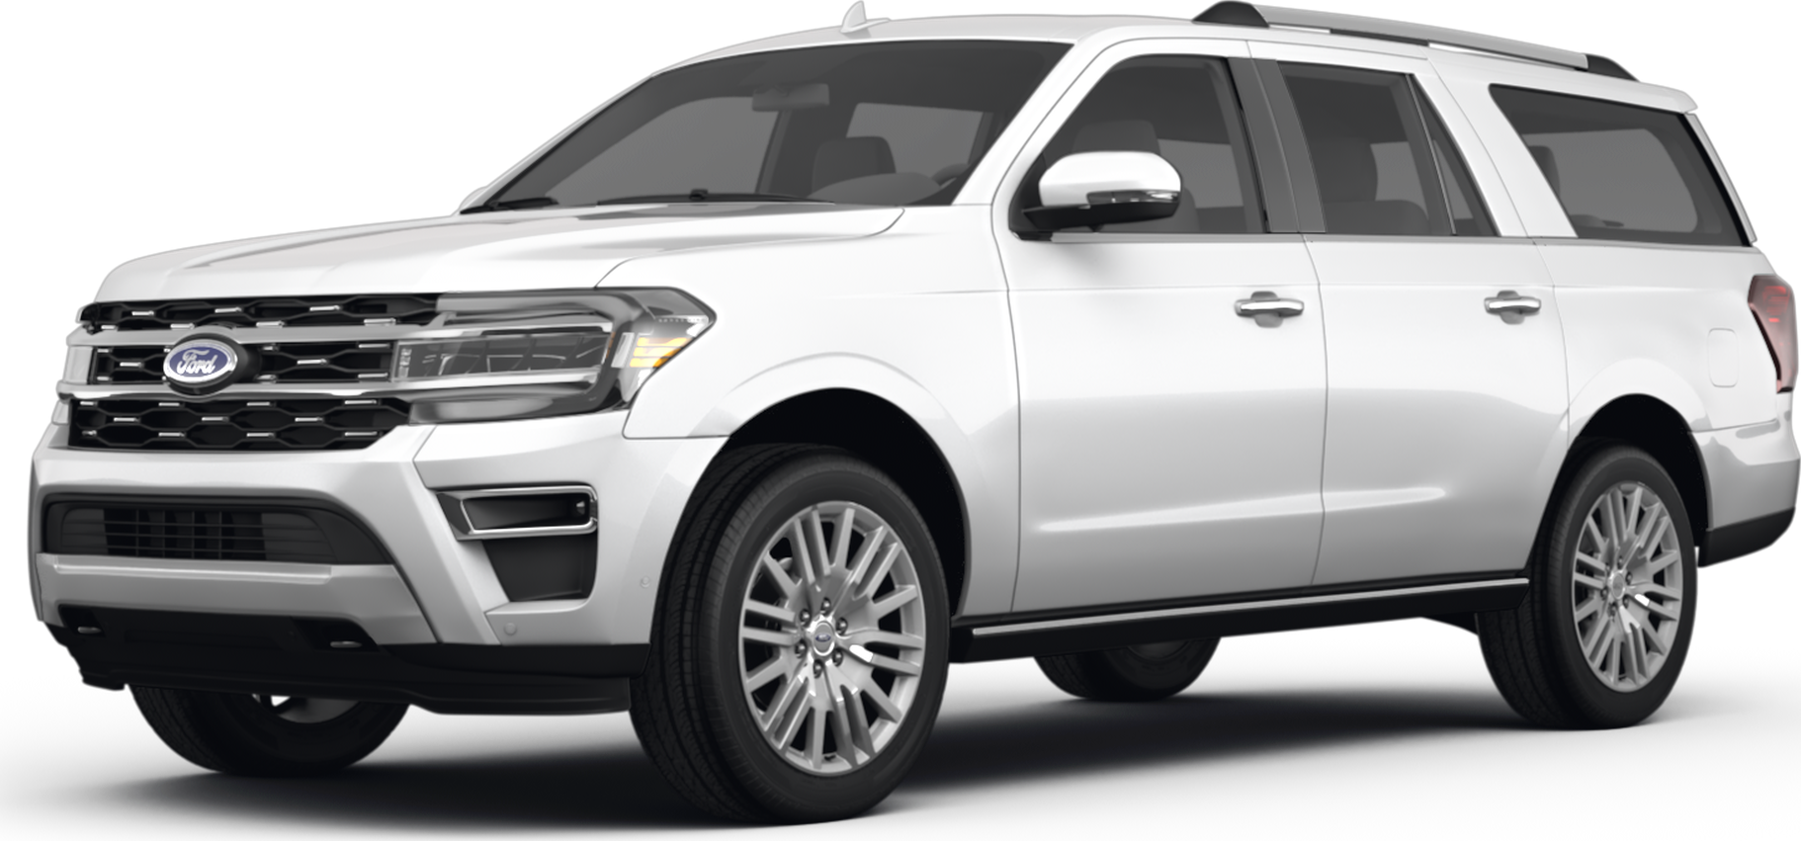
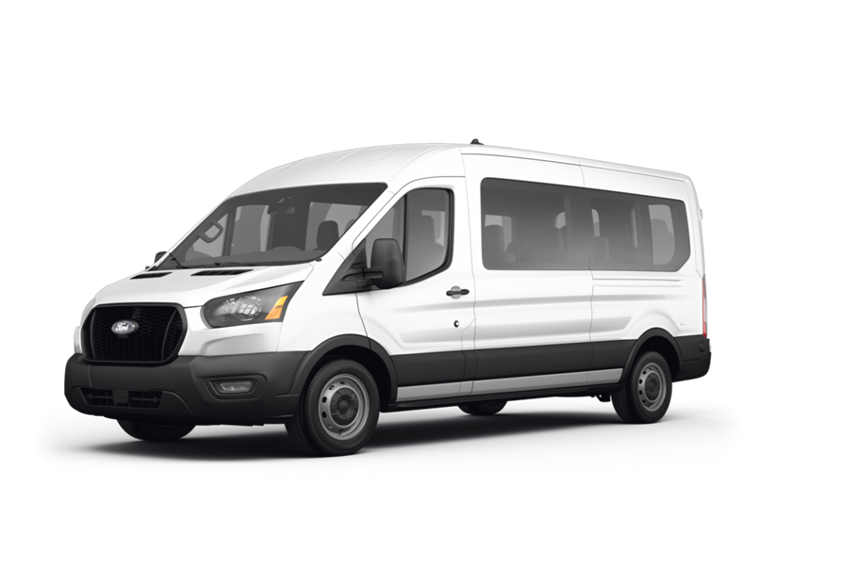
6.41.4 NMAC To-and-From In An SUV
A district owned SUV must be a minimum 6 passenger, full size, extended length, sport utility vehicle – does not include vans or mini vans per 6.41.4.14.C(1)(b)(II) NMAC.
Used only to transport 1 – 6 students.
Students’ residence is 5 or more miles from the school.
Driver shall be a district employee and a certified SUV/Activity driver.
The vehicle and driver shall be insured by the Public School Insurance Authority.

Slide 19
6.41.4 NMAC To-and-From In An SUV
Request for approval, through an application, must be submitted to STB prior to transporting students.
Names of students who will be transported.
Explanation why an SUV needs to be used.
A map highlighting route from students’ home to school.
Copy of the drivers pre-service training record.
Photographs of the vehicle showing one side, the front and rear clearly showing the strobe lights, lettering, and florescent stripes.
Email to suv.transportation@ped.nm.gov for review.

Slide 20
6.41.4 NMAC To-and-From In An SUV
Safety equipment (optional):
Maximum speed limiter set at 75 mph
Two-way radio communication system
Operable recording video camera
Back up camera
Painted national school bus yellow
Half the miles will be counted through the funding formula.
SCHOOL
VEHICLE
LEA LOGO
SCHOOL DISTRICT

Slide 21
6.41.4 NMAC School Owned Activity Vehicle (SOAV)
The driver operating a school owned vehicle shall meet all requirements pursuant to Subsection O of 6.41.4.9 NMAC.
The vehicle shall meet the following criteria:
The school owned activity vehicle shall not be vans or mini vans.
The school owned activity vehicle shall not seat less than 6 and no more than 9 people including the driver.
The vehicle shall have a cargo net or other adequate tie-down for securing items in the vehicle. This excludes hitched trailers.
Trailers shall not be hitched to school owned activity vehicles while the vehicle is transporting students.

Slide 22
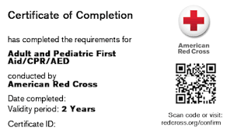
6.41.4 NMAC First Aid & CPR Training
Requires a current first aid and CPR certificate has been obtained from a course approved by the department. No online or hybrid courses.
6.41.4.13 NMAC – Continuing Requirements for Drivers, Substitute Drivers, School Bus Assistants, and Substitute School Bus Assistants
6.41.4.14 NMAC – Using Sport Utility Vehicles (SUVs) for To-and-From Transportation

Slide 23
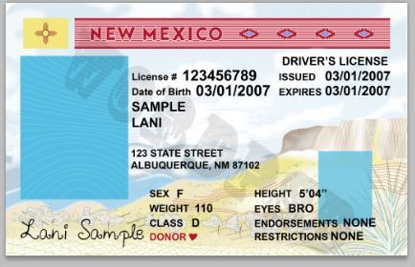
6.41.4 NMAC Driver Files
6.41.4.9.S(1)(c) NMAC – a driving record printed annually then verified for eligibility and placed in the driver's file.

Slide 24
6.41.4 NMAC Supervisor Training
6.41.4.9 NMAC – Responsibilities of the LEA
6.41.4.9.U(2) NMAC – a minimum of 2 hours of in-service training is required annually. Content is determined by the department.

Slide 25
School Bus Inspections
Conducted twice annually – district/charter is responsible for payment and signing off.
Statewide memo sent out with STB expectations.
Current cycle ends May 17, 2024.
Inspection notifications must be sent to bus.inspector@ped.nm.gov. This is required.

Slide 26
School Bus Inspections
Minimum of 30 minutes – unless there is a waiver.
Random inspector audits.
Recommend that a district/charter representative be on site during the inspections.
Recommend alternating inspectors.
Inspectors required to document brake measurements.

Slide 27
School Bus Inspections
Inspections are not the time to conduct maintenance.
Failure to comply may result in reinspection at the cost of the district/charter and/or inspector.

Slide 28
CDL Clearinghouse What Is It?
The US Department of Transportation’s Federal Motor Carrier Safety Administration opened registration for the CDL Clearinghouse on January 6, 2020.
A database that will contain information about CDL drivers’ drug and alcohol violations.
Queries must be conducted annually.

Slide 29
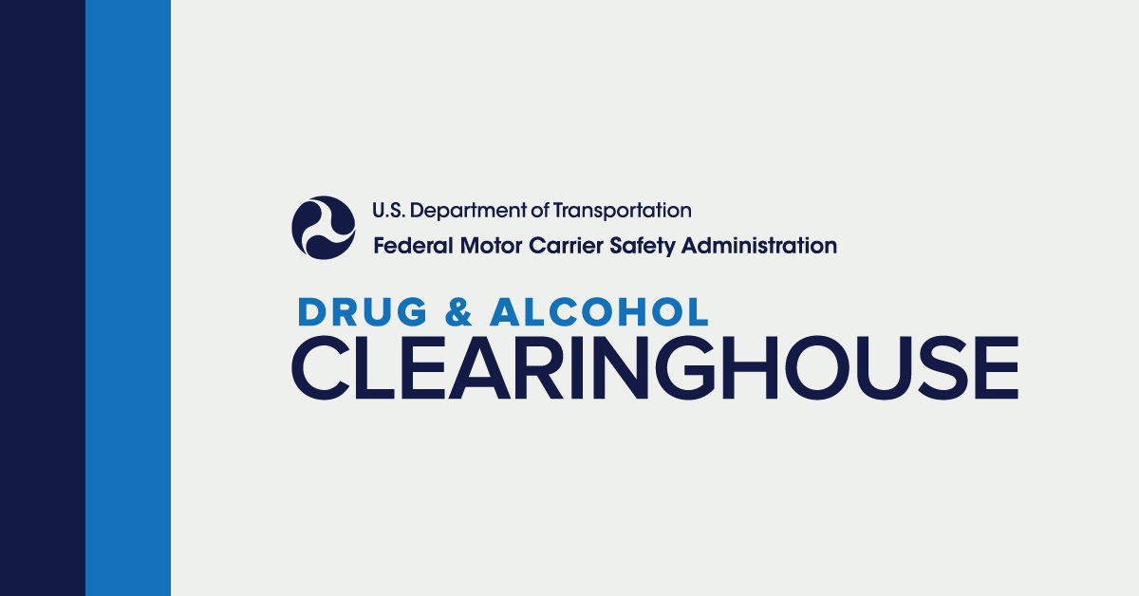
CDL Clearinghouse What Is It?
The US Department of Transportation’s Federal Motor Carrier Safety Administration announced beginning January 1, 2020, the minimum annual percentage rate for random drug testing is 50%.
The minimum annual percentage rate for random alcohol testing will remain at 10%.

Slide 30
CDL Clearinghouse Who Has To Register?
Registration is congressionally mandated for the following individuals:
All drivers who hold a CDL or CLP
Employers of CDL drivers
Consortia/Third-Party Administrators
Substance Abuse Professionals
https://clearinghouse.fmcsa.dot.gov

Slide 31
Training Classes
School Bus Driver Instructor (SBDI)
Commercial Drivers License (CDL) Examiner
Activity Vehicle Instructor (AVI)
If you are interested in a class, email Luis Fierro at luis.fierro@ped.nm.gov to sign up.

Slide 32
Important Dates
April
FY25 Transportation Allocations (Planning Awards)
April
Last month to submit BAR for rental fees
May
Final FY24 Distribution
14 June
School bus contracts due to STB
July
School bus replacement letters sent out
August
New buses shall be placed on order
August
Final expenditure reports and list of unliquidated obligations must be submitted to STB

Slide 33
Important Dates
80D – Second Reporting
December 1, 2024
120D – Third Reporting
February 12, 2025

Slide 34
Contact Us
Amanda Lupardus-Hernandez – Director
amanda.lupardus@ped.nm.gov or 505-677-6692
Alyssa Marquez – Financial Coordinator
alyssa.marquez@ped.nm.gov or 505-629-5821
Luis Fierro – Transportation Supervisor
luis.fierro@ped.nm.gov or 505-677-6697
Cory Brook – Transportation Specialist
cory.brook@ped.nm.gov or 505-531-7615

Slide 35
Questions

