Slide 1
Office Hours
Dr. Margaret Cage
State Director
The Office of Special Education
March 19, 2024
Investing for tomorrow, delivering today.
Notes:
Good afternoon and welcome to our First Office Hours!
_ Today’s Office Hours will be for providing updates, technical assistance, professional development, and question answer sessions.
A few housekeeping notes, we will have 10-15 minutes for questions at the end of the presentation. We will be monitoring the chat however all questions will not be answered until the end of all presentations. Slide decks will be accessible on the PED website after each office hour.

Slide 2
Leadership/Duties of the Office
Dr. Margaret Cage
State Director, OSE
Dr. Tyre Jenkins
Deputy Director, OSE
Charlene Marcotte
Deputy Director of Data & Finance
Ria Gill
Assistant Deputy Director, OSE
Develop, review, and propose updates to state special education statutes, rules, policies, and technical assistance
Consult and coordinate with other units of the Department, other state agencies, public post-secondary educational institutions, and key education and community stakeholders on varying special education topics and issues
Coordinate with school districts and public post-secondary education institutions to develop and provide training and professional development to licensed school employees
Provide technical assistance and recommendations to school districts and public schools to implement evidence- and research-based programs and services that are culturally and linguistically responsive
Conduct activities to promote the recruitment and retention of qualified special education practitioners
Solicit input regarding delivery of special education services in the State from various stakeholders
Oversee and enforce the compliance with the IDEA and any state law pertaining to special education
Collect statewide data on varying aspects of special education within the state
Monitor spending of state and federal funds for special education programs
Develop and annually update a state plan for students with disabilities
Notes:
It is my pleasure to introduce The Office of Special Education Leadership. First, Dr. Margaret Cage, Director of The Office of Special Education.
Dr. Tyre Jenkins, Deputy Director of OSE.
Charlene Marcotte, Deputy Director of Data & Finance and
Rita Gill, Assistant Deputy Director of OSE.
To your right, please find the priorities of The Office of Special Education that align with the executive order per Governor Lujan-Grisham.
Develop, review, and propose updates to state special education statutes, rules, policies, and technical assistance
Coordinate with school districts and public post-secondary education institutions to develop and provide training and professional development to licensed school employees
Conduct activities to promote the recruitment and retention of qualified special education practitioners
Oversee and enforce the compliance with the IDEA and any state law pertaining to special education
Monitor spending of state and federal funds for special education programs
Consult and coordinate with other units of the Department, other state agencies, public post-secondary educational institutions, and key education and community stakeholders on varying special education topics and issues
Provide technical assistance and recommendations to school districts and public schools to implement evidence- and research-based programs and services that are culturally and linguistically responsive
Solicit input regarding delivery of special education services in the State from various stakeholders
Collect statewide data on varying aspects of special education within the state
Develop and annually update a state plan for students with disabilities

Slide 3
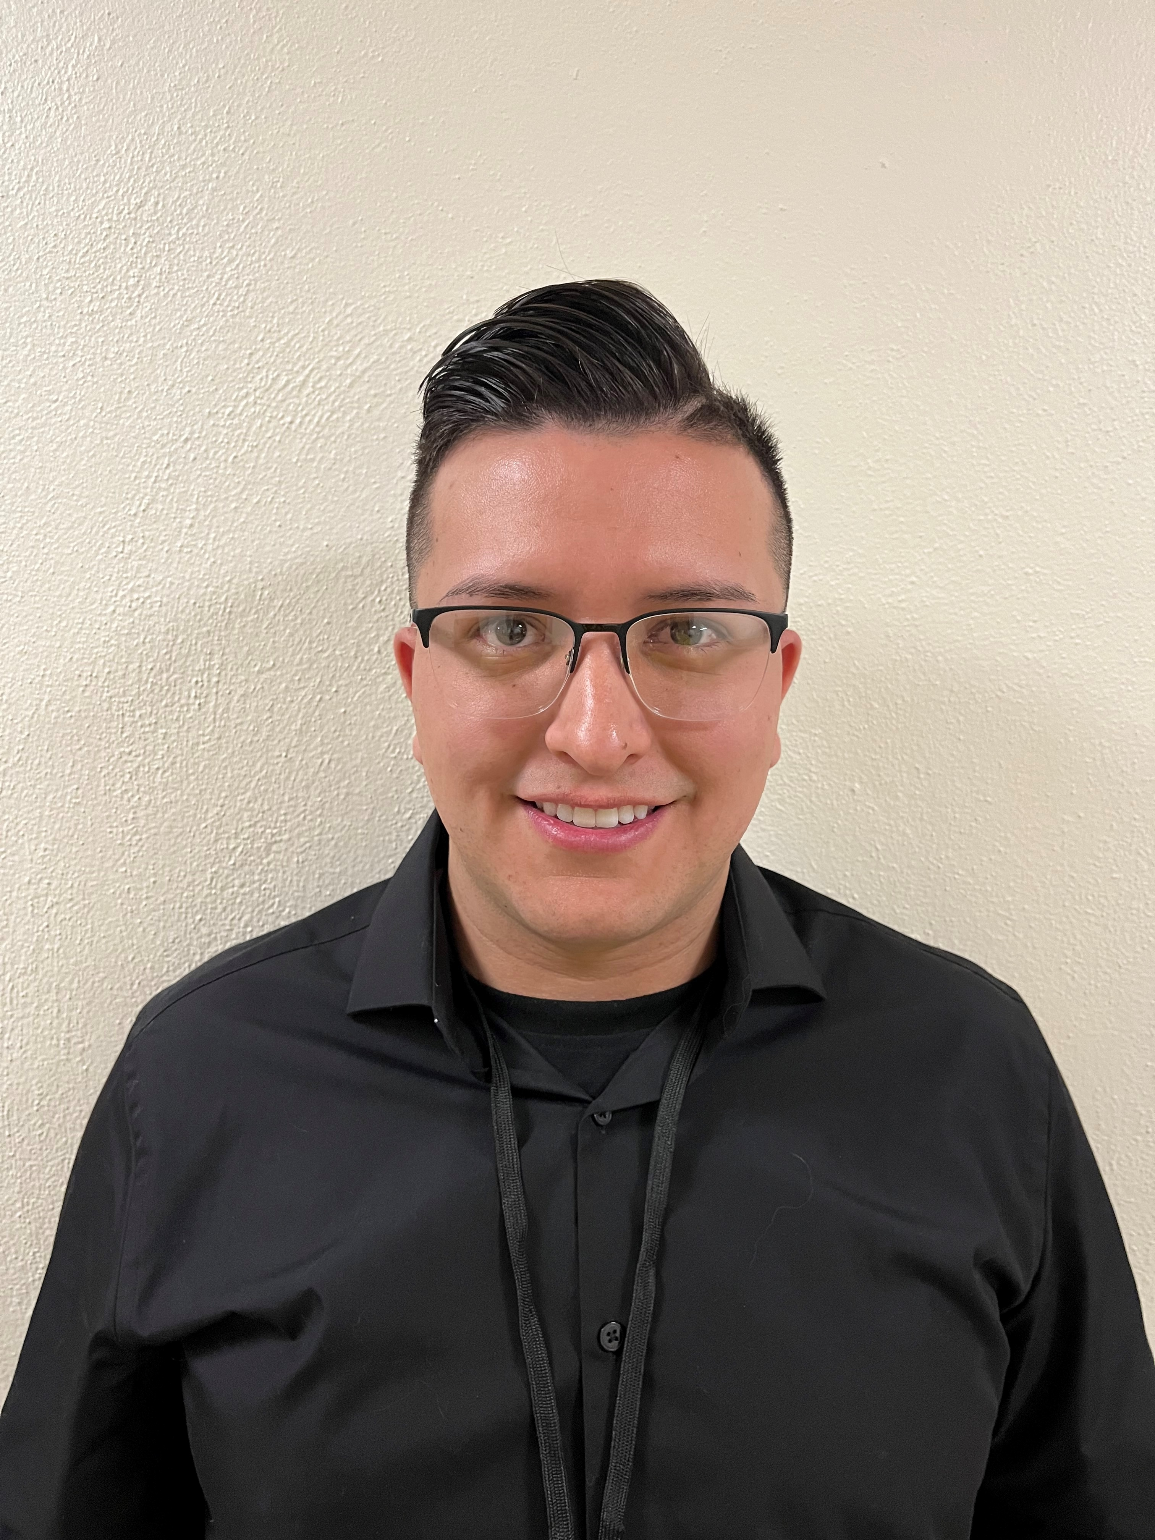
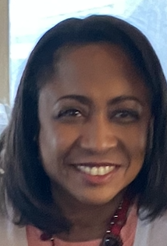
Hiring Updates
JoeMike Rodarte -Secretary of The Office of Special Education
Ria Gill Promoted to Assistant Deputy Director of OSE
Program support positions
Financial Coordinator
Data Analyst
Notes:
The OSE is steadily increasing capacity and staff to better serve you. We want to introduce JoeMike Rodarte as the new Secretary for The Office of Special Education.
And reintroduce you to Ria Gill who was promoted to Assistant Deputy Director of The Office of Special Education.
We are hiring! Please check the state personal office website for program support, financial coordinator, and data analyst positions.

Slide 4
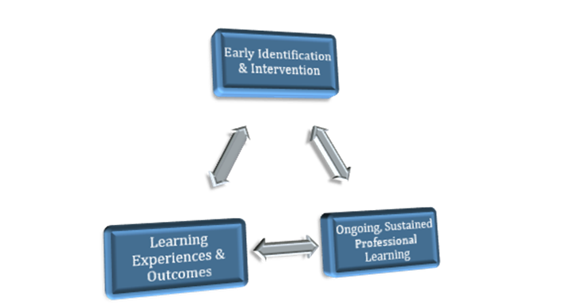
Instructional Best Practice Focus Areas
FOCUS AREAS (SUMMARY OF INSTRUCTIONAL BEST PRACTICES)
Early Identification & Intervention: Implementation of an integrated model of a statewide muti-level system of support with grade level curriculum.
Ongoing, Sustained Professional Learning: focuses on meeting the specific needs of students with disabilities.
Focus on Learning Experiences & Outcomes for Students with Disabilities: guarantee students with disabilities achieve successful educational outcomes from cradle to career.
Notes:
We want to share with you a summary of instructional best practices that will be built out in the state plan.
Early Identification & Intervention: Implementation of an integrated model of a statewide muti-level system of support with grade level curriculum.
Ongoing, Sustained Professional Learning: focuses on meeting the specific needs of students with disabilities.
Focus on learning Experiences & Outcomes for Students with Disabilities: guarantee students with disabilities achieve successful educational outcomes from cradle to career.

Slide 5
Legal (Miguel Lozano)
Graduation and Diploma Programs of Study
Notes:
At this time Chief Counsel, Miguel Lozano, will present on Graduation and Diploma Programs of Study.

Slide 6
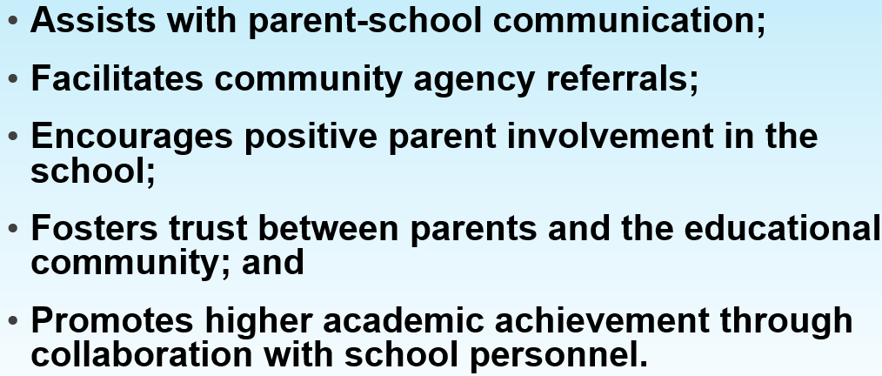
Parent & Community Liaison (Dr. Cassel)
CAP Monitor
Parent & Community Liaison
Notes:
Thank you, Miguel. Our next presenter, Dr. Elizabeth Cassel, OSE’s Parent & Community Liaison.

Slide 7
Data (Charlene Marcotte)
SPP/APR Indicators 1-16
Stakeholder Engagement Meetings
Quadrant 1: CUBA
April 9th 10-1 pm
Quadrant 2: TBD Pojoaque
April 12th 10-1 pm
Quadrant 3: ABQ-EXPO NM
April 22nd 10-1 pm
Quadrant 4: T or C
May 31st 10-1 pm
Quadrant 5: Ruidoso
May 14th 10-1 pm
This Photo by Unknown Author is licensed under CC BY-NC
Notes:
Thank you, Dr. Cassel. Charlene Marcotte will now present for Data and spending.

Slide 8
LEA Allocations Spending

Slide 9
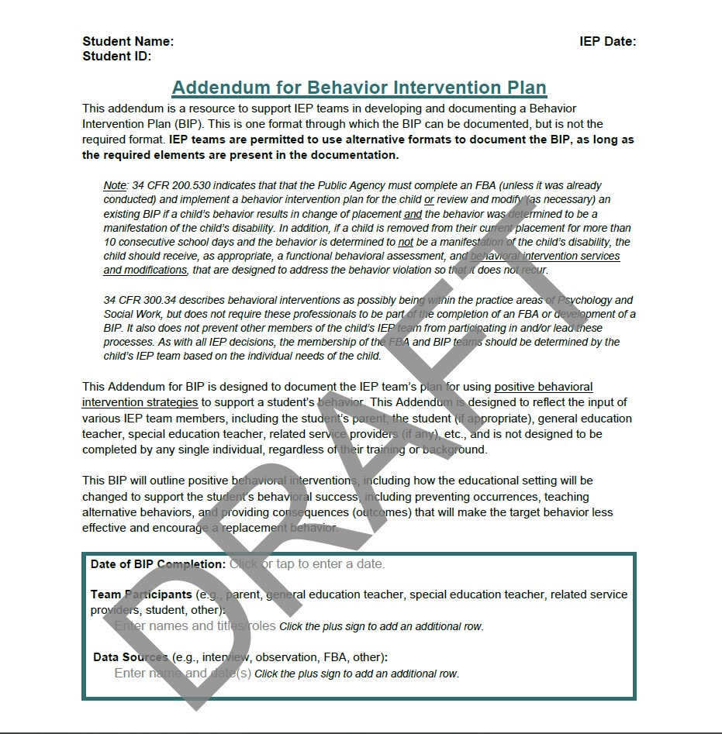
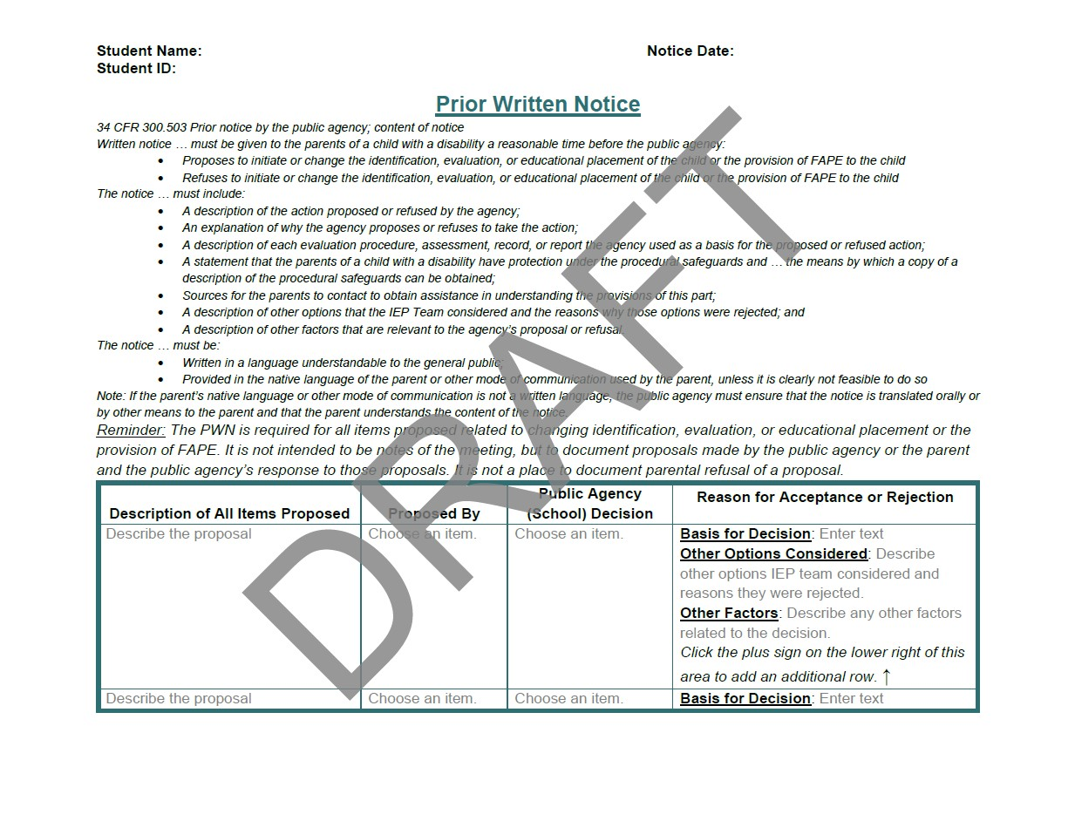
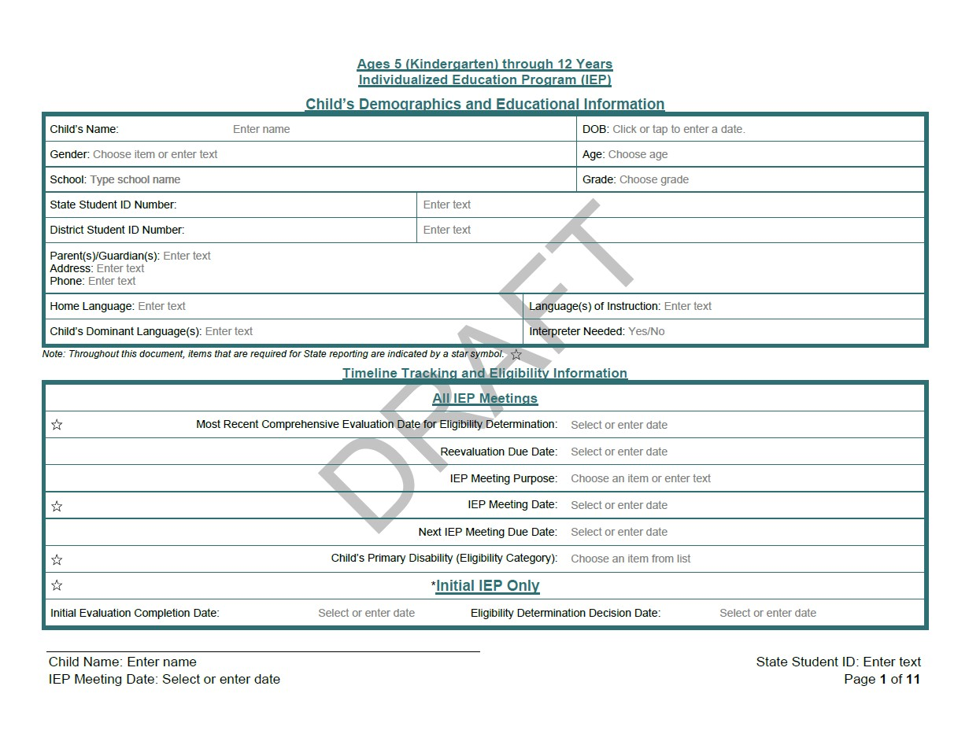
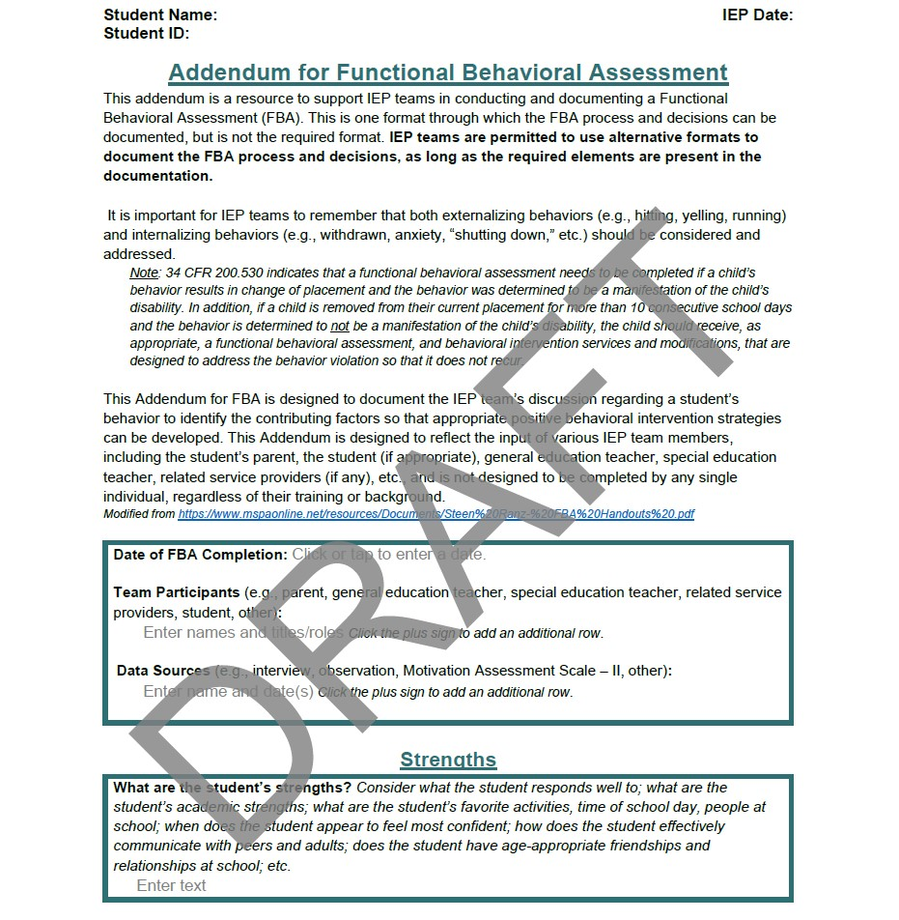
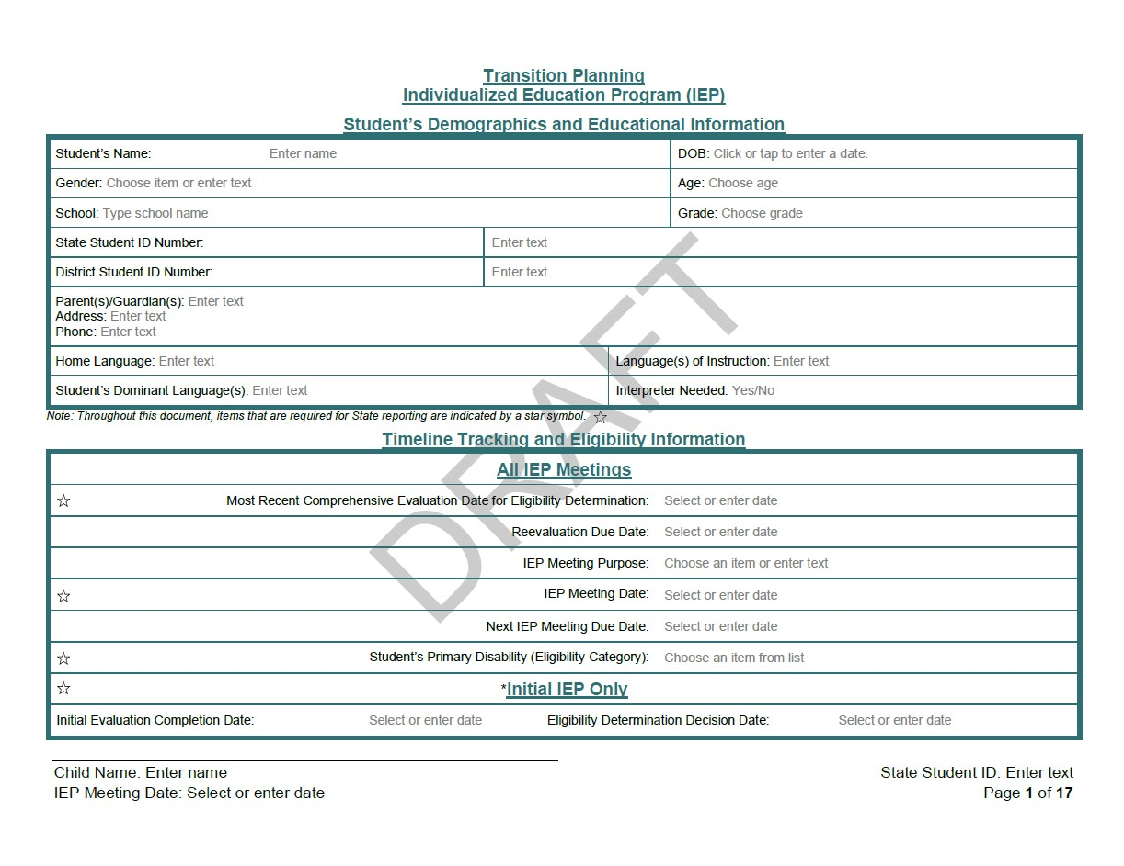
The IEP Template Draft (Ria Gill)
https://acrobat.adobe.com/link/track?uri=urn:aaid:scds:US:3ddabe61-b1d5-3bfe-8902-b934090cf93f
Through IDEA, every state is required to provide a free and appropriate education to children/students ages three through 21, in the least restrictive environment. To better meet the needs of students throughout the State of New Mexico, the Office of Special (OSE) is working on creating a unified IEP infrastructure and template.
These processes and procedures will help ensure that students receive appropriate accommodations, modifications, and supports to access grade level work and create more positive outcomes. Special educators, service providers, and general educators will also have quicker access to student data and carry out specific responsibilities of the IEP.
Wherever families move within the state, parents and students will have access to the same document until a transition at the age of 14 to high school. The unified IEP system is beneficial to all stakeholders.
Notes:
Thank you. Ria Gill will now present on the IEP Template Draft. Ria?

Slide 10
Contact List
NAME | E-MAIL | TITLE
Cage, Margaret | Margaret.Cage@ped.nm.gov | Director of Special Education
Dr. Jenkins, Tyre’ | Tyre.Jenkins@ped.nm.gov | Deputy Director, Office of Special Education
Lozano, Miguel | Miguel.Lozano@ped.nm.gov | Chief Counsel
Cassel, Elizabeth | Elizabeth.Cassel@ped.nm.gov | Education Administrator, Parent and Community Liaison, Complaints and CAPS
Cordova, Trudy | Elizabeth.Cassel@ped.nm.gov | Education Administrator
Gadomski, Michael | Michael.Gadomski@ped.nm.gov | Assistant General Counsel
Gallegos, Katalina | Katalina.Gallegos@ped.nm.gov | Management Analyst
Marcotte, Charlene | Charlene.Marcotte@ped.nm.gov | Deputy Director of Finance and Data
Perea, Sharyn | Sharyn.Perea@ped.nm.gov
Pacheco, Lorie | Lorie.Pacheco@ped.nm.gov | General Supervision, Low Incidence, NIMAS/NIMAC
Quick, Catherine | Catherine.Quick@ped.nm.gov | General Supervision, Section 619-Preschool, Early Childhood Ed
Romero, Corrine | Corrine.Romero3@ped.nm.gov | General Supervision, Differentiated Monitoring
Schweiger, Liz | Liz.Schweiger@ped.nm.gov | General Supervision, Policies/Procedures, Private Schools
Tomicek, Matthew | Matthew.Tomicek@ped.nm.gov | Data Analyst
Gill, Ria | ria.gill@ped.nm.gov | Assistant Deputy Director, OSE
Sellers, Kaylock | kaylock.sellers@ped.nm.gov | OSE Business Operations
OSE Parent Portal
https://webnew.ped.state.nm.us/bureaus/special-education/parent-portal/
OSE Newsletter Link https://acrobat.adobe.com/link/track?uri=urn:aaid:scds:US:5b0e2f11-d0ae-3e94-b95a-63a2ff1fb269
Have questions for OSE?
ose.support@ped.nm.gov
Notes:
Thank you. This contact list is an interactive email slide with today’s presenters highlighted in yellow. As well as the OSE Parent portal, link to OSE Newsletter or if you have questions for OSE.

Slide 11
Office of Special Education Office Hours
April 16, 2024
Time: 3:30 – 4:30 p.m.
Location: Virtual, Microsoft Teams Click here to join the meeting
Meeting ID: 215 062 863 880 Passcode: g4Z38d
Or call in (audio only), Microsoft +1 505-312-4308,894757518# United States, Albuquerque Phone Conference ID: 894 757 518#
Notes:
Office hours will be every third Tuesday of the month, 3:30-4:30. Our next Office hours will be April 16th.

Slide 12
Questions From The Field?
Notes:
Now we will open it up for questions.

