Slide 1
Excess Cost and IDEA B Application
Office of Special Education
Webinar
May 21, 2024
Investing for tomorrow, delivering today.
Notes:
To change the image on this slide, select the picture and delete it. Then click the Pictures icon in the placeholder to insert your own image.

Slide 2
Agenda
Welcome – Dr. Margaret Cage, Director, Office of Special Education
Excess Cost – Lorenzo Dominguez, Assistant Deputy Director of Data and Finance, Office of Special Education
Phased IDEA B Application – Charlene Marcotte, Deputy Director of Data and Finance, Office of Special Education
What is new this year?
Phase 1
Phase 2

Slide 3
Housekeeping
This goal of the training today is to share information on Excess Cost and the IDEA B Application
Questions must be entered here: https://drive.google.com/drive/folders/1gDlYIXxwoJiVf_PKjOGU8F8zm7HQJ5LR?usp=sharing
A Question and Answer (Q&A) Document, containing responses will be posted following the webinar.

Slide 4
Excess Cost Base

Slide 5
Topics for Review
Excess Cost Definition
Relation to MOE and connection to Supplanting
Excess Cost Submission Types
The Excess Cost Submission Process in SharePoint

Slide 6
Excess Cost Definition
Definition of Excess Cost
Excess Cost refers to the additional costs incurred by Local Educational Agencies (LEAs) for providing special education and related services to children with disabilities, over and above the average annual per-student expenditure from all sources (local, state, and federal) on general education students.
Essentially, it represents the extra amount LEAs need to spend to ensure that children with disabilities receive the appropriate education and services they are entitled to under IDEA (Individuals with Disabilities Education Act).
The purpose of calculating excess costs is to ensure that federal IDEA Part B funds are used specifically for these additional expenses, rather than replacing existing funding sources.

Slide 7
Excess Costs vs. MOE
MOE ensures consistent financial support: The MOE requirements prevent LEAs and states from reducing their own spending on special education from year to year, thus maintaining a steady level of financial effort.
Excess Cost Calculation ensures IDEA funds cover additional costs: Before IDEA Part B funds can be used, LEAs must demonstrate they have spent a minimum average amount from local/state funds on general education costs for students with disabilities.
Prevents Supplanting: Together, MOE and excess cost calculations help ensure that IDEA Part B funds are used as intended—to provide additional support for special education rather than replacing existing funding sources.
These processes work together to ensure that special education funding is maintained and appropriately augmented with federal funds, thereby preventing the improper use of federal funds to replace local and state investments in special education.

Slide 8
Connection to Supplanting
Supplanting refers to using federal funds to replace (supplant) state, local, or other federal funds, which is generally prohibited under IDEA:
Supplanting Rule: IDEA Part B funds must be used to supplement and increase the level of funding for special education and related services, not replace existing funding sources. This means federal funds should add to the current funding levels rather than displace them.

Slide 9
Excess Cost Submissions
The New Mexico Public Education Office of Special Education will collect excess cost submissions twice each year:
Base Submission
Collected in the Spring
Compliance Submission
Collected in the Fall

Slide 10
Excess Cost Types
Excess Cost Base Submission (Spring):
These figures are based on budgeted amounts.
May include projections derived from historical data.
The United States Department of Education requires each LEA to submit figures separated between elementary and secondary education levels.
This calculation is to establish eligibility for IDEA B funds by assuring LEAs have estimate of costs from state and local funds.
Excess Cost Compliance Submission (Fall):
These figures are based on the actual expenditures finalized from the prior fiscal year.
The United States Department of Education requires each LEA to submit figures separated between elementary and secondary education levels.

Slide 11
Excess Cost Site Submission
Once logged in to the SharePoint, find your LEA name from the list and click on the Edit button.
Access:
Must have a STARS/Nova login
If you do not have a STARS/NOVA username, please contact LEA NOVA coordinator to gain access.
For access to the Excess Cost site contact:
Mahesh Reddy-Erri
mahesh.reddy@ped.nm.gov

Slide 12
Separating Costs
The United States Department of Education requires the Excess Cost Submission (Base and Compliance) to be submitted separated by Elementary and Secondary grade levels.
Base: Budgets are not submitted by school site. You may use your membership to determine a ratio, and use that ratio to determine budgeted numbers.
Compliance: Actuals are collected by school site, use exact figures based on your submission.

Slide 13
Excess Cost Site Submission
There are two submission fields in the Excess Cost Site, one for Base and one for Compliance.
Base will be collected in the Spring and Compliance will be collected in the Spring.
Base Submission(Spring)
Compliance Submission (Fall)

Slide 14
What is new this year?
2024-2025 IDEA B Application

Slide 15
Assurances - General Education Provisions Act
General Educations Provisions Act (GEPA)
No longer a Yes/No assurance
A plan is required.
Section created in the application

Slide 16
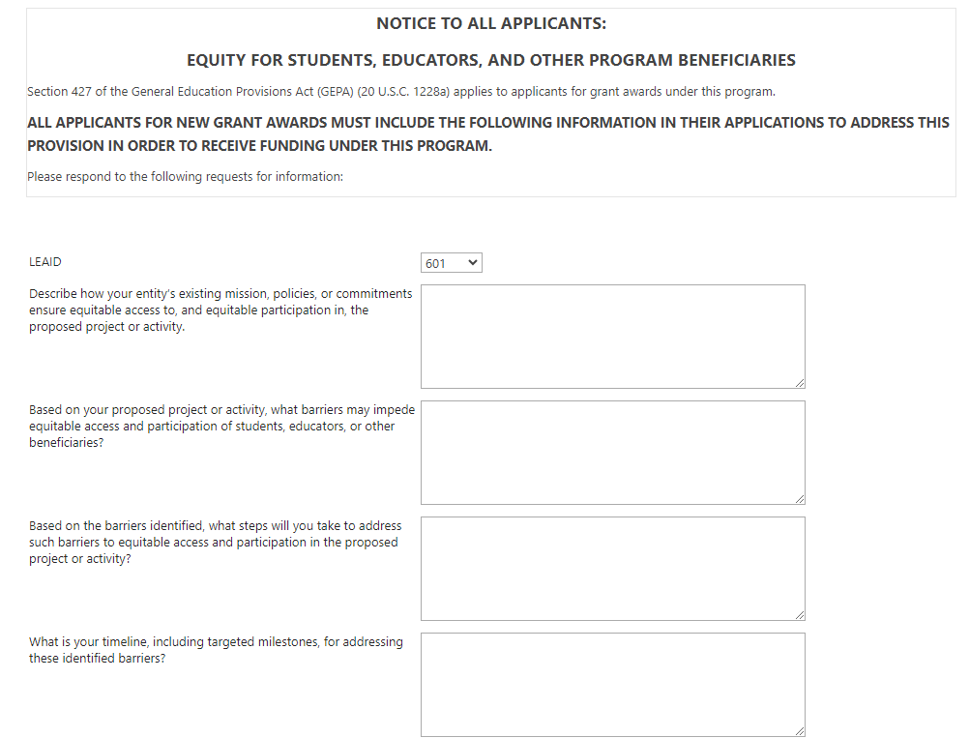
GEPA Plan
Responses required in each field

Slide 17
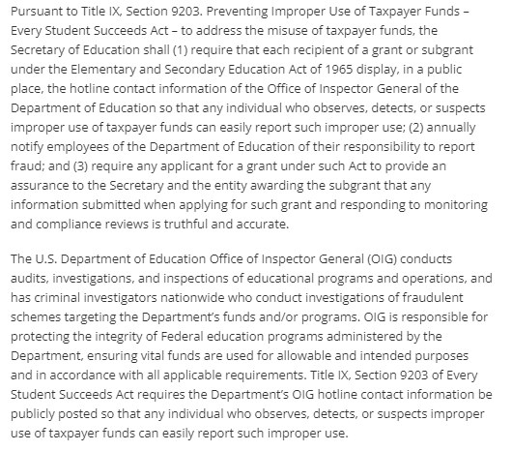
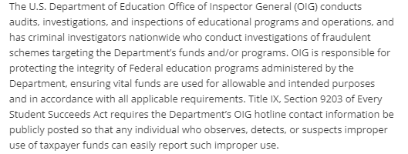
New Assurances – Three in One
1
2
3

Slide 18
Suspension/Debarment Verification
Assurance Verification
The LEA must provide assurance that individuals who are overseeing and operating a Federal grant are not suspended or debarred from doing so.
The Office of Special Education is required to verify that the following, from each LEA are not on the Federal Suspension/Debarment:
Board President
Superintendent
Special Education Director
Business Manager

Slide 19
Private School Allocation
Allocation amount for private schools will be prepopulated.
Section to complete total private school allocation calculation has been removed.

Slide 20
Objective 8 – Excess Cost Section Removed
Excess Cost its own app.
No longer a section in the IDEA B application.
Excess Base requirement to be eligible for IDEA B funds.
Excess Cost Application can be found here: https://webed.ped.state.nm.us/sites/IDEAB/ExcessCosts/SitePages/Home.aspx

Slide 21
Maintenance of Effort (MOE) Eligibility
Assurance 3a. – 3d in the IDEA B application
MOE Eligibility template is being developed.
Once complete, LEAs will be required to complete MOE eligibility calculations

Slide 22
Indirect Cost Verification
Office of Special Education (OSE) Staff will verify IDC amounts in the application to ensure approved rate match what is in the application.
• Link to FY 2024-2025 Indirect Cost Rates:
IDC_LEA.REC_2223_Rev_3.12.24.pdf (state.nm.us)
• LEAs must indicate which staff are to be paid from IDC to avoid double payment from the IDC and program funds.

Slide 23
Award Letters/Memos
Award Letters/Memos will be issued.
All subaward letters/memos must have the required information in 200.332(b)
• Federal award identification information
• All requirements of the subaward
• Any additional requirements imposed on subrecipient
• Indirect cost rate
• Requirements that subrecipient permits PTE and auditors access to records
• Closeout terms and conditions

Slide 24
IDEA B Application
2024-2025 IDEA B Application

Slide 25
Phased Application
Phase 1
Phase 2
Phase 3
Substantial Approvable Application
3 Phases of the Application:
Phase 1:
LEA Analysis and Plans,
Assurances,
Objectives 1, 2 and 3 for fund 24106 ONLY,
Excess Cost – Objective 8
Submission of new and/or revised policies and procedures.
Phase 2:
Objectives 1, 2 and 3 for fund 24109
CEIS – Objective 4
Local Charter Share for funds 24106 and 24109
Private School Share for funds 24106 and 24109
Certification and Approval Page
Private School Consultation
Parent Involvement
Phase 3:
Board of Education/Governing Body Agenda where IDEA B Application was approved
Board of Education/Governing Body Minutes where IDEA B Application was approved
Substantially
Approvable

Slide 26
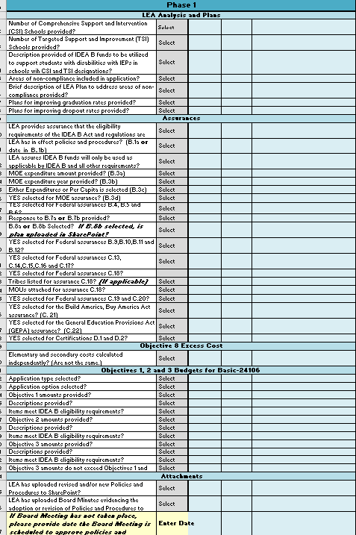
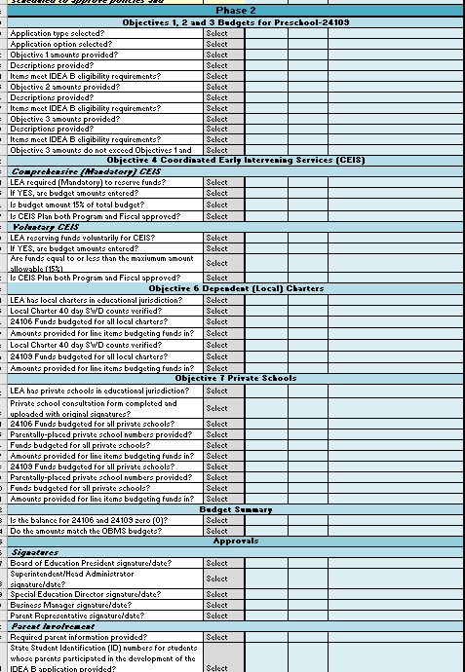
Phased Checklist
Phase 1
Phase 2
Phase 3

Slide 27
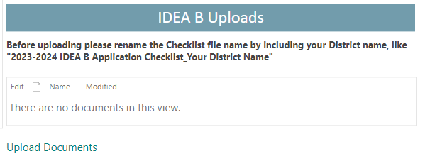
Phased Checklist Submission
A checklist for the 3 different phases of the application must be completed and uploaded.
Be sure to include the Phase Number in the saved name
Example: “Ohkay Owingeh Community School Checklist – Phase 1”
At the completion of the application, there may be up to 6 versions of the checklist saved, 3 by the LEA and 3 by the Education Administrator conducting the review.

Slide 28
Access
IDEA B Application Access Contacts
Excess Cost Access Contact
Kaylock Sellers
Kaylock.sellers@ped.nm.gov
Katalina Gallegos
Katalina.gallegos@ped.nm.gov
Mahesh Reddy-Erri
mahesh.reddy-errl@ped.nm.gov
NOTE: Must have a STARS/Nova login before access to the IDEA B Application and Excess Cost site can be granted

Slide 29
Phase 1

Slide 30
Excess Cost Base
Excess Cost Base must be completed and submitted.
If extension has been granted, submit by due date.
Base must be established before IDEA B application can be approved.
Excess Cost Site: https://webed.ped.state.nm.us/sites/IDEAB/ExcessCosts/SitePages/Home.aspx

Slide 31
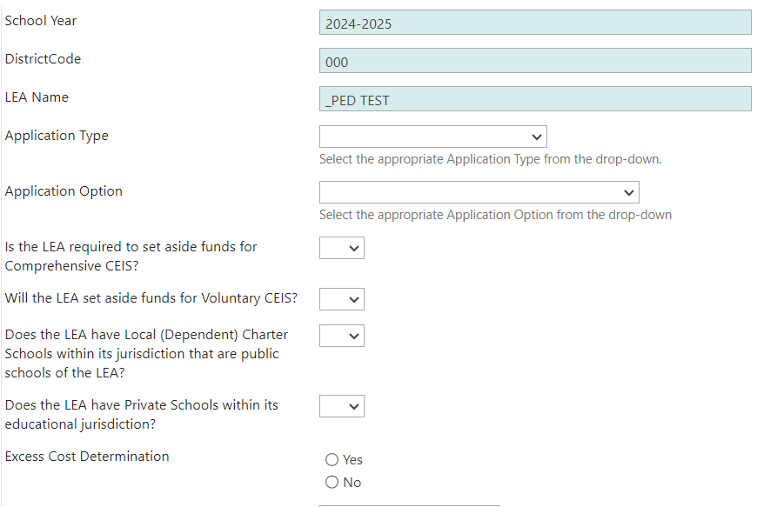
General Information Section
Green Shaded indicates auto populated field.
All LEAs in NM are single-applicants.
Application (Budget) Options:
With Carryover
Without Carryover
Indicate if setting aside funds for voluntary CEIS.
Indicate if have:
Private Schools
Local Charters
OSE Use Only Section

Slide 32
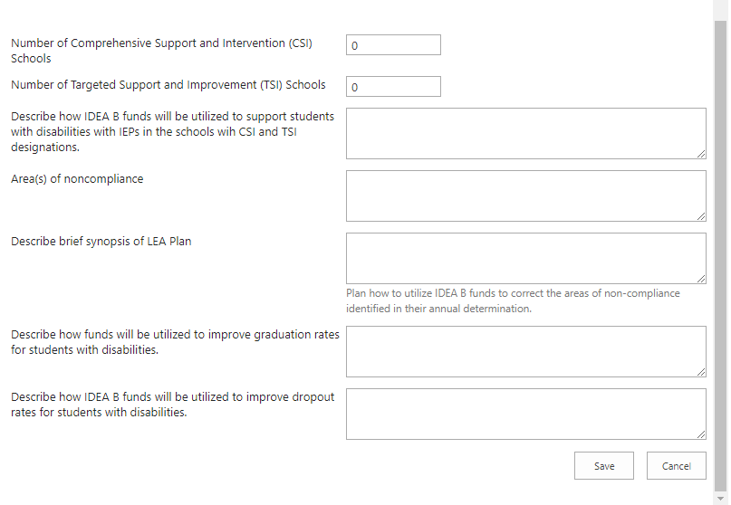
LEA Analysis and Plans

Slide 33
Assurances and GEPA Sections
Click here to enter data.

Slide 34
Assurances and GEPA Sections
Read each section carefully.
Use the checklist to guide you through the assurances section.
Ensure responses are provided in each section.
Appropriate responses are pre-loaded and must be selected.
If assurance cannot be provided, LEA will be required to provide a date of when all assurances can be provided.
LEA will not be eligible for IDEA B funds until all assurances can be provided.

Slide 35
Uploads
Upload Policies and Procedures
Must submit Policies and Procedures if LEA:
Is new
Revised policies and procedures

Slide 36
Phase 2

Slide 37
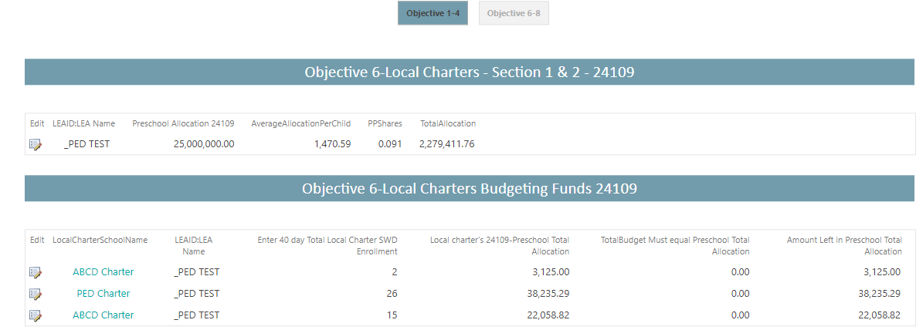
Objective 6 – Local Charters
24109 allocation required for local charters.
LEAs and Local Charters that serve students with disabilities between the ages of 3 to 5 are eligible for 24109 funds.
The 40-day count of students, ages 3 to 5 must be entered to determine the amount to be allocated to local charters.

Slide 38
Objective 7 – Private Schools
24109 allocation required for private schools.
Private School Consultation must be submitted in the IDEA B Uploads Section
Private schools serving students with disabilities between the ages of 3 to 5 are eligible for 24109 funds.

Slide 39
Private Schools
IDEA B requires that LEAs spend a proportionate amount of its IDEA Part B funds to provide equitable services to private school children, which could include direct and/or indirect services.
LEAs are required to engage in Private School Consultation.
On the design and development of special education and related services for students with IEPs, on the five items below, specifically described at 20 U.S.C. 1412(a)(10)(A)(iii) [ 34 CFR § 300.134]:
Child find;
Proportionate share of funds;
Consultation Process;
Provision of special education and related services; and
Written explanation by LEA regarding services.

Slide 40
Private Schools
Wet signatures are preferred on the Consultation Form
DocuSign is permissible if wet signatures cannot be attained.
If Private Schools do not want to participate in the consultation, LEAs are still required to set-aside funds for the LEA.
Federal Guidance Document on serving Private School Students: https://sites.ed.gov/idea/files/QA_on_Private_Schools_02-28-2022.pdf

Slide 41
Coordinated Early Intervening Services
Section separate to account for students with and without disabilities being served through the Coordinated Early Intervening Services. (CEIS)
Comprehensive (Mandatory) CEIS
Voluntary CEIS
Comprehensive CEIS may be provided to children with or without disabilities age 3 through grade 12, particularly, but not exclusively, children in those groups who were significantly overidentified (see 34 CFR §300.646(d)(2)).
Comprehensive CEIS activities cannot be limited to only children with disabilities.
Voluntary CEIS may be provided to children without a disability in grades K–12, with a particular emphasis on students in kindergarten through grade three.
Quick Reference Guide on Coordinated Early Intervening Services (wested.org)

Slide 42
Basic Factors of Allowability - 200.403*
To be allowable a cost must:
An excess cost of providing special education and related services
Be necessary, reasonable, and allocable
Comply with the cost principles and Federal award
Be consistent with policies and procedures applying uniformly to Federal and non-Federal activities and costs
Be consistently treated as either direct or indirect costs
Be determined in accordance with GAAP (Generally Accepted Accounting Principles)
Be adequately documented

Slide 43
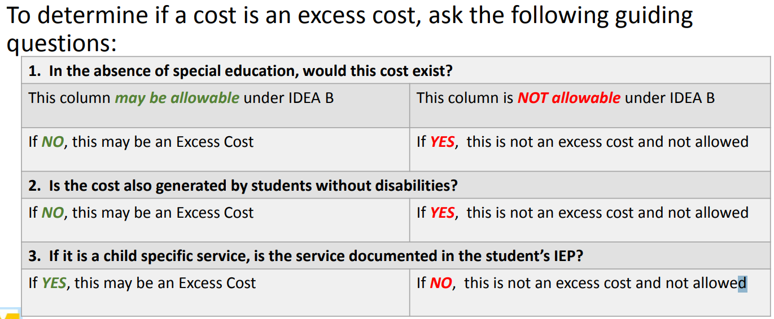
Excess Cost*
Before charging a cost to the IDEA B grant, must ask the following questions:

Slide 44
Necessary - 200.404*
A cost is “generally recognized as ordinary and necessary for the recipient’s or subrecipient’s operation or the proper and efficient performance of the Federal award.”
Ask:

Slide 45
Reasonable - 200.404*
“A cost is reasonable if it does not exceed an amount that a prudent person would incur under the circumstances prevailing when the decision was made to incur cost.”
Prudent person standard
If it was on the front page of the newspaper, could you defend it?
Reasonableness is focused on the cost
Robust procurement system supports competition and reasonableness

Slide 46
Allocable - 200.405*
A cost is allocable to a Federal award if the cost is as assignable to that Federal award in accordance with the relative benefits received.
Ask:
Was it incurred specifically for the award?
If it benefits both award and other work, can the cost be distributed in proportions that may be approximated using reasonable methods?
Is it necessary to the overall operation of the entity and assignable to the award in accordance with this support?

Slide 47
Direct Costs - 200.413*
Direct Costs: those costs that can be identified specifically with a particular final cost objective, such as a federal award, or other internally or externally funded activity, or that can be directly assigned to such activities relatively easily with a high degree of accuracy.
Typically incurred specifically to benefit an award

Slide 48
Indirect Costs - 200.414*
Most costs are directly charged to the grant
For costs that cannot be directly charged, LEAs have an indirect cost rate
Salaries of administrative and clerical staff should be treated as “indirect” unless all of the following are met
Such services are integral to the activity
Individuals can be specifically identified with the activity
Costs not also recovered as indirect

Slide 49
Budget Considerations
All of the factors on the previous slides denoted with and asterisk (*) must be considered before assigning costs to the IDEA B grant.
If an LEA is unable to meet any of the above criteria for a particular cost, it must not be charged to the grant.

Slide 50
Parent Involvement in the IDEA B Application
Parents of students with disabilities with current IEPs (does not include students that are gifted only) must have input in the development of the IDEA B Application.
Parents should not be employees of the LEA or the Regional Educational Cooperative (REC) which serve the LEA.

Slide 51
Parent Involvement
The completed application should be reviewed with the parents of students with disabilities.
Parents must be allowed to provide input on the entire IDEA B application including the budget, programs and services.
One parent, of a student with disabilities, must sign the Assurance section of the IDEA B application.
All parents, of students with disabilities, that provided input into the application must provide their information on the Parent Involvement form in the application.

Slide 52
Timelines
Phase 1
Phase 2
Phase 3
Phase 1
Release Date: Tuesday, May 21, 2024
LEA Due Date: Friday, May 31, 2023
Phase 2
Release Date: To be announced
LEA Due Date: To be announced
Phase 3
Due as soon as Board/Governing Body Agenda and Minutes for meeting where IDEA B application was approved are available.
IDEA B application must be denoted as agenda items and minutes must reflect the vote and approval.

Slide 53
Sources
[Supplanting](https://sites.ed.gov/idea/regs/b/b/300.164/a)
[MOE](https://www2.ed.gov/policy/speced/guid/idea/idea-edjobs-guidance.pdf)
[Excess Costs Calculation](https://sites.ed.gov/idea/regs/b/appendix-a)

Slide 54
Contact us with questions
Office of Special Education Finance Team:
charlene.marcotte@ped.nm.gov
lorenzo.dominguez@ped.nm.gov
kaylock.sellers@ped.nm.gov
katalina.gallegos@ped.nm.gov

