Slide 1
SPED - Student Infraction and Response Detail

Slide 2
SPED - Student Infraction and Response Exceptions

Slide 3
SPED - SPP Indicator 07 Preschool Outcomes Report

Slide 4
SPED - SPP Indicator 11 Parental Consent 60 Day Timeline Report

Slide 5
SPED - SPP Indicator 12 Early Childhood Part C to B Transition Summary Report

Slide 6
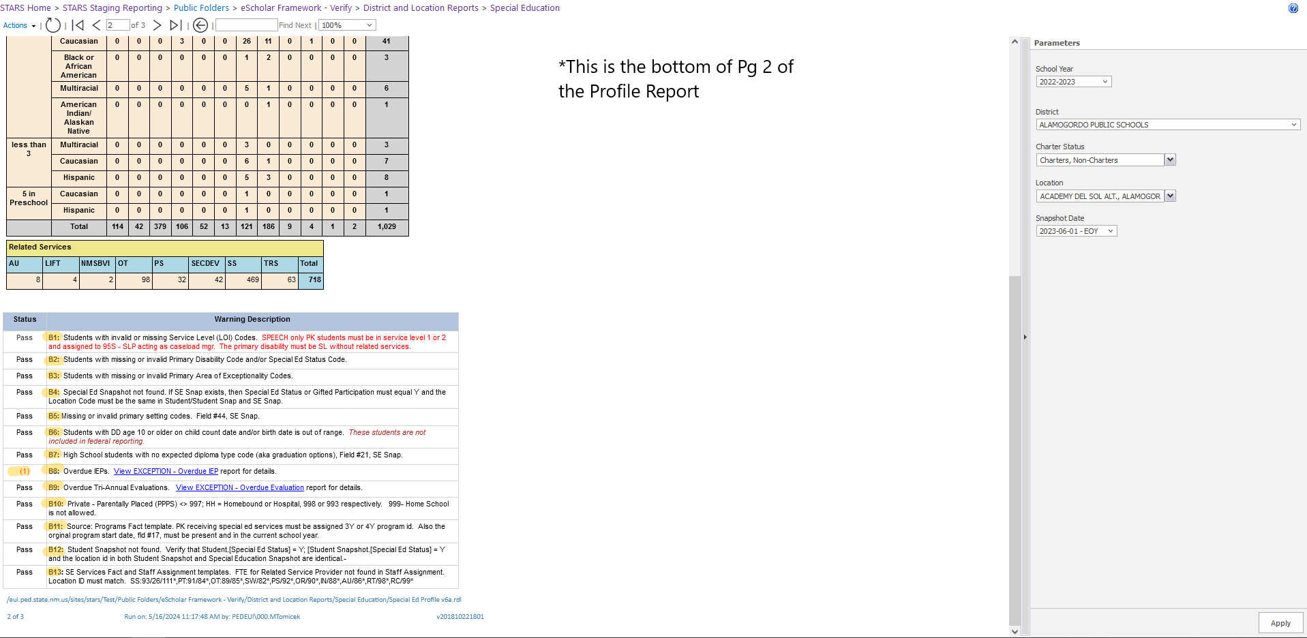
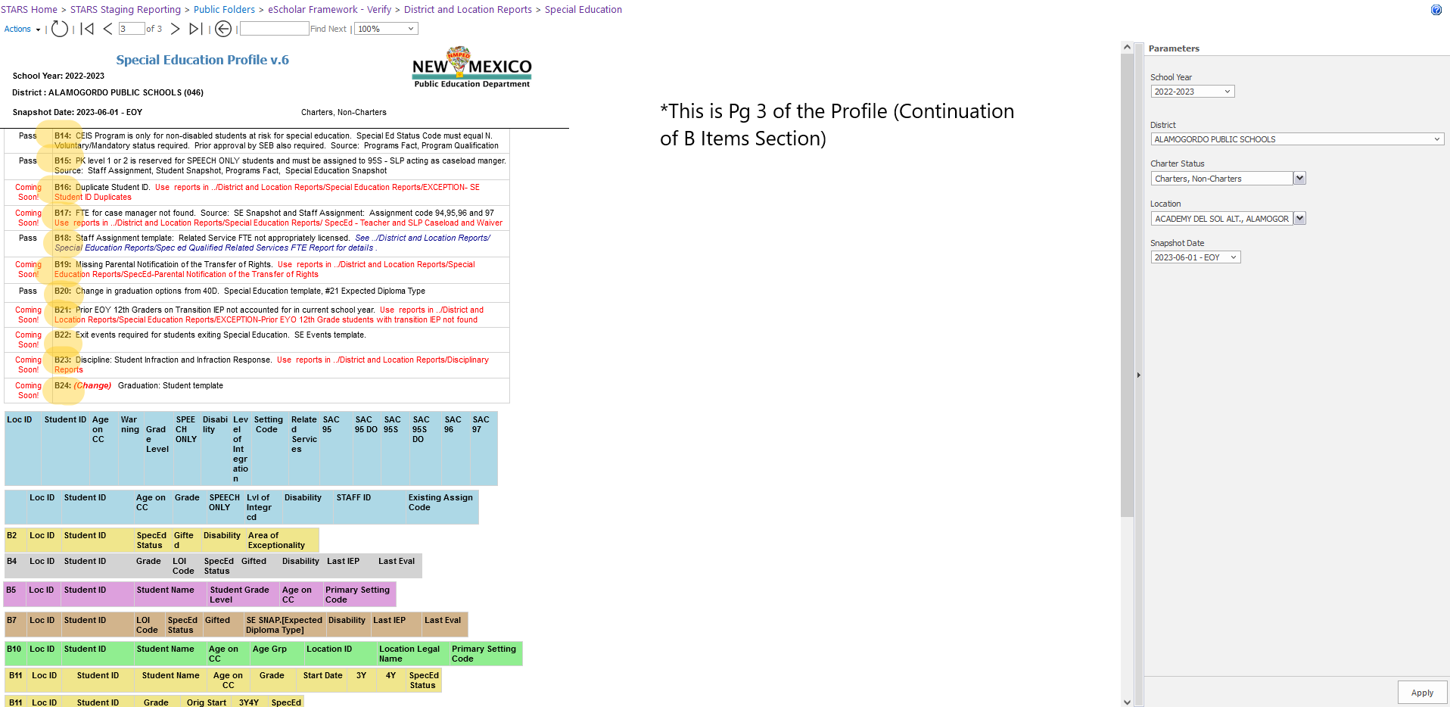
SPED - Profile

Slide 7
SPED - Profile
All or SPED - Duplicate ID Report

Slide 8
SPED - Missing Special Education Exit Events

Slide 9
SPED - Child Count Location Errors

