Slide 1
The Office of Special Education
2024
Stakeholder
Engagement Meeting
Ruidoso, New Mexico
May 14th, 2024
Presented By:
Charlene Marcotte, Deputy Director of Data & Finance
Miguel Lozano, Chief Counsel for Special Education
Lorenzo Dominguez, Asst. Deputy Director of Data & Finance
Matthew Tomicek, Education Administrator, Data Analyst
Lizana (Liz) Schweiger, Education Administrator, Data Analyst
Tamara Burkett, Education Administrator, Data Analyst
Investing for tomorrow, delivering today.

Slide 2
Today’s Agenda
Welcome – Dr. Margaret Cage, Office of Special Education Director
Review Data and receive Stakeholder Feedback on each area below:
Graduation, Dropout and Post-School Outcomes – Lizana (Liz) Schweiger
Assessment Participation and Outcomes and Learning Environments (Ages 5 in Kinder to 21) – Tammy Burkett
Preschool Learning Environments, Preschool Outcomes (Ages 3-5 in Preschool) and Parent Involvement – Lorenzo Dominguez
Suspensions/Expulsions – Matthew Tomicek
Resolution Sessions and Mediations – Miguel Lozano

Slide 3
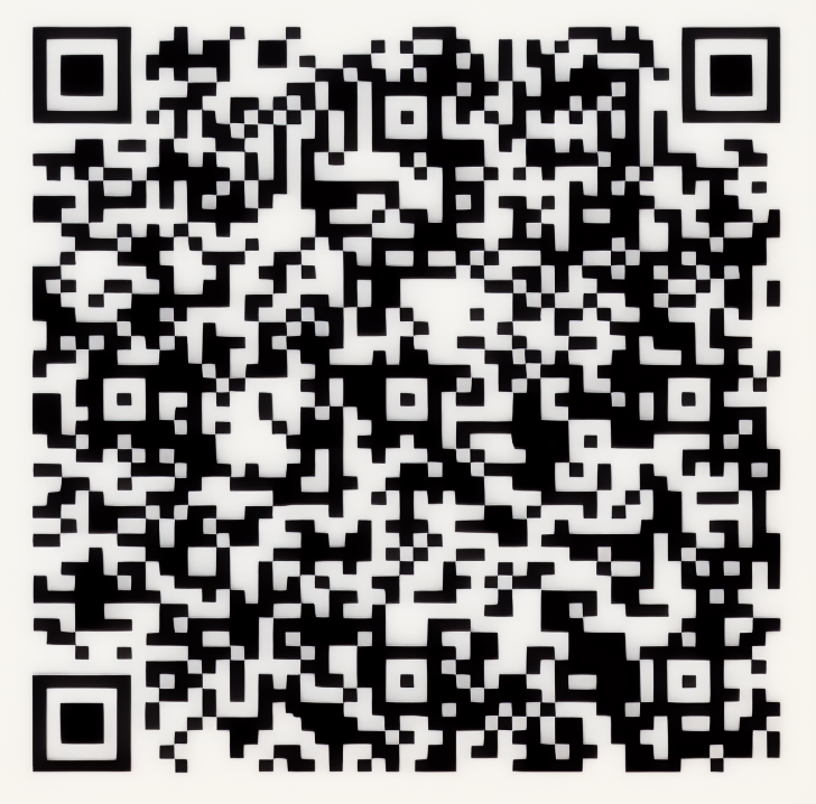
Sign in Sheet
Please take a moment to sign in.
If you are joining us virtually, scan the QR code.
If you are joining us in person, sign the physical sign-in sheet.

Slide 4
Meeting Objectives & Goals
Meeting Goals and Objectives
By the End of Today’s Meeting
Stakeholders to share feedback based on data and ideas for improving outcomes for students with disabilities.
The state will record feedback and share with internal stakeholders that have a role in decision making.
By the end this meeting, we would like actionable feedback that will allow the OSE to make meaningful change and set new state targets.
Stakeholders will provide feedback on the following:
1. Target setting for SPP/APR indicators
2. Analyzing SPP/APR data
3. Providing strategies for improving outcomes for children and youth with disabilities,
4. Evaluating the progress the State is making

Slide 5
Norms & Expectations
We are not here to pass blame. We are here to create solutions for statewide issues.
Practice positive and forward thinking.
The OSE is here to partner with stakeholders. Please work alongside us as we are all here to support students.
Please use sticky notes to write questions and comments. We will review the questions after each section.

Slide 6
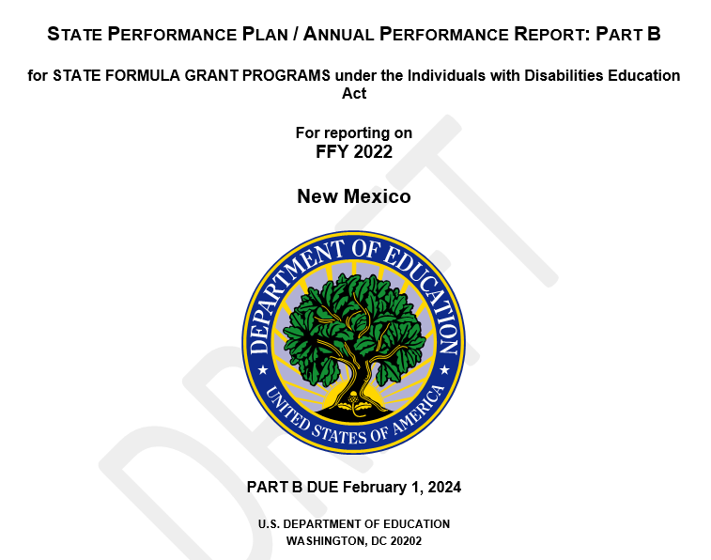
State Performance Plan/Annual Performance Report
In accordance with section 616(b)(2)(C)(ii)(II) of the Individuals with Disabilities Education Act (IDEA), each State must report annually to the Secretary of Education, through the IDEA Part B SPP/APR. Each State is required to submit all Part B Indicators 1-17 of its Federal fiscal year (FFY) SPP/APR by February 1st each year.
SPP/APR Website Posting:
https://webnew.ped.state.nm.us/bureaus/special-education/district-data/

Slide 7
SPP/APR Indicators
2 Types of Indicators:
Compliance: OSEP sets targets/requirements which must be met.
Target: The State sets targets/requirements the state must strive to meet.
Each are identified with a number
Compliance Indicators
4b - Suspension/Expulsion by Race/Ethnicity
9 - Disproportionate Representation by Race/Ethnicity
10 - Disproportionate Representation by Disability Category
11 - Child Find (60 Day Timeline)
12 - Part C to B Transition
13 - Secondary Transition
7 - Preschool Outcomes
8 - Parent Involvement (8)
14 - Post-School Outcomes (14)
15 - Resolution Sessions (15)
16 - Mediation Sessions
17 - State Systemic Improvement Plan
Target Indicators **Focus of Stakeholder Engagement **
1 - Graduation
2 - Dropout
3 - Assessment Participation and Outcomes
4 - Suspension/Expulsion
5 - Learning Environments
6 - Preschool Learning Environments

Slide 8
Data reported in the SPP/APR
School District Data
State Charter School Data
State Supported School Data
Data Reported in SPP/APR

Slide 9
Term Review
OSEP: Office of Special Education Programs. Oversees the implementation of the Individuals with Disabilities Education Act, Part B
IDEA Part B: Individuals with Disabilities Education Act, Part B which outlines the requirements for serving students with disabilities for ages 3-21
SPP/APR: State Performance Plan where the state establishes baselines and targets. Annual Performance Report where the state reports progress on baselines and targets.
Indicator: Each requirement reported in the SPP/APR is called and indicator. Each indicator is assigned a number, 1 through 16.
Baseline: Data starting point
Target: Rate the State has set to meet for each target indicator
Met Target: The target the State has established was met or exceeded.
Did Not Meet Target: The target the state has established was not met.
Lag Year: Data from year prior than reporting.

Slide 10
SPP/APR Feedback Considerations
What do you see?
What are your initial thoughts and reactions?
Is this what you expected to see? If so, how? If not, why not?
What surprises you?
How can the state improve outcomes
Are there particular data that catch your attention (e.g., a certain survey question, student score)?
What do these data not tell you?
Are the targets attainable?
Ideas for increasing response rates?
What does success look like?

Slide 11
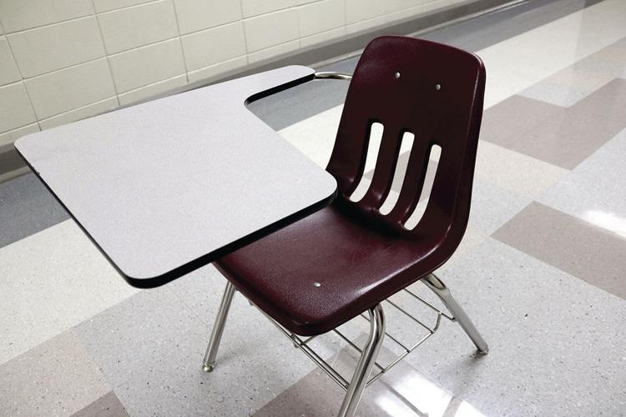
SPP/APR Indicators: 1 – Graduation 2- Dropout 14 – Post-school outcomes

Slide 12
SPP/APR Indicator 1 - Graduation
Percent of youth with Individualized Education Programs (IEPs) exiting special education due to graduating with a regular high school diploma. (20 U.S.C. 1416 (a)(3)(A))
Regular high school diploma explanation
Lag year indicator, data from year prior is reported.

Slide 13
Information for Indicator 1 - Graduation
2019 and Previous Year Calculation Information
2020 to 2025 Calculation Information
State’s 4 Year Cohort Rate
In 2005 the National Governors Association (NGA) convened a task force to make recommendations on how states could measure graduation rates in a way that was comparable based on high-quality, student-level longitudinal data. The resulting recommendation, ultimately agreed to by all 50 governors, was for all states to calculate a high school graduation rate based on the following formula:
Federal Exiting Data
Calculation:
All youth with IEPs who left high school (ages 14-21)
Youth with IEPs that (a) graduated with a regular high school diploma + (d) reached maximum age; + (e) dropped out

Slide 14
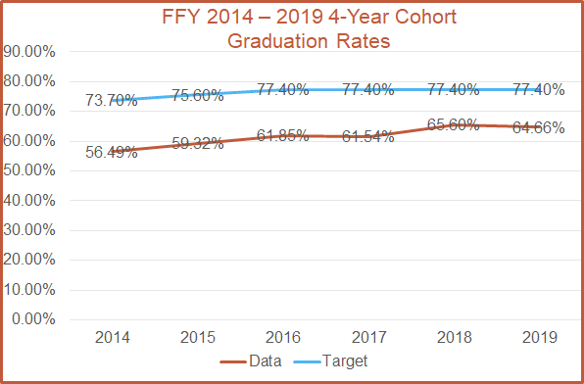
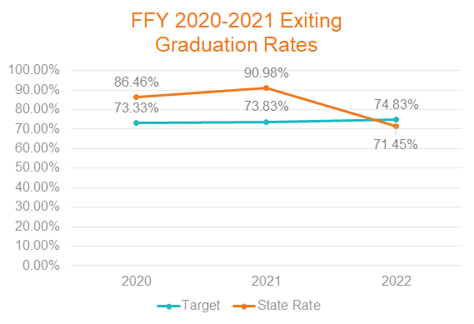
Graduation Rates (Indicator 1)
Youth with IEPs (ages 14-21) that graduated with a regular high school diploma

Slide 15
Information for Dropout - Indicator 2
Percent of youth with IEPs who exited special education due to dropping out. (20 U.S.C. 1416 (a)(3)(A))
OSEP did not make changes to Indicator 2 measurements
Lag year data used
Same data points used as in Indicator 1
Calculation:
All youth with IEPs who left high school (ages 14-21)
(a) graduated with a regular high school diploma + (d) reached maximum age + (e) dropped out

Slide 16
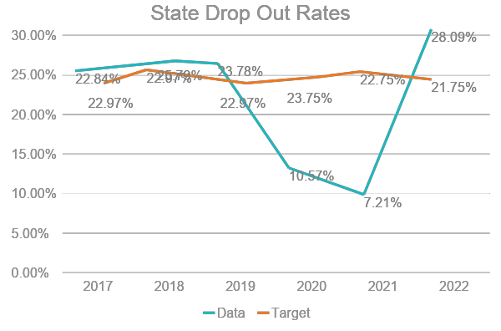
Dropout Rates (Indicator 2)
Number of youth with IEPs (ages 14-21) who exited special education due to dropping out.

Slide 17
Indicator Targets 1, 2
Indicator 1:
FFY | 2022 | 2023 | 2024 | 2025
Target >= | 74.83% | 76.33% | 78.33% | 80.83%
Indicator 2:
FFY | 2022 | 2023 | 2024 | 2025
Target >= | 21.75% | 20.75% | 19.75% | 18.75%

Slide 18
SPP/APR Indicator 14 – Post-School Outcomes
Percent of youth who are no longer in secondary school, had IEPs in effect at the
time they left school, and were: (20 U.S.C. 1416(a)(3)(B))
A. Enrolled in higher education within one year of leaving high school.
B. Enrolled in higher education or competitively employed within one year of leaving high
school.
C. Enrolled in higher education or in some other postsecondary education or training program;
or competitively employed or in some other employment within one year of leaving high
school.
Data Collected through a survey.
New OSEP requirements:
Non-response bias
Representativeness by race/ethnicity
A new component for representativeness by the State’s choosing

Slide 19
Post School Outcomes (Indicator 14)
Enrolled in higher education or some other postsecondary education or training program; or competitively employed or in some other employment
Enrolled in higher education.
Enrolled in higher education or competitively employed.
# of youth who are no longer in secondary school, had IEPs in effect at the time they left school and were enrolled in higher education within one year of leaving high school
# of respondent youth who are no longer in secondary school and had IEPs in effect at the time they left school
# of youth who are no longer in secondary school, had IEPs in effect at the time they left school and were enrolled in higher education or competitively employed within one year of leaving high school
# of respondent youth who are no longer in secondary school and had IEPs in effect at the time they left school
# of youth who are no longer in secondary school, had IEPs in effect at the time they left school and were enrolled in higher education, or in some other postsecondary education or training program; or competitively employed or in some other employment
# of respondent youth who are no longer in secondary school and had IEPs in effect at the time they left school

Slide 20
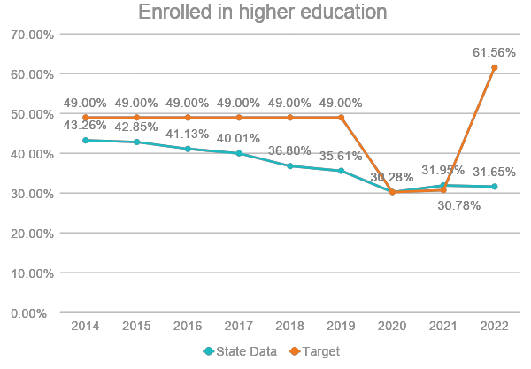
Post School Outcomes (Indicator 14A)
Re-established targets in 2020.

Slide 21
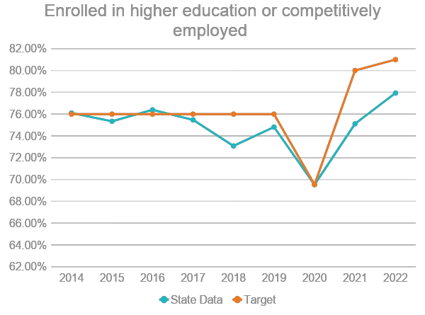
Post School Outcomes (Indicator 14B)

Slide 22
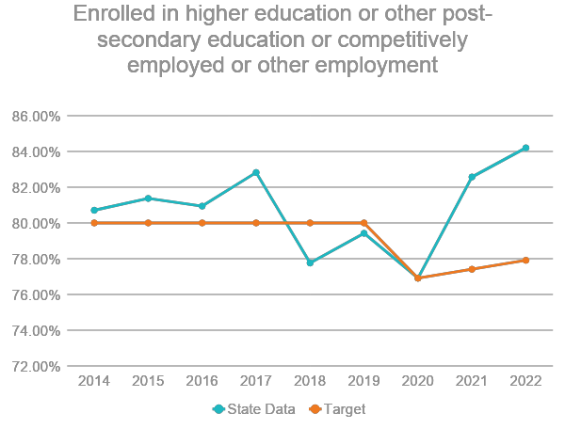
Post School Outcomes (Indicator 14C)

Slide 23
Indicator Targets 14
FFY | 2022 | 2023 | 2024 | 2025
Target A>= | 61.56% | 62.56% | 63.06% | 65.06%
Target B>= | 81.00% | 82.50% | 84.50% | 87.00%
Target C>= | 77.91% | 78.91% | 80.41% | 82.41%

Slide 24
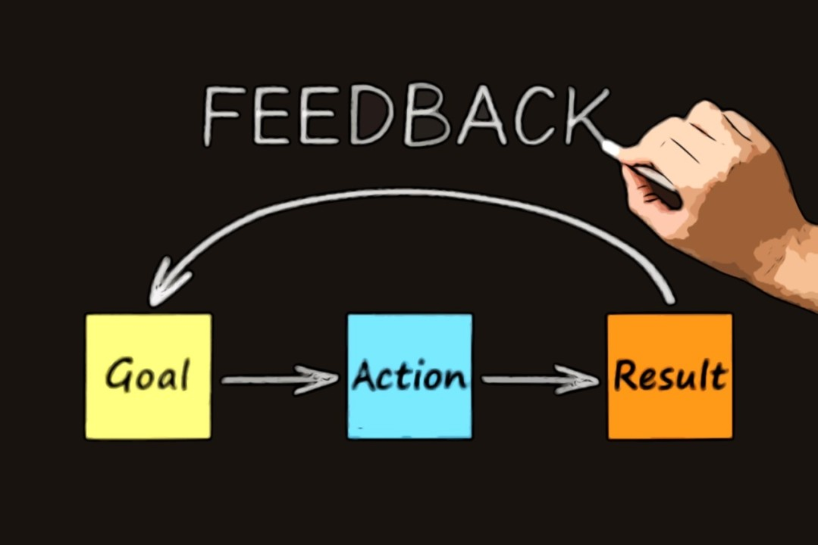
Reflection
Please ask any Questions at this time.
Please use the Chat or Sticky Notes for submissions.
Please take the time to mark notes on the feedback form as well.

Slide 25
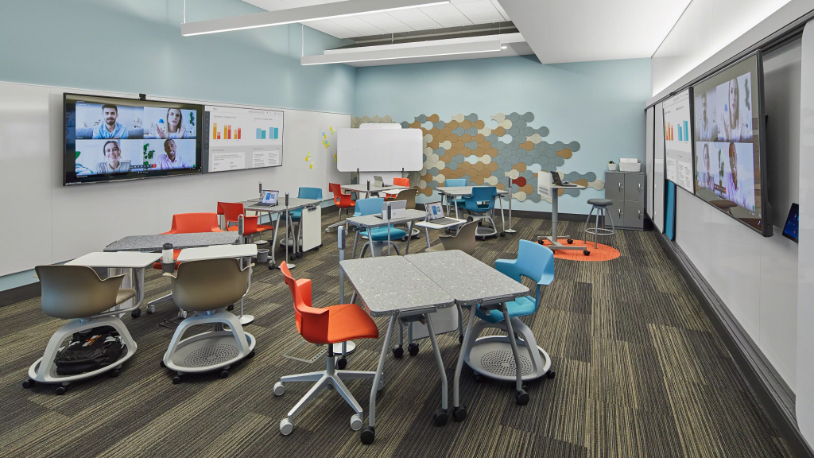
SPP/APR Indicators: 3 – Assessment participation and outcomes 5 – Learning environment

Slide 26
SPP/APR Indicator 3 – Assessment Participation and Outcomes
Participation and performance of children with IEPs on statewide assessments:
A. Participation rate for children with IEPs.
B. Proficiency rate for children with IEPs against grade level academic achievement standards.
C. Proficiency rate for children with IEPs against alternate academic achievement standards.
D. Gap in proficiency rates for children with IEPs and all students against grade level academic achievement standards. (20 U.S.C. 1416 (a)(3)(A))
The State received a waiver from administering statewide assessments in FFY2019 due to the COVID 19 pandemic
For FFY2020, the State received a waiver from meeting the 95% participation rate requirement

Slide 27
Indicator Changes and Additions by OSEP
2019 and Previous Years
2020 - Present
No Indicator 3A
Indicator 3A - Participation Rates in Statewide Assessments
Indicator 3B – Participation Rates in Statewide Assessments
Indicator 3B – Proficiency Rates on Reading and Math Statewide Assessments
Indicator 3C – Outcomes on Reading and Math Statewide Assessments
NEW
Indicator 3C – Proficiency Rates on Reading and Math Alternate Assessments
No Indicator 3D
NEW
Indicator 3D – Gap in Proficiency Rates between Students with IEPs and All Students
All Grades Calculated in One Rate.
NEW
Grades Separated By Grades 4, 8 and High School for each Indicator

Slide 28
Statewide Assessment Participation (Indicator 3A)
Participation rate for children with IEPs.
Reading and Math statewide assessments
OSEP Changes
OSEP requires data be separated by grades 4, 8 and High School
In New Mexico, High School is grade 11 only as approved in the State ESSA plan
High School = Grade 11
3A Formula:
# of children with IEPs participating in an assessment
total # of children with IEPs enrolled during the testing window

Slide 29
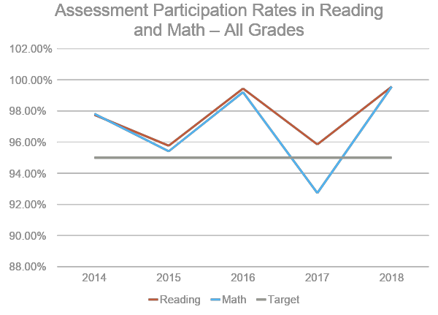
State Assessment Participation Rate (Indicator 3A)

Slide 30
State Assessment Participation Rate (Indicator 3A)
Reading Assessment Participation Rates for Students with Disabilities
Math Assessment Participation Rates for Students with Disabilities
Grade | FFY 2021 Target | FFY 2021 Data | FFY 2022 Target | FFY 2022 Data
Grade 4 | 95.00% | 92.47% | 95.00% | 97.52%
Grade 8 | 95.00% | 89.38% | 95.00% | 94.38%
Grade HS | 95.00% | 75.45% | 95.00% | 87.58%
Grade | FFY 2021 Target | FFY 2021 Data | FFY 2022 Target | FFY 2022 Data
Grade 4 | 95.00% | 92.59% | 95.00% | 97.00%
Grade 8 | 95.00% | 89.16% | 95.00% | 94.62%
Grade HS | 95.00% | 75.48% | 95.00% | 87.55%
Waiver from meeting the 95.00% requirement in 2020.

Slide 31
Statewide Assessment Proficiency Rates (Indicator 3B)
B. Proficiency rate for children with IEPs against grade level academic achievement standards.
Reading and Math statewide assessments
OSEP Changes
OSEP requires data be separated by grades 4, 8 and High School
In New Mexico, High School is grade 11 only as approved in the State ESSA plan
High School = Grade 11
3B Formula:
# of children with IEPs scoring at or above proficient against grade level academic achievement standards
total # of children with IEPs who received a valid score and for whom a proficiency level was assigned for the regular assessment

Slide 32
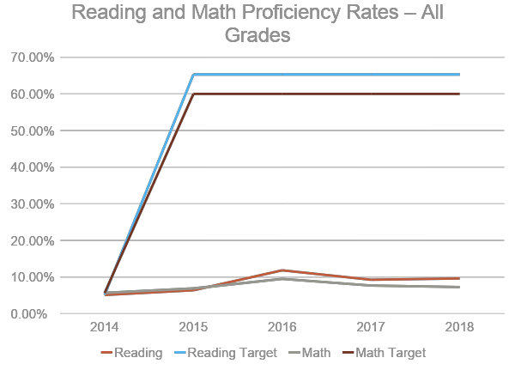
State Assessment Reading Proficiency Rate (Indicator 3B)

Slide 33
State Assessment Proficiency Rate (Indicator 3B)
Reading Assessment Proficiency Rates for Students with Disabilities
Math Assessment Proficiency Rates for Students with Disabilities
Grade | FFY 2021 Target | FFY 2021 Data | FFY 2022 Target | FFY 2022 Data
Grade 4 | 8.41% | 8.41% | 8.86% | 12.49%
Grade 8 | 7.06% | 7.06% | 7.51% | 10.82%
Grade HS | 3.32% | 6.32% | 3.77% | 7.67%
Grade | FFY 2021 Target | FFY 2021 Data | FFY 2022 Target | FFY 2022 Data
Grade 4 | 6.00% | 6.00% | 6.41% | 7.57%
Grade 8 | 2.84% | 2.84% | 3.25% | 3.31%
Grade HS | 1.99% | 1.93% | 2.40% | 2.08%

Slide 34
Statewide Assessment (Indicator 3)
3C Formula:
# of children with IEPs scoring at or above proficient against alternate academic achievement standards
total # of children with IEPs who received a valid score and for whom a proficiency level was assigned for the alternate assessment
C. Proficiency rate for children with IEPs against alternate academic achievement standards.
New indicator in FFY2020

Slide 35
State Assessment Proficiency vs. Alternate Assessment Proficiency (Indicator 3C)
Reading Assessment Proficiency vs. Alternate Assessment Proficiency Rates for Students with Disabilities
Math Assessment Proficiency vs. Alternate Assessment Proficiency Rates for Students with Disabilities
Grade | FFY 2021 Target | FFY 2021 Data | FFY 2022 Target | FFY 2022 Data
Grade 4 | 8.14% | 15.21% | 8.59% | 15.54%
Grade 8 | 8.00% | 25.39% | 8.45% | 24.37%
Grade HS | 36.16% | 32.92% | 36.61% | 32.28%
Grade | FFY 2021 Target | FFY 2021 Data | FFY 2022 Target | FFY 2022 Data
Grade 4 | 13.62% | 40.55% | 14.03% | 36.86%
Grade 8 | 2.33% | 7.42% | 2.74% | 7.30%
Grade HS | 30.04% | 26.34% | 30.45% | 25.98%

Slide 36
Statewide Assessment (Indicator 3)
3D Formula:
Proficiency rate for children with IEPs scoring at or above proficient against grade level academic achievement standards for the 2020-2021 school year - Proficiency rate for all students scoring at or above proficient against grade level academic achievement standards for the 2020-2021 school year
D. Gap in proficiency rates for children with IEPs and all students against grade level academic achievement standards.
New indicator in FFY2020

Slide 37
State Assessment Proficiency Achievement Gap SWDs vs. All Students(Indicator 3D)
Reading Assessment Proficiency Rates for Students with Disabilities vs. All Students
Math Assessment Proficiency Rates for Students with Disabilities vs. All Students
Group Name | FFY 2021 Target | FFY 2021 Data | FFY 2022 Target | FFY 2022 Data
Grade 4 | 39.42 | 27.02 | 38.97 | 28.64
Grade 8 | 31.27 | 26.27 | 30.82 | 28.38
Grade HS | 39.45 | 26.79 | 39.00 | 27.88
Group Name | FFY 2021 Target | FFY 2021 Data | FFY 2022 Target | FFY 2022 Data
Grade 4 | 11.15 | 18.29 | 10.74 | 16.62
Grade 8 | 10.07 | 17.01 | 9.66 | 15.26
Grade HS | 28.86 | 13.81 | 28.45 | 13.31

Slide 38
Indicator Targets 3
Subject | Group | Group Name | 2022 | 2023 | 2024 | 2025
Reading | A <= | Grade 4 | 38.97 | 38.52 | 38.07 | 37.62
Reading | B <= | Grade 8 | 30.82 | 30.37 | 29.92 | 29.47
Reading | C <= | Grade HS | 39.00 | 38.55 | 38.10 | 37.65
Math | A <= | Grade 4 | 10.74 | 10.33 | 9.92 | 9.51
Math | B <= | Grade 8 | 9.66 | 9.25 | 8.84 | 8.43
Math | C <= | Grade HS | 28.45 | 28.04 | 27.63 | 27.22

Slide 39
SPP/APR Indicator 5 – Learning Environments
Percent of children with IEPs aged 5 who are enrolled in kindergarten and aged 6 through 21 served:
A. Inside the regular class 80% or more of the day;
B. Inside the regular class less than 40% of the day; and
C. In separate schools, residential facilities, or homebound/hospital placements.
(20 U.S.C. 1416(a)(3)(A))
OSEP changed the requirement to include students with disabilities in Kindergarten in these categories and indicator calculation.

Slide 40
Learning Environments –Ages 5 to 21 (Indicator 5)
C. In separate schools, residential facilities, or homebound/hospital placements.
B. Inside the regular class less than 40% of the day; and
A. Inside the regular class 80% or more of the day
# of children with IEPs aged 5 who are enrolled in kindergarten and aged 6 through 21 served inside the regular class 80% or more of the day
total # of students aged 5 who are enrolled in kindergarten and aged 6 through 21 with IEPs
# of children with IEPs aged 5 who are enrolled in kindergarten and aged 6 through 21 served inside the regular class less than 40% of the day
total # of students aged 5 who are enrolled in kindergarten and aged 6 through 21 with IEPs
# of children with IEPs aged 5 who are enrolled in kindergarten and aged 6 through 21 served in separate schools, residential facilities, or homebound/hospital placements
total # of students aged 5 who are enrolled in kindergarten and aged 6 through 21 with IEPs

Slide 41
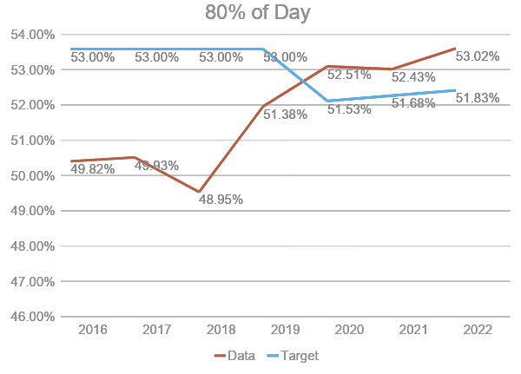
Indicator 5A

Slide 42
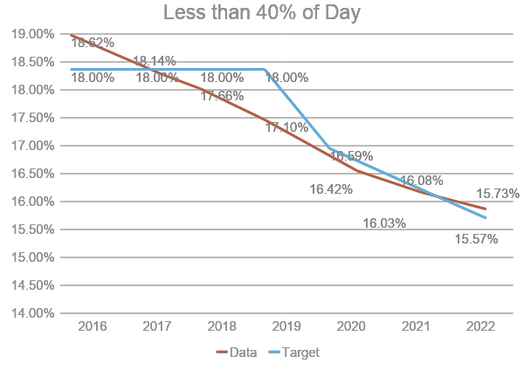
Indicator 5B

Slide 43
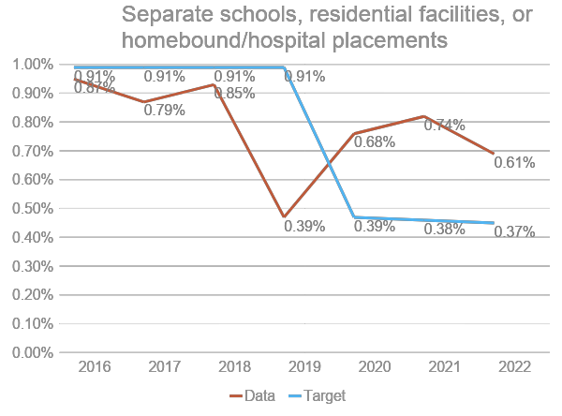
Indicator 5C

Slide 44
Indicator Targets 5
FFY | 2022 | 2023 | 2024 | 2025
Target A >= | 51.83% | 51.98% | 52.13% | 52.28%
Target B <= | 15.57% | 15.06% | 14.55% | 14.04%
Target C <= | 0.37% | 0.36% | 0.35% | 0.34%

Slide 45
Reflection
Please ask any Questions at this time.
Please use the Chat or Sticky Notes for submissions.
Please take the time to mark notes on the feedback form as well.

Slide 46
Intermission
Please enjoy a short break!
We will reconvene in a few minutes.

Slide 47
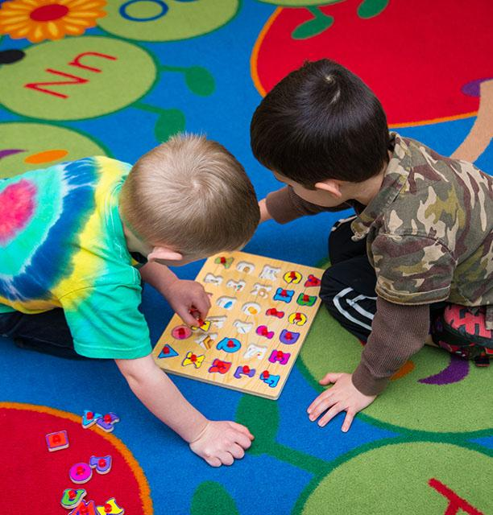
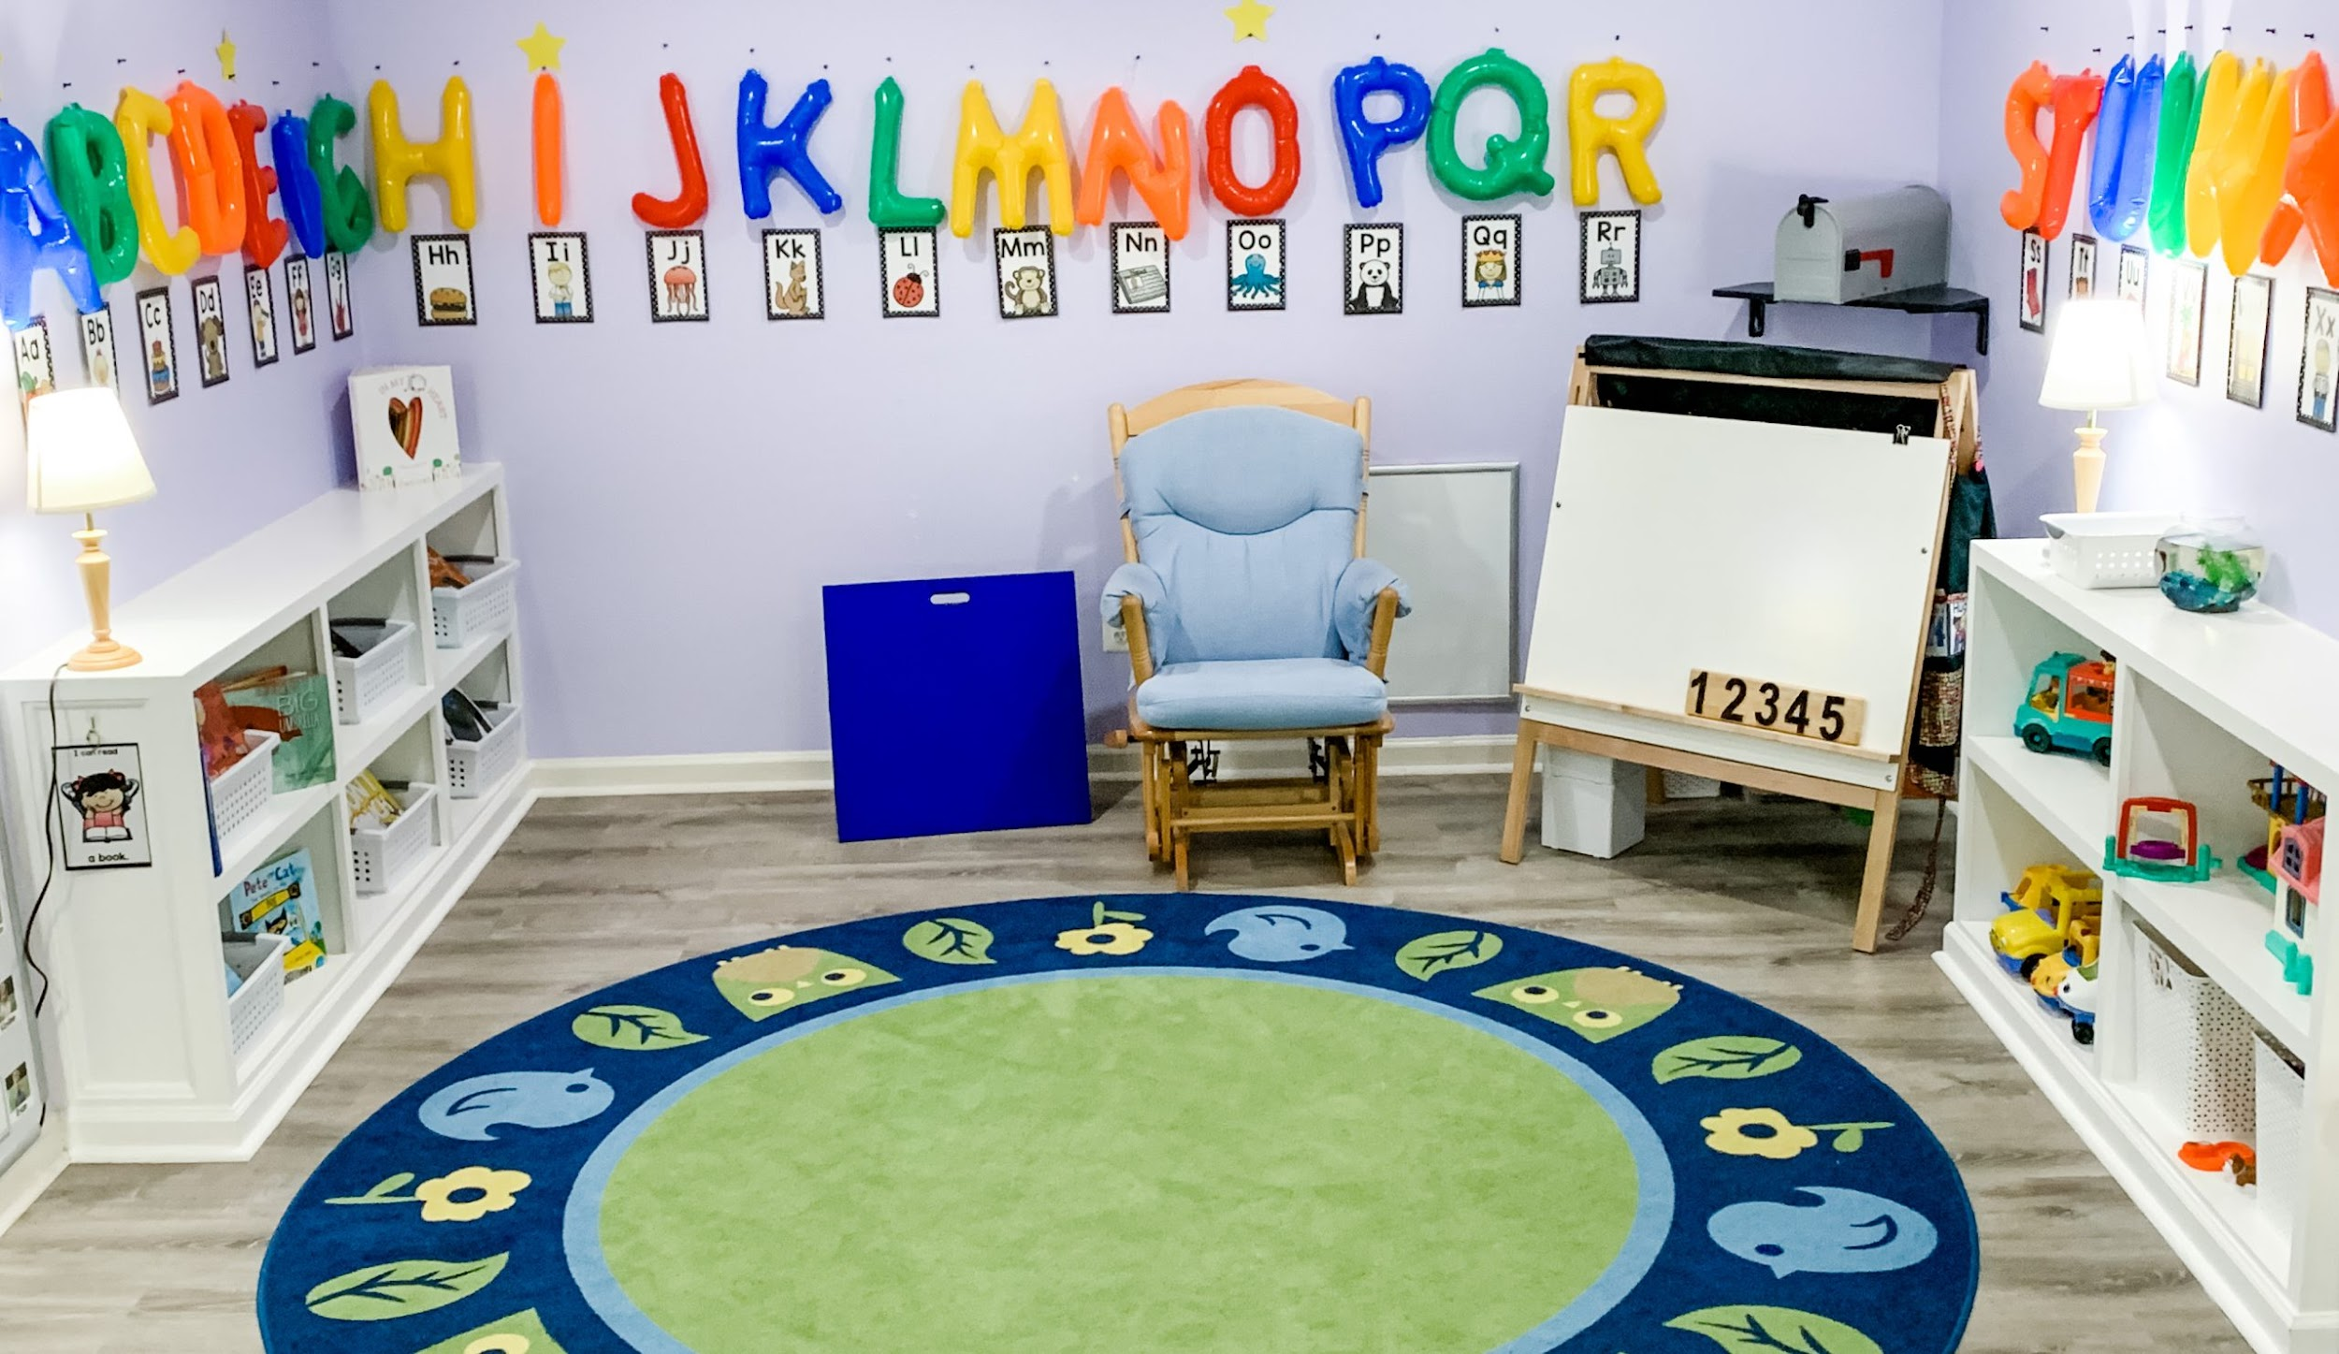
SPP/APR Indicators: 6 – Preschool Learning environment 7- Preschool outcomes

Slide 48
SPP/APR Indicator 6 – Preschool Learning Environments
Percent of children with IEPs aged 3, 4, and aged 5 who are enrolled in a preschool program attending a:
A. Regular early childhood program and receiving the majority of special education and related
services in the regular early childhood program; and
B. Separate special education class, separate school or residential facility.
C. Receiving special education and related services in the home.
(20 U.S.C. 1416(a)(3)(A))
OSEP changed the requirement to exclude students with disabilities in Kindergarten in these categories and indicator calculation.
Indicator 6C is a new indicator added in FFY2020.

Slide 49
Preschool Learning Environments –Ages 3 to 5 (Indicator 6)
A. Regular early childhood program and receiving the majority of special education and related services in the regular early childhood program.
B. Separate special education class, separate school or residential facility.
C. Receiving special education and related services in the home.
# of children ages 3, 4, and 5 with IEPs attending a regular early childhood program and receiving the majority of special education and related services in the regular early childhood program
total # of children ages 3, 4, and 5 with IEPs
# of children ages 3, 4, and 5 with IEPs attending a separate special education class, separate school or residential facility)
total # of children ages 3, 4, and 5 with IEPs
# of children ages 3, 4, and 5 with IEPs receiving special education and related services in the home
total # of children ages 3, 4, and 5 with IEPs

Slide 50
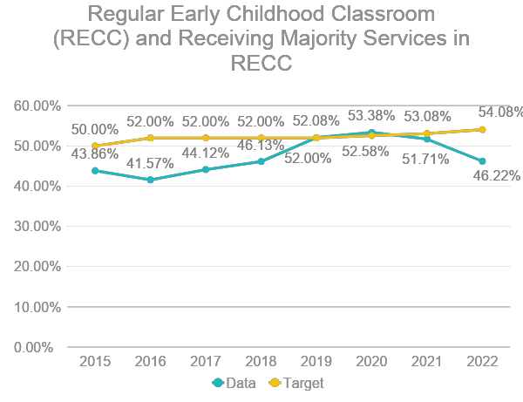
Indicator 6A

Slide 51
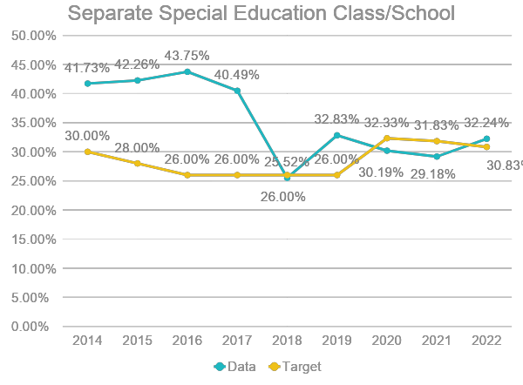
Indicator 6B

Slide 52
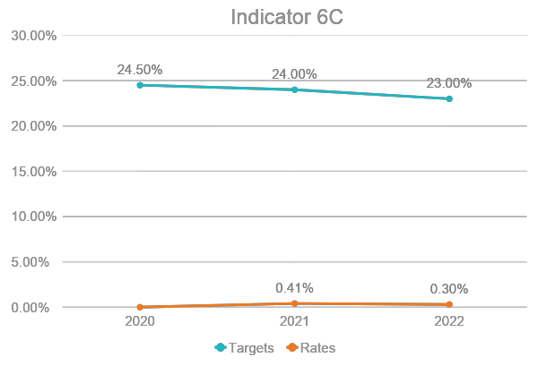
Indicator 6C

Slide 53
Indicator Targets 6
Targets – 6A, 6B:
FFY | 2022 | 2023 | 2024 | 2025
Target A >= | 54.08% | 55.58% | 57.58% | 60.08%
Target B <= | 30.83% | 29.33% | 27.33% | 24.83%
Targets – 6C
FFY | 2022 | 2023 | 2024 | 2025
Target C <= | 23.00% | 21.50% | 19.50% | 17.00%

Slide 54
Preschool Outcomes (Indicator 7)
Percent of preschool children aged 3 through 5 with IEPs who demonstrate improved:
Positive social-emotional skills (including social relationships);
1. Of those children who entered or exited the program below age expectations in Outcome A, the percent who substantially increased their rate of growth by the time they turned 6 years of age or exited the program.
2. The percent of preschool children who were functioning within age expectations in Outcome A by the time they turned 6 years of age or exited the program.
Acquisition and use of knowledge and skills (including early language/ communication and early literacy); and
1. Of those children who entered or exited the program below age expectations in Outcome B, the percent who substantially increased their rate of growth by the time they turned 6 years of age or exited the program.
2. The percent of preschool children who were functioning within age expectations in Outcome B by the time they turned 6 years of age or exited the program.
Use of appropriate behaviors to meet their needs.
1. Of those children who entered or exited the program below age expectations in Outcome C, the percent who substantially increased their rate of growth by the time they turned 6 years of age or exited the program.
2. The percent of preschool children who were functioning within age expectations in Outcome C by the time they turned 6 years of age or exited the program.

Slide 55
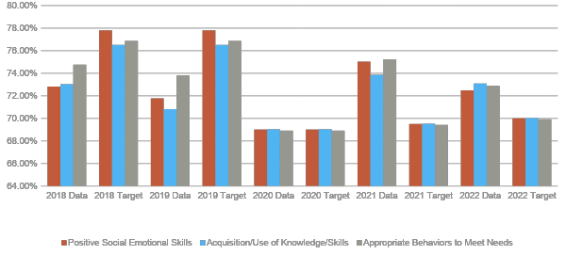
Indicator 7 - A1, B1, C1

Slide 56
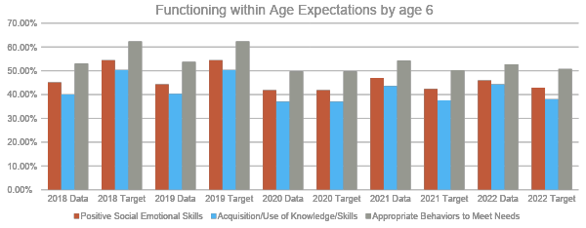
Indicator 7 – A2, B2, C2

Slide 57
Indicator Targets 7
FFY | 2022 | 2023 | 2024 | 2025
Target A1 >= | 70.01% | 71.01% | 72.51% | 74.51%
Target A2 >= | 42.92% | 43.92% | 45.42% | 47.42%
Target B1 >= | 70.03% | 71.03% | 72.53% | 74.53%
Target B2 >= | 38.09% | 39.09% | 40.59% | 42.59%
Target C1 >= | 69.91% | 70.91% | 72.41% | 74.41%
Target C2 >= | 50.76% | 51.76% | 53.26% | 55.26%

Slide 58
Reflection
Please ask any Questions at this time.
Please use the Chat or Sticky Notes for submissions.
Please take the time to mark notes on the feedback form as well.

Slide 59
SPP/APR INDICATOR:
8- PARENT INVOLVEMENT

Slide 60
Parent Involvement (Indicator 8)
Percent of parents with a child receiving special education services who report that schools facilitated parent involvement as a means of improving services and results for children with disabilities. (20 U.S.C. 1416(a)(3)(A))
Data collected via a survey sent to a sample of parents.
Have a 25-question survey but only 1 question counts:
Did schools facilitate parent involvement as a means of improving services and results for children with disabilities?
New OSEP requirements:
Non-response bias
Representativeness by race/ethnicity
A new component for representativeness by a factor of the state’s choosing

Slide 61
Parent Involvement (Indicator 8)
# of respondent parents who report schools facilitated parent involvement as a means of improving services and results for children with disabilities
total # of respondent parents of children with disabilities

Slide 62
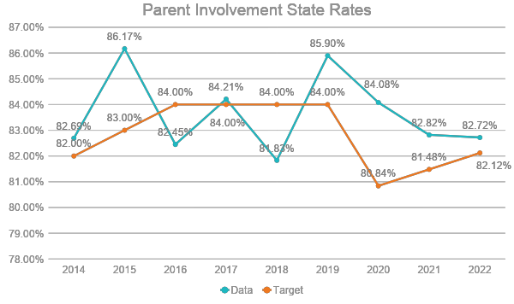
Parent Involvement (Indicator 8)

Slide 63
Indicator Targets 8
FFY | 2022 | 2023 | 2024 | 2025
Target >= | 82.12% | 82.76% | 83.40% | 84.04%

Slide 64
Reflection
Please ask any Questions at this time.
Please use the Chat or Sticky Notes for submissions.
Please take the time to mark notes on the feedback form as well.

Slide 65
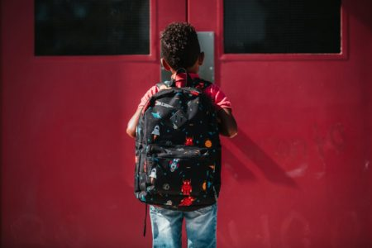
SPP/APR INDICATOR:
4A- SUSPENSIONS AND EXPULSIONS
GREATER THAN 10 DAYSdays

Slide 66
SPP/APR Indicator 4A –Suspensions/ Expulsions greater than 10 days
Rates of suspension and expulsion:
A. Percent of local educational agencies (LEA) that have a significant discrepancy, as defined by the State, in the rate of suspensions and expulsions of greater than 10 days in a school year for children with IEPs; and
(20 U.S.C. 1416(a)(3)(A); 1412(a)(22))
Lag year indicator.
Methodology has changed for FY 2022- FY 2022. Target & Actual were both 12.14%

Slide 67
Suspension/Expulsion Rates (Indicator 4A)
The State defines significant discrepancy in the rates of suspension and expulsions of greater than 10 days in a school year for students with IEPs (disabilities) among LEAs in the State if the following criteria are met: • The LEA must have a “cell” size of greater than 10 with suspensions and expulsions of students with disabilities greater than 10 days in a school year; and • The rate of suspensions/expulsions for students with IEPs is more than 1% higher than state rate of suspensions and expulsions greater than 10 days among LEAs in the State. The rates of suspensions and expulsions of greater than 10 days in a school year for students with IEPs are compared among LEAs in the State. If an LEA had a “cell” size at least 11 students with disabilities who were suspended or expelled greater than 10 days and a long-term suspension and expulsion rate for students with IEPs that was more than 1% higher than the State’s rate of 0.0074%, the LEA was considered to have significant discrepancy in the rates of suspensions and expulsions.
Formula:
# of LEAs that meet the State-established n and/or cell size (if applicable) that have a significant discrepancy, as defined by the State, in the rates of suspensions and expulsions for more than 10 days during the school year of children with IEPs
# of LEAs in the State that meet the State-established n and/or cell size (if applicable)

Slide 68
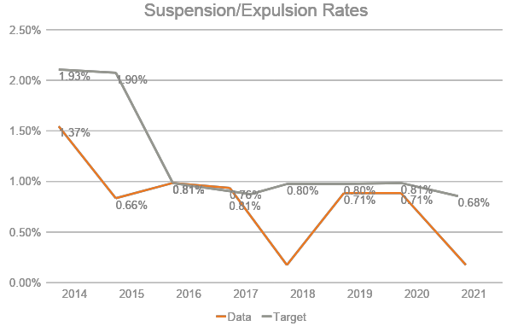
Suspension/Expulsion Rates (Indicator 4A)

Slide 69
Indicator Targets 4a
FFY | 2022 | 2023 | 2024 | 2025
Target >= | 12.14% | 12.10% | 12.05% | 12.00%

Slide 70
Reflection
Please ask any Questions at this time.
Please use the Chat or Sticky Notes for submissions.
Please take the time to mark notes on the feedback form as well.

Slide 71
SPP/APR Indicators: 15 – RESOLUTION SESSIONS 16 - MEDIATIONS

Slide 72
Resolution Sessions (Indicator 15)
Percent of hearing requests that went to resolution sessions that were resolved through resolution session settlement agreements
Targets are set in a range:
Low: 55.0% - High: 70.0%
Resolution agreements related to due process complaints + resolution agreements not related to due process complaints
Resolutions held

Slide 73
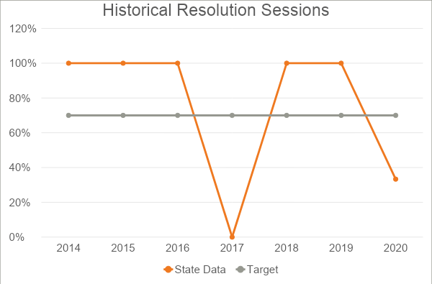
Resolution Sessions (Indicator 15)
The State is not required to establish baseline or targets if the number of resolution sessions is less than 10.

Slide 74
Mediation Sessions (Indicator 16)
Number mediation sessions resolved through settlement agreements
Number of mediation sessions
Percent of mediations held that resulted in mediation agreements.
Targets are set in a range:
Low - High
New Targets set for FFY 2020-FFY 2025:
Low: 70.0% - High: 80.0%

Slide 75
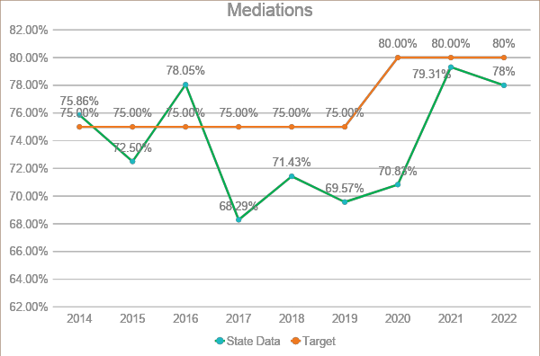
Mediations (Indicator 16)
The State is not required to establish baseline or targets if the number of resolution sessions is less than 10.

Slide 76
Indicator Targets 15, 16
FFY | 2022 (low) | 2022 (high) | 2023 (low) | 2023 (high) | 2024 (low) | 2024 (high) | 2025 (low) | 2025 (high)
Target >= | 55.00% | 70.00% | 55.00% | 70.00% | 55.00% | 70.00% | 55.00% | 70.00%
Indicator 15
FFY | Current Relationship | 2022 | 2023 | 2024 | 2025
Target | Data must be greater than or equal to the target | 17.00% | 17.60% | 18.60% | 20.10%
Indicator 16

Slide 77
Reflection
Please ask any Questions at this time.
Please use the Chat or Sticky Notes for submissions.
Please take the time to mark notes on the feedback form as well.

Slide 78
Final Reflections
Please take 10-15 Minutes to fill out any additional sections of the feedback form.
Please Sign and Date your Forms.
If you want to submit virtually, you can do so here: https://forms.gle/zQRDcrXGDQ2mrhfu8
Thank You for Joining us Today!

Slide 79
Next Meeting

