Slide 1
Excess Cost Base Submission Overview
Office of Special Education
Investing for tomorrow, delivering today.
Notes:
To change the image on this slide, select the picture and delete it. Then click the Pictures icon in the placeholder to insert your own image.

Slide 2
Agenda
Excess Cost Definition
Relation to MOE and connection to Supplanting
Excess Cost Submission Types
The Excess Cost Submission Process in SharePoint

Slide 3
Excess Cost Definition
Definition of Excess Cost
Excess Cost refers to the additional costs incurred by Local Educational Agencies (LEAs) for providing special education and related services to children with disabilities, over and above the average annual per-student expenditure from all sources (local, state, and federal) on general education students.
Essentially, it represents the extra amount LEAs need to spend to ensure that children with disabilities receive the appropriate education and services they are entitled to under IDEA (Individuals with Disabilities Education Act).
The purpose of calculating excess costs is to ensure that federal IDEA Part B funds are used specifically for these additional expenses, rather than replacing existing funding sources.

Slide 4
Excess Costs vs. MOE
MOE ensures consistent financial support: The MOE requirements prevent LEAs and states from reducing their own spending on special education from year to year, thus maintaining a steady level of financial effort.
Excess Cost Calculation ensures IDEA funds cover additional costs: Before IDEA Part B funds can be used, LEAs must demonstrate they have spent a minimum average amount from local/state funds on general education costs for students with disabilities.
Prevents Supplanting: Together, MOE and excess cost calculations help ensure that IDEA Part B funds are used as intended—to provide additional support for special education rather than replacing existing funding sources.
These processes work together to ensure that special education funding is maintained and appropriately augmented with federal funds, thereby preventing the improper use of federal funds to replace local and state investments in special education.

Slide 5
Connection to Supplanting
Supplanting refers to using federal funds to replace (supplant) state, local, or other federal funds, which is generally prohibited under IDEA:
Supplanting Rule: IDEA Part B funds must be used to supplement and increase the level of funding for special education and related services, not replace existing funding sources. This means federal funds should add to the current funding levels rather than displace them.

Slide 6
Excess Cost Submissions
The New Mexico Public Education Office of Special Education will collect excess cost submissions twice each year:
Base Submission
Collected in the Spring
Compliance Submission
Collected in the Fall

Slide 7
Excess Cost Types
Excess Cost Base Submission (Spring):
These figures are based on budgeted amounts.
May include projections derived from historical data.
The United States Department of Education requires each LEA to submit figures separated between elementary and secondary education levels.
This calculation is to establish eligibility for IDEA B funds by assuring LEAs have estimate of costs from state and local funds.
Excess Cost Compliance Submission (Fall):
These figures are based on the actual expenditures finalized from the prior fiscal year.
The United States Department of Education requires each LEA to submit figures separated between elementary and secondary education levels.

Slide 8
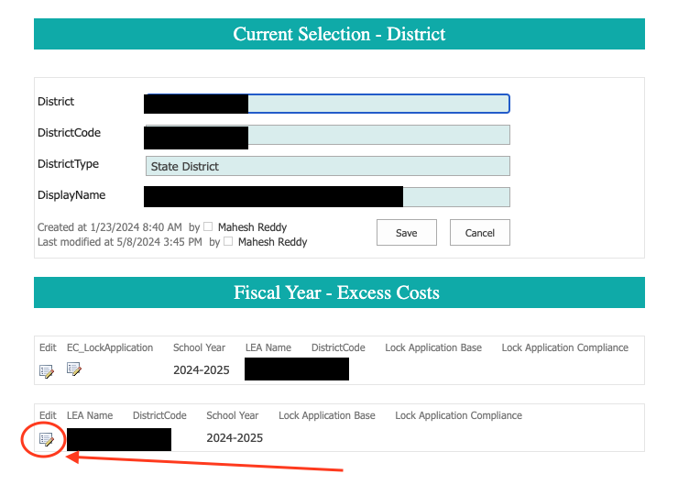
Excess Cost Site Submission
Once logged in to the SharePoint, find your LEA name from the list and click on the Edit button.
Access:
Must have a STARS/Nova login
If you do not have a STARS/NOVA username, please contact LEA NOVA coordinator to gain access.
For access to the Excess Cost site contact:
Mahesh Reddy-Erri
mahesh.reddy@ped.nm.gov

Slide 9
Separating Costs
The United States Department of Education requires the Excess Cost Submission (Base and Compliance) to be submitted separated by Elementary and Secondary grade levels.
Base: Budgets are not submitted by school site. You may use your membership to determine a ratio, and use that ratio to determine budgeted numbers.
Compliance: Actuals are collected by school site, use exact figures based on your submission.

Slide 10
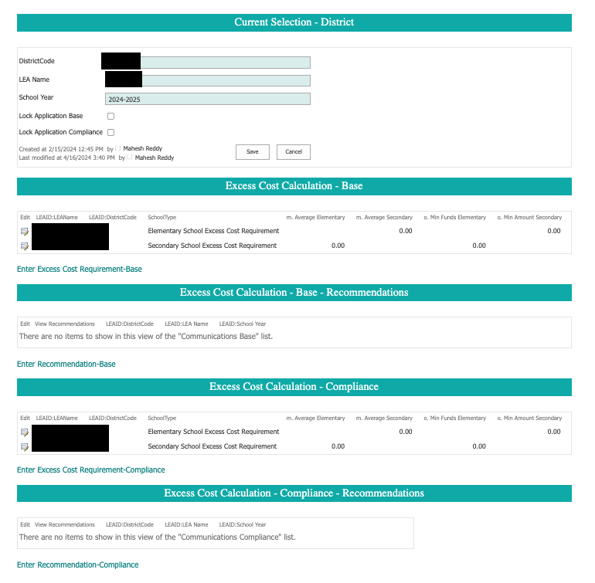
Excess Cost Site Submission
There are two submission fields in the Excess Cost Site, one for Base and one for Compliance.
Base will be collected in the Spring and Compliance will be collected in the Spring.
Base Submission(Spring)
Compliance Submission (Fall)

Slide 11
Sources
[Supplanting](https://sites.ed.gov/idea/regs/b/b/300.164/a)
[MOE](https://www2.ed.gov/policy/speced/guid/idea/idea-edjobs-guidance.pdf)
[Excess Costs Calculation](https://sites.ed.gov/idea/regs/b/appendix-a)

