Slide 1
School Transportation Data
Presentation for …
School Transportation Bureau
Alyssa Marquez, Financial Coordinator
August 1, 2024
Investing for tomorrow, delivering today.

Slide 2
GOALS
Ensure school districts and charter schools can:
Accurately report transportation data;
Understand who/what should be reported;
Understand the difference between category 1 and category 2 students;
Understand what mileages should be reported;
Understand data will affect FY26 allocations.

Slide 3
REPORTING DATES
Regular to-and-from transportation data is submitted on 80th and 120th day
80th – December 1, 2024
120th – February 12, 2025
If your school district or charter school is an approved PED 4-day week; data must be taken the next school day.

Slide 4
REQUIRED DATA
Regular to-and-from transportation
Only report students that are eligible and riding the bus.
All transportation templates must be submitted to include ridership, miles, per capita miles, buses, SPED buses, and the number of school days.

Slide 5
RIDERSHIP DATA
22-8-29 NMSA 1978 – Transportation Distributions; Reports; Payments
A. On the 2nd and 3rd reporting date of each year, each local school board of a school district and governing body of a state-chartered charter school shall report to the state transportation director…
(3) The number of students, including special education students, transported on each reporting date of the current year.
(6) The number of total miles traveled for each school district or state-chartered schools per capita feeder route.

Slide 6
RIDERSHIP DATA
Category 1 students
All regular education students in grades K-12 and 3Y/4Y special education students not requiring an accommodation or special service.
A student counted in category 1 CANNOT be counted in category 2. These students are identified with a program code of “BUS” for regular to-and-from; and “BSCE” for vocational education.

Slide 7
RIDERSHIP DATA
Category 2 students
All students with disabilities in grades K-12 and 3Y/4Y who are receiving transportation services.
A student counted in category 2 CANNOT be counted in category 1. The student must have an IEP requiring an accommodation or special service. These students are identified with a program code of “BUSA”.
Wheelchair
Bus aide
Car seat

Slide 8
MILEAGE DATA
Regular to-and-from school routes
Regular to-and-from school bus routes are those which have been established for the purpose of transporting eligible children to school in the morning and back home in the afternoon at the end of the school day during the regular school day calendar.
These routes transport eligible children from their home or a designated school bus stop (hub). These transportation services must be performed by use of a school bus or per capita feeder agreement.

Slide 9
MILEAGE DATA
School districts and charter schools must report:
Essential deadhead mileage;
Live route mileage;
Vocational mileage;
Per capita feeder mileage.
School districts and charter schools cannot report:
Non-essential deadhead mileage.

Slide 10
MILEAGE DATA
Essential deadhead mileage (reportable)
Mileage from the bus lot to the first stop in the morning and miles back to the bus lot or storage location after the last stop after school.

Slide 11
MILEAGE DATA
SCHOOL
NON-ESSENTIAL
DEADHEAD MILEAGE
LIVE ROUTE
MILEAGE
FIRST/
LAST
STOP
ESSENTIAL DEADHEAD
MILEAGE
BUS LOT/
STORAGE
NON-ESSENTIAL
DEADHEAD MILEAGE
LIVE ROUTE
MILEAGE
SCHOOL

Slide 12
MILEAGE DATA
Live route mileage (reportable)
Mileage from the point where the first child boards the bus to the school where the last child gets off; and from the school where the first child boards the bus to the point where the last child gets off.

Slide 13
MILEAGE DATA
Vocational mileage (reportable)
Vocational mileage will be reported the same as the regular school bus route, on the daily live mileage. Mileage from the point where the first child boards the bus to school where the last child gets off; and from the school where the first child boards the bus to the point where the last child gets off.

Slide 14
MILEAGE DATA
SCHOOL
NON-ESSENTIAL
DEADHEAD MILEAGE
LIVE ROUTE
MILEAGE
FIRST/
LAST
STOP
ESSENTIAL DEADHEAD
MILEAGE
BUS LOT/
STORAGE
NON-ESSENTIAL
DEADHEAD MILEAGE
LIVE ROUTE
MILEAGE
SCHOOL

Slide 15
MILEAGE DATA
Per capita feeder mileage (reportable)
To provide a per capita reimbursement to a parent or guardian in cases where regular school bus transportation is impractical because of distance, road conditions, or sparseness of population.

Slide 16
MILEAGE DATA
Non-essential deadhead mileage (non-reportable)
Total mileage does not include mileage from the last morning school stop back to the bus lot or daytime storage location back to the mid-day or afternoon school.

Slide 17
MILEAGE DATA
SCHOOL
NON-ESSENTIAL
DEADHEAD MILEAGE
LIVE ROUTE
MILEAGE
FIRST/
LAST
STOP
ESSENTIAL DEADHEAD
MILEAGE
BUS LOT/
STORAGE
NON-ESSENTIAL
DEADHEAD MILEAGE
LIVE ROUTE
MILEAGE
SCHOOL

Slide 18
BUS DATA
All buses in fleet must be entered into Nova; including activity buses and spares.
Only regular to-and-from buses used on the specific reporting day shall be marked “YES” if in use; “NO” if not in use.
No mileage should be reported for buses not in use.
Activity buses should not be marked as in use if activities land on a reporting day.

Slide 19
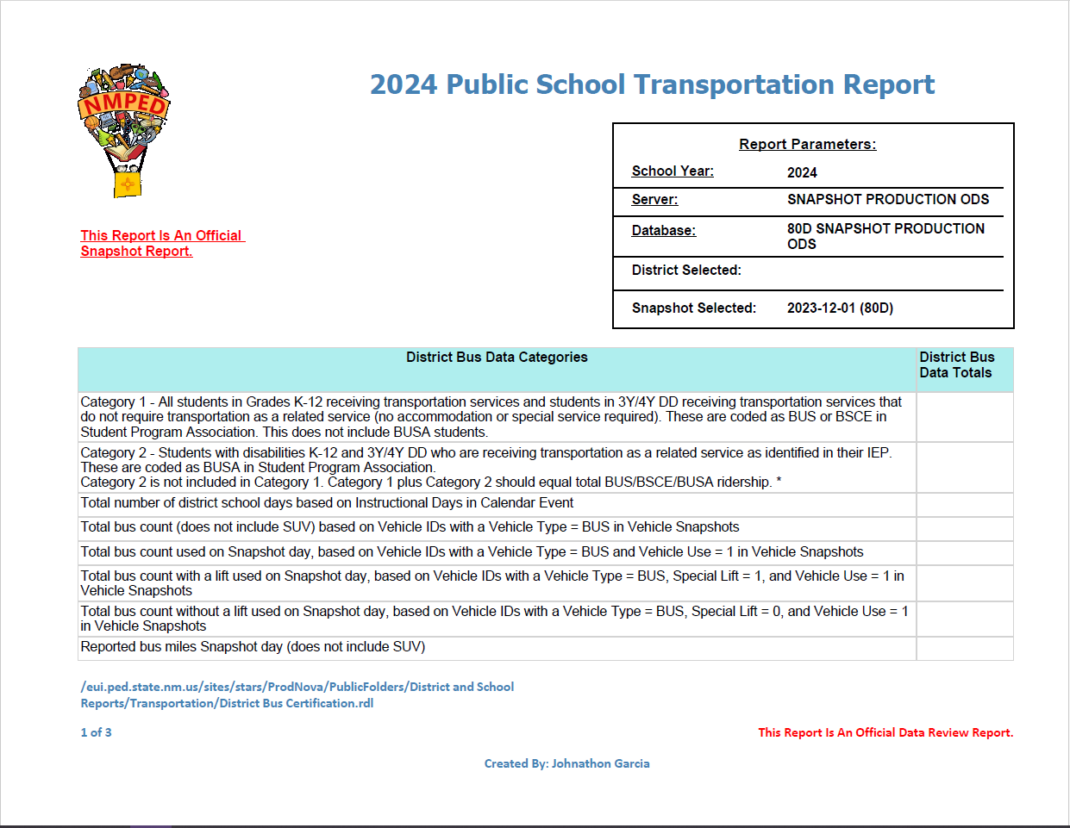
CERTIFICATION FORM
STB will not finalize the data review until the certification form has been submitted.
Certification form must be signed by the superintendent of the school district or the head administrator of the charter school.
Certification will be returned for failure to provide the applicable signature.
Submit the Snapshot Production ODS, not the Live Production ODS.

Slide 20
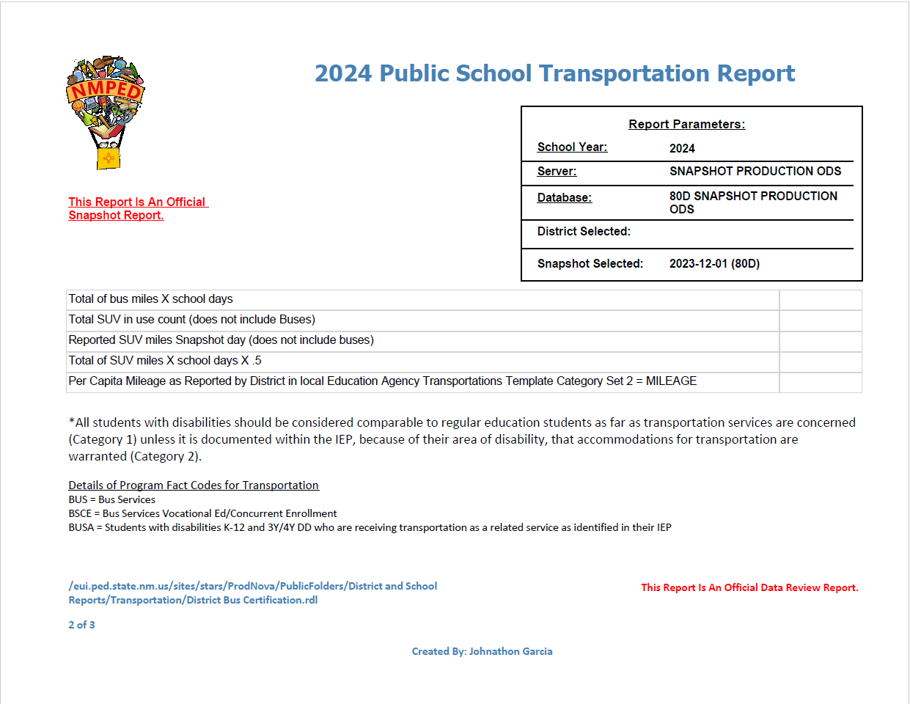
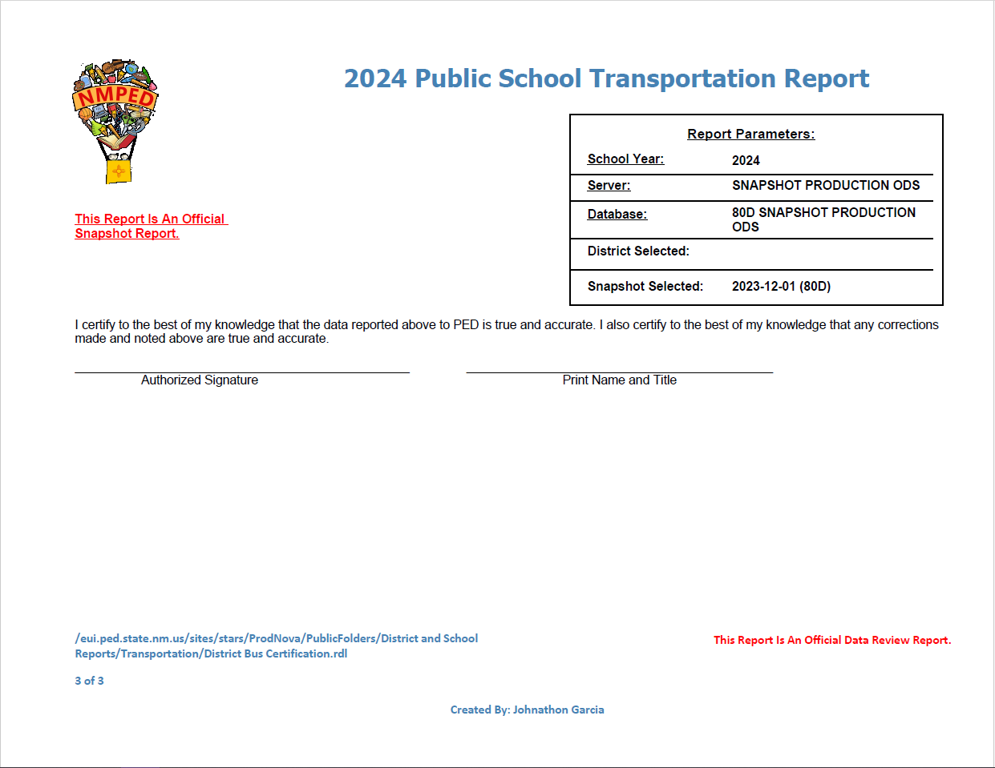
CERTIFICATION FORM

Slide 21
WHY DO I NEED TO REPORT?
All data submitted in the current year is utilized to determine next years allocations.
Inaccurate data submitted WILL affect your future allocation.

Slide 22
SUMMARY
Understand who/what is to be reported for all reporting dates;
On 80th and 120th day, only those who ride on the reporting dates are reported;
Understand what miles should be reported;
Review data before submitting certification form;
Sign and submit certification form to School Transportation Bureau via email.

Slide 23
CONTACT INFORMATION
Amanda Lupardus-Hernandez, Director
amanda.lupardus@ped.nm.gov or 505-677-6692
Alyssa Marquez, Financial Coordinator
alyssa.marquez@ped.nm.gov or 505-629-5821

Slide 24
QUESTIONS

