Slide 1
Nova Reporting for Special Education
40 Day Training
Office of Special Education
Charlene Marcotte, Deputy Director, Data & Finance
Lorenzo Dominguez, Asst. Deputy Director, Data & Finance
Tammy Burkett, Data Analyst
Liz Schweiger, Data Analyst
Matt Tomicek, Data Analyst
September 18th, 2024
Investing for tomorrow, delivering today.

Slide 2
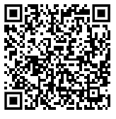
Housekeeping
Office Hours slides can be accessed:
From the Office of Special Education website, on the Resources page under Office Hours.
https://webnew.ped.state.nm.us/bureaus/special-education/resources/
“Make a copy” if you want to take notes on the presentation.
Use the QR code or click here, to write down your questions.
Make sure you are on mute so all can hear today’s presentation.

Slide 3
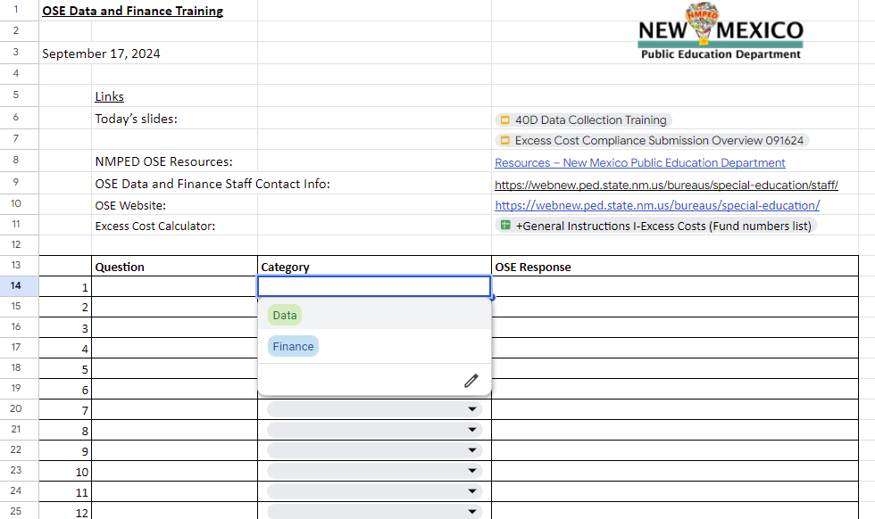
Q & A

Slide 4
Agenda
Overview of Special Education Data
Overview of Nova reports Reviewed for Validation
Data Reporting Expectations
What is collected, why it’s collected, and how to read your LEA’s data
The DTS and Necessary Validation Forms
Updates on Graduation Reporting
Data Collection Changes
Other Information

Slide 5
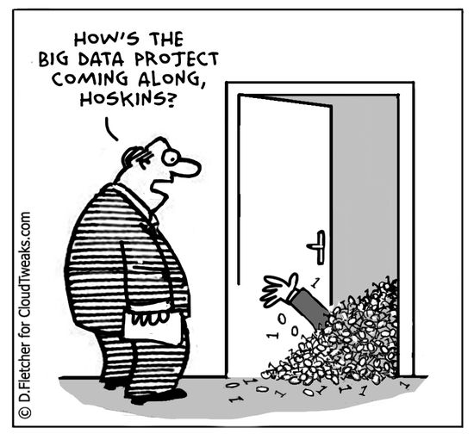
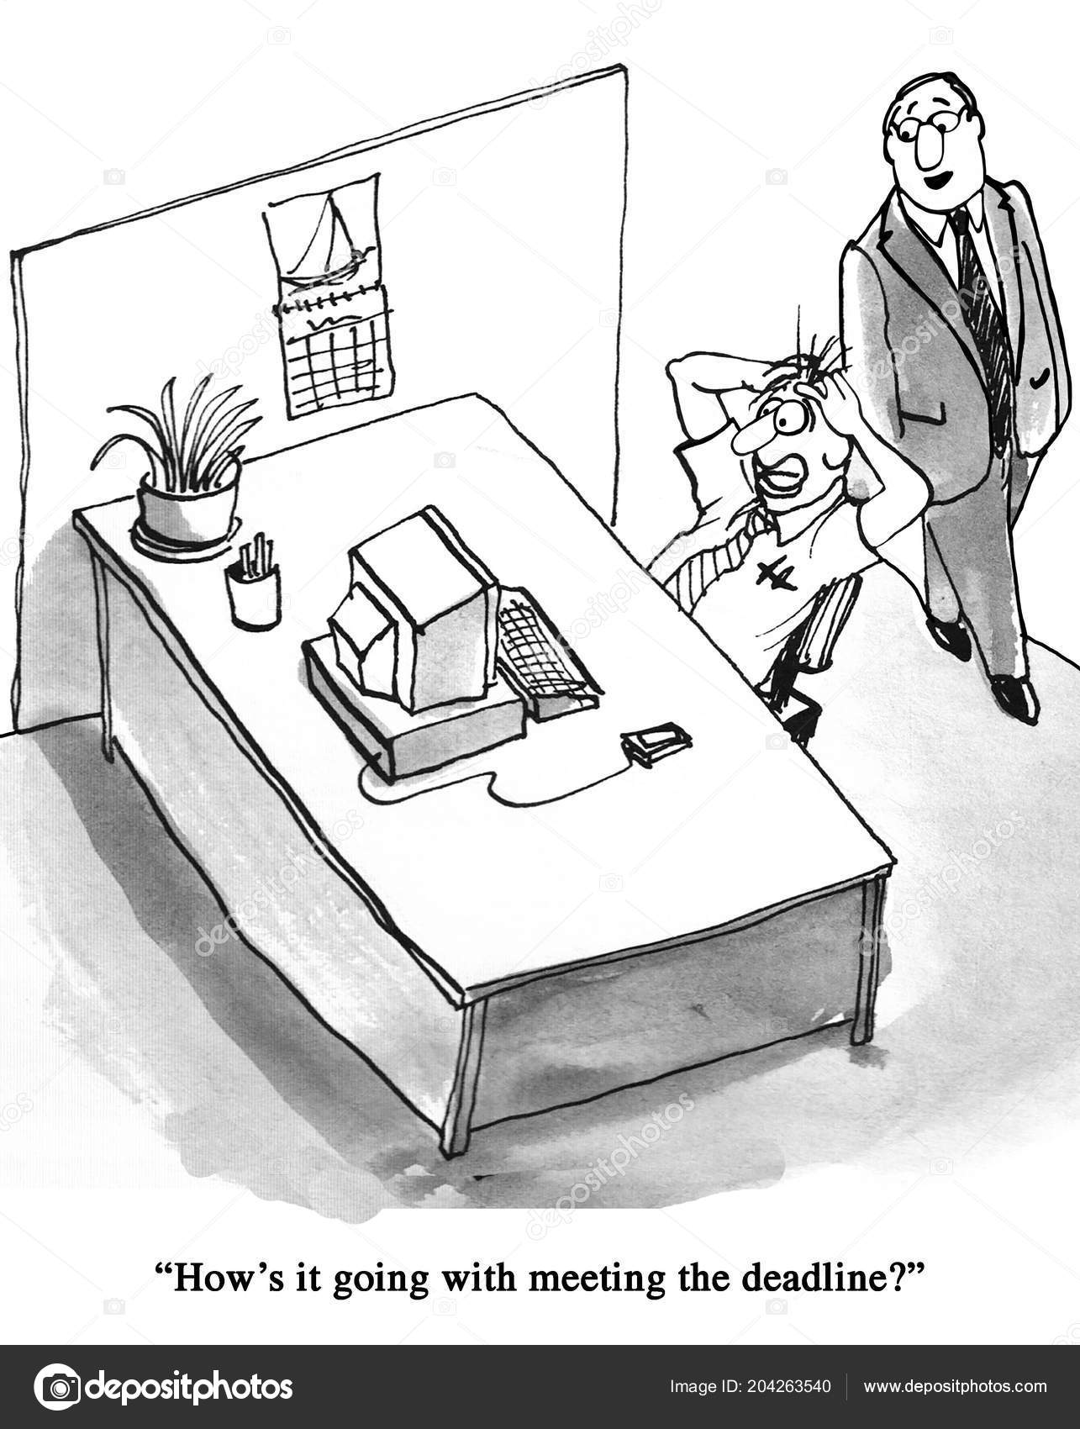
Special Education Data Review

Slide 6
Special Education Data Review
What is the Special Education Quality Data Review?
The Office of Special Education (OSE) reviews all Special Education Data submissions to ensure that all data reported is as complete and accurate as possible.
Why do we need this data?
OSE is required to report all data to the US Department of Education’s Office of Special Education Programs (OSEP). In addition, OSE uses the data to review compliance indicators and district performance to identify LEAs that need program support.
What does this mean for my LEA?
LEAs must report on the current enrollment and status of all students in Special Education, as well as a number of Special Education-related events that happened throughout the school year.

Slide 7
Special Education Data Review
What is quality data?
Quality data is data that is as accurate, valid, complete, and consistent.
When is Special Education data collected?
Data collected on 40D, 80D, 120D and EOY.
EOY
LEAs have 10 days from the last day of school to submit accurate and complete data.
OSE has 10 days from the submission of accurate and complete data to review the data.

Slide 8
LEA Responsibilities
LEAs must:
Review their data for accuracy and completion BEFORE:
The Office of Special Education (OSE) reviews the data.
Errors in LEA data must be corrected BEFORE OSE begins data reviews.
Signing and uploading the Data Validation and Certification form and uploading to the Document Transfer Station (DTS).
DTS link: https://eui.ped.state.nm.us/sites/stars/DocTransferStation/SitePages/DocumentTransfer.aspx
Upload the completed and accurate form to the DTS before OSE reviews the data.
Contact their data reviewer immediately if they have questions about data validation.

Slide 9
Q & A
Take a moment to enter your questions on the general information discussed so far.
Use the QR code or click here, to write down your questions.

Slide 10
Profile Report
This report provides a summary of many important data points that help ensure LEAs are providing students with disabilities a Free and Appropriate Public Education (FAPE).
Data this report provides:
Child count
Ancillary Full Time Equivalency (FTE)
Setting data
Alternate Assessment participants
Link to Profile Report in Nova:
https://eui.ped.state.nm.us/sites/stars/ProdNova/_layouts/15/ReportServer/RSViewerPage.aspx?rv:RelativeReportUrl=/sites/stars/ProdNova/PublicFolders/District%20and%20School%20Reports/Special%20Education/SPED%20-%20Profile.rdl

Slide 11
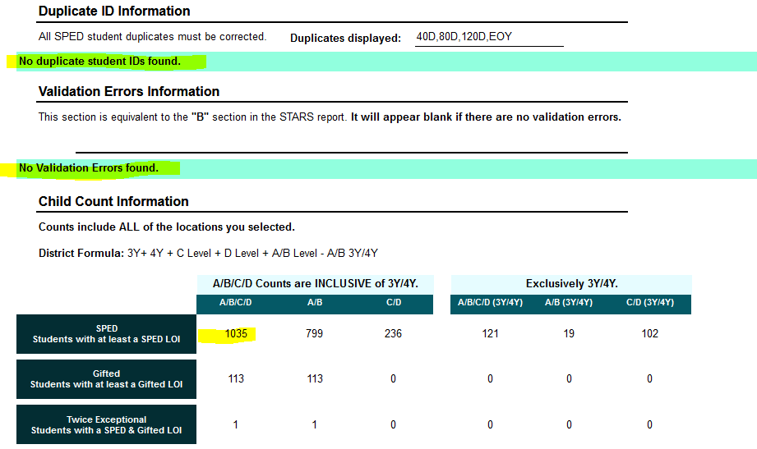
Profile Report (cont.)
Validation requirements:
Ensure Child Count Number matches:
SIS/internal records.
Across all sections in the Profile report which have a total child count.
All Validation Errors need to be corrected.

Slide 12
Profile Report (cont.)
Validation requirements:
Verify Alternate Assessment participant information is correct.
Late IEPs and Triennial Evals require justification letters include the date IEP/Evals will be reviewed, upload to the DTS if they are actually late (if they are errors, the need to be corrected).

Slide 13
Profile Report (cont.)
Verify Indicator 5 and 6 data to ensure the appropriate setting by age is being used.
Verify Indicator 9 and 10 data to ensure all data is correct by race/ethnicity and disability category.

Slide 14
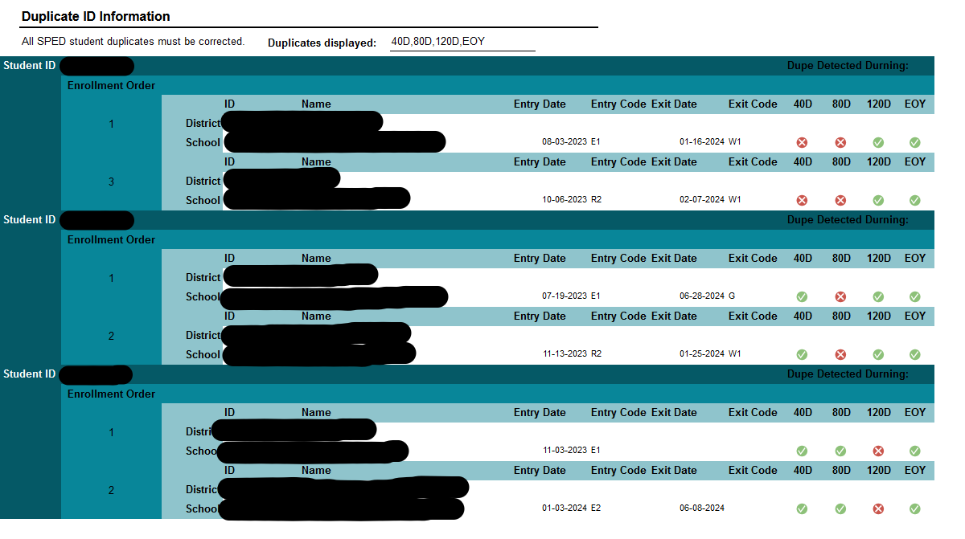
Profile Report Errors
Validation requirements:
Duplicate Student IDs must be corrected each reporting period.
OSE is concerned with duplication between LEAs

Slide 15
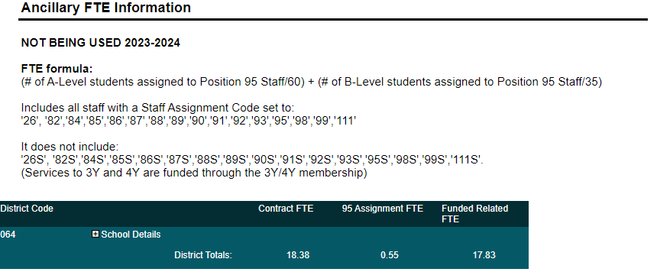
Profile Report Errors, Cont.
Validation requirements:
Verify Ancillary FTE for accuracy.

Slide 16
Teacher/SLP Caseload Report
NMAC 6.29.1.9 requires that service providers carry a caseload within a ratio to ensure students are receiving FAPE. Teachers whose FTE exceed the ratio are required to submit a waiver.
Caseloads: the number of students with disabilities whom the teacher is responsible for supporting, including creating and implementing individualized education plans (IEPs)
FTE: Full Time Equivalent
Why is this data important?
This ratio helps ensure that students with disabilities have the resources necessary to be successful in their education.
Routinely exceeding the ratio leads the question, “Is a student receiving FAPE?”
Link to Teacher/SLP Caseload Report in Nova:
https://eui.ped.state.nm.us/sites/stars/ProdNova/_layouts/15/ReportServer/RSViewerPage.aspx?rv:RelativeReportUrl=/sites/stars/ProdNova/PublicFolders/District%20and%20School%20Reports/Special%20Education/SPED%20-%20Teacher%20and%20SLP%20Caseload%20Report.rdl

Slide 17
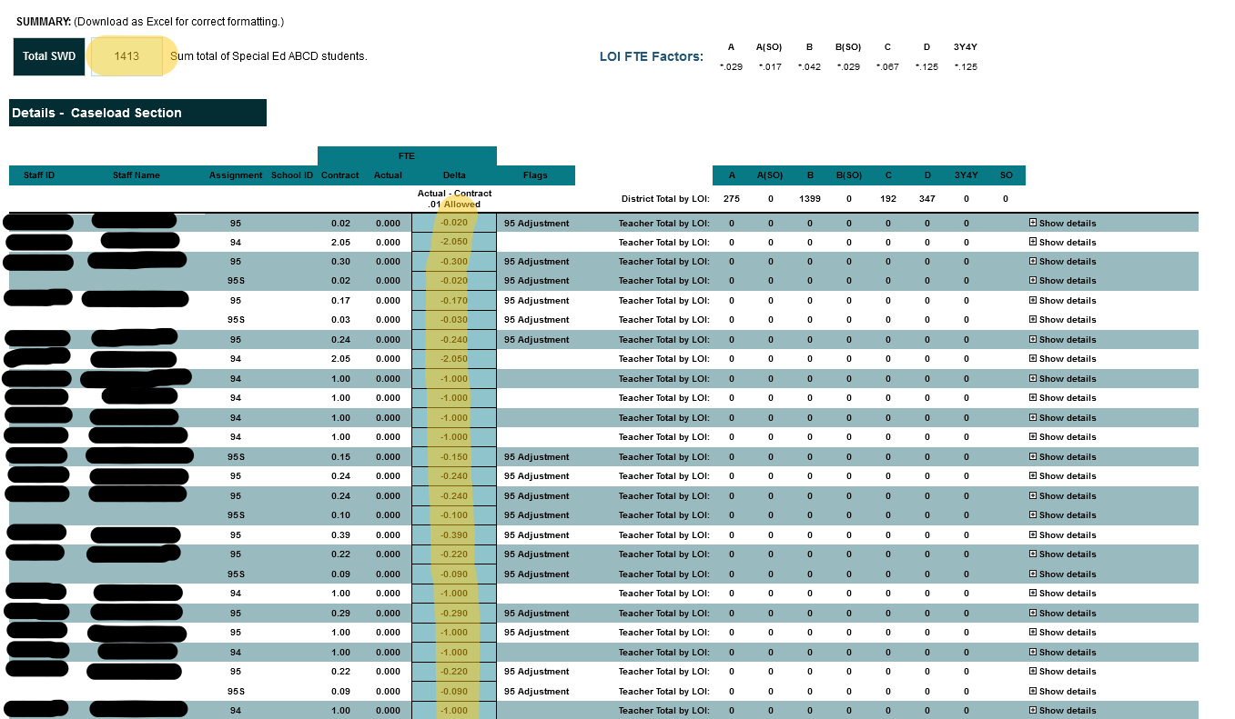
Teacher/SLP Caseload Report
Validation requirements:
Ensure the “Total SWD” number matches the Profile Child Count.
If Child Counts do not match other reports, must find and correct the discrepancy to ensure all child counts in each report match.
If any of the highlighted cells are orange, a Caseload Waiver is required.
Correct any noted errors.

Slide 18
Indicator 7 Report - Preschool Outcomes
Indicator 7 report informs on progress special education preschoolers are making. Progress is measured twice each year in 3 areas: behavior, language acquisition, and social-emotional development.
Why is this data important?
A student’s progress, or lack of progress, will help educators and families identify strengths and areas of need.
Without data, you’re just another person with an opinion.
~W. Edwards Deming
Link to Indicator 7 Report in Nova:
https://eui.ped.state.nm.us/sites/stars/ProdNova/_layouts/15/ReportServer/RSViewerPage.aspx?rv:RelativeReportUrl=/sites/stars/ProdNova/PublicFolders/District%20and%20School%20Reports/Special%20Education/SPED%20-%20SPP%20Indicator%2007%20Preschool%20Outcomes%20Report.rdl

Slide 19
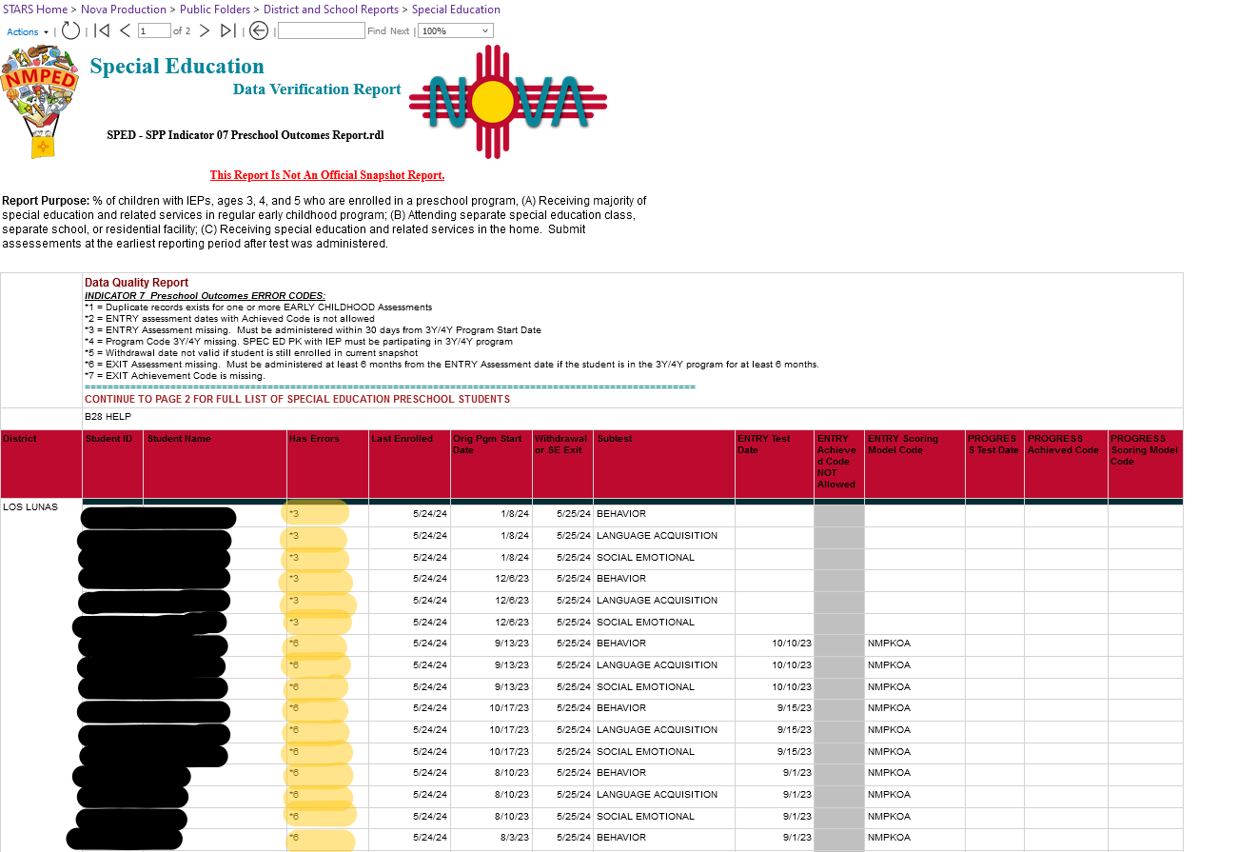
Indicator 7 Report - Preschool Outcome Errors
Validation requirements:
Ind. 7 has multiple pages.
Errors are listed on the first page, others on the second page, and some are on both pages.
Red comments are errors that must be fixed, Yellow comments are warnings but are not required to be fixed.
Errors requiring correction.

Slide 20
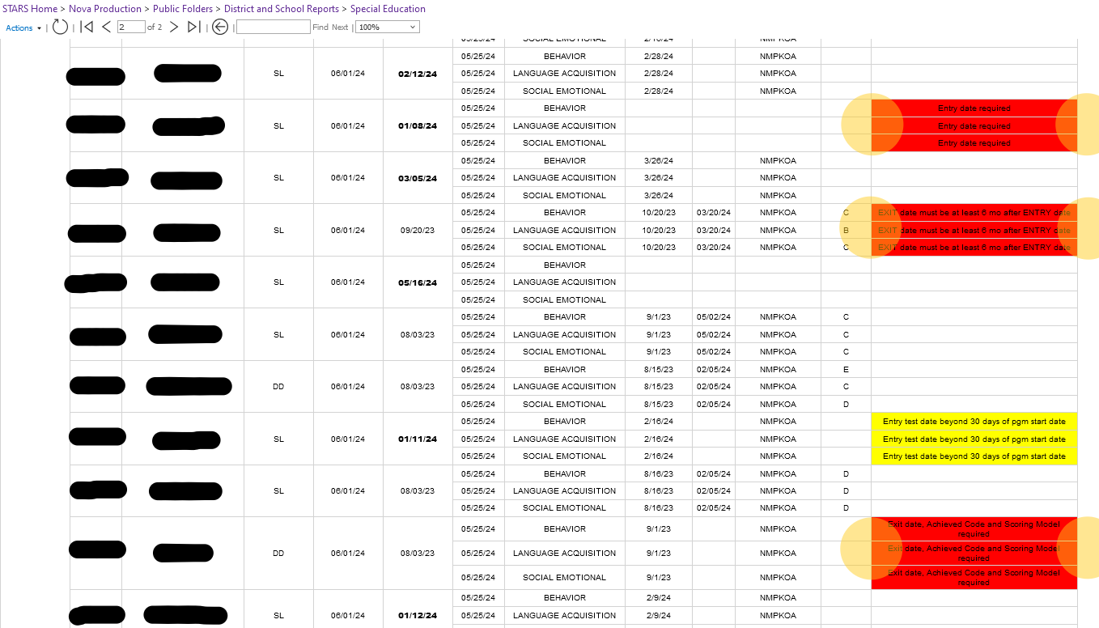
Indicator 7 Report - Preschool Outcome Errors (Cont.)

Slide 21
Q & A
Take a moment to enter your questions on the reports discussed so far.
Use the QR code or click here, to write down your questions.

Slide 22
Indicator 12 Report - Preschool Transition
The Indicator 12 report provides the percentage of students referred by Part C to Part B of the Individuals with Disabilities Education Act (IDEA).
This report ensures that eligible students are evaluated and receive services in a timely manner.
Why is this important?
Addressing needs as soon as possible significantly improves a child’s long-term outcomes in learning, behavior, and overall development.
Link to Indicator 12 Report in Nova:
https://eui.ped.state.nm.us/sites/stars/ProdNova/_layouts/15/ReportServer/RSViewerPage.aspx?rv:RelativeReportUrl=/sites/stars/ProdNova/PublicFolders/District%20and%20School%20Reports/Special%20Education/SPED%20-%20SPP%20Indicator%2012%20Early%20Childhood%20Part%20C%20to%20B%20Transition%20Summary%20Report.rdl

Slide 23
Indicator 12 Report - Preschool Transition
Validation requirements:
Check for errors in pink section; the key will explain errors.
Data table at bottom; please ensure records are as complete, accurate and free of errors.
Key for error explanation.

Slide 24
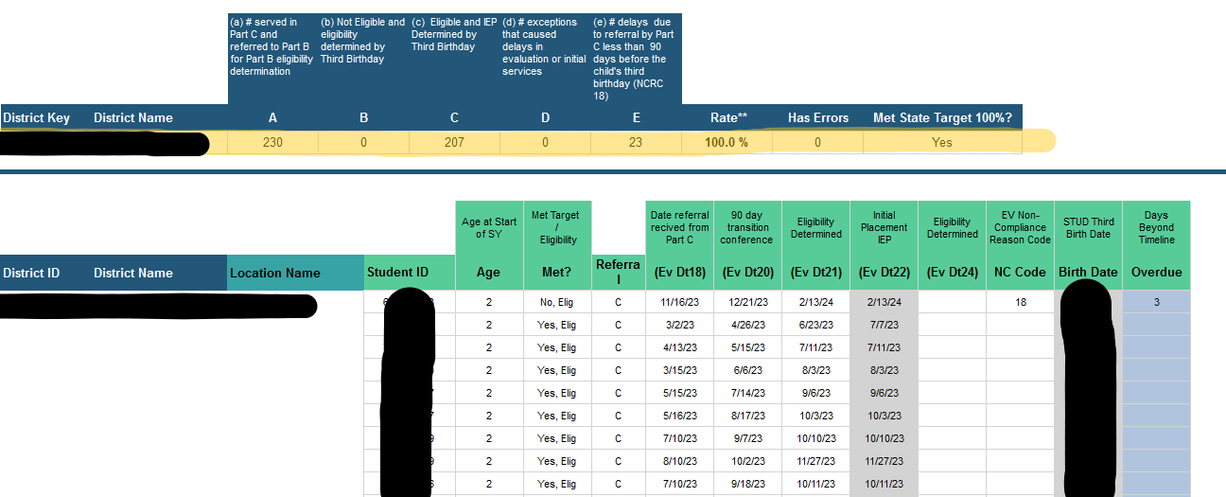
Indicator 12 Report - Preschool Transition (Cont.)
Compliance data

Slide 25
Indicator 11 Report - Evaluation Timelines
The Indicator 11 provides the percentage of students who were evaluated within 60 days of parental consent.
Why is this important?
The timely evaluation of children for special education services is monitored. This indicator is crucial for ensuring that students who may need special education services receive timely assessments, allowing for prompt intervention and support. This helps address educational needs and provides necessary services to students as early as possible.
Link to Indicator 11 Report in Nova:
https://eui.ped.state.nm.us/sites/stars/ProdNova/_layouts/15/ReportServer/RSViewerPage.aspx?rv:RelativeReportUrl=/sites/stars/ProdNova/PublicFolders/District%20and%20School%20Reports/Special%20Education/SPED%20-%20SPP%20Indicator%2011%20Parental%20Consent%2060%20Day%20Timeline%20Report.rdl

Slide 26
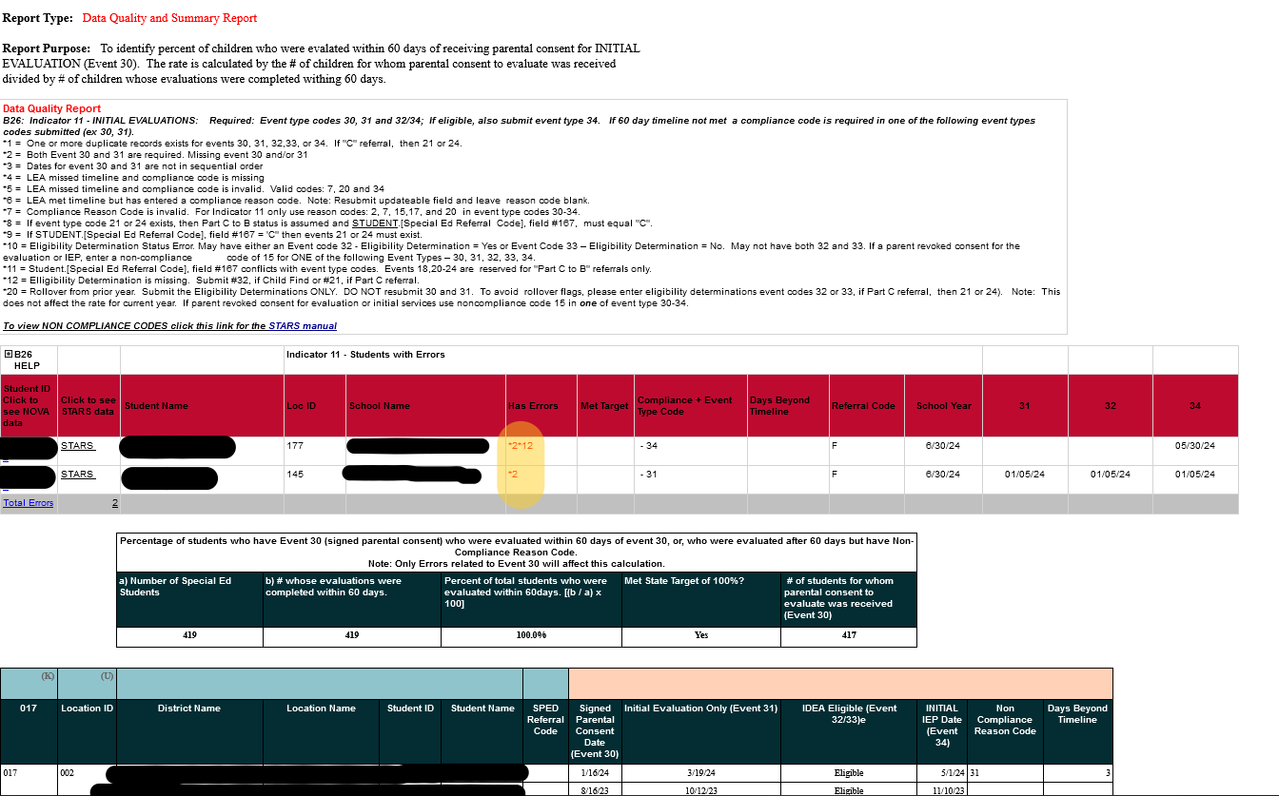
Indicator 11 Report - Evaluation Timelines
Validation requirements:
Check for errors in red section; the key will explain errors.
I11 Compliance info is found in the blue section in the middle (for program side; info not required for data validation.)
Data table is at bottom; please ensure records are complete, accurate and free of errors.
Key for error explanation.

Slide 27
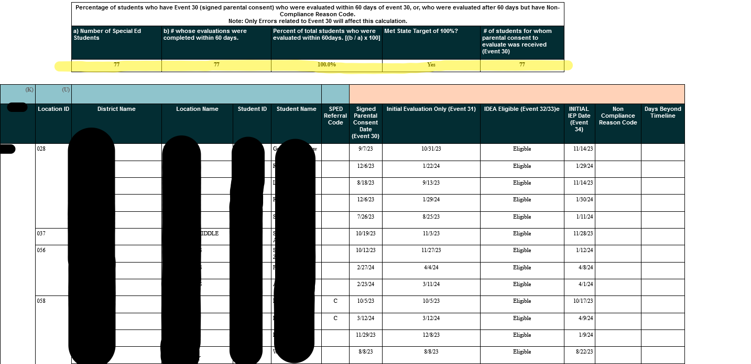
Indicator 11 Report - Evaluation Timelines
Compliance data.

Slide 28
Student Infraction & Response - Detail & Exceptions
These reports show us that LEAs have reported all student infractions for students with disabilities, as required by the Office of Special Education Programs (OSEP).
This includes LEAs reporting all uses of restraint and seclusion, even when use is not linked to an infraction.
NMAC 6.11.2.10(E)(6):
(c) Schools shall report to the department, through the department's data collection and reporting system, the following information on a timeline and reporting frequency established by the department:
(i) all instances in which a restraint or seclusion technique is used;
(ii) all instances in which law enforcement is summoned instead of using a restraint or seclusion technique;
(iii) the names of the students and school personnel involved in an incident in which restraint or seclusion was used; and
(iv) if a student was restrained, the type of restraint, including mechanical restraint or physical restraint, that was used.
(d) If a school summons law enforcement instead of using a restraint or seclusion technique on a student, the school shall comply with the reporting, documentation, and review procedures established pursuant to this rule and Section 22-5-4.12 NMSA 1978.

Slide 29
Student Infraction & Response - Detail & Exceptions
Why is this important?
Tracking infractions and events in which restraint and/or seclusion are utilized is crucial for ensuring compliance with regulations and ensuring students have access to FAPE.
Note: A PED Memo was issued in 2021 regarding the requirement to report restraint & seclusion events. The document can be viewed here: https://webnew.ped.state.nm.us/wp-content/uploads/2021/09/Restraint_and_Seclusion_Memo_7_29_21.pdf
Link to Infraction Exception Report in Nova:
https://eui.ped.state.nm.us/sites/stars/ProdNova/_layouts/15/ReportServer/RSViewerPage.aspx?rv:RelativeReportUrl=/sites/stars/ProdNova/PublicFolders/District%20and%20School%20Reports/Special%20Education/SPED%20-%20Student%20Infraction%20and%20Response%20Exceptions.rdl
Link to Infraction Detail Report in Nova:
https://eui.ped.state.nm.us/sites/stars/ProdNova/_layouts/15/ReportServer/RSViewerPage.aspx?rv:RelativeReportUrl=/sites/stars/ProdNova/PublicFolders/District%20and%20School%20Reports/Special%20Education/SPED%20-%20Student%20Infraction%20and%20Response%20Detail.rdl

Slide 30
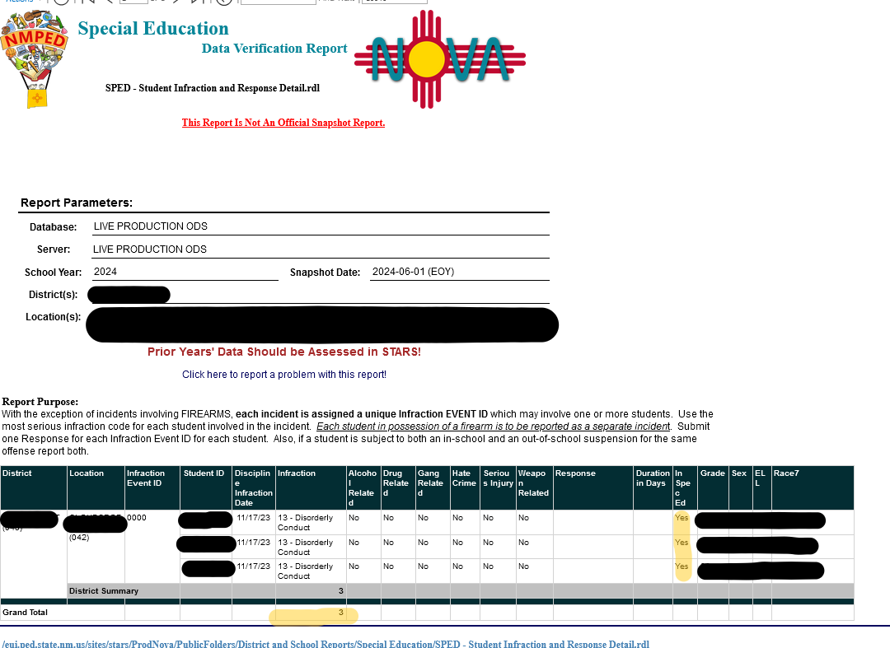
Student Infraction & Response Detail Report
Validation requirements:
This report must contain data.
All infractions:
no matter how minor or major must be reported.
those requiring a Manifestation Determination Meeting (MDR) and those that do not require an MDR must be reported.
those where restorative justice is used.
Informal removals must be reported, i.e. sending home to cool down, taking a break, etc.
Failure to report data will result in a non-valid and non-reliable data finding.

Slide 31
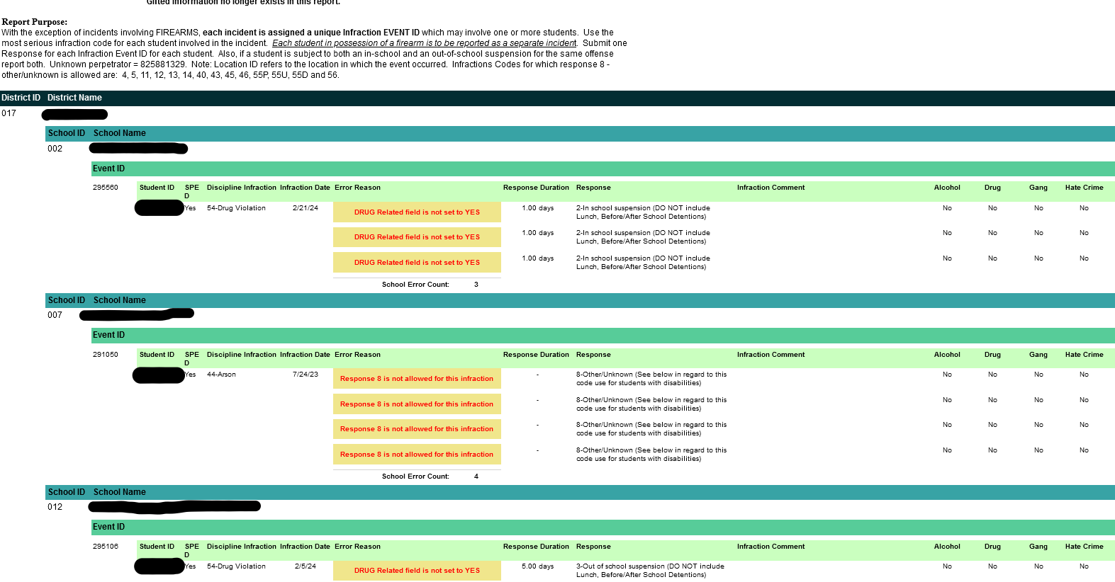
Student Infraction & Response Exception Report
Validation requirements:
All errors noted in this report must be corrected.
A blank report indicates:
there are no errors; or
no data has been reported.
Using a response type of “Other” will cause Error 8 on this report. Error 8 must be corrected.

Slide 32
Missing Exit Events Report
This report ensures that LEAs have correctly exited a student from special education.
Why is this important?
This information ensures that students with disabilities has been exited from special education. It also acts as a safeguard to ensure that as student is not inadvertently exited from special education when there is movement between LEAs.
Link to Missing Exit Events Report in Nova:
https://eui.ped.state.nm.us/sites/stars/ProdNova/_layouts/15/ReportServer/RSViewerPage.aspx?rv:RelativeReportUrl=/sites/stars/ProdNova/PublicFolders/District%20and%20School%20Reports/Special%20Education/SPED%20-%20Missing%20Special%20Education%20Exit%20Events.rdl

Slide 33
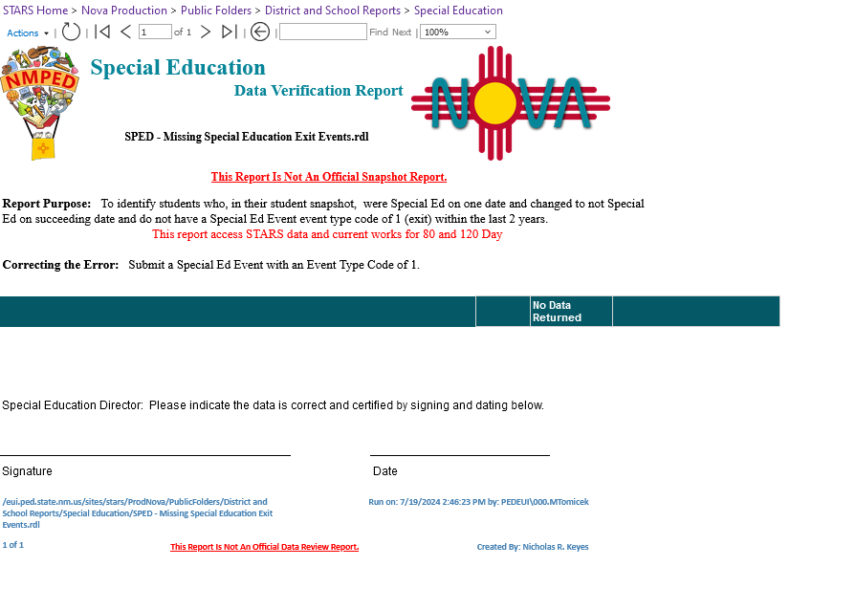
Missing Exit Events Report
Validation requirements:
All errors must be cleared.
The report will display “blank” if there are no missing exit events.
This report only displays errors.

Slide 34
Child Count Location Report
This report checks to make sure that each special education student is tied to a location with a valid NCES code required for federal reporting.
Why is this important?
This report identifies any students at off site locations and alerts the LEA so that a correction can be made.
Any students that are not corrected cannot be reported in the Federal Child Count.
Link to Child Count Location Report in Nova:
https://eui.ped.state.nm.us/sites/stars/ProdNova/_layouts/15/ReportServer/RSViewerPage.aspx?rv:RelativeReportUrl=/sites/stars/ProdNova/PublicFolders/District%20and%20School%20Reports/Special%20Education/SPED%20-%20Child%20Count%20Location%20Errors.rdl

Slide 35
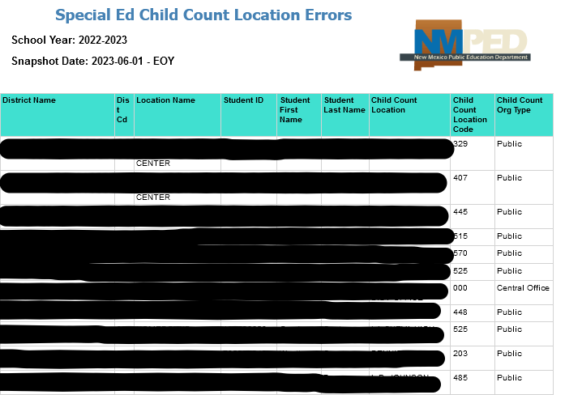
Child Count Location Report
Validation requirements:
All errors must be cleared.
The report will display “blank” if there are no child count location errors.
This report only displays errors.
Example: Child Count Report from SY 22-23 STARS

Slide 36
Q & A
Take a moment to enter your questions on the reports discussed so far.
Use the QR code or click here, to write down your questions.

Slide 37
Document Transfer Station (DTS)
Upload the Data Validation form and any necessary justifications to the respective 40/80/120/EOY folder for your LEA.
Data notes must also be provided here.
Contact Mahesh (mahesh.reddy-erri@ped.nm.gov)if you do not see the DTS link on the homepage.

Slide 38
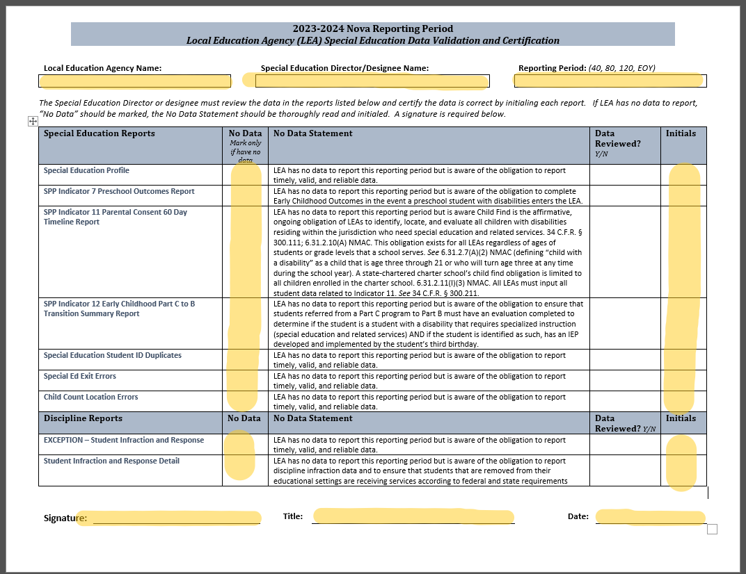
Data Validation Form
ALL lines must be initialed and must affirm that each report is accurate.
Must mark “No Data” on reports where have no data to report, not just reports that are blank.
Only sign off on the bottom of this report when all of data is accurate.
Upload form to the DTS when complete.
Please notify assigned reviewer when this is complete.

Slide 39
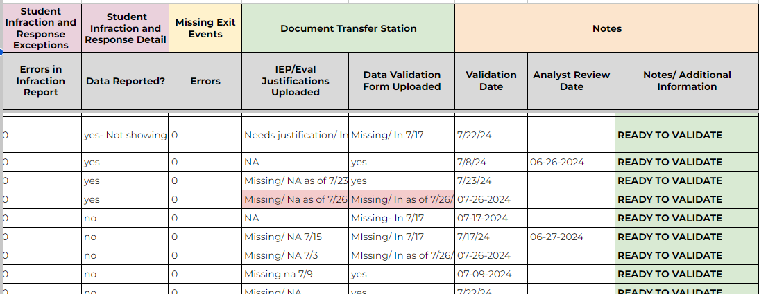
Special Education Data Quality Tab
Data filled with this color indicate “Errors” or data that needs correction.

Slide 40
Regular High School Diploma
Standard Program of Study
Fully aligned with state standards
Meets definition of “Regular High School Diploma”
Ends right to FAPE
IDEA Statutes and Regulations
Regular High School Diploma: “the standard high school diploma awarded to the preponderance of students in the State that is fully aligned with State standards”
Modified and Ability Programs of Study
Permit minor to significant deviations from the state standards and credit requirements required by students without disabilities to obtain a diploma
Do not meet the definition of “Regular High School Diploma”
Student has continued right to FAPE
State Statute & Rule
Diploma of Excellence
Three Programs of Study to Obtain a Diploma
Standard
Modified (Formerly Career Readiness)
Ability
Conditional Certificate of Transition
To be provided to students that did not receive a diploma through one of the programs of study after 4 years of high school
Student has continued right to FAPE
Permitted to participate in graduation activities

Slide 41
Graduation Reporting
Student must be submitted with Diploma Type AND one of the following:
Code 13 The student received a conditional certificate of conditional transition and Plans to return for a Free and Appropriate Public Education (FAPE).
Code 14 To be used for students with disabilities that have been awarded a Modified Diploma or Ability Diploma and are continuing to work toward a Standard Diploma and/or IEP goals. Plans to return for a Free and Appropriate Public Education (FAPE).
Code 15 Graduation – Student with a disability graduated with a diploma on the ability or modified option; and Will not be returning for a Free and Appropriate Public Education (FAPE).
Code 16 Completion – Student with a disability earned a conditional certificate of transition; and Will not be returning for a Free and Appropriate Public Education (FAPE).
Event Reason 9-12 should also be submitted with those codes.
Mark a student Graduated (G) if the student has received an Ability or Modified Option. Regardless of if they plan to return next school year or not.
If the student does return you will not mark them Graduated (G) again if they do not receive a Standard Diploma or until they receive a Standard Diploma.

Slide 42
Errors in Data - Corrections Overview
Encountered an error on Nova report
Check your SIS
(Your SIS is purchased by your district, PED cannot make corrections to your SIS)
Located problem
Your SIS data is correct, but Nova errors remain
The Nova errors are correct
(Ex: Student was not tested or IEP was late)
Fix problem and rerun report to ensure no errors on Nova report
Put a ticket in ticket with your SIS and Nova- work with them to correct the error
Reach out to your Data Reviewer for verification and next steps
Rerun your report to ensure Nova errors have corrected

Slide 43
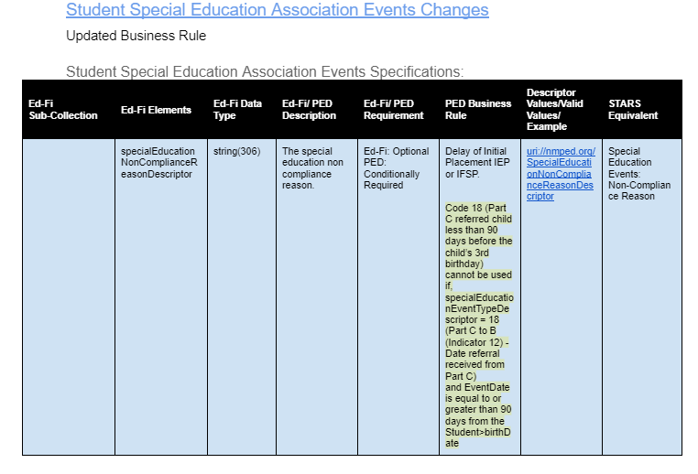
2024-2025 Changes
Link to Nova changes log:
Nova Changes Log Document - Google Docs

Slide 44
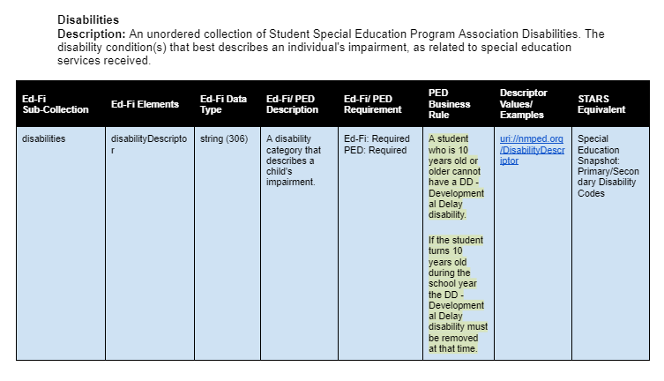
2024-2025 Changes

Slide 45
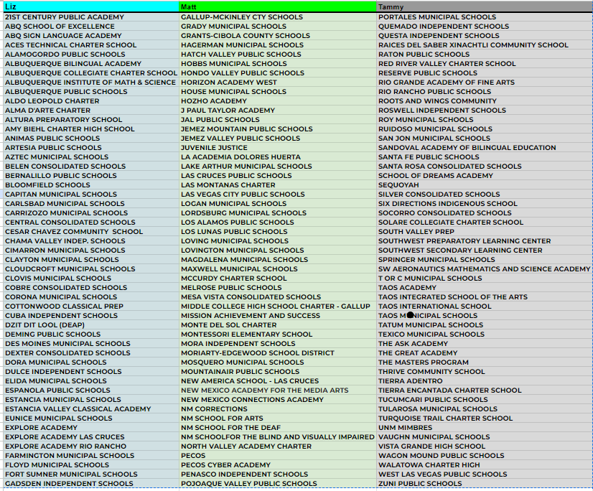
Data Reviewers for LEAs

Slide 46
Nova Office Hours
The Nova team has office hours weekly on Tuesdays at 11:00 am.
This is a good time to join and have up to date Nova information and to ask any questions you may have if you are having trouble with Nova.
Microsoft Teams
Join the meeting now
Meeting ID: 248 580 542 464
Passcode: 2qjuXJ

Slide 47
Other Reminders
Indicator 14 data due September 30, 2024. Check with Glenn D on the status for your LEA.
Indicator 8 parent survey to be sent out soon for SY23-24. Please encourage parents who receive the survey to complete it.

Slide 48
Data Team Contact List
Office of Special Education Data Team:
charlene.marcotte@ped.nm.gov
lorenzo.dominguez@ped.nm.gov
liz.schweiger@ped.nm.gov
matthew.tomicek@ped.nm.gov
tamara.burkett@ped.nm.gov
trudy.cordova@ped.nm.gov (back up)
Indicator 14:
gdamian@nmhu.edu
NOVA Data:
alison.watt@ped.nm.gov
nicholas.keyes@ped.nm.gov
Notes:
Charlene

Slide 49
Questions
For specific questions, email the assigned data reviewer:
Assigned data reviewer list can be found here:Data Reviewers
Scan the QR code to join our live Q&A on Google Sheets:

Slide 50
Office of Special Education
Understanding Local Education Agency (LEA) Maintenance of Effort (MOE)
Charlene Marcotte, Deputy Director, Data & Finance
Lorenzo Dominguez, Asst. Deputy Director, Data & Finance
Kaylock Sellers, Financial Coordinator
Katalina Gallegos, Management Analyst
September 18th, 2024
Investing for tomorrow, delivering today.

Slide 51
Housekeeping
Office Hours slides can be accessed:
From the Office of Special Education website, on the Resources page under Office Hours.
https://webnew.ped.state.nm.us/bureaus/special-education/resources/
“Make a copy” if you want to take notes on the presentation.
Use the QR code or click here, to write down your questions.
Make sure you are on mute so all can hear today’s presentation.

Slide 52
Agenda
Maintenance of Effort (MOE) Introduction
MOE Exceptions
MOE Adjustments
MOE Site
General Information

Slide 53
LEA MOE
What is Local Education Agency (LEA) Maintenance of Effort (MOE)?
LEA MOE: In each year, for the education of children with disabilities, an LEA must:
Budget at least as much as it expended in the most recent year it met LEA MOE, referred to as “eligibility standard”.
Expend at least as much as it expended in the most recent year it met LEA MOE, referred to as “compliance standard”.
Investing for tomorrow, delivering today.
2

Slide 54
LEA MOE
Why is MOE Required?
LEA MOE is required to ensure that LEAs do not replace state/local funding with federal funds.
NOTE: IDEA B funds are to supplement state and local funds and not to take the place of (supplant).
Investing for tomorrow, delivering today.
2

Slide 55
LEA MOE Verification
How is LEA MOE verified?
Through a submission of calculations to the Office of Special Education (OSE).
The OSE ensures that the LEA:
Budgeted (Eligibility Standard); and
Expended (Compliance Standard)
The same amount or more in the most recent year it met
LEA MOE.
Investing for tomorrow, delivering today.
3

Slide 56
Calculating MOE
How is LEA MOE calculated?
Four Methods:
Total amount of local funds.
Total amount of state and local funds.
Per capita amount of local funds.
Per capita amount of state and local funds.
3

Slide 57
LEA MOE
When do LEAs complete MOE calculations?
Budget (Eligibility Standard) - Due in the Spring
Expenditures (Compliance Standard) - Due in the Fall
MOE Compliance calculations based on 2023-2024 expenditures are the focus of this presentation.
Investing for tomorrow, delivering today.
2

Slide 58
OBMS Data Used to Calculate MOE
Fund | Description | Object | Description | Job Class | Description
11000 | Operational | 51100 | Salary | 1311 | Diagnostician
13000 | Pupil Transportation | 51200 | Overtime | 1312 | Speech Therapist
 |  | 51300 | Additional Compensation | 1313 | Occupational Therapist
 |  |  |  | 1314 | Physical / Recreational Therapist
 |  |  |  | 1315 | Psychologist / Counselor
 |  |  |  | 1316 | Audiologist
 |  |  |  | 1317 | Interpreter
 |  |  |  | 1318 | Specialist
 |  |  |  | 1319 | Special Education Assistant (Non- Instructional)
 |  |  |  | 1412 | Special Education Teacher
 |  |  |  | 1712 | Special Education Instructional Assistant
 |  | 53211 | Diagnostician - contracted | 0000 | Contracted staff job class
 |  | 53212 | Speech Therapist - contracted | 0000 | Contracted staff job class
 |  | 53213 | Occupational Therapist - contracted | 0000 | Contracted staff job class
 |  | 53214 | Physical / Recreational Therapist - contracted | 0000 | Contracted staff job class
 |  | 53215 | Psychologist / Counselor - contracted | 0000 | Contracted staff job class
 |  | 53216 | Audiologist - contracted | 0000 | Contracted staff job class
 |  | 53217 | Interpreter - contracted | 0000 | Contracted staff job class
 |  | 53218 | Specialist - contracted | 0000 | Contracted staff job class
 |  | 53219 | Special Education Assistant (Non-Instructional) - contracted | 0000 | Contracted staff job class

Slide 59
OBMS Data Used to Calculate MOE
Fund | Description | Object | Description | Job Class | Description
11000 | Operational | 52111 | Educational Retirement | 1311 | Diagnostician
13000 | Pupil Transportation | 52112 | ERA Retiree Health | 1312 | Speech Therapist
 |  | 52210 | FICA Payments | 1313 | Occupational Therapist
 |  | 52220 | Medicare Payments | 1314 | Physical / Recreational Therapist
 |  | 52311 | Health and Medical Premiums | 1315 | Psychologist / Counselor
 |  | 52312 | Life | 1316 | Audiologist
 |  | 52313 | Dental | 1317 | Interpreter
 |  | 52314 | Vision | 1318 | Specialist
 |  | 52315 | Disability | 1319 | Special Education Assistant (Non- Instructional)
 |  | 52316 | Other Insurance | 1412 | Special Education Teacher
 |  | 52500 | Unemployment Compensation | 1712 | Special Education Instructional Assistant
 |  | 52710 | Workers Compensation Premium
 |  | 52720 | Workers Compensation Employer's Fee
 |  | 52730 | Workers Compensation (Self Insured)
 |  | 52911 | Cafeteria Plan Fees
 |  | 52912 | Employee Assistance Programs
 |  | 52913 | Workers Compensation Employee Fee
 |  | 52914 | Deferred Sick Leave Reserve

Slide 60
OBMS Data Used to Calculate MOE
REQUIRED (If Applicable) - LEA enters data into the calculator. Backup documents include employment contract, time and effort sheets
Fund | Description | Object | Description | Job Class | Description
11000 | Operational | 51100 | Salary | 1211 | Coordinator / Subject Matter Specialist
13000 | Pupil Transportation | 51200 | Overtime | 1214 | Guidance Counselor / Social Worker
 |  | 51300 | Additional Compensation
 |  | 52111 | Educational Retirement
 |  | 52112 | ERA Retiree Health
 |  | 52210 | FICA Payments
 |  | 52220 | Medicare Payments
 |  | 52311 | Health and Medical Premiums
 |  | 52312 | Life
 |  | 52313 | Dental
 |  | 52314 | Vision
 |  | 52315 | Disability
 |  | 52316 | Other Insurance
 |  | 52500 | Unemployment Compensation
 |  | 52710 | Workers Compensation Premium
 |  | 52720 | Workers Compensation Employer's Fee
 |  | 52730 | Workers Compensation (Self Insured)
 |  | 52911 | Cafeteria Plan Fees
 |  | 52912 | Employee Assistance Programs
 |  | 52913 | Workers Compensation Employee Fee
 |  | 52914 | Deferred Sick Leave Reserve

Slide 61
LEA MOE
How does the LEA complete the MOE calculation?
OSE will request for closed OBMS data from the previous 3 slides to be entered into the OSE MOE site: https://webed.ped.state.nm.us/sites/SpEdIDEA/SitePages/MOE.aspx
LEAs must review the data for accuracy and make any necessary corrections.
Back-up documentation for all costs:
Must be kept on file
Provided to the OSE upon request.
Documentation examples can include:
Contracts
Time and Effort documentation
2

Slide 62
OSE MOE Review
Once an LEA has submitted their MOE data, what happens next?
OSE will review the data LEAs submitted in the MOE site: https://webed.ped.state.nm.us/sites/SpEdIDEA/SitePages/MOE.aspx
OSE will determine if the LEA met the compliance standard by verifying expenditures were at least as much as expended in the most recent year the LEA met MOE.
Investing for tomorrow, delivering today.
2

Slide 63
Q & A
Take a moment to enter your questions on the general information discussed so far.
Use the QR code or click here, to write down your questions.

Slide 64
Exceptions – General Information
If an LEA does not meet MOE after all expenditures have been entered, an LEA may apply exceptions to reduce its required MOE level and meet the compliance standard using any of the four methods.
Exceptions:
All exceptions must be supported by an auditable paper trail.
If the LEA has met MOE, exceptions cannot be applied.
It is permissible to take multiple exceptions in one year, as long as
each exception applies in that year.
Investing for tomorrow, delivering today.
8

Slide 65
Exception (a)
Allowable Exception:
(a) The voluntary departure, by retirement or otherwise, or departure for just cause, of special education or related services personnel.
Note: If staff worked .5 FTE on special education duties then .5 FTE can be the exception; not the entire salary and benefit of that FTE

Slide 66
Exception (a) Non-Qualifications
The following do not qualify under the Voluntary Departure exception (a):
The LEA reassigns the special education teacher or ancillary staff to other duties in the district;
The LEA reduces the number of special education staff due to a reduction in force;
The LEA changes local special education policy or procedure, reducing the number of staff and/or hours;
The LEA releases or does not renew the contract of a probationary employee; and
The LEA is not able to recruit or hire a special education teacher and relies on long term substitute teachers during the school year.

Slide 67
Exception (b)
Allowable Exception:
(b) A decrease in the enrollment of children with disabilities.
If there is a decrease in enrollment of students with disabilities in an LEA, the calculator automatically accounts for the difference between the two years.
That difference is converted to a percentage, which is multiplied by the prior year expenditures.

Slide 68
Exception (c)
Allowable Exception:
(c) Termination of obligation to provide special education to a student in an exceptionally costly program.
Cost to provide FAPE is greater than two times the annual per pupil cost.
An LEA may reduce the amount of expenditures if the LEA no longer has an obligation to serve a child with an exceptionally costly program because the child:
Has left the jurisdiction of the agency; or
Has reached the age at which the obligation of the agency to provide FAPE has terminated; or
No longer needs the program of special education.

Slide 69
Exception (d)
Allowable Exception:
(d) Termination of costly expenditures for long-term purchases, such as the acquisition of equipment or the construction of school facilities.
Is equal to or greater than $20,000 and paid out over a period of more than one year.
Examples include acquisition of special education equipment, construction and/or renovation of designated special education spaces.

Slide 70
Exception (e)
Allowable Exception:
(e) The assumption of cost by the high cost fund operated by the PED.
If your LEA has applied for and received this grant, the expenditures that were initially funded through a state or local source from fund 24120 can be entered as exception (e).

Slide 71
OSE MOE Review
What if an LEA does not meet MOE?
LEAs will be required to pay back the PED with non-federal funds lesser of the amount of the failure, or the LEA’s entire Part B subgrant for that fiscal year.
(34 CFR 300.203 (b))
Investing for tomorrow, delivering today.
2

Slide 72
Q & A
Take a moment to enter your questions on the general information discussed so far.
Use the QR code or click here, to write down your questions.

Slide 73
Adjustment
Similar to an exception; the adjustment provision may allow an LEA to lower its MOE obligation if the LEA will not or does not meet MOE.
If an LEA received an increase in their IDEA B 611 award, the adjustment can be up to 50% of that increase.
Adjustment is from operation funds not IDEA B grant funds
“Adjusted” funds must be used toward an Elementary and Secondary Education Act (ESEA) program.
LEA can reduce spending obligation for MOE by using operational funds to carry activities.
The LEA may only apply the adjustment up to the amount by which the LEA is deficient in meeting MOE

Slide 74
Conditions for Using Adjustment
The LEA must:
Receive an annual determination of “meets requirements” from the SEA for the
FY of the adjustment.
Not have had action taken against it by the SEA under IDEA Section 616.
Not have had the responsibility for providing FAPE taken away by the SEA.
Not be determined to have significant disproportionality for the FY of the adjustment.
Use the freed-up local (or state and local) funds to carry out
ESSA activities during the FY in which the adjustment takes place.

Slide 75
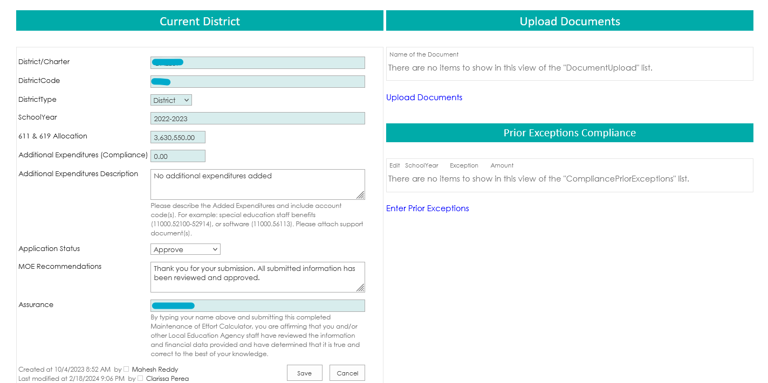
MOE site
OSE MOE site: https://webed.ped.state.nm.us/sites/SpEdIDEA/SitePages/MOE.aspx

Slide 76
MOE Site
OSE MOE site
Four-tab options:

Slide 77
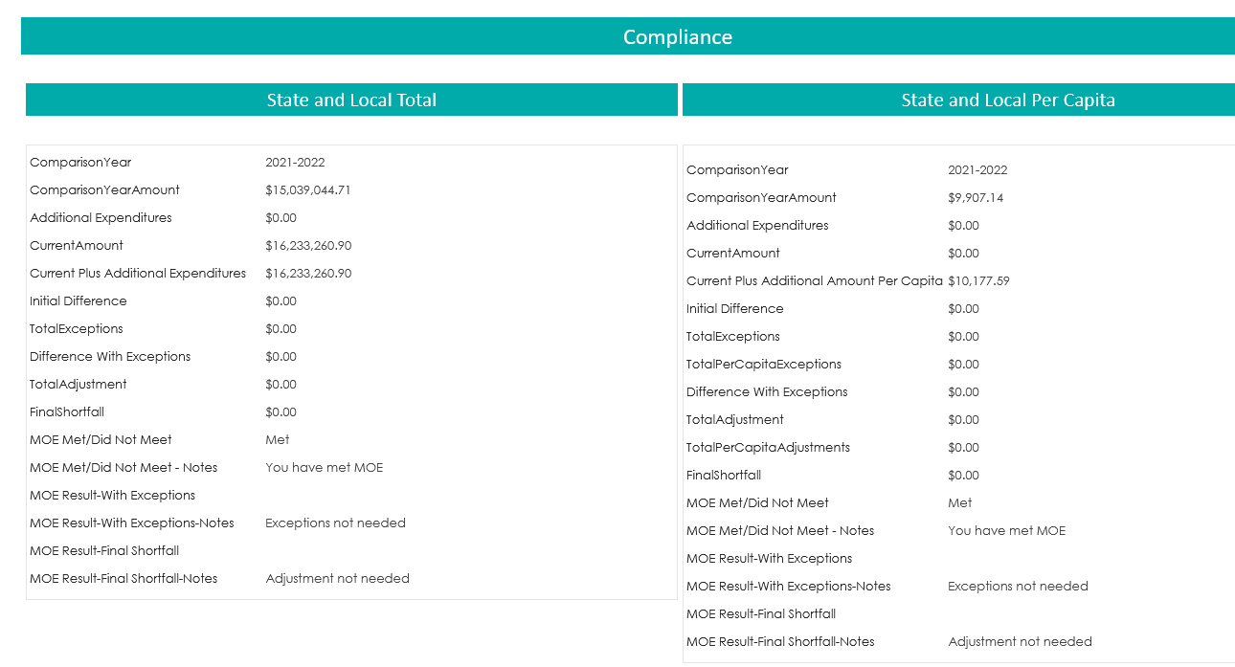
MOE site - MOE Compliance

Slide 78
MOE Site - Multiyear MOE Summary
When button selected, turns light grey.

Slide 79
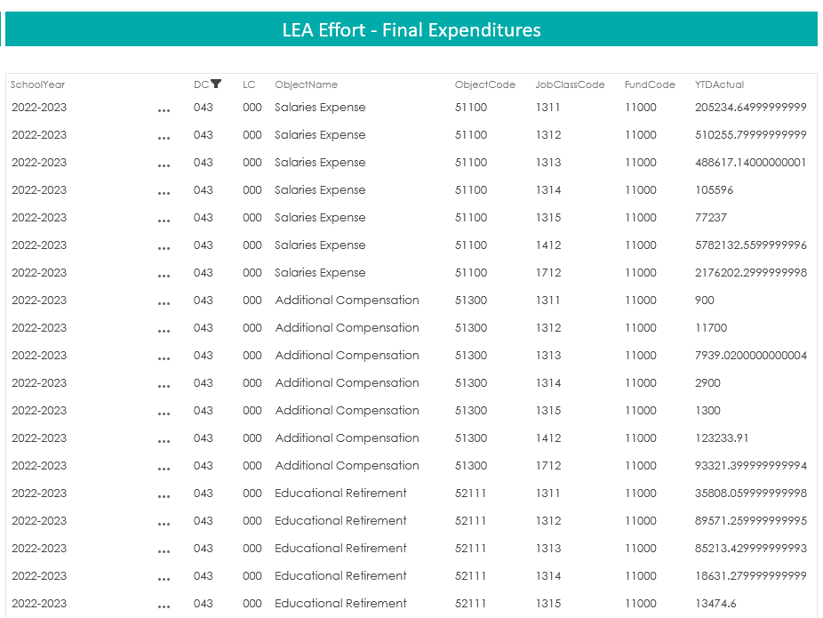
MOE Site - Amounts

Slide 80
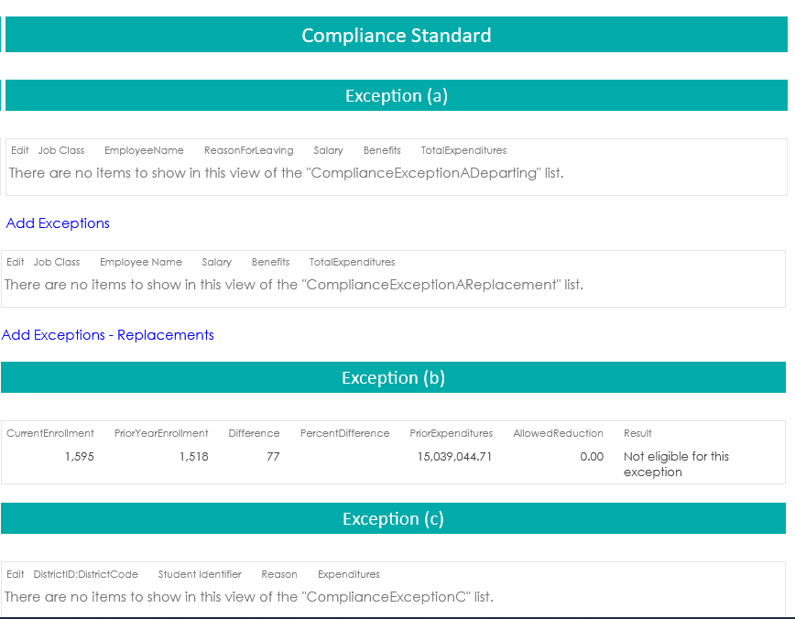
MOE site - Exceptions and Adjustments

Slide 81
Next Steps
Be on look out for timeframe in which to enter MOE.
Ensure all LEA staff requiring access have access to the MOE site.
For access to the MOE site, contact:
Katalina Gallegos Katalina.Gallegos@ped.nm. gov
Kaylock Sellers Kaylock.Sellers@ped.nm. gov

Slide 82
MOE Reviewer List
Kaylock Sellers |  | Katalina Gallegos |  | Matthew Tomicek/Lorenzo Dominguez
21ST CENTURY PUBLIC ACADEMY | CIMARRON MUNICIPAL SCHOOLS* | MAGDALENA MUNICIPAL SCHOOLS | QUEMADO INDEPENDENT SCHOOLS | GALLUP-MCKINLEY CTY SCHOOLS | SPRINGER MUNICIPAL SCHOOLS
ABQ SCHOOL OF EXCELLENCE | CLAYTON MUNICIPAL SCHOOLS | MAXWELL MUNICIPAL SCHOOLS | QUESTA INDEPENDENT SCHOOLS | GRADY MUNICIPAL SCHOOLS | SW AERO MATH AND SCIENCE ACADEMY
ABQ SIGN LANGUAGE ACADEMY | CLOUDCROFT MUNICIPAL SCHOOLS | MCCURDY CHARTER SCHOOL | RAICES DEL SABER XINACHTLI COMM SCH | GRANTS-CIBOLA COUNTY SCHOOLS | T OR C MUNICIPAL SCHOOLS
ACES TECHNICAL CHARTER SCHOOL | CLOVIS MUNICIPAL SCHOOLS | MELROSE PUBLIC SCHOOLS | RATON PUBLIC SCHOOLS | HAGERMAN MUNICIPAL SCHOOLS | TAOS ACADEMY
ALAMOGORDO PUBLIC SCHOOLS | COBRE CONSOLIDATED SCHOOLS | MESA VISTA CONSOLIDATED SCHOOLS | RED RIVER VALLEY CHARTER SCHOOL | HATCH VALLEY PUBLIC SCHOOLS | TAOS INTEGRATED SCHOOL OF THE ARTS
ALBUQUERQUE BILINGUAL ACADEMY | CORONA MUNICIPAL SCHOOLS | MIDDLE COLLEGE HIGH SCHOOL CHARTER | RESERVE PUBLIC SCHOOLS | HOBBS MUNICIPAL SCHOOLS | TAOS INTERNATIONAL SCHOOL
ALBUQUERQUE COLLEGIATE CHARTER SCH | COTTONWOOD CLASSICAL PREP | MISSION ACHIEVEMENT AND SUCCESS | RIO GRANDE ACADEMY OF FINE ARTS | HONDO VALLEY PUBLIC SCHOOLS | TAOS MUNICIPAL SCHOOLS*
ALBUQUERQUE INST OF MATH & SCIENCE | CUBA INDEPENDENT SCHOOLS | MONTE DEL SOL CHARTER | RIO RANCHO PUBLIC SCHOOLS | HORIZON ACADEMY WEST | TATUM MUNICIPAL SCHOOLS
ALBUQUERQUE PUBLIC SCHOOLS* | DEAP | MONTESSORI ELEMENTARY SCHOOL | ROOTS AND WINGS COMMUNITY | HOUSE MUNICIPAL SCHOOLS | TEXICO MUNICIPAL SCHOOLS
ALDO LEOPOLD CHARTER | DEMING PUBLIC SCHOOLS* | MORA INDEPENDENT SCHOOLS | ROSWELL INDEPENDENT SCHOOLS* | HOZHO ACADEMY | THE ASK ACADEMY
ALMA D'ARTE CHARTER | DES MOINES MUNICIPAL SCHOOLS | MORIARTY-EDGEWOOD SCHOOL DISTRICT | ROY MUNICIPAL SCHOOLS | J PAUL TAYLOR ACADEMY | THE GREAT ACADEMY
ALTURA PREPARATORY SCHOOL | DEXTER CONSOLIDATED SCHOOLS | MOSQUERO MUNICIPAL SCHOOLS | RUIDOSO MUNICIPAL SCHOOLS | JAL PUBLIC SCHOOLS | THE MASTERS PROGRAM
AMY BIEHL CHARTER HIGH SCHOOL | DORA MUNICIPAL SCHOOLS | MOUNTAINAIR PUBLIC SCHOOLS | SAN JON MUNICIPAL SCHOOLS | JEMEZ MOUNTAIN PUBLIC SCHOOLS | THRIVE COMMUNITY SCHOOL
ANIMAS PUBLIC SCHOOLS | DULCE INDEPENDENT SCHOOLS | NEW AMERICA SCHOOL - LAS CRUCES | SANDOVAL ACADEMY OF BILINGUAL ED | JEMEZ VALLEY PUBLIC SCHOOLS* | TIERRA ADENTRO
ARTESIA PUBLIC SCHOOLS | ELIDA MUNICIPAL SCHOOLS | NM ACADEMY FOR THE MEDIA ARTS | SANTA FE PUBLIC SCHOOLS* | JUVENILE JUSTICE | TIERRA ENCANTADA CHARTER SCH
AZTEC MUNICIPAL SCHOOLS* | ESPANOLA PUBLIC SCHOOLS | NEW MEXICO CONNECTIONS ACADEMY | SANTA ROSA CONSOLIDATED SCHOOLS | LA ACADEMIA DOLORES HUERTA | TUCUMCARI PUBLIC SCHOOLS
BELEN CONSOLIDATED SCHOOLS | ESTANCIA MUNICIPAL SCHOOLS | NM CORRECTIONS | SCHOOL OF DREAMS ACADEMY | LAKE ARTHUR MUNICIPAL SCHOOLS | TULAROSA MUNICIPAL SCHOOLS
BERNALILLO PUBLIC SCHOOLS | ESTANCIA VALLEY CLASSICAL ACADEMY | NM SCHOOL FOR ARTS | SEQUOYAH | LAS CRUCES PUBLIC SCHOOLS | TURQUOISE TRAIL CHARTER SCHOOL
BLOOMFIELD SCHOOLS | EUNICE MUNICIPAL SCHOOLS | NM SCHOOL FOR THE DEAF | SILVER CONSOLIDATED SCHOOLS | LAS MONTANAS CHARTER | UNM MiMBRES
CAPITAN MUNICIPAL SCHOOLS | EXPLORE ACADEMY | NM SCH FORBLIND AND VISUALLY IMPAIRED | SIX DIRECTIONS INDIGENOUS SCHOOL | LAS VEGAS CITY PUBLIC SCHOOLS | VAUGHN MUNICIPAL SCHOOLS
CARLSBAD MUNICIPAL SCHOOLS* | EXPLORE ACADEMY LAS CRUCES | NORTH VALLEY ACADEMY CHARTER | SOCORRO CONSOLIDATED SCHOOLS* | LOGAN MUNICIPAL SCHOOLS | VISTA GRANDE HIGH SCHOOL
CARRIZOZO MUNICIPAL SCHOOLS | EXPLORE ACADEMY RIO RANCHO | PECOS CONNECTIONS ACADEMY | SOLARE COLLEGIATE CHARTER SCHOOL | LORDSBURG MUNICIPAL SCHOOLS | WAGON MOUND PUBLIC SCHOOLS
CENTRAL CONSOLIDATED SCHOOLS* | FARMINGTON MUNICIPAL SCHOOLS | PECOS INDEPENDENT SCHOOLS | SOUTH VALLEY PREP | LOS ALAMOS PUBLIC SCHOOLS | WALATOWA CHARTER HIGH
CESAR CHAVEZ COMMUNITY SCHOOL | FLOYD MUNICIPAL SCHOOLS | PENASCO INDEPENDENT SCHOOLS | SW PREPARATORY LEARNING CENTER | LOS LUNAS PUBLIC SCHOOLS | WEST LAS VEGAS PUBLIC SCHOOLS*
CHAMA VALLEY INDEP. SCHOOLS | FORT SUMNER MUNICIPAL SCHOOLS | POJOAQUE VALLEY PUBLIC SCHOOLS | SW SECONDARY LEARNING CENTER | LOVING MUNICIPAL SCHOOLS | ZUNI PUBLIC SCHOOLS
 | GADSDEN INDEPENDENT SCHOOLS | PORTALES MUNICIPAL SCHOOLS |  | LOVINGTON MUNICIPAL SCHOOLS

Slide 83
Q & A
Take a moment to enter your questions on the general information discussed so far.
Use the QR code or click here, to write down your questions.

Slide 84
Finance Team Contact List
Office of Special Education Finance Team:
charlene.marcotte@ped.nm.gov
lorenzo.dominguez@ped.nm.gov
katalina.gallegos@ped.nm.gov
kaylock.sellers@ped.nm.gov
matthew.tomicek@ped.nm.gov (back up)
Notes:
Charlene

Slide 85
Excess Cost Compliance Submission Overview
Office of Special Education
Charlene Marcotte, Deputy Director, Data & Finance
Lorenzo Dominguez, Asst. Deputy Director, Data & Finance
Kaylock Sellers, Financial Coordinator
Katalina Gallegos, Management Analyst
September 18th, 2024
Investing for tomorrow, delivering today.
Notes:
To change the image on this slide, select the picture and delete it. Then click the Pictures icon in the placeholder to insert your own image.

Slide 86
Housekeeping
Office Hours slides can be accessed:
From the Office of Special Education website, on the Resources page under Office Hours.
https://webnew.ped.state.nm.us/bureaus/special-education/resources/
“Make a copy” if you want to take notes on the presentation.
Use the QR code or click here, to write down your questions.
Make sure you are on mute so all can hear today’s presentation.

Slide 87
Q & A

Slide 88
Agenda
Defining Excess Costs
Excess Cost Federal Requirement
Accessing the NMPED Calculator
Data Used in the Calculation

Slide 89
Introduction to Excess Cost
Definition: Excess Cost refers to the additional expenditures Local Educational Agencies (LEAs) must incur to provide special education and related services to children with disabilities. These costs are over and above the average per-student, or total expenditure on general education students, which includes funding from local, state, and federal sources.
Purpose: The goal of calculating excess costs is to ensure that federal IDEA Part B funds are allocated specifically for these additional special education expenses. These funds must supplement existing funding sources (local, state, and federal) and cannot be used to replace them, ensuring that children with disabilities receive the full services they are entitled to under IDEA (Individuals with Disabilities Education Act).
(34 CFR §300.202)

Slide 90
What Is Excess Cost?
Excess Costs Definition:
Excess costs are the additional expenditures required to provide special education and related services to students with disabilities. These costs go beyond the average per-student or total spending for general education.
Expenditure Requirement:
LEAs must calculate the annual average expenditure for general education at both the elementary and secondary levels. This calculation helps determine the minimum amount that must be spent before IDEA Part B funds can be used for special education services.
Once this minimum threshold is met, IDEA Part B funds can be applied to cover excess costs.
Separated by Elementary and Secondary Levels:
LEAs are required to calculate excess costs separately for elementary and secondary education levels. This ensures that funds are appropriately allocated based on the needs of students in different age groups.
IDEA Part B Funds Usage:
IDEA Part B funds are used only for the additional costs incurred for special education once the minimum general education expenditure has been met. The goal is to ensure that local, state, and federal funds are not replaced by IDEA funds, but rather supplemented by them.

Slide 91
Excess Costs vs. MOE
MOE ensures consistent financial support: The MOE requirements prevent LEAs and states from reducing their own spending on special education from year to year, thus maintaining a steady level of financial effort.
Excess Cost Calculation ensures IDEA funds cover additional costs: Before IDEA Part B funds can be used, LEAs must demonstrate they have spent a minimum average amount from local/state funds on general education costs for students with disabilities.
Prevents Supplanting: Together, MOE and excess cost calculations help ensure that IDEA Part B funds are used as intended—to provide additional support for special education rather than replacing existing funding sources.
These processes work together to ensure that special education funding is maintained and appropriately augmented with federal funds, thereby preventing the improper use of federal funds to replace local and state investments in special education.

Slide 92
Connection to Supplanting
Preventing Supplanting
IDEA funds are intended to supplement, not replace, existing state, local, or federal funds used for education.
Supplanting occurs when federal funds are used in place of, rather than in addition to, local or state funding.
This ensures LEAs maintain a consistent level of financial commitment to general and special education, and IDEA funds are used to enhance services for students with disabilities.
(34 CFR 300.202(a)(3))

Slide 93
Excess Cost Requirement
Federal Requirements
Excess Cost Requirement (from § 300.202(b))
LEAs cannot use Part B funds to pay for all costs related to educating a child with a disability, except in cases where no local or state funds are available for nondisabled children of similar age.
LEAs meet the excess cost requirement by spending a minimum average amount on general education costs before applying IDEA Part B funds.

Slide 94
Meeting Compliance
Minimum Expenditure Requirement:
LEAs must spend a minimum average on the education of students with disabilities before they can apply IDEA Part B funds to cover excess costs.
This ensures that the basic educational needs of students with disabilities are met using existing state, local, and federal funding.
Simultaneous Spending:
LEAs may use IDEA Part B funds concurrently with other funding sources (state, local, and federal) throughout the fiscal year.
However, to comply with the excess cost requirement, the minimum total expenditures or average amount per students with disabilities must be reached by the end of the fiscal year.
End of Fiscal Year Compliance:
The minimum expenditure requirement must be met before the fiscal year ends in order to maintain compliance with IDEA regulations.
Failure to meet this requirement could result in the improper use of IDEA Part B funds, which may lead to penalties or the need to reimburse funds.
Key Compliance Reference:
This requirement aligns with the federal mandate that IDEA funds are meant to supplement, not supplant, existing funding, ensuring that LEAs maintain a consistent financial effort toward special education.

Slide 95
Excess Cost Submissions
Excess Cost Base
Submitted in the Spring.
Figures based on budgeted amounts.
May include projections derived from historical data.
The United States Department of Education requires each LEA to submit figures separated between elementary and secondary education levels.
This calculation is to establish eligibility for IDEA B funds by assuring LEAs have estimate of costs from state and local funds.
Excess Cost Compliance
Submitted in the Fall.
Figures based on the actual expenditures finalized from the prior fiscal year.
The United States Department of Education requires each LEA to submit figures separated between elementary and secondary education levels.

Slide 96
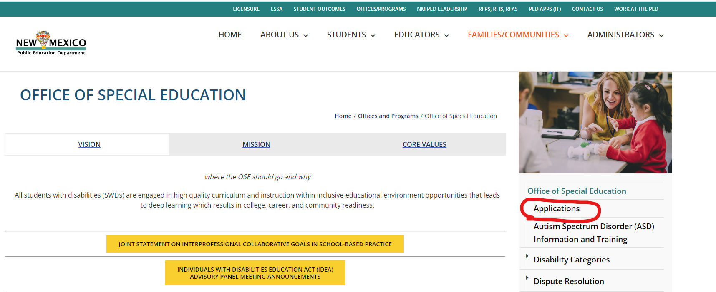
OSE Applications

Slide 97
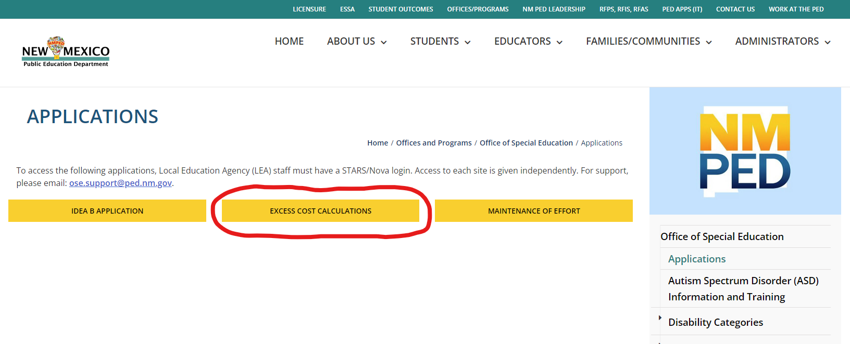
OSE Applications

Slide 98
Q & A
Take a moment to enter your questions on the general information discussed so far.
Use the QR code or click here, to write down your questions.

Slide 99
Excess Cost Site Submission
Once logged in to the SharePoint, find your LEA name from the list and click on the Edit button.
Access:
Must have a STARS/Nova login
If you do not have a STARS/NOVA username, please contact LEA NOVA coordinator to gain access.
For access to the Excess Cost site contact:
Kaylock Sellers or Katalina Gallegos
kaylock.sellers@ped.nm.gov katalina.gallegos@ped.nm.gov

Slide 100
Excess Cost Site Submission
There are two submission fields in the Excess Cost Site, one for Base and one for Compliance.
Base will be collected in the Spring
Compliance will be collected in the Fall.
Base Submission (Spring)
Compliance Submission (Fall)

Slide 101
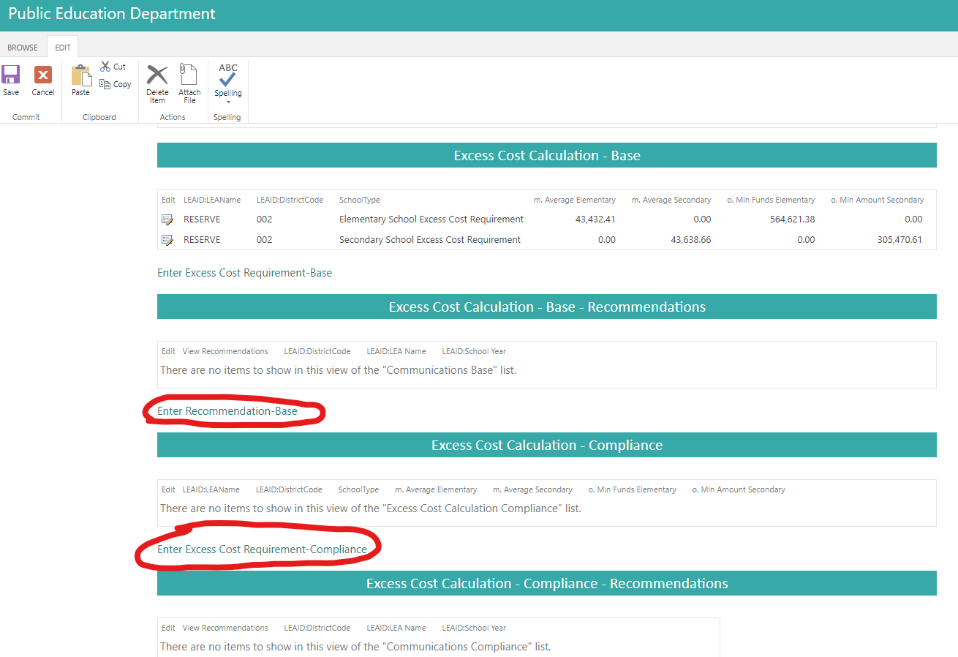
Excess Cost Site Submission

Slide 102
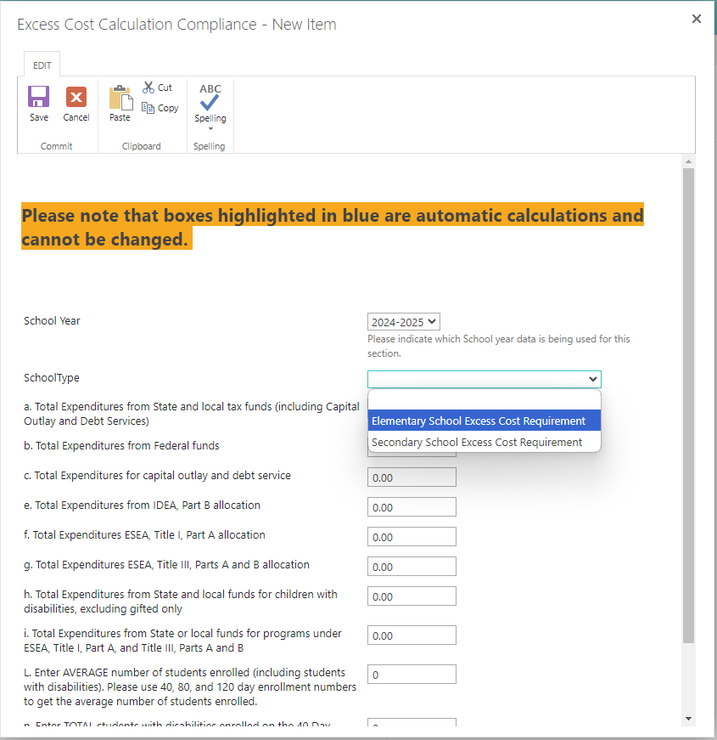
Excess Cost Submission

Slide 103
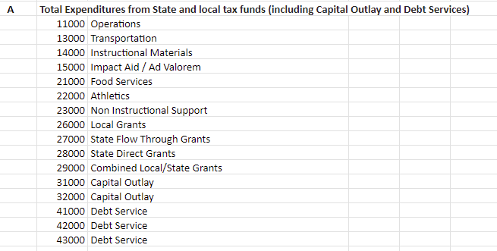
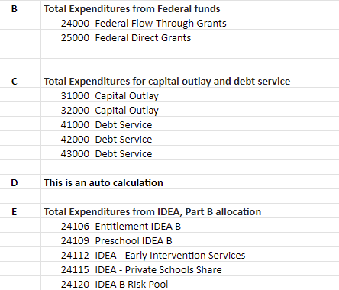
Excess Cost Calculator

Slide 104
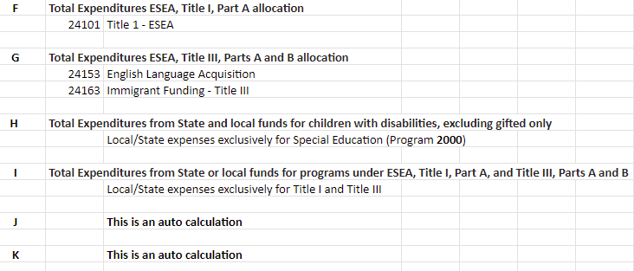
Excess Cost Calculator

Slide 105
Data for Excess Cost Calculation
Data Required for Calculation
Membership data collected by School Budget Bureau. Enter the average number of students enrolled (including students with disabilities). Please use 40, 80, and 120 day enrollment numbers to get the average number of students enrolled.
Total number of students with disabilities (SWD) enrolled on the 40 Day snapshot, excluding gifted only students.
Total expenditures from all sources: local, state, and federal (excluding capital outlay and debt services). Report pulled from OBMS. Reports/Actuals Reports/Actuals Expenditure Rollup Report

Slide 106
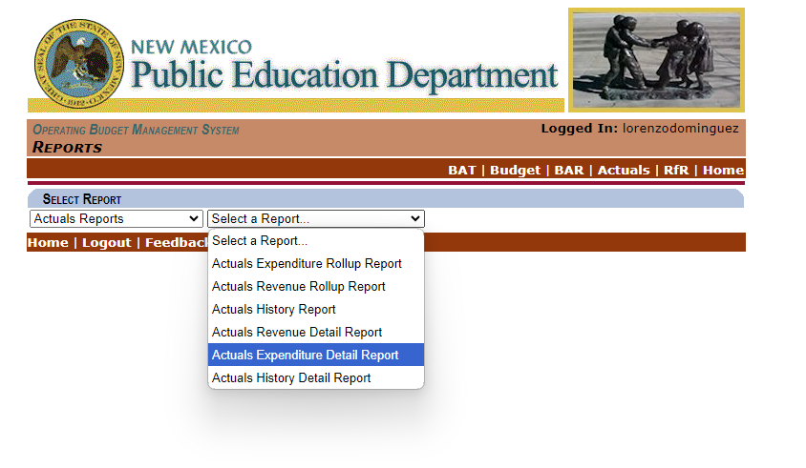
OBMS Actuals Report

Slide 107
Excess Cost Submission to OSE
The window for Excess Cost will open once all actuals have been finalized by School Budget Bureau.
Communication will be sent out statewide once the window is open.
Ensure all LEA staff requiring access have access to the MOE site.

Slide 108
Q & A
Take a moment to enter your questions on the general information discussed so far.
Use the QR code or click here, to write down your questions.

Slide 109
Sources
Supplanting: U.S. Department of Education, IDEA Regulations, Part B - Assistance to States for the Education of Children with Disabilities. Retrieved from https://sites.ed.gov/idea/regs/b/b/300.164/a
MOE Guidance: U.S. Department of Education, Guidance on IDEA and Education Jobs Fund. Retrieved from https://www2.ed.gov/policy/speced/guid/idea/idea-edjobs-guidance.pdf
Excess Costs Calculation: U.S. Department of Education, Appendix A to Part 300 - Excess Costs Calculation. Retrieved from https://sites.ed.gov/idea/regs/b/appendix-a
Excess Cost Guidance Handbook: New York State Education Department. (n.d.). Excess Cost Guidance Handbook. Retrieved from https://www.nysed.gov/sites/default/files/programs/special-education/excess-cost-guidance-handbook.pdf
MOE Quick Reference Guide: Center for IDEA Fiscal Reporting. (2021). LEA MOE Quick Reference Guide. Retrieved from https://cifr.wested.org/wp-content/uploads/2021/04/CIFR-LEA-MOE-QRG.pdf

Slide 110
Finance Team Contact List
Office of Special Education Finance Team:
charlene.marcotte@ped.nm.gov
lorenzo.dominguez@ped.nm.gov
katalina.gallegos@ped.nm.gov
kaylock.sellers@ped.nm.gov
Notes:
Charlene

