Slide 1
Office Hours
Dr. Margaret Cage
Deputy Secretary
The Office of Special Education
September 17, 2024
Investing for tomorrow, delivering today.
Notes:
Good afternoon and welcome to Office Hours!
Today’s Office Hours will be providing updates, technical assistance, professional development, and question answer sessions.
A few housekeeping notes, we will have 10-15 minutes for questions at the end of the presentation. We will be monitoring the chat however; all questions will not be answered until the end of all the presentations. The Office Hours Slide deck will be accessible on the PED website, in special education, under resources or may be found in the LEA Managed Booklet, under the resources tab.

Slide 2
Leadership/Duties of the Office
Dr. Margaret Cage
Deputy Secretary, OSE
Dr. Tyre Jenkins
Deputy Director, OSE
Charlene Marcotte
Deputy Director of Data & Finance
Ria Gill
Assistant Deputy Director, OSE
Lorenzo Dominguez
Assistant Deputy Director of Data & Finance
Develop, review, and propose updates to state special education statutes, rules, policies, and technical assistance
Consult and coordinate with other units of the Department, other state agencies, public post-secondary educational institutions, and key education and community stakeholders on varying special education topics and issues
Coordinate with school districts and public post-secondary education institutions to develop and provide training and professional development to licensed school employees
Provide technical assistance and recommendations to school districts and public schools to implement evidence- and research-based programs and services that are culturally and linguistically responsive
Conduct activities to promote the recruitment and retention of qualified special education practitioners
Solicit input regarding delivery of special education services in the State from various stakeholders
Oversee and enforce the compliance with the IDEA and any state law pertaining to special education
Collect statewide data on varying aspects of special education within the state
Monitor spending of state and federal funds for special education programs
Develop and annually update a state plan for students with disabilities
Notes:
To the right, please find The Office of Special Education priorities that align with the executive order per Governor Lujan-Grisham. To your left, you will find The Office of Special Education Leadership team.

Slide 3
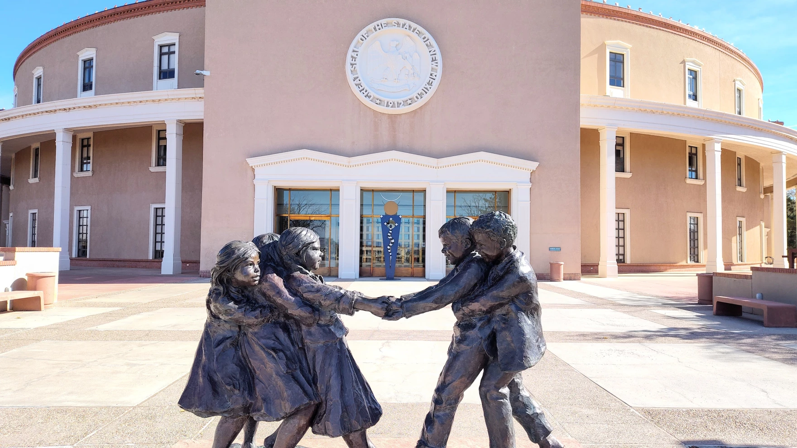
Hiring Updates
https://www.spo.state.nm.us/
Notes:
The OSE is steadily increasing capacity and staff to better serve you. Just a reminder, we are hiring! Please check the state personal office website for job openings.

Slide 4
Special Education Pay Differentials Phase I
Phase I Pay Differential applications: Focus on hard to staff vacant special education positions
Phase I Application Timeline: The application and rubric will be released on August 15, 2024, and will remain open through September 30, 2024.
The recruitment stipend for qualifying positions will be $10,000 for the year, distributed in two payments of $5,000 each in December and May.
Furthermore, LEAs are relieved of the need to budget for "hard to staff" stipends, as all funding will be provided through PED.
Upon approval of an application, additional information will be requested from the LEAs to ensure seamless payment to participating special education teachers and support staff.
Training Sessions:
The OSE conducted virtual training sessions on the application process, links to those recordings can be found below:
Hard to Staff Video Training
Hard to Staff Slide Deck
Notes:
Now turning it over to Deputy Secretary Dr. Cage. Dr. Cage?

Slide 5
Special Education Pay Differentials Phase II
Phase II Pay Differential applications: Focus on retention stipends for current certificated special education teachers in long term positions
Phase II Application Timeline: The application and rubric will be released on October 15, 2024, and will remain open through November 30, 2024.
The retention stipend for qualifying positions will be $5,000 for the year, distributed in two payments of $2,500 each in January and May.
Furthermore, LEAs are relieved of the need to budget for "hard to staff" stipends, as all funding will be provided through PED.
Upon approval of an application, additional information will be requested from the LEAs to ensure seamless payment to participating special education teachers and support staff.

Slide 6
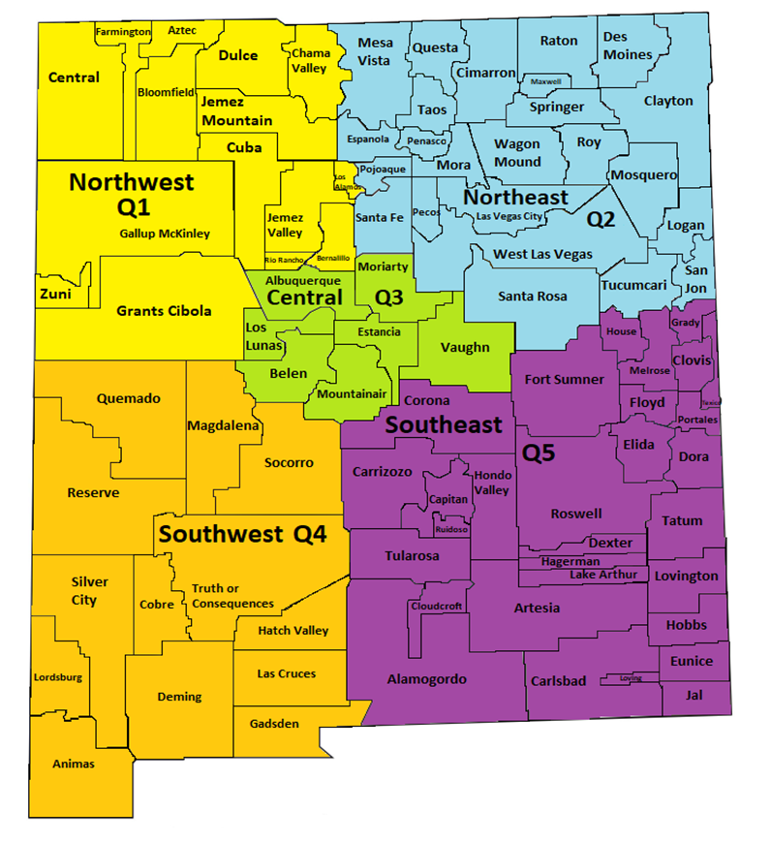
PD Tour
Region | Location | Address | Parent Night | Conference
Quadrant 1 Farmington | San Juan College, Henderson Fine Arts Building | 4601 College Blvd Farmington, Nm 87402 | 5:00-7:00 p.m. Mon., Sept. 30 | 9:00 a.m.-3:00 p.m. Tues., Oct.1
Quadrant 2 Las Vegas | New Mexico Highlands University | 800 National Avenue Las Vegas, NM 87701 | 5:00-7:00 p.m. Tues., Oct. 15 | 9:00 a.m.-3:00 p.m. Wed., Oct. 16
Quadrant 3 Albuquerque | University of New Mexico Division of Continuing Education | 1634 University Blvd, Albuquerque, NM 87102 | 5:00-7:00 p.m. Mon., Nov. 4 | 9:00 a.m.-3:00 p.m. Tues., Nov. 5
Quadrant 4 Las Cruces | New Mexico State University-Las Cruces | TBD | 5:00-7:00 p.m. Tues., Oct 22 | 9:00 a.m.-3:00 p.m. Wed., Oct. 23
Quadrant 5 Hobbs | Hobbs Training Center | 2110 East Sanger Street, Hobbs, New Mexico 88240 | 5:00-7:00 p.m. Tues., Oct. 28 | 9:00 a.m.-3:00 p.m. Wed., Oct. 29
PD Tour Schedule
Notes:
Thank you, Dr. Cage! Jessica Dinsmore from the Professional Development team is next. Jessica?

Slide 7
Parent University
Goal of 500 participants
National panel discussion on supporting students with disabilities
Local & state resources for parents
Providing learning opportunities for parents of students with disabilities
Start of ongoing support for parents
Event Details
Dates
November 13 & 14, 2024
Location
Buffalo Thunder Resort & Casino

Slide 8
Data & Finance
DEADLINES
Indicator 14-September 30th
GY 22 Funds Expire September 30th
Indicator 8 Parent Surveys En Route
DATA & FINANCE TRAINING AGENDA 9.18.24
40-DAY REPORTING
EXCESS COST
MOE
Notes:
Thank you, Jessica! Next up, Deputy Director of Data & Finance Charlene Marcotte. Charlene?

Slide 9
Data/Finance Team Contact List
Office of Special Education Data Team:
charlene.marcotte@ped.nm.gov
lorenzo.dominguez@ped.nm.gov
liz.schweiger@ped.nm.gov
matthew.tomicek@ped.nm.gov
tamara.burkett@ped.nm.gov
Indicator 14:
gdamian@nmhu.edu
NOVA Data:
alison.watt@ped.nm.gov
nicholas.keyes@ped.nm.gov
Notes:
Charlene

Slide 10
Empowering Success for Preschool Children with
Special Needs
Sandy Trujillo-Medina
Shana Runck
Director, Early Care, Education and Nutrition Division
Deputy Director, Early Care, Education and Nutrition Division
Sandy.TrujilloMedina@ececd.nm.gov
Shana.Runck@ececd.nm.gov
Presented by:
The Early Childhood Education and Care Department (ECECD)
Notes:
Thank you, Deputy Director Marcotte! Now, It is our pleasure to introduce Sandy Trujillo-Medina Director of early care, education, and nutrition division for ECECD. Sandy?

Slide 11
ECECD and PED
Advancing Positive Outcomes for Preschool Students with Special Needs and their Families
Improve outcomes for preschool children with disabilities and their families through the implementation of comprehensive technical assistance, monitoring, and support systems that increases access to high-quality inclusive, PreK programming.
Enhance collaboration and strengthen communication between PED and ECECD in providing preschool special education and related services programmatic support and technical assistance to local education agencies (LEAs), NM PreK, Head Start, and childcare programs.
Increase compliance with the Individuals with Disabilities Education Act (IDEA) Part B-619, ensuring the provision of a free appropriate public education (FAPE) in the least restrictive environment for children with disabilities ages three through five.
Improve monitoring and oversight of LEAs and early childhood programs. Ensure the provision of high-quality services to preschool children with disabilities and their families.
11

Slide 12
Memorandum of Agreement (MOA) between ECECD and PED:
The purpose of the MOA is to establish the respective roles and responsibilities of the ECECD and the PED in implementing Executive Order 2023-062, particularly on the:
Implementation of the IDEA Part B-619 grant
Transfer of the 619 Coordinator to ECECD
Ensuring ongoing responsibilities of the state under IDEA Part B-619
12

Slide 13
Roles of the 619 Coordinator
COMPLIANCE
COLLABORATION
PARTNERSHIP
TECHNICAL ASSISTANCE
Conduct IDEA-compliant state-level administration and activities in adherence with the IDEA Part B-619 grant and federal funding requirements.
Collaborate with ECECD colleagues to align Part C-B transition policies and procedures across the state’s early childhood education system, including IDEA Part C programs (Early Intervention Services), Early Head Start and Head Start, Early PreK, and PreK programs.
Work in partnership with PED Office of Special Education in its general supervision and programmatic monitoring of the provision of special education and related services to children with disabilities ages three through five.
Provide special education and related services programmatic support, intensive training, and technical assistance, focused on transitions, to LEAs (both public schools and public charter schools) and other early childhood programs (Part C programs, Head Start, and PreK programs).
13

Slide 14
We’re here to help!
To support implementation of the MOA, ECECD will host weekly virtual office hours from May to June, during which time questions or concerns related to Part B-619 can be addressed. Further information regarding the virtual office hours will be provided before the end of April.
If you have any questions or concerns about the Office of Special Education, roles of ECECD and PED, or Part B-619 Coordinator transition, we encourage you to reach out to us for clarification and guidance. ECECD and PED are collaborating to ensure a timely and smooth transition.
Don't hesitate to contact us for support!
(505) 372-8670
https://webnew.ped.state.nm.us
https://www.nmececd.org/
619Coordinator@ececd.nm.gov
14

Slide 15
Special Education Ombud Flyers
Please direct all website staff, schools, and school personnel to take down the old flyers and post the new flyers in well trafficked areas.
If you would like information about our intake process, family presentations, or general information about our work, please contact:
Clare Gallegos (505) 841-3885
Michelle Tregembo (505)274-3885.
Notes:
Thank you, Sandy! Next up, we are excited to have Michelle Tregembo, Special Education Ombudsmen. Michelle?

Slide 16
IDEA B Panel Meetings
Quadrants: Dates
Q1: September 5 & 6
(Española Public Schools)
Q2: November 7 & 8
(Virtual)
Q3: February 20 and 21
(Virtual, with the ICC joining on the 21st)
Q4: May 1 & 2
(Location to TBD)
Contact Kaity Ellis for questions
kaitlin.ellis@ped.nm.gov
505-709-7690
Notes:
Thank you, Michelle! Chief Counsel Miguel Lozano is on deck next. Miguel?

Slide 17
OSE Monthly Newsletter
Submissions are due by the third Friday of each month and should be sent to special.ednews@ped.nm.gov. The only month that submissions are not due the third Friday of the month is February.
The following form can be shared with colleagues who wish to receive the OSE Newsletter: OSE Signup Form.
Here is a linked newsletter submissions schedule through November 2025, as to when article submissions are due.
If you have questions about the newsletter email special.ednews@ped.nm.gov.
Notes:
Thank you, Miguel! Next up, Liz Schweiger, Liz?

Slide 18
Contact List
Cage, Margaret | margaret.cage@ped.nm.gov | Director of Special Education
Jenkins, Tyre’ | tyre.jenkins@ped.nm.gov | Deputy Director, Office of Special Education
Lozano, Miguel | miguel.lozano@ped.nm.gov | Chief Counsel
Marcotte, Charlene | charlene.marcotte@ped.nm.gov | Deputy Director of Finance and Data
Gill, Ria | ria.gill@ped.nm.gov | Assistant Deputy Director, OSE
Dominguez, Lorenzo | lorenzo.dominguez@ped.nm.gov | Assistant Deputy Director of Data & Finance
Perea, Sharyn | sharyn.perea@ped.nm.gov | Dispute Resolution Coordinator
Cassel, Elizabeth | elizabeth.cassel@ped.nm.gov | Parent and Community Liaison, Complaints and CAPS
Pacheco, Lorie | lorie.pacheco@ped.nm.gov | General Supervision, Low Incidence, NIMAS/NIMAC
Schweiger, Liz | liz.schweiger@ped.nm.gov | Education Administrator, Data Analyst, Indicator 13
Sellers, Kaylock | kaylock.sellers@ped.nm.gov | Financial Coordinator
Quick, Catherine | catherine.Quick@ped.nm.gov | General Supervision, Early Childhood Ed
Notes:
Switching gears to the updated OSE Contact list.

Slide 19
Contact List
Gallegos, Katalina | katalina.gallegos@ped.nm.gov | Management Analyst
Cordova, Trudy | trudy.cordova@ped.nm.gov | Education Administrator, Professional Development
Dinsmore, Jessica | jessica.dinsmore@ped.nm.gov | Education Administrator, Program and Support Specialist
Burkett, Tammy | tamara.burkett@ped.nm.gov | Education Administrator Data Analyst
Hedrick, Yaling | yaling.hedrick@ped.nm.gov | Education Administrator Program & Support monitor
Gonzales, Kim | kimberly.gonzales1@ped.nm.gov | Education Administrator Program & Support Specialist
Ellis, Katiy | kaitlin.ellis@ped.nm.gov | Social & Community Coordinator
Campbell, Natalie | natalie.campbell@ped.nm.gov | Assistant General Counsel
Tomicek, Matthew | matthew.tomicek@ped.nm.gov | Education Administrator, Data Analyst
Rodriguez, Jennifer | jennifer.rodriguez1@ped.nm.gov | Executive Secretary
Notes:
This is our continued contact list.

Slide 20
Resources
Topics Covered March-August 2024
Graduation and Diploma Programs of Study
Instructional Best Practices
OSEP Indicators 1-17
LEA Allocation Spending
IDEA B Application Training
IEP Template Draft
IDEA B Monitoring Protocol
Excess Cost Application
NOVA Validations
Funding Awards
Have Questions for OSE?
ose.support@ped.nm.gov
OSE Parent Portal
September 2024 OSE Newsletter
OSE Resources
LEA Managed Booklet
Notes:
Just a reminder, you can find Office Hours recordings and slide decks on the PED website, navigate to special education, under the resources tab. Listed are some of the many topics that we have covered in Office Hours since March of 2024. Navigating to the right, please find links to the OSE Parent portal, Newsletter, Resources, LEA Managed Booklet or if you have questions for OSE.

Slide 21
OFFICE HOURS SESSIONS
OFFICE HOURS SESSIONS
10.15.24
Notes:
Now that we have strolled down memory lane with the topics from the last 6 months, we are looking forward to the next six months. Due to popular demand and lots of feedback, The Office of Special Education will be transitioning from regular Office Hours to “Office Hours Sessions”. Office Hours Sessions will be your one stop shop for OSE trainings, updates, technical assistance, professional development, with extended hours of operation, and presentations from other Departments and/or Bureaus. Office Hours sessions begin October 15th, 2024.

Slide 22
Office of Special Education Office Hours Sessions
October 15, 2024
Time: 3:30 – TBD
Location: Virtual, Microsoft Teams Click here to join the meeting
Click here to join the meeting
Meeting ID: 252 341 847 618 Passcode: 7tVTBm
Or call in (audio only)
+1 505-312-4308,,779020632#
Phone Conference ID: 779 020 632#
Notes:
Office Hours Sessions will be held every third Tuesday of the month @ 3:30 pm. Our next Office hours will be October 15th

Slide 23
Questions From The Field?
Notes:
Now we will open it up for questions. Please remember to raise your hand or type in chat.

