Slide 1


Indicator 13 Secondary Transition for Students
Presentation for …
Lizana Schweiger, EA Secondary Transition Coordinator OSE
Charlene Marcotte Deputy Director Data and Finance (DDDF)
October 2024
Investing for tomorrow, delivering today.

Slide 2

What is Secondary Transition
States are required to report data on the “percent of youth with IEPs aged 14 and above with an IEP that includes appropriate measurable postsecondary goals that are annually updated and based upon an age-appropriate transition assessment, transition services, including courses of study, that will reasonably enable the student to meet those postsecondary goals, and annual IEP goals related to the student’s transition service needs. There also must be evidence that the student was invited to the IEP Team meeting where transition services are to be discussed and evidence that, if appropriate, a representative of any participating agency was invited to the IEP Team meeting with the prior consent of the parent or student who has reached the age of majority.”(20 U.S.C. 1416(a)(3)(B)).
Secondary Transition is the process of preparing students for adult life after they leave high school. (This is their game plan for a productive life after high school) Transition planning begins at age 14, or younger if determined appropriate by the IEP team, as students consider their goals for the time after graduation through career awareness exploration activities.
Notes:
Reminder Secondary Transition is a game plan for a productive adult life for our students after high school

Slide 3

What is SPP Indicator 13
A State Performance Plan (SPP) is a plan developed by each state in the United States to evaluate its efforts to implement the requirements and purposes of the Individuals with Disabilities Education Act (IDEA) and to describe how the state will improve its implementation. Indicator 13 or Secondary Transition is a Compliance Indicator that measures compliance with the requirements of the IDEA
New Mexico as a state reports to OSEP each year on Indicator 13 to annually determine if New Mexico meets the requirements and purposes of the IDEA.
Notes:
This is the process NM uses to report to OSEP our results that’s why it is important that we get this process correct for our students. Reminder if you do not score 100% this is required by OSEP you will have to do another draw of student ID and correct the student IEP you did not get correct the first time. I will go over this process again later in this presentation.

Slide 4

LEA must score 100% for Indicator 13
How to score 100% on Indicator 13 the IEP must contain the following:
Age-appropriate transition assessments starting at or before age 14
Postsecondary goals based upon transition assessments
Annual transition goals
Transition services/Coordinated activities
Courses of study
Student input (invited to meeting and preferences and interests considered)
Outside agency participation example DVR
Notes:
Please note all the members sitting around the table they all can help with the secondary transition process for our students. One Key and most important application in this process is the students themselves they need to participate advocate for themselves if they do not start at these meetings when will they start to advocate for themselves.

Slide 5

Students' role in their Secondary Transition IEP
Our students have the most important role. As educators we are creating their future with their input or game plan or life plan
Our students need to set goals, make plans to achieve their goals
Attend their IEP meeting
Actively participate in the transition planning process
Learn how to Help lead in their IEP meeting
Learn and practice self-determination skills this will help them to deal with others in their future work environment.

Slide 6


QUESTIONS
Q&A Booklet

Slide 7
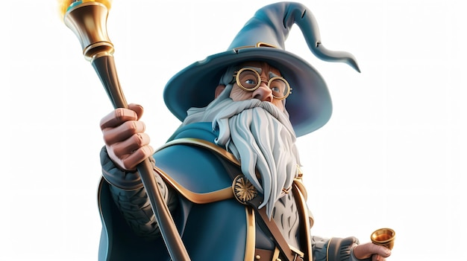
Evaluating your IEPs per OSEP
Now how do we evaluate these IEPs you send to us here at OSE
We created a Rubric for our reviewers to use to make sure we are all evaluating the IEP the same.
We have a team of Educators who look at and review each IEP in accordance with OSEP guidelines and the Rubric
When all IEPs are reviewed from each district we will share the results with you.
If you do not score 100% you will be asked to correct the IEPs that did not pass along with another random sample of IEPs for review.

Slide 8

What are the 8 OSEP Questions??
Here we go the following pages will outline the 8 OSEP questions The reviewers use these questions to determine your score for Indicator 13, Secondary Transition.
And these questions have not changed for years.

Slide 9

Question 1 from OSEP
Are there appropriate measurable post-secondary annual goals in the areas of training, secondary education, employment and where appropriate, independent living skills?
  Based upon results from transition assessments each student must have postsecondary goals in the areas of:
  Secondary Education/Training
  Employment Independent Living
  The IEP team may also address the following if determined appropriate
  Independent Living (Money management, Adult life etc.)
  Community Participation
  Postsecondary Goals are measurable if they answer the following questions:
  Where will the student LEARN after high school?
  Where will the student WORK after high school?
  Where will the student LIVE after high school?

Slide 10
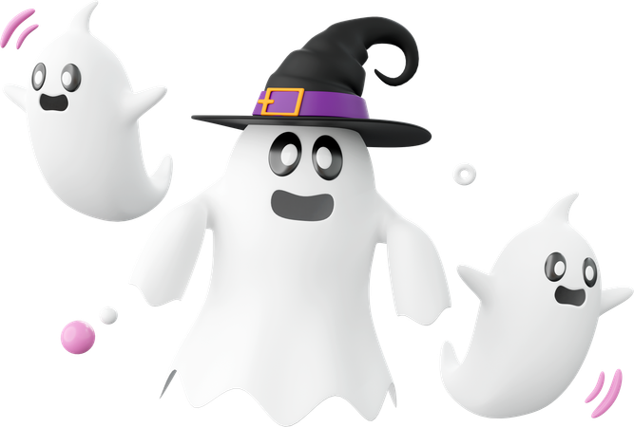
Do You know about IL?? Independent Living Center
Independent Living Pass through contacts go through DVR for IDEA B
  Self Advocacy
  Financial, Money Management

Slide 11
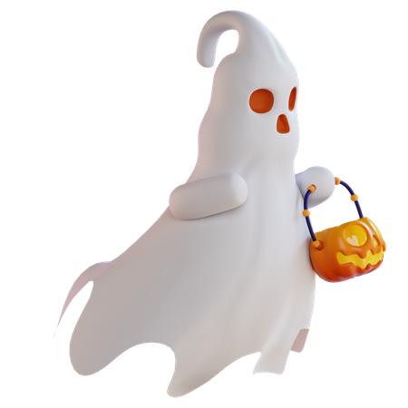
Question 2 from OSEP
Are the Postsecondary goals updated annually?
Should be updated annually
These goals should focus on helping the student succeed in school subjects and with everyday life skills.
Once new IEP goals are set the IEP team decides what supports and services will help the student reach those goals.
REMINDER Student input is very important when creating annual goals.

Slide 12

Question 3
3. Are the measurable post-secondary goals based upon an age-appropriate transition assessment?
Age-appropriate transition assessments are a set of tools and methods that help students with disabilities to identify their strengths, preferences, interests, and needs as they relate to the demands of current and future working, educational, living, and personal and social environments.
These assessments provide a means to obtain data that serves as a common thread in the transition process and forms the basis for defining goals and services to be included in the Individualized Education Program (IEP)

Slide 13
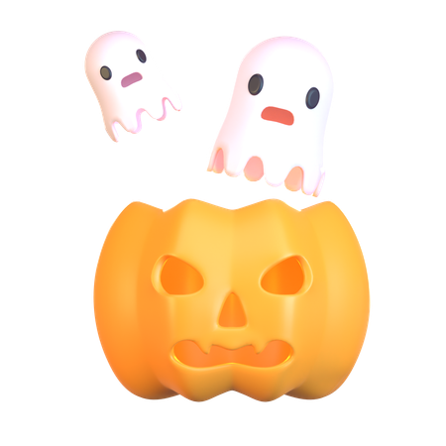
Questions 4 from OSEP
4. Does the plan include transition services?
A coordinated set of activities designed to help students with IEPs prepare for life after high school. Planning is about more than just college — it covers jobs and daily life skills too.
Collecting data serves as the common thread in the transition process and forms the basis for defining goals and services to be included in the IEP
Notes:
As you collect the assement on each student use this data to help define the students strengths this will be mentioned several times in this presentation the Data is the most important aspect of developing a well-rounded Transition plan

Slide 14
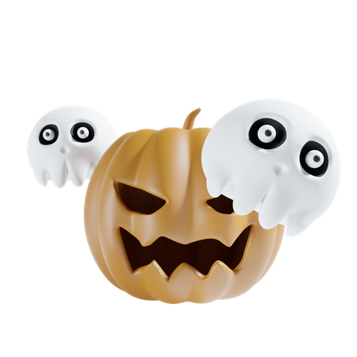
Question 5 from OSEP
5. Does the plan include courses of study?
The Course of Study should identify the specific courses that a student will take, whether in special education or general education, that directly support progress toward postsecondary and annual goals.
Example:
If a student wants to become a Graphic Designer.
Course of study should list core classes in addition to classes related to the postsecondary goals.
Creating the course of Study, the student needs to answer the following questions
What classes and activities do I need to prepare me to learn, work and live where I want after leaving school?
What extra activities do I need?
The answer to this question becomes the course of study.

Slide 15
QUESTIONS
Q&A Booklet

Slide 16

Course of study
Course of Study
Courses and other educational experiences to help students reach postsecondary goals.
Developed for 4years of a student’s education.
Appropriate electives listed by course name.
Individualized and linked to the student’s post school goals.
Course of Study

Slide 17

Question 6 from OSEP
6. Are there annual IEP goals related to the students transition service needs?
For Indicator 13 compliance, at least one annual goal must relate to the student’s transition service needs. Annual goals address transition needs when they state the present level of academic or functional skill or knowledge that needs to be improved in order for the student to achieve their postsecondary goals. Based on NEEDS Identified through transition assessments.

Slide 18
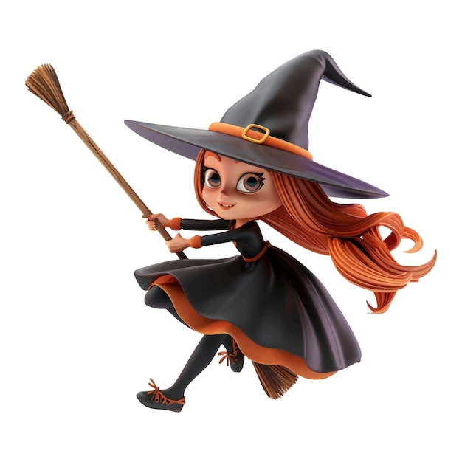
Annual IEP Goals
Post-secondary goals and transition needs drive the annual IEP goal development process.
Transition IEPs must contain the following annual goals:
One goal for each of the PS goals.
Goals to address student’s soft skills needs.
Measurable Post -Secondary Goals
Annual IEP Goals

Slide 19
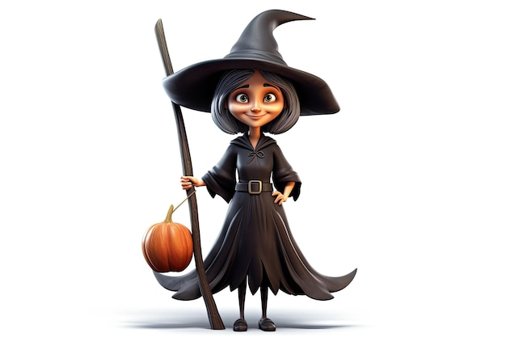
Questions 7 and 8 from OSEP
Is there evidence that the student was invited to the IEP team meeting?
Student and Parent/Guardian should both have a personal IEP invite for the meeting.
Is there evidence that a representative of a participating agency was invited to the IEP meeting? Is there evidence parent or student consent was received?
Was DVR invited, who attended the meeting, what did they review with the IEP team. Was consent received?
Reminder this process must be documented in the IEP.

Slide 20
QUESTIONS
Q&A Booklet

Slide 21

Providing the Student and Youth with Support to Make Their Decisions
Beyond developing social skills, it is crucial for students with disabilities to understand and acquire the skills for self-determination during high school to ensure success in postsecondary education and the workplace. Students with strong self-advocacy skills who understand and fully participate in the development of their IEP have better transition outcomes.
Key characteristics of self-determination are the ability to:
• Speak for yourself (self-advocacy);
• Solve problems;
• Set goals
Make decisions;
• Possess self-awareness
Exhibit independence
Notes:
As mentioned before self-determination/self advocacy skills are vital for our students to have. Getting used to attending IEP meetings and participating will help them in the long run for a successful life after high school.

Slide 22
Educators can help students develop self-determination skills when they:
• Support students in establishing their own transition goals, including postsecondary education, career, and independent living goals;
• Ensure that students are actively involved in IEP meetings and understand their IEPs, including their specialized instruction and related services, the accommodations they receive for instruction and assessments, if applicable, and supplementary aids and services to facilitate their education in the least restrictive environment;
• Help students develop skills to direct their own learning;
• Create and maintain a system that supports family involvement and empowers families to support the self-determination of their sons and daughters.

Slide 23
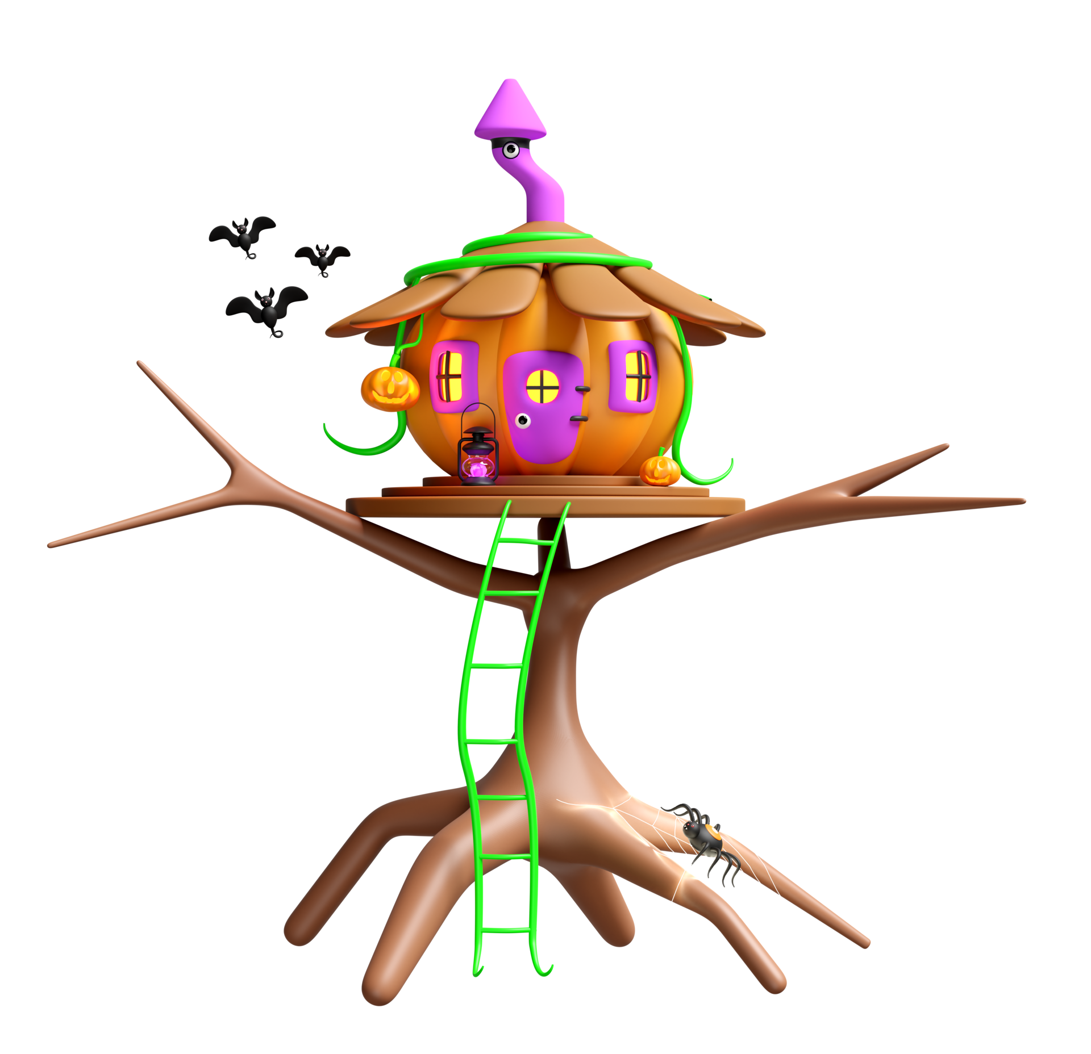
continued
Developing self-determination and making informed choices heighten students’ knowledge of the transition process and success in post-school settings
Notes:
Self Determination is a big part of the students development I know I keep mentioning this but it is very important.

Slide 24
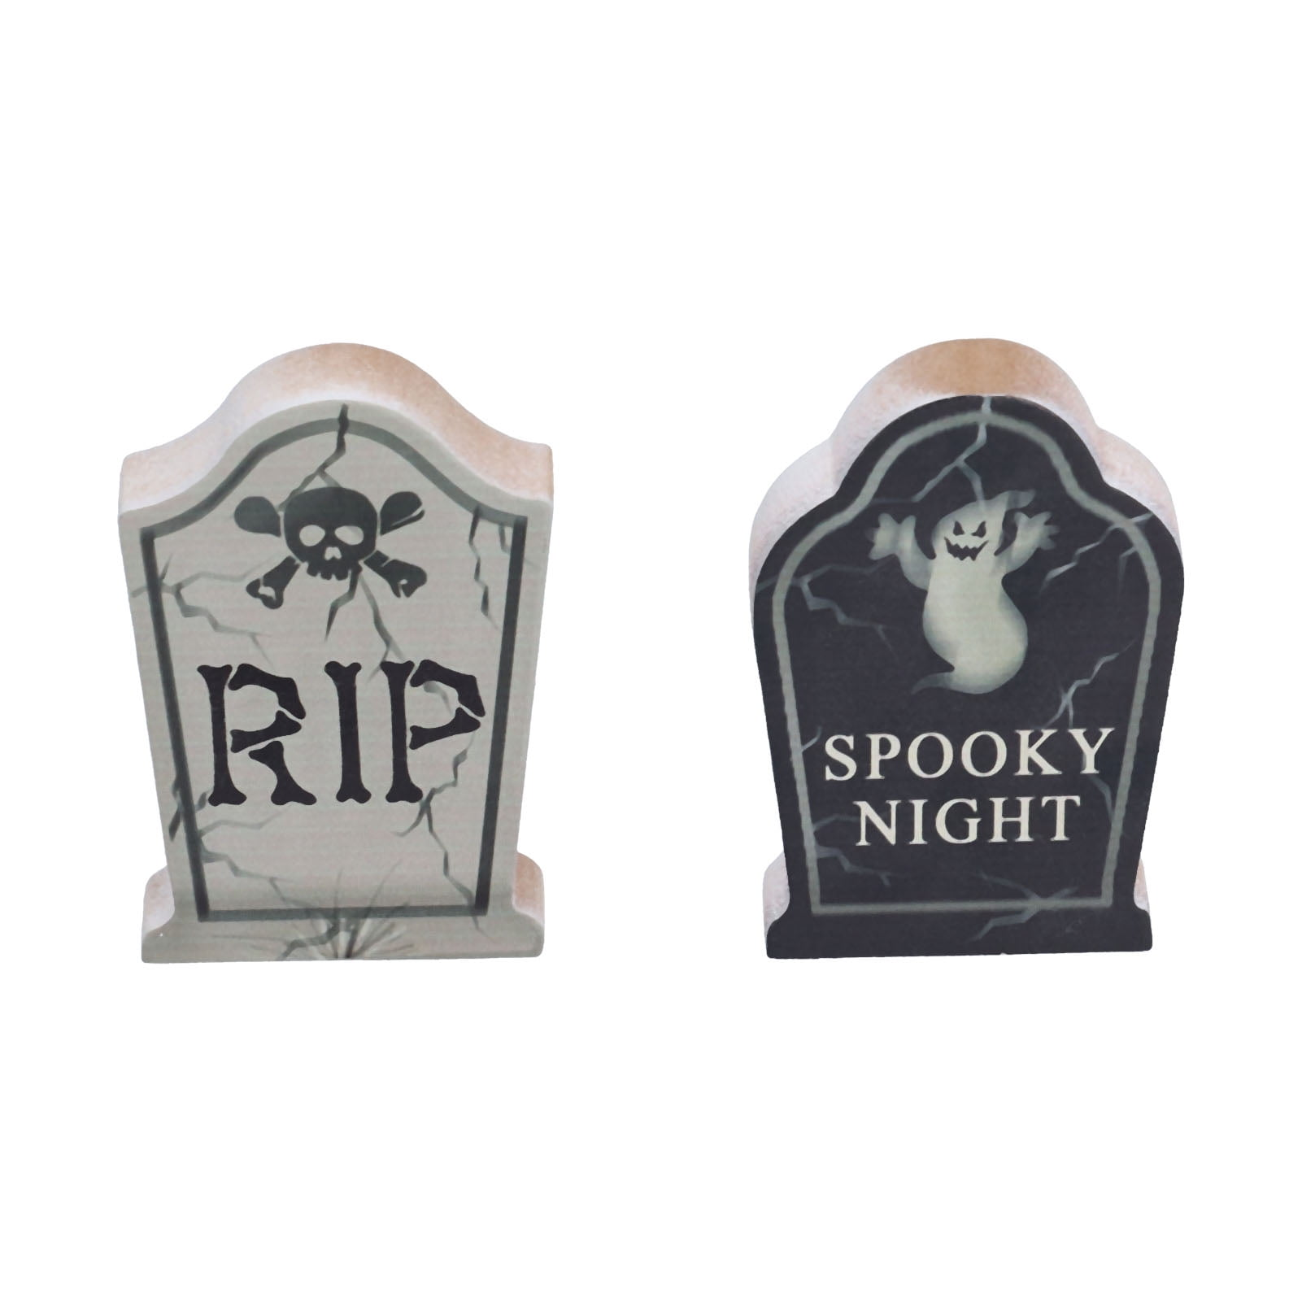
Guidance and Writing Tips
• Postsecondary goals are what the student will do after exiting the public school system. Because students in 18-21 transition programs are still part of the public school system, postsecondary goals must address what the student will do after exiting the 18-21 program.
• The postsecondary goals should succinctly state what the student will do and must be written as measurable outcomes that take place after exiting the public school system. Postsecondary goals are not stating a process but rather a point in time after high school graduation.
Using the phrase “plans to” or “hopes to” is not an outcome and implies a process. Use definitive language like “will be enrolled”, “will be employed”, “will participate”.
• All postsecondary goals should be driven by data, including:
Transition assessments
Student interviews (formal and informal)
Additional data points (e.g., classroom data, on the job data) Strengths, interests, preferences, and needs.

Slide 25

Postsecondary Goals
Postsecondary goals are required in training/education and career/employment, regardless of the severity of the student’s disability.
If the IEP team determines that a postsecondary goal is not needed for independent living skills, it is best practice to indicate/document.
“The IEP team has considered the independent living domain and at this time has decided it is not needed in this transition plan.”
Postsecondary Goals for Education/Training (Required)
Within one year of graduation, Henry will be enrolled at the Institute of Animal Technology to become a Vet Tech.

Slide 26

Postsecondary Goals
Postsecondary Goals for Independent Living (where appropriate)
• After graduation from high school, Bill will live at home and independently participate to the maximum extent possible in his daily routines (e.g., feeding, dressing, bathing, etc.).
• After graduation from high school, Jackie will dress and feed herself with assistance.
• After graduation, Barry will live independently in his own home/apartment, schedule appointments, pay his own bills, and access services in his community by using the city bus.
• N/A- The IEP team determined that a goal for Independent Living is not needed for Ethan at this time as a result of the data from his transition assessments again please document in the IEP.

Slide 27

OSE Process for Indicator 13 Review
Where to find the Special Education program go to:
  PED Website
  PED Apps (IT)
  (IT) Applicator
Early December 2024 you will have 2 weeks to submit your randomly chosen IEP(s) into the Special Education Monitoring site/2024-2025/Indicator 13 Post Secondary Transition/Student 14-15 or Student 16+
NOTE: If you do not submit your IEP within the 2-week time notification your IEPs will be identified as not submitting timely data which will impact your determination.

Slide 28

IEP Upload
IEPs must be in PDF format
Upload the entire IEP
  •Parent invitation
  •Student invitation
  •Signature page (Required)
Name IEP files as follows:
•Last 4 digits of the student ID number, underscore, then type of document.
•Do not use student names.
•Examples:
•1234_invitation
•1234_correction

Slide 29

OSE Process for Indicator 13 Review
OSE will start reviewing IEP in early January 2025
Your score will be provided to you once all the reviews are complete in early February 2025 check the Special Education Monitoring Site for your score. You will not get an email from OSE about your score you must check the Special Education Monitoring Site for your score.

Slide 30

OSE Process for Indicator 13 Review
You will only get an email from me if you did not score 100% on your review
Prong II
Prong II, you will be asked to make whole the IEP(s) you did not score 100% and provide another randomly selected group of IEP for review (Special Education Monitoring Site) This must be completed within 10 days of notification.
Please check NOW to make sure you have access to the Special Education Monitoring Site if not who do you notify?

Slide 31
QUESTIONS
Q&A Booklet

Slide 32
Access to Special Education Monitoring Site
Mahesh
Mahesh.Reddy-Erri@ped.nm.gov

Slide 33

Questions
This Photo by Unknown Author is licensed under CC BY

Slide 34
Lizana Schweiger you can call me Liz Liz.Schweiger@ped.nm.gov
505 500 7450
Don’t forget to enter your questions I want to help you to help our students be successful after high school.

Slide 35
Process for Annual IEP review

Slide 36
2023-2024 Annual IEP Review
Each Local Education Agency (LEA) with students with disabilities (SWDs), age 14 and above, must participate in the annual review
All SWDs, enrolled at 40th day are eligible for review.
  This includes SWDs in local charter schools
LEA will select the student ID for review only this year. You should have received an email that we will review next.

Slide 37
EMAIL from January 3, 2024
This year, there will be changes in the process of selecting and submitting Individualized Education Programs (IEPs) for the Indicator 13 Annual Review. The new process is outlined below:
The Annual IEP Review 2023-2024 for Indicator 13 Secondary Transition Student ID’s will not be randomly selected by PED/Office of Special Education(OSE) this year. LEAs will select the sample of student IEPs to be reviewed. To select the IEPs:
  Go to the Annual IEP Review spreadsheet to determine the number of student IEPs requested for review by group, ages 14-15 and 16+.

Slide 38
Annual IEP Review Spreadsheet Attachment Charter Schools will submit the same amount as last year.
District | Prong I (State) 14-15 | Prong I 16+
Aldo Leopold High School | 10 | 10
Amy Biehl Charter High School | 10 | 10
21st Century Public Academy | 4 | 0
ACES Technical High School | 0 | 0
AIMS @ UNM | 5 | 1
Alamogordo Public Schools | 17 | 15
Albuquerque Bilingual Academy/La Promesa | 2 | 0

Slide 39
Email Continued
Use the attached template 14-15 IEP Verification and 16+ IEP Verification to create a list with the student’s full State student identification number and name.
  Upload the completed spreadsheet templates to the Special Education Monitoring site (https://eui.ped.state.nm.us/sites/SpecialEdMon/default.aspx) by Friday 1.12.24, close of business (COB).
  Deadline to submit student IEP into the Special Education Monitoring site is Wednesday,1.31.24 COB.
  The Sample size for the review is 10 or 10% which ever is greater.
  All IEPs will be requested from LEAs with a sample size of less than 10

Slide 40
14-15 IEP Verification Spreadsheet Attachment
Student ID | Student Name

Slide 41
The following slides are consistent procedures followed last year but we will still review.

Slide 42
STEP 1 NOVA/STARS
NOVA/STARS Credentials required to access the Special Education Monitoring site.
Reminder your STARS credential will let you access the Special Education Monitoring site.
Log in and password
To obtain Nova Credentials: Nova – New Mexico Public Education Department (state.nm.us)
Complete and submit the online NOVA Authorization Form.
A username and password will be assigned.

Slide 43
STEP 2 Access to the Special Education Monitoring Site
Obtain access to the Special Education Monitoring Site from Mahesh Reddy-Erri
Mahesh.Reddy-Erri@ped.nm.gov please CC Liz.Schweiger@ped.nm.gov
Use NOVA credentials (login and password) to access the collection site.
Please note this step is required. NOVA access alone does not authorize access to the Special Education Monitoring site.

Slide 44
STEP 3 Uploading IEPs for Review
Friday 1.12.24 through Wednesday 1.31.24, upload the IEPs to the Special Education Monitoring Site
Wednesday 1.31.24 is the absolute last day to upload IEPs to be reviewed no exceptions.
How to upload IEPs:
  Monitoring site location
  PED website > PED APPS (IT) > IT Applications > Click in Special Education Monitoring > Click PROCEED to leave PED website > Enter STARS login and password
  In SE Monitoring site, upload IEP’s
  Click on Special_Ed_Monitoring > Select LEA > Select Indicator 13 Post Secondary Transition > Select 2021-2022 > Select Annual Review folder > Upload IEPs

Slide 45
STEP 4 IEP Upload Guidance
LEAs that do not submit IEPs by Wednesday 1.31.24 will be identified as not submitting timely data, which will impact the LEAs annual determination
LEAs have 10 days to correct upload notification of Indicator Non-compliance
IEPs must be in PDF format

Slide 46
STEP 4 Continued
Upload the entire IEP
  Parent invitation
  Student invitation
  Signature page
  Name IEP Files as listed below
  Last 4 digits of the student ID number, underscore, then type of document.
  Do not use student names.
  Examples
  1234_invitation
  1234_Correction

Slide 47
STEP 5 Notification
When all your IEP are uploaded into the Special Education Monitoring site
Email: matthew.tomicek@ped.nm.gov and cc Liz.Schweiger@ped.nm.gov
Please note, this step is required. IEPs uploaded outside the upload timeframe may result in the IEP not being reviewed.
With a score of 0% for Indicator 13 you will receive a Non-Timely and Non-Reliable, Needs Intervention determination letter.

Slide 48
Pre-Finding Corrections
  LEAs have 10 days from notification from Liz Schweiger to correct non-compliance:
    Upload missing documents; and/or
    Make corrections and upload corrected IEP/addendum
  IEPs missing an invitation which the LEA does not have in it’s
possession are automatically non-compliant.
IEPs with missing documents and/or requiring corrections, not uploaded within 10 days of notification, will be considered non-compliant.

Slide 49
Important Information
Please review your submitted IEPs carefully take the time to ensure they are in compliance.
Reminder IEP Review Sheets are always available in the Special Education Monitoring site for you to review.
If you have personnel changes in Special Education Directors/LEA, please send me an email with the new contact information.
Any questions during the review should be directed to me. Please do not contact the REC reviewers.
Any LEA that does not have a score of 100% after Pre-Finding will have to participate in a Prong II review.

Slide 50
Overdue IEPs
Overdue IEPs will:
  Automatically be considered non-compliant
  Not be reviewed
LEAs who submit Overdue IEPs will be considered non-compliant with the indicator.

Slide 51
Thank you for your time today
Liz.Schweiger@ped.nm.gov
matthew.tomicek@ped.nm.gov Data
QUESTIONS/COMMENTS

