Slide 1
Reminders
Notes:
Please take a minute to ensure you are muted and any AI notetakers are turned off. Thank you!

Slide 2
Office Hour Sessions
Dr. Margaret Cage
Deputy Secretary
The Office of Special Education
October 15, 2024
Investing for tomorrow, delivering today.
Notes:
Good afternoon and welcome to Office Hour Sessions!
Today’s Office Hours will be providing updates, technical assistance, professional development, and question answer sessions.
A few housekeeping notes, we will have 10-15 minutes for questions at the end of the presentation preceding the training portion of todays session. Training questions will be answered on The Office of Special Education’s Q& A Booklet that is a living document, link will be in the chat. The Office Hour Sessions Slide deck will be accessible on the PED website, in special education, under resources or may be found in the LEA Managed Booklet, under the resources tab.

Slide 3
Leadership/Duties of the Office
Dr. Margaret Cage
Deputy Secretary, OSE
Dr. Tyre Jenkins
Deputy Director, OSE
Charlene Marcotte
Deputy Director of Data & Finance
Ria Gill
Assistant Deputy Director, OSE
Lorenzo Dominguez
Assistant Deputy Director of Data & Finance
Develop, review, and propose updates to state special education statutes, rules, policies, and technical assistance
Consult and coordinate with other units of the Department, other state agencies, public post-secondary educational institutions, and key education and community stakeholders on varying special education topics and issues
Coordinate with school districts and public post-secondary education institutions to develop and provide training and professional development to licensed school employees
Provide technical assistance and recommendations to school districts and public schools to implement evidence- and research-based programs and services that are culturally and linguistically responsive
Conduct activities to promote the recruitment and retention of qualified special education practitioners
Solicit input regarding delivery of special education services in the State from various stakeholders
Oversee and enforce the compliance with the IDEA and any state law pertaining to special education
Collect statewide data on varying aspects of special education within the state
Monitor spending of state and federal funds for special education programs
Develop and annually update a state plan for students with disabilities
Notes:
To the right, please find The Office of Special Education priorities that align with the executive order per Governor Lujan-Grisham. To your left, you will find The Office of Special Education Leadership team.

Slide 4
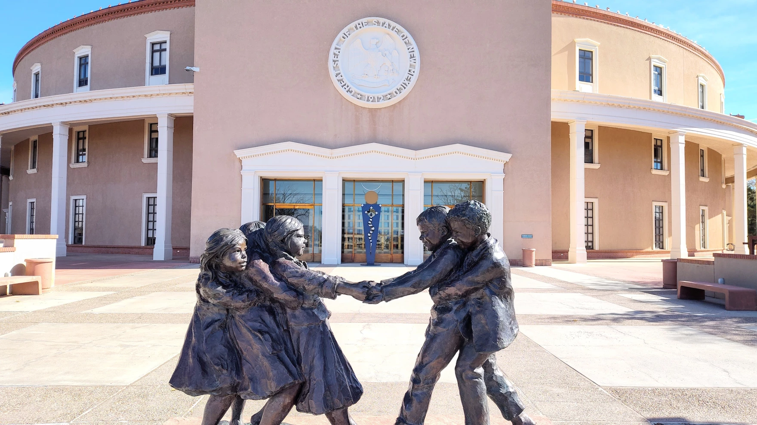
Hiring Updates
https://www.spo.state.nm.us/
Notes:
The OSE is steadily increasing capacity and staff to better serve you. Just a reminder, we are hiring! Please check the state personal office website for job openings.

Slide 5
Special Education Pay Differentials Phase II
Phase II Pay Differential applications: Focus on retention stipends for current certificated special education teachers in long term positions
Phase II Application Timeline: The application and rubric will be released on October 15, 2024, and will remain open through November 30, 2024.
The retention stipend for qualifying positions will be $5,000 for the year, distributed in two payments of $2,500 each in January and May.
Furthermore, LEAs are relieved of the need to budget for "hard to staff" stipends, as all funding will be provided through PED.
Upon approval of an application, additional information will be requested from the LEAs to ensure seamless payment to participating special education teachers and support staff.
Notes:
Dr. Cage will now present on pay differentials. Dr. Cage?

Slide 6
Special Education Pay Differentials Training
Training Sessions:
The OSE conducted virtual training sessions on the application process, links to those recordings can be found below:
Hard to Staff Video Training
Hard to Staff Slide Deck
Notes:
Training sessions

Slide 7
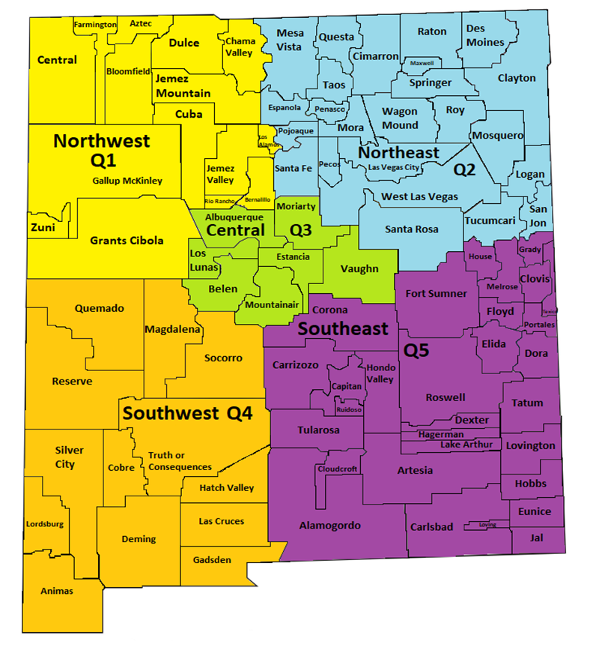
PD Tour
Region | Location | Address | Parent Night | Conference
Quadrant 1 Farmington | San Juan College, Henderson Fine Arts Building | 4601 College Blvd Farmington, NM 87402 | 5:00-7:00 p.m. Mon., Sept. 30 | 9:00 a.m.-3:00 p.m. Tues., Oct.1
Quadrant 2 Las Vegas | New Mexico Highlands University | 800 National Avenue Las Vegas, NM 87701 | 5:00-7:00 p.m. Tues., Oct. 15 | 9:00 a.m.-3:00 p.m. Wed., Oct. 16
Quadrant 3 Albuquerque | University of New Mexico Division of Continuing Education | 1634 University Blvd, Albuquerque, NM 87102 | 5:00-7:00 p.m. Mon., Nov. 4 | 9:00 a.m.-3:00 p.m. Mon., Nov. 4
Quadrant 4 Las Cruces | New Mexico State University-Las Cruces | 3000 Herb Wimberly Dr, Las Cruces, NM 88011 | 5:00-7:00 p.m. Tues., Oct 22 | 9:00 a.m.-3:00 p.m. Wed., Oct. 23
Quadrant 5 Hobbs | Hobbs Training Center | 2110 East Sanger Street, Hobbs, NM 88240 | 5:00-7:00 p.m. Mon., Oct. 28 | 9:00 a.m.-3:00 p.m. Tues., Oct. 29
PD Tour Schedule
Notes:
Thank you, Dr. Cage! Jessica Dinsmore from the Professional Development team is next. Jessica?

Slide 8
PD Tour Promotions Library

Slide 9
November 14th
Buffalo Thunder Resort
Parent University

Slide 10
Data & Finance
October 2024
Indicator 13 Annual Review Training for LEAs
Pre-finding Correction Training for LEAs
40-Day reporting opens, data review begins
Excess cost compliance completion by LEAs
MOE compliance completion by LEAs
Determination letters sent to LEAs
Notes:
Thank you, Jessica! Next up, Deputy Director of Data & Finance Charlene Marcotte. Charlene?

Slide 11
Data & Finance Calendar
Data Training: Purple
Finance Training: Blue
Training Key
October 2024
November 2024
December 2024
January 2025
Indicator 13 Annual Review Training for LEAs
Pre-finding Correction Training for LEAs
40-Day Reporting opens, data review begins
Excess cost compliance completion by LEAs
MOE compliance completion by LEAs
Determination Letters sent to LEAs
80-Day data reporting training
40-Day data review closes
Time and Effort Training for LEAs
High-Cost Fund Training
40-Day Pre-finding letter released
MOE Letters sent to LEAs
Indicator 13 Review sample provided to LEAs
80-Day data reporting opens, data review begins
Quarterly spending reports sent to LEAs
Puente Para Los Ninos High-Cost Fund applications released
120-Day data Reporting Training
80-Day data review closes
Indicator 13 Pre-finding notices sent to LEAs
80-Day Pre-finding letters released to LEAs
Time & Effort due from LEAs
Puente Para Los Ninos High-Cost Fund application submission deadline
February 2025
March 2025
April 2025
May 2025
120-Day data review opens, data review begins
Indicator 13-Prong 2 review completion
BOLO for NMASBO Spring Budget Conference Announcements
Advertisements for SPP/APR Stakeholder Meetings
SPP/APR Due to OSEP
MOE Eligibility Training for LEAs
Excess Cost Base trainings for LEAs
IDEA B Application Training
120-Day data review closes
120-Day Prefinding letter released
NMASBO School Budget Conference
SPP/APR Stakeholder Engagement meetings
Quarterly Spending Reports sent to LEAs
State IDEA B Application posted for public review
Puente Para Los Ninos High-Cost Fund awards issued
Indicator 8-Parent Surveys sent out to sampled parents.
MOE eligibility completion by LEAs
Excess Cost Base completion by LEAs
SPP/APR Stakeholder meetings
State Application-Public Comment opens
End of Year (EOY) data reporting training
DPR Training
Indicator 14-Post School Outcomes survey data collections begin
EOY reporting opens, reviews begin
IDEA B application open for LEA completion
SPP/APR Stakeholder engagement meeting
District Profile Report (DPR) data posted on DPR site
State Application-Public Comment closes
1 month to the end of state fiscal year
June 2025
July 2025
August 2025
September 2025
Budgets in OBMS due
Quarterly spending report sent to LEAs
IDEA B applications due from LEAs
Submit RfRs prior to end of Fiscal Year
All LEA IDEA B applications in “Approved by State” or “Substantially Approved” status
State Fiscal Year ends (6/30)
Start of New Fiscal Year (7/1)
Nova Conference
OBMS Deadlines-Reimbursement requests, accounts and payable invoices
Time & Effort for LEAs due
Encumber Funds expiring September 30
EOY Pre-finding letters released to LEAs
Federal Child Count DUE to USDE
Complete and submit Indicator 14 Data Collection
EOY Pre-finding notices sent to LEAs
Nova Conference
IDEA B applications must be fully approved
Board meeting agendas and minutes must be submitted on or before (8/30)
Encumber funds expiring in September
Complete Inventory of Supplies and Materials
40-Day data reporting training
Annual determination training
Excess cost compliance training
MOE Compliance training
Indicator 14 data due from LEAs
Quarterly spending reports sent to LEAs
OSE Law Conference
Federal Funding expires (9/30)

Slide 12
Data/Finance Team Contact List
Office of Special Education Data Team:
charlene.marcotte@ped.nm.gov
liz.schweiger@ped.nm.gov
tamara.burkett@ped.nm.gov
Office of Special Education Finance Team:
katalina.gallegos@ped.nm.gov
kaylock.sellers@ped.nm.gov
jingchao.jiang@ped.nm.gov
Indicator 14:
gdamian@nmhu.edu
NOVA Data:
alison.watt@ped.nm.gov
nicholas.keyes@ped.nm.gov
Notes:
Charlene

Slide 13
OSE Monthly Newsletter
Submissions are due by the third Monday of each month and should be sent to special.ednews@ped.nm.gov.
We have a new section that debut in the October 2024 Newsletter called Good News from LEAs in New Mexico. Please share great things happening in your LEA to special.ednews@ped.nm.gov.
The following form can be shared with colleagues who wish to receive the OSE Newsletter: OSE Signup Form.
Here is a linked newsletter submissions schedule through November 2025, as to when article submissions are due.
If you have questions about the newsletter email special.ednews@ped.nm.gov.
Notes:
Thank you, Charlene! Next up, Liz Schweiger, Liz?

Slide 14
IDEA B Panel Meetings
Quadrants: Dates
Q1: September 5 & 6
(Española Public Schools)
Q2: November 7 & 8
(Virtual)
Q3: February 20 and 21
(Virtual, with the ICC joining on the 21st)
Q4: May 1 & 2
(Location to TBD)
Contact Kaity Ellis for questions
kaitlin.ellis@ped.nm.gov
505-709-7690
Notes:
Thank you,! Next up, Kaity Ellis. Kaity?

Slide 15
Special Education Ombud Flyers
Please direct all website staff, schools, and school personnel to take down the old flyers and post the new flyers in well trafficked areas.
If you would like information about our intake process, family presentations, or general information about our work, please contact:
Clare Gallegos (505) 841-3885
Jody Myers (682)554-6672
Michelle Tregembo (505)274-3885.
Notes:
Thank you, Kaity! Next up, we are excited to have Gwenna presenting on behalf of the Special Education Ombud. Gwenna?

Slide 16
Contact List
Cage, Margaret | margaret.cage@ped.nm.gov | Director of Special Education
Jenkins, Tyre’ | tyre.jenkins@ped.nm.gov | Deputy Director, Office of Special Education
Lozano, Miguel | miguel.lozano@ped.nm.gov | Chief Counsel
Marcotte, Charlene | charlene.marcotte@ped.nm.gov | Deputy Director of Finance and Data
Gill, Ria | ria.gill@ped.nm.gov | Assistant Deputy Director, OSE
Vacant |  | Assistant Deputy Director of Data & Finance
Perea, Sharyn | sharyn.perea@ped.nm.gov | Dispute Resolution Coordinator
Cassel, Elizabeth | elizabeth.cassel@ped.nm.gov | Parent and Community Liaison, Complaints and CAPS
Pacheco, Lorie | lorie.pacheco@ped.nm.gov | General Supervision, Low Incidence, NIMAS/NIMAC
Schweiger, Liz | liz.schweiger@ped.nm.gov | Education Administrator, Data Analyst, Indicator 13
Sellers, Kaylock | kaylock.sellers@ped.nm.gov | Financial Coordinator
Quick, Catherine | catherine.Quick@ped.nm.gov | General Supervision, Early Childhood Ed
Notes:
Switching gears to the updated OSE Contact list.

Slide 17
Contact List
Gallegos, Katalina | katalina.gallegos@ped.nm.gov | Management Analyst
Cordova, Trudy | trudy.cordova@ped.nm.gov | Education Administrator, Professional Development
Dinsmore, Jessica | jessica.dinsmore@ped.nm.gov | Education Administrator, Program and Support Specialist
Burkett, Tammy | tamara.burkett@ped.nm.gov | Education Administrator Data Analyst
Hedrick, Yaling | yaling.hedrick@ped.nm.gov | Education Administrator Program & Support monitor
Gonzales, Kim | kimberly.gonzales1@ped.nm.gov | Education Administrator Program & Support Specialist
Ellis, Kaity | kaitlin.ellis@ped.nm.gov | Social & Community Coordinator
Campbell, Natalie | natalie.campbell@ped.nm.gov | Assistant General Counsel
Jiang, Jingchao | jingchao.jiang@ped.nm.gov | Financial Coordinator
Rodriguez, Jennifer | jennifer.rodriguez1@ped.nm.gov | Executive Secretary
Notes:
This is our continued contact list.

Slide 18
Resources
October 2024 OSE Newsletter
OSE Parent Portal
Have Questions for OSE?
ose.support@ped.nm.gov
LEA Managed Booklet
OSE Resources
Notes:
Please find links to the OSE Parent portal, Newsletter, Resources, LEA Managed Booklet or if you have questions for OSE. Just a reminder, you can find Office Hours recordings and slide decks on the PED website, navigate to special education, under the resources tab.

Slide 19
Questions From The Field?
Notes:
Now we will open it up for questions. Please remember to raise your hand or type in chat.

Slide 20
Notes:
Switching gears into the training portion of Office Hour Sessions. Please ensure all questions are asked in the Q& A Training booklet. The link will be in the chat. Just a reminder, today’s presentation and slide deck will be on Ped’s website under, OSE, on the resources link to your right.

Slide 21
Pre-Finding Correction
Presentation for …
Charlene Marcotte Deputy Director Data and Finance (DDDF)
October 15, 2024
Investing for tomorrow, delivering today.

Slide 22
Pre-Finding Correction
Question B-11: What is “pre-finding correction?”
Answer: Pre-finding correction may occur when the State has exercised due diligence and reached a conclusion in a reasonable amount of time that the LEA has violated an IDEA requirement, but has not yet issued a finding.
If the State is able to verify prior to issuing a finding that an LEA or EIS program or provider:
(1) is correctly implementing the specific regulatory requirements (i.e., achieved 100 percent compliance with the relevant IDEA requirements) based on a review of updated data such as data subsequently collected through monitoring or the State’s data system (systemic compliance); and
(2) if applicable, has corrected each individual case of child-specific noncompliance, unless the child is no longer within the jurisdiction of the LEA or EIS program or provider, and no outstanding corrective action exists under a State complaint or due process hearing decision for the child (child-specific compliance) (see Question B-10), then this would be considered “pre-finding correction.”
OSEP QA 23-01:
https://sites.ed.gov/idea/files/Guidance_on_State_General_Supervision_Responsibilities_under_Parts_B_and_C_of_IDEA-07-24-2023.pdf

Slide 23
Pre-Finding Correction
Pre-finding Corrections and 40-Day Data:
Overdue Annual IEPs
Overdue Triannual Evaluations
Once 40 day (and data from all other reporting periods) data is validated and certified, Pre-finding Correction Notifications letters will be sent out.
LEAs will 15 days from the date on the Pre-finding Correction Notifications letter to correct the issue.
If by the timeline:
Issue is corrected, no official finding will be provided
Issue is not corrected, LEA will receive an official finding of non-compliance.
Corrective action will be required.

Slide 24
Pre-Finding Correction Cycle
Overdue Item Identified
Notification Sent to LEA
LEA corrects prong 1 and 2
OSE reviews corrections
Determination of official finding or correction made by OSE

Slide 25
Indicator 18
Corrected and non-corrected data will be reported for OSEP's new State Performance Plan (SPP)/Annual Performance Report (APR) Indicator 18.
Although both corrected and non-corrected data must be reported to OSEP, issues corrected for both prongs 1 and 2 during the pre-finding phase, will not result in any further action from the LEAs.

Slide 26
Indicator 13 Secondary Transition for Students
Presentation for …
Lizana Schweiger, EA Secondary Transition Coordinator OSE
Charlene Marcotte Deputy Director Data and Finance (DDDF)
October 15, 2024
Investing for tomorrow, delivering today.

Slide 27
What is Secondary Transition
States are required to report data on the “percent of youth with IEPs aged 14 and above with an IEP that includes appropriate measurable postsecondary goals that are annually updated and based upon an age-appropriate transition assessment, transition services, including courses of study, that will reasonably enable the student to meet those postsecondary goals, and annual IEP goals related to the student’s transition service needs. There also must be evidence that the student was invited to the IEP Team meeting where transition services are to be discussed and evidence that, if appropriate, a representative of any participating agency was invited to the IEP Team meeting with the prior consent of the parent or student who has reached the age of majority.”(20 U.S.C. 1416(a)(3)(B)).
Secondary Transition is the process of preparing students for adult life after they leave high school. (This is their game plan for a productive life after high school) Transition planning begins at age 14, or younger if determined appropriate by the IEP team, as students consider their goals for the time after graduation through career awareness exploration activities.
Notes:
Reminder Secondary Transition is a game plan for a productive adult life for our students after high school

Slide 28
What is SPP Indicator 13
A State Performance Plan (SPP) is a plan developed by each state in the United States to evaluate its efforts to implement the requirements and purposes of the Individuals with Disabilities Education Act (IDEA) and to describe how the state will improve its implementation. Indicator 13 or Secondary Transition is a Compliance Indicator that measures compliance with the requirements of the IDEA
New Mexico as a state reports to OSEP each year on Indicator 13 to annually determine if New Mexico meets the requirements and purposes of the IDEA.
Notes:
This is the process NM uses to report to OSEP our results that’s why it is important that we get this process correct for our students. Reminder if you do not score 100% this is required by OSEP you will have to do another draw of student ID and correct the student IEP you did not get correct the first time. I will go over this process again later in this presentation.

Slide 29
LEA must score 100% for Indicator 13
How to score 100% on Indicator 13 the IEP must contain the following:
Age-appropriate transition assessments starting at or before age 14
Postsecondary goals based upon transition assessments
Annual transition goals
Transition services/Coordinated activities
Courses of study
Student input (invited to meeting and preferences and interests considered)
Outside agency participation example DVR
Notes:
Please note all the members sitting around the table they all can help with the secondary transition process for our students. One Key and most important application in this process is the students themselves they need to participate advocate for themselves if they do not start at these meetings when will they start to advocate for themselves.

Slide 30
Students' role in Secondary Transition IEP
Our students have the most important role. As educators we are creating their future with their input for their game plan or life plan.
Students need to set goals and make plans to achieve their goals.
Attend their IEP meeting
Actively participate in the transition planning process
Learn how to help lead their IEP meeting
Learn and practice self-determination skills; this will help students work with others in their future work environment.

Slide 31
QUESTIONS
Q&A Booklet

Slide 32
Evaluating your IEPs per OSEP
How does OSE evaluate IEPs submitted to OSE:
A rubric for IEP reviewers to use has been developed.
IEP reviewers are a team of educators who review each IEP in accordance with OSEP guidelines.
When all IEPs are reviewed from each district, results are available in the Special Education (SE) Monitoring site.
If you do not score 100% you will be asked to correct the IEPs that did not pass along with another random sample of IEPs for review.
SE Monitoring Site link:
https://eui.ped.state.nm.us/sites/SpecialEdMon/Special_Ed_Monitoring/Forms/AllItems.aspx

Slide 33
New Mexico Indicator 13 Compliance Rubric
Indicator 13 Compliance Requirements | Distinguished High quality transition plan | Proficient Meets compliance requirements | Unsatisfactory Does not meet quality and/or compliance requirements
Compliance Rating = Y or N | Quality Rating = 2 | Quality Rating = 1 | Quality Rating = 0
1. Are there appropriate measurable postsecondary goals in the areas of training, education, employment, and, where appropriate, independent living skills? | ☐ The transition plan includes a specific secondary goal for education/training, employment, and independent living when appropriate. Goals are measurable, results-oriented, and are clearly based on appropriate transition assessments. Where there are no deficits for the child in independent living skills, there is a statement to support that with assessment results as evidence. ☐ Student indicated agreement with the post-secondary goals and was provided information on the transition requirements. | ☐ The transition plan includes a broad postsecondary goal for education/training, employment, and independent living when appropriate, and is measurable and results oriented. Goals are somewhat connected to transition assessments. If it was determined that there are no deficits in independent living skills and there is a statement that indicates that. | ☐ The transition plan includes post-secondary goals that are not measurable and/or are not results oriented, and/or are not clearly based on appropriate transition assessments. OR ☐ there are no post-secondary goals in place.
1. Ratings: Click to enter text | Click to enter text | Click to enter text | Click to enter text
2. Are the postsecondary goals updated annually? | ☐ The transition plan of the IEP includes an initial date of transition plan development, as well as subsequent dates for each year it was reviewed. Assessment information is clearly provided each year and correlated with any revisions to goals in the transition plan. | ☐ The transition plan of the IEP includes an initial date of transition plan development as well as subsequent dates for each year after that it was reviewed. | ☐ There are no dates indicated to show annual review of the transition plan of the IEP or there are missing annual dates indicating it was not reviewed each year after the initial development.
2. Ratings: Click to enter text | Click to enter text | Click to enter text | Click to enter text
3. Is there evidence that the measurable postsecondary goals were based on age-appropriate transition assessment(s)? | ☐ The transition plan indicates two or more age-appropriate transition assessments were provided annually to the child and assessments are available for review. Assessment results show a clear connection to the post-school goals, present levels of performance, transition services, program of study, and annual goals. | ☐ The transition plan indicates at least one transition assessment was provided. The results show a clear connection to the post-school goals. | ☐ The transition plan indicates inappropriate assessments or no assessments. The assessment results do not show a clear connection to the post school goals or there are no available assessments for review.

Slide 34
New Mexico Indicator 13 Compliance Rubric
Questions 4-7
3. Ratings: Click to enter text | Click to enter text | Click to enter text | Click to enter text
4. Are there transition services in the IEP that will reasonably enable the student to meet his or her postsecondary goals? | ☐ The transition services in the transition plan are a coordinated set of activities provided for the current year, have a specific responsible party assigned to them with a specific timeframe, and each postsecondary goal has two or more transition activities that promote movement toward those goals. ☐ For Employment ☐ For Education/Training ☐ For Independent Life Skills (if appropriate) | ☐ The transition services in the transition plan are a coordinated set of activities provided for the current year, have a responsible party assigned to them with a specific timeframe, and each postsecondary goal has one activity that promotes movement toward those goals. | ☐ There is at least one activity, but it does not promote movement toward the postsecondary goal OR ☐ there is no specific responsible party or timeframe assigned to the activity OR ☐ there are no activities/services listed in the transition plan of the IEP (courses should not be listed as activities).
4. Ratings: Click to enter text | Click to enter text | Click to enter text | Click to enter text
5. Does the plan include courses of study that will reasonably enable the student to meet his or her postsecondary goals? Current year + 3 consecutive years up to graduation. | ☐ The transition plan includes a multi-year list or narrative description of courses that are proposed through the projected graduation year and that reasonably enable the student to meet post school goals. As goals have appeared to change coursework has been amended to continue to relate to goals. | ☐ The transition plan includes a multi-year list or narrative description of courses that are proposed through the projected graduation year and that reasonably enable the student to meet postsecondary goals. | ☐ The transition plan contains a course of study that does not relate to the child’s post-secondary goals OR ☐ is not projected through the graduation year. OR ☐ there is NO course of study included.
5. Ratings: Click to enter text | Click to enter text | Click to enter text | Click to enter text
6. Is (are) there annual IEP goal(s) related to the student’s transition service needs? | ☐ There is/are annual goal (included in the IEP that specifically support postsecondary goals and transition services). | ☐ There is at least one annual goal in the IEP that generally supports a postsecondary goal. | ☐ There are no annual goals that appear to support any postsecondary goals in a specific or broad way OR ☐ there are NO annual goals in the IEP.
6. Ratings: Click to enter text | Click to enter text | Click to enter text | Click to enter text
7. Is there evidence that the student was invited to the IEP Team meeting where transition services were discussed? | ☐ Evidence of separate Notice of IEP meeting addressed to the student, inviting student to IEP meeting where transition will be discussed or student written Invitation and ☐ Student participated in the IEP meeting and helped to lead the meeting. ☐ Student preferences and interests are evident in IEP if student did not attend. | ☐ Evidence of Notice of IEP Meeting or written invitation addressed separately to student OR ☐ Student did not participate in the IEP meeting. | ☐ No evidence of a Notice of IEP Meeting or written invitation OR ☐ No documentation of preferences and interests OR ☐ Parent and student invitation combined

Slide 35
New Mexico Indicator 13 Compliance Rubric
Question 8
7. Ratings: Click to enter text | Click to enter text | Click to enter text | Click to enter text
8. If appropriate, is there evidence that a representative of any participating agency was invited to the IEP Team meeting with the prior consent of the parent or student who has reached the age of majority? Documentation must be provided. | ☐ A representative(s) of a participating agency (or there is potential to participate) was invited to the IEP meeting as evidenced by the prior consent for permission to invite a third party signed by the parents or by the child if child has reached the age of majority. Evidence of the agency’s role (or possible role) in the IEP is indicated. The agency name/representative is also included on the notice of conference and an invitation to the agency is available for review. (Need to add wording on those going to pay must be invited) | ☐ Evidence that, if appropriate, a representative of any participating agency that is likely to be responsible for providing or paying for transition services, including, if appropriate, pre-employment transition services, was invited to the IEP Team meeting with the prior consent of the parent or student who has reached the age of majority. | ☐ A representative of a participating agency was invited to the IEP meeting without parent or child consent as evidenced by notice of conference or similar invitation OR ☐ It appears that it is necessary to invite a participating agency to the IEP meeting and no agency was invited.
8. Ratings: Click to enter text | Click to enter text | Click to enter text | Click to enter text
Final Scores: Click to enter text | Click to enter text | Click to enter text | Click to enter text

Slide 36
What are the 8 OSEP Questions??
The following pages outline the 8 OSEP questions.
The reviewers use these 8 questions to determine your score for Indicator 13, Secondary Transition.
These questions have not changed.

Slide 37
Question 1 from OSEP
Are there appropriate measurable post-secondary annual goals in the areas of training, secondary education, employment and where appropriate, independent living skills?
Based upon results from transition assessments each student must have postsecondary goals in the areas of:
Secondary Education/Training
Employment Independent Living
The IEP team may also address the following if determined appropriate
Independent Living (Money management, Adult life etc.)
Community Participation
Postsecondary Goals are measurable if they answer the following questions:
Where will the student LEARN after high school?
Where will the student WORK after high school?
Where will the student LIVE after high school?

Slide 38
Do You know about IL?? Independent Living Center
Independent Living pass through contacts go through DVR for IDEA B
Self Advocacy
Financial, Money Management

Slide 39
Question 2 from OSEP
Are the Postsecondary (PS) goals updated annually?
Must be updated annually
PS goals must focus on helping the student succeed in school subjects and with everyday life skills.
Once new IEP goals are set, the IEP team decides what supports and services will help the student reach those goals.
REMINDER: Student input is very important when creating annual goals.

Slide 40
Question 3
3. Are the measurable post-secondary goals based upon an age-appropriate transition assessment?
Age-appropriate transition assessments are a set of tools and methods that help students with disabilities to identify their strengths, preferences, interests, and needs as they relate to the demands of current and future working, educational, living, and personal and social environments.
These assessments provide a means to obtain data that serve as a common thread in the transition process and forms the basis for defining goals and services to be included in the Individualized Education Program (IEP)

Slide 41
Questions 4 from OSEP
4. Does the plan include transition services?
Transition Services are:
A coordinated set of activities designed to help students with IEPs prepare for life after high school. Planning is about more than just college — it covers jobs and daily life skills too.
Collecting data serves as the common thread in the transition process and forms the basis for defining goals and services to be included in the IEP
Notes:
As you collect the assement on each student use this data to help define the students strengths this will be mentioned several times in this presentation the Data is the most important aspect of developing a well-rounded Transition plan

Slide 42
Question 5 from OSEP
5. Does the plan include courses of study?
The Course of Study must identify the specific courses that a student will take, whether in special education or general education, that directly support progress toward postsecondary and annual goals.
Example:
If a student wants to become a Graphic Designer.
Course of study should list core classes in addition to classes related to the postsecondary goal of becoming a graphic designer.
Creating the course of Study
1. the student needs to answer the following questions:
What classes and activities do I need to prepare me to learn, work and live where I want after leaving school?
What extra activities do I need?
The answer to this question becomes the course of study.

Slide 43
QUESTIONS
Q&A Booklet

Slide 44
Course of study
Course of Study
Courses and other educational experiences to help students reach postsecondary goals.
Developed for 4 years of a student’s education.
Appropriate electives must be listed by course name.
Individualized and linked to the student’s post school goals.
Course of Study

Slide 45
Question 6 from OSEP
6. Are there annual IEP goals related to the students transition service needs?
For Indicator 13 compliance, at least one annual goal must relate to the student’s transition service needs.
Annual goals:
Address transition needs when they state the present level of academic or functional skill or knowledge that needs to be improved for the student to achieve their postsecondary goals.
Based on NEEDS Identified through transition assessments.

Slide 46
Annual IEP Goals
Post-secondary goals and transition needs drive the annual IEP goal development process.
Transition IEPs must contain the following annual goals:
One goal for each of the PS goals.
Goals to address student’s soft skills needs.
Measurable Post -Secondary Goals
Annual IEP Goals

Slide 47
Questions 7 and 8 from OSEP
Is there evidence that the student was invited to the IEP team meeting?
Student and Parent/Guardian should both have a personal IEP invite for the meeting.
Is there evidence that a representative of a participating agency was invited to the IEP meeting? Is there evidence parent or student consent was received?
Was DVR invited? Who attended the meeting? What did they review with the IEP team? Was consent received?
Reminder this process must be documented in the IEP.

Slide 48
QUESTIONS
Q&A Booklet

Slide 49
Providing the Student and Youth with Support to Make Their Decisions
Beyond developing social skills, it is crucial for students with disabilities to understand and acquire the skills for self-determination during high school to ensure success in postsecondary education and the workplace. Students with strong self-advocacy skills who understand and fully participate in the development of their IEP have better transition outcomes.
Key characteristics of self-determination are the ability to:
• Speak for yourself (self-advocacy);
• Solve problems;
• Set goals
Make decisions;
• Possess self-awareness
Exhibit independence
Notes:
As mentioned before self-determination/self advocacy skills are vital for our students to have. Getting used to attending IEP meetings and participating will help them in the long run for a successful life after high school.

Slide 50
Educators can help students develop self-determination skills when they:
• Support students in establishing their own transition goals, including postsecondary education, career, and independent living goals;
• Ensure that students are actively involved in IEP meetings and understand their IEPs, including their specialized instruction and related services, the accommodations they receive for instruction and assessments, if applicable, and supplementary aids and services to facilitate their education in the least restrictive environment;
• Help students develop skills to direct their own learning;
• Create and maintain a system that supports family involvement and empowers families to support the self-determination of their sons and daughters.

Slide 51
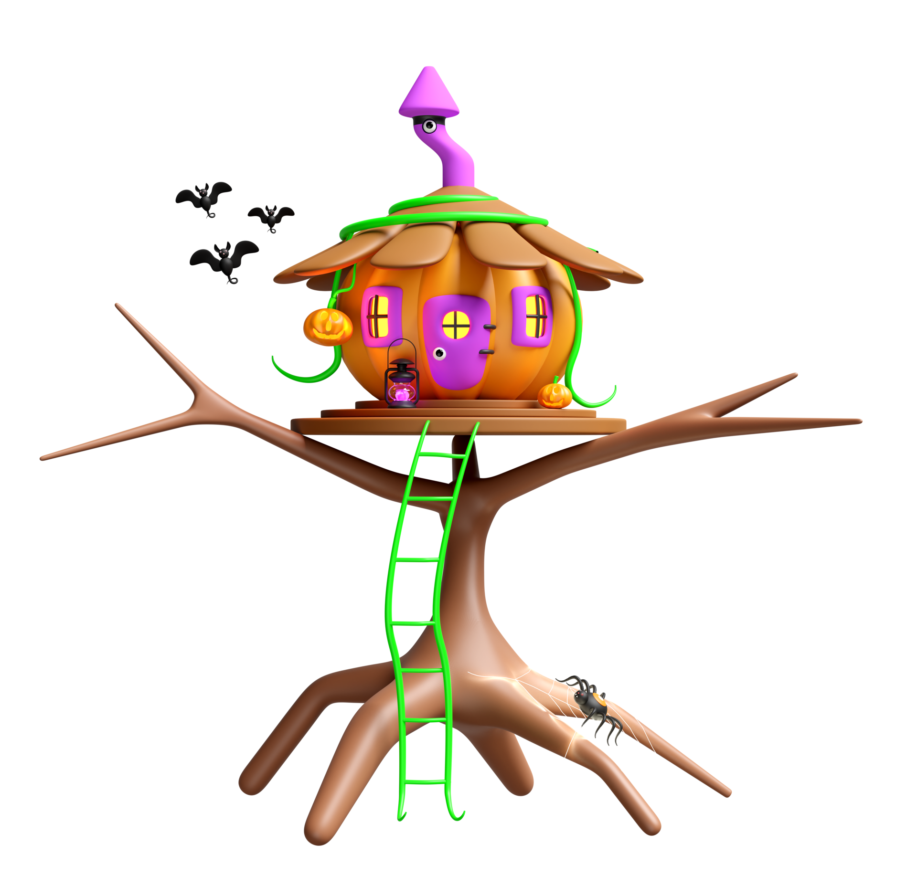
Continued
Create and maintain a system that supports family involvement and empowers families to support the self-determination of their sons and daughters.
Developing self-determination and making informed choices heighten students’ knowledge of the transition process and success in post-school settings
Notes:
Self Determination is a big part of the students development I know I keep mentioning this but it is very important.

Slide 52
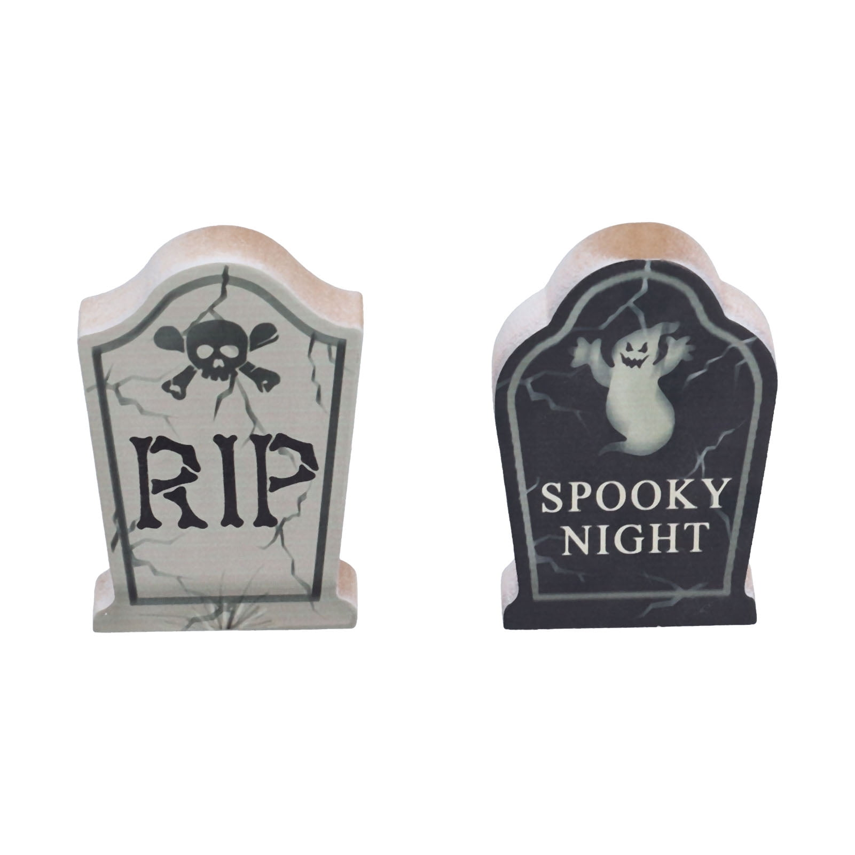
Guidance and Writing Tips
•
Postsecondary goals are what the student will do after exiting the public school system. Because students in 18-21 transition programs are still part of the public school system, postsecondary goals must address what the student will do after exiting the 18-21 program.
• The postsecondary goals should succinctly state what the student will do and must be written as measurable outcomes that take place after exiting the public school system. Postsecondary goals are not stating a process but rather a point in time after high school graduation.
Using the phrase “plans to” or “hopes to” is not an outcome and implies a process. Use definitive language like “will be enrolled”, “will be employed”, “will participate”.
• All postsecondary goals should be driven by data, including:
Transition assessments
Student interviews (formal and informal)
Additional data points (e.g., classroom data, on the job data) Strengths, interests, preferences, and needs.

Slide 53
Postsecondary Goals
Postsecondary goals are required in training/education and career/employment, regardless of the severity of the student’s disability.
If the IEP team determines that a postsecondary goal is not needed for independent living skills, it is best practice to indicate/document.
“The IEP team has considered the independent living domain and at this time has decided it is not needed in this transition plan.”
Postsecondary Goals for Education/Training(Required) Example:
Within one year of graduation, Henry will be enrolled at the Institute of Animal Technology to become a Vet Tech.

Slide 54
Postsecondary Goals
Postsecondary Goals for Independent Living (where appropriate) Examples:
• After graduation from high school, Bill will live at home and independently participate to the maximum extent possible in his daily routines (e.g., feeding, dressing, bathing, etc.).
• After graduation from high school, Jackie will dress and feed herself with assistance.
• After graduation, Barry will live independently in his own home/apartment, schedule appointments, pay his own bills, and access services in his community by using the city bus.
• N/A- The IEP team determined that a goal for Independent Living is not needed for Ethan at this time as a result of the data from his transition assessments again please document in the IEP.

Slide 55
OSE Process for Indicator 13 Review
Where to find the Special Education Monitoring site, go to:
PED Website
PED Apps (IT)
(IT) Applications
Special Education Monitoring
Early December 2024 you will have 2 weeks to submit your randomly chosen IEP(s) into the Special Education Monitoring site/2024-2025/Indicator 13 Post Secondary Transition/Student 14-15 or Student 16+
NOTE: If you do not submit your IEP within the 2-week time notification your IEPs will be identified as not submitting timely data which will impact your determination.

Slide 56
IEP Upload
IEPs must be in PDF format
Upload the entire IEP
•Parent invitation
•Student invitation
•Signature page (Required)
Name IEP files as follows:
•Last 4 digits of the student ID number, underscore, then type of document.
•Do not use student names.
•Examples:
•1234_invitation
•1234_correction

Slide 57
OSE Process for Indicator 13 Review
OSE will start reviewing IEP in early January 2025
LEA scores will be made available once all the reviews are complete in early February 2025.
Check the Special Education Monitoring Site for score sheet.
Email notifications will not be made check the Special Education Monitoring Site for your score.

Slide 58
OSE Process for Indicator 13 Review
You will only get an email from Liz Schweiger if you did not score 100% on your review
Prong 2 Review:
Prong 2: LEAs must correct the IEP(s) where did not score 100%.
Another randomly selected group of IEP for review must be uploaded to the Special Education Monitoring Site.
This must be completed within 10 days of notification.
Please check NOW to make sure you have access to the Special Education Monitoring Site if not who do you notify?

Slide 59
QUESTIONS
Q&A Booklet

Slide 60
Access to Special Education Monitoring Site
Mahesh
Mahesh.Reddy-Erri@ped.nm.gov

Slide 61
Secondary Transition Contact
Lizana (Liz)Schweiger: Liz.Schweiger@ped.nm.gov
(505) 500 - 7450
Don’t forget to enter your questions. I want to help you to help our students be successful after high school.

Slide 62
Office of Special Education Office Hour Sessions
November 19, 2024
Time: 3:30 – TBD
Location: Virtual, Microsoft Teams Click here to join the meeting
Click here to join the meeting
Meeting ID: 252 341 847 618 Passcode: 7tVTBm
Or call in (audio only)
+1 505-312-4308,,779020632#
Phone Conference ID: 779 020 632#
Notes:
Office Hour Sessions will be held every third Tuesday of the month @ 3:30 pm. Our next Office hours will be November 19th

