Slide 1
Reminders
Notes:
Please take a minute to ensure you are muted and any AI notetakers are turned off. Thank you!

Slide 2
Office Hour Sessions
Dr. Margaret Cage
Deputy Secretary
The Office of Special Education
November 19, 2024
Investing for tomorrow, delivering today.
Notes:
Good afternoon and welcome to November’s Office Hour Session!
Today’s Office Hour Session will be providing updates, technical assistance, and professional development
A few housekeeping notes, we will have 10-15 minutes for questions at the end of the main presentation preceding the today’s training portion. Training questions will be answered on The Office of Special Education’s Q& A Booklet. This is a living document, and the link will be in the chat. The Office Hour Sessions Slide deck will be accessible on the PED website, in special education, under resources or may be found in the LEA Managed Booklet, under the resources tab.

Slide 3
Leadership/Duties of the Office
Dr. Margaret Cage
Deputy Secretary, OSE
Dr. Tyre Jenkins
Deputy Director, OSE
Charlene Marcotte
Deputy Director of Data & Finance
Ria Gill
Assistant Deputy Director, OSE
Vacancy
Assistant Deputy Director of Data & Finance
Develop, review, and propose updates to state special education statutes, rules, policies, and technical assistance
Consult and coordinate with other units of the Department, other state agencies, public post-secondary educational institutions, and key education and community stakeholders on varying special education topics and issues
Coordinate with school districts and public post-secondary education institutions to develop and provide training and professional development to licensed school employees
Provide technical assistance and recommendations to school districts and public schools to implement evidence- and research-based programs and services that are culturally and linguistically responsive
Conduct activities to promote the recruitment and retention of qualified special education practitioners
Solicit input regarding delivery of special education services in the State from various stakeholders
Oversee and enforce the compliance with the IDEA and any state law pertaining to special education
Collect statewide data on varying aspects of special education within the state
Monitor spending of state and federal funds for special education programs
Develop and annually update a state plan for students with disabilities
Notes:
To the right, please find The Office of Special Education priorities that align with the executive order per Governor Lujan-Grisham. To your left, you will find The Office of Special Education Leadership team.

Slide 4
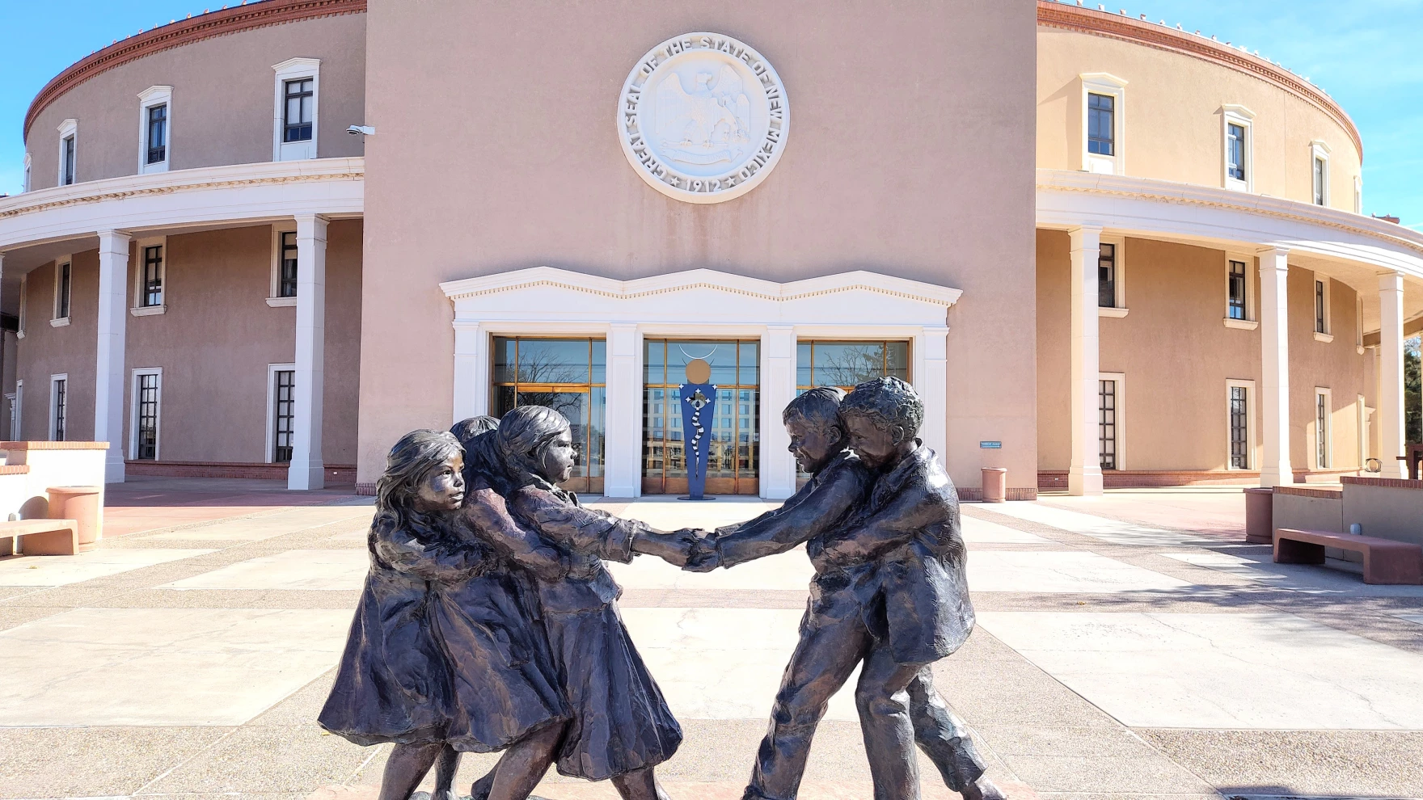
Hiring Updates
https://www.spo.state.nm.us/
Notes:
The OSE is steadily increasing capacity and staff to better serve you. Just a reminder, we are hiring! Please check the state personal office website for job openings.

Slide 5
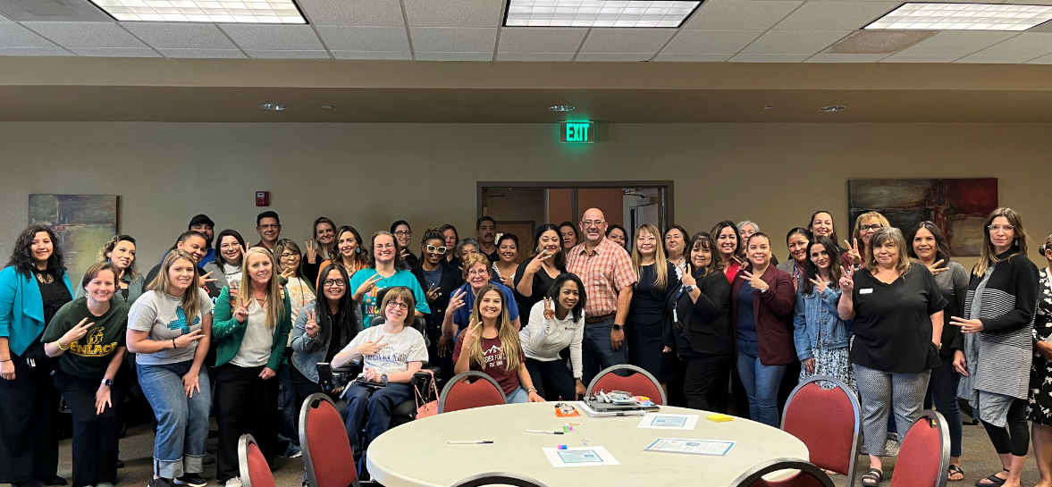
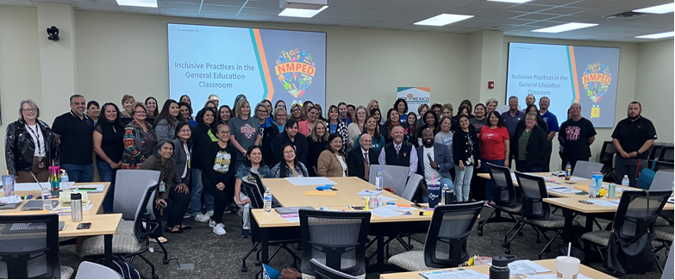
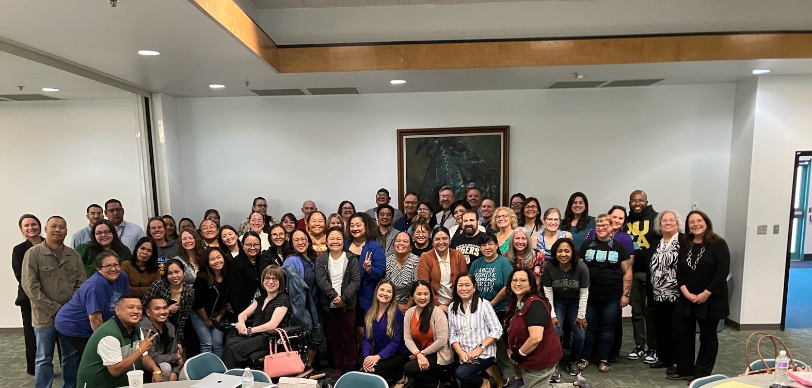
Regional Professional Development Tour
Notes:
OSE has been touring each quitrent of the state. Here to present on what we found is Assistant Deputy Director of OSE Ria Gill. Ria?

Slide 6
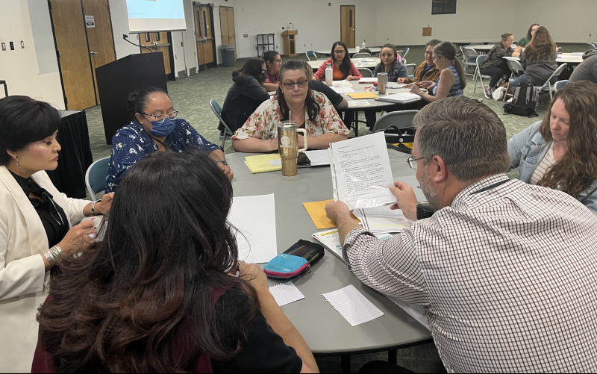
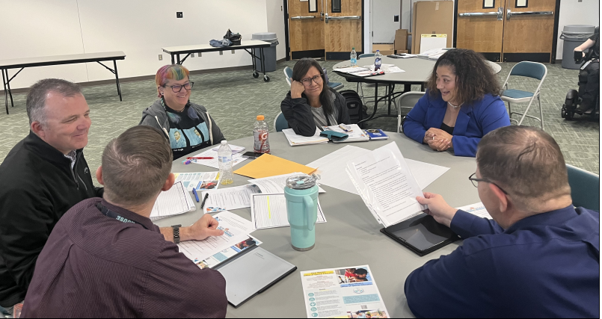
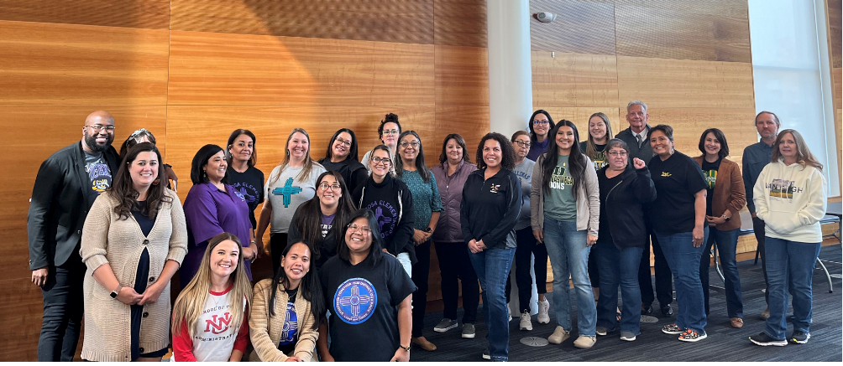
Regional Professional Development Tour
Locations
Farmington – 33 educators
Las Vegas – 28 educators
Las Cruces – 33 educators
Hobbs – 80 educators
Albuquerque – 100 educators
Over 25 State & Local Partners
90% Satisfaction from Professional Development Participants

Slide 7
Regional Professional Development Tour Vendors

Slide 8
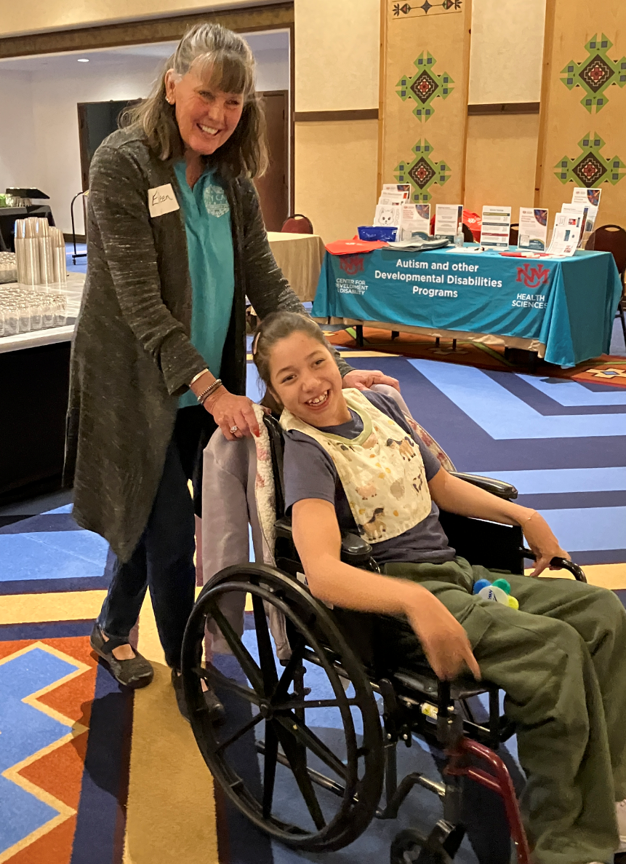
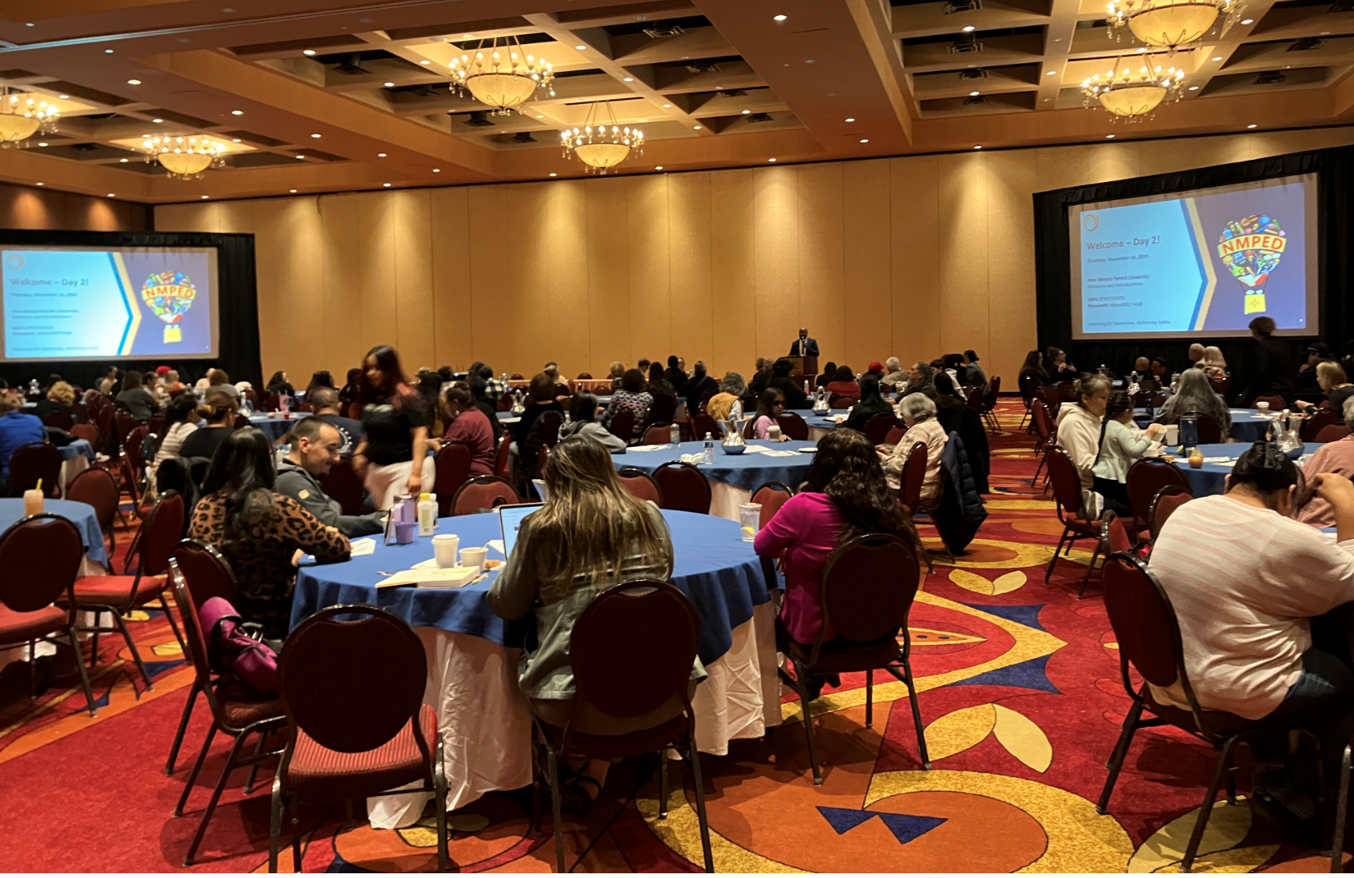
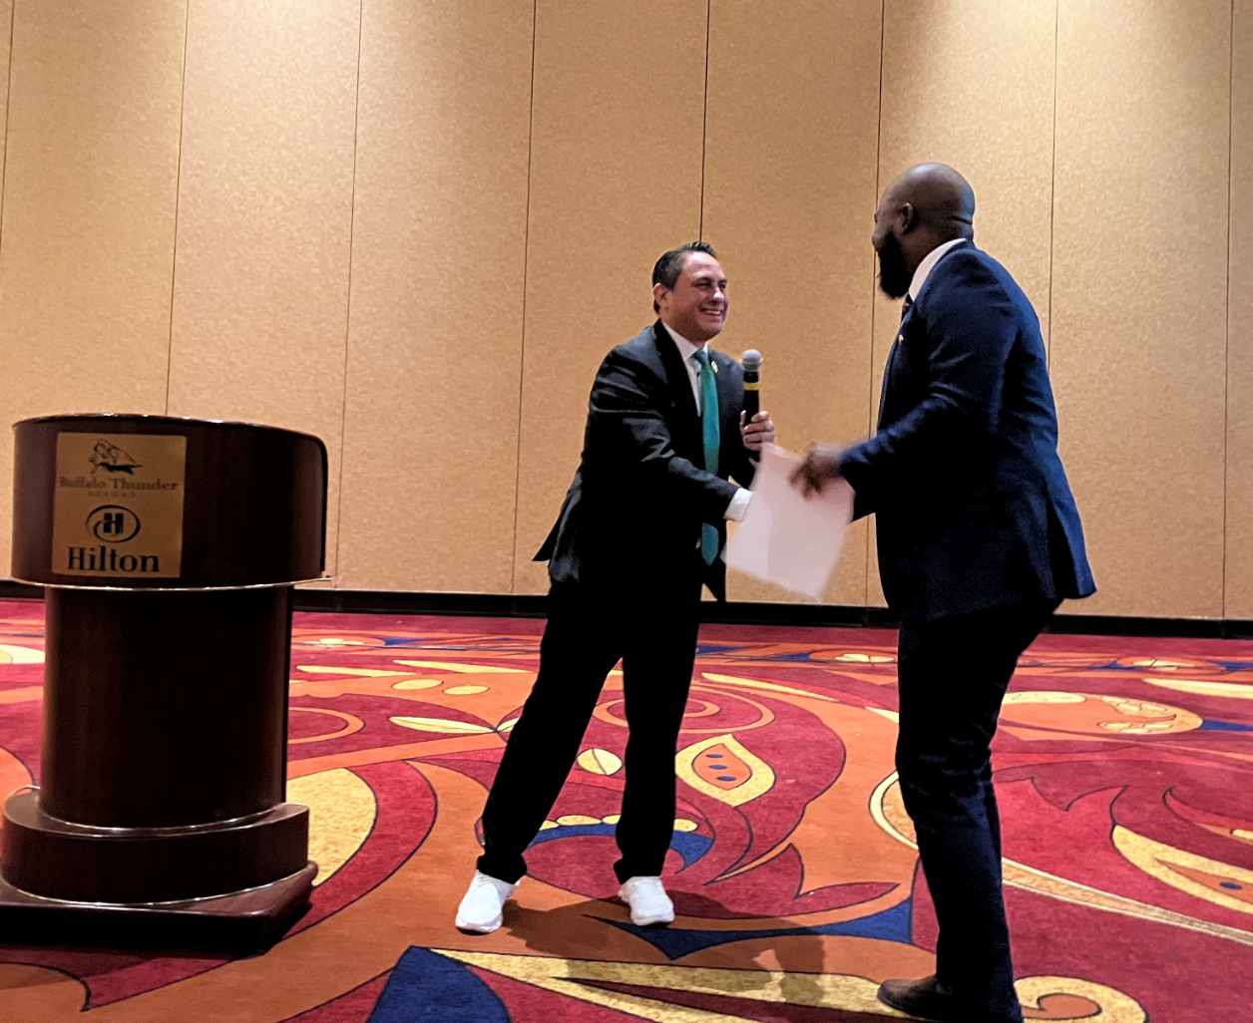
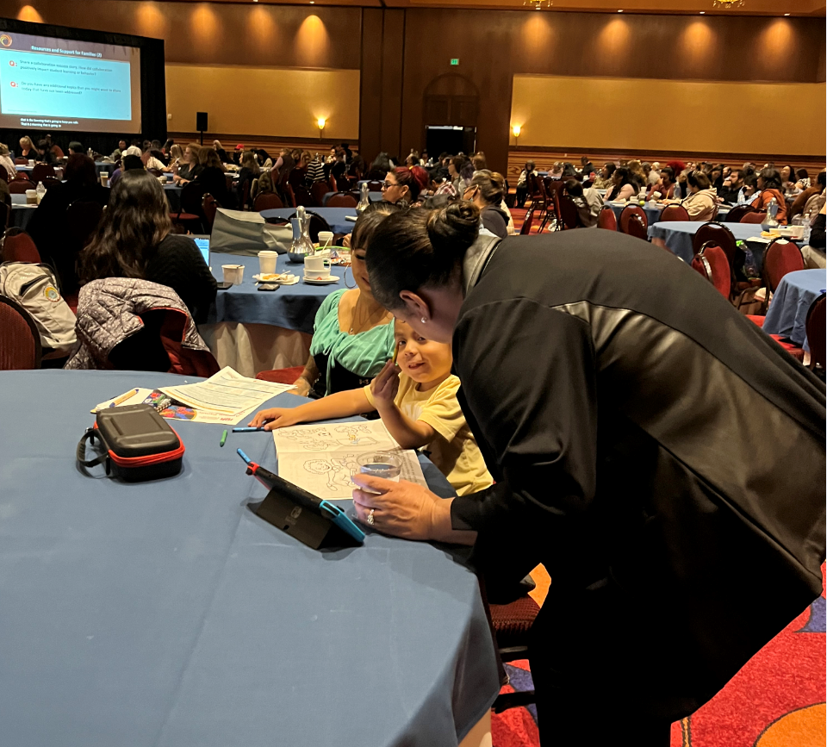
2024 Parent University
221 Families Members in Attendance
National & Local Expert Presenters
Two-Large Group Panel Discussions
Partnering for Success: Building a Support Network Through Collaboration
Opportunities for Advocacy: Effective Techniques for Parents and Students
Eight Breakout Sessions covering a variety of topics
Free Childcare available for families
Lodging Assistance for families traveling 75 miles or more

Slide 9
2024 Parent University Testimonials
“Yes, this helped to empower us advocate for our child.”
“Encouraging parents to speak up”
“ The extra perk such as a hotel room (I drive 5 hours from SE NM), I heard many parents mention daycare, the personal connections (i.e. Dr Cage greeting parents, staff meeting parents 1:1….
So, unlike most state led trainings! Kudos to you all! “
“I enjoyed the family engagement, family support with their children, and the multiple modes of presentation provided to all individuals. “
“How they took time to talk to us individually and give us more information. “
“It was much appreciated to encourage us to network with other parents.; It was nice to hear that others are going through our struggles as well.; The gifts given to us for our children were also very considerate.; Choosing our breakout sessions based on our individual needs was very nice.”
“Would be honored to attend. As I explained to Dr Cassell, I came with a purpose and left with a passion! “
“Absolutely no doubt! It was sooooo helpful and fun too. Felt at home finally! It was incredibly well organized and planned. I felt very valued because of the care and attention others put into this. It makes me hopeful. “
“ABSOLUTELY and I would bring so many parents with me. Please consider a Parent University in the Spring or Summer this year.”
“ Yes!! The sessions left me feeling as if I’m now able to go into and IEP with knowledge not fear. How to stand my ground for my kids but not come across defensive”
“That they catered
to our needs”

Slide 10
2025 Special Education Academy

Slide 11
Data & Finance
November 2024
80-Day data reporting training
40-Day data review closes
Time and Effort Training
High-Cost Fund Training
MOE & Excess Cost Open Today
Deadline to submit:
MOE-12.13.24
Excess Cost-1.13.25
Notes:
Thank you for that information! Deputy Director of Data & Finance, Charlene Marcotte is next on deck. Charlene?

Slide 12
Data & Finance Calendar
Data Training: Purple
Finance Training: Blue
Training Key
October 2024
November 2024
December 2024
January 2025
Indicator 13 Annual Review Training for LEAs
Pre-finding Correction Training for LEAs
40-Day Reporting opens, data review begins
Excess cost compliance completion by LEAs
MOE compliance completion by LEAs
Determination Letters sent to LEAs
80-Day data reporting training
40-Day data review closes
Time and Effort Training for LEAs
High-Cost Fund Training
40-Day Pre-finding letter released
MOE Letters sent to LEAs
Indicator 13 Review sample provided to LEAs
80-Day data reporting opens, data review begins
Quarterly spending reports sent to LEAs
Puente Para Los Ninos High-Cost Fund applications released
120-Day data Reporting Training
80-Day data review closes
Indicator 13 Pre-finding notices sent to LEAs
80-Day Pre-finding letters released to LEAs
Time & Effort due from LEAs
Puente Para Los Ninos High-Cost Fund application submission deadline
February 2025
March 2025
April 2025
May 2025
120-Day data review opens, data review begins
Indicator 13-Prong 2 review completion
BOLO for NMASBO Spring Budget Conference Announcements
Advertisements for SPP/APR Stakeholder Meetings
SPP/APR Due to OSEP
MOE Eligibility Training for LEAs
Excess Cost Base trainings for LEAs
IDEA B Application Training
120-Day data review closes
120-Day Prefinding letter released
NMASBO School Budget Conference
SPP/APR Stakeholder Engagement meetings
Quarterly Spending Reports sent to LEAs
State IDEA B Application posted for public review
Puente Para Los Ninos High-Cost Fund awards issued
Indicator 8-Parent Surveys sent out to sampled parents.
MOE eligibility completion by LEAs
Excess Cost Base completion by LEAs
SPP/APR Stakeholder meetings
State Application-Public Comment opens
End of Year (EOY) data reporting training
DPR Training
Indicator 14-Post School Outcomes survey data collections begin
EOY reporting opens, reviews begin
IDEA B application open for LEA completion
SPP/APR Stakeholder engagement meeting
District Profile Report (DPR) data posted on DPR site
State Application-Public Comment closes
1 month to the end of state fiscal year
June 2025
July 2025
August 2025
September 2025
Budgets in OBMS due
Quarterly spending report sent to LEAs
IDEA B applications due from LEAs
Submit RfRs prior to end of Fiscal Year
All LEA IDEA B applications in “Approved by State” or “Substantially Approved” status
State Fiscal Year ends (6/30)
Start of New Fiscal Year (7/1)
Nova Conference
OBMS Deadlines-Reimbursement requests, accounts and payable invoices
Time & Effort for LEAs due
Encumber Funds expiring September 30
EOY Pre-finding letters released to LEAs
Federal Child Count DUE to USDE
Complete and submit Indicator 14 Data Collection
EOY Pre-finding notices sent to LEAs
Nova Conference
IDEA B applications must be fully approved
Board meeting agendas and minutes must be submitted on or before (8/30)
Encumber funds expiring in September
Complete Inventory of Supplies and Materials
40-Day data reporting training
Annual determination training
Excess cost compliance training
MOE Compliance training
Indicator 14 data due from LEAs
Quarterly spending reports sent to LEAs
OSE Law Conference
Federal Funding expires (9/30)
Notes:
Charlene

Slide 13
Data/Finance Team Contact List
Office of Special Education Data Team:
charlene.marcotte@ped.nm.gov
liz.schweiger@ped.nm.gov
tamara.burkett@ped.nm.gov
Office of Special Education Finance Team:
katalina.gallegos@ped.nm.gov
kaylock.sellers@ped.nm.gov
jingchao.jiang@ped.nm.gov
Indicator 14:
gdamian@nmhu.edu
NOVA Data:
alison.watt@ped.nm.gov
nicholas.keyes@ped.nm.gov
Notes:
Charlene

Slide 14
OSE Monthly Newsletter
Submissions are due by the third Monday of each month and should be sent to special.ednews@ped.nm.gov.
Please share great things happening in your LEA to special.ednews@ped.nm.gov.
The following form can be shared with colleagues who wish to receive the OSE Newsletter: OSE Signup Form.
Here is a linked newsletter submissions schedule through November 2025, as to when article submissions are due.
If you have questions about the newsletter email special.ednews@ped.nm.gov.
Notes:
Thank you, Charlene! Next up, Assistant Deputy Director of OSE, Ria Gill. Ria?

Slide 15
IDEA B Panel Meetings
Quadrants: Dates
Q1: September 5 & 6
(Española Public Schools)
Q2: November 7 & 8
(Virtual)
Q3: February 20 and 21
(Virtual, with the ICC joining on the 21st)
Q4: May 1 & 2
(Location to TBD)
Contact Kaity Ellis for questions
kaitlin.ellis@ped.nm.gov
505-709-7690
Notes:
Thank you, Ria! Next up, Kaity Ellis. Kaity?

Slide 16
Special Education Ombud Flyers
Please direct all website staff, schools, and school personnel to take down the old flyers and post the new flyers in well trafficked areas.
If you would like information about our intake process, family presentations, or general information about our work, please contact:
Clare Gallegos (505) 841-3885
Jody Myers (682)554-6672
Michelle Tregembo (505)274-3885
Notes:
Thank you, Kaity!

Slide 17
Contact List
Cage, Margaret | margaret.cage@ped.nm.gov | Director of Special Education
Jenkins, Tyre’ | tyre.jenkins@ped.nm.gov | Deputy Director, Office of Special Education
Lozano, Miguel | miguel.lozano@ped.nm.gov | Chief Counsel
Marcotte, Charlene | charlene.marcotte@ped.nm.gov | Deputy Director of Finance and Data
Gill, Ria | ria.gill@ped.nm.gov | Assistant Deputy Director, OSE
Vacant |  | Assistant Deputy Director of Data & Finance
Perea, Sharyn | sharyn.perea@ped.nm.gov | Dispute Resolution Coordinator
Cassel, Elizabeth | elizabeth.cassel@ped.nm.gov | Parent and Community Liaison, Complaints and CAPS
Pacheco, Lorie | lorie.pacheco@ped.nm.gov | General Supervision, Low Incidence, NIMAS/NIMAC
Schweiger, Liz | liz.schweiger@ped.nm.gov | Education Administrator, Data Analyst, Indicator 13
Sellers, Kaylock | kaylock.sellers@ped.nm.gov | Financial Coordinator
Quick, Catherine | catherine.Quick@ped.nm.gov | General Supervision, Early Childhood Ed
Notes:
Switching gears to the updated OSE Contact list.

Slide 18
Contact List
Gallegos, Katalina | katalina.gallegos@ped.nm.gov | Management Analyst
Cordova, Trudy | trudy.cordova@ped.nm.gov | Education Administrator, Professional Development
Dinsmore, Jessica | jessica.dinsmore@ped.nm.gov | Education Administrator, Program and Support Specialist
Burkett, Tammy | tamara.burkett@ped.nm.gov | Education Administrator Data Analyst
Hedrick, Yaling | yaling.hedrick@ped.nm.gov | Education Administrator Program & Support monitor
Gonzales, Kim | kimberly.gonzales1@ped.nm.gov | Education Administrator Program & Support Specialist
Ellis, Kaity | kaitlin.ellis@ped.nm.gov | Social & Community Coordinator
Campbell, Natalie | natalie.campbell@ped.nm.gov | Assistant General Counsel
Jiang, Jingchao | jingchao.jiang@ped.nm.gov | Financial Coordinator
Rodriguez, Jennifer | jennifer.rodriguez1@ped.nm.gov | Executive Secretary
Notes:
This is our continued contact list.

Slide 19
Resources
November 2024 OSE Newsletter
OSE Parent Portal
OSE Resources
LEA Managed Booklet
Have Questions for OSE?
ose.support@ped.nm.gov
Notes:
Please find links to the OSE Parent portal, Newsletter, Resources, LEA Managed Booklet or if you have questions for OSE. Just a reminder, you can find Office Hours recordings and slide decks on the PED website, navigate to special education, under the resources tab.

Slide 20
Notes:
Switching gears into the training portion of Office Hour Sessions. Please ensure all questions are asked in the Q& A Training booklet. The link will be in the chat. Just a reminder, today’s presentation and slide deck will be on Ped’s website under, OSE, on the resources link to your right.

Slide 21
Puente para–Los niño’s high-cost Fund
Kaylock Sellers, Financial Coordinator
November 19, 2024
Investing for tomorrow, delivering today.
Notes:
This month's training session will be kicked off by Kaylock Sellers. Kaylock?

Slide 22
What is a High-Cost Fund?
The purpose of the High-Cost Fund is to assist Local Education Agencies (LEAs) in addressing the needs of high need children with disabilities (excluding gifted-only).
The New Mexico Public Education Department (PED) has elected to create a High-Cost Fund called Puente para los Niños Fund pursuant to the provisions of 34 C.F.R. § 300.704(c) and 6.31.2.9(B)(5) NMAC

Slide 23
Who is eligible for High-Cost Funds?
To receive funds distributed from the Puente para los Niños Fund, an LEA must meet the following requirements:
(1) the definition of a high need child with a disability
Cost Threshold—A high need child with a disability is a student whose total cost to provide a Free and Appropriate Public Education (FAPE) is three times greater than the average per pupil cost or greater than $33,606.00.
Financial Impact on LEA Budget—The cost to provide FAPE to a high needs student with a disability must have a financial impact on the LEA’s total budget.

Slide 24
Who is eligible for High-Cost Funds?
To receive funds distributed from the Puente para los Niños Fund, an LEA must meet the following requirements:
(2) the eligibility criteria
1. Documentation of Required Services and Costs: LEAs must provide written documentation including the student’s IEP and a detailed description of the costs associated in providing direct special education and related services to the student.
2. Number and Percentage of High Need Students: Each LEA must identify the number and percentage of high needs students with disabilities served by the LEA.
3. Carryover Deduction: If an LEA’s application reimbursement is accepted and an award determined, carryover funds (if any) that the LEA has not used prior to the application deadline date, will be subtracted from the LEAs final Puente para los Niños award amount. All LEA’s carryover amounts will be determined as of the application deadline date
It is beneficial for LEAs to ensure that all outstanding Requests for Reimbursement (RfRs) from IDEA B funds be submitted prior to the deadline date to maximize any potential award amount.
Federal funds (which are the RfR’s funds) are not eligible to be accrued as expenditures for the high-cost fund.
4. Local Charters: Carryover amounts for local charters applying will be based on a calculated percentage of applicable carryover proportionate to the local charter’s percentage of the parent district’s Students with Disabilities NOVA count (prior year-end count).

Slide 25
What is required to apply?
LEAs accessing the Puente para los Niños Fund must assure the following requirements have been met:
1. Evaluation—The student must have been evaluated in accordance with Subsection (C), (D) or (E) of 6.31.2.10 NMAC.
2. Special Education Eligibility—The student is determined eligible for special education and/or related services in accordance with Subsections (F) of 6.31.2.10 NMAC.
3. Current IEP—The student has a properly constituted and up-to-date IEP in accordance with 6.31.2.11 NMAC.
4. Placement—The student’s placement was decided by the student’s IEP team in accordance with 6.31.2.11 NMAC.
5. Least Restrictive Environment—The student’s placement is in the Least Restrictive Environment (LRE) in accordance with Subsection (C) of 6.31.2.11 NMAC.
6. Local Charter Schools—Parent districts of local charter schools applying for funds from the Puente para los Niños fund must agree to:
a. submit a Budget Adjustment Request which includes any funds awarded;
b. accept the awarded funds on behalf of the local charter school applying for the funds; and
c. distribute the funds to the local charter school for reimbursements for the costs associated with providing the direct special education and related services identified in the IEP for the student with high needs.

Slide 26
How does an LEA apply for funds?
LEAs applying for Puente para los Niños funds must:
Complete the PED Application for Approval Form. LEAs
Provide the following supporting documentation:
1. Student Data—Number of students meeting the high needs definition and the total special education student enrollment. This information should come directly from the most recent certified enrollment counts submitted to the PED.
2. Financial Impact—A narrative describing how the cost of the student with high needs impacted the LEA’s budget. LEAs applicants must disclose the percentage of IDEA Part B allocation funds that are expended to cover the cost of servicing high student needs.
3. Service History—A description of the course of action taken to date by the LEA to serve students with high needs. Be sure to include the number and type of Full Time Equivalent staff (FTEs) affected for each such student.
4. Expenditures—The most recent detailed expenditure report showing budgeted and actual year-to-date expenditures for each student with high needs.
5. Documentation—Copies of all contracts and invoices that pertain to the student with high needs.
6. Identifier—The Prior Written Notice and the Schedule of Services pages from the student’s current IEP including the student’s unique identifier number

Slide 27
What are the Reporting Requirements?
An end of the year report is required by each LEA awarded Puente para los Niños funds.
Reports are due to the OSE Fiscal by June 30th of the award year.
Reports must include the following information:
1. Student’s most current IEP, health plan, and transition plan for students fourteen years old or older;
2. Student’s proof of continued enrollment in the LEA during the award year; and
3. Expenditure reports, invoices, and receipts.
For students who disenroll:
Notification in writing must be made to the OSE Deputy Director, within fifteen days, if and when a student with high needs disenrolls from the LEA that received an award from the Puente para los Niños fund for that student.
Final RfRs for students who have disenrolled from the LEA must be submitted in the Operating Budget Management System (OBMS)

Slide 28
Are there any restrictions?
1. Funds cannot be used to pay costs that otherwise would be reimbursed as medical assistance under Medicaid. 34 C.F.R. § 300.704(c)(8).
2. Funds from the Puente para los Niños fund shall not be used to pay for legal fees, court costs, or other costs associated with a cause of action brought on behalf of a child with a disability to ensure FAPE for such a child

Slide 29
Deadline Reminders
The Puente High-Cost fund application form and guidelines:
https://webnew.ped.state.nm.us/bureaus/special-education/fiscal/
Application submission – the month of January 2025
Note: e-mail attachments, IEPs, must be redacted
Application deadline date – January 31, 2025
Puente High-Cost fund committee meeting – February 14, 2025

Slide 30
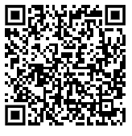
Housekeeping
Office Hours slides can be accessed:
From the Office of Special Education website, on the Resources page under Office Hours.
https://webnew.ped.state.nm.us/bureaus/special-education/resources/
“Make a copy” if you want to take notes on the presentation.
Use the QR code or click here, to write down your questions.
Make sure you are on mute so all can hear today’s presentation.
Notes:
Place ? Link in chat

Slide 31
OSE Fiscal:
Request for Reimbursement FAQs
Kaylock Sellers, Financial Coordinator
Katalina Gallegos, Management Analyst
Jessie Jiang, Financial Coordinator
November 19, 2024
Investing for tomorrow, delivering today.
Notes:
Jessie

Slide 32
Agenda
Indirect and Direct Cost Definitions
Job Class Updates
Administrative and Clerical Staff Direct Cost Determination Form
New RfR Deadlines

Slide 33
Direct Costs - CFR 200.413
Direct Costs: those costs that can be identified specifically with a particular final cost
objective, such as a federal award, or other internally or externally funded activity,
or that can be directly assigned to such activities relatively easily with a high degree
of accuracy.
• Typically incurred specifically to benefit an award
•The federal award is the Individuals with Disabilities Education Act (IDEA) Part B.
Slides taken from EDGAR Academy, The
Bruman Group, PLLC

Slide 34
Indirect Costs - CFR 200.414
Most costs are directly charged to the grant
For costs that cannot be directly charged, grantees have an indirect cost rate
Salaries of administrative and clerical staff should be treated as “indirect” unless all of the following are met
Such services are integral to the activity
Individuals can be specifically identified with the activity
Costs not also recovered as indirect
Pass-through entities must accept all federally negotiated indirect cost rates for subrecipients
Object Code 53713
Slides taken from EDGAR Academy, The
Bruman Group, PLLC

Slide 35
Job Class Updates
Job Class Code 1217: Secretarial/Clerical/Technical Assistants. Secretaries, receptionists, clerks, data entry clerks, system analysts, work-study students, and other related employees.
Job Class Code 1511: Data Processing. Computer programmers, systems managers, and operators. This does not include data entry personnel which are included in 1217.
Notes:
Kaylock

Slide 36
Job Class Updates
Is this a direct or indirect cost?
Considerations:
Such services are integral to the activity
Individuals can be specifically identified with the activity
Costs not also recovered as indirect

Slide 37
Job Class Updates
Job Class Code 1610: Substitutes Professional Development. Substitute employees assuming the duties of personnel absent due to professional development training regardless of the length of absence.
Job Class Code 1611: Substitutes - Sick Leave. Substitute employees assuming the duties of personnel absent due to sick leave regardless of the length of absence.
Job Class Code 1612: Substitutes - Other Leave. Substitute employees assuming the duties of personnel absent due to other school board approved leave such as personal leave.

Slide 38
Job Class Updates
Substitutes can only cover for special education staff and not for general education staff.
Considerations:
Substitutions for special education professional development
Proportionality
Substitution for special education classroom or caseload
Entirely allowable
Substitutions for a regular education classroom
Not allowable

Slide 39
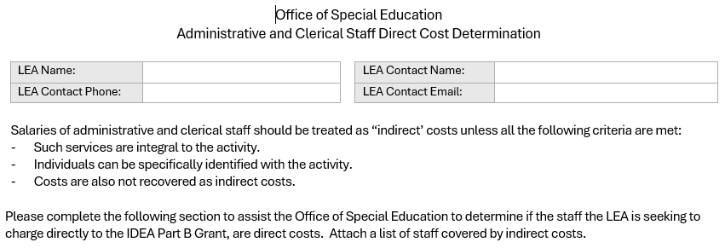
Administrative and Clerical Staff Direct Cost Determination Form
Notes:
Katalina

Slide 40
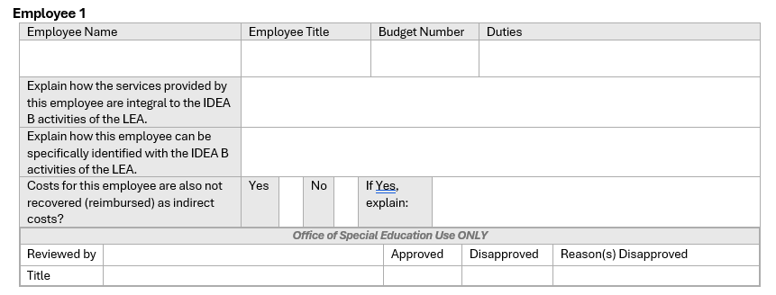
Administrative and Clerical Staff Direct Cost Determination Form

Slide 41
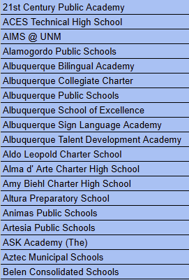
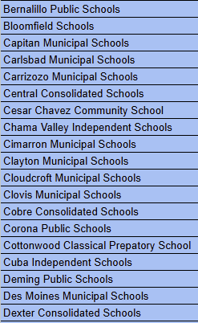
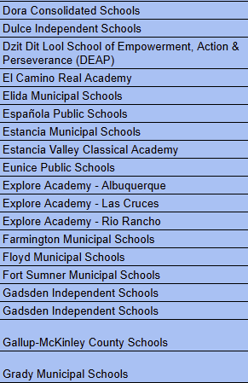
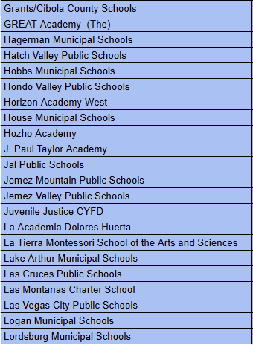
LEA Assignments - Kaylock Sellers

Slide 42
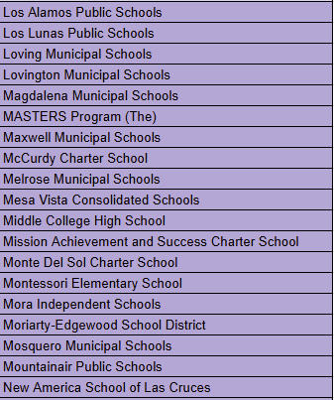
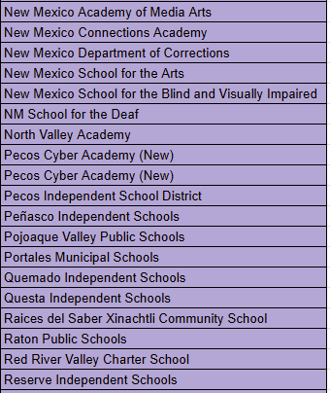
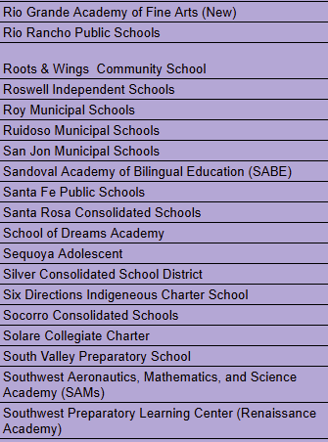
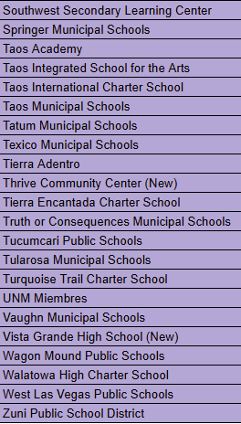
LEA Assignments - Jessie Jiang

Slide 43
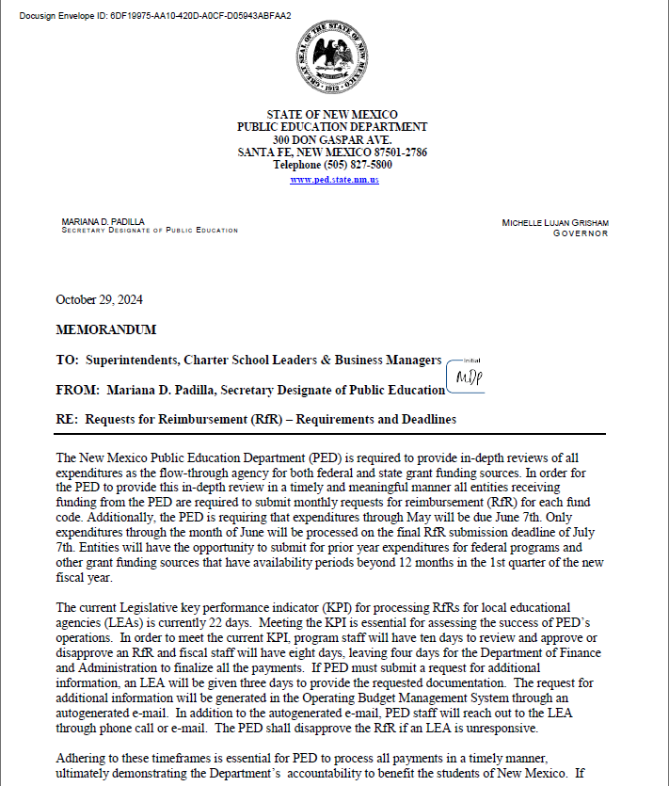
New RfR Deadlines
The OSE Fiscal Staff reviews RfRs daily to ensure efficient processing
LEAs will have 3 days to reply to info requests entered into OBMS
After 2 days of no LEA response, phone calls and emails will be sent out
If the RfR reaches 10 days pending with the OSE it will be disapproved
To avoid the need for info requests and delays in approval please ensure that backup documentation is provided for all expenses
For example:
Purchase orders
Invoices
Administrative Staff Consideration Form

Slide 44
Contact Information
Charlene Marcotte
OSE Deputy Director of Data and Finance
Email: Charlene.marcotte@ped.nm.gov
Phone: (505) 309-1688
Jessie Jiang
OSE Financial Coordinator
Email: jingchao.jiang@ped.nm.gov
Phone: (505) 709-7327
Kaylock Sellers
OSE Financial Coordinator
Email: kaylock.sellers@ped.nm.gov
Phone: (505) 479-0175
Katalina Gallegos
OSE Management Analyst
Email: katalina.gallegos@ped.nm.gov
Phone: (505) 531-7410

Slide 45
Housekeeping
Office Hours slides can be accessed:
From the Office of Special Education website, on the Resources page under Office Hours.
https://webnew.ped.state.nm.us/bureaus/special-education/resources/
“Make a copy” if you want to take notes on the presentation.
Use the QR code or click here, to write down your questions.
Make sure you are on mute so all can hear today’s presentation.
Notes:
Place ? Link in chat

Slide 46
Nova Reporting for Special Education
80 Day Training
Office of Special Education
Charlene Marcotte, Deputy Director, Data & Finance
Liz Schweiger, Data Analyst
Tammy Burkett, Data Analyst
Trudy Cordova, EA - Professional Development/Data Reviewer
November 19, 2024
Investing for tomorrow, delivering today.
Notes:
Charlene

Slide 47
Housekeeping
Office Hours slides can be accessed:
From the Office of Special Education website, on the Resources page under Office Hours.
https://webnew.ped.state.nm.us/bureaus/special-education/resources/
“Make a copy” if you want to take notes on the presentation.
Use the QR code or click here, to write down your questions.
Make sure you are on mute so all can hear today’s presentation.
Notes:
Place ? Link in chat

Slide 48
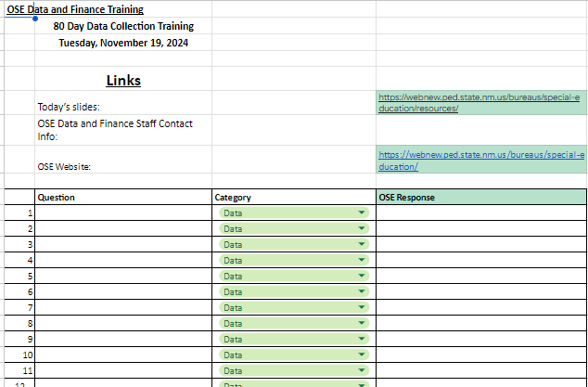
Q & A
Enter LEA questions here.
OSE will enter responses here.
Click on this tab to enter questions.

Slide 49
Agenda
Overview of Nova reports Reviewed for 80 Day Validation
Data Reporting Expectations
The DTS and Necessary Validation Forms
Other Information

Slide 50
Special Education Data Review
What is the Special Education Quality Data Review?
The Office of Special Education (OSE) reviews all Special Education data submissions to ensure that all data reported is as complete and accurate as possible and accurately reflects what is happening in each LEA
Why do we need this data?
OSE is required to report all data to the US Department of Education’s Office of Special Education Programs (OSEP). In addition, OSE uses the data to review compliance indicators and district performance to identify LEAs that need program support.
What does this mean for my LEA?
LEAs must report on the current enrollment and status of all students in Special Education, as well as a number of Special Education-related events that happen throughout the school year.

Slide 51
Special Education Data Review
What is quality data?
Quality data is data that accurately reflects what is occurring within an LEA, valid, complete, and consistent.
When is Special Education data collected?
Data collected on 40D, 80D, 120D and EOY.
80 Day
LEAs have 10 days from the last day of school to submit accurate and complete data.
OSE has 10 days from the submission of accurate and complete data to review the data.

Slide 52
Data Validation Timeline
80 Day Data Snapshot Date
LEAs Submit Valid and Reliable Data
Data is Error Free by Day 10
10 Days
Office of Special Education
OSE Reviews Data
OSE Validates Data
10 Days

Slide 53
LEA Responsibilities
LEAs must:
Review their data for accuracy and completion BEFORE:
The Office of Special Education (OSE) reviews the data.
Errors in LEA data must be corrected BEFORE OSE begins data reviews.
Signing and uploading the Data Validation and Certification form and uploading it to the Document Transfer Station (DTS).
DTS link: https://eui.ped.state.nm.us/sites/stars/DocTransferStation/SitePages/DocumentTransfer.aspx
Contact their data reviewer immediately if:
They have questions about data validation.
Updated and/or corrected their data so reviewers can conduct another review of the updated data.

Slide 54
Q & A
Take a moment to enter your questions on the general information discussed so far.
Use the QR code or click here, to write down your questions.
Notes:
Place ? In chat

Slide 55
Profile Report
Link to Profile Report in Nova:
https://eui.ped.state.nm.us/sites/stars/ProdNova/_layouts/15/ReportServer/RSViewerPage.aspx?rv:RelativeReportUrl=/sites/stars/ProdNova/PublicFolders/District%20and%20School%20Reports/Special%20Education/SPED%20-%20Profile.rdl

Slide 56
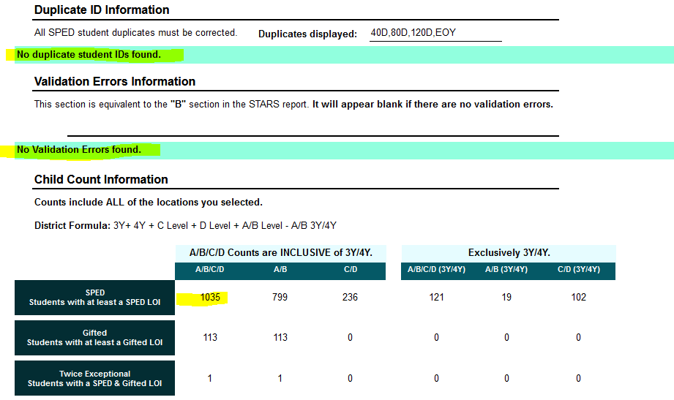
Profile Report (cont.)
Profile Validation Requirements:
All Validation Errors must be corrected
Exception: Validation error may remain for students who are in grade 8 but do not yet have a diploma type.
Diploma type required at EOY.
Ensure Child Count numbers match:
SIS/internal records.
Across all sections in the Profile report which have a total child count.

Slide 57
Profile Report (cont.)
Profile Validation Requirements:
Verify Alternate Assessment participant information is correct.
Late IEPs and Triennial Evals require written justification to include the date IEP/Evals will be updated, upload to the DTS if they are actually late OR If they are errors, the need to be corrected.

Slide 58
Profile Report (cont.)
Profile Validation Requirements:
Verify Indicator 5 and 6 data to ensure the appropriate setting by age is being used AND the child count is correct.
Verify Indicator 9 and 10 data to ensure all data is correct by race/ethnicity and disability category AND the child count is correct.

Slide 59
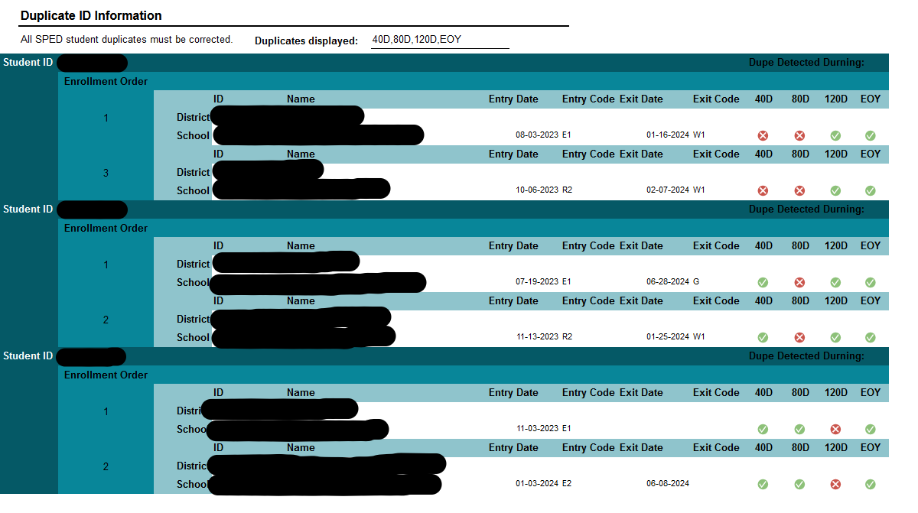
Profile Report Errors
Profile Validation Requirements:
Duplicate Student IDs must be corrected each reporting period.
No duplication of students between LEAs may exist.

Slide 60
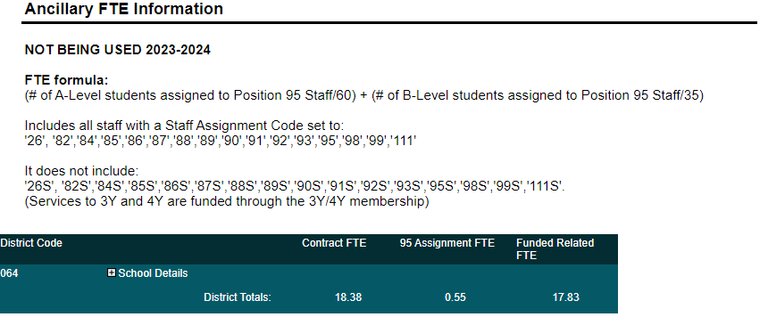
Profile Report Errors, Cont.
Profile Validation Requirements:
Verify Ancillary FTE for accuracy.
If there is a +/- 10% variance between 40 and 80 day ancillary FTE, justification will be required in the DTS.

Slide 61
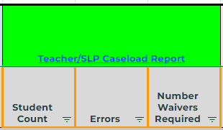
Teacher/SLP Caseload Report
Link to Teacher/SLP Caseload Report in Nova:
https://eui.ped.state.nm.us/sites/stars/ProdNova/_layouts/15/ReportServer/RSViewerPage.aspx?rv:RelativeReportUrl=/sites/stars/ProdNova/PublicFolders/District%20and%20School%20Reports/Special%20Education/SPED%20-%20Teacher%20and%20SLP%20Caseload%20Report.rdl

Slide 62
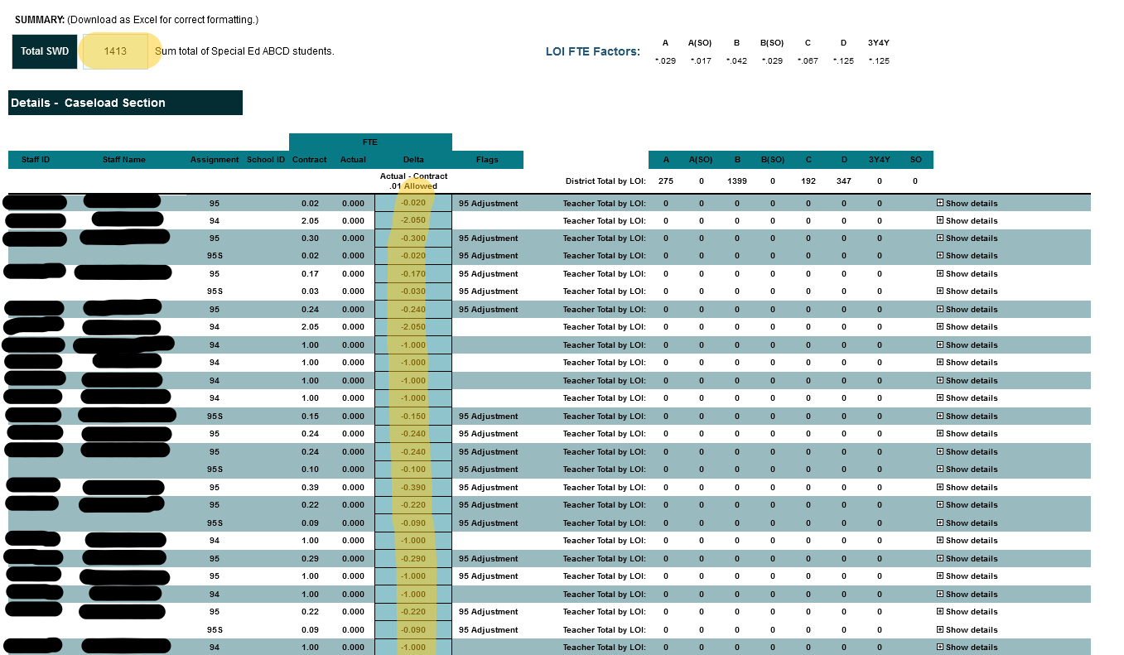
Teacher/SLP Caseload Report
T/SLP Validation Requirements:
Ensure the “Total SWD” number matches the Profile Child Counts.
If Child Counts do not match other reports, must find and correct the discrepancy to ensure all child counts in each report match.
If any of the highlighted cells are orange, a Caseload Waiver is required.
Correct any noted errors.

Slide 63
Caseload Manager Requirements
Applicable Rule 6.29.1.9 NMAC
H. Student/staff caseloads in special education.
(1) The student/staff caseload shall not exceed 35:1 for a special education teacher and 60:1 for a speech-language pathologist for special education services or speech-only services, in which properly licensed special education teachers OR speech-language pathologists travel from class to class or school to school, providing services to students with disabilities whose individualized education programs (IEPs) require a minimal amount of special education. (A minimal amount of special education services shall not exceed 10 per cent of the school day/week.)
(2) The student/staff caseload shall not exceed 24:1 for a special education teacher and 35:1 for a speech-language pathologist for special education services or speech-only services which properly-licensed special education teachers OR speech-language pathologists provide to students with disabilities whose IEPs require a moderate amount of special education. (A moderate amount of special education services shall be less than 50 per cent of the school day.)
(3) The student/staff caseload shall not exceed 15:1 for special education services in which properly licensed special education teachers provide services to students with disabilities whose IEPs require an extensive amount of special education for a portion of the school day as appropriate to implement the plan. (An extensive amount of special education services shall be provided 50 per cent or more of the school day.)
(4) The student/staff caseload shall not exceed 8:1 for special education services in which a properly licensed professional provides services to students with disabilities whose IEPs require a maximum amount of special education. (A maximum amount of special education services shall be provided in an amount approaching a full school day.)

Slide 64
Caseload Manager Requirements
Applicable Rule 6.29.1.9 NMAC
H. Student/staff caseloads in special education continued
(5) The student/adult caseload shall not exceed 4:1 for center-based special education services in which one of the adults in the program is a properly licensed professional providing three- and four-year old children with the amount of special education needed to implement each child's IEP. This includes a child who will turn three at any time during the school year, and who is determined to be eligible for Part B services. The child may be enrolled in a Part B preschool program at the beginning of the school year if the parent so chooses, whether or not the child has previously been receiving Part C services.
(6) The student/adult caseload shall not exceed 2:1 for center-based special education services in which three- and four-year old children have profound educational needs. This includes children who will turn three at any time during the school year, and who are determined to be eligible. The child may be enrolled in a Part B preschool program at the beginning of the school year if the parent so chooses, whether or not the child has previously been receiving Part C services.
(7) Adequate student/staff caseloads shall be provided to appropriately address needs identified in the IEPs. Paraprofessionals and assistants who are appropriately trained and supervised in accordance with applicable department licensure rules or written department policy may be used to assist in the provision of special education and related services to students with disabilities under Part B of IDEA.
(8) If the student/staff caseload ratio exceeds the standards provided above, a request for waiver shall be submitted to the department for review and approval by the secretary.

Slide 65
Applicable Staff Codes for Case Managers
Teachers’ Position Codes | Description of Position
95 | Special Education Speech Language Pathologist Acting as a Caseload Manager (6–21 year olds)
95S | Special Education Speech Language Pathologist Acting as a Caseload Manager (3–5 year olds)
96 | Special Education Preschool Teacher
97 | General Special Education Teacher (K–12)

Slide 66
Determining Caseload Maximums
Level of Student | Student Category | Nova Category Level | Amount of Special Education Services | Teacher Category | FTE
A or minimum level | Student with Disabilities | 1 | 10% or less of the school day | 96 / 97 | 1/35 or .029
A or minimum level | “Speech-Only” Student | 1 | 10% or less of the school day | 95 / 95S | 1/60 or .017
B or moderate level | Student with Disabilities | 2 | 11%–49% of the school day | 96 / 97 | 1/24 or .042
B or moderate level | “Speech-Only” Student | 2 | 11%–49% of the school day | 95 / 95S | 1/35 or .029
C or extensive level | Student with Disabilities | 3 | 50% or more of the school day | 96 / 97 | 1/15 or .067
D or maximum level | Student with Disabilities | 4 | Approaching 100% of the school day | 96 / 97 | 1/8 or .125

Slide 67
Teacher/SLP Caseload Report
T/SLP Validation Requirements:
Correct any noted errors.
Some exceptions may apply.

Slide 68
Exceptions to Correcting T/SLP Errors
No caseload manager is assigned due to lack of availability/teacher and/or SLP shortage.
Caseload manager does not meet the qualifications to carry a caseload.
LEAs using these exceptions must:
Provide a justification for the errors in the DTS.
Submit a waiver request.
Be actively recruiting to fill positions.
Determine if any service time is owed to students.

Slide 69
Twice Exceptional Students
The special education caseload for a twice exceptional student, must be assigned proportionally to the applicable special education codes (95, 95S, 96, 97). This includes for Nova reporting purposes.
Any 94s assigned as a primary provider in Nova must be REPLACED with a 96 or 97 caseload teacher as the Primary Provider for students receiving special education services. For students who are Speech Only, the Caseload Teacher/Primary Provider must be a 95 or 95s.
Nova does not collect Gifted Caseload Teacher data. LEAs must send a gifted record to Nova, and a completely separate special education record to Nova

Slide 70
Q & A
Take a moment to enter your questions on the reports discussed so far.
Use the QR code or click here, to write down your questions.
Notes:
Place ? In chat

Slide 71
Indicator 7 Report - Preschool Outcomes
Link to Indicator 7 Report in Nova:
https://eui.ped.state.nm.us/sites/stars/ProdNova/_layouts/15/ReportServer/RSViewerPage.aspx?rv:RelativeReportUrl=/sites/stars/ProdNova/PublicFolders/District%20and%20School%20Reports/Special%20Education/SPED%20-%20SPP%20Indicator%2007%20Preschool%20Outcomes%20Report.rdl
Notes:
Tammy

Slide 72
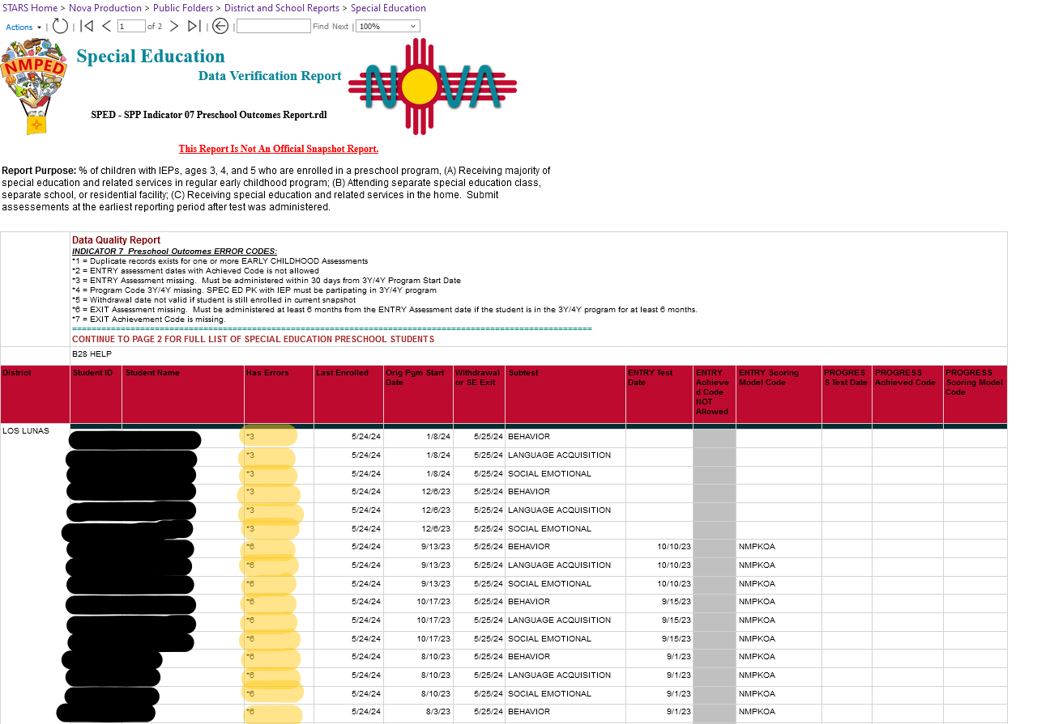
Indicator 7 Report - Preschool Outcome Errors
I7 Validation Requirements:
Ind. 7 has multiple pages.
Errors are listed on the first page, others on the second page, and some are on both pages.
Red comments are errors that must be fixed
Yellow comments are warnings but are not required to be fixed.
Key for error explanation.
Error section

Slide 73
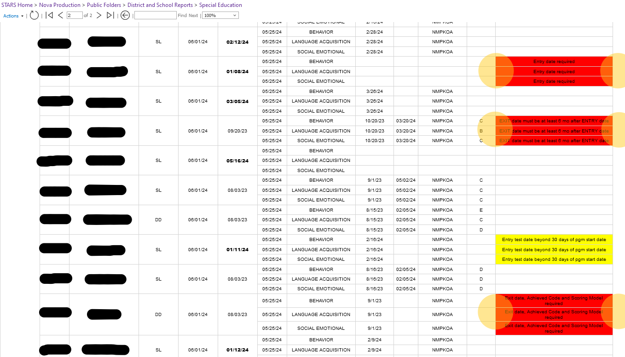
Indicator 7 Report - Preschool Outcome Errors (Cont.)
Error section

Slide 74
Indicator 7 Requirements
Early Childhood Assessments
Students who enroll in the program MORE than 30 days from the end of the school year require an EARLY CHILDHOOD “ENTRY” assessment in all three content areas:
BEHAVIOR,
SOCIAL EMOTIONAL and
LANGUAGE ACQUISITION
This includes students receiving Speech Only services.
Submit the ENTRY and EXIT EARLY CHILDHOOD assessment only ONCE in the school year in the first reporting period after the test is administered (40D, 80D, 120D or EOY).
The ENTRY test for EARLY CHILDHOOD assessments must be administered within 30 DAYS of the child’s program start date in the current school year.
The EXIT test for EARLY CHILDHOOD assessments is administered at least six months after the ENTRY test was administered. An EXIT test is required if the student was enrolled in the program for at least six months.
Standard Achieved Code is now used to collect the PROGRESS ASSESSMENT VALUE and is to be submitted into Nova for each of the Early Childhood EXIT Assessments. Discontinue use of the Standard Achieved Code for the Early Childhood ENTRY assessments.
When determining the student's PROGRESS ASSESSMENT VALUE, utilize the Childhood Outcomes Summary Form (COSF).

Slide 75
Q & A
Take a moment to enter your questions on the reports discussed so far.
Use the QR code or click here, to write down your questions.
Notes:
Place ? in chat

Slide 76
Indicator 8 Report - Parent Involvement
Link to Indicator 8 Report in Nova:
https://eui.ped.state.nm.us/sites/stars/ProdNova/_layouts/15/ReportServer/RSViewerPage.aspx?rv:RelativeReportUrl=/sites/stars/ProdNova/PublicFolders/District%20and%20School%20Reports/Special%20Education/SPED%20-%20SPP%20Indicator%2008.rdl

Slide 77
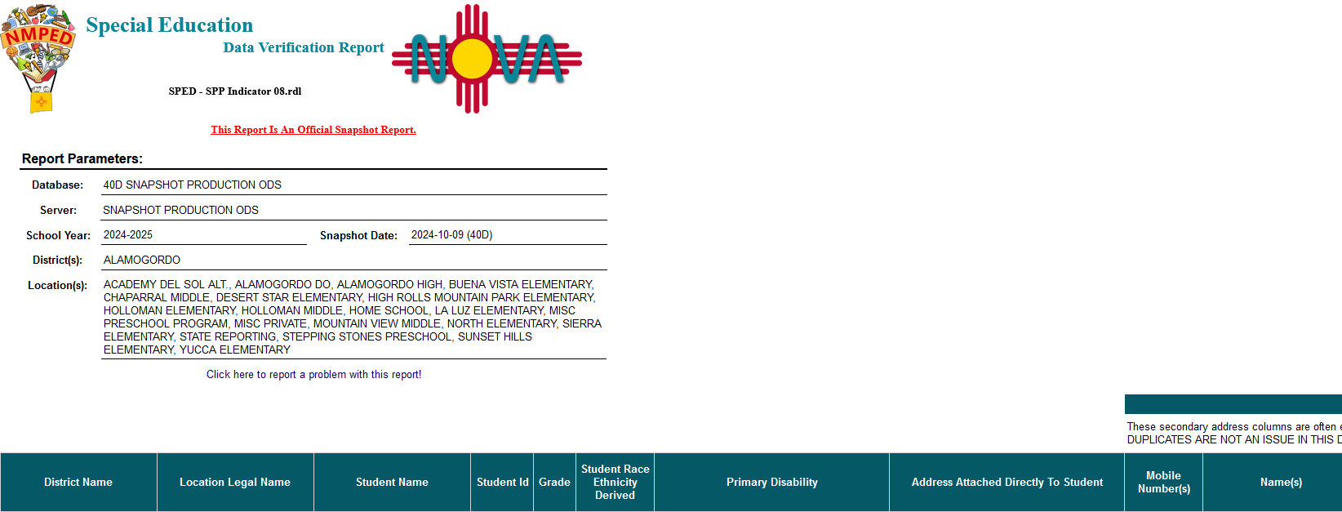
Indicator 8 - Parent Involvement Information
I8 Validation Requirements:
Ensure all data required for parents are reported.

Slide 78
Indicator 11 Report - Evaluation Timelines
Link to Indicator 11 Report in Nova:
https://eui.ped.state.nm.us/sites/stars/ProdNova/_layouts/15/ReportServer/RSViewerPage.aspx?rv:RelativeReportUrl=/sites/stars/ProdNova/PublicFolders/District%20and%20School%20Reports/Special%20Education/SPED%20-%20SPP%20Indicator%2011%20Parental%20Consent%2060%20Day%20Timeline%20Report.rdl

Slide 79
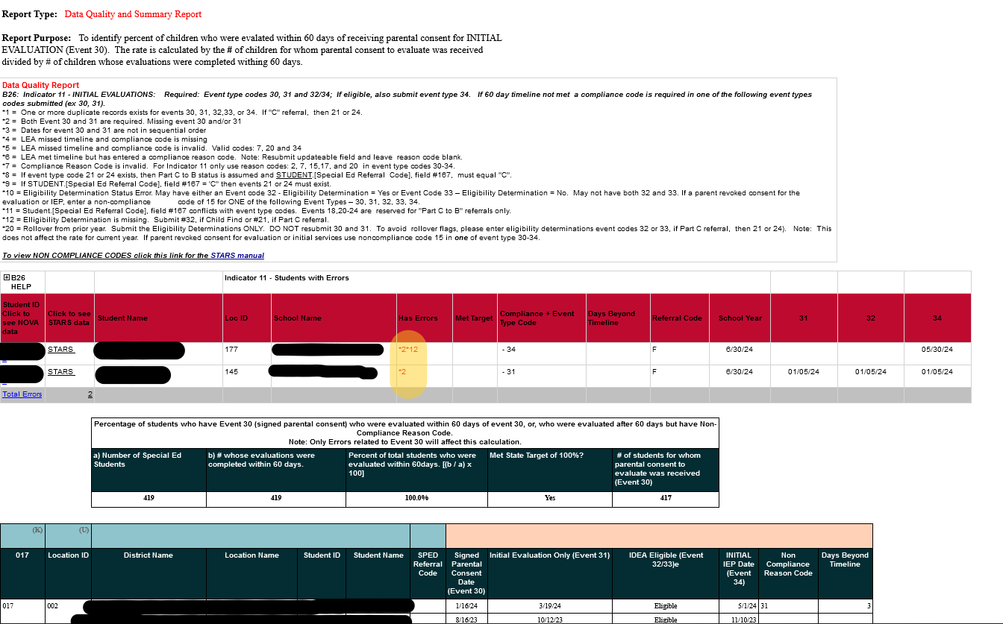
Indicator 11 Report - Evaluation Timelines
I11 Validation Requirements:
Check for errors in error (red) section; the key will explain errors.
Correct errors
Ensure all records are complete, accurate and free of errors.
Key for error explanation.
Error section

Slide 80
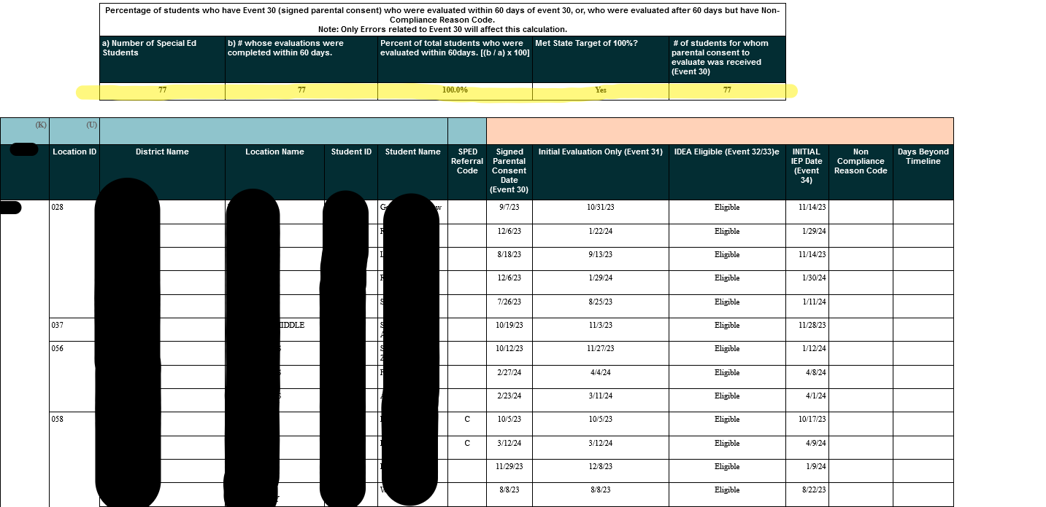
Indicator 11 Report - Evaluation Timelines
Compliance data.
Data Table

Slide 81
Indicator 12 Report - Preschool Transition
Link to Indicator 12 Report in Nova:
https://eui.ped.state.nm.us/sites/stars/ProdNova/_layouts/15/ReportServer/RSViewerPage.aspx?rv:RelativeReportUrl=/sites/stars/ProdNova/PublicFolders/District%20and%20School%20Reports/Special%20Education/SPED%20-%20SPP%20Indicator%2012%20Early%20Childhood%20Part%20C%20to%20B%20Transition%20Summary%20Report.rdl

Slide 82
Indicator 12 Report - Preschool Transition
I12 Validation Requirements:
Check for errors in pink section; the key will explain errors.
Data table at bottom; please ensure records are complete, accurate and free of errors.
Key for error explanation.
Error section

Slide 83
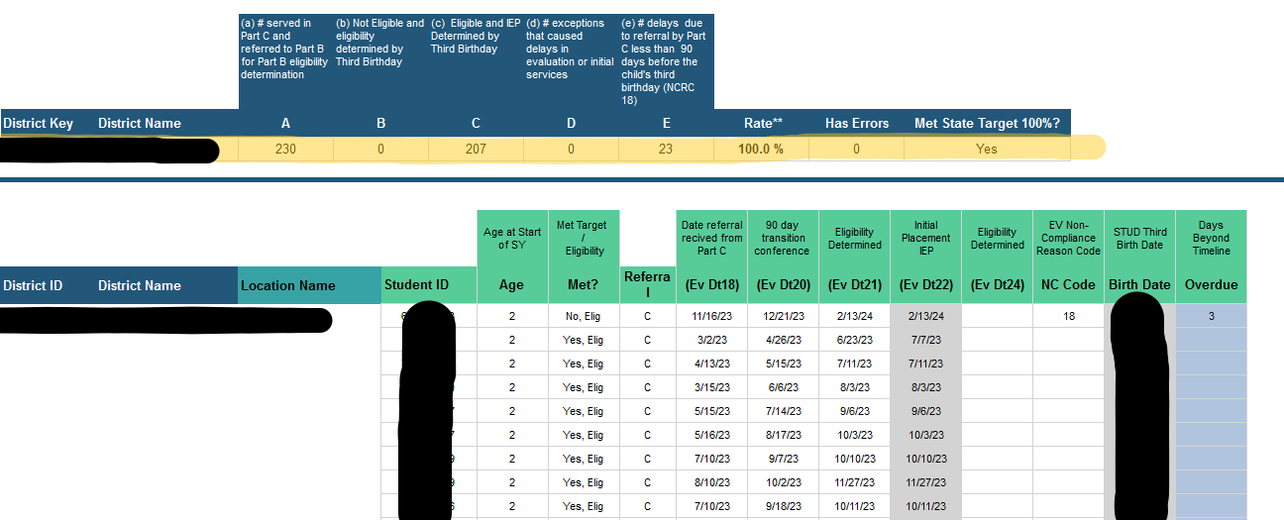
Indicator 12 Report - Preschool Transition (Cont.)
Compliance data
Data Table

Slide 84
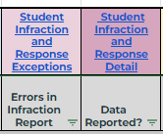
Student Infraction & Response - Detail & Exceptions
Link to Infraction Exception Report in Nova:
https://eui.ped.state.nm.us/sites/stars/ProdNova/_layouts/15/ReportServer/RSViewerPage.aspx?rv:RelativeReportUrl=/sites/stars/ProdNova/PublicFolders/District%20and%20School%20Reports/Special%20Education/SPED%20-%20Student%20Infraction%20and%20Response%20Exceptions.rdl
Link to Infraction Detail Report in Nova:
https://eui.ped.state.nm.us/sites/stars/ProdNova/_layouts/15/ReportServer/RSViewerPage.aspx?rv:RelativeReportUrl=/sites/stars/ProdNova/PublicFolders/District%20and%20School%20Reports/Special%20Education/SPED%20-%20Student%20Infraction%20and%20Response%20Detail.rdl

Slide 85
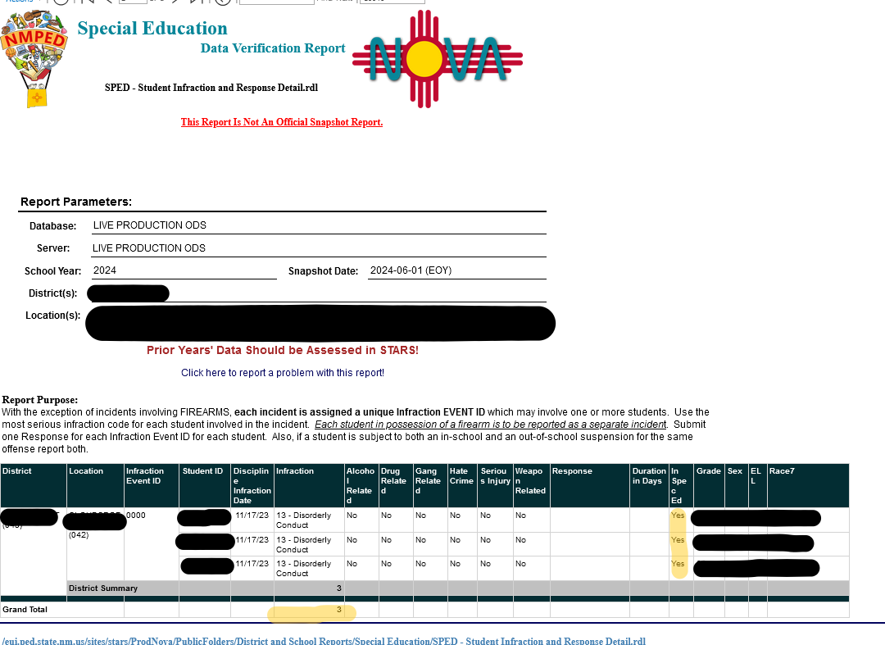
Student Infraction & Response Detail Report
Infraction Detail Validation Requirements:
This report must contain data.
All infractions must be reported:
no matter how minor or major the infraction is
those requiring a Manifestation Determination Meeting (MDR) and those that do not require an MDR
those where restorative justice is used.
Informal removals must be reported, i.e. sending home to cool down, taking a break, etc.
Failure to report data will result in a non-valid and non-reliable data finding.

Slide 86
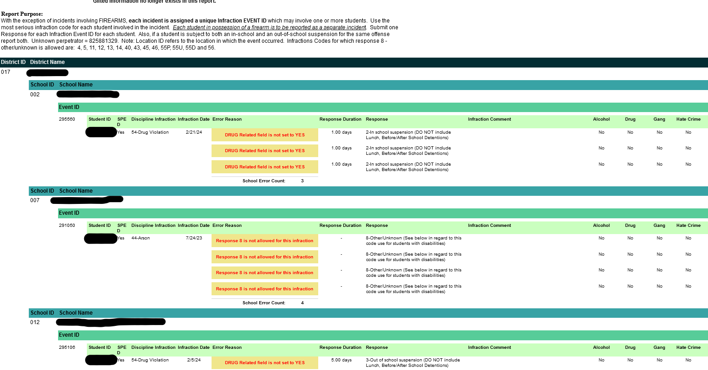
Student Infraction & Response Exception Report
Infraction Exception Validation Requirements:
All errors noted in this report must be corrected.
A blank report indicates:
there are no errors; or
no data has been reported.
Using a response type of “Other” will cause Error 8 on this report.
Error 8 must be corrected.

Slide 87
Student Infraction & Response - Restraint and Seclusion
All uses of restraint and seclusion, even when use is not linked to an infraction, must be reported.
NMAC 6.11.2.10(E)(6):
(c) Schools shall report to the department, through the department's data collection and reporting system, the following information on a timeline and reporting frequency established by the department:
(i) all instances in which a restraint or seclusion technique is used;
(ii) all instances in which law enforcement is summoned instead of using a restraint or seclusion technique;
(iii) the names of the students and school personnel involved in an incident in which restraint or seclusion was used; and
(iv) if a student was restrained, the type of restraint, including mechanical restraint or physical restraint, that was used.
(d) If a school summons law enforcement instead of using a restraint or seclusion technique on a student, the school shall comply with the reporting, documentation, and review procedures established pursuant to this rule and Section 22-5-4.12 NMSA 1978.
Note: A PED Memo was issued in 2021 regarding the requirement to report restraint & seclusion events. The document can be viewed here: https://webnew.ped.state.nm.us/wp-content/uploads/2021/09/Restraint_and_Seclusion_Memo_7_29_21.pdf

Slide 88
Missing Exit Events Report
Why is this data important?
The data in this report acts as a safeguard to ensure that students are not inadvertently removed from special education when a student moves between LEAs.
The report will show if a student was in special education at a prior LEA but not in special education at the current LEA.
LEAs must then determine:
If the student’s IEP must be implemented and services provided; OR
If the student should exited from special education
Link to Missing Exit Events Report in Nova:
https://eui.ped.state.nm.us/sites/stars/ProdNova/_layouts/15/ReportServer/RSViewerPage.aspx?rv:RelativeReportUrl=/sites/stars/ProdNova/PublicFolders/District%20and%20School%20Reports/Special%20Education/SPED%20-%20Missing%20Special%20Education%20Exit%20Events.rdl

Slide 89
Missing Exit Events Report
Exit Event Validation Requirements:
All errors must be cleared.
The report will display “blank” if there are no missing exit events.
This report only displays errors.

Slide 90
Child Count Location Report
Why is this important?
This report identifies students reported at off site locations and alerts the LEA to link these students to a school with a valid NCES code.
Any student not reported at a school with a valid NCES code cannot be reported in the Federal Child Count.
This will impact funding for the LEA.
Link to Child Count Location Report in Nova:
https://eui.ped.state.nm.us/sites/stars/ProdNova/_layouts/15/ReportServer/RSViewerPage.aspx?rv:RelativeReportUrl=/sites/stars/ProdNova/PublicFolders/District%20and%20School%20Reports/Special%20Education/SPED%20-%20Child%20Count%20Location%20Errors.rdl

Slide 91
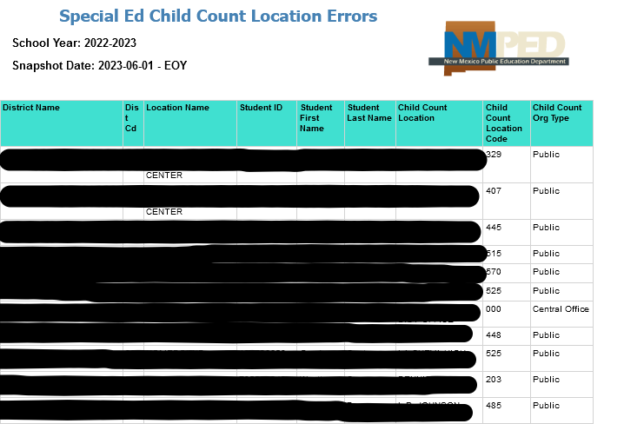
Child Count Location Report
Child Count Location Validation Requirements:
All errors must be cleared.
The report will display “blank” if there are no child count location errors.
This report only displays errors.
Example: Child Count Report from SY 22-23 STARS

Slide 92
Q & A
Take a moment to enter your questions on the reports discussed so far.
Use the QR code or click here, to write down your questions.
Notes:
Tammy end, place ? In chat

Slide 93
Errors in Data - Corrections Overview
Encountered an error on Nova report
Identify problem
Located problem
SIS data is correct, but Nova errors remain
Nova errors are correct
(Ex: Student was not tested or IEP was late)
Correct problem and re- submit data
Submit a ticket with your SIS and Nova - work with both to correct the error
Reach out to your Data Reviewer for verification and next steps
Rerun your report to ensure Nova errors have corrected
Rerun your report to ensure Nova errors have corrected
Notes:
Trudy Start

Slide 94
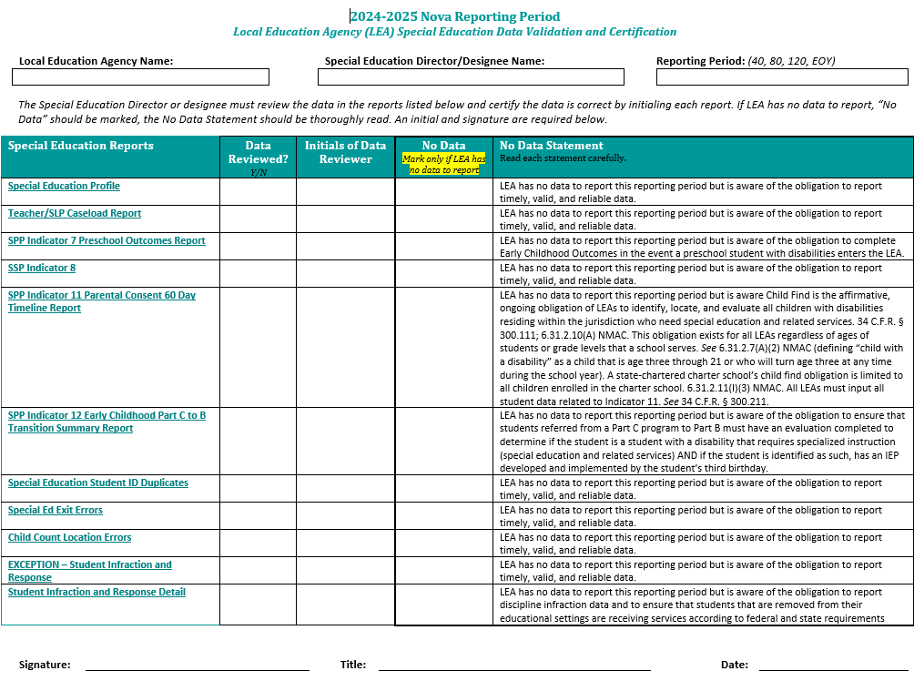
Data Validation Form
ALL lines must be initialed and must affirm that each report is accurate.
Must mark “No Data” on reports where have no data to report, not just reports that are blank.
Only sign off on the bottom of this report when all of data is accurate.
Upload form to the DTS when complete.
Please notify assigned reviewer when this is complete.

Slide 95
Document Transfer Station (DTS)
Upload the Data Validation form and any necessary justifications to the respective 40/80/120/EOY folder for your LEA.
Data notes must also be provided here.
Contact Mahesh (mahesh.reddy-erri@ped.nm.gov)if you do not see the DTS link on the homepage.
Notes:
Place DTS link in chat

Slide 96
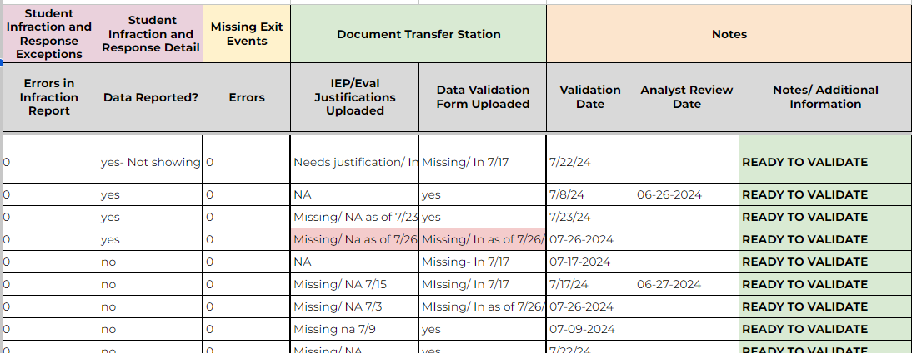
Special Education Data Quality Tab
Data filled with this color indicate “Errors” or data that needs correction.

Slide 97
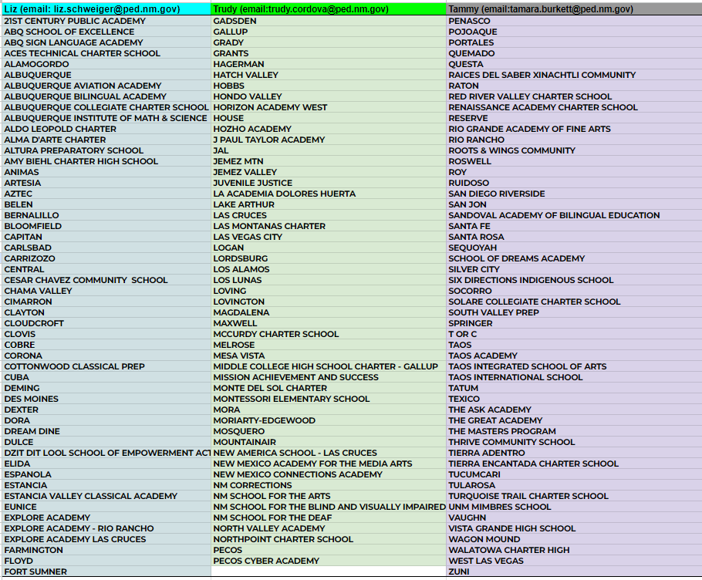
Data Reviewers for LEAs

Slide 98
Nova Office Hours
The Nova team has office hours weekly on Tuesdays at 11:00 am.
This is a good time to join and have up to date Nova information and to ask any questions you may have if you are having trouble with Nova.
Microsoft Teams
Join the meeting now
Meeting ID: 248 580 542 464
Passcode: 2qjuXJ

Slide 99
Data Team Contact information
Liz Schweiger, Data Analyst
liz.schweiger@ped.nm.gov
Tammy Burkett, Data Analyst
tamara.burkett@ped.nm.gov
Trudy Cordova, EA
trudy.cordova@ped.nm.gov
Charlene Marcotte, Deputy Director, Data & Finance
charlene.marcotte@ped.nm.gov

Slide 100
Questions and Communication
For specific questions, email the assigned data reviewer:
Assigned data reviewer list can be found here:Data Reviewers
Ensure constant communication with data reviewer from start to finish of data review process.
Scan the QR code to join our live Q&A on Google Sheets:
Notes:
Place ? In chat

Slide 101
Office of Special Education Office Hour Sessions
December 17, 2024
Time: 3:30 – TBD
Location: Virtual, Microsoft Teams Click here to join the meeting
Click here to join the meeting
Meeting ID: 252 341 847 618 Passcode: 7tVTBm
Or call in (audio only)
+1 505-312-4308,,779020632#
Phone Conference ID: 779 020 632#
Notes:
Office Hour Sessions will be held every third Tuesday of the month @ 3:30 pm. Our next Office hours will be December 17th

