Slide 1


WBL Business/Industry Partners
A Panel Discussion
Work-Based Learning Community of Practice
Scott Groginsky, Deputy Cabinet Secretary NMDWS
Judith Cruz, Education Administrator CCRB NMPED
Denise Ojeda, Education Administrator CCRB NMPED
November 19th 2024 (3:00 pm)
Investing for tomorrow, delivering today.
Notes:
Judy

Slide 2
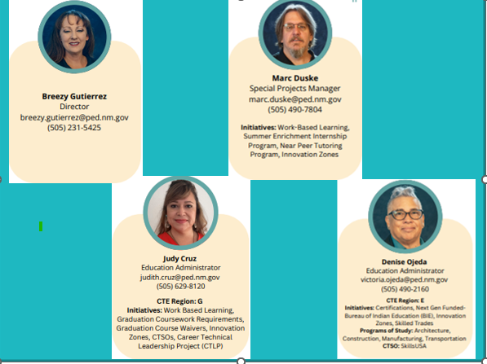
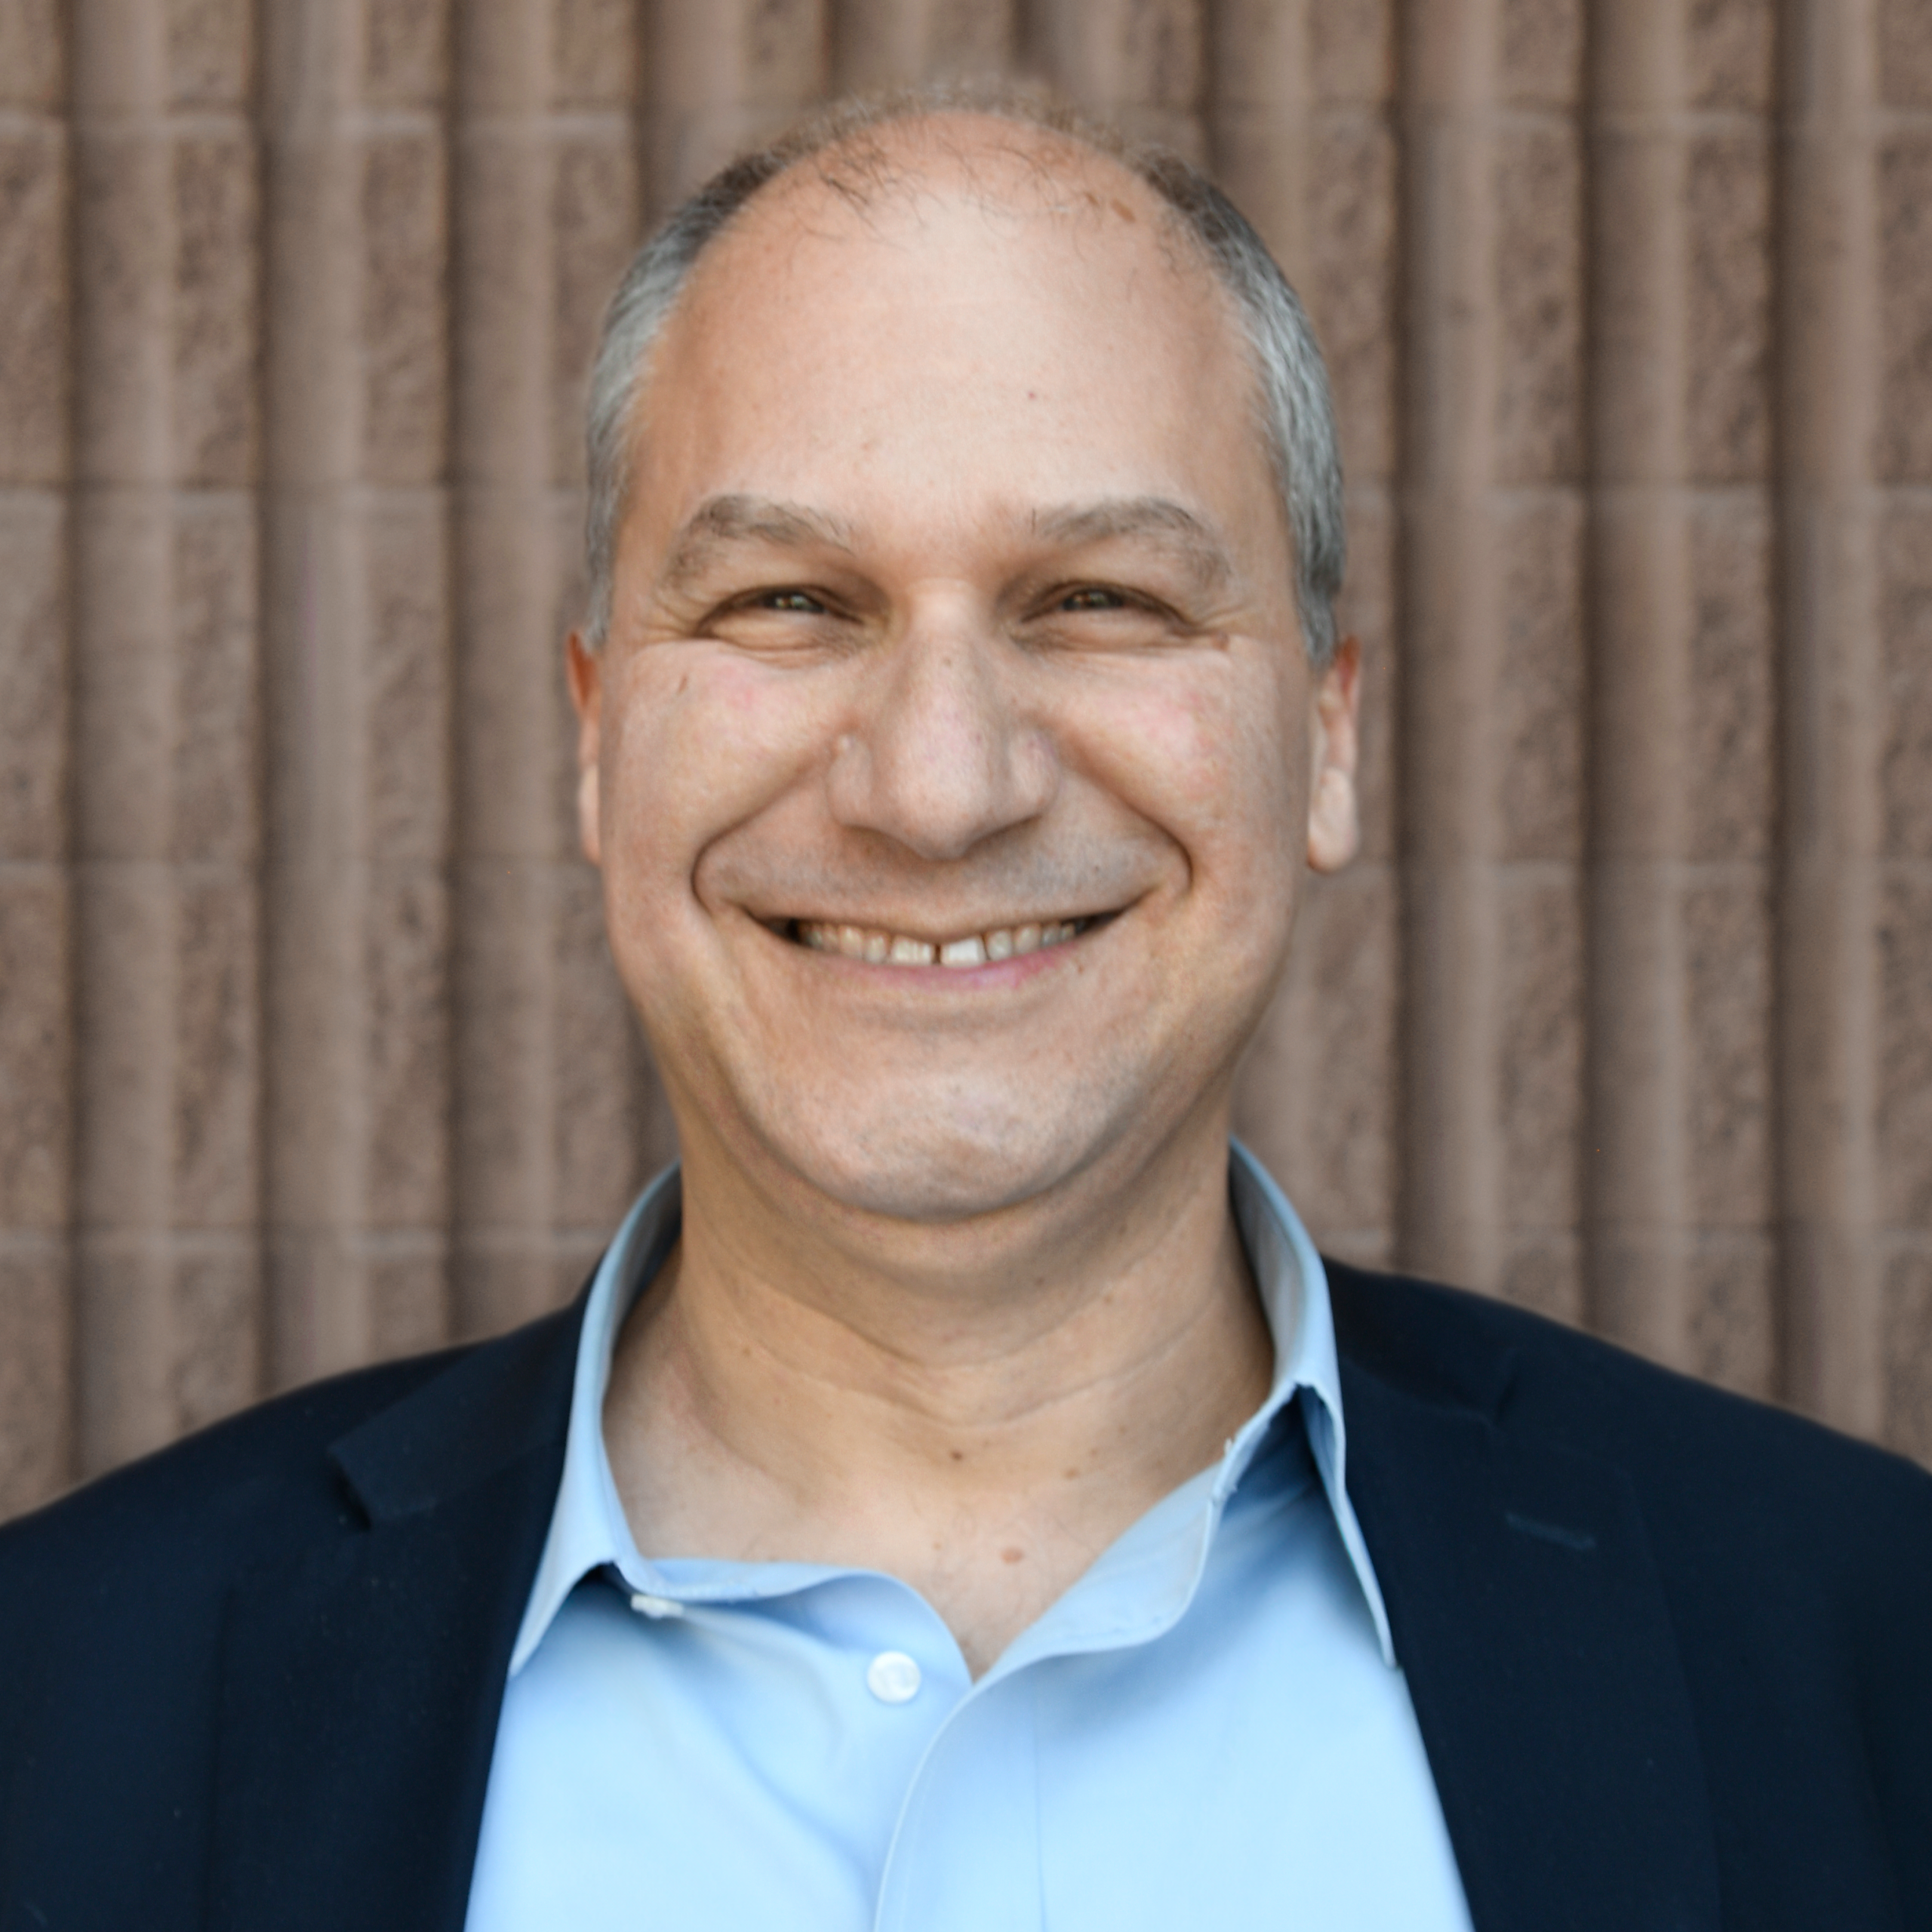
Who We Are?
New Mexico Department of Workforce Solutions Contacts
College and Career Readiness Contacts
Scott Groginsky
Deputy Cabinet Secretary
Scott.Groginsky@dws.nm.gov
Notes:
Karla (DWS)

Slide 3
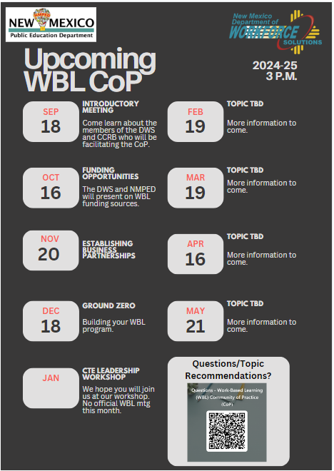
Notes:
Judy

Slide 4
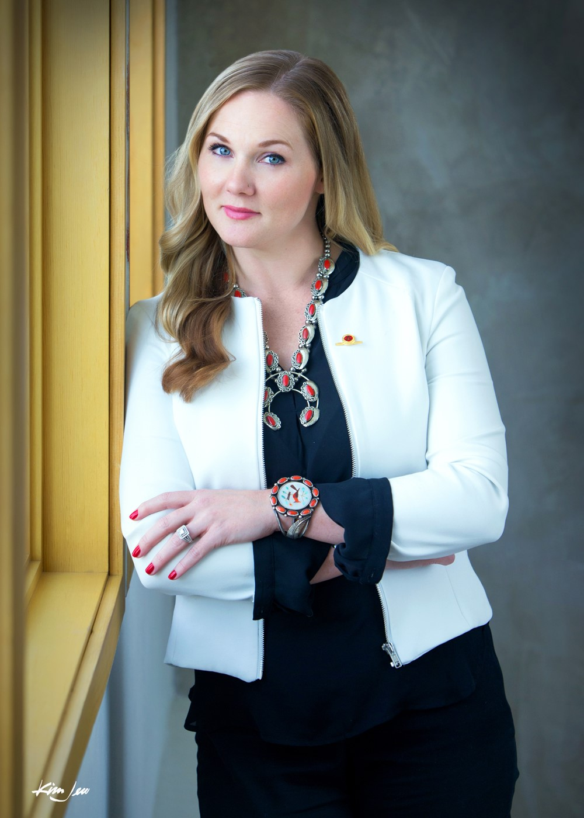
Panelists
Associated General Contractors (AGC)
Kelly Roepke-Orth
About AGC-NM
AGC New Mexico stands as the state's premier unified voice in the construction industry, steadfastly dedicated to enhancing the profession on a daily basis.
Our mission is centered on collaboratively addressing challenges and crafting programs that enhance the construction profession, the communities it serves, and the financial success of individual businesses within the industry. In so doing, the ethical standards of Skill, Integrity, and Responsibility are promoted and followed.
Kelly Roepke-Orth is the CEO of AGC New Mexico, bringing over 12 years of experience in association management. Having been with AGC NM for 17 years, Kelly rose through the ranks to assume the CEO role in March 2020. She is responsible for setting goals, overseeing daily operations, hiring and maintaining staff within budgetary constraints, and fostering relationships with AGC of America, industry representatives, and other organizations, both public and private, and sees that the position of AGC NM and its members are enhanced in accordance with the policies and objectives of the organization
Kelly also serves on the State Workforce Development Board (SWDB) and chairs the SWDB's Education and Workforce Committee

Slide 5
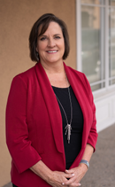
Panelists
NewSpace Nexus
Casey Anglada DeRaad
CEO and Founder of NewSpace Nexus (rebranded from NewSpace New Mexico), a non-profit established to grow the commercial space industry from New Mexico for the nation with a mission to Unite & Ignite Space by accelerating the pace of innovation, creating a bigger voice for the space industry stakeholders, and leveraging the significant R&D investment from federal, state, and local organizations.
Casey was a 30-year executive of the Air Force Research Laboratory leading programs in space technology, strategic business development, investment leveraging, technology engagement, and workforce development for Air Force, NASA, and private industry.
Casey has promoted opportunities for space industries and STEM students for her entire career. Casey earned her master’s and bachelor’s degrees in electrical engineering from the University of New Mexico and is an Albuquerque Business First 2021 Women of Influence honoree.
Casey@NewSpaceNexus.org, 505-235-5141, NewSpaceNexus.org

Slide 6
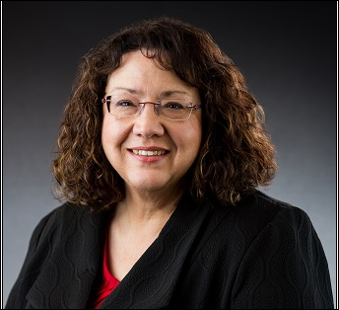
Panelists
Public Service Company of New Mexico (PNM)
Becky Teague, Vice President Human Resources
I oversee Human Resources and Safety for TXNM Energy, the parent company of both PNM and our Texas based utility Texas-New Mexico Power. I have been with the company over 36 years.
I am a graduate of University of New Mexico Anderson School of Management and have spent my entire career at PNM. I have over 25 years’ experience in Accounting, 5 years leading Customer Service and over 5 years leading Human Resources.

Slide 7
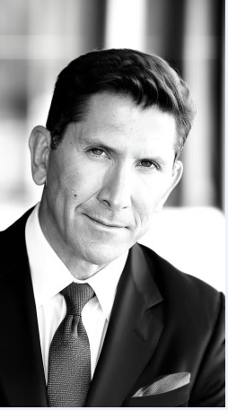
Panelists
Vida Mejor Capital
Scott Lopez, Founder
Drawing on more than 30 years of leadership experience in the military, financial services, life sciences and utilities infrastructure and telecommunications industries, Scott has uncommon insight into investment banking, investor relations, government affairs and the public and private markets.
Scott Lopez is a passionate supporter of his home state of New Mexico and is engaged in Community, Infrastructure and Economic Development initiatives to help the state improve the prosperity and quality of life for its citizens.
Scott founded a community development nonprofit organization, Vida Mejor Capital, to provide advocacy, patient and friendly capital and technical assistance to underserved and underprivileged minority entrepreneurs and communities. Specifically, with a focus of Healthy Fresh Food financing that targets Food Insecurity, Food Deserts, Digital Equity initiatives and improving Energy, Power, Broadband and Drinking Water Infrastructure.

Slide 8
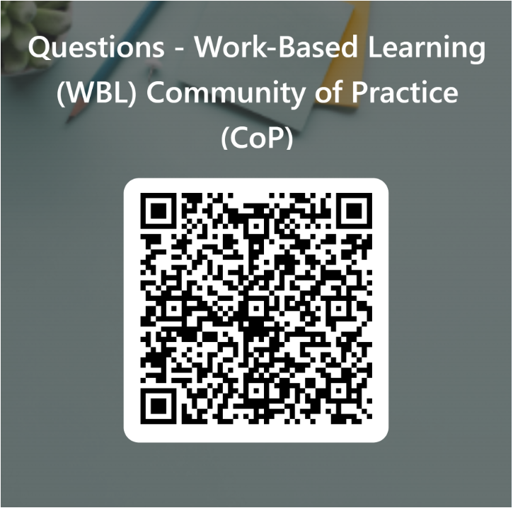
Questions QR Code & Next Steps
Next Meeting – December 18, 2024 (3:00 pm)
Agenda- Ground Zero: Building your Work-Based Learning Program
Notes:
CoP #2 Topics for discussion-

